Slide 1


VaR calculation and evolution
Market Risk Modelling
Dr. Sebastian Irle
Group 4: Bilguudei Enkhbaatar (xxxxxx), Cornelius Dziuron (xxxxxx), Jonas Hoelscher (xxxxxx), Ben-Luca Lösche (xxxxxx), Kira Pedersen (xxxxx), Keanu Kilka (8542714)
Notes:
Good morning, everyone.
We are Group 10 and today we present the paper “Corporate Discount Rates” by Gormsen and Huber.
The paper addresses a key question at the intersection of corporate finance and macroeconomics:
How closely are corporate investment decisions linked to financial market conditions?
This question turns out to be far more important and more controversial than it may initially seem.

Slide 2
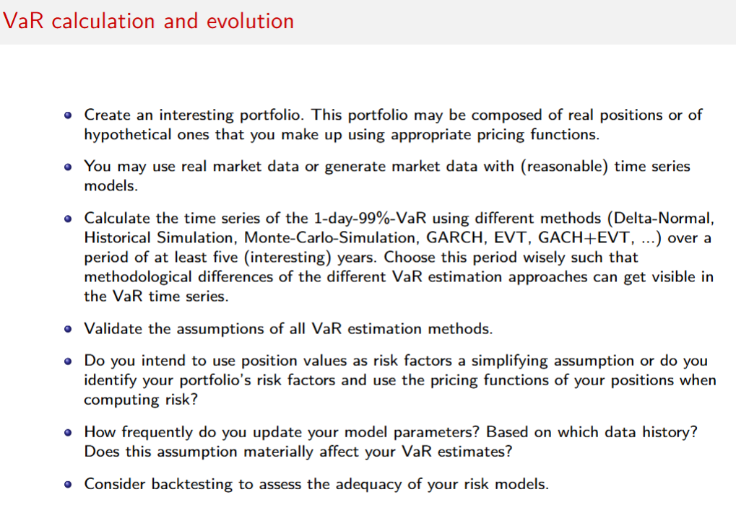
Table of Contents
Portfolio Overview
Data and Methodology
Delta-Normal
Historical Simulation
Monte-Carlo-Simulation
GARCH
EVT
GARCH + EVT
Assumption Validation
Backtesting
Comparative Results
Conclusion
Notes:
Let’s dive in. We begin with the motivation and explain why this topic is highly relevant today.
Then we position the paper in the literature, before discussing the data, the empirical strategy, and the main results.
Let’s start with why this question matters in the current economic environment.

Slide 3
Methodology
Notes:
Motivation. Why should any of us care about corporate discount rates?

Slide 4
Portfolio Overview
Ticker | Description | Class | Type
SPY | S&P 500 ETF | Equity | Linear
IEF | 7-10Y US Treasury ETF | Fixed Income | Linear
GLD | Gold ETF | Commodity | Linear
EUR/USD | EUR/USD Spot | FX | Linear
IRS | Interest Rate Swap | Rates | Non-linear
Straddle | ATM Straddle on SPY | Eq. Vol. | Non-linear

Slide 5
Data and Methodology
Sample & Data
Methodology
Stress-Test Mixing linear and non-linear instruments to stress-test each VaR method
Validation All six methods applied to the same portfolio: Assumption validation and Kuplec / Christoffersen backtesting applied to each
Period: | January 2006 – December 2024
Horizon: | 1-day, 99% confidence level
Risk Factors: | Asset prices, DGS10(FRED), VIX
Pricing: | Full repricing, IRS (DV01), Straddle (B-S)
Data: | Yahoo Finance + FRED
Est. Window: | 250-day rolling, re-estimated daily
Delta-Normal
Historical Sim.
Monte Carlo
GARCH
EVT
GARCH + EVT

Slide 6
VaR Methods
Notes:
Motivation. Why should any of us care about corporate discount rates?

Slide 7
Delta-Normal

Slide 8
Historical Simulation

Slide 9
GARCH

Slide 10
Monte Carlo Simulation

Slide 11
Assumption validation
Notes:
Motivation. Why should any of us care about corporate discount rates?

Slide 12
Comparison & conclusion
Notes:
Motivation. Why should any of us care about corporate discount rates?

Slide 13
Motivation
Notes:
Motivation. Why should any of us care about corporate discount rates?

Slide 14
Investigation of Current Management Decision Making
Historical Economic Baseline:
The World Economy has experienced decades of less investment despite low-interest rate policies
Investment is 10x less responsive to financial conditions than theory predicts
1
Fewer investment in corporate projects lead to overall less economic growth
2
Slows innovation, technological progress and contributes to decreasing labour market share
3
Questionable effectiveness of Central Bank Monetary Policy
Notes:
Over the last two decades, the global economy has experienced historically low interest rates and high asset valuations. From a policy perspective, this environment was expected to stimulate corporate investment and economic growth.
However, aggregate investment has remained surprisingly low. Evidence is showing that investment is 10x less responsive than theory predicts.
This matters for several important reasons:
First, fewer investment in corporate projects lead to overall less economic growth
Second, it slows innovation and technological progress while contributing to a decline in the labor share
Third, this raises serious concerns about the effectiveness of central bank monetary policy
Monetary policy relies on firms responding to lower interest rates by increasing investment. If that response is weak, the transmission mechanism does not operate as intended.
In that case, lowering interest rates may have far smaller real effects than policymakers assume.

Slide 15
Stylized View vs. “Sticky Reality”
Research Question: Why do firms´ internal discount rates, not move one-to-one with the cost of capital in financial markets?
Standard models assume firms immediately adjust discount rates to reflect changes in cost of capital
Monetary policy transmission depends on this link between cost of capital and firm hurdle rates
Evidence suggests firms use sticky discount rates far above their Weighted Average Cost of Capital (WACC)
Notes:
So, what’s going wrong?
The standard assumption is that when the cost of capital falls, firms lower the bar for which projects they approve. More projects become profitable. Investment rises.
The authors suspected something different. The internal hurdle rates, the rates managers use to decide which projects get funded are sticky. They don’t move one to one with the cost of capital.
Evidence had already hinted at this: firms set hurdle rates well above their weighted average cost of capital and rarely update them.
This leads to the paper’s central question: why don’t firms’ internal discount rates move one-to-one with financial markets?

Slide 16
The Missing Puzzle in Investment Decisions
Interest rates plummeted and asset prices increased, significantly lowering cost of capital
Despite elevated market valuations, “missing investment” exceeded 20% of the capital stock by 2019
Investment shortfalls may reflect rigid internal decision rules rather than external market signals
Sticky Discount Rate
Discount rates barely respond to cost-of-capital changes in the first one to two years
Full adjustment takes over a decade because firms revise hurdle rates infrequently
Discount Rate Wedge
The “wedge” grew by about 2.5 percentage points
“Adjusted Q” model that accounts for the wedge largely resolves the missing investment puzzle
Notes:
At this point, the puzzle becomes even more interesting.
Financial markets clearly signal that capital has become cheaper. Interest rates have fallen and asset prices are elevated. Yet corporate investment has not responded accordingly.
This suggests that the disconnect may not originate in financial markets but inside the firm.
The paper argues that two concepts are central to understanding this disconnect:
Sticky discount rates and the Discount rate wedge. We will define these precisely later.
For now, it is enough to understand the broader concern:
If firms do not adjust their internal discount rates in line with financial market conditions, then even substantial changes in the cost of capital may have limited real effects.
In that case, the link between financial markets and corporate investment may be weaker and slower than we assume.

Slide 17
CONTRIBUTION TO LITERATURE
Notes:
Now let’s talk about where this paper sits within the broader academic landscape.

Slide 18
Literature Positioning
1. Cost of Capital and Investment
Jorgensen (1963): Neoclassical investment depends on user cost of capital
Hall & Jorgenson (1967): Tax policy affects investment through cost of capital
2. Hurdle Rates and Discount Rates Surveys
Graham & Harvey (2001): Survey finding hurdle rates exceed WACC​
Jagannathan et al. (2016): Firms keep discount rates stable despite rate changes​
Krüger et al. (2015): Firms use uniform discount rates across divisions
3. Missing Investment Puzzle
Gutiérrez & Philippon (2017): Investment has declined relative to Tobin's Q and profits​
Crouzet & Eberly (2019): Intangibles partially explain the gap
Notes:
The paper brings together three areas of research.
The first is the classic cost-of-capital-and-investment literature, going back to the 1960s and the foundational view that changes in the cost of capital should drive investment.
The second area is survey-based research on hurdle rates. Graham and Harvey’s survey found that CFOs routinely set hurdle rates above their WACC. Krüger and co-authors documented that many firms use a single, uniform discount rate across all divisions, even when those divisions have very different risk profiles.
The third area is the “missing investment”. In 2017 it was found that investment has declined relative to Tobin’s Q and profits.
Its argued that intangible assets partially explain the gap.
But none of these papers could directly measure what firms were actually using as their internal discount rates. That’s the gap Gormsen and Huber fill.

Slide 19
Key Contribution
First large-scale measurement of corporate discount rates using actual firm statements
Novel Data: Extract discount rates and perceived cost of capital from earnings conference calls (2002–2021)
Incomplete transmission: Document that cost of capital changes pass through to discount rates only slowly
Rising wedge: Show the gap between discount rates and cost of capital grew by 2.5 pp in the US from 2002–2021​
Mechanism: Identify market power, risk as real options and financial constraints as key drivers of the wedge
Investment implications: Link rising wedges to the "missing investment" puzzle
Notes:
What makes this work groundbreaking is its data.
For the first time, the authors extract corporate discount rates and perceived costs of capital directly from what executives say in earnings conference calls, covering roughly 2,500 large firms across 20 countries from 2002 to 2021.
Using this new dataset, the authors show several things that were suspected but never measured at scale.
First, changes in the cost of capital are only slowly passed through to internal discount rates. Second, the gap between the two, the so called wedge, has increased over time. Finally, they show that rising wedges help explain the missing investment puzzle.
Overall, this is the first large-scale study of how firms actually set their internal discount rates and the results differ clearly from what standard textbooks assume.

Slide 20
Data and Methodology
Notes:
So how did they built their dataset?

Slide 21
Data Acquisition from Corporate Conference Calls
Source
Corporate conference call transcripts from the Thomson One database (2002-2021)
Practical Example – Intuit (2014):
Manual Data entry
Read 74,000 distinct paragraphs over 2.5 years to ensure context and background were correctly interpreted
“We continued to take a disciplined approach to capital management ( … ). Our weighted average cost of capital is about 9 or 9.5 percent ( … ). Our IRR hurdle is a 15 percent rate of return.”
Search Criteria
Identification using keywords combined with percentage terms
Discount rate: 15 %
Perceived cost of capital: 9.25 %
Sample Scope
2,500 large firms from 20 Countries
Notes:
The authors went with the Thomson One database (now known as LSEG T1) and pulled every earnings conference call transcript from 2002 to 2021 for around 2,500 large firms across 20 countries.
They searched for keywords related to discount rates, hurdle rates, and cost of capital combined with percentage terms.
What makes this effort extraordinary is that they didn’t just run an algorithm but read 74,000 distinct paragraphs over two and a half years.
Why did they do that? Because context matters enormously.
When a CEO mentions “a fifteen percent target,” you need to know: is that an IRR hurdle or a divisional return target?
Consider a concrete example. Intuit’s CFO stated in 2014 that their weighted average cost of capital was about 9 to 9.5%, but their IRR hurdle was 15%.
That gap between what the market says capital costs and what the firm demands as a return is exactly what this paper measures.

Slide 22



Defining Key Variable and the “Wedge”
Discount Rate δ
Minimum required IRR for new projects , “hurdle rate”
The discount rate Wedge $κ$
$$κ \text{=} \text{δ}\text{−}{ r}^{per}$$
Financial Cost of Capital
Stylized market measures calculated using CAPM and government bond yields
Practical Example:
Nasdaq 100 firm Intuit (2014) reported WACC of 9.25% but used an IRR hurdle of 15%
Perceived Cost of Capital $r^{per}$
Firms internal estimate of own WACC
Clear Wedge
Notes:
The discount rate is the minimum internal rate of return a firm requires before approving a project.
So, it is the bar a project must clear. The financial cost of capital is the market’s view, calculated using tools like the CAPM and government bond yields.
However, the perceived cost of capital is the firm’s own estimate of its WACC, what it believes it costs to raise money.
The wedge is simply the difference between the discount rate and the perceived cost of capital.
For Intuit: the difference gives you a wedge of over 5 percentage points. That’s a substantial buffer that screens out many projects the market would consider perfectly worthwhile.

Slide 23
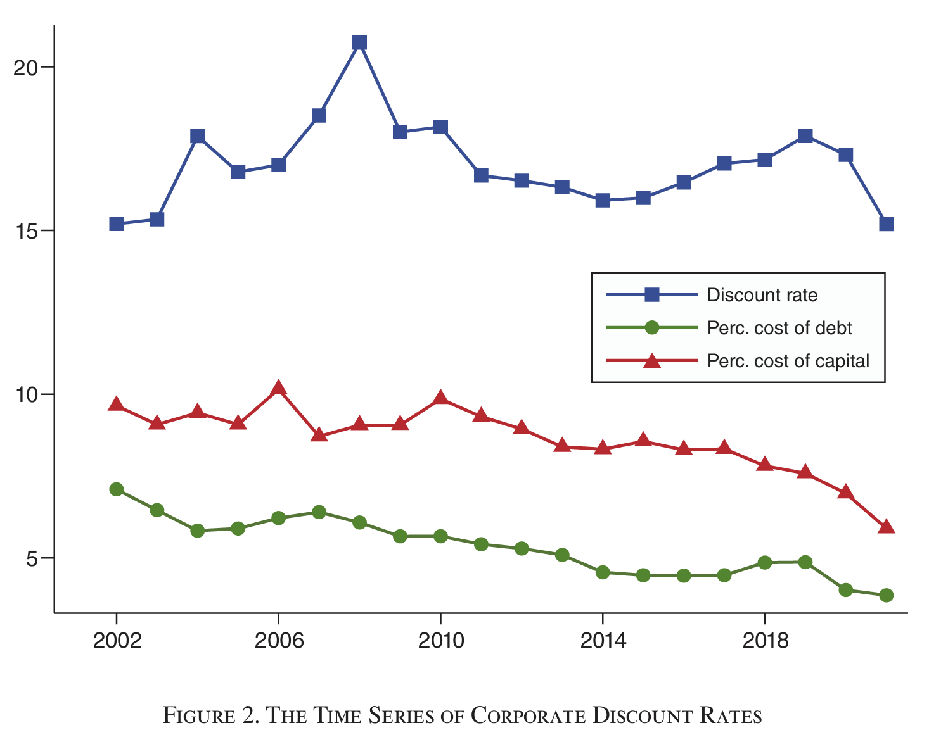
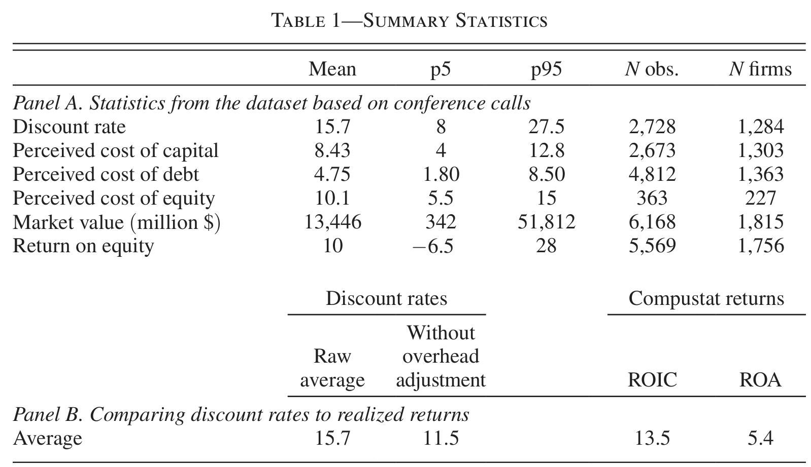
Sample Coverage and Trend Parameters
Notes:
Looking at the summary statistics, the average discount rate in the sample is about 15.7 percent, while the average perceived cost of capital is about 8.4 percent.
On the time-series chart you can see that while the perceived cost of capital and cost of debt trended downward—reflecting the broader fall in interest rates—the discount rate stayed high, hovering around 15 to 20 percent, not signalizing a clear trend.
The lines should be converging, but they’re not.

Slide 24
Empirical Methodology and Identification
Firm Panel
Study focuses on within-firm variation, controlling for firm fixed effects to see how a specific firm changes its rates over time
Measurement Error
Predicted Perceived Cost of Capital constructed via a Lasso procedure using 7 predictors
Transmission Horizons
Transmission of market shocks to internal rates over different time horizons, ranging from 1 year to over 12 years
Overhead Adjustment
Authors control for firm specific overhead costs to ensure they do not drive the results
Notes:
Looking more closely at the Empirical Methodology and Identification …
The authors use within-firm variation, controlling for firm fixed effects, so they’re tracking how the same firm changes its rates over time, not comparing different companies.
They construct a predicted perceived cost of capital using a Lasso procedure with seven predictors, which helps address measurement error.
They examine transmission over horizons from one year to twelve-plus years.
And they adjust for overhead costs, since some of the wedge might reflect legitimate overhead markups rather than genuine stickiness.

Slide 25
FINDINGS
Notes:
So, what did all this accurate data collection reveal? Let’s go through the key findings.

Slide 26
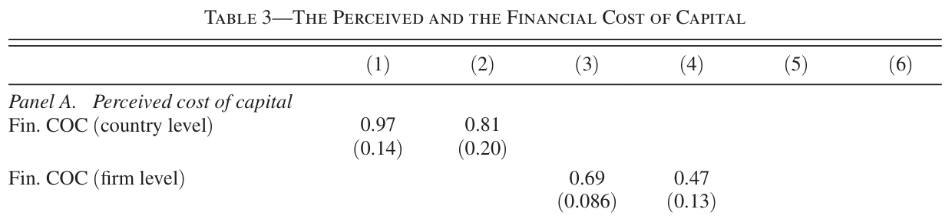
Firms Perceive Financial Market Conditions Correctly
Firms report a Weighted Average Cost of Capital (WACC) consistent with market inputs
Perceived cost of capital co-moves strongly with market-based measures
Changes in interest rates and equity valuations are reflected in internal capital cost estimates
Key Takeaway:
The disconnect does not arise from misperception
Notes:
The first finding is crucial because it tells us what the problem is not.
Firms are not ignorant of financial markets. When you regress the perceived cost of capital on the financial cost of capital, the coefficients are fairly high.
Firms see that interest rates have fallen.
They know their borrowing costs are lower and therefore lower their perceived cost of capital but not on a one-to-one basis. This means there is no information problem.
And that’s exactly what makes the next finding so striking.

Slide 27
Sticky Discount Rates & Slow Transmission
Horizon | 1-2 Years | 3-4 Years | 5-8 Years | 12+ Years
Transmission Rate | ≈ 0% | ≈ 25% | ≈ 40% | ≈ 60%
Interpretation:
A 1pp decrease in cost of capital leads to no change in discount rates in the first 1-2 years
Even after 12+ years, roughly 40% of the change remains unabsorbed
Sharply contrast standard model assumptions of immediate, full pass-through (β = 1)
Cost of capital changes pass through to discount rates only gradually
Notes:
Even though firms correctly perceive changes in the cost of capital, they barely pass those changes through to their internal discount rates. In the first one to two years, the transmission rate is essentially zero.
After three to four years, about 25 percent has passed through. After five to eight years, roughly 40 percent.
And even after twelve-plus years, about 40 percent of the original change still hasn’t been absorbed.
This is a radical departure from textbook assumptions, where transmission is supposed to be immediate and complete.
When a central bank cuts rates, more than a decade may pass before firms fully incorporate that change into their investment decisions.
Think about what that implies for the real-world effectiveness of monetary policy ?!?

Slide 28
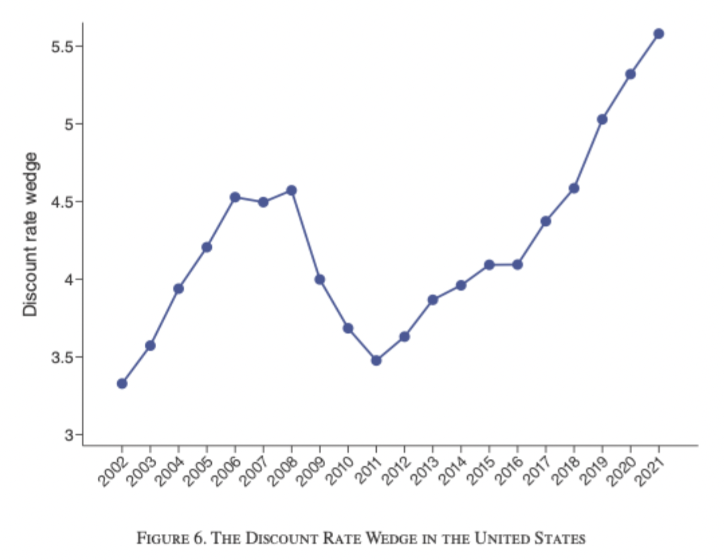
Discount Rate Wedges Reduce Investment
Discount rate wedges increased by ~2.5pp since 2002
Higher discount rate wedges predict lower future investment
A 1pp increase in the wedge reduces next-year investment by approx. 0.8pp
Missing investment
Notes:
The wedge between discount rates and the cost of capital has been growing.
Since 2002, it increased by about 2.5 percentage points in the United States.
A 1.0 percentage-point increase in the wedge reduces next-year investment by roughly 0.8 percentage points.
Meaning a higher wedge predicts lower future investment.
As the wedge widens, investment falls further behind where models say it should be - this is the “missing investment” in a nutshell.

Slide 29
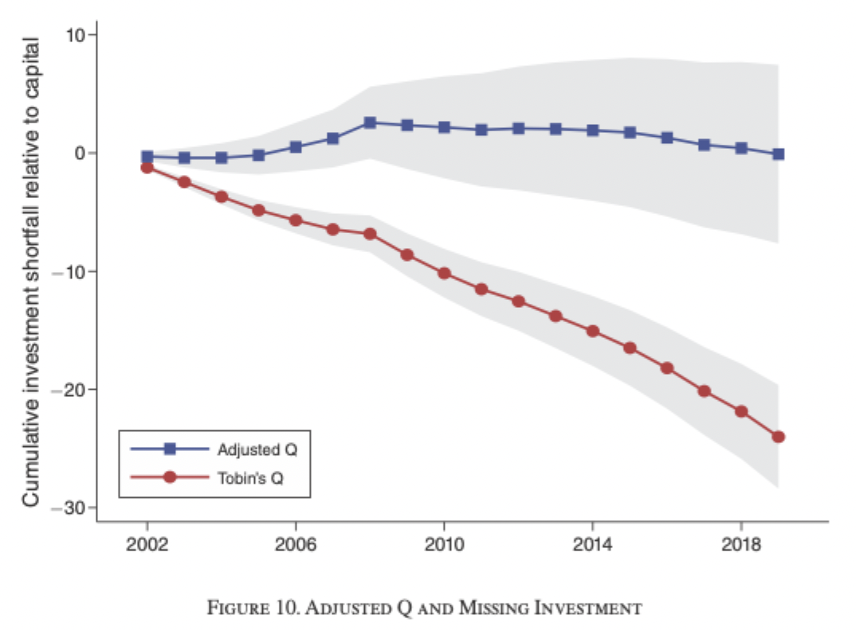
“Adjusted Q” resolves the missing Investment Puzzle
Tobin’s Q predicts a large investment shortfall since 2002
Adjusting for discount rate wedges largely eliminates the gap
Internal hurdle rates explain the disconnect between valuations and investment
Notes:
Here’s where it comes together. The chart shows two lines.
The red line, standard Tobin’s Q—predicts a cumulative investment shortfall of around 25 to 30 percent since 2002.
That’s the puzzle. The blue line—“Adjusted Q,” which incorporates the wedge—stays close to zero.
Once you account for inflated hurdle rates, the shortfall largely disappears.
Investment is not “missing.” Firms are simply not investing because their internal hurdle rates make many projects unattractive.

Slide 30
EXTENSIONS & RESEARCH IDEAS
Notes:
Last but not least, we focus on some Extensions and Research Ideas from now on and conclude our presentation, as well as the further findings of the paper.

Slide 31
Drivers of Discount Rate Wedges: Market Power and Risk
The Role of Market Power
The secular increase in “wedges” since 2002 is primarily driven by firms with high market power
Firms with high markups have kept their discount rates stable, even as interest rates and financial costs of capital have declined
Discount Rate
Rigidity
Competitive forces in low-market-power firms compel them to align discount rates with market costs to survive
However, firms with market power face less pressure and can afford to maintain higher, “sticky” rates to signal prudence and prevent “Empire Building” etc.
Real Options and Irreversibility
Time-varying risk is a significant driver of short-term wedge fluctuations
Increases in risk raise the discount rates of firms with irreversible assets
Managers often add a ”buffer” to market rates to account for uncertainty
Notes:
Let’s move from what happens to why it happens on a more corporate psychological level …
The big question remains: Why would firms keep their hurdle rates high on purpose, even when capital becomes cheaper, like we saw in the past decades?
The paper highlights three main forces:
First: The role of market power
Firms with strong market power, meaning they face less competitive pressure, have increased their wedges the most since 2002. Why? Because they can afford to.
If you’re in a highly competitive industry, you cannot be overly conservative.
If you reject too many projects, your competitors will take market share. But if you’re dominant, with strong markups and limited competition, you have more room to be selective.
Second: Discount rate rigidity
Some firms simply don’t update their hurdle rates often. Even if interest rates fall dramatically, they stick to, say, a 10% or 15% IRR threshold. This creates a wedge almost mechanically.
Managers often justify this by saying they want to be “disciplined” or prevent empire building.
In other words: they prefer to signal prudence to investors rather than aggressively expand just because money is cheap.
Third: Real Options and Irreversibility
When investment is irreversible and uncertainty rises, firms become cautious, especially in the short and medium run.
Even if markets lower required returns, managers may add a “buffer” to accord to this uncertainty.
So risk pushes up discount rates independently of financial market conditions.

Slide 32
Social Debates: The Missing Investment Puzzle and Corporate Rents
Solving Missing Investment
Standard Economic Theory (Tobin´s Q) US investment has been “missing” relative to high Q-values since the early 2000s
“Adjusted Q” as Key Instrument Accounts for internal discount rate wedges and demonstrates that the observed increase in these wedges is large enough
Rising Corporate Rents and Falling Labour Share
Persistent Discount Rate Wedges Stable discount rates amid declining costs of capital generate rising internal rent wedges
Macroeconomic Implication The accumulation of corporate rents reduces reinvestment and contributes to the long-run decline in the labour share
Notes:
Now let’s zoom out to the macro picture and reflect on certain social debates arising in the paper.
First, the “missing investment” puzzle is largely solved once you account for these wedges. The Adjusted Q framework shows that rising internal hurdle rates explain why investment has lagged behind valuations, as we saw in the US Investment example in figure 6.
Once we adjust Q for the discount rate wedge, meaning we account for firms internally using higher hurdle rates than financial markets imply, the puzzle largely disappears. The problem becomes somewhat non-existent, if one applies the right perspective.
But this has broader consequences …
Secondly, If firms systematically require returns above the financial cost of capital, they are generating corporate rents. So, what initially looks like a technical issue about discount rates actually connects to big societal debates, we already discussed in the Motivation:
Once again, the macroeconomic implications will be:
Slower growth
Rising markups
Increasing concentration
And distributional consequences, like a long run decline in labor share
-> The question remains. Is our monetary policy effective in stimulating the economy the way it is intended to be?
That’s what makes this paper so fascinating.

Slide 33
Potential Extensions & Further Ideas
Methodological
Apply NLP/LLM methods to extract discount rate information more systematically from transcripts​
Extend to international settings beyond US and Europe (e.g., emerging markets)​
Use real-time data to study how quickly firms update discount rates after Fed announcements
Theoretical
Model optimal wedge under rational inattention or menu costs​
Welfare analysis: How much investment is "lost" due to sticky discount rates?​
Empirical Questions
How do ESG considerations interact with corporate discount rates?
Do firms with better governance have smaller wedges?​
Can CEO/CFO characteristics predict discount rate stickiness?
Notes:
Finally, let’s think about where this research could go next. Based on what we critically assessed.
Methodologically, large language models could automate the extraction of discount rate information from transcripts, massively expanding the dataset on a larger scale.
Another extension would be to apply this framework to emerging markets. Do firms in developing economies also have sticky discount rates? Or is this mainly a feature of advanced markets like the observed US or European market.
On the theoretical side, there’s room to model the optimal wedge and to quantify how much investment is actually lost due to stickiness.
Concluding Empirically, there are possible questions about …
whether ESG considerations interact with discount rates,
whether firms with better governance have smaller wedges,
and whether individual CEO and CFO characteristics predict how sticky a company’s discount rate turns out to be

Slide 34
THANKS FOR YOUR ATTENTION
Notes:
Thank you very much for your attention!
----------------------------------------------
To conclude:
The paper challenges a fundamental assumption in macro and finance: that firms immediately adjust their hurdle rates to financial market conditions.
Instead, discount rates are sticky, rather strategic, and shaped by market power and risk.
Lastly, something you should definitely take away from this paper:
The Authors open an entirely new research agenda around how firms internally translate financial market signals into real investment decisions.
Therefore, It challenges the prevailing economic mechanisms through its investigative approach, which happens to be quite unique in this field.
Thank you very much for your attention!
----------------------------------------------
Now moving on to the questions …

Slide 35
Quiz 1 – Motivation & Contribution to Literature
Q1: What is the primary data source used by Gormsen & Huber?
SEC filings (10-K reports)
Earnings conference call transcripts
CFO surveys
A
B
C
Q2: How sensitive is investment to financial conditions compared to theory?
Factor of 2
Roughly the same
Factor of 10
A
B
C
Q3: What is the core “missing investment” puzzle since the early 2000s?
The cost of capital increased despite falling interest rates
Investment remained low despite high Tobin´s Q
Firms stopped using hurdle rates in capital budgeting
A
B
C
Notes:
Let’s test what we’ve covered.
(read along)

Slide 36
Quiz 1 – Motivation & Contribution to Literature
Q1: What is the primary data source used by Gormsen & Huber?
SEC filings (10-K reports)
Earnings conference call transcripts
CFO surveys
A
B
C
Q2: How sensitive is investment to financial conditions compared to theory?
Factor of 2
Roughly the same
Factor of 10
A
B
C
Q3: What is the core “missing investment” puzzle since the early 2000s?
The cost of capital increased despite falling interest rates
Investment remained low despite high Tobin´s Q
Firms stopped using hurdle rates in capital budgeting
A
B
C
Notes:
Q1 (B): The authors manually extract discount rates from earnings conference call transcripts.
Q2 (C): Investment is about 10 times less responsive to financial conditions than standard theory predicts.
Q3 (B): The puzzle is that investment stayed low even though Tobin’s Q was high since the early 2000s.

Slide 37
Quiz 2 – Data and Methodology & Findings
Q4: What is the discount rate “wedge” composed of?
The difference between the financial cost of capital and the risk-free rate
The difference between a firm’s discount rate and its perceived cost of capital
The difference between Tobin’s Q and the marginal profitability of capital
A
B
C
Q5: By how many percentage points did the wedge increase in the US from 2002–2021?​
0.5pp
2.5pp
5.0pp
A
B
C
Q6: Why did the authors choose manual data entry over an automated algorithm?
It was faster to complete within the 2.5 year timeframe
Context and background are essential for identifying discount rates in transcript
Thomson One database does not allow for algorithmic searching
A
B
C
Notes:
Three more questions.
(read along)

Slide 38
Quiz 2 – Data and Methodology & Findings
Q4: What is the discount rate “wedge” composed of?
The difference between the financial cost of capital and the risk-free rate
The difference between a firm’s discount rate and its perceived cost of capital
The difference between Tobin’s Q and the marginal profitability of capital
A
B
C
Q5: By how many percentage points did the wedge increase in the US from 2002–2021?​
0.5pp
2.5pp
5.0pp
A
B
C
Q6: Why did the authors choose manual data entry over an automated algorithm?
It was faster to complete within the 2.5 year timeframe
Context and background are essential for identifying discount rates in transcript
Thomson One database does not allow for algorithmic searching
A
B
C
Notes:
Q4 (B): The wedge is the difference between a firm’s discount rate and its perceived cost of capital.
Q5 (B): The average US discount rate wedge increased by about 2.5 percentage points from 2002 to 2021.
Q6 (B): Manual reading was necessary because identifying discount rates requires understanding context, not just keywords.

Slide 39
Quiz 3 – Extensions & Research
Q7: Why does market power lead to higher wedges?
Firms with market power maintain stable high discount rates, regardless of cost of capital
Market power reduces the number of investment opportunities
Firms with higher market power face higher financing costs
A
B
C
Q8: Since when have US investments been ”missing”?
After 2008
Before 1990s
Since the early 2000s
A
B
C
Q9: Which of the following is NOT identified as a driver of the wedge?​
Market power
Empire Building
Financial Constraints
A
B
C
Notes:
Let’s quickly test your intuition just once more …
(read along)

Slide 40
Quiz 3 – Extensions & Research
Q7: Why does market power lead to higher wedges?
Firms with market power maintain stable high discount rates, regardless of cost of capital
Market power reduces the number of investment opportunities
Firms with higher market power face higher financing costs
A
B
C
Q8: Since when have US investments been ”missing”?
After 2008
Before 1990s
Since the early 2000s
A
B
C
Q9: Which of the following is NOT identified as a driver of the wedge?​
Market power
Empire Building
Financial Constraints
A
B
C
Notes:
Q7 (A): Firms with market power can keep discount rates high even when the cost of capital falls, creating larger wedges.
Q8 (C): The “missing investment” refers to the gap between high Tobin’s Q and low investment since the early 2000s.
Q9 (B): Empire building is discussed as a managerial concern but not identified as a structural driver of the wedge.

Slide 41
Sources
Gormsen, N. J., & Huber, K. “Corporate Discount Rates.”
AER, 115(6), 2001–2049, American Economic Association, 2025.
https://doi.org/10.1257/aer.20231246

Slide 42
V1 ARCHIV

Slide 43
Podcast notes
Important Storytelling … (René Notes):
… warum wenige Investitionen trotz niedriger Zinsen / Kapitalkosten? -> Logik der Vorstandsetagen als Mittelpunkt des Papers! -> Investoren vs. Manager
Hier geht es um Investigativrecherche um Management Entscheidungen zu verstehen (entlarven)
Storytelling geht in die Richtung Abkehr von Standardtheorien der allgemeinen Wirtschaftspolitik … -> Investing wenn NPV positiv, Discount oder Hurdle Rate sollte im Gleichschritt mit dem Kapitalmarkt gehen … so die Theorie …
Perceived Cost of Capital und 2) Discount Rate wurden untersucht … Entscheidend ist diese Diskrepanz „Wedge“
Finding: Kein Zusammenhang Realität und Theorie! -> Raten sind sehr starr, nur in Long-Run nah am Lehrbuch!
Insbesondere für große Unternehmen (Sticky Rates), da diese sich den Wedge leisten können und gleichzeitig Empire Building verhindern …
„Wedge“ blockiert Investitionen … Blackbox der Investitionen verhindert … Tobins Q ist falsch (basiert auf niedrigen Cost of Capital des Marktes), Adjusted Q als Ergebnis vom Paper (bereinigt um den Wedge, psychologische Realität) -> Das Rätsel löst sich auf
„Arrogante Abkopplung von der Finanzwelt“ „Zinsen können Achterbahn fahren, does not matter to us“ -> Wirksamkeit von Geldpolitik wenn keine Wirkung auf Realwirtschaft?
Übergang in Unternehmenspychologie: Schutzmechanismen wie „Empire Building“ erhöhen den Wedge und verhindern Investitionen (unfreiwillig) … darauf aufbauen …

Slide 44
Drivers and Macroeconomic Implications of Discount Rate Wedges
Managers maintain stable hurdle rates as a form of governance device
Market power enables firms to sustain elevated wedges without competitive pressure
Investment is 10x less responsive to financial conditions than theory predicts
Central bank interest rate cuts become less effective at stimulating the real economy
Key Takeaway:
Rising wedges explain the "Missing Investment" and falling labour share since 2002

Slide 45
Audience Check
Why did the authors choose manual data entry over an automated algorithm for the 74,000 paragraphs?
It was faster to complete within the 2.5 year timeframe
Context and background are essential for identifying discount rates in transcript
Thomson One database does not allow for algorithmic searching

Slide 46
Audience Check
Why did the authors choose manual data entry over an automated algorithm for the 74,000 paragraphs?
It was faster to complete within the 2.5 year timeframe
Context and background are essential for identifying discount rates in transcript
Thomson One database does not allow for algorithmic searching

Slide 47
Check Keanu
Data Acquisition from Corporate Conference Calls
Source
Corporate conference call transcripts from the Thomson One database (2002-2021)
Manual Data entry
Read 74,000 distinct paragraphs over 2.5 years to ensure context and background were correctly interpreted
Search Criteria
Identification using keywords combined with percentage terms
Sample Scope
2,500 large firms from 20 Countries

Slide 48


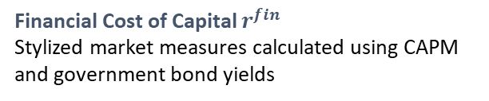

Check Keanu
Defining Key Variable and the “Wedge”
Discount Rate σ
Minimum required IRR for new projects , “hurdle rate”
The Wedge $κ$
$$κ\text{ =} \text{σ}\text{ −}{ r}^{per}$$
Perceived Cost of Capital $r^{per}$
Firms internal estimate of own WACC
Practial Example:
Nasdaq 100 firm Intuit (2014) reported WACC of 9.25 % but used and IRR hurdle of 15%
Financial Cost of Capital $r^{fin}$
Stylized market measures calculated using CAPM and government bond yields
Clear Wedge

Slide 49
Check Keanu
Empirical Methodology and Identification
Firm Panel
Study focuses on within-firm variation, controlling for firm fixed effects to see how a specific firm changes its rates over time
Measurement Error
Predicted Perceived Cost of Capital constructed via a Lasso procedure is used
Transmission Horizons
Transmission of market shocks to internal rates over different time horizons, ranging from 1 year to over 12 years
Quality Control
Relevant paragraphs were read by at least two assistants and outliers were checked by hand by the authors

Slide 50
Cheaper capital has not led to more investment
Financing conditions for firms improved over past decades
Interest rates declined and asset prices increased
Standard economic theory predicts a strong investment response
Corporate investment remained weak
Key Takeaway:
Cheaper capital alone cannot explain firms’ investment behavior

Slide 51
How investment should respond to cheaper capital
Firms aim to maximize firm value
Investment decisions compare expected returns to the cost of capital
Lower cost of capital lowers the required return on projects
More projects become profitable, so investment should increase

Slide 52
Do firms actually follow this rule?
The benchmark assumes firms adjust discount rates with financing conditions
In practice, changing internal hurdle rates may be costly or infrequent
Whether firms follow this rule is ultimately an empirical question
Answering it requires observing firms’ internal discount rates

Slide 53
Unnötig da schon in Findings erklärt und in den anderen zwei Slides angeschnitten
Connections to Important Debates
Monetary Policy Transmission​
If discount rates are sticky, rate cuts are less effective at stimulating investment → implications for central bank policy design
Secular Stagnation
Rising wedges reduce investment even as cost of capital
declines → contributes to secular decline in investment rates and low growth
Market Power & Competition​
Market power as a driver of high discount rates connects to debate on rising markups and declining business dynamism (De Loecker et al. 2020)
Climate & Green Investment​
If firms over-discount long-term projects, green investments with long payback periods are disproportionately penalized → policy implications for energy transition

Slide 54
Checke was claude da gemacht hat finde ich aber etwas generisch und nicht zeigenswert
Challenges to Authors' Interpretation
1. Measurement Concerns​
Conference call statements may not reflect actual internal discount rates; managers may strategically misrepresent hurdlerates to analysts
2. Selection Bias
Firms that disclose discount rates may differ systematically from those that do not; results may not generalize to the full
cross-section
3. Causality vs. Correlation
While the authors use monetary policy shocks as instruments, the IV approach relies on assumptions about exclusion that
are difficult to fully verify
4. Rational vs. Behavioral Interpretation
Sticky discount rates could be rational (real options, financial constraints) or behavioral (anchoring, inattention), difficult to fully distinguish

