Slide 1
Music Recommendation System
Team Members:
Bilguun Azjargalbayar (Billy)
Dulamkhand Batjargal (Khandaa)
Erdenezaya Erdenepil (Zaya)

Slide 2




TEAM MEMBER (Captain)
Dulamkhand (Khandaa)
Certification List:
Big Data 101
Hadoop 101
MapReduce and YARN
Data Science 101
Python 101
R 101
Scala 101
Statistics 101
Text Analytics 101
BADGE: 3
CERTIFICATION: 9

Slide 3










TEAM MEMBER (Sergeant)
ERDENEZAYA (ZAYA)
BADGE: 12
CERTIFICATE: 24

Slide 4


TEAM MEMBER (Agent)
Bilguun (MR. ABBI)
Certification List:
Big Data 101
Hadoop 101
Data Science 101
R 101
BADGE: 3
CERTIFICATION: 4

Slide 5

What is a Recommendation System?
Recommendation system is an information filtering technique, which provides users with information, which he/she may be interested in.
It seeks prediction by “rating” or “preference” that a user would give to an item.
It’s also called Recommendation Engine.
Example: Video-on-demand provider in North America and UK.
- Matches 23 million customers with a huger inventory of movies according to their tastes
- 60 – 70% of views result from the recommendations

Slide 6



Example /Continuous/
Gold standart of e-commerce. Pioneer in using recommendations.
Sits on huge volume of collective information of its customers
Customers can view that people with similar tastes viewed or purchased
Social and Professional networking sites
Sits on a huge volume of collective information of its customers
Customers can view that people with similar tastes viewed or purchased
Music station. Offers music suggestions based on ratings
Sits on a huge volume of collective information of its customers
Customers can view what people with similar tastes viewed or purchased

Slide 7
Collaborative vs content-based filtering
Last.fm creates a "station" of recommended songs by observing what bands and individual tracks the user has listened to on a regular basis and comparing those against the listening behavior of other users. Last.fm will play tracks that do not appear in the user's library, but are often played by other users with similar interests. As this approach leverages the behavior of users, it is an example of a collaborative filtering technique.
Pandora uses the properties of a song or artist (a subset of the 400 attributes provided by the Music Genome Project) in order to seed a "station" that plays music with similar properties. User feedback is used to refine the station's results, deemphasizing certain attributes when a user "dislikes" a particular song and emphasizing other attributes when a user "likes" a song. This is an example of a content-based approach.

Slide 8
Collaborative Filtering method
Collaborative Filtering method finds a subset of users who have similar tastes and preferences to the target user and use this subset for offering recommendations.
Basic Assumptions:
- Users with similar interests have common preferences
- Sufficiently large number of user preferences are available
Main Approaches:
- User Based
- Item Based

Slide 9
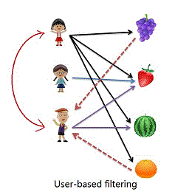
User – Based Collaborative Filtering
Use user-item rating matrix
Make user-to-user correlations
Find highly correlated users
Recommend items preferred by those user

Slide 10
Advantage:
- No knowledge about item features needed
Problems:
- New User cold start problem
- New Item cold start problem:
- New item cold start problem: items with few rating cannot easily be recommended
- Sparsity problem: if there are many items to be recommended, user/rating matrix is sparse and it hard to find the users who have rated the same item.

Slide 11
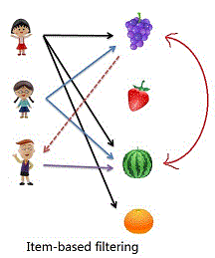
Item Based Collaborative Filtering
User user-item ratings matrix
Make item-to-item correlations
Find items that are highly correlated
Recommend items with highest correlation

Slide 12
Content Based Systems
Content Based Systems recommend items similar to those a user has liked (browsed / purchased) in the past.
OR
Recommendation are based on the content of items rather on other user’s opinion.
User Profiles: Create user profiles to describe the types of items that user prefers. E.g. User1 likes sci-fi, action and comedy.
Recommendation on the basis of keywords are also classified under content based. e.g. Letizia
E.g IBDM, Last.fm(scrobbler)

Slide 13
Content Based Systems Cont’d
Advantages:
- No need for data on other users. No cold start and sparsity.
- Able to recommend users with unique taste.
- Able to recommend new and unpopular items.
- Can provide explanation for recommendation.
Limitations:
- Data should be in structured format.
- Unable to use quality judgements from other users.

Slide 14





Technologies

Slide 15
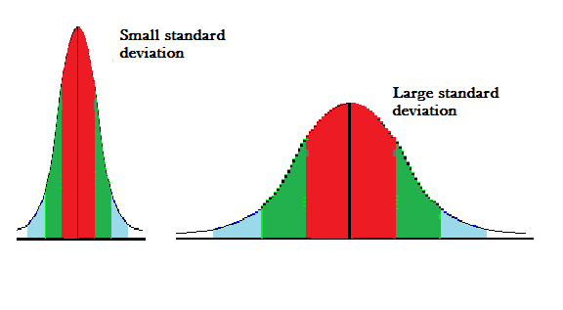
Algorithms
DEVIATION
Standard deviation (SD, also represented by the Greek letter sigma σ or the Latin letter s) is a measure that is used to quantify the amount of variation or dispersion of a set of data values.
A low standard deviation indicates that the data points tend to be close to the mean (also called the expected value) of the set, while a high standard deviation indicates that the data points are spread out over a wider range of values.

Slide 16
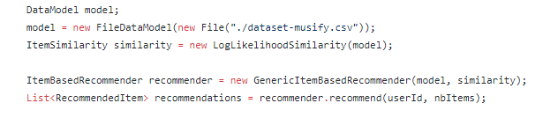
Algorithms
We’re using Collaborative Filtering
AND
Log Likelihood Similarity

Slide 17
Log Likelihood Similarity?
In statistics, a likelihood function (often simply the likelihood) is a function of the parameters of a statistical model given data. Likelihood functions play a key role in statistical inference, especially methods of estimating a parameter from a set of statistics. In informal contexts, "likelihood" is often used as a synonym for "probability.“
In statistics, a distinction is made depending on the roles of outcomes vs. parameters. Probability is used before data are available to describe possible future outcomes given a fixed value for the parameter (or parameter vector). Likelihood is used after data are available to describe a function of a parameter (or parameter vector) for a given outcome.

Slide 18


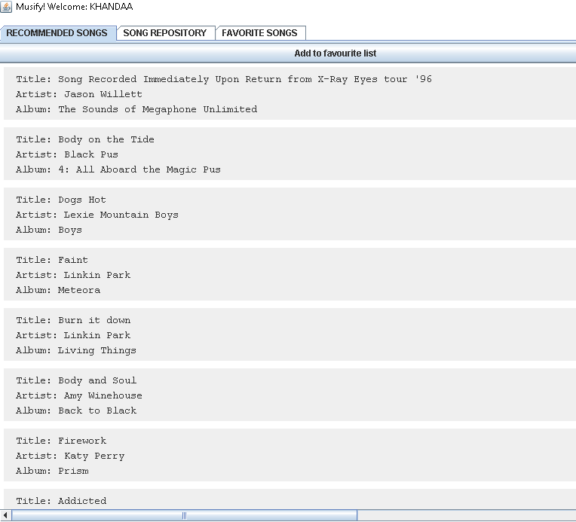



Our app

Slide 19
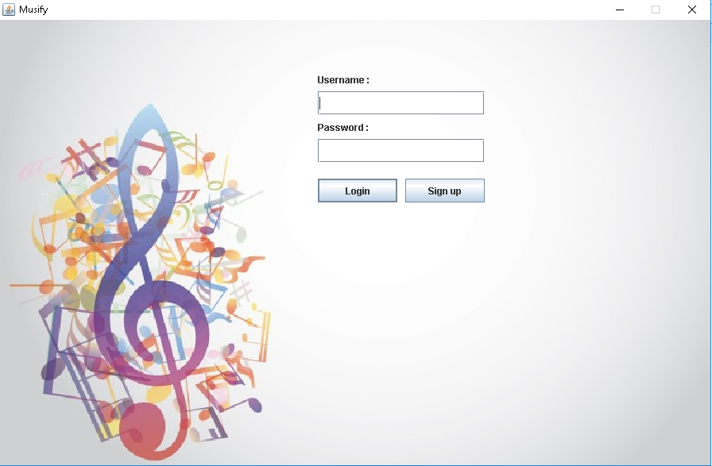
Our app

Slide 20

Demo
Please ask question after the demo demonstration.
Thanks for your cooperation.

Slide 21

QUESTION AND ANWERS

