Slide 1
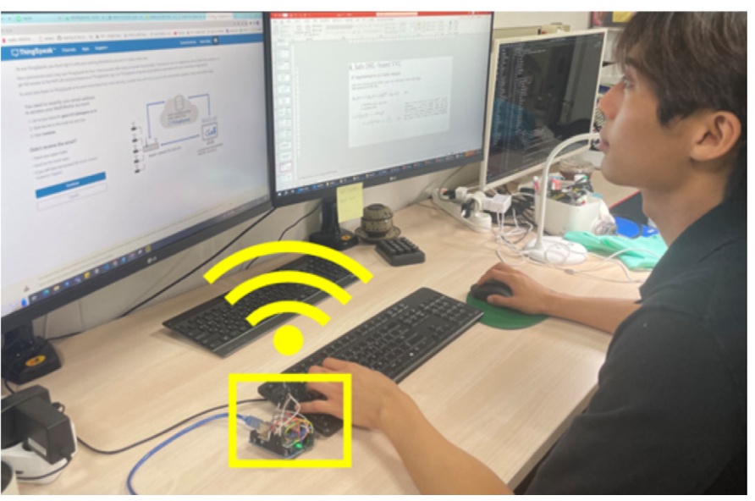
ENERGY & BUILDINGS | JOURNAL MEETING
Robust deep reinforcement
learning for personalized
HVAC system
Learn personal comfort.
Keep control stable when the building changes.
Real office data collection
Original photograph from Fig. 4b
Se-Heon Lim • Tae-Geun Kim
Dongwoo Jason Yeom • Sung-Guk Yoon
DOI: 10.1016/j.enbuild.2024.114551
Energy & Buildings 319 (2024), 114551
Notes:
This paper joins two ideas: a model that learns each person’s thermal sensation, and a controller that learns how much cooling air to supply. The human comfort data came from a real office. The HVAC control results came from simulations. This presentation follows the five-section structure of the supplied meeting slides.
SOURCE: Lim et al. (2024), pp. 1, 5–6; Fig. 4b. DOI: 10.1016/j.enbuild.2024.114551.
All paper figures are reproduced from the user-provided ROBUST.pdf. The slide design follows MEETING-10-14-.pptx. Advisor questions and proposed next steps are presentation commentary, not paper results.

Slide 2
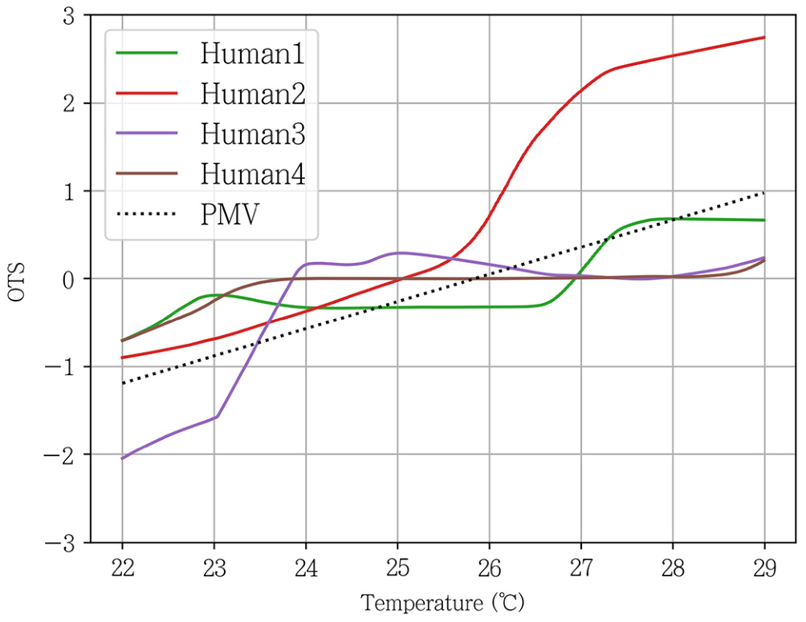
INTRODUCTION
METHODOLOGY
RESULTS
DISCUSSION
CONCLUSION
Why one comfort target is not enough
HVAC = heating, ventilation, and air conditioning
People feel temperature differently.
The same room can feel warm to one person and cool to another.
PMV uses a common comfort model.
PMV means Predicted Mean Vote. It does not learn each person’s preference.
The building also changes.
Heat loads and building properties can differ from the values used in training.
Fig. 9: the personal comfort curves do not follow one common line.
Research question: can we improve personal comfort and handle model errors?
Lim et al. (2024) • pp. 1–3; Fig. 9
02
Notes:
Start with the problem rather than the algorithm. In Fig. 9, the horizontal axis is temperature and the vertical axis is thermal sensation. Different personal curves mean that one shared target can miss someone’s comfort. The second problem is mismatch: a controller trained with estimated building properties may face a different building in use. The paper studies both problems together.
SOURCE: Lim et al. (2024), pp. 1–3, 10; Fig. 9. DOI: 10.1016/j.enbuild.2024.114551.
All paper figures are reproduced from the user-provided ROBUST.pdf. The slide design follows MEETING-10-14-.pptx. Advisor questions and proposed next steps are presentation commentary, not paper results.

Slide 3
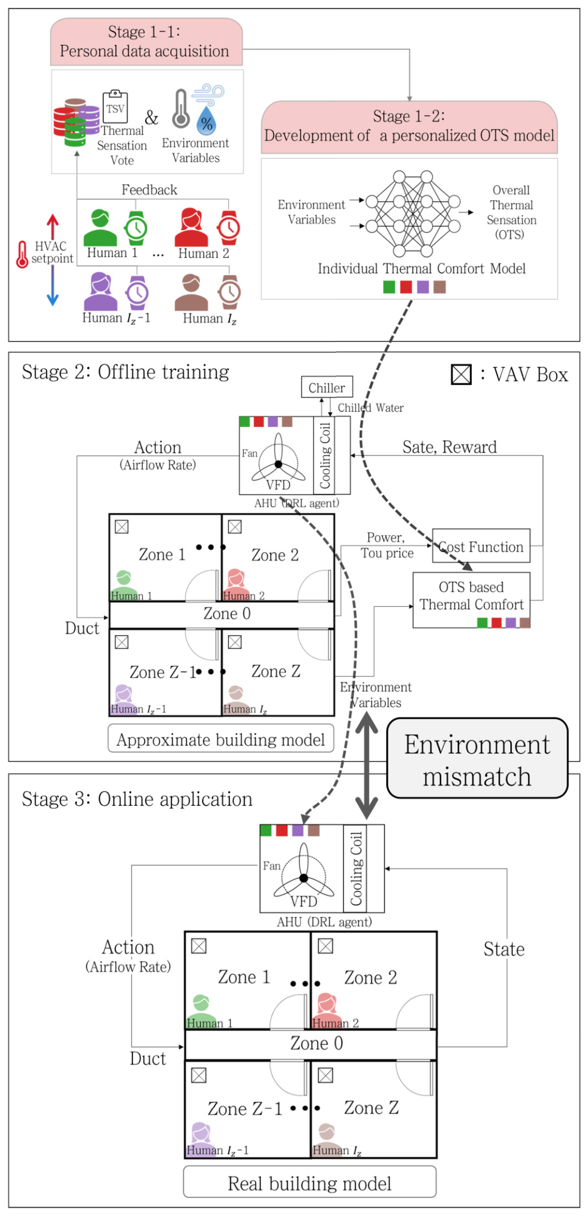
INTRODUCTION
METHODOLOGY
RESULTS
DISCUSSION
CONCLUSION
The method has three stages
Personalization learns the person. Robustness handles building-model errors.
1 Collect data and learn personal comfort.
Use room temperature, humidity, and each person’s comfort votes.
2 Train the controller in simulation.
Use the personal model to balance comfort and electricity cost.
3 Test in a changed simulation.
Change building parameters to check whether control still works.
Fig. 2: full study framework.
Important: Stage 3 was tested in simulation, not in a live building.
Lim et al. (2024) • pp. 4–5; Fig. 2
03
Notes:
Walk through the three stages on the original framework. Stage 1 uses real human data. Stage 2 is offline controller training, so exploration does not disturb a real building. Stage 3 is called online application in the figure, but the paper implements the changed building through simulation. The figure’s label “real building model” should not be read as proof of real-building controller deployment.
SOURCE: Lim et al. (2024), pp. 4–5; Fig. 2; p. 5 footnote 1. DOI: 10.1016/j.enbuild.2024.114551.
All paper figures are reproduced from the user-provided ROBUST.pdf. The slide design follows MEETING-10-14-.pptx. Advisor questions and proposed next steps are presentation commentary, not paper results.

Slide 4
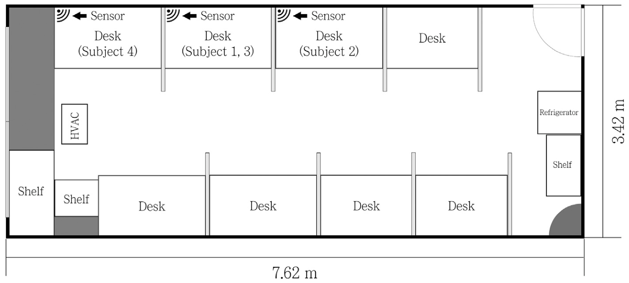
INTRODUCTION
METHODOLOGY
RESULTS
DISCUSSION
CONCLUSION
Human study: four people in an office
The real experiment supplies data for the personal comfort models.
4 participants
Each person has a separate comfort model.
Ordinary office work
Participants worked at desks during the study.
Room size
7.62 m × 3.42 m × 2.5 m.
Fig. 3: room plan, desks, sensors, and portable air conditioner.
The model learns from individual data collected in a normal office setting.
Lim et al. (2024) • pp. 5–6; Fig. 3
04
Notes:
The authors used a normal office instead of a special climate chamber. The room had regular desks and chairs, and a portable air conditioner changed the temperature. Four people participated. These details make the data practical, but four people are too few to represent a wider population. The floor plan belongs to the data-collection office; it is not the same as the multi-zone control simulation.
SOURCE: Lim et al. (2024), pp. 5–6; Fig. 3. DOI: 10.1016/j.enbuild.2024.114551.
All paper figures are reproduced from the user-provided ROBUST.pdf. The slide design follows MEETING-10-14-.pptx. Advisor questions and proposed next steps are presentation commentary, not paper results.

Slide 5
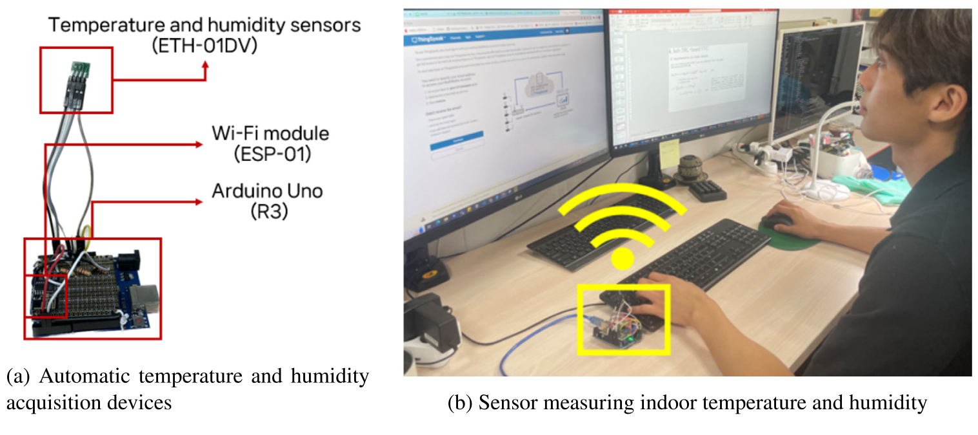
INTRODUCTION
METHODOLOGY
RESULTS
DISCUSSION
CONCLUSION
How the comfort data were collected
Room measurements were collected beside the participant.
TEMPERATURE
20°C • 24°C • 28°C
Three days at each setting.
DAILY SCHEDULE
10 a.m. to 6 p.m.
Eight working hours per day.
RECORDING
1 minute / 1 hour
Sensors each minute; votes each hour.
Fig. 4: sensor device and original photograph of data collection.
People report how they feel; sensors record the conditions around them.
Lim et al. (2024) • pp. 5–6; Fig. 4
05
Notes:
Explain the photograph and device. The sensor measures temperature and relative humidity. An Arduino and Wi-Fi module send the data. The sensor was placed next to the person. The three room settings were 20, 24, and 28 degrees Celsius, with three days at each setting. Environmental data were recorded every minute, but people reported thermal sensation only once an hour. Do not describe the final sample count as thousands of independent comfort votes.
SOURCE: Lim et al. (2024), pp. 5–6; Figs. 3–4. DOI: 10.1016/j.enbuild.2024.114551.
All paper figures are reproduced from the user-provided ROBUST.pdf. The slide design follows MEETING-10-14-.pptx. Advisor questions and proposed next steps are presentation commentary, not paper results.

Slide 6
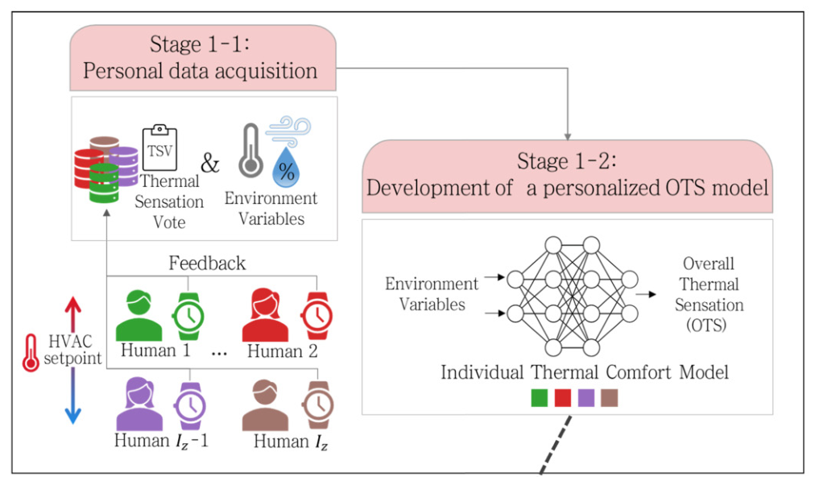
INTRODUCTION
METHODOLOGY
RESULTS
DISCUSSION
CONCLUSION
Learn a separate comfort model for each person
OTS = Overall Thermal Sensation: how cold or hot a person feels.
Input
Room temperature and relative humidity.
Output
One person’s predicted thermal sensation.
Training
Compare three learning methods. Use 90% of the data to train and 10% to test.
-3
-2
-1
0
+1
+2
+3
Cold
Cool
Slightly cool
Neutral
Slightly warm
Warm
Hot
The vote scale runs from −3 (cold) to +3 (hot). Zero means neutral.
Lim et al. (2024) • pp. 6–7; Fig. 2 (Stage 1)
06
Notes:
A personal model predicts thermal sensation from temperature and humidity. The authors compared linear regression, a support vector machine, and an artificial neural network. They trained a separate model for each of the four participants. Final sample counts were 3,960, 4,010, 3,360, and 3,190 after preprocessing. The split was 90% training and 10% testing. ANN was selected after comparison; it had two hidden layers of 1,024 units each. Neutral sensation is 0. A negative vote means cool, while a positive vote means warm. After initial training, the method can run without ongoing manual comfort votes, using room measurements as inputs.
SOURCE: Lim et al. (2024), pp. 6–7, 13; Fig. 2, Stage 1; Table 3. DOI: 10.1016/j.enbuild.2024.114551.
All paper figures are reproduced from the user-provided ROBUST.pdf. The slide design follows MEETING-10-14-.pptx. Advisor questions and proposed next steps are presentation commentary, not paper results.

Slide 7
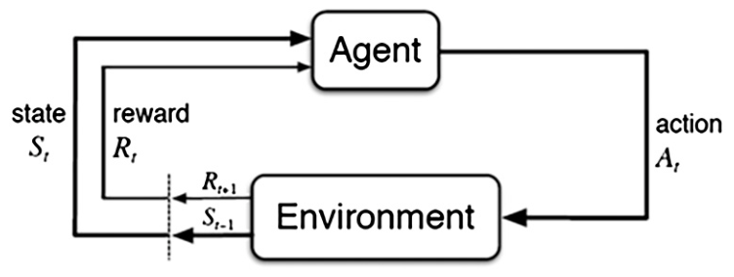
INTRODUCTION
METHODOLOGY
RESULTS
DISCUSSION
CONCLUSION
How the controller makes a decision
Every 5 minutes: read the room and choose airflow. Rewards guide training.
STATE
ACTION
REWARD
What does it know?
What can it change?
What is a good result?
Time, room and outdoor temperatures, occupancy, electricity prices, and the previous action.
Cooling airflow to each zone. The allowed range is 0.0015–0.3 kg/s.
Good personal comfort with a low electricity cost for the chiller and fan.
Reward = w × comfort − electricity cost
Fig. 1: agent–environment loop.
A higher comfort weight (w) asks the controller to spend more on comfort.
Lim et al. (2024) • p. 7, Eqs. 17–18; Fig. 1
07
Notes:
The state contains time, outside and zone temperatures, occupancy and operating status, current and the next two electricity prices, and the previous airflow action. The action is continuous airflow for the four occupied zones. The reward combines a comfort score and electricity cost. Comfort is closer to zero when better; discomfort gives a negative score. The paper includes the chiller and supply-fan cost. Operation can begin one hour before people arrive, allowing pre-cooling.
SOURCE: Lim et al. (2024), p. 7; Eqs. 12–18; p. 8 Table 5; Fig. 1. DOI: 10.1016/j.enbuild.2024.114551.
All paper figures are reproduced from the user-provided ROBUST.pdf. The slide design follows MEETING-10-14-.pptx. Advisor questions and proposed next steps are presentation commentary, not paper results.

Slide 8
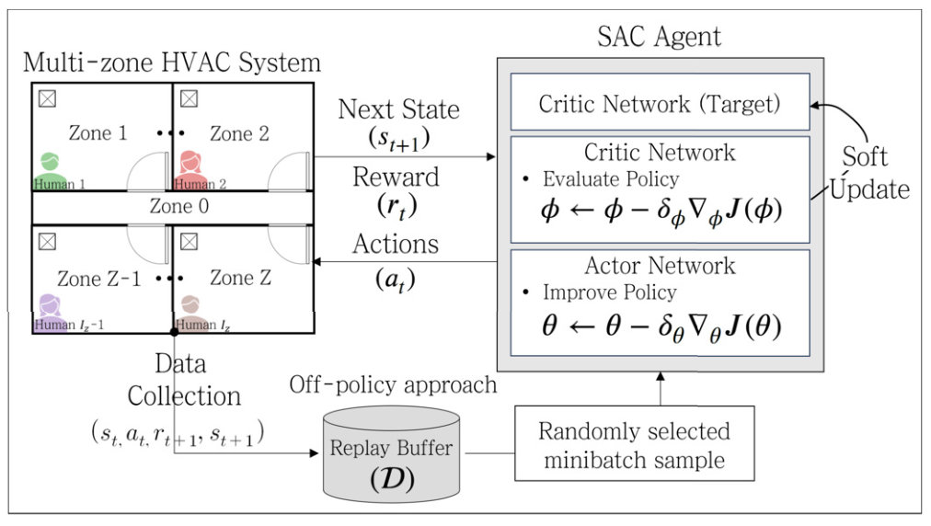
INTRODUCTION
METHODOLOGY
RESULTS
DISCUSSION
CONCLUSION
Why use Soft Actor-Critic (SAC)?
For the same room conditions, SAC can explore several airflow choices.
Actor: chooses airflow.
The policy can sample different possible actions.
Critic: evaluates the choice.
It learns which actions work well over time.
Replay memory: reuses data.
An exploration bonus helps SAC test different solutions.
Fig. 5: SAC training process and replay memory.
Training uses simulation. The trained policy is then tested with model errors.
Lim et al. (2024) • pp. 4, 7–8; Fig. 5
08
Notes:
SAC means Soft Actor-Critic. The actor produces an action and the critic estimates its value. Replay memory stores past state, action, reward, and next-state data for later learning. SAC also rewards policy entropy: in simple terms, it keeps several possible actions available during learning. The authors argue this helps when the environment is uncertain. This is an empirical robustness result, not a guarantee of safety in every building. The paper compares SAC with two other learning controllers, DDPG and PPO.
SOURCE: Lim et al. (2024), pp. 4, 7–8; Fig. 5. DOI: 10.1016/j.enbuild.2024.114551.
All paper figures are reproduced from the user-provided ROBUST.pdf. The slide design follows MEETING-10-14-.pptx. Advisor questions and proposed next steps are presentation commentary, not paper results.

Slide 9
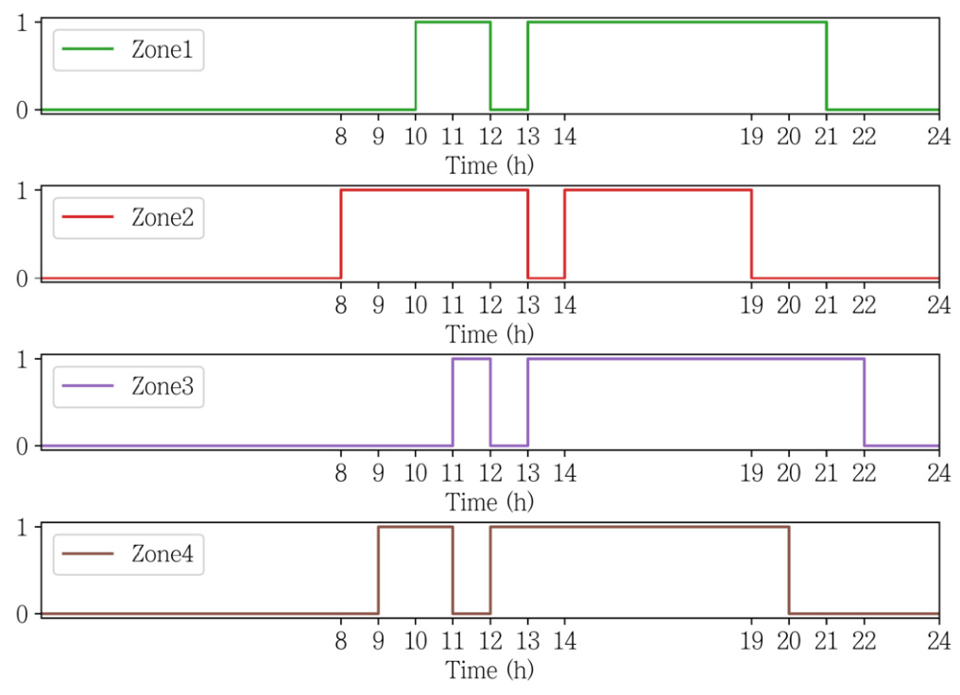
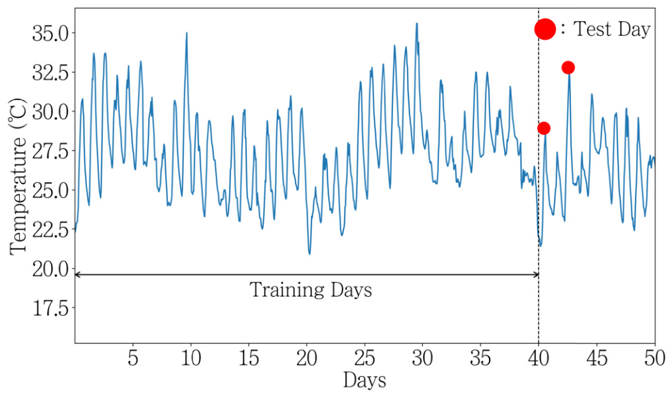
INTRODUCTION
METHODOLOGY
RESULTS
DISCUSSION
CONCLUSION
Simulation: eight test cases
2 comfort models × 2 comfort weights × 2 weather days = 8 cases
Compared methods
SAC: proposed
DDPG and PPO:
other learning methods
GA: model-based search
Fig. 7: Seoul summer weather for training and testing.
Fig. 6: different occupancy times in four zones.
40 training days • 2 test days • 5 random trials
Four occupied zones are controlled separately, with one person in each zone.
Lim et al. (2024) • pp. 8–9; Table 4, Figs. 6–7
09
Notes:
The building diagram includes Zone 0 and four occupied zones. Humans 1 to 4 occupy Zones 1 to 4. The eight cases combine PMV or personal ANN comfort, weights 5 or 10, and sunny or cloudy test weather. Training used Seoul weather from July 1 to August 9, 2022. Testing used August 10, a cloudy day, and August 12, a sunny day. The control interval was five minutes. The comparison methods were a genetic algorithm with a known building model, DDPG, PPO, and SAC. Reported simulation results average five random trials.
SOURCE: Lim et al. (2024), pp. 8–10; Tables 4–7; Figs. 6–7. DOI: 10.1016/j.enbuild.2024.114551.
All paper figures are reproduced from the user-provided ROBUST.pdf. The slide design follows MEETING-10-14-.pptx. Advisor questions and proposed next steps are presentation commentary, not paper results.

Slide 10
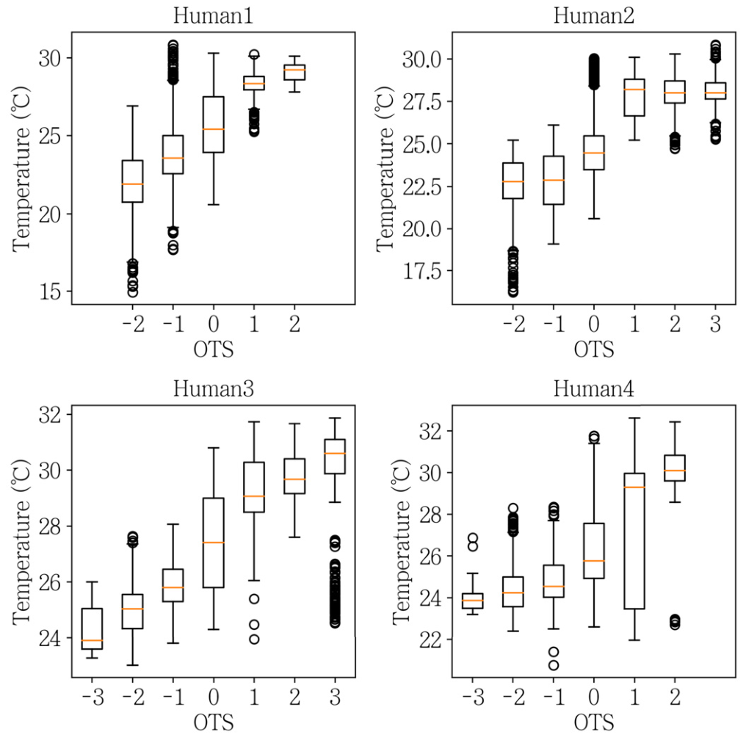
INTRODUCTION
METHODOLOGY
RESULTS
DISCUSSION
CONCLUSION
The real votes show personal differences
The same temperature does not create the same thermal sensation for everyone.
Warmer rooms usually feel warmer.
Temperature and thermal sensation were positively related for all four people.
The patterns are different.
The vote distribution changes from one participant to another.
Why this matters
A single general comfort curve cannot fully describe each person.
These results support learning personal comfort models.
Lim et al. (2024) • p. 9; Fig. 8
10
Notes:
Fig. 8 is based on the real office experiment. Each panel shows one person’s thermal sensation groups and the temperatures linked to those groups. The reported Pearson correlations were 0.70, 0.76, 0.82, and 0.58, all with p less than 0.01. The authors also report significant temperature differences between thermal-sensation groups. These results show a relationship in this small sample; they do not prove that the same models will work for a new person.
SOURCE: Lim et al. (2024), p. 9; Fig. 8; Section 4.1. DOI: 10.1016/j.enbuild.2024.114551.
All paper figures are reproduced from the user-provided ROBUST.pdf. The slide design follows MEETING-10-14-.pptx. Advisor questions and proposed next steps are presentation commentary, not paper results.

Slide 11
INTRODUCTION
METHODOLOGY
RESULTS
DISCUSSION
CONCLUSION
Preferred temperatures are not the same
Example from the learned models at 25% relative humidity
≈25°C
Human 2
≈26°C
PMV model
≈27°C
Human 1
The controller should aim for each person’s neutral point, not one shared target.
Lim et al. (2024) • p. 10; Fig. 9
11
Notes:
Read the zero crossing of each comfort curve. At 25% relative humidity, the paper describes Human 2 as comfortable near 25 degrees, the PMV model near 26 degrees, and Human 1 near 27 degrees. These are examples from the learned curves at one humidity level, not universal fixed setpoints for those people. Fig. 9 uses model predictions rather than a new independent human experiment.
SOURCE: Lim et al. (2024), p. 10; Fig. 9. DOI: 10.1016/j.enbuild.2024.114551.
All paper figures are reproduced from the user-provided ROBUST.pdf. The slide design follows MEETING-10-14-.pptx. Advisor questions and proposed next steps are presentation commentary, not paper results.

Slide 12
INTRODUCTION
METHODOLOGY
RESULTS
DISCUSSION
CONCLUSION
ANN gave the best comfort predictions
ANN = Artificial Neural Network. MAE = average prediction error; lower is better.
Model | MAE | Accuracy (%)
PMV | 1.013 | 27.88%
Linear regression | 0.710 | 44.57%
SVM | 0.482 | 63.27%
ANN | 0.375 | 73.12%
≈63%
lower overall MAE
than PMV
Calculated from Table 8.
The paper reports up to 70% for an individual.
All-participant results. Accuracy compares rounded predictions with reported votes.
The authors selected ANN as the personal comfort model for HVAC control.
Lim et al. (2024) • p. 10; Table 8
12
Notes:
This table reproduces the all-humans row of Table 8. ANN has the lowest mean absolute error and the highest rounded-vote accuracy. The overall relative MAE reduction is (1.013 minus 0.375) divided by 1.013, which is about 63%. The paper’s “up to 70%” describes the best participant-level result, not the overall reduction. Accuracy is based on discretized regression predictions, so 73.12% is not a general measure of continuous prediction accuracy. The full participant table is in the backup slides.
SOURCE: Lim et al. (2024), p. 10; Table 8; Section 4.2. DOI: 10.1016/j.enbuild.2024.114551.
All paper figures are reproduced from the user-provided ROBUST.pdf. The slide design follows MEETING-10-14-.pptx. Advisor questions and proposed next steps are presentation commentary, not paper results.

Slide 13
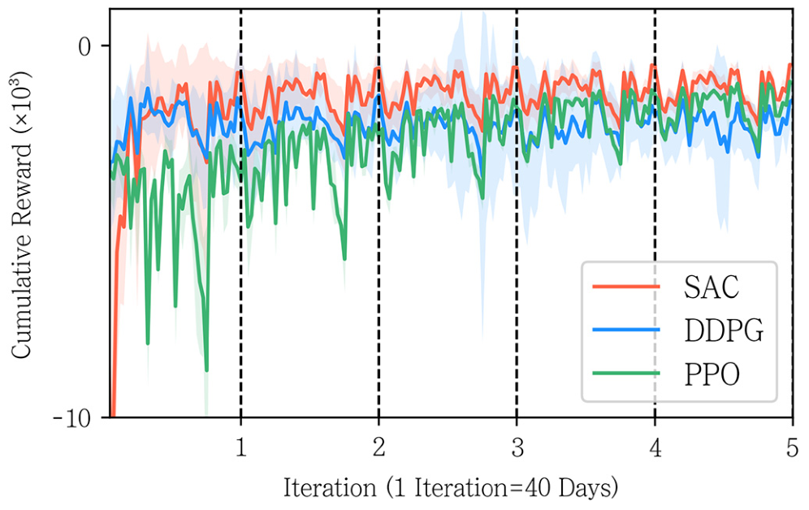
INTRODUCTION
METHODOLOGY
RESULTS
DISCUSSION
CONCLUSION
SAC learned a stable control policy
Training example: PMV comfort model and comfort weight w = 10
Higher reward is better.
SAC reached the highest reward in this training example.
Five random trials
Solid lines show the average; shading shows the 95% confidence interval.
Comparison limit
PPO used a different discount setting and stopped earlier for stability.
A strong training curve is useful, but separate test results are still needed.
Lim et al. (2024) • p. 10; Fig. 10
13
Notes:
Fig. 10 shows cumulative training reward, not a direct comfort or energy result. SAC was more stable and reached a higher reward in this example. The paper reports a maximum reward improvement of 41% over DDPG and 23% over PPO, but these are reward comparisons with negative baselines, so they should not be presented as energy savings. SAC and DDPG trained for ten iterations; PPO used a zero discount factor and stopped at six to reduce instability. The displayed curves are truncated to five iterations. These choices limit a perfectly equal comparison.
SOURCE: Lim et al. (2024), p. 10; Fig. 10; Section 4.3.1. DOI: 10.1016/j.enbuild.2024.114551.
All paper figures are reproduced from the user-provided ROBUST.pdf. The slide design follows MEETING-10-14-.pptx. Advisor questions and proposed next steps are presentation commentary, not paper results.

Slide 14
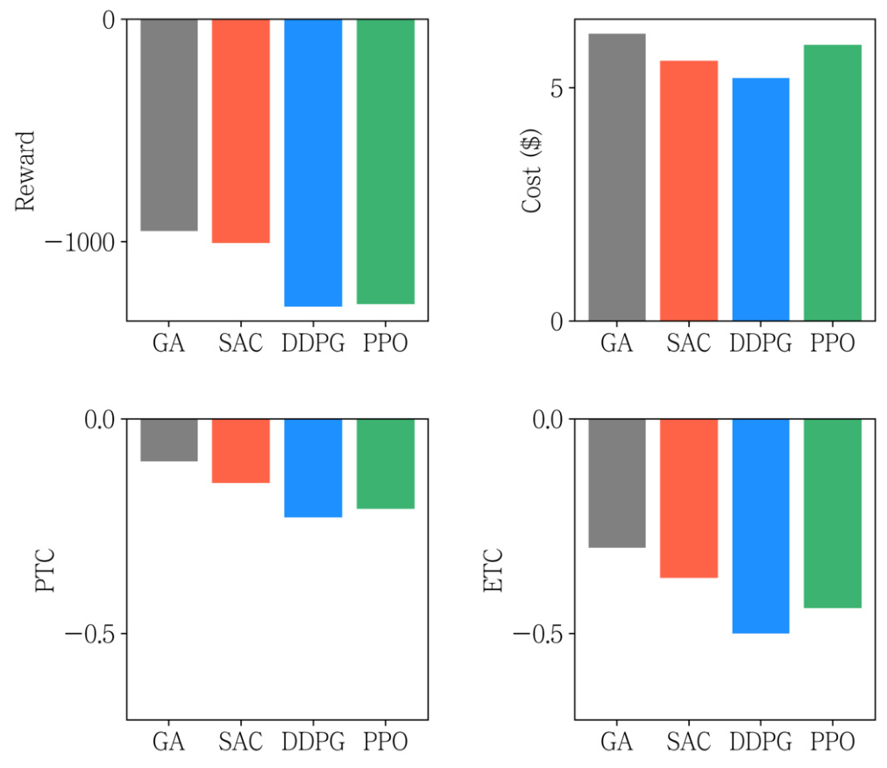
INTRODUCTION
METHODOLOGY
RESULTS
DISCUSSION
CONCLUSION
With an accurate model, GA is strongest overall
Average performance across the eight cases, before adding parameter errors
GA knows the building model.
It gives the best overall objective when the model is correct.
SAC leads the tested DRL methods.
Its reward is about 5% below GA in this normal-model comparison.
Low cost alone is not enough.
A controller can save money by giving people less comfort.
Read cost and comfort together. The lowest cost does not mean the best control.
Lim et al. (2024) • p. 11; Fig. 11
14
Notes:
The four panels show reward, cost, predicted comfort, and experienced comfort. For reward and the negative comfort scores, higher is better; for cost, lower is better. GA has access to the correct physical model, which gives it an advantage before uncertainties are added. SAC provides the best overall balance among the tested deep reinforcement learning methods. The authors report its reward about 5% below GA. DDPG emphasizes low cost at the expense of comfort, illustrating why all metrics must be considered together.
SOURCE: Lim et al. (2024), p. 11; Fig. 11; Section 4.3.2. DOI: 10.1016/j.enbuild.2024.114551.
All paper figures are reproduced from the user-provided ROBUST.pdf. The slide design follows MEETING-10-14-.pptx. Advisor questions and proposed next steps are presentation commentary, not paper results.

Slide 15
INTRODUCTION
METHODOLOGY
RESULTS
DISCUSSION
CONCLUSION
Personalization improves estimated comfort
Averages across the compared algorithms and cases; these are not SAC-only results.
Control target | Cost ($) | PTC | ETC
PMV | 6.18 | −0.15 | −0.62
Personal model | 5.26 | −0.19 | −0.19
+0.43
comfort-index points
in estimated ETC
PTC: comfort used by the controller.
ETC: evaluated with the personal ANN.
It uses PMV or the personal model.
It is an estimate, not a new human vote.
Closer to 0 means better comfort. Personalization also lowers average simulated cost.
Lim et al. (2024) • p. 11; Table 10
15
Notes:
The PMV control row has predicted comfort of minus 0.15, but ANN-estimated experienced comfort of minus 0.62. The personal-control row has minus 0.19 for both metrics. The change in estimated ETC is 0.43 comfort-index points. Average simulated electricity cost falls from $6.18 to $5.26, about 14.9%, but this is not a measured energy saving and it is not specific to SAC. PTC and ETC are equal in the personal row because the same ANN calculates both. This is not independent confirmation that people felt better. The paper explicitly says exact experienced comfort requires a human experiment.
SOURCE: Lim et al. (2024), p. 11; Table 10; p. 10 footnote 5. DOI: 10.1016/j.enbuild.2024.114551.
All paper figures are reproduced from the user-provided ROBUST.pdf. The slide design follows MEETING-10-14-.pptx. Advisor questions and proposed next steps are presentation commentary, not paper results.

Slide 16
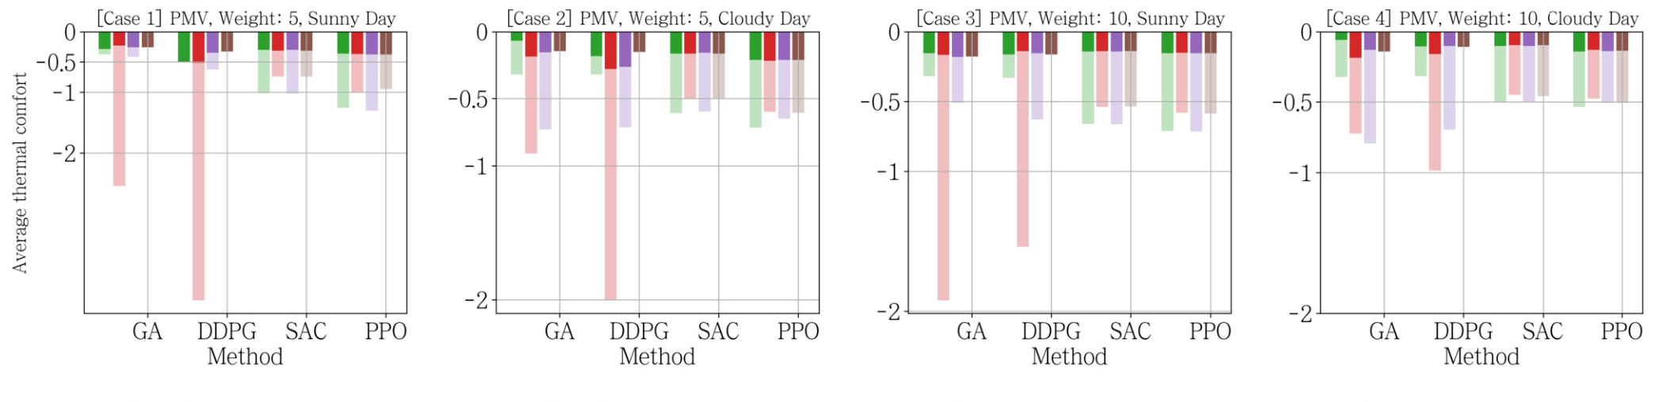
INTRODUCTION
METHODOLOGY
RESULTS
DISCUSSION
CONCLUSION
PMV control can miss one person’s comfort
Solid bars = PTC. Pale bars = ANN-estimated ETC. Values closer to 0 are better.
Human 1
Human 2
Human 3
Human 4
Human 2 shows a large gap in several cases. A good PMV score can hide personal discomfort.
Check the result for every person, not only the building average.
Lim et al. (2024) • p. 12; Fig. 12, Cases 1–4
16
Notes:
These four panels show Cases 1 to 4, where PMV is the controller’s comfort target. Colors identify the four people. Strong colors show PTC; light colors show estimated ETC. Human 2 has a large mismatch in several GA and DDPG cases. Its personal curve differs sharply from PMV above 26 degrees, so a temperature that looks comfortable under PMV may be uncomfortable under that person’s model. Values shown here are negative comfort scores, not signed hot-versus-cold sensation.
SOURCE: Lim et al. (2024), pp. 11–12; Fig. 12, top row. DOI: 10.1016/j.enbuild.2024.114551.
All paper figures are reproduced from the user-provided ROBUST.pdf. The slide design follows MEETING-10-14-.pptx. Advisor questions and proposed next steps are presentation commentary, not paper results.

Slide 17
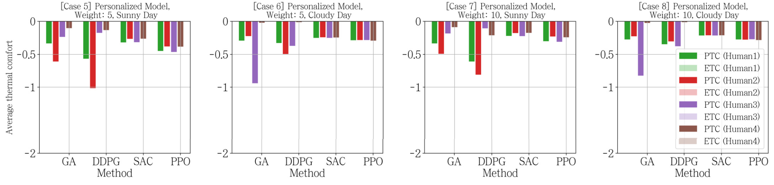
INTRODUCTION
METHODOLOGY
RESULTS
DISCUSSION
CONCLUSION
Personal control reduces the mismatch
Here PTC and ETC use the same personal model, so the two bars coincide.
SAC is steady across people.
GA gives the best average ETC here.
Its reported average ETC is about −0.16.
Its reported average ETC is about −0.10.
Personal models improve the target, but the controller still affects the final result.
Lim et al. (2024) • p. 12; Fig. 12, Cases 5–8
17
Notes:
These four panels show Cases 5 to 8, which use the personalized ANN target. The paper reports mean ETC of about minus 0.10 for GA and minus 0.16 for SAC in these personal-model cases. SAC had lower variation across people. Do not say SAC always has the single best comfort score: with the correct model, GA is best on this average. Also emphasize that matching PTC and ETC is built into the metric definitions here; both use the same ANN, rather than two independent measurements.
SOURCE: Lim et al. (2024), pp. 11–12; Fig. 12, bottom row. DOI: 10.1016/j.enbuild.2024.114551.
All paper figures are reproduced from the user-provided ROBUST.pdf. The slide design follows MEETING-10-14-.pptx. Advisor questions and proposed next steps are presentation commentary, not paper results.

Slide 18
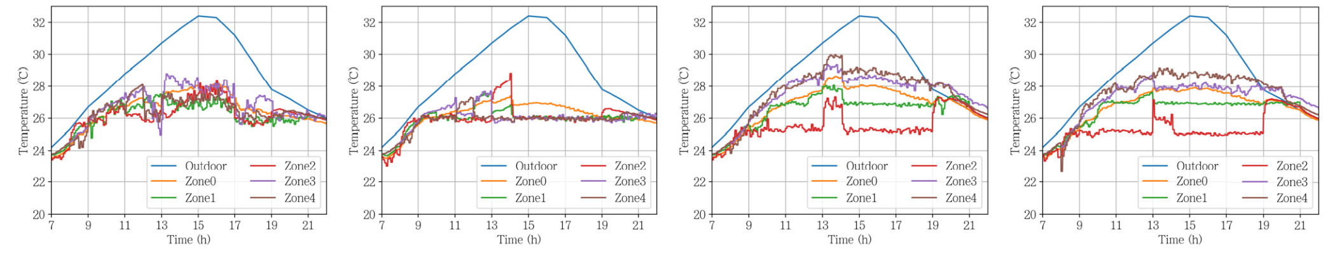
INTRODUCTION
METHODOLOGY
RESULTS
DISCUSSION
CONCLUSION
Personal control gives each zone a different temperature
Sunny-day results. The full airflow and temperature figure is in the backup slides.
PMV • w = 5
PMV • w = 10
Personal • w = 5
Personal • w = 10
PMV control: similar temperatures.
Personal control: different temperatures.
The controller uses a common comfort target.
For example, Human 2’s zone is kept cooler.
Higher comfort weight makes the controller follow personal preferences more closely.
Lim et al. (2024) • pp. 11–12; Fig. 13, temperature panels
18
Notes:
The original Fig. 13 has airflow in the top row and temperature in the bottom row. This slide enlarges the temperature panels. In the PMV cases, occupied-zone temperatures are similar. In the personal cases, the zones follow different preferred temperatures; the red Zone 2 line is cooler. At weight 5 the controller accepts somewhat warmer rooms to reduce cost. At weight 10 it follows comfort targets more closely. The full figure also shows airflow falling around 1 p.m. when a zone is empty. All of these are simulated behaviors.
SOURCE: Lim et al. (2024), pp. 11–12; Fig. 13, lower row. DOI: 10.1016/j.enbuild.2024.114551.
All paper figures are reproduced from the user-provided ROBUST.pdf. The slide design follows MEETING-10-14-.pptx. Advisor questions and proposed next steps are presentation commentary, not paper results.

Slide 19
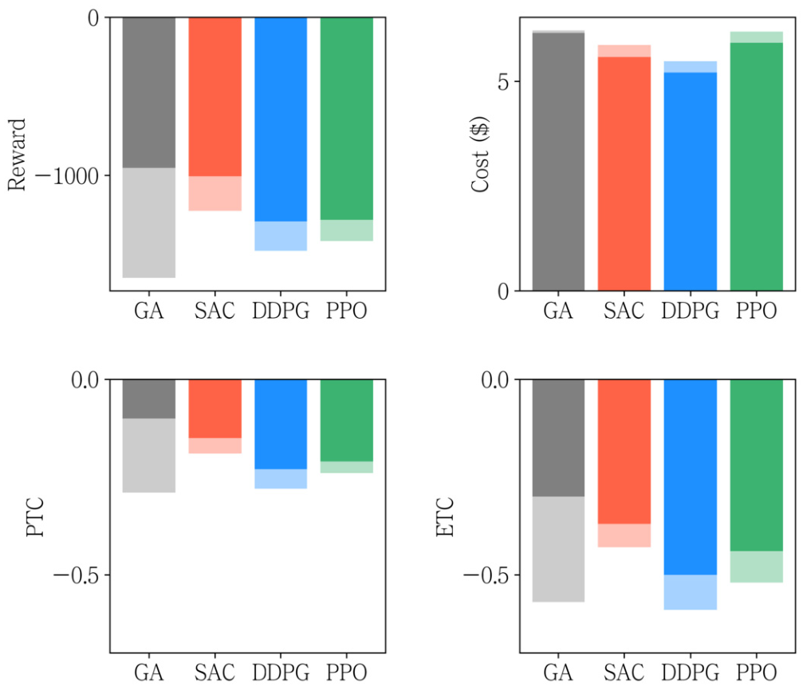
INTRODUCTION
METHODOLOGY
RESULTS
DISCUSSION
CONCLUSION
SAC handles building-model errors better
Thermal resistance, heat capacity, and heat load were changed by 0.5–2.0 times.
Reported ETC improvement with SAC
Compared with | Improvement
GA | 25%
DDPG | 28%
PPO | 18%
≈24% average ETC improvement.
This is not an energy-saving result.
Under these model errors, SAC gives the best balance, but not the lowest cost.
Lim et al. (2024) • pp. 11–13; Fig. 14
19
Notes:
The uncertain parameters are the thermal resistances between zones and outdoors, the zone thermal capacitance, and internal heat load. They were multiplied by values between half and twice the estimated amount. In Fig. 14, solid bars show the original model and pale bars show uncertainty. The authors report SAC’s estimated ETC improvements of 25% versus GA, 28% versus DDPG, and 18% versus PPO, averaging about 24%. This is the source of the abstract’s robustness headline. It is not an energy-saving percentage. SAC performs best on the reported uncertain-model metrics except cost.
SOURCE: Lim et al. (2024), pp. 11–13; Section 4.3.3; Fig. 14. DOI: 10.1016/j.enbuild.2024.114551.
All paper figures are reproduced from the user-provided ROBUST.pdf. The slide design follows MEETING-10-14-.pptx. Advisor questions and proposed next steps are presentation commentary, not paper results.

Slide 20
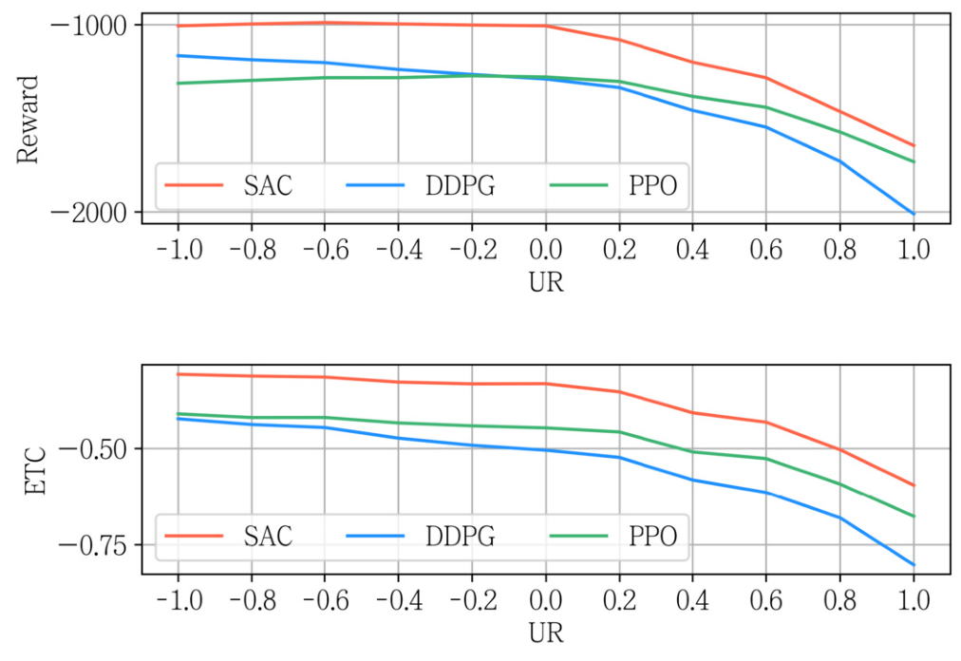
INTRODUCTION
METHODOLOGY
RESULTS
DISCUSSION
CONCLUSION
A harder heat-load test shows the limit
Uncertainty Rate (UR) describes the mean real heat load relative to the estimate.
UR | Mean heat load
−1 | 0.5 × estimated
0 | 1 × estimated
+1 | 2 × estimated
SAC has the highest reward at all tested UR values.
Its ETC also worsens at the hardest setting.
SAC is more resilient in these tests; it is not safe under every possible condition.
Lim et al. (2024) • pp. 12–13; Fig. 15
20
Notes:
In this stress test, UR equals log base 2 of the mean multiplier mu. The actual-to-estimated heat-load ratio is sampled uniformly between mu divided by two and three mu divided by two. Thus UR of zero means a mean multiplier of one, not zero uncertainty. The sweep goes from minus one to plus one. SAC has the highest reward at all tested values. DDPG’s estimated ETC falls below minus 0.5 from UR 0.2, and PPO’s from 0.4. SAC stays above that reference level except at UR 1, the most severe tested case. Robustness is relative and limited to these simulated disturbances.
SOURCE: Lim et al. (2024), pp. 12–13; Eq. 20; Fig. 15. DOI: 10.1016/j.enbuild.2024.114551.
All paper figures are reproduced from the user-provided ROBUST.pdf. The slide design follows MEETING-10-14-.pptx. Advisor questions and proposed next steps are presentation commentary, not paper results.

Slide 21
INTRODUCTION
METHODOLOGY
RESULTS
DISCUSSION
CONCLUSION
What the evidence supports—and what is still missing
The personal model is promising. Real-building performance still needs testing.
SUPPORTED BY THIS PAPER
MAIN LIMITATIONS
Useful results
Small and simulated
• Personal curves differ.
• ANN predicts better than PMV in this dataset.
• SAC handles the tested model errors better than the comparison methods.
• Only four people and three temperature settings.
• Comfort uses only temperature and humidity.
• ETC is ANN-estimated.
• No live HVAC control trial.
The paper is a useful proof of concept, not yet a broad field validation.
Lim et al. (2024) • pp. 5, 10, 13
21
Notes:
The authors identify small sample size, limited temperature range, changing personal preferences, and limited uncertainty models as key limitations. Season, health, and adaptation may change comfort, but the model only uses temperature and humidity. The dataset is confidential. In addition, the evaluation metric assumes that the learned ANN is the person’s true comfort. That assumption should be tested with fresh human feedback during real control. These limitations do not remove the method’s value, but they define the strength of the evidence.
SOURCE: Lim et al. (2024), p. 5 footnote 1; p. 10 footnote 5; p. 13 limitations and data availability. DOI: 10.1016/j.enbuild.2024.114551.
All paper figures are reproduced from the user-provided ROBUST.pdf. The slide design follows MEETING-10-14-.pptx. Advisor questions and proposed next steps are presentation commentary, not paper results.

Slide 22
INTRODUCTION
METHODOLOGY
RESULTS
DISCUSSION
CONCLUSION
Questions to discuss with the advisor
These are proposed questions and next steps, not results from the paper.
01 DATA
02 VALIDATION
03 DEPLOYMENT
Will it work on a new day?
Do people really feel better?
How can we test it safely?
Test on a separate day or season, with more people and a wider temperature range.
Collect fresh votes while the controller operates. Compare them with ANN estimates.
Use strict temperature and airflow limits. Start with supervised trials and a fallback controller.
Suggested next step: validate personal comfort first, then test control with safety limits.
Lim et al. (2024) • Presentation discussion, based on pp. 6, 10–13
22
Notes:
These questions are my discussion prompts for the meeting. First, the paper states a 90/10 split but does not describe a separate-day split. Ask whether a held-out day or season would give a stronger estimate of performance. Do not claim that leakage has been proven. Second, compare model-estimated ETC with new human votes during control. Third, plan a supervised trial with explicit comfort limits and a fallback controller. The authors also propose safe reinforcement learning and broader uncertainty modeling as future work.
SOURCE: Lim et al. (2024), pp. 6, 10–13; presentation commentary. DOI: 10.1016/j.enbuild.2024.114551.
All paper figures are reproduced from the user-provided ROBUST.pdf. The slide design follows MEETING-10-14-.pptx. Advisor questions and proposed next steps are presentation commentary, not paper results.

Slide 23
INTRODUCTION
METHODOLOGY
RESULTS
DISCUSSION
CONCLUSION
Main takeaways
Personal comfort and robust control should be designed together.
1 PERSONAL MODEL
2 COMFORT TARGET
3 ROBUST CONTROL
Learn the person
Use personal preferences
Prepare for model errors
ANN lowered overall prediction error from 1.013 to 0.375 MAE in this dataset.
Personal control improved model-estimated ETC by 0.43 comfort-index points.
SAC improved estimated comfort by about 24% versus the tested baselines under uncertainty.
Next: more people, fresh comfort votes, and safe real-building tests.
Lim et al. (2024) • pp. 10–13; Tables 8, 10; Figs. 14–15
23
Notes:
Conclude with three connected points. First, collect feedback and learn personal comfort rather than relying only on a general PMV curve. Second, use those personal targets to avoid a mismatch between predicted and estimated experienced comfort. Third, train a controller that can handle changes between its model and the building. The 0.43-point and about 24% results are model-estimated comfort findings from simulations, not measured field energy savings. The next evidence needed is independent human validation and safe real-building control.
SOURCE: Lim et al. (2024), pp. 10–13; Tables 8 and 10; Figs. 14–15. DOI: 10.1016/j.enbuild.2024.114551.
All paper figures are reproduced from the user-provided ROBUST.pdf. The slide design follows MEETING-10-14-.pptx. Advisor questions and proposed next steps are presentation commentary, not paper results.

Slide 24
INTRODUCTION
METHODOLOGY
RESULTS
DISCUSSION
CONCLUSION
Backup: all eight simulation cases
Case | Comfort target | Weight w | Test weather
1 | PMV | 5 | Sunny
2 | PMV | 5 | Cloudy
3 | PMV | 10 | Sunny
4 | PMV | 10 | Cloudy
5 | Personal ANN | 5 | Sunny
6 | Personal ANN | 5 | Cloudy
7 | Personal ANN | 10 | Sunny
8 | Personal ANN | 10 | Cloudy
All four algorithms are compared across the same case combinations.
BACKUP | Lim et al. (2024) • p. 8; Table 4
24
Notes:
Use this slide if the advisor asks what the eight cases mean. Only comfort target, comfort weight, and test-day weather change in the case definitions. PMV and personalized ANN are used to generate the control reward in their respective cases. The same weight applies in training and testing.
SOURCE: Lim et al. (2024), p. 8; Table 4. DOI: 10.1016/j.enbuild.2024.114551.
All paper figures are reproduced from the user-provided ROBUST.pdf. The slide design follows MEETING-10-14-.pptx. Advisor questions and proposed next steps are presentation commentary, not paper results.

Slide 25
INTRODUCTION
METHODOLOGY
RESULTS
DISCUSSION
CONCLUSION
Backup: prediction results for each person
Mean Absolute Error (MAE); lower is better.
Participant | PMV | Linear regression | SVM | ANN
Human 1 | 1.141 | 0.507 | 0.437 | 0.365
Human 2 | 1.103 | 0.796 | 0.558 | 0.326
Human 3 | 0.897 | 0.703 | 0.574 | 0.559
Human 4 | 0.856 | 0.849 | 0.333 | 0.258
All humans | 1.013 | 0.710 | 0.482 | 0.375
ANN is best for all four participants, but its error still differs between people.
The model’s quality matters because the controller also uses it to evaluate comfort.
BACKUP | Lim et al. (2024) • p. 10; Table 8
25
Notes:
These are the MAE values from the complete participant table. Human 3 has the largest ANN MAE, 0.559, while Human 4 has the smallest, 0.258. This variation is important when deciding whether a personal model is reliable enough to use for control. The all-humans number is the reported aggregate, not an arithmetic claim about an equal-weight mean of the displayed rounded participant errors.
SOURCE: Lim et al. (2024), p. 10; Table 8. DOI: 10.1016/j.enbuild.2024.114551.
All paper figures are reproduced from the user-provided ROBUST.pdf. The slide design follows MEETING-10-14-.pptx. Advisor questions and proposed next steps are presentation commentary, not paper results.

Slide 26
INTRODUCTION
METHODOLOGY
RESULTS
DISCUSSION
CONCLUSION
Backup: important settings and metric definitions
Setting | Value
Comfort ANN | 2 hidden layers × 1,024 units
Comfort inputs | Temperature + relative humidity
Control interval | 5 minutes
Supply-air temperature | 16°C
Zone airflow | 0.0015–0.3 kg/s
SAC hidden layers | 128 / 128
Comfort score: 0 is best.
If |OTS| ≤ 1: score = −|OTS|
If |OTS| > 1: score = −OTS²
Reward = w × comfort − cost
PTC uses the training comfort model.
ETC always uses the personal ANN.
ETC is not independent human feedback.
SAC = Soft Actor-Critic • GA = Genetic Algorithm • DRL = Deep Reinforcement Learning
BACKUP | Lim et al. (2024) • pp. 6–9; Eqs. 12, 18; Tables 3, 5, 7
26
Notes:
The comfort score is not the signed thermal sensation scale. It is minus the magnitude of OTS near neutral, and minus the square for magnitudes above one. This penalizes large discomfort. The total reward subtracts the electricity cost of the chiller and supply fan from weighted total comfort. DDPG means Deep Deterministic Policy Gradient; PPO means Proximal Policy Optimization; SVM means Support Vector Machine; ANN means Artificial Neural Network. ANN settings also include ReLU, learning rate 0.0001, dropout 0.5, and mean squared error loss. SAC uses a batch size of 32, memory size 50,000, and discount factor 0.9.
SOURCE: Lim et al. (2024), pp. 6–9; Eq. 12; Eq. 18; Tables 3, 5, 7. DOI: 10.1016/j.enbuild.2024.114551.
All paper figures are reproduced from the user-provided ROBUST.pdf. The slide design follows MEETING-10-14-.pptx. Advisor questions and proposed next steps are presentation commentary, not paper results.

Slide 27
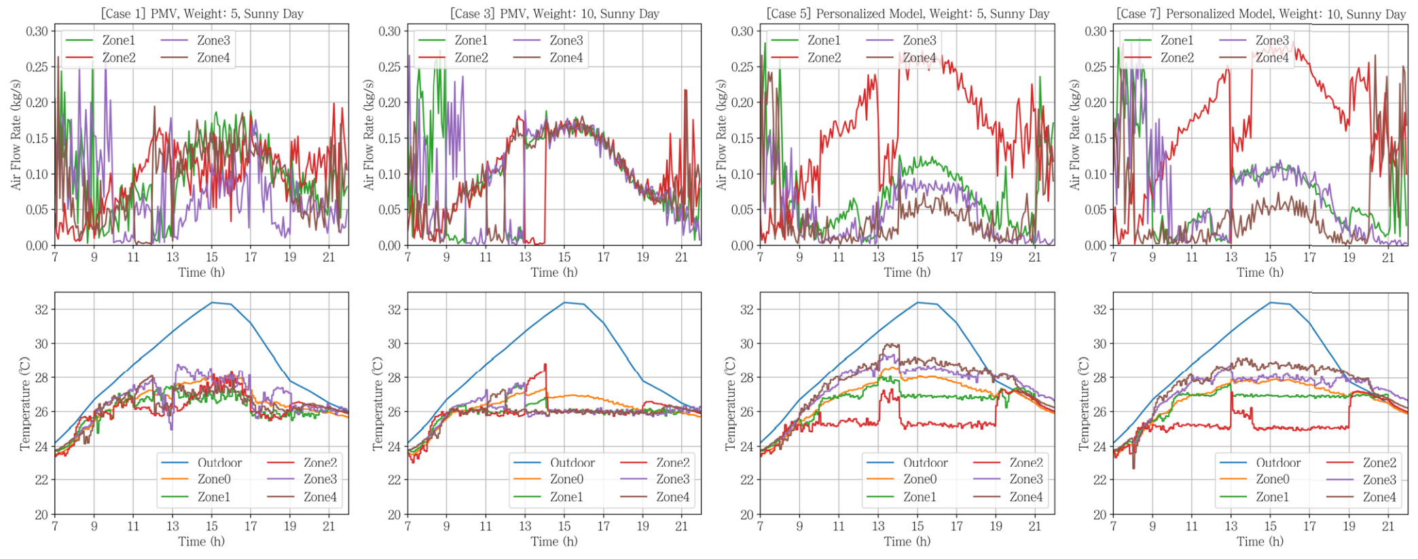
INTRODUCTION
METHODOLOGY
RESULTS
DISCUSSION
CONCLUSION
Backup: full airflow and temperature results
Sunny day: top row = airflow; bottom row = zone temperatures.
Personal control changes airflow by zone. Airflow falls when the zone is empty.
BACKUP | Lim et al. (2024) • p. 12; Fig. 13
27
Notes:
This is the full original Fig. 13. Columns show Cases 1, 3, 5, and 7: PMV or personal model, at weights 5 or 10, on the sunny test day. Top panels show airflow in kilograms per second. Bottom panels show temperatures in degrees Celsius. Compare the common PMV zone temperatures with the distinct personal-model temperatures. Also observe the lower airflow during the absence period around 1 p.m.
SOURCE: Lim et al. (2024), pp. 11–12; Fig. 13. DOI: 10.1016/j.enbuild.2024.114551.
All paper figures are reproduced from the user-provided ROBUST.pdf. The slide design follows MEETING-10-14-.pptx. Advisor questions and proposed next steps are presentation commentary, not paper results.

