Slide 1

CSCI-3753: Operating Systems Fall 2020
Biljith Thadichi
Department of Computer Science
University of Colorado Boulder
Slides based on presentation by Anh Nguyen and Erika Hunhoff

Slide 2
Week 2 > Administrivia > Setting up VM > Using Cloud VM > PA1 > LKM

Slide 3
Administrivia
Use Piazza and mailing list
osclass@colorado.edu
Office Hours
Mon and Wed 10 – 11 am
Zoom link
Also available on Course home page.

Slide 4
Week 2 > Administrivia > Setting up VM > Using Cloud VM > PA1 > LKM

Slide 5
Setting up the VM
Download and install VMware Workstation Pro
Visit Computer Science OnTheHub Portal and sign in with IdentiKey.
Add VMWare Workstation 15.x Pro to your cart, checkout and download it.
You will receive a serial number in your email which you can use to activate the software for a year.
Download CU CS Virtual Machine
Instructions for downloading and importing the VM can be found here.

Slide 6
Week 2 > Administrivia > Setting up VM > Using Cloud VM > PA1 > LKM

Slide 7
Using Cloud VM
Connect to the Campus VPN if you’re not on campus.
Download and Install Cisco VPN client. Instructions can be found here
vpn.colorado.edu
Navigate to vSphere website.
Login using your IdentiKey.
Type in your identikey into the Search in all environments box at the top of the screen and hit return
You can also find these instructions here

Slide 8
Week 2 > Administrivia > Setting up VM > Using Cloud VM > PA1 > LKM

Slide 9
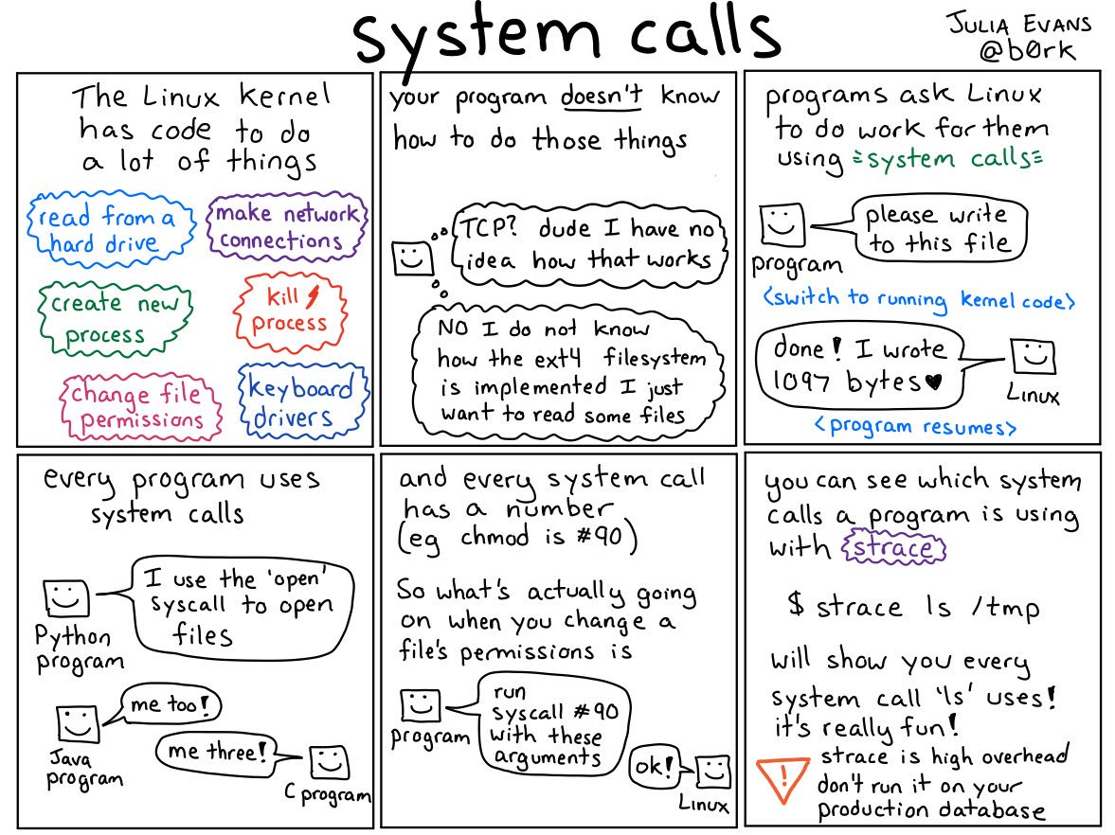
CSCI 3753: Operating Systems Fall 2019
@b0rk on Twitter, or https://drawings.jvns.ca/

Slide 10
Executing a System Call
A user space program invokes the syscall
A (typically) software interrupt called a trap is triggered (INT)
Mode bit is flipped from user to kernel (1 to 0)
The interrupt tells the kernel which syscall was called
Requisite data may be passed in
The kernel verifies if all parameters are legal before executing the system call
After execution, mode bit flips and user program resumes
Notes:
Emphasize mode bit

Slide 11
Adding a System Call
Write the system call source code
arch/x86/kernel/newSysCall.c
Add the syscall prototype to the syscalls header file
include/linux/syscalls.h
Add the new syscall to the Makefile
arch/x86/kernel/Makefile
Add the syscall to the syscalls table
arch/x86/entry/syscalls/syscall_64.tbl

Slide 12
Compiling the Kernel
Source the kernel
sudo apt-get source linux-source-4.15.0
Create a config file and setup a name to append to the release
sudo cp /boot/config-$(uname -r) .config
Make
sudo make -j2 CC="ccache gcc"
sudo make -j2 modules_install
sudo make -j2 install
Reboot

Slide 13
Some useful Kernel APIs
copy_from_user / get_user
copy_to_user / put_user
printk()
Notes:
The fundamental part is protection. The kernel should never let user-space access any kernel memory directly. So, there is an access_ok() that is called on the address to ensure that the address is a user space address and not a kernel space address, and also check if it can be read or written. It is very critical for obvious security reason.
The natural next question is why can't the kernel just complete this check and read from this address directly when needed instead of copying into its buffer?
What happens when there is a page fault when reading this address and the memory pointed is invalid. Usually, if we have a page fault inside the kernel the kernel will panic() and give up. It is definitely not a good idea to let a user-space process panic the kernel. So, if there is a page-fault during copy_from_user the kernel does not panic but nicely returns a error like -EFAULT to the user.

Slide 14
Question
Why would you use copy_to_user?
Notes:
The fundamental part is protection. The kernel should never let user-space access any kernel memory directly. So, there is an access_ok() that is called on the address to ensure that the address is a user space address and not a kernel space address, and also check if it can be read or written. It is very critical for obvious security reason.
The natural next question is why can't the kernel just complete this check and read from this address directly when needed instead of copying into its buffer?
What happens when there is a page fault when reading this address and the memory pointed is invalid. Usually, if we have a page fault inside the kernel the kernel will panic() and give up. It is definitely not a good idea to let a user-space process panic the kernel. So, if there is a page-fault during copy_from_user the kernel does not panic but nicely returns a error like -EFAULT to the user.

Slide 15
Question
Why would you use copy_to_user?
Because a program running in user space will not be able to access memory from the kernel space
Notes:
The fundamental part is protection. The kernel should never let user-space access any kernel memory directly. So, there is an access_ok() that is called on the address to ensure that the address is a user space address and not a kernel space address, and also check if it can be read or written. It is very critical for obvious security reason.
The natural next question is why can't the kernel just complete this check and read from this address directly when needed instead of copying into its buffer?
What happens when there is a page fault when reading this address and the memory pointed is invalid. Usually, if we have a page fault inside the kernel the kernel will panic() and give up. It is definitely not a good idea to let a user-space process panic the kernel. So, if there is a page-fault during copy_from_user the kernel does not panic but nicely returns a error like -EFAULT to the user.

Slide 16
Question
Why would you use copy_from_user?
Notes:
The fundamental part is protection. The kernel should never let user-space access any kernel memory directly. So, there is an access_ok() that is called on the address to ensure that the address is a user space address and not a kernel space address, and also check if it can be read or written. It is very critical for obvious security reason.
The natural next question is why can't the kernel just complete this check and read from this address directly when needed instead of copying into its buffer?
What happens when there is a page fault when reading this address and the memory pointed is invalid. Usually, if we have a page fault inside the kernel the kernel will panic() and give up. It is definitely not a good idea to let a user-space process panic the kernel. So, if there is a page-fault during copy_from_user the kernel does not panic but nicely returns a error like -EFAULT to the user.

Slide 17
Question
Why would you use copy_from_user?
Kernel should never let user programs access kernel space directly
The memory address could be invalid causing the kernel to panic.
Notes:
The fundamental part is protection. The kernel should never let user-space access any kernel memory directly. So, there is an access_ok() that is called on the address to ensure that the address is a user space address and not a kernel space address, and also check if it can be read or written. It is very critical for obvious security reason.
The natural next question is why can't the kernel just complete this check and read from this address directly when needed instead of copying into its buffer?
What happens when there is a page fault when reading this address and the memory pointed is invalid. Usually, if we have a page fault inside the kernel the kernel will panic() and give up. It is definitely not a good idea to let a user-space process panic the kernel. So, if there is a page-fault during copy_from_user the kernel does not panic but nicely returns a error like -EFAULT to the user.

Slide 18
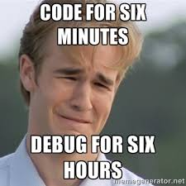

Slide 19
How to Add a code to a Linux Kernel
Method 1:
Step 1: Add source files to the Linux kernel source tree
Step 2: Recompile the kernel
PA1
It takes a long time to compile the kernel source code (2-3 hours) !!!
Method 2: Add code to the Linux kernel while it is running
Loadable Kernel Module (LKM)

Slide 20
Loadable Kernel Module (LKM)
LKM is a chunk of code that we add to the Linux kernel while it is running.
Typical modules
Device drivers
Filesystem drivers

Slide 21
Loadable Kernel Module (LKM)
LKMs (when loaded) are very much part of the kernel.
→ Part of the kernel that is bound into the image that you boot is “base kernel”.
LKMs communicate with the base kernel.

Slide 22
LKM Advantages
DON’T have to rebuild the kernel
Help diagnose system problems
A bug in a device driver which is bound into the base kernel can stop the system from booting at all.
Save memory
Have them loaded only when we are actually using them
Be MUCH faster to maintain and debug
Notes:
And it can be really hard to tell which part of the base kernel caused the trouble. If the same device driver is an LKM, though, the base kernel is up and running before the device driver even gets loaded. If your system dies after the base kernel is up and running, it's an easy matter to track the problem down to the trouble-making device driver and just not load that device driver until you fix the problem.

Slide 23
LKM Utilities
insmod: Insert an LKM into the kernel.
rmmod: Remove an LKM from the kernel.
lsmod: List currently loaded LKMs.
kerneld: Kernel daemon program
allows kernel modules to be loaded automatically rather than manually with insmod/modprobe
modprobe: Insert/remove an LKM or set of LKMs intelligently.
e.g., if you must load A before loading B, modprobe will automatically load A when you tell it to load B.

Slide 24
LKM Utilities
depmod: Determine interdependencies between LKMs.
modinfo: Display contents of .modinfo section in an LKM object file.

Slide 25

Week 2 – Checklist
Submit PS1 by next Thursday (10th September)
Start PA1
Read more about LKM

