Slide 1

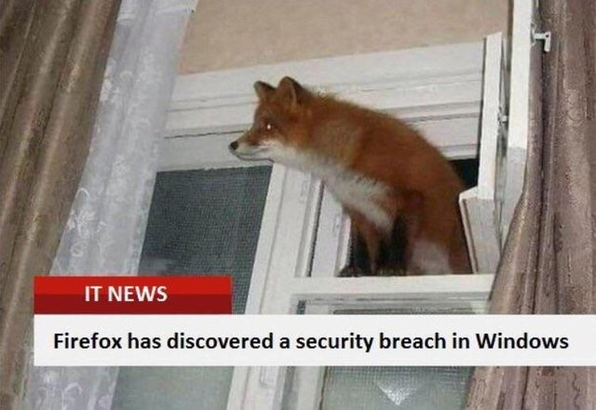

Slide 2

CSCI-3753: Operating Systems Fall 2020
Biljith Thadichi
Department of Computer Science
University of Colorado Boulder
Slides based on presentation by Anh Nguyen and Erika Hunhoff

Slide 3
Interview Grading for PA1
Register for a timeslot for PA1 interview grading!
What to prepare for the interview?
Laptop
Submitted source code
Knowledge… for example:
Bootloader?
System call?
Files you modified to add your own system call?
Used functions?

Slide 4
Week 3: LKM Example & Device Drivers

Slide 5
A device driver…
Is a program
Runs in the kernel
Operates or controls a particular type of device attached to a computer
Communicates with the device through the computer bus or communications subsystem to which the hardware connects
Transfers data to and from a user process

Slide 6
A device driver…
Is a program
Runs in the kernel
Operates or controls a particular type of device attached to a computer
Communicates with the device through the computer bus or communications subsystem to which the hardware connects
Transfers data to and from a user process
Device Driver

Slide 7
A device driver…
Is a program
Runs in the kernel
Operates or controls a particular type of device attached to a computer
Communicates with the device through the computer bus or communications subsystem to which the hardware connects
Transfers data to and from a user process
Kernel
Device Driver

Slide 8
A device driver…
Is a program
Runs in the kernel
Operates or controls a particular type of device attached to a computer
Communicates with the device through the computer bus or communications subsystem to which the hardware connects
Transfers data to and from a user process
Kernel
Device Driver
Physical Device

Slide 9
A device driver…
Is a program
Runs in the kernel
Operates or controls a particular type of device attached to a computer
Communicates with the device through the computer bus or communications subsystem to which the hardware connects
Transfers data to and from a user process
Kernel
Device Driver
Physical Device

Slide 10
A device driver…
Is a program
Runs in the kernel
Operates or controls a particular type of device attached to a computer
Communicates with the device through the computer bus or communications subsystem to which the hardware connects
Transfers data to and from a user process
User Space
Kernel
Programs
Device Driver
Physical Device

Slide 11
Device Driver
When a calling program invokes a routine in the driver, the driver issues commands to the device
Once the device sends data back to the driver, the driver may invoke routines in the original calling program
A program cannot directly access the driver in the kernel directly
User Space
Kernel
cmd
cmd
Programs
Device Driver
Physical Device

Slide 12
A device driver…
When a calling program invokes a routine in the driver, the driver issues commands to the device
Once the device sends data back to the driver, the driver may invoke routines in the original calling program
A program cannot directly access the driver in the kernel directly
User Space
Kernel
Programs
Device Driver
Physical Device
Invoke routine
data

Slide 13
A device driver…
When a calling program invokes a routine in the driver, the driver issues commands to the device
Once the device sends data back to the driver, the driver may invoke routines in the original calling program
A program cannot directly access the driver in the kernel directly
User Space
Kernel
Programs
Device Driver
Physical Device
Notes:
via an appropriate device special file.

Slide 14
A device file is…
An interface between the programs and the device driver
Usually found in the /dev directory
Also called ‘device nodes’
User Space
Kernel
Device
File
Programs
Device Driver
Physical Device
Notes:
https://unix.stackexchange.com/questions/101759/difference-between-device-file-and-device-drivers

Slide 15
A Device File
A device file can represent:
Character devices, provide unbuffered direct access to the hardware (e.g., mouse)
Block devices, which allow random access to blocks of data (e.g., hard disk). Provide buffered access.
Major number: identifies a device driver that should be called
Minor number: identifies a particular device the driver controls
The corresponding device-table entry gives the port address or the memory-mapped address of the device controller
Notes:
cd /dev -> ls –l
Device Type, Permissions, Owner, Group, Major Device Number, Minor Device Number, Timestamp, Device Name
c – character; b – block; p – pipe; s – socket
Documentation/admin-guide/devices.txt
https://www.ibm.com/support/knowledgecenter/en/linuxonibm/com.ibm.linux.z.lgdd/lgdd_c_udev.html

Slide 16
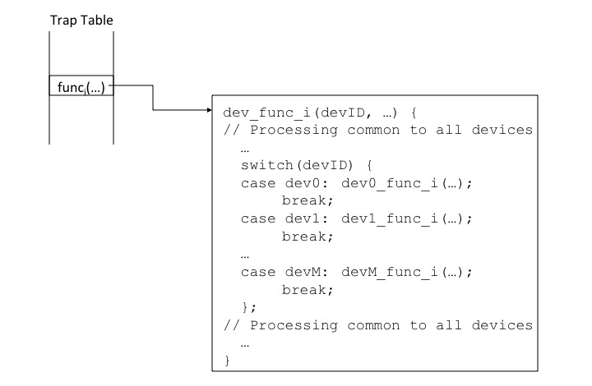
Add a new device driver
Traditional device driver code in the kernel
case devN: devN_func_i (…);
break;

Slide 17
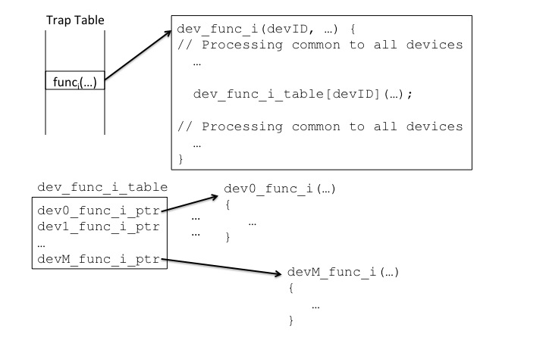
Add a new device driver
For the kernel that allows LKM
Table of function pointers

Slide 18
PA2: Device Character File
Open, Read, Write, Close, Seek
User Space
File Operations
Kernel
Device
File
Programs
Device Driver
Physical Device

Slide 19
LKM command – insmod
insmod makes an init_module system call to load the LKM into kernel memory.
init_module system call invokes the LKM's initialization routine (named module_init) right after it loads the LKM.
insmod passes to init_module the address of the subroutine in the LKM named module_init as its initialization routine.
Notes:
The LKM author sets up init_module to call a kernel function that registers the subroutines that the LKM contains.

Slide 20
LKM command – rmmod
rmmod makes a delete_module system call to unload the LKM into kernel memory.
delete_module system call invokes the LKM’s cleanup routine (named module_exit) right before it unloads the LKM.
rmmod passes to delete_module the address of the subroutine in the LKM named module_exit as its cleanup routine.

Slide 21
Demo time!

Slide 22
Create, add, and remove an LKM
Step 1
Create hello.c and the Makefile
Step 2
Compile the code
Step 3
Insert the compiled module into the running kernel
sudo insmod hello.ko
Step 4
Remove the module when you’re finished
sudo rmmod hello
Notes:
→ dmesg

Slide 23
Create, add, and remove
an LKM
Step 1
Create hello.c and the Makefile
Step 2
Compile the code
Step 3
Insert the compiled module into the running kernel
sudo insmod hello.ko
Step 4
Remove the module when you’re finished
sudo rmmod hello
Notes:
→ dmesg

Slide 24
Create, add, and remove an LKM
Step 1
Create hello.c and the Makefile
Step 2
Compile the code
Step 3
Insert the compiled module into the running kernel
sudo insmod hello.ko
Step 4
Remove the module when you’re finished
sudo rmmod hello
Notes:
→ dmesg

Slide 25
Create, add, and remove an LKM
Step 1
Create hello.c and the Makefile
Step 2
Compile the code
make –C /lib/modules/$(uname –r)/build M=$PWD modules
Step 3
Insert the compiled module into the running kernel
sudo insmod hello.ko
Step 4
Remove the module when you’re finished
sudo rmmod hello
Notes:
→ dmesg

Slide 26

Week TODO Checklist
Write an LKM example
Read more about device driver and device files
Register for time slot for PA1 interview
Have a great weekend!

