Slide 1

CSCI-3753: Operating Systems Fall 2019
Biljith Thadichi
Department of Computer Science University of Colorado Boulder
Slides based on presentation by Abigail Fernandes

Slide 2
PA 1 Learnings
Prepare well for your interview
Know what every command does
Write correct code
Brownie points for writing clean readable code
Don’t miss your appointment
No (TA) Office Hours during the week of interview grading
CSCI 3753 Fall 2018
2

Slide 3
Week 5
Inter-Process Communication (IPC)
CSCI 3753 Spring 2019
3

Slide 4

Visual Metaphor
IPC is like working together in a toy shop
Workers share work area
Parts and tools on the table
Workers call each other
Explicit requests and responses
Requires synchronization
I’ll start when you finish

Slide 5
Visual Metaphor
IPC is like working together in a toy shop
Processes share memory
Data in shared memory
Processes exchange messages
Message passing via sockets
Requires synchronization
Mutexes, waiting
Workers share work area
Parts and tools on the table
Workers call each other
Explicit requests and responses
Requires synchronization
I’ll start when you finish

Slide 6
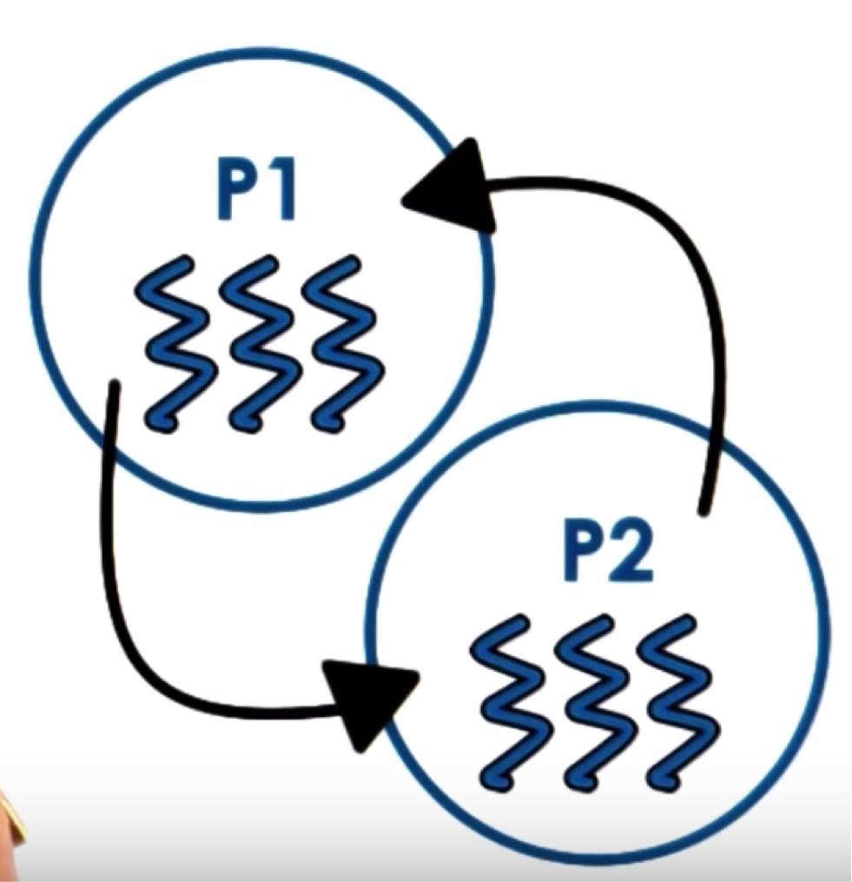
Inter Process Communication
IPC = OS supported mechanisms for interaction amongst processes (co-ordination and communication)
Message Passing
Sockets, pipes, message queues
Memory Based IPC
Shared memory, memory mapped files
Higher level semantics
Files, RPC
Synchronization primitives
Signals, interrupts

Slide 7
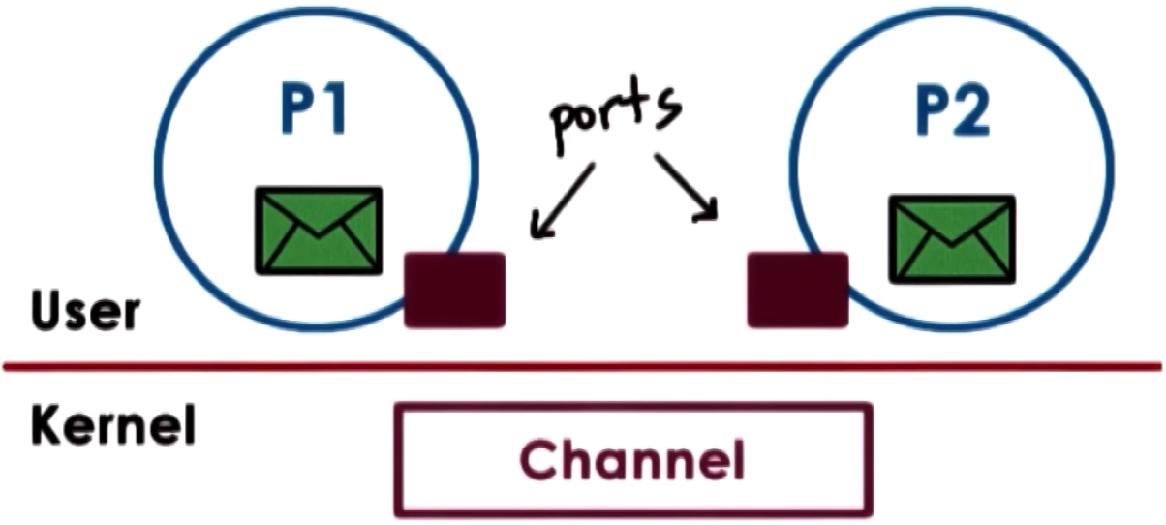
Message Passing
Send / Receive messages
OS creates and maintains a channel
Buffer, FIFO queue
OS provides an interface to the process
A port
Processes send/write messages to a port
Processes receive/read messages from a port

Slide 8

Message Passing
Kernel required to
Establish communication
Perform each IPC operation
Send: System call+ data copy
Receive: System call + data copy

Slide 9
Message Passing
How many user/kernel crossings needed to send a request and receive a response?

Slide 10
Message Passing
How many user/kernel crossings needed to send a request and receive a response?
Answer: 4x user – kernel crossings + 4 data copies.

Slide 11



Message Passing
Overheads
Time Consuming
Simplicity: Kernel does channel
management and synchronization

Slide 12
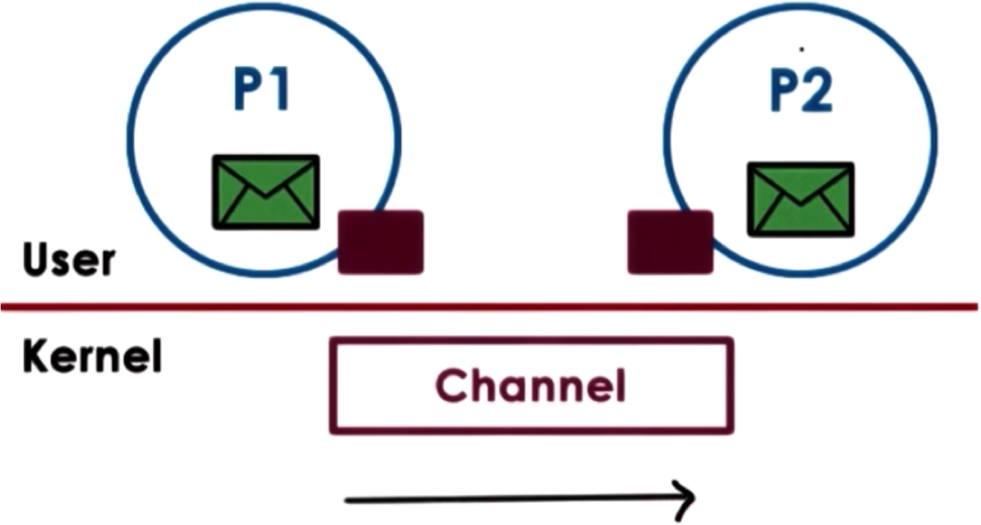
Message Passing (Pipes)
Pipes
Carry byte stream between 2 processes.
Eg. Connect output from one process to input of another.
Unidirectional in nature
Data written to the write end of the pipe is buffered by the kernel until it is read from the read end of the pipe.

Slide 13
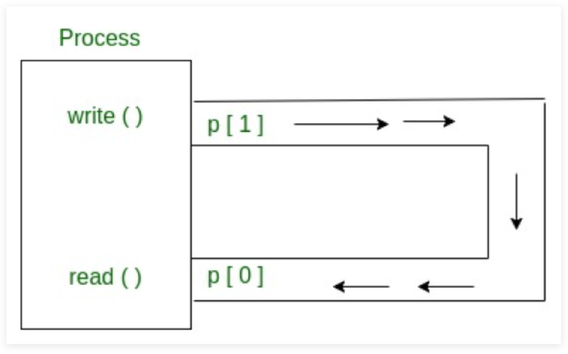
Linux Pipes
A pipe is created using the pipe() system call:
int pipe(int fildes[2]);
Parameters :
fd[0] will be the fd (file descriptor) for the read end of pipe.
fd[1] will be the fd for the write end of pipe.
Returns :
0 on Success.
- 1 on Error.
CSCI 3753 Spring 2019
13

Slide 14
















Pipe Example (Code Demo)
Main Process
mcpipe2[1]
Messages are streams of numeric
mcpipe1[1]
data
“Square” file
“Cube” file
Pipe 2
Pipe 1
mcpipe2[0]
mcpipe1[0]
Child Process 2
Child Process 1
CSCI 3753 Spring 2019
14

Slide 15
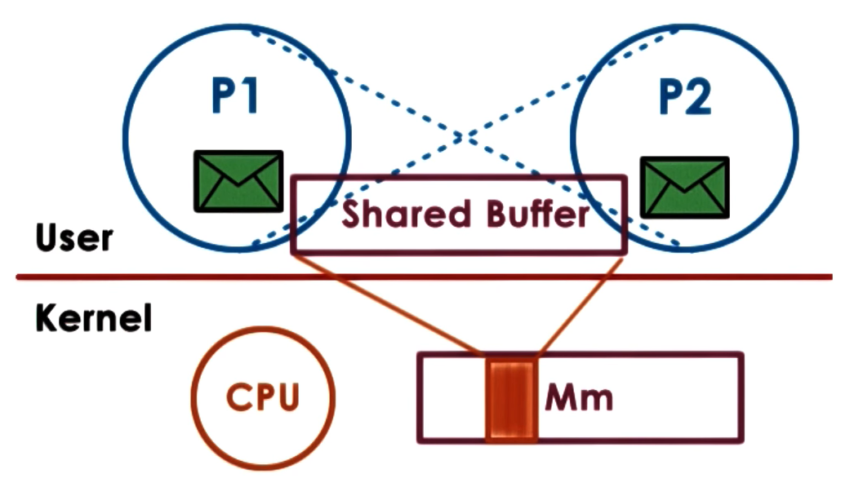
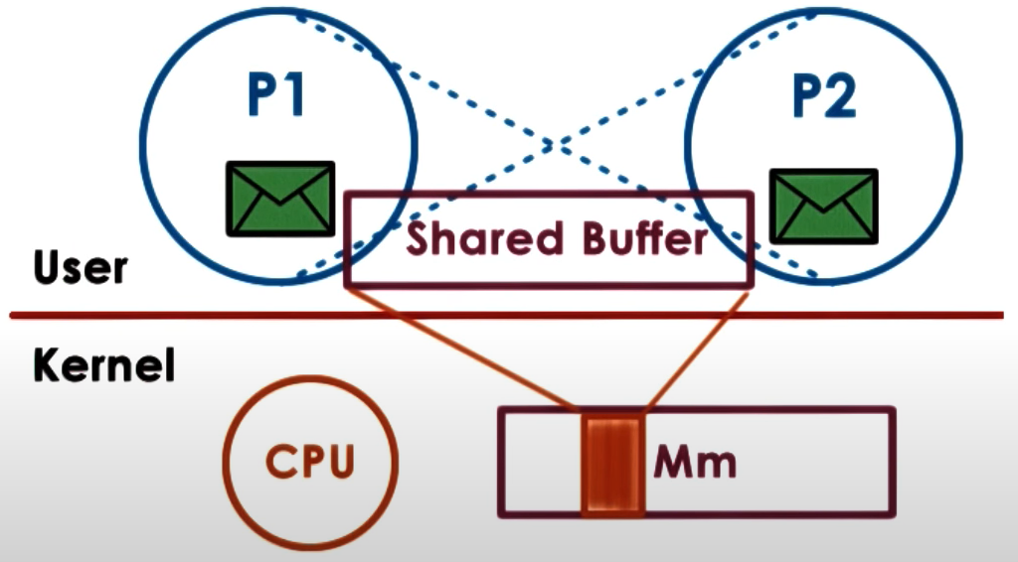
Shared memory
Read / Write to Shared Memory
OS establishes the channel
Different virtual addresses mapped to the same physical address

Slide 16
Shared memory
Explicit synchronization
Shared buffer management and communication protocol is programmer’s responsibility
System calls only for setup
Large amounts of data can be exchanged

Slide 17
Shared Memory
Create a shared memory segment or get the ID of an existing shared segment
int shmget(key_t key, size_t size, int shmflg);
Other processes (if permitted) can access.
Library: sys/ipc.h and sys/shm.h
key: a value used to share between processes
size: size of the shared memory segment
shmflg: options for segment creation

Slide 18
Shared Memory
Attach the shared segment to a process address space
void *shmat(int shmid, const void *shmaddr,…
int shmflg);
Once attached, a process can read or write to the segment.
Library: sys/types.h and sys/shm.h
shmid: id of the shared memory segment
shmaddr: address in the process space
shmflg: options for shared memory permission

Slide 19
Shared Memory
Detach the shared memory segment located at the
shmaddr address
int shmdt(const void *shmaddr);
Library: sys/types.h and sys/shm.h
shmaddr: attaching address in the process space

Slide 20








Shared Memory Example
Process SERVER
Write
Process CLIENT
Read
Code
Code
Data
Data
shmaddr
shmaddr
Heap
Heap
Key = 5678
Key = 5678
Stack
Shared Memory
Stack

Slide 21
Week 5 – Checklist
Work on PA2
Read more about IPC
17

