Slide 1

CSCI-3753: Operating Systems Fall 2019
Biljith Thadichi
Department of Computer Science University of Colorado Boulder
Slides based on presentation by Abigail Fernandes

Slide 2
PSA
PA2 due on Sunday and not Monday (Oct 4)
Resolve any conflicts with interview slots by Sunday

Slide 3
Week 6 >Threads PThreads

Slide 4

Visual Metaphor
A thread is like a worker in a toy shop!
Worker in a toy shop
Is an active entity
Executing a unit of toy order
Works simultaneously with others
Many workers completing toy orders
Requires co-ordination
Sharing of tools, parts and workstations

Slide 5
Visual Metaphor
A thread is like a worker in a toy shop!
Thread
Is an active entity
Executing a unit of process
Works simultaneously with others
Many threads executing
Requires co-ordination
Sharing I/0 devices, CPUs, memory
Worker
Is an active entity
Executing a unit of toy order
Works simultaneously with others
Many workers completing toy orders
Requires co-ordination
Sharing of tools, parts and workstations

Slide 6
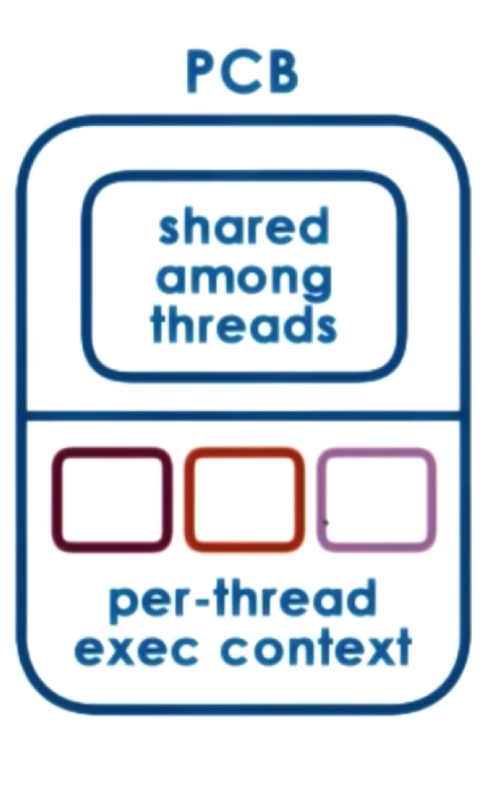
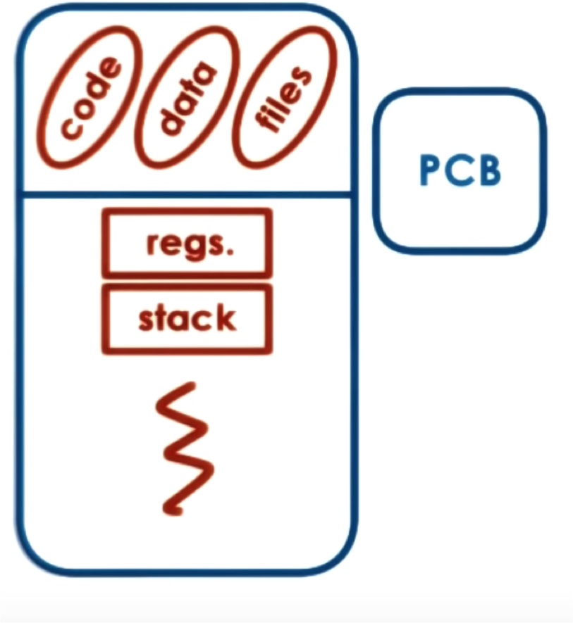
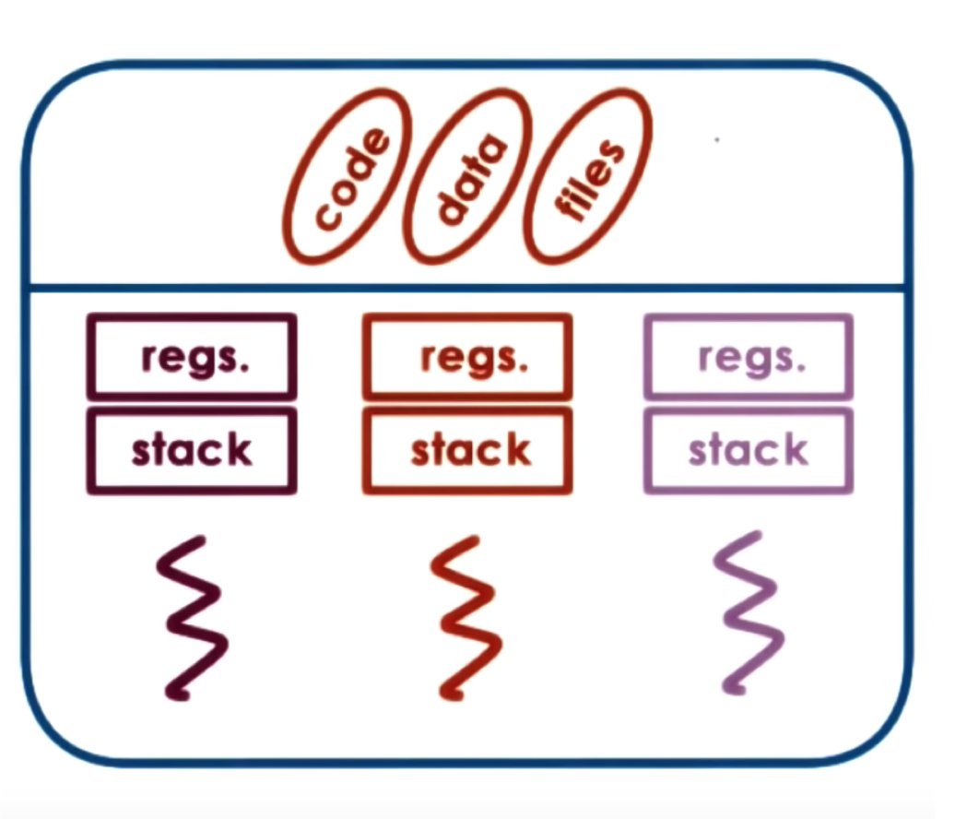
vs Threads
Process

Slide 7
Threads
Threads share the same address space
Code
Data
Other OS resources
Heap segments
Open file descriptors
Signal and signal handlers
Current working directory
User and group ids
Each thread has its own unique
Thread ID
Stack
Set of registers
Program counter

Slide 8

Common Pitfalls with Multithreading
Race Conditions
Thread Safe Code
Mutex deadlock

Slide 9
Common Pitfalls with Multithreading
Race Conditions
While the code may appear on the screen in the order you wish the code to execute, threads are scheduled by the operating system and are executed at random
Thread Safe Code
Mutex deadlock

Slide 10
Common Pitfalls with Multithreading
Race Conditions
Thread Safe Code
There should be no static or global variables which other threads may clobber or read assuming single threaded operation.
Many non-reentrant functions return a pointer to static data. →
Thread-unsafe functions
Mutex deadlock
Notes:
Swap example

Slide 11
Common Pitfalls with Multithreading
Race Conditions
Thread Safe Code
Mutex deadlock
Occur when a mutex is applied but then not "unlocked".
Cause program execution to halt indefinitely.

Slide 12
Week 6 Threads >PThreads

Slide 13
PThreads
PThreads == POSIX Threads
POSIX = Portable Operating Systems Interface
POSIX Threads
API for thread creation and synchronization
Specifies syntax and semantics of the operations
#include <pthread.h>

Slide 14
The PThreads API
Thread management: The first class of functions work directly on threads - creating, terminating, joining, etc.
Mutexes: provide for creating, destroying, locking and unlocking mutexes.
Semaphores: provide for create, destroy, wait, and post on semaphores.
Condition variables: synchronization primitives that enable threads to wait until a particular condition occurs.

Slide 15
Thread Creation
PThreads
pthread_t aThread; // type of thread
int pthread_create (thread, attr, start_routine, arg)
int pthread_join(pthread_t thread, void ** status)

Slide 16
Thread Creation
int pthread_create (tid, attr, start_routine, arg)
It returns the new thread ID via the tid argument.
The attr parameter is used to set thread attributes, NULL for the default values.
The start_routine is the C routine that the thread will execute once it is created.
A single argument may be passed to start_routine via arg. It must be passed by reference as a pointer cast of type void.
Returns status information that indicates if creation was successful or not.

Slide 17
Thread Termination and Join
int pthread_exit (void *value)
int pthread_join(pthread_t thread_id, void ** status)
This function is used by a thread to terminate
The return value is passed as a pointer.
This subroutine blocks the calling thread until the specified thread_id thread terminates
Returns 0 on success, error number on failure.
The returned value is a pointer returned by reference.
If you do not care about the return value, you can pass NULL for the second argument

Slide 18
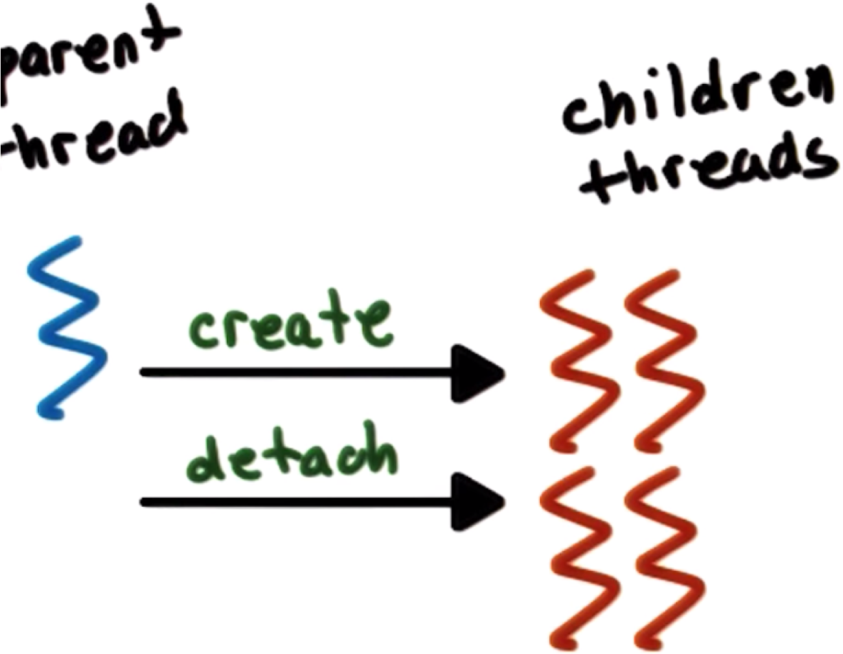
Detatching PThreads
Default: Joinable Threads
Detached Threads

Slide 19


Compiling PThreads
1.
in main file.
2. Compile source with –lpthread or -pthread

Slide 20

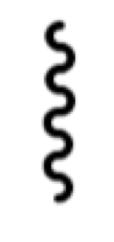

Process P1
Example 1
Threads T1 T2
One main thread creates two new threads with
default parameters.
Main thread:
Write whole numbers in a file called whole_num
New thread 1:
Execute odd() function that writes odd numbers in a file called
odd_num
New thread 2:
Execute even() function that writes even numbers in a file called
even_num

Slide 21
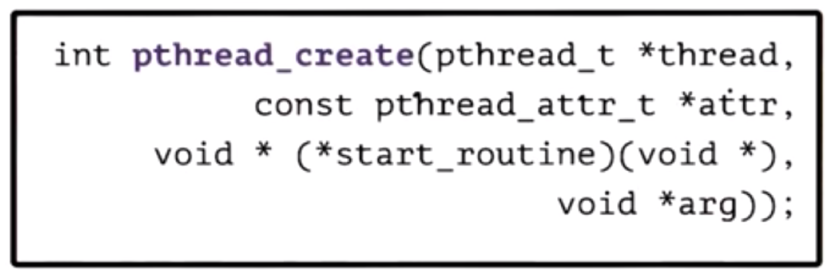

PThread Attributes
pthread_attr_t
Specified in pthread_create
Defines features of the new thread
Has default behavior with NULL in pthread_create
Stack size
Scheduling policy
Priority
Joinable
System/Process scope
Inheritance

Slide 22
PThread Attributes
int pthread_attr_init(pthread_attr_t *attr); int pthread_attr_destroy(pthread_attr_t *attr);
int pthread_attr_setstacksize(pthread_attr_t *attr, size_t sz);
int pthread_attr_getstacksize(const pthread_attr_t
*attr, size_t *sz);
int pthread_attr_setstack(pthread_attr_t *attr, void
*addr, size_t stacksize);
int pthread_attr_getstack(const pthread_attr_t *attr, void **addr, size_t *stacksize);

Slide 23
Thread Creation (Attributes)
Thread’s SET SCOPE
Scope values
PTHREAD_SCOPE_PROCESS (unbound, default)
The thread competes for resources with all other threads in the same process.
They are scheduled relative to one another according to their scheduling policy and priority.
PTHREAD_SCOPE_SYSTEM (bound)
int pthread_attr_setscope(pthread_attr_t *attr, int scope);
int pthread_attr_getscope(const pthread_attr_t
*attr, int *scope);

Slide 24
Thread Creation (Attributes)
Thread scheduling attributes
Inherit values
PTHREAD_INHERIT_SCHED (default)
Threads that are created using attr inherit scheduling attributes from the creating thread.
PTHREAD_EXPLICIT_SCHED
Threads that are created using attr take their scheduling attributes from the values specified by the attributes object.
int pthread_attr_setinheritsched(pthread_attr_t *attr, int inherit);
int pthread_attr_getinheritsched(const pthread_attr_t
*attr, int *inherit);

Slide 25
Thread Creation (Attributes)
Thread scheduling attributes
Policy values
SCHED_FIFO (First in-first out scheduling)
SCHED_RR (Round-robin scheduling)
SCHED_OTHER (Default Linux time-sharing scheduling)
int pthread_attr_setschedpolicy(pthread_attr_t
*attr, int policy);
int pthread_attr_getschedpolicy(const pthread_attr_t
*attr, int *policy);

Slide 26

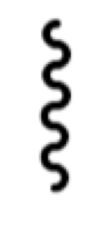
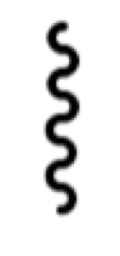
Process P1
Example 2
Threads T1 T2
One main thread creates two new threads with
specific parameters.
All 3 threads write to standard output (i.e., only monitor).
All 3 threads use
Case 1: Local variables -> predict the execution
Case 2: The same global variable -> predict the execution

Slide 27
PThread Mutexes
Solve mutual exclusion problems among concurrent threads.
PThreads
pthread_mutex_t aMutex; // mutex type
int pthread_mutex_lock (pthread_mutex_t *mutex)
int pthread_mutex_unlock (pthread_mutex_t *mutex)

Slide 28
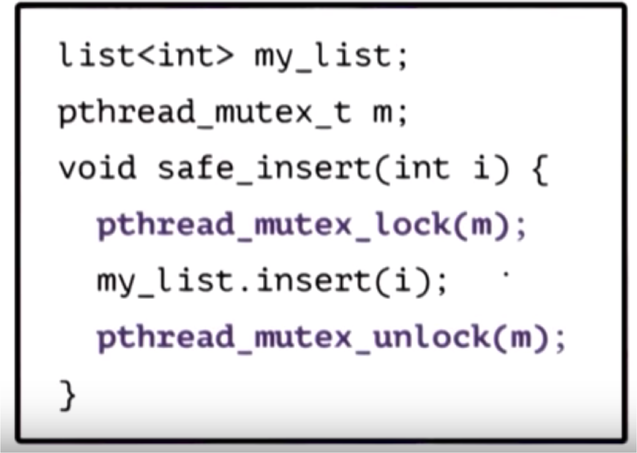
Pthread Mutexes
PThreads

Slide 29
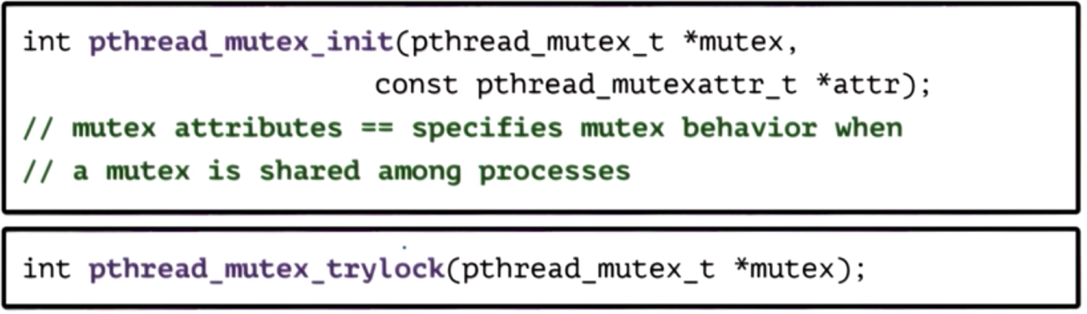
Other Mutex Operations
A null value of attr initializes mutex with default attributes.

Slide 30

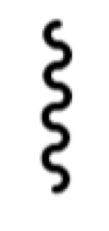

Process P1
Example 3 (Mutex)
Threads T1 T2
One main thread creates two new threads with
specific parameters.
All 3 threads write to standard output (i.e., only monitor).
The threads use mutexes to synchronize their writes in the following 2 cases:
Case 1: Local variables -> predict the execution
Case 2: The same global variable -> predict the execution

Slide 31
Week 6 – Checklist
Discuss PThreads
Reviewed examples on PThreads
Read more about threads
Book interview grading slots

