Slide 1

CSCI-3753: Operating Systems Fall 2019
Biljith Thadichi
Department of Computer Science University of Colorado Boulder
Slides based on presentation by Erika Hunhoff and Anh Nguyen

Slide 2
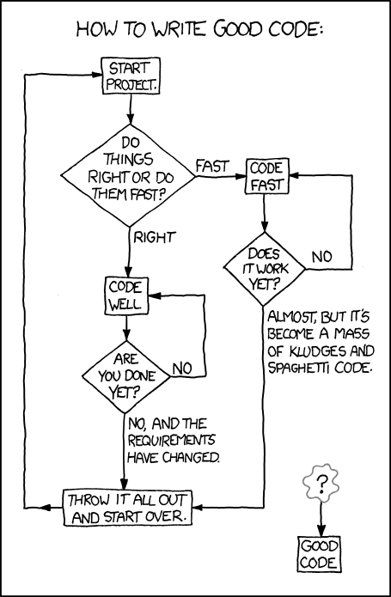
https://xkcd.com/844/

Slide 3
Midterm FCQs
Look for an email with subject “Fall 2020 TA Mid Term Reviews”

Slide 4


Slide 5
Recap
Create and join threads
pthread_create
pthread_join
Set attributes on threads
Stack size, scheduling policy, scope, etc.
Mutexes
pthread_mutex_lock
pthread_mutex_unlock

Slide 6
Thread Synchronization
Condition variables
A mechanism
Allow threads to suspend execution and relinquish the processor until some condition is true.
of type pthread_cond_t
Used with the appropriate functions for waiting and later, process continuation

Slide 7
Thread Synchronization
Condition variables
pthread_cond_t aCond;
int pthread_cond_wait(pthread_cond_t *cond,
pthread_mutex_t *mutex);
int pthread_cond_signal(pthread_cond_t *cond);
int pthread_cond_broadcast(pthread_cond_t *cond);

Slide 8
Thread Synchronization
Condition variables
int pthread_cond_timedwait(pthread_cond_t *cond, pthread_mutex_t *mutex,
const struct timespec *abstime);

Slide 9
Thread Synchronization
Condition variables
pthread_cond_wait()
Used to block on a condition variable
Must be called with mutex locked by the calling thread
Atomically release mutex and block the calling thread on the condition variable cond. Before return, the mutex is reacquired for the calling thread.
pthread_cond_timedwait()
An error is returned if the absolute time specified by
abstime passes before the waiting thread is signaled.
If a time-out occurs, it still reacquires mutex before returning to the caller.

Slide 10
Thread Synchronization
Condition variables
int pthread_cond_init(pthread_cond_t *cond, pthread_condattr_t *attr);
int pthread_cond_destroy(pthread_cond_t *cond);

Slide 11
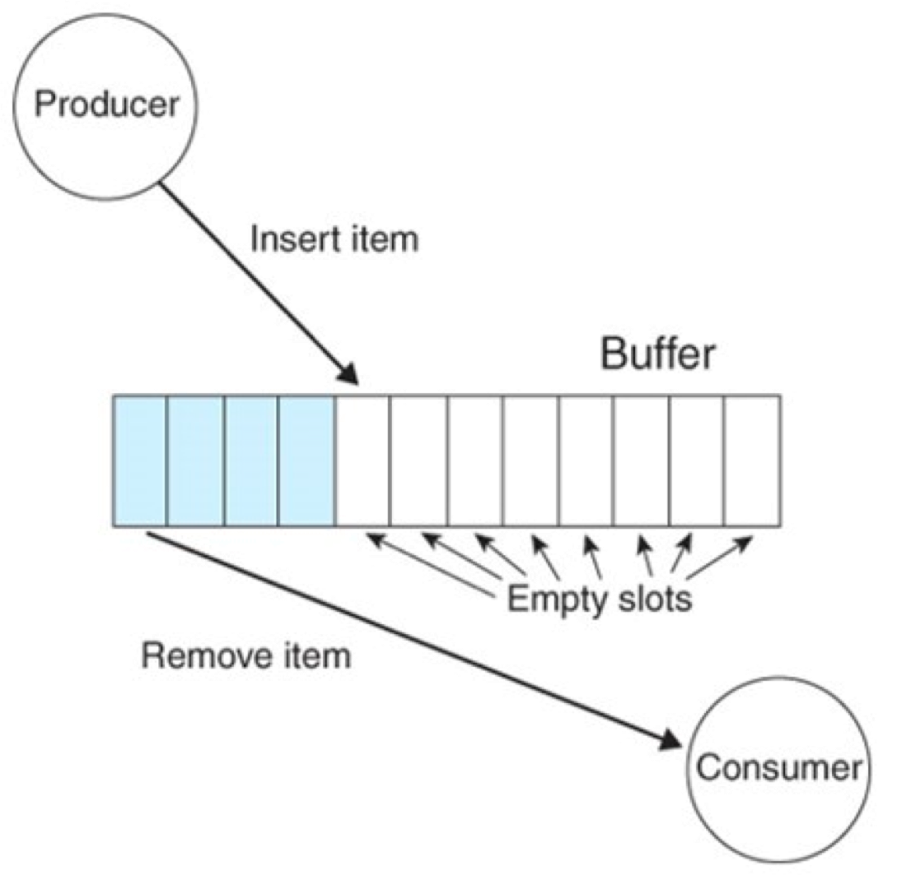
Example 4 (Producer Consumer problem)
The producer is putting numbers into the shared buffer (in this case sequentially).
The consumer is taking them out.
If the buffer contains zero,
that indicates that the buffer is empty. Any other value is valid.

Slide 12
Example 4 (Producer Consumer problem)
pthread_mutex_t the_mutex; pthread_cond_t condc, condp; int buffer = 0;
void* producer(void *ptr) { int i;
for (i = 1; i <= MAX; i++) {
pthread_mutex_lock(&the_mutex); while (buffer != 0) pthread_cond_wait(&condp,
&the_mutex);
buffer = i;
printf("Producer wrote %d\n", i); pthread_cond_signal(&condc); pthread_mutex_unlock(&the_mutex);
}
pthread_exit(0);
}
void* consumer(void *ptr) { int i;
for (i = 1; i <= MAX; i++) { pthread_mutex_lock(&the_mutex); while (buffer == 0)
pthread_cond_wait(&condc, &the_mutex);
printf("Consumer reads %d\n", buffer); buffer = 0; pthread_cond_signal(&condp);
pthread_mutex_unlock(&the_mutex);
}
pthread_exit(0);
}

Slide 13
Why do we need a while loop in the previous example?

Slide 14
Why do we need a while loop in the previous example?
Because of spurious wakes!
Why do we need a while loop in the previous example?

Slide 15
Thread Synchronization
Semaphore
Linked with the following library
#include #include #include
<fcntl.h>
<sys/stat.h>
<semaphore.h>
Two types of POSIX semaphores
Named
sem_t *sem_open (const char *name, int sem_t *sem_open (const char *name, int unsigned int value);
Unnamed
int sem_init (sem_t *sem, int pshared,
oflag);
oflag, mode_t mode,
unsigned int value);

Slide 16
Thread Synchronization
Semaphore
To increment the semaphore
int sem_post (sem_t *sem);
To decrement the semaphore
int sem_wait (sem_t *sem); int sem_trywait (sem_t *sem);
int sem_timedwait (sem_t *sem, const
struct timespec
*abs_timeout);
To get value of semaphore
int sem_getvalue (sem_t *sem, int *sval);
To destroy the unnamed semaphore
int sem_destroy (sem_t *sem);

Slide 17
Example 5 (Dining Philosophers problem)
P2
P3
P1
P4
P5
Solution: Using Ptheads and semaphores

Slide 18
Example 5 (Dining Philosophers problem)
Key insight: Pick up 2 chopsticks only if both are free
Reword insight: a philosopher moves to his/her eating state only if both neighbors are not in their eating states
This avoids deadlock → Need to define a state for each philosopher – What are the states?
2nd insight: if one of my neighbors is eating, and I’m hungry, ask them to signal() me when they’re done
States of each philosopher are: thinking, hungry, eating
Need condition variables to signal() waiting hungry philosopher(s)
Also need to take_fork() and put_fork() chopsticks

Slide 19
Week 6 – Checklist
Discuss Pthreads & example
Start PS2
Complete quiz 7 before midnight

