Slide 1

CSCI-3753: Operating Systems Fall 2020
Biljith Thadichi
Department of Computer Science University of Colorado Boulder
Based on slides by Anh Nguyen and Christopher Godley

Slide 2
Week 11: Memory Management

Slide 3
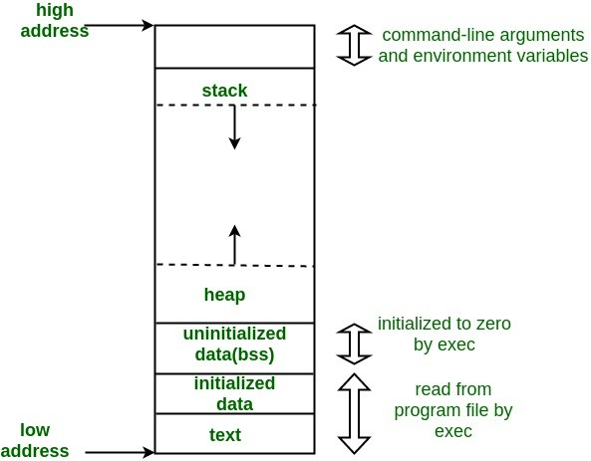
Memory Address Space of a Process
Allocated and initialized when loading and executing a program
0xbfffffff
Stack
Free space
Heap
Static (initialized and bss)
Code (a.k.a. text)
0x00000000

Slide 4
Memory Address Space of a Process
Allocated and initialized when loading and executing a program
Consist of
Code segment
.o and executable code
Below the heap or stack in order to prevent heaps and stack
overflows from overwriting it
Usually be
Sharable
Read-only
0xbfffffff
Stack
Free space
Heap
Static (initialized and bss)
Code (a.k.a. text)
0x00000000

Slide 5
Memory Address Space of a Process
Allocated and initialized when loading and executing
a program
Consist of
Static segments
Initialized global and C static Variables
→ Data segment
Uninitialized global
variables that are zeroed when initializing the process, also called .bss
→ BSS segment
0xbfffffff
Stack
Free space
Heap
Static (initialized and bss)
Code (a.k.a. text)
0x00000000

Slide 6
Memory Address Space of a Process
Allocated and initialized when loading and executing
a program
Consist of
Stack segment
Stack frames of function call arguments and local variables, also called automatic variables in C
Heap segment
Dynamic allocation
malloc, realloc, and free,
0xbfffffff
Stack
Free space
Heap
Static (initialized and bss)
Code (a.k.a. text)
0x00000000
brk and sbrk system calls to adjust its size

Slide 7
System Calls
0xbfffffff
Stack
Free space
To change data segment
brk()
sbrk()
Heap
Static (initialized and bss)
Code (a.k.a. text)
0x00000000
Program break is the first location after the end of the heap.
Increasing the program break has the effect of allocating memory to the process
Decreasing the break deallocates memory.
Both functions are deprecated as “programmer interface” functions.

Slide 8
System Calls
0xbfffffff
Stack
Free space
Heap
Static (initialized and bss)
Code (a.k.a. text)
0x00000000
int brk(void *end_data_segment);
Set the end of the data segment when that value is reasonable, i.e. the system does have enough memory and the process does not exceed its max data size

Slide 9
System Calls
0xbfffffff
Stack
Free space
Heap
Static (initialized and bss)
Code (a.k.a. text)
0x00000000
void *sbrk(intptr_t displacement);
Add a displacement (possibly 0) and returns
The previous program break
sbrk(0) returns the current location of the program break.

Slide 10
System Calls
0xbfffffff
Stack
Free space
Heap
Static (initialized and bss)
Code (a.k.a. text)
0x00000000
Both brk() and sbrk() extend heap.
brk(b) sets the end of the heap to b and returns 0 on success
sbrk(n) extends the end of the heap by n bytes and returns the previous end of the heap.

Slide 11
System Calls
0xbfffffff
Stack
Free space
Heap
Static (initialized and bss)
Code (a.k.a. text)
0x00000000
void* malloc(size_t size);
Allocate size bytes of uninitialized storage
Calls sbrk() to get the memory to allocate in the heap
More efficient than allocating memory using brk() or
sbrk()
It does buffering
Internally calls sbrk() / mmap() (we’ll see mmap soon)

Slide 12
Virtual Memory
getpagesize()
getrlimit() and setrlimit()
Process virtual memory size limit
Max CPU time
Max data segment size
…
pmap pid/pids
report memory map of a process or processes
getconf
get configuration values of standards set in the current operating environment

Slide 13
System Calls
0xbfffffff
Stack
Free space
Heap
Static (initialized and bss)
Code (a.k.a. text)
0x00000000
void * mmap(void *start, size_t length, int prot, int flags, int fd, off_t offset)
Create a new mapping in the virtual address space of the calling process

Slide 14
Week 11 – Checklist
Quiz 11
Read memory management
Go through example programs

