Slide 1
Formulation of L. P. Problem
Objective Function:
Maximize: 20B+30C
Constraints -- Subject To:
3B+2C<=16 Machine
1B+3C<=12 Plate
2B+2C<=6 Polish

Slide 2
bearings channels resulting contribution
1.5 3.5 135

Slide 3
How Long Will The Project Take?
2
8
3
1
3
14

Slide 4
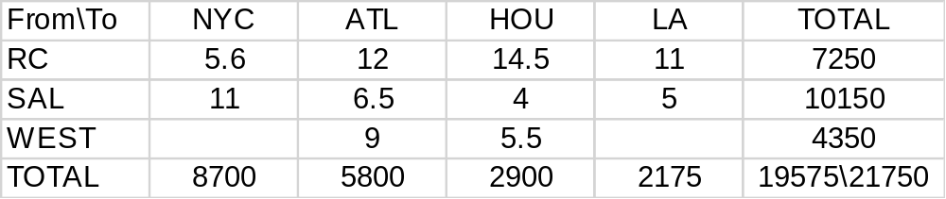

Slide 5
FROM\TO NY ATL HOU LA DUMMY TOTAL
RC 5.6 12 14.5 11 0 7250
SAL 11 6.5 4 5 0 10150
WEST 100 9 5.5 100 0 4350
TOTAL 8700 5800 2900 2175 2175 21750

