Slide 1
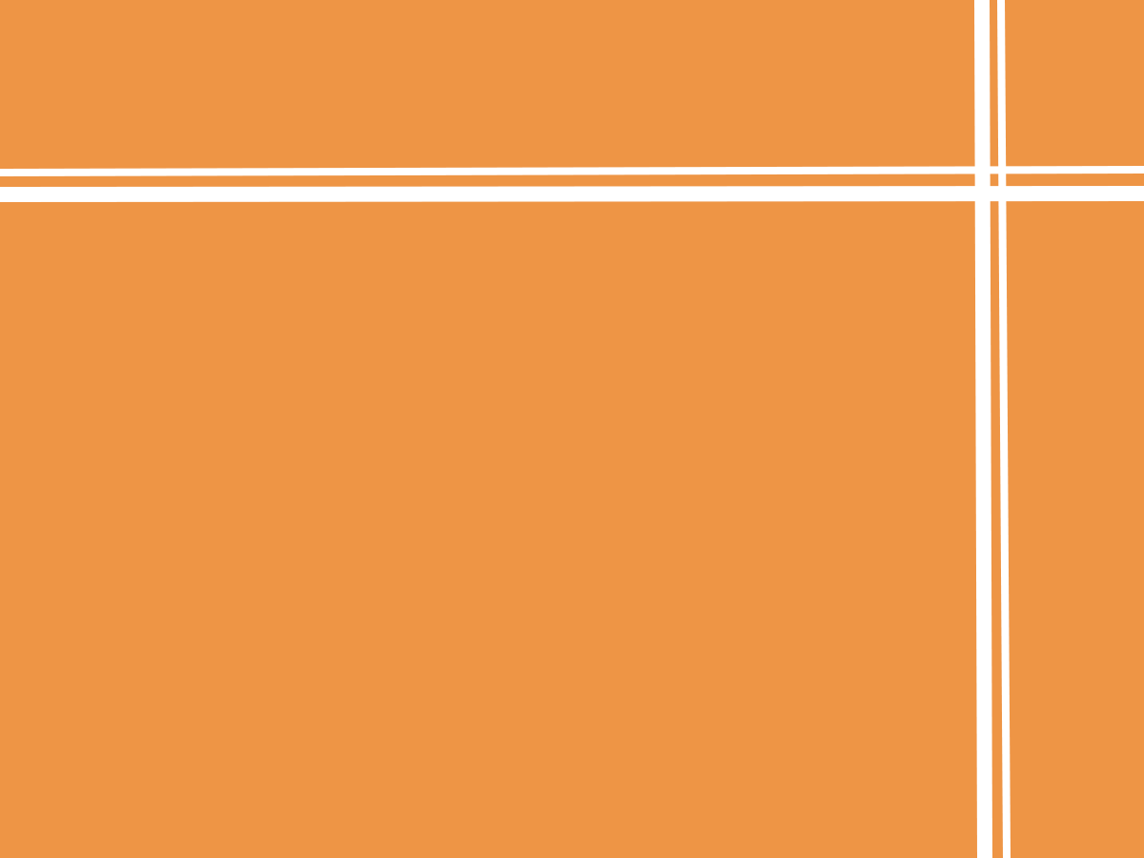

Proposal Presentation
Designed by:
Han, Shuo
Xu, Lan Xiao
Cui, Xi Wen
Wong, Fu Tsz Lik
Kan, Pak Ho
Not3r!
Notes:
Hey everyone! Now I’m giving you a brief introduction of our creation. It is called Noter.

Slide 2
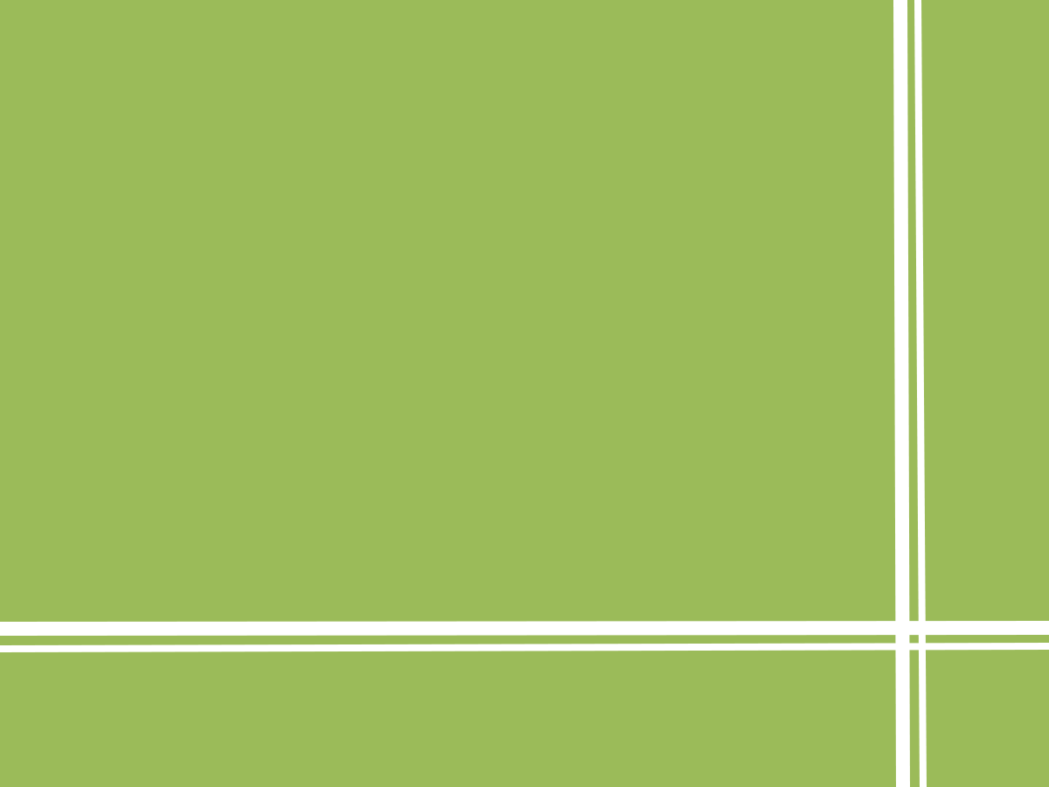

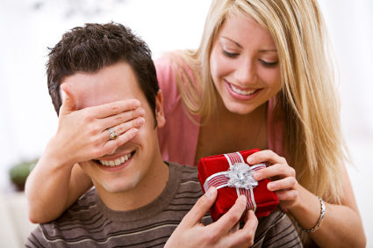


How to balance?
Notes:
Have you ever this experience where lots of things pop out at the same time, maybe your school assignment conflicts with your date, or your community work totally ruins your daily exercise?
So the question is how to balance?

Slide 3
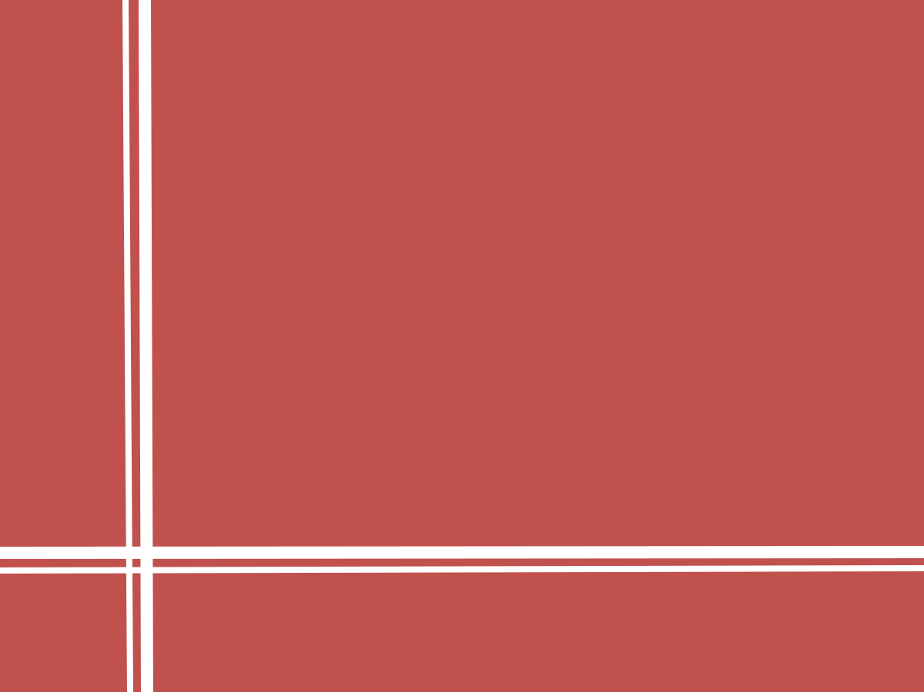
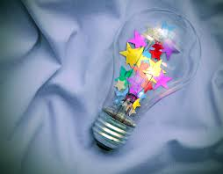
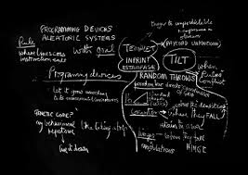
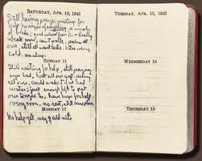
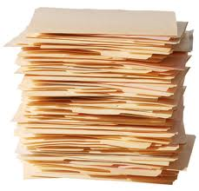
How can I remember?
Notes:
You may also run into the circumstance that you have tons of things to remember so that you have no choice but to note them down. Your ideas, your notes, even your diaries.

Slide 4

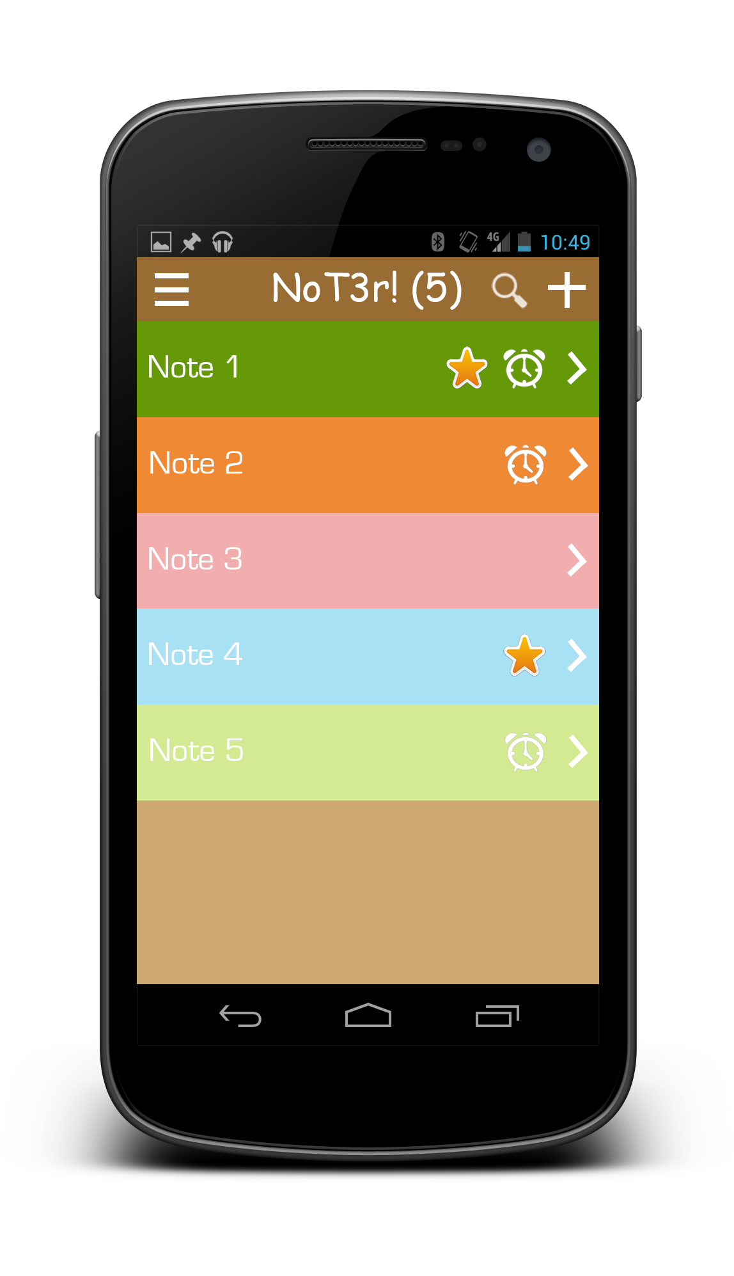
Not3r!
=
Notes
+
Todo
+
Many awesome features
Notes:
In answer to those questions, we decide to create Noter. It combines functions of Notes and to-do app and many awesome features…

Slide 5

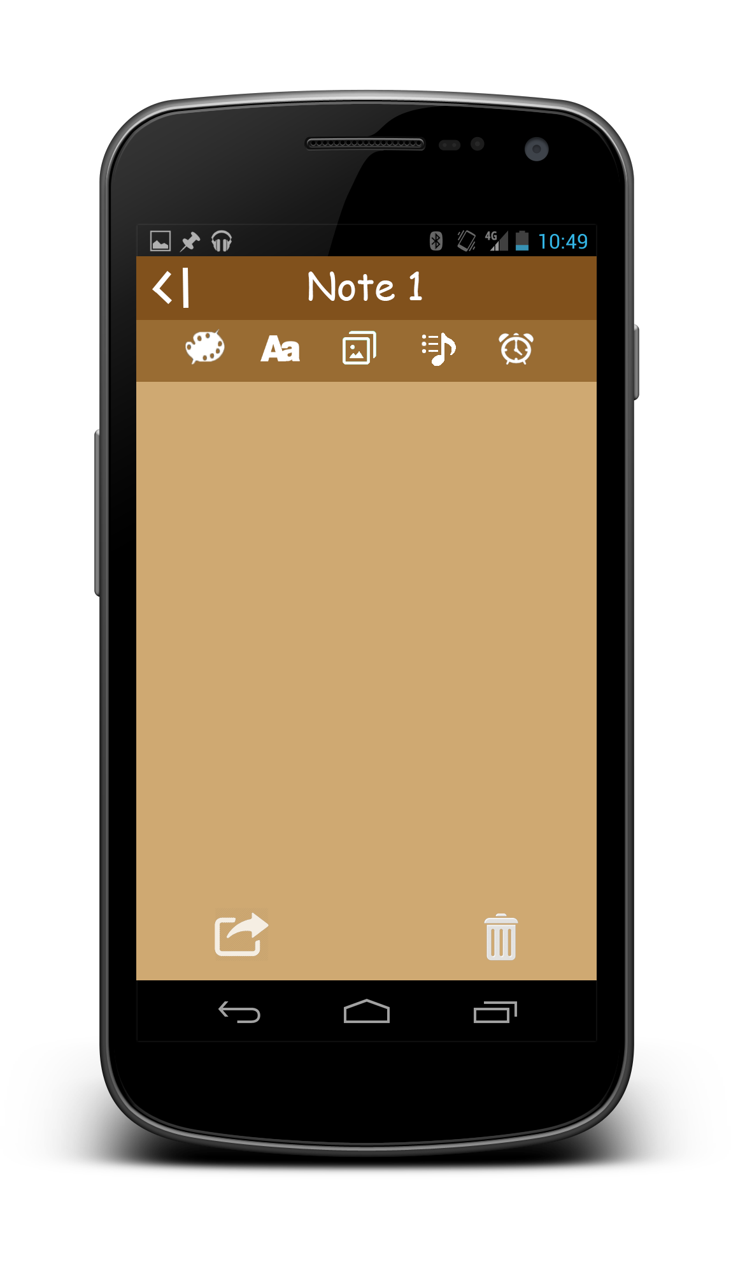
Create and edit the notes with images or audio files
Notes:
…which includes: Creating and editing the notes with images or audio files. You can see that there are those little icons on the edition bar that enables these feature.

Slide 6
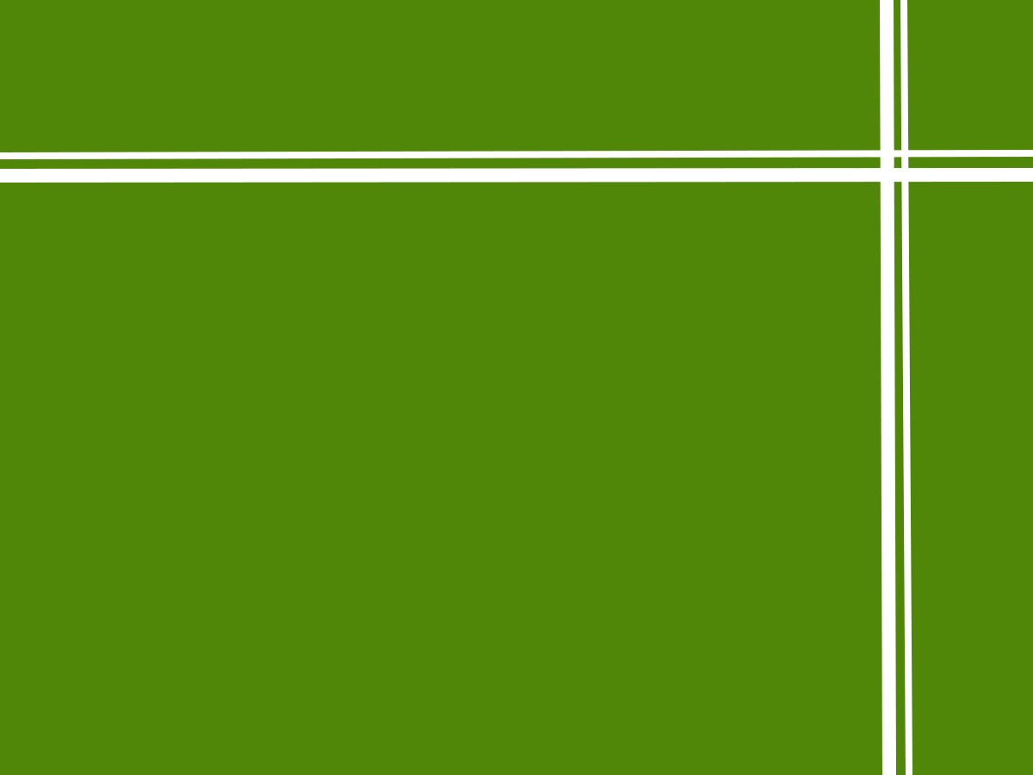
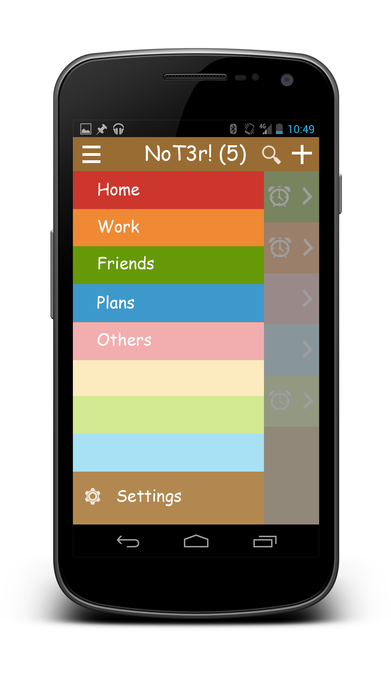
Tag the notes with different colors and Filter your notes by tags
Notes:
What’s awesome is that you can tag the notes with different colors and filter you notes by tags. For example you classify your issues and group them into tags of different colors.

Slide 7

Alarm clock
Notes:
For each note you can add an alarm to it to remind you of the issue at certain time in the future.

Slide 8





Sharing
Searching
Notes:
You can also share your notes among a couple of platforms, like facebook. And we provide you with remarkably effective searching tools to help you find a certain note instantly.

Slide 9

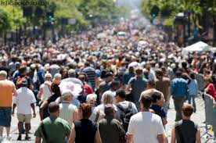
Why a note + to-do app?
The majority of people will need one.
Notes:
That’s he end of the features. Now I will explain to you why the users will choose Noter.
First of all, we chose to create a note plus to-do app is because most of people will face the situation that requires multiple tasks. And we want to create an app that will smooth the way and benefit a majority of people.

Slide 10

Why NoT3r! ?
It’s user-friendly, neat and clean.
Notes:
However all of us know that there are tons of todo or notes app. Why Noter?
We understand that many of us don’t use todo or note app simply because they won’t bother.
So it is our goal to make NoTer simple to use. And you can check out the sketch of our user interface and you can find that it is neat and clean. There are no complex operations, no redundant designs and we promise that it will be reliable and extremely easy to use.

Slide 11
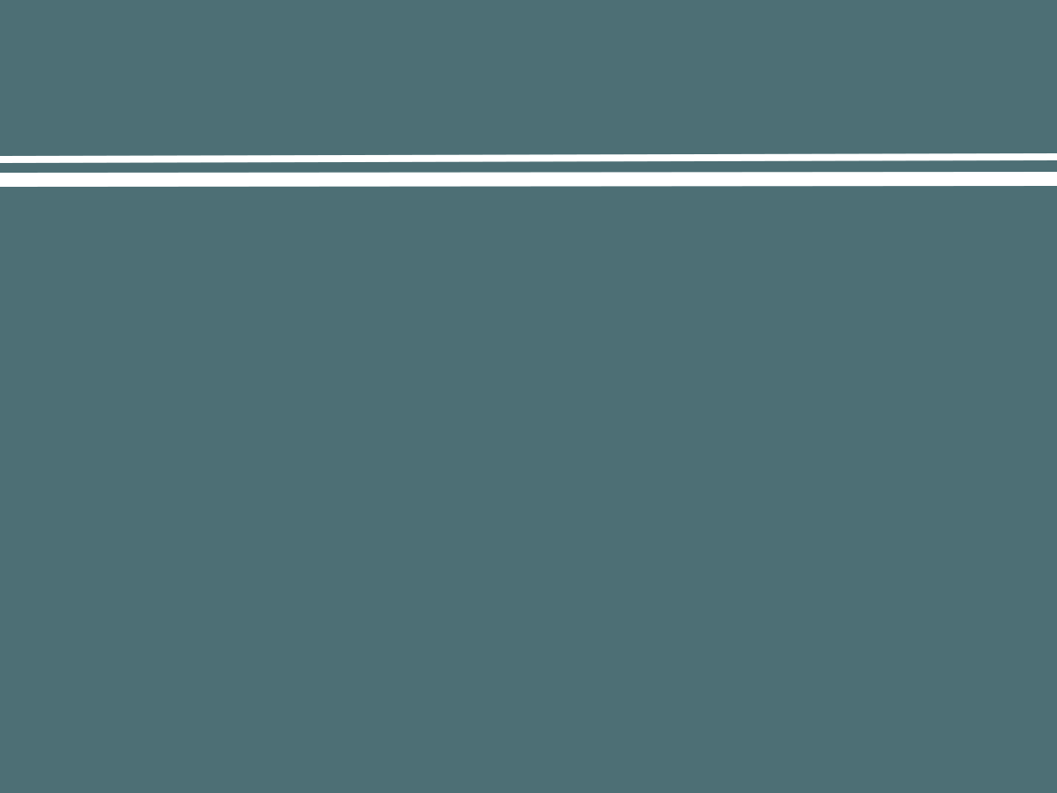
We hope you like it!
Thanks for listening!
Notes:
Well… we hope you like Not3r! Thanks for listening!

