Slide 1
Median House Price Trends In Various US Cities Over Time
Jun Leng Tan

Slide 2
Agenda
About the datasets used
Smooth vs raw data sets
House price trends in different sized cities
House price trend before and during covid

Slide 3


About the datasets used
Four major tables
SSSM
SRSM
ISSM
IRSM
(between 62,000 to 90,000 rows)

Slide 4
Agenda
About the datasets used
Smooth vs raw data sets
House price trends in different sized cities
House price trend before and during covid

Slide 5
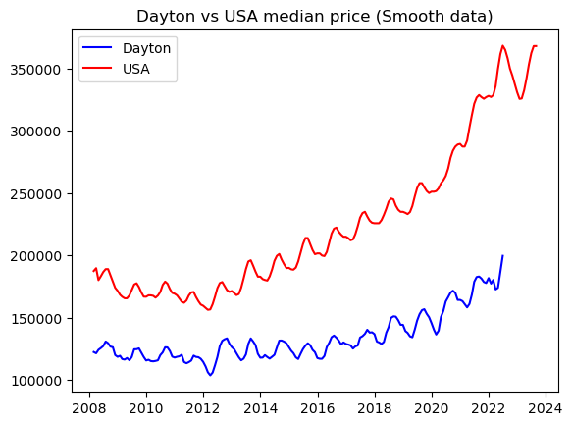
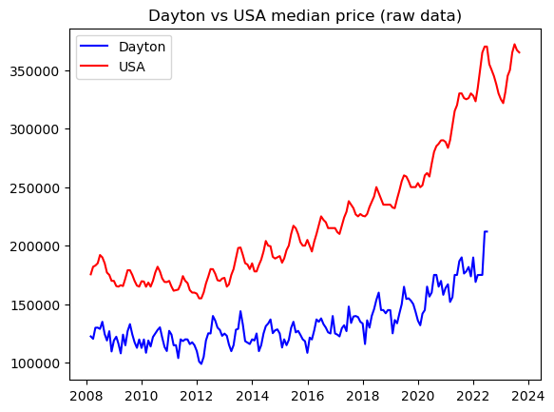

Slide 6
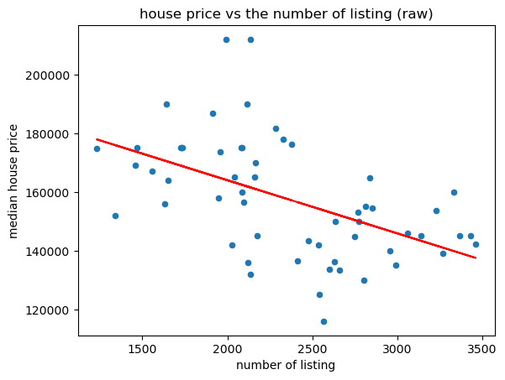
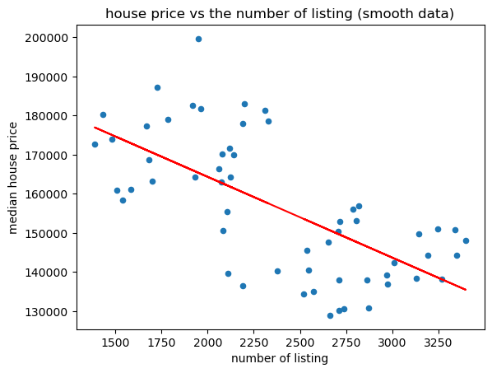

Slide 7
Agenda
About the datasets used
Smooth vs raw data sets
House price trends in different sized cities
House price trend before and during covid

Slide 8
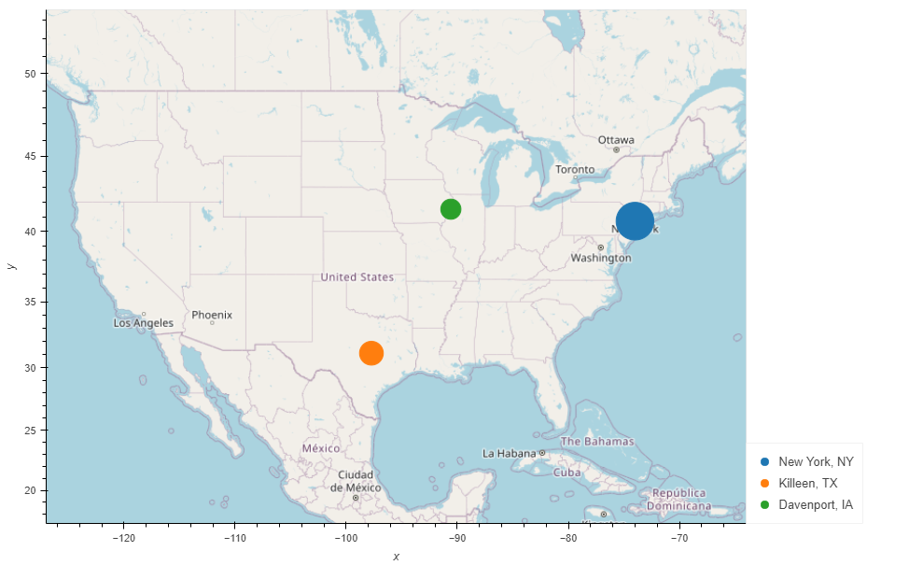

Slide 9
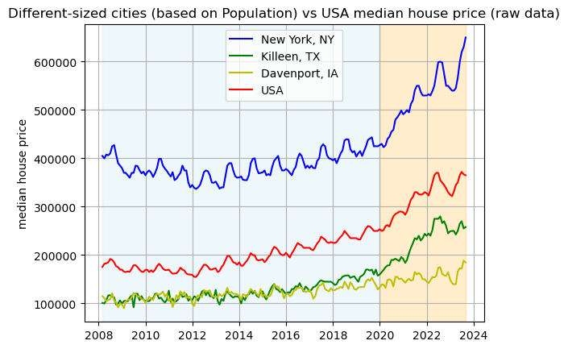

Slide 10
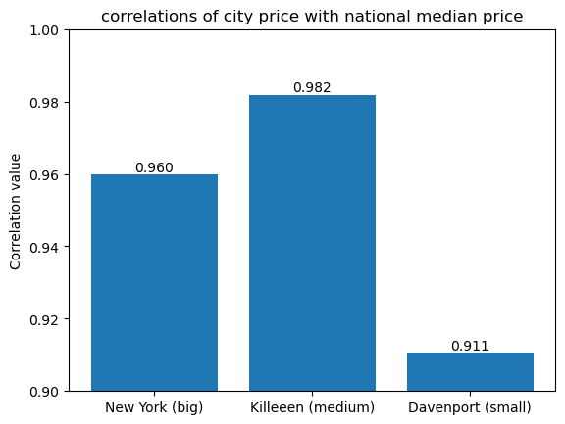

Slide 11
Agenda
About the datasets used
Smooth vs raw data sets
House price trends in different sized cities
House price trend before and during covid

Slide 12
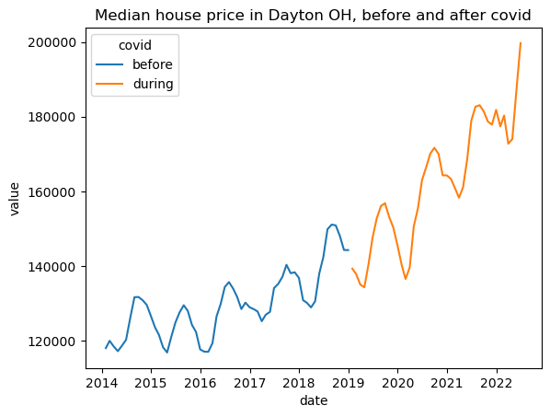

Slide 13
Thank you
Presenters
Wassim Deen
Gabriel Adriano
Jun Leng Tan

