Slide 1
Stock Price Visualization
Group 1
Jun Leng Tan
Rohit Asopa
Ammar Bashoeb
Sujatha
Ekjyot

Slide 2

Agenda
Demo - Jun
Stock Price comparison - Rohit
Pre and post covid trading volume - Ammar
When to buy a stock – Sujatha
Lines of Support and Resistance - Ekjyot

Slide 3
Agenda
Demo - Jun
Stock Price comparison - Rohit
Pre and post covid trading volume - Ammar
When to buy a stock – Sujatha
Lines of Support and Resistance - Ekjyot

Slide 4

Comparison of Performance of Major stocks over past decade Meta (Facebook), Amazon, Apple, Netflix, Google, Microsoft by Rohit

Slide 5
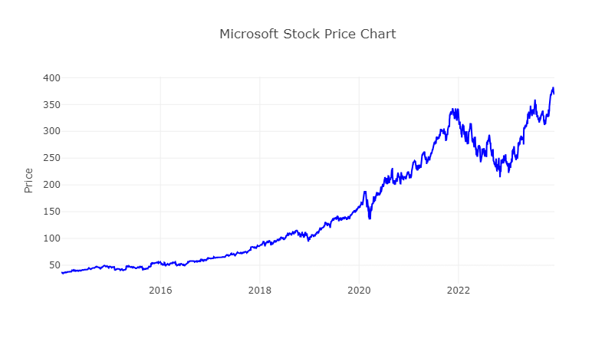
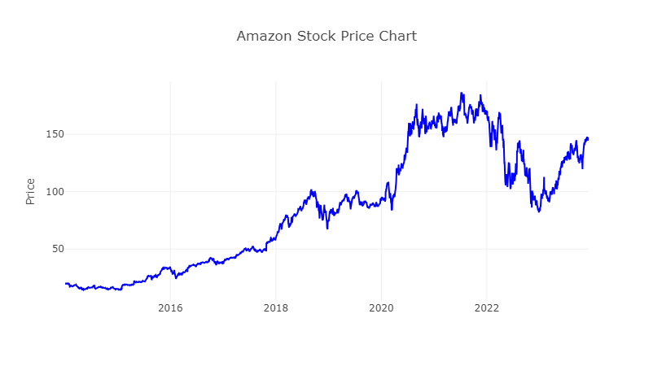
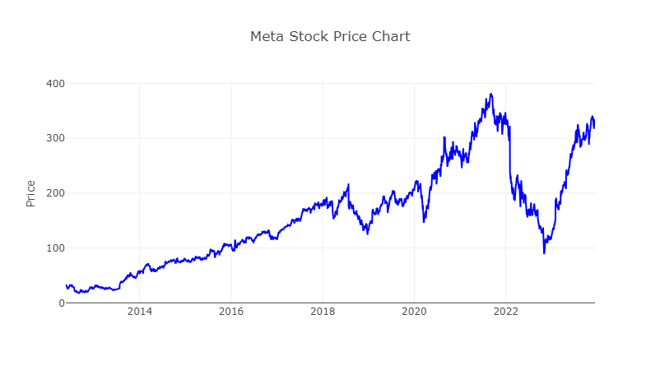
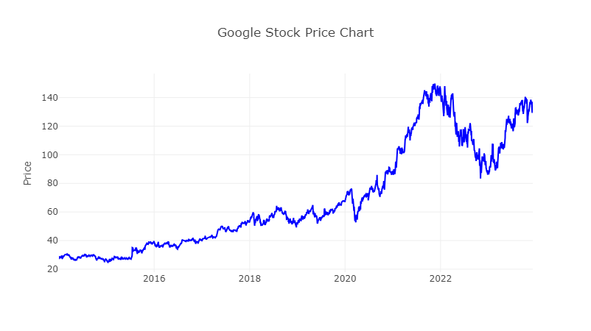

Slide 6
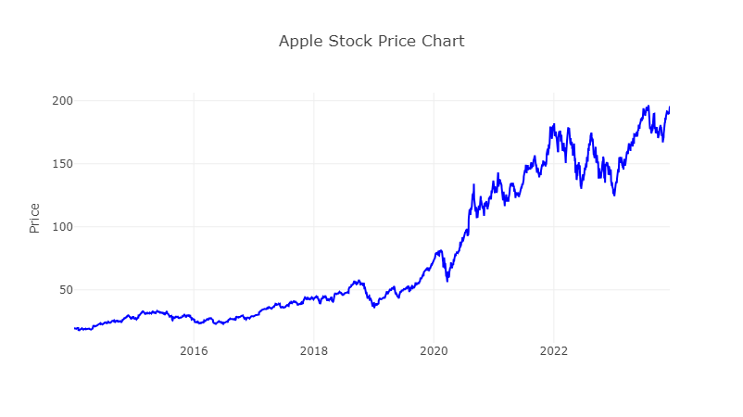
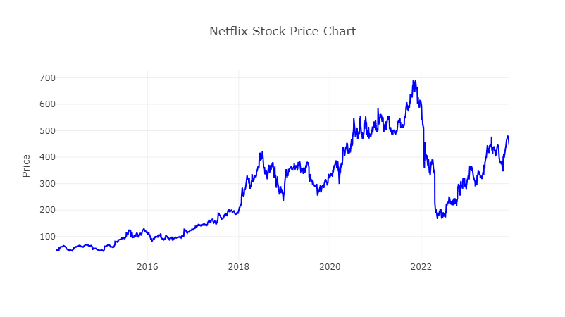
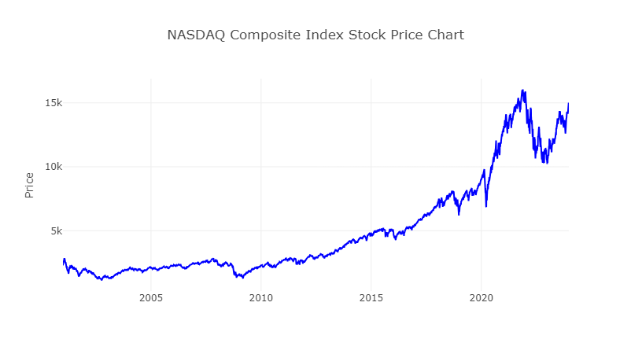

Slide 7
Comparison of Major Australian Stocks (BHP, Woolworths) since their inceptions

Slide 8
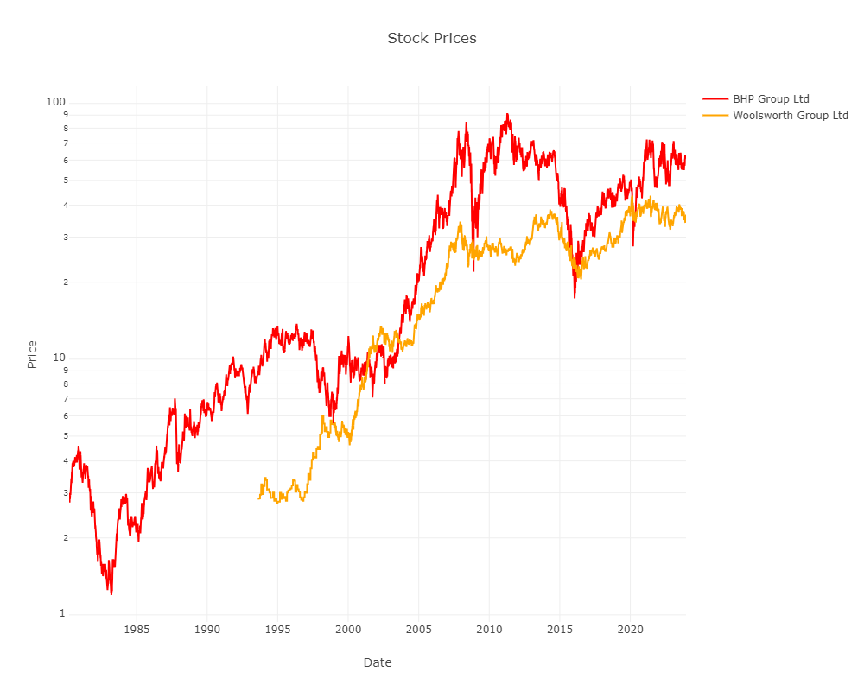

Slide 9
Limitations
Many other factors to determine stock performance
Earnings per share
Price to earnings ratio
Net margins (how efficiently a company is creating profit)

Slide 10
Volume changes of Major stocks Meta (formerly Facebook and Microsoft by Ammar

Slide 11
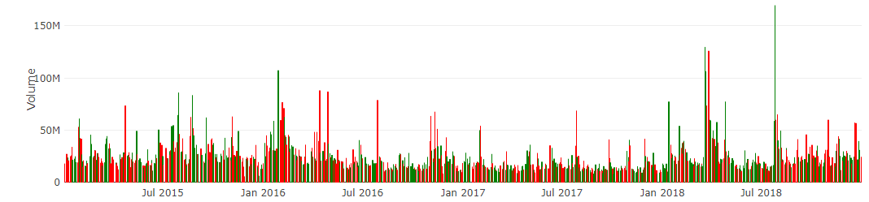
Volume changes for the period 2015 – 2018 for Meta
Earnings reports and Financial Performance
Strategic Developments and Corporate News
Regulatory Changes and Privacy Concerns

Slide 12
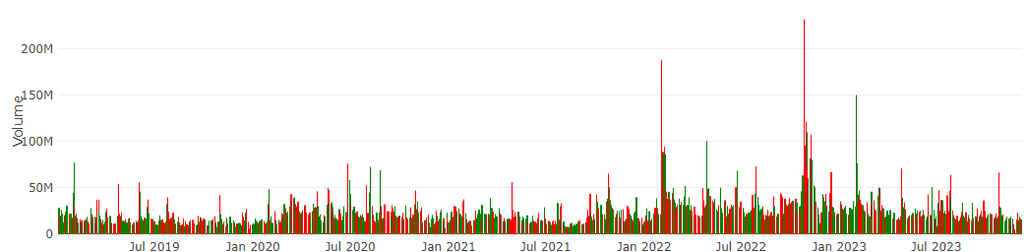
Volume changes for the period 2019 – 2023 for Meta
Earnings Reports and financial Performance
Market Sentiment and Investor Perception
Global Economic Conditions and Industry Trends

Slide 13
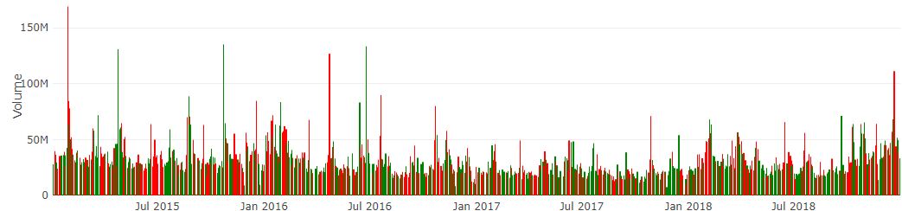
Volume changes for the period 2015 – 2018 for Microsoft
Dividend Announcements and Share Buybacks
Product Releases and Strategic Initiatives
Technology Sector Trends and Market Conditions

Slide 14
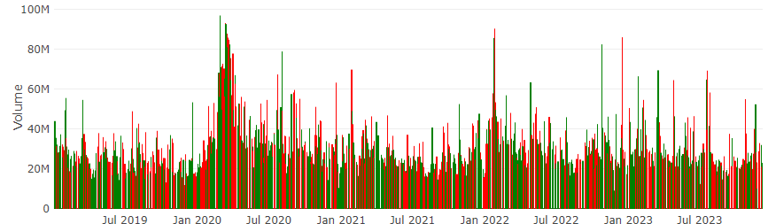
Volume changes for the period 2019 – 2023 for Microsoft
Cloud Computing Growth
Regulatory Environment and Antitrust Concerns
Macro-economic Conditions and Global Events

Slide 15

Stock Analysis by Sujatha
Fundamental Analysis
Technical Analysis
Fundamental Analysis : Data from Sources
Metrics: Financial statement – balance sheet, income statement, cash flow statement, foot notes
Technical Analysis :
Past and present price action
Analyse the financial market as a
whole
- price & volume, demand & supply
E.g. Using a chart

Slide 16
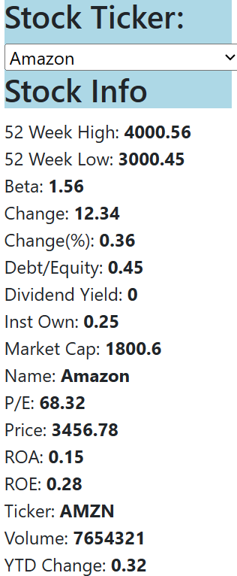
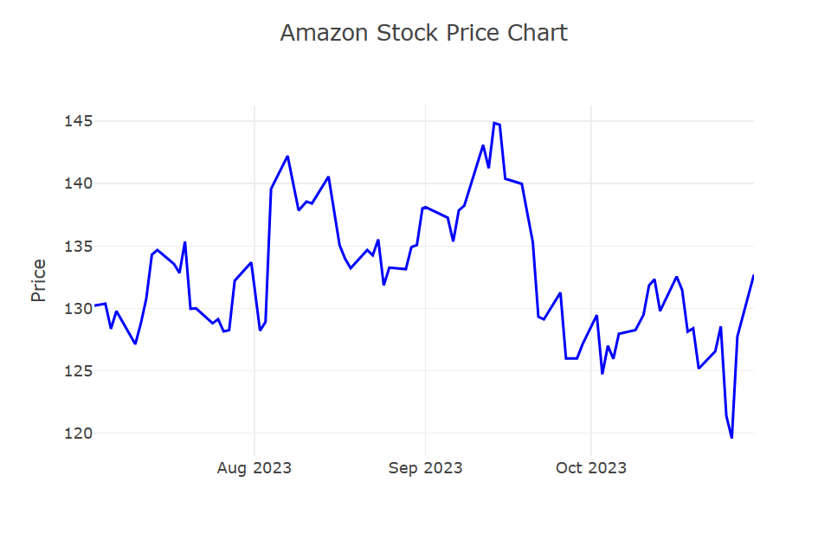
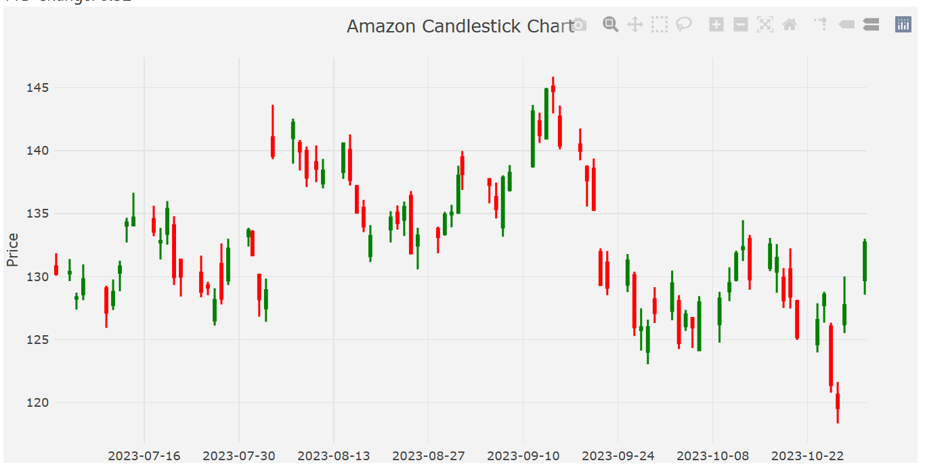
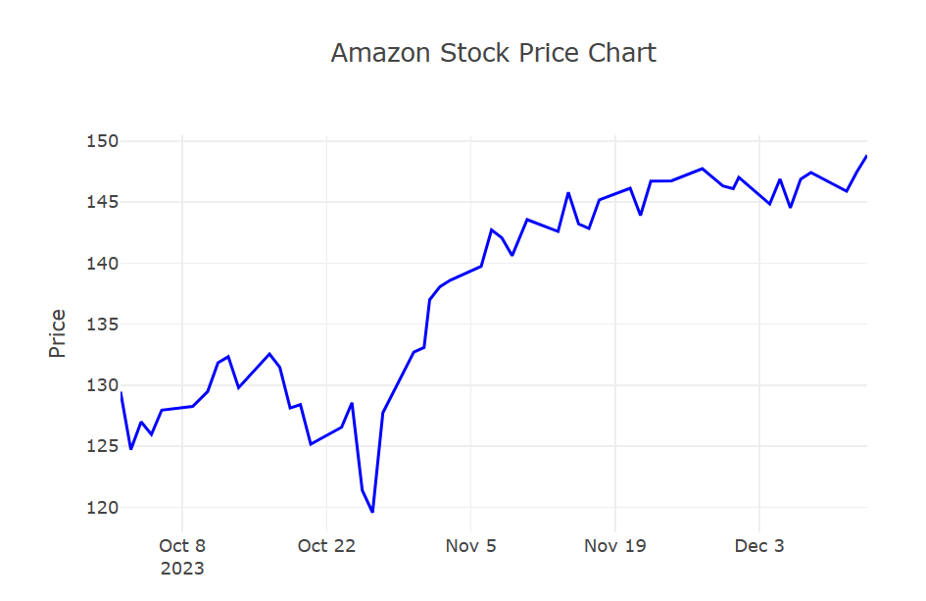
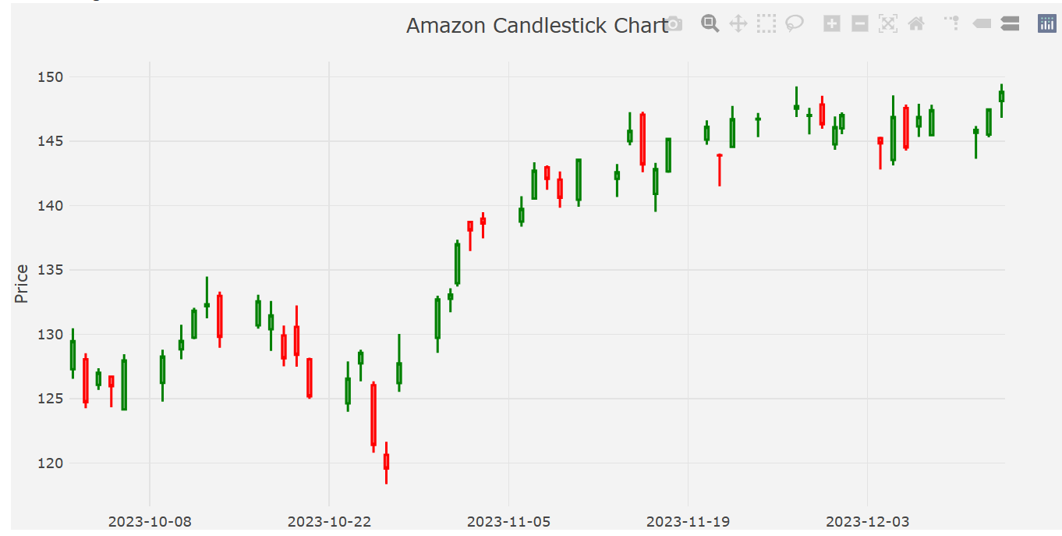
Amazon – Trend Analysis

Slide 17
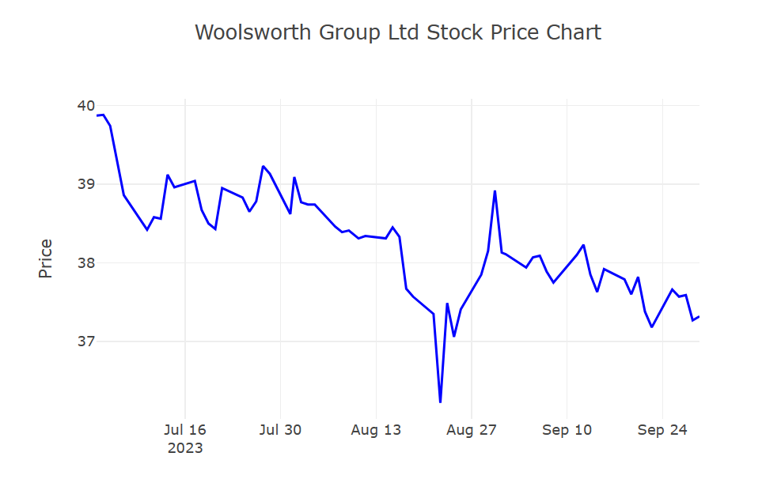
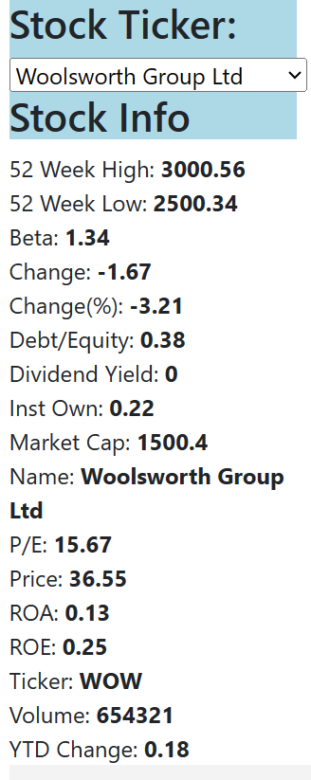
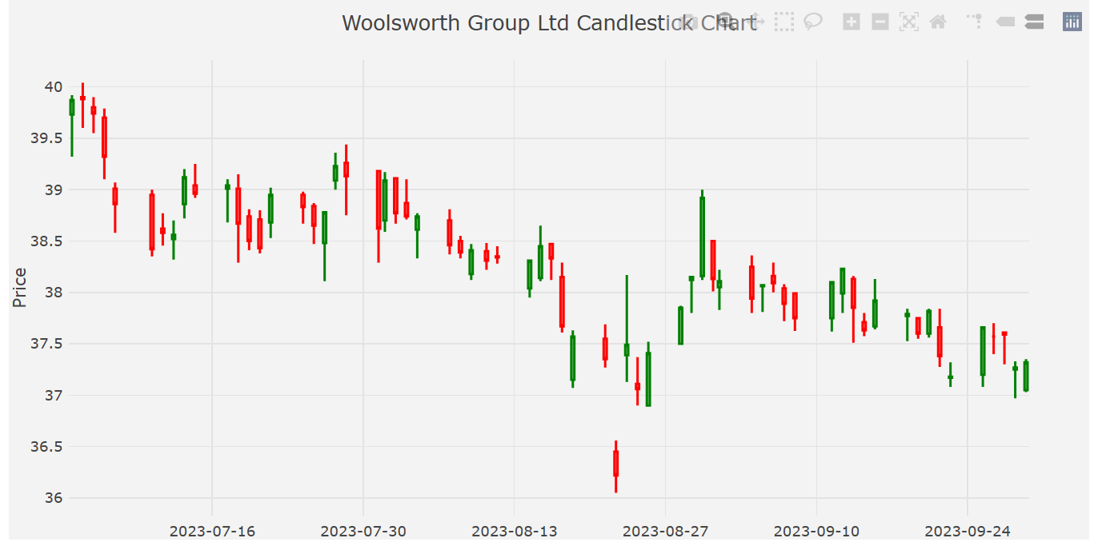
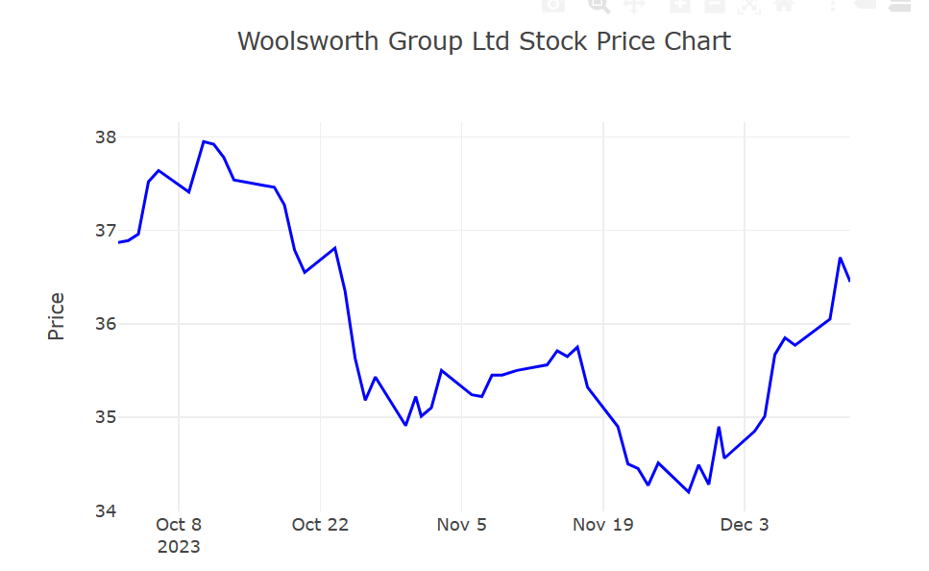
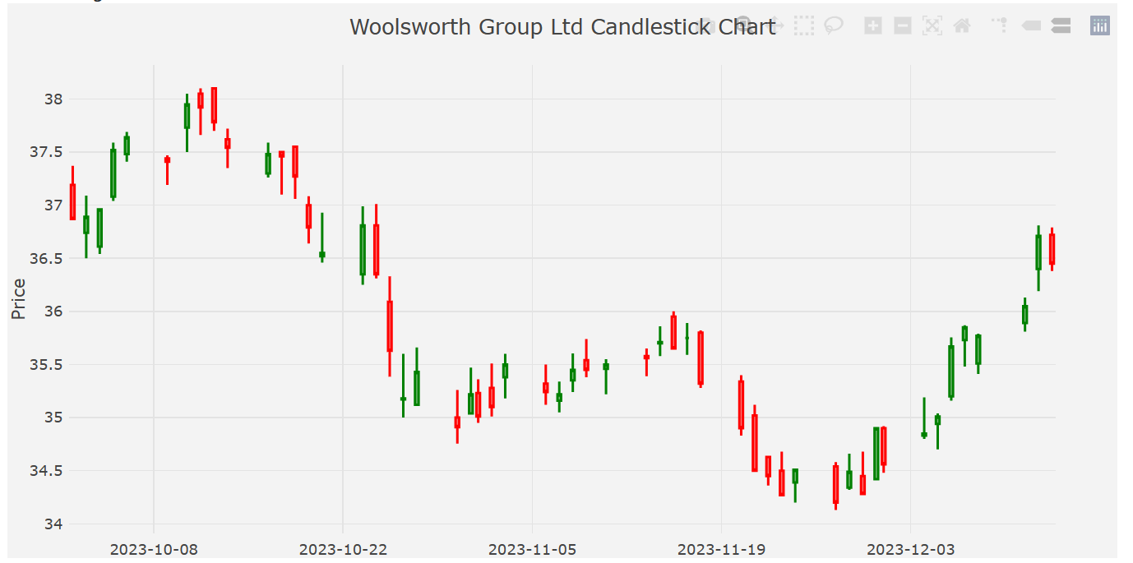
Woolworths – Trend Analysis

Slide 18

Lines of Support and Resistance: Cornerstones of Technical Analysis by Ekjyot

Slide 19
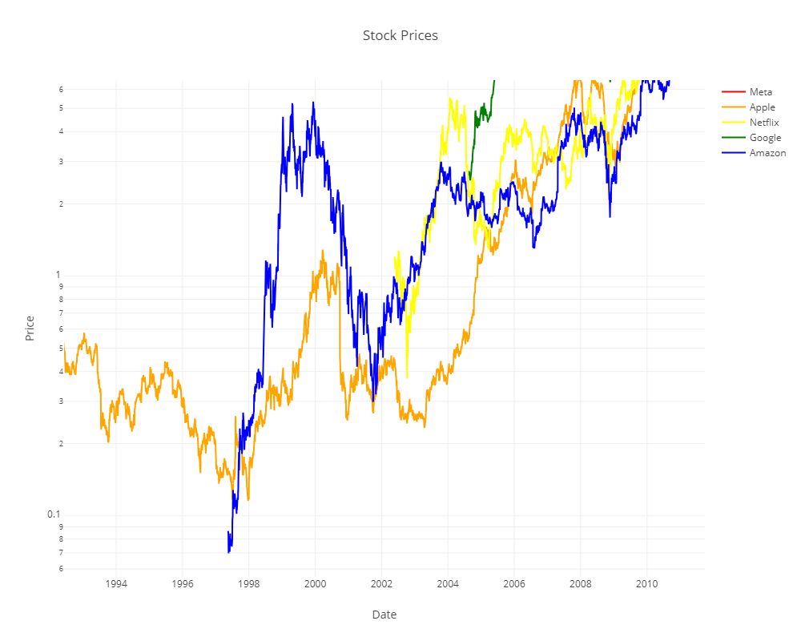
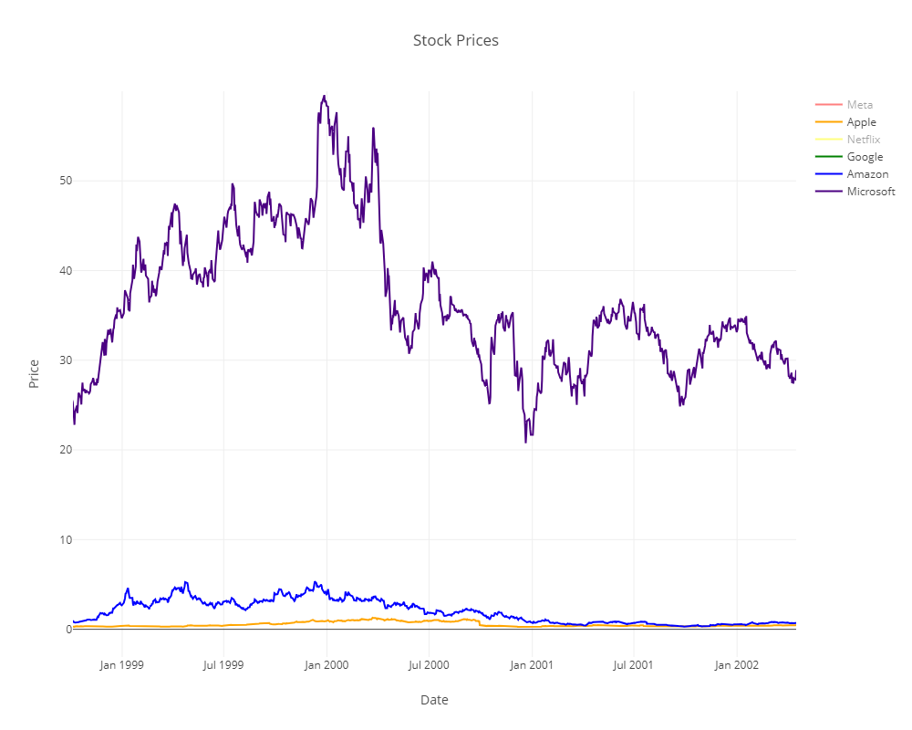
resistance
resistance
support
support

Slide 20
Significance in Technical Analysis
Psychological Significance
Levels with psychological impact on traders' decisions.
Round numbers or previous highs/lows act as strong levels.
Indicators and Tools
Use of technical indicators (moving averages, Fibonacci, pivot points).
Enhances accuracy in identifying support and resistance.
Dynamic Nature
Levels shift based on new information and market sentiment.
Influenced by economic reports, geopolitical events, etc.
Notes:
Analyzing support and resistance across different time frames (daily, weekly, monthly) provides a comprehensive view of price behavior. Levels that align across various time frames often carry more significance and are regarded as stronger support or resistance zones.
These levels often hold psychological significance for market participants. Round numbers or previous highs/lows are likely to act as strong support or resistance levels due to the psychological impact on traders' decisions.
Indicators and Tools: Various technical indicators such as moving averages, Fibonacci retracement levels, and pivot points are used to complement the identification of support and resistance levels, enhancing the accuracy of predictions.
Dynamic Nature: Support and resistance levels are not static and can shift based on new information, market sentiment, or external factors like economic reports, geopolitical events, or corporate announcements.
Understanding the dynamics of support and resistance levels empowers traders and investors to formulate effective strategies, manage risk, and anticipate potential price movements in the stock market. Their utilization in conjunction with other analytical tools forms the cornerstone of technical analysis methodologies. Lines of support and resistance, when understood and interpreted wisely, can become powerful tools in your investment arsenal. By recognizing these battlegrounds on the price chart, you gain valuable insights into the tug-of-war between buyers and sellers, potentially enhancing your ability to navigate the ever-changing landscape of the financial markets.

Slide 21
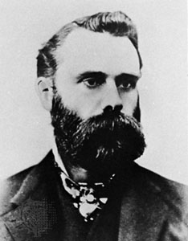
Q&A
“The man who trades to make a fortune usually goes broke, whereas the man who trades to get a good interest on his money sometimes gets rich.”
~Charles Dow, inventor of Dow Jones Industrial Average, father of Technical Analysis.

