Slide 1
Regression
改編自李宏毅老師 Machine Learning課程(2017)

Slide 2

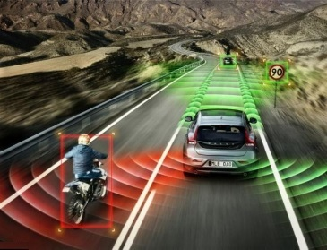


何時使用Regression: When output is a scalar
Stock Market Forecast
Self-driving Car
Recommendation
Dow Jones Industrial Index at tomorrow
$$f\left( \right)=$$
$$f\left( \right)=$$
方向盤角度
$$f\left( \right)=$$
購買可能性
使用者 A
商品 B

Slide 3








Example Application
Estimating the Combat Power (CP) of a pokemon after evolution
$$x_{cp}$$
CP after evolution
$$f\left( \right)=$$
$$y$$
$$x_{s}$$
$$x$$
$$x_{hp}$$
$$x_{w}$$
$$x_{h}$$

Slide 4
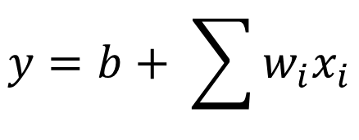
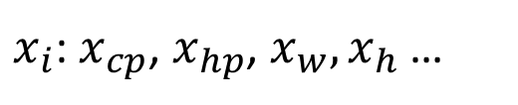



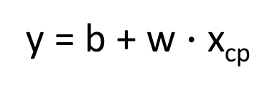

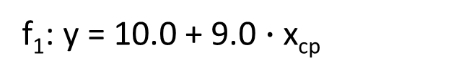
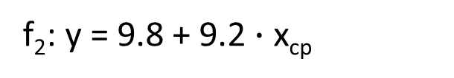
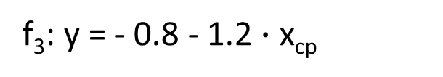
Step 1: Model
w and b are parameters (can be any value)
y = b + w $∙$ x_{cp}
f₁: y = 10.0 + 9.0 $∙$ x_{cp}
A set of function
Model
f₂: y = 9.8 + 9.2 $∙$ x_{cp}
f₃: y = - 0.8 - 1.2 $∙$ x_{cp}
…… infinite
CP after evolution
$$x$$
$$y$$
$$f\left( \right)=$$
$x_{i}$: $x_{cp}$, $x_{hp}$, $x_{w},x_{h}$ …
$$y=b+ \sum{w_{i}x_{i}}$$
Linear model:
feature
$w_{i}$: weight, b: bias

Slide 5






Step 2: Goodness of Function
y = b + w $∙$ x_{cp}
A set of function
Model
function
input:
function
Output (scalar):
$${\hat{y}}^{1}$$
$$x^{1}$$
$${\hat{y}}^{2}$$
$$x^{2}$$
Training
Data
Notes:
卡咪龜

Slide 6
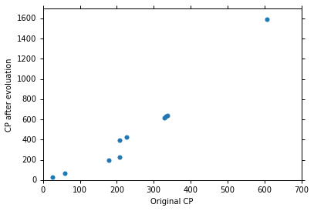







Step 2: Goodness of Function
Training Data: 10 pokemons
$$\left(x^{1},{\hat{y}}^{1}\right)$$
$$\left(x^{2},{\hat{y}}^{2}\right)$$
$$\left(x_{cp}^{n},{\hat{y}}^{n}\right)$$
$$……$$
$$\hat{y}$$
$$\left(x^{10},{\hat{y}}^{10}\right)$$
This is real data.
$$x_{cp}$$
Source: https://www.openintro.org/stat/data/?data=pokemon

Slide 7
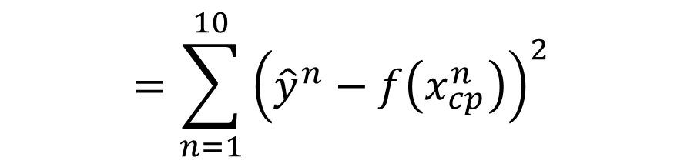
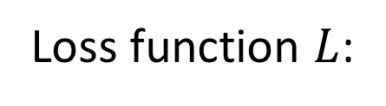

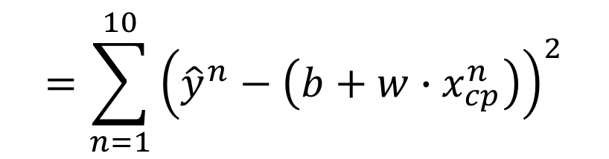

Step 2: Goodness of Function
y = b + w $∙$ x_{cp}
A set of function
Loss function $L$:
Model
Input: a function, output: how bad it is
Estimation error
$$=\sum_{n=1}^{10}{{\left({\hat{y}}^{n}−f\left(x_{cp}^{n}\right)\right)}^{2}}$$
Goodness of function f
$$L\left(f\right)$$
Estimated y based on input function
Sum over examples
Training
Data
$$L\left(w,b\right)$$
$$=\sum_{n=1}^{10}{{\left({\hat{y}}^{n}−\left(b+w∙x_{cp}^{n}\right)\right)}^{2}}$$

Slide 8
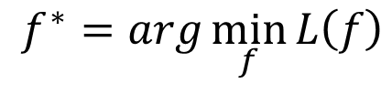

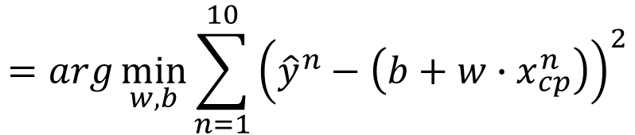

Step 3: Best Function
$$L\left(w,b\right)$$
$$=\sum_{n=1}^{10}{{\left({\hat{y}}^{n}−\left(b+w∙x_{cp}^{n}\right)\right)}^{2}}$$
A set of function
Model
Goodness of function f
Pick the “Best” Function
$$f^{∗}=\arg{\min_{f}{L\left(f\right)}}$$
Gradient Descent
Training
Data
$$w^{∗},b^{∗}=arg\min_{w,b}{L\left(w,b\right)}$$
$$=arg\min_{w,b}{\sum_{n=1}^{10}{{\left({\hat{y}}^{n}−\left(b+w∙x_{cp}^{n}\right)\right)}^{2}}}$$
Notes:
http://speech.ee.ntu.edu.tw/~tlkagk/courses/LA_2016/Lecture/orthogonal%20projection%20(v2).ecm.mp4/index.html

Slide 9

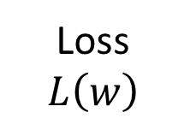

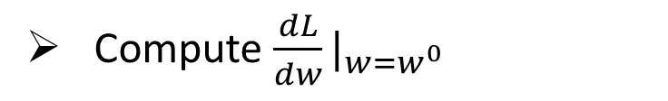
Step 3: Gradient Descent
http://chico386.pixnet.net/album/photo/171572850
$$w^{∗}=arg\min_{w}{L\left(w\right)}$$
Consider loss function 𝐿(𝑤) with one parameter w:
(Randomly) Pick an initial value w⁰
Compute $\frac{dL}{dw}|_{w=w^{0}}$
Loss
$$L\left(w\right)$$
Negative
Increase w
Positive
Decrease w
w⁰

Slide 10

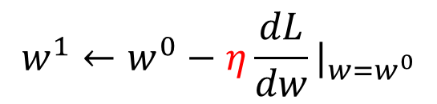
Step 3: Gradient Descent
http://chico386.pixnet.net/album/photo/171572850
$$w^{∗}=arg\min_{w}{L\left(w\right)}$$
Consider loss function 𝐿(𝑤) with one parameter w:
(Randomly) Pick an initial value w⁰
Compute $\frac{dL}{dw}|_{w=w^{0}}$
$$w^{1}←w^{0}−η\frac{dL}{dw}|_{w=w^{0}}$$
Loss
$$L\left(w\right)$$
η is called “learning rate”
w⁰
$$−η\frac{dL}{dw}|_{w=w^{0}}$$

Slide 11

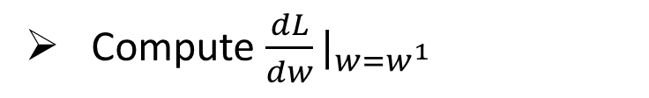

Step 3: Gradient Descent
$$w^{∗}=arg\min_{w}{L\left(w\right)}$$
Consider loss function 𝐿(𝑤) with one parameter w:
(Randomly) Pick an initial value w⁰
Compute $\frac{dL}{dw}|_{w=w^{0}}$
$$w^{1}←w^{0}−η\frac{dL}{dw}|_{w=w^{0}}$$
Loss
$$L\left(w\right)$$
Compute $\frac{dL}{dw}|_{w=w^{1}}$
$$w^{2}←w^{1}−η\frac{dL}{dw}|_{w=w^{1}}$$
…… Many iteration
Local minima
global minima
w⁰
w¹
w²
w^{T}

Slide 12

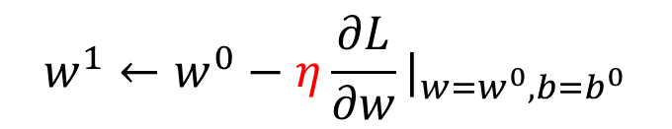
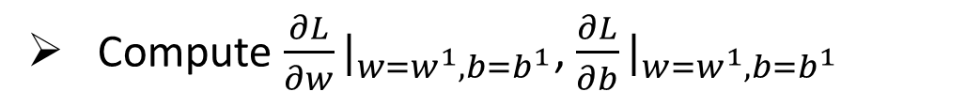
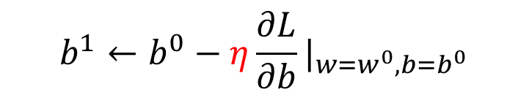

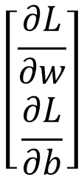


Step 3: Gradient Descent
$$\left[\begin{aligned}\frac{∂L}{∂w} \\ \frac{∂L}{∂b}\end{aligned}\right]$$
$$∇L=$$
gradient
How about two parameters?
$$w^{∗},b^{∗}=arg\min_{w,b}{L\left(w,b\right)}$$
(Randomly) Pick an initial value w⁰, b⁰
Compute $\frac{∂L}{∂w}|_{w=w^{0},b=b^{0}}$, $\frac{∂L}{∂b}|_{w=w^{0},b=b^{0}}$
$$w^{1}←w^{0}−η\frac{∂L}{∂w}|_{w=w^{0},b=b^{0}}$$
$$b^{1}←b^{0}−η\frac{∂L}{∂b}|_{w=w^{0},b=b^{0}}$$
Compute $\frac{∂L}{∂w}|_{w=w^{1},b=b^{1}}$, $\frac{∂L}{∂b}|_{w=w^{1},b=b^{1}}$
$$w^{2}←w^{1}−η\frac{∂L}{∂w}|_{w=w^{1},b=b^{1}}$$
$$b^{2}←b^{1}−η\frac{∂L}{∂b}|_{w=w^{1},b=b^{1}}$$
Notes:
鄭凱文

Slide 13
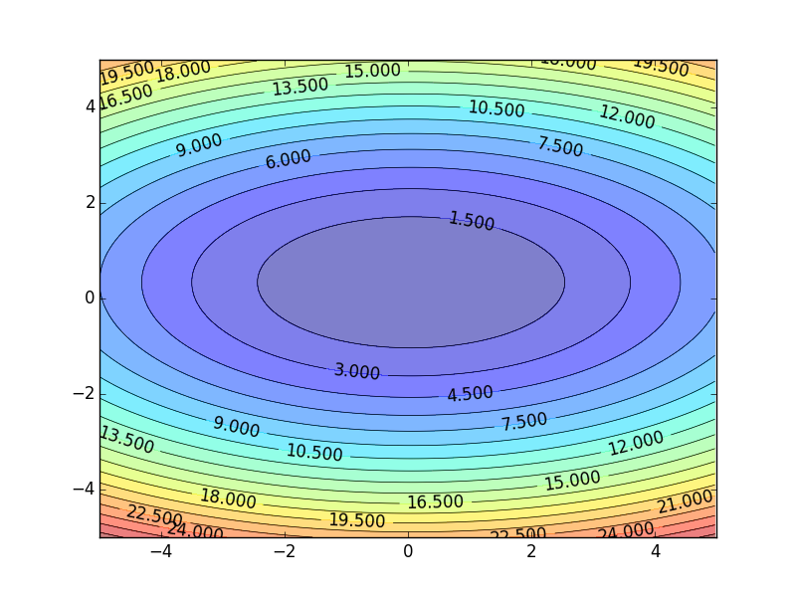


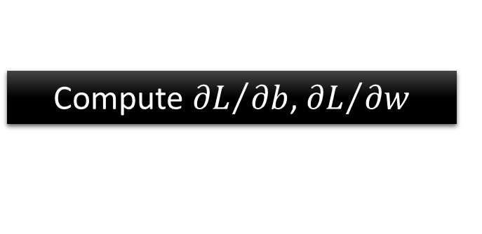
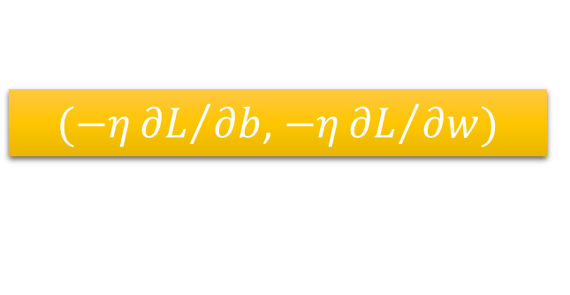
Step 3: Gradient Descent
Color: Value of Loss L(w,b)
$$w$$
$(−η{∂L}/{∂b}$, $−η{∂L}/{∂w})$
Compute ${∂L}/{∂b}$, ${∂L}/{∂w}$
$$b$$
Notes:
Don’t worry. In linear regression, the loss function L is convex.
No local minima
Questions: image you are playing AOC
A network can have millions of parameters.
Backpropagation is the way to compute the gradients efficiently (not today)
Ref: http://speech.ee.ntu.edu.tw/~tlkagk/courses/MLDS_2015_2/Lecture/DNN%20backprop.ecm.mp4/index.html

Slide 14
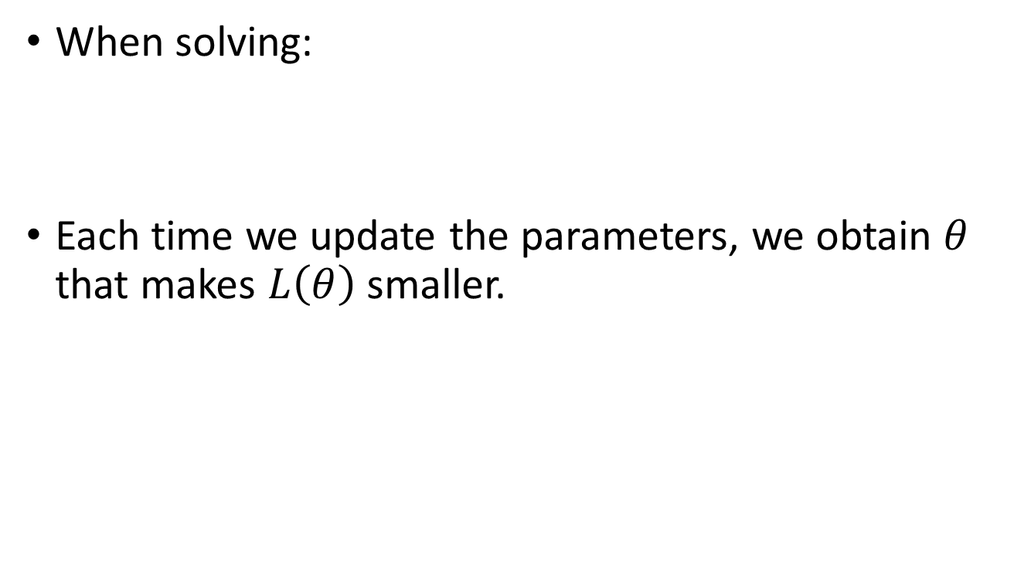

Step 3: Gradient Descent
When solving:
Each time we update the parameters, we obtain $θ$ that makes $L\left(θ\right)$ smaller.
$$θ^{∗}=arg\max_{θ}{L\left(θ\right)}$$
by gradient descent
$$L\left(θ^{0}\right)>L\left(θ^{1}\right)>L\left(θ^{2}\right)>…$$
Is this statement correct?
Notes:
Demo minecraft

Slide 15
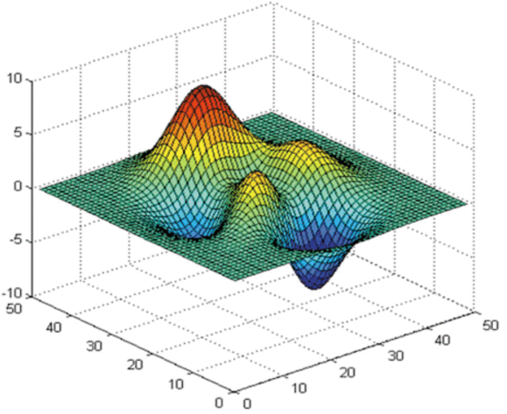






Step 3: Gradient Descent
Loss
Very slow at the plateau
$$L$$
Stuck at saddle point
$$w_{1}$$
$$w_{2}$$
Stuck at local minima
$$∂L∕∂w$$
$$≈0$$
$$∂L∕∂w$$
$$=0$$
$$∂L∕∂w$$
$$=0$$
The value of the parameter w
Notes:
Demo: Why all the problmes/

Slide 16
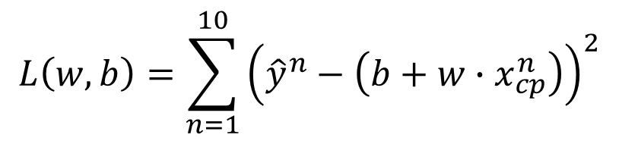


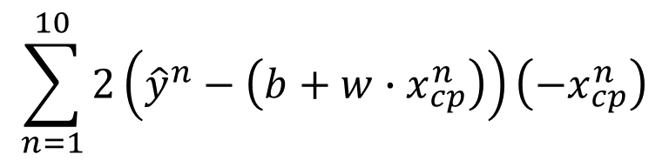
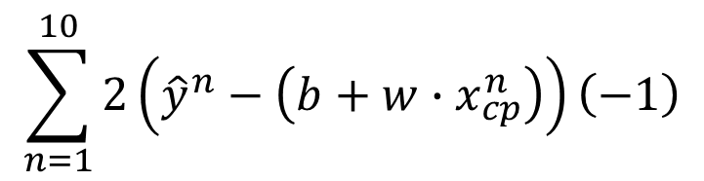
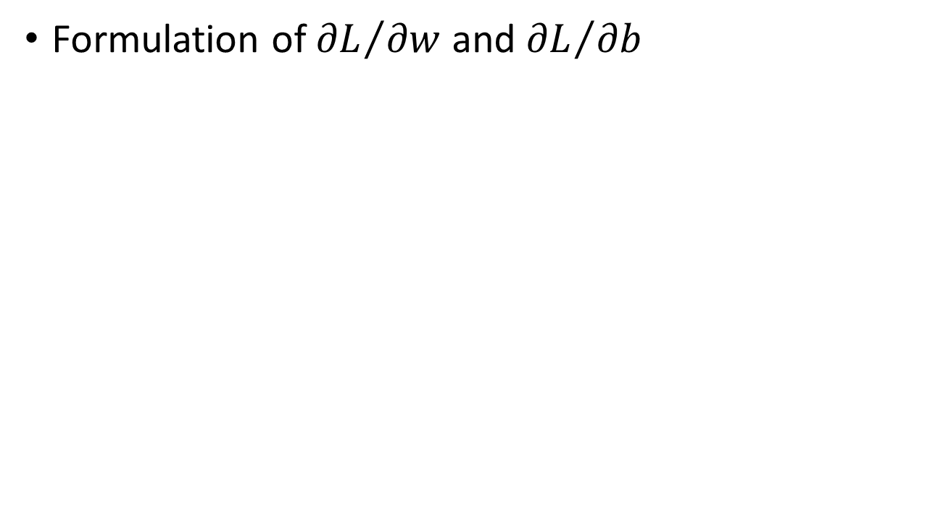
Step 3: Gradient Descent
Formulation of ${∂L}/{∂w}$ and ${∂L}/{∂b}$
$$L\left(w,b\right)=\sum_{n=1}^{10}{{\left({\hat{y}}^{n}−\left(b+w∙x_{cp}^{n}\right)\right)}^{2}}$$
$$\sum_{n=1}^{10}{2\left({\hat{y}}^{n}−\left(b+w∙x_{cp}^{n}\right)\right)\left(−x_{cp}^{n}\right)}$$
$$\frac{∂L}{∂w}=?$$
$$\frac{∂L}{∂b}=?$$
$$\sum_{n=1}^{10}{2\left({\hat{y}}^{n}−\left(b+w∙x_{cp}^{n}\right)\right)\left(−1\right)}$$

Slide 17
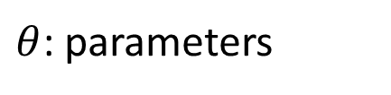
Gradient Descent
We have to solve the following optimization problem:
$$θ^{∗}=arg\min_{θ}{L\left(θ\right)}$$
L: loss function
$θ$: parameters
Suppose that θ has two variables {θ₁, θ₂}
Randomly start at $θ^{0}=\left[\begin{matrix}θ_{1}^{0} \\ θ_{2}^{0}\end{matrix}\right]$
$$∇L\left(θ\right)=\left[\begin{matrix}{∂L\left(θ_{1}\right)}/{∂θ_{1}} \\ {∂L\left(θ_{2}\right)}/{∂θ_{2}}\end{matrix}\right]$$
$$\left[\begin{matrix}θ_{1}^{1} \\ θ_{2}^{1}\end{matrix}\right]=\left[\begin{matrix}θ_{1}^{0} \\ θ_{2}^{0}\end{matrix}\right]−η\left[\begin{matrix}{∂L\left(θ_{1}^{0}\right)}/{∂θ_{1}} \\ {∂L\left(θ_{2}^{0}\right)}/{∂θ_{2}}\end{matrix}\right]$$
$$θ^{1}=θ^{0}−η∇L\left(θ^{0}\right)$$
$$\left[\begin{matrix}θ_{1}^{2} \\ θ_{2}^{2}\end{matrix}\right]=\left[\begin{matrix}θ_{1}^{1} \\ θ_{2}^{1}\end{matrix}\right]−η\left[\begin{matrix}{∂L\left(θ_{1}^{1}\right)}/{∂θ_{1}} \\ {∂L\left(θ_{2}^{1}\right)}/{∂θ_{2}}\end{matrix}\right]$$
$$θ^{2}=θ^{1}−η∇L\left(θ^{1}\right)$$

Slide 18
Review: Gradient Descent
$$θ_{2}$$
Gradient: Loss 的等高線的法線方向
$$∇L\left(θ^{0}\right)$$
Start at position $θ^{0}$
$$θ^{0}$$
$$∇L\left(θ^{1}\right)$$
Compute gradient at $θ^{0}$
$$θ^{1}$$
$$∇L\left(θ^{2}\right)$$
Move to $θ^{1}$ = $θ^{0}$ - η$∇L\left(θ^{0}\right)$
$$θ^{2}$$
Gradient
Compute gradient at $θ^{1}$
Movement
$$∇L\left(θ^{3}\right)$$
$$θ^{3}$$
Move to $θ^{2}$ = $θ^{1}$ – η$∇L\left(θ^{1}\right)$
……
$$θ_{1}$$
Notes:
Draw is so comply use minecraft
Easy for more than two variables

Slide 19
Gradient Descent
Tip : Tuning your
learning rates

Slide 20
Learning Rate
Set the learning rate η carefully
If there are more than three parameters, you cannot visualize this.
Loss
Very Large
small
Large
Loss
Just make
No. of parameters updates
But you can always visualize this.

Slide 21
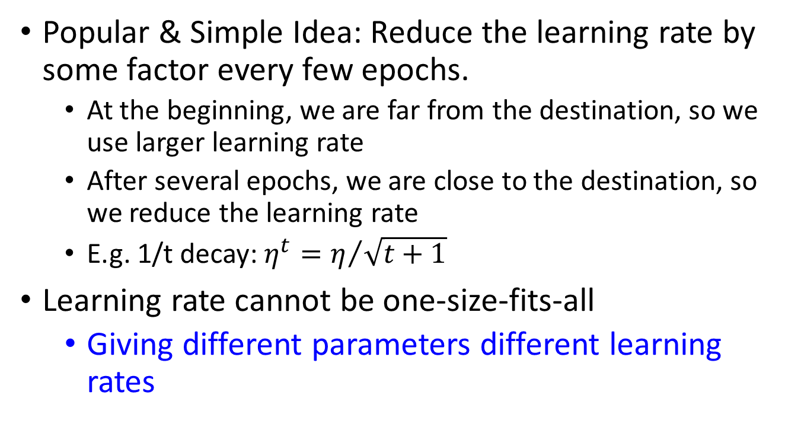
Adaptive Learning Rates
Popular & Simple Idea: Reduce the learning rate by some factor every few epochs.
At the beginning, we are far from the destination, so we use larger learning rate
After several epochs, we are close to the destination, so we reduce the learning rate
E.g. 1/t decay: $η^{t}=η/{\sqrt{t+1}}$
Learning rate cannot be one-size-fits-all
Giving different parameters different learning rates
Notes:
Advanced Idea: Eta
Can we give each parameters different learning rates?

Slide 22


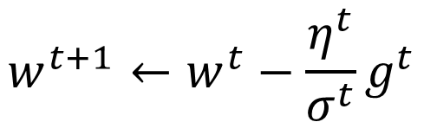
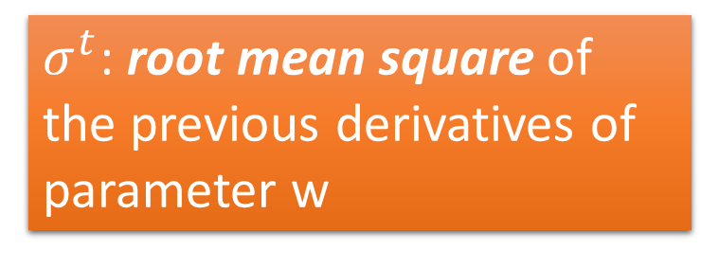
Adagrad
$$η^{t}=\frac{η}{\sqrt{t+1}}$$
$$g^{t}=\frac{∂L\left(θ^{t}\right)}{∂w}$$
Divide the learning rate of each parameter by the root mean square of its previous derivatives
Vanilla Gradient descent
$$w^{t+1}←w^{t}−{\text{η}}^{t}g^{t}$$
w is one parameters
Adagrad
$σ^{t}$: root mean square of the previous derivatives of parameter w
$$w^{t+1}←w^{t}−\frac{{\text{η}}^{t}}{σ^{t}}g^{t}$$
Parameter dependent

Slide 23

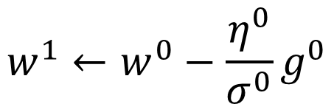

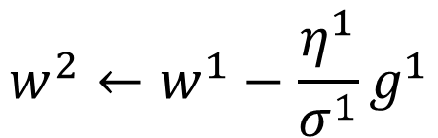
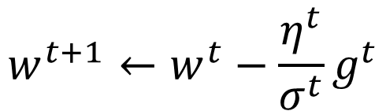

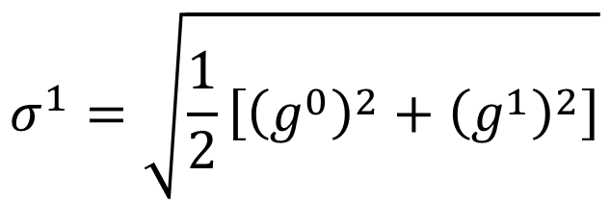
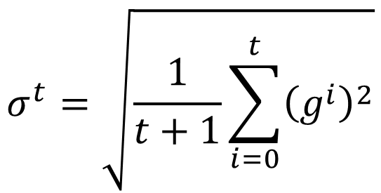
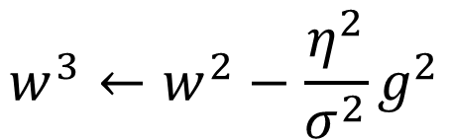
Adagrad
$σ^{t}$: root mean square of the previous derivatives of parameter w
$$w^{1}←w^{0}−\frac{{\text{η}}^{0}}{σ^{0}}g^{0}$$
$$σ^{0}=\sqrt{{\left(g^{0}\right)}^{2}}$$
$$σ^{1}=\sqrt{\frac{1}{2}\left[{\left(g^{0}\right)}^{2}+{\left(g^{1}\right)}^{2}\right]}$$
$$w^{2}←w^{1}−\frac{{\text{η}}^{1}}{σ^{1}}g^{1}$$
$$σ^{2}=\sqrt{\frac{1}{3}\left[{\left(g^{0}\right)}^{2}+{\left(g^{1}\right)}^{2}+{\left(g^{2}\right)}^{2}\right]}$$
$$w^{3}←w^{2}−\frac{{\text{η}}^{2}}{σ^{2}}g^{2}$$
$$……$$
$$σ^{t}=\sqrt{\frac{1}{t+1}\sum_{i=0}^{t}{{\left(g^{i}\right)}^{2}}}$$
$$w^{t+1}←w^{t}−\frac{{\text{η}}^{t}}{σ^{t}}g^{t}$$
Notes:
Why square

Slide 24

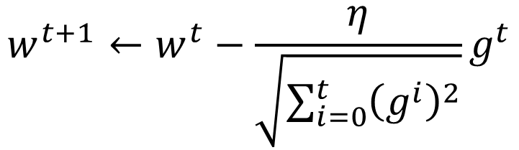
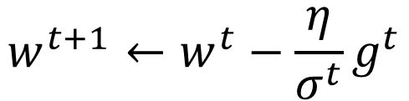



Adagrad
Divide the learning rate of each parameter by the root mean square of its previous derivatives
$$η^{t}=\frac{η}{\sqrt{t+1}}$$
1/t decay
$${\text{η}}^{t}$$
$$w^{t+1}←w^{t}−\frac{η}{σ^{t}}g^{t}$$
$$σ^{t}=\sqrt{\frac{1}{t+1}\sum_{i=0}^{t}{{\left(g^{i}\right)}^{2}}}$$
$$σ^{t}$$
$$w^{t+1}←w^{t}−\frac{η}{\sqrt{\sum_{i=0}^{t}{{\left(g^{i}\right)}^{2}}}}g^{t}$$

Slide 25





How’s the results?
Training Data
y = b + w $∙$ x_{cp}
b = -188.4
$$e^{1}$$
w = 2.7
Average Error on Training Data
$$e^{2}$$
$$=\frac{1}{10}\sum_{n=1}^{10}{e^{n}}$$
= 31.9

Slide 26


How’s the results? - Generalization
What we really care about is the error on new data (testing data)
Another 10 pokemons as testing data
y = b + w $∙$ x_{cp}
b = -188.4
How can we do better?
w = 2.7
Average Error on Testing Data
$$=\frac{1}{10}\sum_{n=1}^{10}{e^{n}}$$
= 35.0
> Average Error on Training Data (31.9)

Slide 27



Selecting another Model
y = b + w₁ $∙$ x_{cp} + w₂ $∙$ (x_{cp})²
Best Function
b = -10.3
w₁ = 1.0, w₂ = 2.7 x 10⁻³
Average Error = 15.4
Testing:
Average Error = 18.4
Better! Could it be even better?

Slide 28



Selecting another Model
y = b + w₁ $∙$ x_{cp} + w₂ $∙$ (x_{cp})²
+ w₃ $∙$ (x_{cp})³
Best Function
b = 6.4, w₁ = 0.66
w₂ = 4.3 x 10⁻³
w₃ = -1.8 x 10⁻⁶
Average Error = 15.3
Testing:
Average Error = 18.1
Slightly better.
How about more complex model?

Slide 29



Selecting another Model
y = b + w₁ $∙$ x_{cp} + w₂ $∙$ (x_{cp})²
+ w₃ $∙$ (x_{cp})³ + w₄ $∙$ (x_{cp})⁴
Best Function
Average Error = 14.9
Testing:
Average Error = 28.8
The results become worse ...

Slide 30



Selecting another Model
y = b + w₁ $∙$ x_{cp} + w₂ $∙$ (x_{cp})²
+ w₃ $∙$ (x_{cp})³ + w₄ $∙$ (x_{cp})⁴
+ w₅ $∙$ (x_{cp})⁵
Best Function
Average Error = 12.8
Testing:
Average Error = 232.1
The results are so bad.

Slide 31





Model Selection
Training Data
1.
y = b + w $∙$ x_{cp}
2.
y = b + w₁ $∙$ x_{cp} + w₂ $∙$ (x_{cp})²
y = b + w₁ $∙$ x_{cp} + w₂ $∙$ (x_{cp})²
+ w₃ $∙$ (x_{cp})³
3.
y = b + w₁ $∙$ x_{cp} + w₂ $∙$ (x_{cp})²
+ w₃ $∙$ (x_{cp})³ + w₄ $∙$ (x_{cp})⁴
4.
y = b + w₁ $∙$ x_{cp} + w₂ $∙$ (x_{cp})²
+ w₃ $∙$ (x_{cp})³ + w₄ $∙$ (x_{cp})⁴
+ w₅ $∙$ (x_{cp})⁵
A more complex model yields lower error on training data.
5.
If we can truly find the best function

Slide 32

Model Selection
 | Training | Testing
1 | 31.9 | 35.0
2 | 15.4 | 18.4
3 | 15.3 | 18.1
4 | 14.9 | 28.2
5 | 12.8 | 232.1
Overfitting
A more complex model does not always lead to better performance on testing data.
This is Overfitting.
Select suitable model
Notes:
metaphohr

Slide 33
延伸閱讀
Cross_validation
Another form of regression
Scikit-learn documentation:
https://scikit-learn.org/stable/model_selection.html
etc

