Slide 1
Tracking Racial Discrimination within the Financial System
How Does the Database Help and Hurt the Bureau's Efforts to Expand Credit to Underserved Communities
William Morris

Slide 2
Goals for the CFPB
Enforcement: Identify those companies that are noncompliant with Equal Credit Opportunity Act (ECOA).
Education: Inform consumers of their rights and responsible financial practices.
Advertisement: Encourage companies to expand their credit offerings into underserved communities.

Slide 3
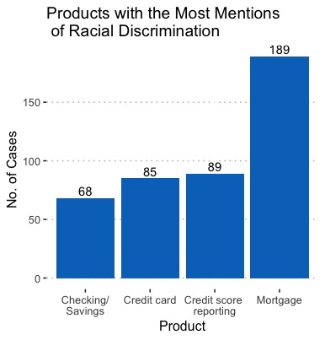
Data was collected with a keyword search in the consumer narrative section. Keywords: " race ", "racial", and "ethnic" produced 657 cases.
The database currently does a poor job of recording any sort of discrimination.
No consumer narratives before 03-2015
Since then, 46% have no narrative
4379 cases have some form of the word "discriminate", but not always in the right context.
A better solution to recording discrimination would be a series of drop-down menus with prompts that can easily be recorded into the database.

Slide 4
Top 10 Companies Accused of Discrimination
Company | Product | Cases
CITIBANK, N.A. | Credit card or prepaid card | 15
EQUIFAX, INC. | Credit reporting, credit repair services, or other personal... | 22
EQUIFAX, INC. | Credit reporting | 14
Experian Information Solutions Inc. | Credit reporting, credit repair services, or other personal... | 21
JPMORGAN CHASE & CO. | Checking or savings account | 12
JPMORGAN CHASE & CO. | Credit card or prepaid card | 12
JPMORGAN CHASE & CO. | Mortgage | 11
SELECT PORTFOLIO SERVICING, INC. | Mortgage | 13
TRANSUNION INTERMEDIATE HOLDINGS, INC. | Credit reporting, credit repair services, or other personal... | 23
WELLS FARGO & COMPANY | Mortgage | 24

Slide 5
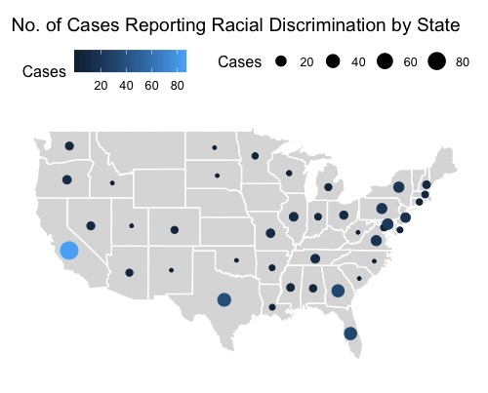
The prevalence of cases in a region should be accounted for when developing education efforts.
As measurements get better, we can use existing database structure to identify zip-codes with large numbers of cases involving discrimination.
Geographical data can be made available to compliant companies to support efforts of increased advertisement.

Slide 6
Final Thoughts
The simple addition of drop-down menus would improve the bureau's ability to collect data on discrimination of every protected status.
Investigations should be targeted towards the mortgage industry and companies which tolerate discrimination across multiple product divisions.
Public access to geographical data informs companies on where their advertisements should be focused.

