Slide 1
機器學習導論 ─ Deep Learning Model Implementation with Keras
吳順吉、李松鴻
Data Analysis and Interpretation Lab
Department of Engineering and System Science

Slide 2
Outline
MNIST with LeNet-5
CNN
Overfitting
Data Augmentation
Normalization
Batch Normalization
LeNet-5 implementation with Keras
Homework

Slide 3
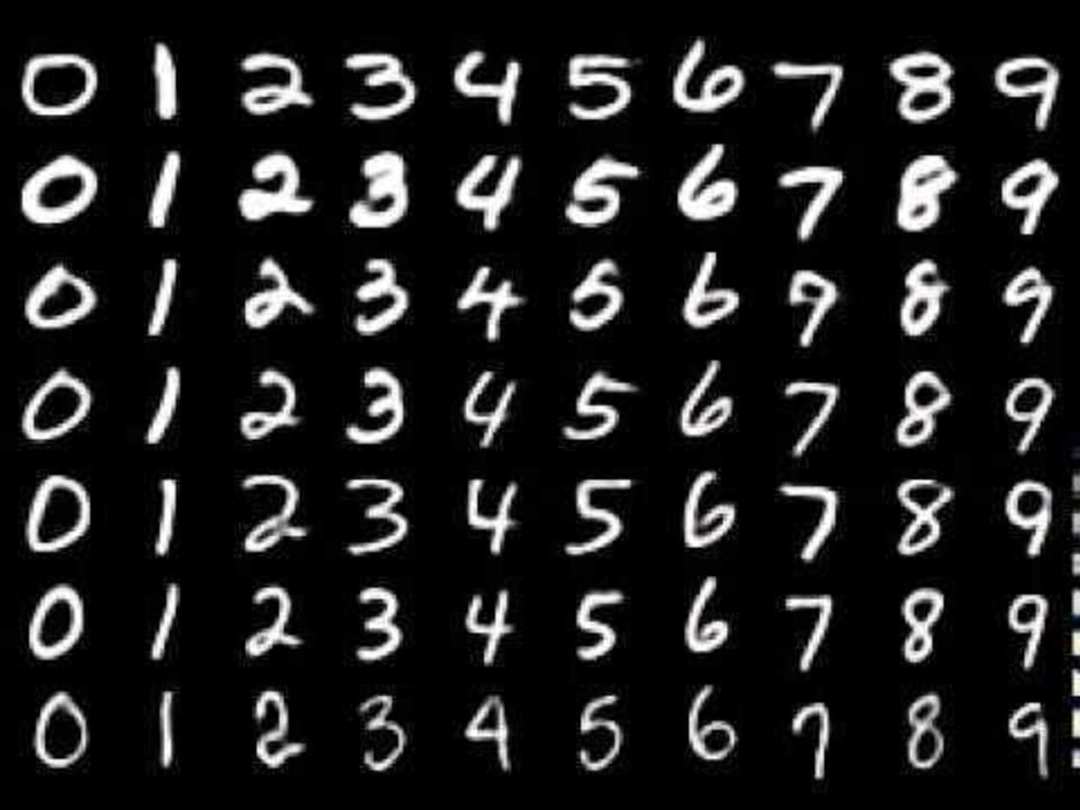
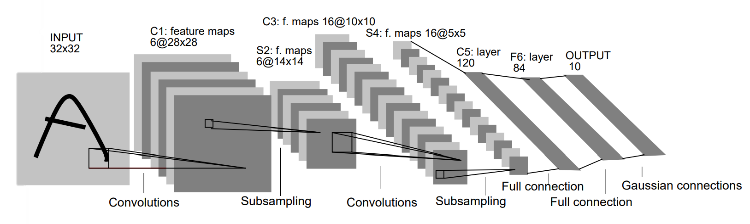
MNIST with LeNet-5
MNIST: a large database of handwritten digits.
LeNet-5: A neural network architecture for handwritten and machine-printed character recognition in 1990’s

Slide 4
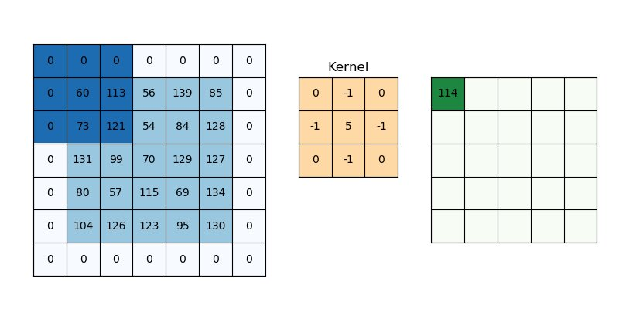
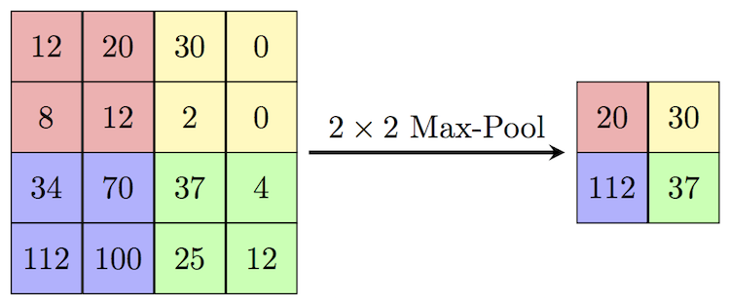
CNN (Convolutional Neural Network)
Conv2D(6, kernel_size, padding='same', activation='relu’)
Kernel size : 5*5
Convolution
Max Pooling

Slide 5
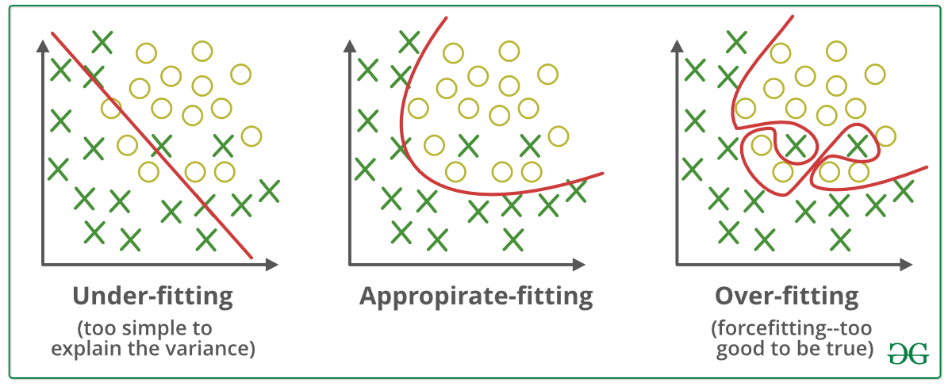
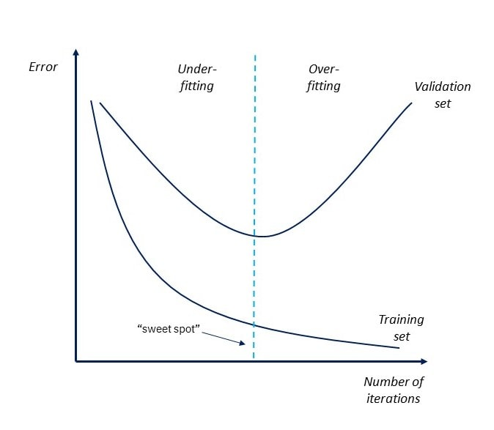
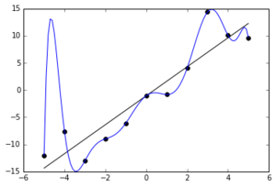
Overfitting
How do we prevent?
1. Find the “sweet spot”
Early Stopping
2. Simplify the model
3. Increase Training Data
(data augmentation)
tensorflow.keras.callbacks.EarlyStopping

Slide 6
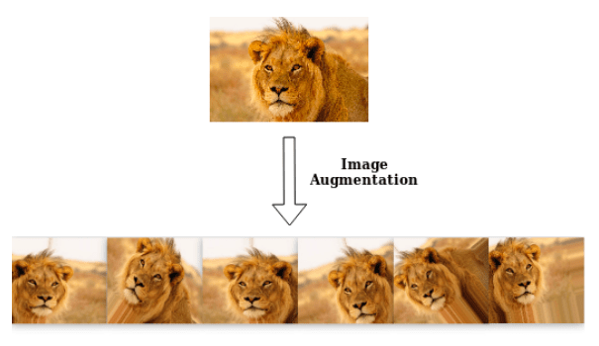
Data Augmentation
Not Enough Data? -> Why not try make some fake data yourself?
EX :
Flip horizontally/vertically
Zoom in/ Zoom out
Rotation
Shift
Use this package ↓ or implement it with your own code.
tensorflow.keras.preprocessing.image.ImageDataGenerator

Slide 7
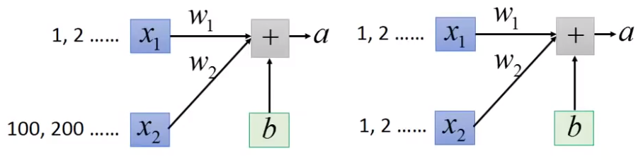
Normalization
How does Normalization and Standardization help the model training?
Loss L
W
Loss L
W
2
2
W
W
1
1
small
+Δw1
+Δa
+Δa
+Δw2
Large

Slide 8
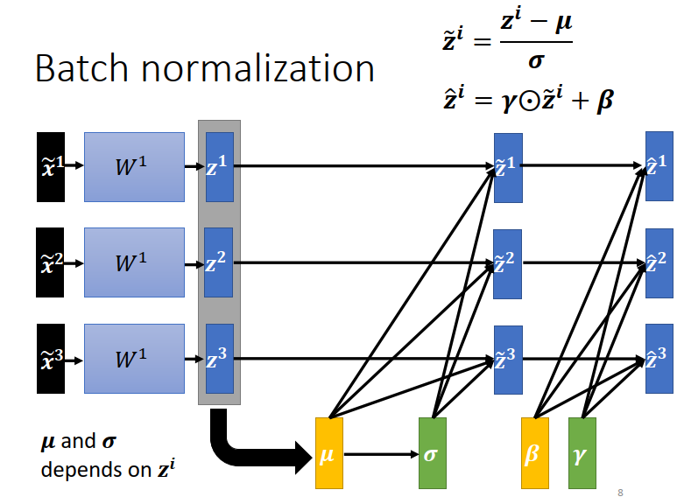
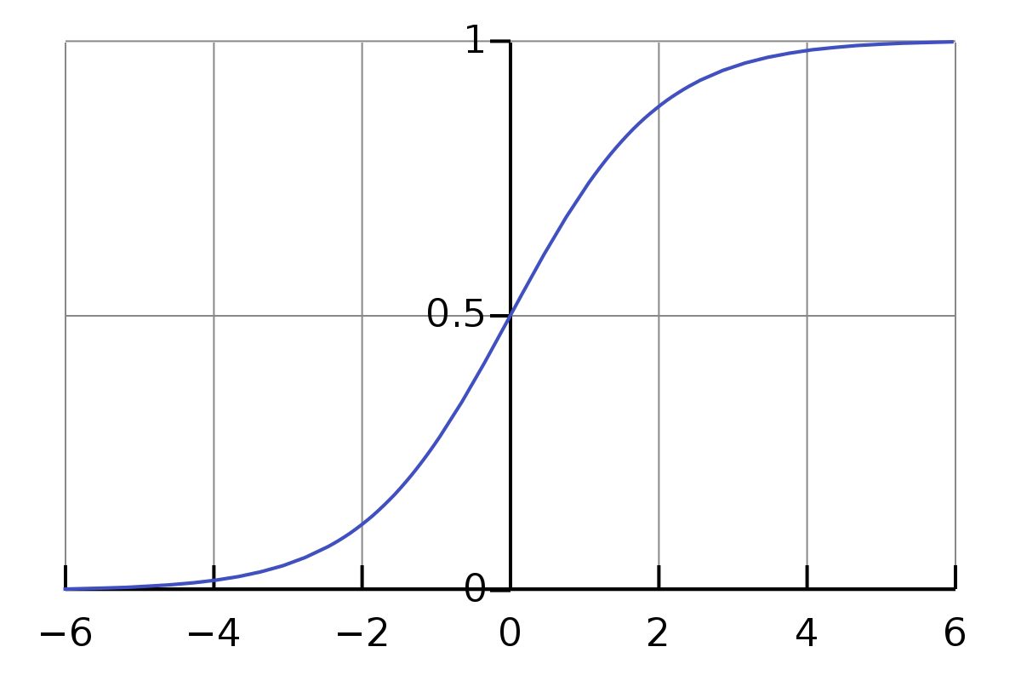
Batch Normalization
Input with same scale
How about Hidden Layer?
x1
y1
z1
output1
x2
y2
z2
output2
Benefits
Reduce training time
Prevent gradient vanishing
small gradient
sigmoid

Slide 9
Building LeNet with Keras

Slide 10


Keras
What is Keras?
Keras is a high-level neural networks API, written in Python and capable of running on top of TensorFlow, CNTK, or Theano.
Why Keras?
Less code
Easy to use/learn
Reference: https://www.tensorflow.org/api_docs/python/tf/keras

Slide 11
Keras
Import packages from tensorflow.keras if you are using Tensorflow 2.x ex:
The following examples are provided with Tensorflow 2.3
from tensorflow.keras.layers import Input, Flatten, Dense
from tensorflow.keras.layers import Conv2D, MaxPooling2D
from tensorflow.keras.models import Model
Reference: https://www.tensorflow.org/api_docs/python/tf/keras

Slide 12
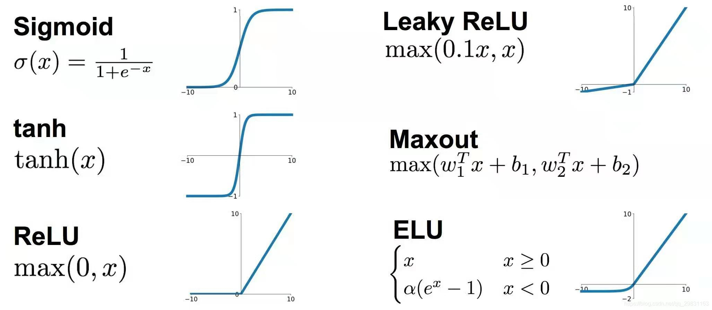
Build Model
class LeNet(Model):
def __init__(self, input_shape = (28,28,1), output_shape = 10):
kernel_size = 5
input_layer = Input(shape = input_shape)
x = Conv2D(6, kernel_size, padding='same',
activation='relu')(input_layer)
x = MaxPooling2D((2, 2))(x)
x = Conv2D(16, kernel_size, activation='relu')(x)
x = MaxPooling2D((2, 2))(x)
x = Flatten()(x)
x = Dense(120, activation='relu')(x)
x = Dense(64, activation='relu')(x)
output_layer = Dense(output_shape, activation = 'softmax')(x)
super().__init__(input_layer, output_layer, name = 'LeNet')
self.compile(optimizer='adam',
loss='sparse_categorical_crossentropy',
metrics=['accuracy'])
Activation functions
*softmax used in the output layer of a classification problem
(sum of the output =1 (act as probability))
If you have labels like 0,1,2
-> Use ‘sparse_categorical_crossentropy ’
If you have one-hot labels such as (1,0,0) (0,1,0) (0,0,1)
-> Use ‘categorical_crossentropy ’
# If you want to do one-hot encoding, use either:
np.eye(#of labels)[labels]
pd.get_dummies(labels)
Examples are based on Tensorflow 2.3

Slide 13
Model Training
history = model.fit(x_train,y_train,
batch_size = 128,
epochs = 20,
validation_split = 0.2)
# another way of training with validation data using train_test_split
from sklearn.model_selection import train_test_split
x_train,y_train,x_test,y_test = train_test_split(x_train, y_train, test_size = 0.2)
history = model.fit(x_train,y_train,
batch_size = 128,
epochs = 20,
validation_data = (x_val,y_val))

Slide 14
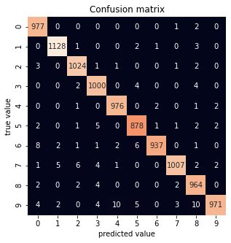
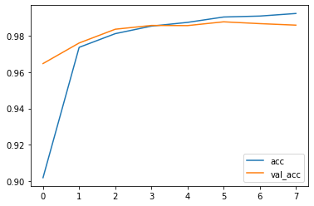
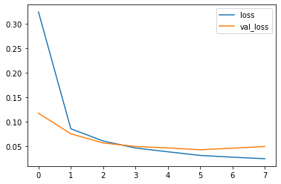
Model Evaluation
Verify the model accuracy
Plot out the training curve
Plot the Confusion Matrix
model.evaluate(x_train,y_train)
model.evaluate(x_test,y_test)
# you can also can do for same results:
from sklearn.metrics import accuracy_score
pred_test = model.predict(x_test).argmax(1)
accuracy_score(pred_test, y_test))
print('Test Accuracy:', accuracy_score(pred_test, y_test))

Slide 15
Homework

Slide 16
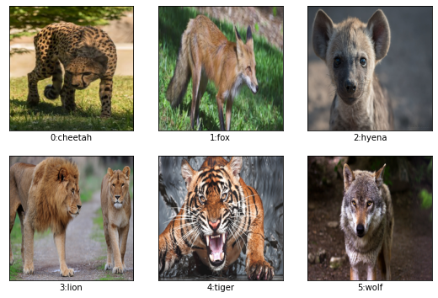
Homework-Dataset
Kaggle DataSet: Wildlife animals
Label | Category
0 | cheetah
1 | fox
2 | hyena
3 | lion
4 | tiger
5 | wolf
Image size: 224*224*3 You a free to resize the images if they are too large for you.
The data are split to training and testing data, please download it from the google drive

Slide 17
Homework-Dataset
Define and train your own CNN model.
Upload a report with your model to eeclass
Feel free to use any code provided today
Content of the report: 1. Preprocessing steps (including augmentation) 2. Model structure 3. Training history (train/validation loss or accuracy) Optional: 1. How did you optimize the model 2. Results analysis 3. Any problems you met 4. Any thoughts

