Slide 1

Sales Offsite
Product Training · Strategy · Pipeline
March 19–20, 2026
Industrious · 41 E. 11th Street, 11th Floor, New York City
Marissa · Declan · Celisa · Andrew Bidwell · Andrew Buron
OFFSITE GOAL
Align the sales team on Abra's full product offering, sharpen competitive positioning, and build a concrete 2026 sales pipeline and strategy.
Confidential · Abra Sales Offsite · March 2026
abra.com

Slide 2
2-Day Agenda Overview
DAY 1 · MARCH 19
DAY 2 · MARCH 20
Product Deep Dive
RIA Strategy & Pipeline
Product demo & UX walkthrough (Deepak, Adarsh, Prashant)
Custody, Trading, Loans & Yield products
Yield strategy mechanics (Bharat & Willie)
Competitive landscape & objection handling
RIA product discussion (Celisa, Bill, Deepak, Adarsh)
2026 sales pipeline review (Marissa)
Lead generation & inbound/outbound mix
Events calendar & sales collateral needs
Confidential · Abra Sales Offsite · March 2026
abra.com

Slide 3
Product Orientation
DAY 1 · 9:00 AM – 12:00 PM
Day 1 · March 19 · 9:00 AM – 12:00 PM
9:00 – 9:45 AM
10:00 AM – 12:00 PM
Product Demo & Discussion
Overview of Specific Products
Demo led by Deepak, Adarsh & Prashant
Full platform walkthrough
Key features & differentiators
CUSTODY
TRADING
LOANS
YIELD
9:30 – 10:00 AM
Client UX & Onboarding
Client onboarding flow walkthrough
Product demo for prospects
White-glove service — who qualifies?
Post-onboarding client service model
Support team overview
Confidential · Abra Sales Offsite · March 2026
abra.com

Slide 4
Abra's Core Products
A unified platform for custody, trading, yield, and lending — all in one place.
01
Custody
02
Trade
Your assets. Your vault.
Deep liquidity across 200+ assets.
Fireblocks MPC Wallet Technology — multi-party computation
Separately Managed Accounts (SMAs) — full segregation, legal title stays with client
SEC-registered RIA fiduciary standard — legal obligation to act in client's best interest
Florida Trust in progress (summer 2026)
Currently BTC, ETH, SOL pairs with USDC
Onboarding with Kraken to support 200+ asset pairs via Kraken integration
Backend is Talos infra + onboarded with LPs - OTC style pricing
T+1 settlement currently in product
03
Yield
04
Loans
Grow your holdings intelligently.
Unlock liquidity without selling.
Abra USD Yield Strategy — variable yield on stablecoins
Abra Digital Income Strategy — beta + variable yield
Abra Bitcoin Yield Strategy — monthly rate (2–3% APY range)
Levered ETH and SOL Strategies launching soon (~5% yield)
ETH, SOL staking
Borrow against BTC or ETH at up to 50% LTV — no credit checks
Competitive rates 4–8% APR; interest accrues to principal, no monthly payments
Open-term loans — repay when you choose, as long as LTV stays healthy
Solana loan product in testing — 3-month build
Low / no interest loan concept in development
Confidential · Abra Sales Offsite · March 2026
abra.com

Slide 5
DAY 1 · YIELD STRATEGY DEEP DIVE
How We Generate Yield
Discussion with Bharat & Willie · CIO hiring / staffing needs
Perpetual LP Hedging
DeFi Market Making
Fixed Rate / Yield Tokenization
Delta-neutral exposure to perp exchange LP pools (JLP, GLP/GM). Captures trading fees & borrowing revenue.
Concentrated & full-range liquidity across AMMs. Active position management to optimize fee capture vs. impermanent loss.
Strategies on yield-splitting protocols (e.g. Pendle) to isolate fixed vs. variable rate exposure.
Stablecoin Lending & Looping
Yield Aggregation
Staking & Liquid Staking
Leveraged supply-side: deposit → borrow → re-supply to amplify net lending yield.
Systematic allocation across lending markets & vaults for highest risk-adjusted supply rates.
Native & liquid staking across PoS networks. Includes restaking and LST yield optimization.
Options Overlay
Basis Trading
Funding Rate Arbitrage
Systematic covered call writing on BTC/ETH via Deribit. Captures vol premium via theta decay.
Long spot, short perp. Yield source: funding rate collection from persistent spread.
Cross-venue funding rate capture. Long on paying venue, short on charging. Market-neutral.
UPCOMING: Higher yield BTC product (Marissa) · ETH/SOL higher yield products (Bharat/Willie)
Confidential · Abra Sales Offsite · March 2026
abra.com

Slide 6
Competitive Landscape
Day 1 · 12:00 PM – 2:00 PM · Lief + Bill to join
12:00 – 2:00 PM
2:00 – 2:30 PM
Discussion Agenda
Fintrex Demo
How does Abra stack up to competitors?
What is our competitive edge?
Main client objections — and how to overcome them
Expected timelines to close different ICPs
Positioning vs. traditional custodians & crypto-native platforms
Outbound lead generation platform
Demo of capabilities
Integration with sales workflow
Use cases for prospecting
Confidential · Abra Sales Offsite · March 2026
abra.com

Slide 7
COMPETITIVE LANDSCAPE · ICP
Who Is Abra For?
Short-term target
Long-term target
HNW Crypto Holders
RIAs & Wealth Advisors
Long-term holders on Ledn, Coinbase, Gemini, Kraken, Nexo or self-custody. Successful and wealthy. Not active DeFi users. Want complexity abstracted away.
$100T in wealth reallocating in 5 years. Major platforms recommending 1–4% crypto exposure. Abra provides white-label SMA infrastructure for digital asset advisory.
High-value segment
Treasury management
Family Offices
Corporates & Miners
Multi-generational wealth managers needing fiduciary-grade governance, tax efficiency, reporting, and segregated custody with institutional-grade infrastructure.
ATM operators, miners, treasury companies managing BTC/stablecoin reserves. Need yield on idle assets, credit lines, and operational efficiency without counterparty risk.
Confidential · Abra Sales Offsite · March 2026
abra.com

Slide 8
Competitor Comparison
Abra vs. Ledn · Coinbase · Nexo · Custodians
Feature
Abra (ACM)
Ledn
Coinbase Prime
Nexo
Custodians
Regulatory
SEC-registered RIA (fiduciary)
No RIA; MTLs only
No RIA; Exchange
Re-entered US Feb 2026
Trusts / OCC Charters
Accounts
Segregated SMAs
Omnibus / pooled
Omnibus / pooled
Omnibus / pooled
Segregated
Rehypoth.
Zero ✓
Removed mid-2025
No
Uses client assets
No
Assets
BTC, ETH, SOL, stables, RWA
BTC only (dropped ETH)
470+ assets
Multi-asset
Broad
Yield
DeFi, staking, model portfolios
Up to 8% USDC / 5.25% BTC
Staking (Figment)
Flexible & fixed-term
Staking
Lending
Crypto-backed via DeFi
BTC loans, 50% LTV, 12% APR
BTC/ETH up to $5M
Credit lines, 2.9%+
No
Weakness
Smaller brand; pre-public
BTC-only limits appeal
No fiduciary duty
Trust deficit from 2023
—
Confidential · Abra Sales Offsite · March 2026
abra.com

Slide 9
COMPETITIVE LANDSCAPE · DIFFERENTIATORS
Abra's Key Differentiators
1
Segregated SMA Vaults
Client retains legal title. Assets independently verifiable on-chain. No commingling risk — directly addresses post-Celsius anxiety.
2
SEC-Registered RIA (Fiduciary)
Legal obligation to act in client's best interest. No other crypto-native competitor in this comparison operates under a fiduciary standard.
3
Proprietary Yield Strategies
BTC, ETH, SOL, Stables, and more
4
Loans
Extremely competitive rates, no rehypothecation, no limits on loan size, no terms.
5
Unified Platform
Custody, trading, lending, yield, staking, and portfolio management in one interface. Eliminates fragmentation across 3–4 tools.
Confidential · Abra Sales Offsite · March 2026
abra.com

Slide 10
Target Personas & Switching Triggers
Who we're targeting and why they move to Abra
Persona
Current Platform
Pain Point
Abra's Hook
BTC Whale / Long-Term Holder
Ledn
BTC-only limitation; wants multi-asset + tokenization
Multi-asset SMA + USDAF yield + zero rehypothecation
Family Office
Coinbase Prime / self-custody
Needs fiduciary-grade governance, reporting, tax efficiency
RIA fiduciary + segregated vaults + model portfolios
Corporate Treasury
Coinbase / self-managed
Wants yield on idle BTC/stablecoin reserves without counterparty risk
SMA-based yield, lending, and collateral optimization
HNW Yield Seeker
Nexo
Counterparty trust deficit; rehypothecation concerns post-2023 exit
Zero rehypothecation + SEC oversight + competitive yield
RIA / Wealth Advisor
Multiple fragmented tools
No single regulated platform for digital asset advisory
White-label SMA infrastructure for client portfolio management
Confidential · Abra Sales Offsite · March 2026
abra.com

Slide 11
COMPETITIVE LANDSCAPE · OBJECTION HANDLING
Handling Common Objections
"I'm happy with Coinbase — they're the biggest."
Coinbase is an exchange, not a fiduciary. Your assets sit in omnibus accounts. At Abra, you have a segregated SMA vault in your name, verified on-chain, with an RIA legally obligated to act in your best interest.
"Ledn gives me yield on my BTC."
Ledn dropped ETH entirely and went BTC-only. If you hold ETH, SOL, or stablecoins, those assets have no home there. Abra offers yield across BTC, ETH, SOL, and stables — plus USDAF synthetic dollar yield.
"Nexo offers lower borrow rates."
Nexo just re-entered the US after a 3-year exit and still uses client assets for yield generation (rehypothecation). The question isn't just 'what rate?' — it's 'are my assets safe?' Abra's zero-rehypothecation guarantee removes that risk.
"I don't want to move my assets — it's a hassle."
We handle the heavy lifting. Our concierge team manages the full transfer process. Most clients are fully onboarded within 48 hours. We also offer fee waivers for the first 90 days to make the switch frictionless.
"I've never heard of Abra."
Abra has been serving customers since 2018. We are a backed by top tier institutional investors and preparing to go public via SPAC. We're not new — we're just now scaling our footprint institutional side.
Confidential · Abra Sales Offsite · March 2026
abra.com

Slide 12
RIA Discussion
Day 2 · March 20 · 9:00 AM – 12:00 PM · Celisa Morin + Bill, Deepak, Adarsh
What RIAs care about
Key RIA Considerations
RIAs want to grow assets
They want to control the client relationship
They don’t want to loose assets
We have to meet them where they are with existing workflows
Due diligence checklist for RIA prospects
Regulatory & custody questions
Model portfolios & allocation frameworks
Client reporting capabilities
White-glove onboarding for RIA clients
Revenue share & partner incentive structure
Confidential · Abra Sales Offsite · March 2026
abra.com

Slide 13
RIA Discussion
Day 2 · March 20 · 9:00 AM – 12:00 PM · Celisa Morin + Bill, Deepak, Adarsh
Crypto as a Service - Infrastructure Solution
Integrate with Reporting Platforms
Focus on Infrastructure solution Crypto as a Service approach
PRO: Technology based solution - still requires selling to RIAs but less reliant on existing reporting platform timelines
CONS: Coinbase, Kraken and Bitgo already have this and are going after large banks
Focus on small regional banks and advisors?
Focus on selling into RIAs and getting SMA yield products through investment committee and compliance and/or senior leadership
6 months away from being able to start any diligence process
Go to market:
Team
Significant investment by tech team to build out transactional APIs
Scale for assets (larger strategies and with longer track record)
Trust
Need to onboard with a major reporting platform like Orion
Confidential · Abra Sales Offsite · March 2026
abra.com

Slide 14
2026 Sales Pipeline & Strategy
Day 2 · 12:30 PM – End · Lief joins
Pipeline Review (Marissa)
Lead Generation
2026 sales targets
Current pipeline status & deal stages
Conversion rates & deal velocity
Priority accounts & ICP profiles
Forecasting & tracking methodology
Where leads will come from
Inbound vs. outbound mix
Podcast & media channel strategy
Partner & referral channels
Sales Enablement & Events
Sales collateral needed to support the team
Pitch decks, one-pagers, objection guides
Events calendar for rest of 2026
Conference & networking priorities
Confidential · Abra Sales Offsite · March 2026
abra.com

Slide 15
SUCCESS METRICS
90-Day & 6-Month Targets
Metric
90-Day Target
6-Month Target
New AUM (Competitive Switches)
$195M+
$420M+
Qualified Leads Generated
150+
500+
Meeting → Funded Conversion Rate
10%
20%
Active RIA Partners
0
1 Pilot
Average Days to Onboard
<5 days
<3 days
Outbound Activity
?
?
Churn
?
?
Confidential · Abra Sales Offsite · March 2026
abra.com

Slide 16
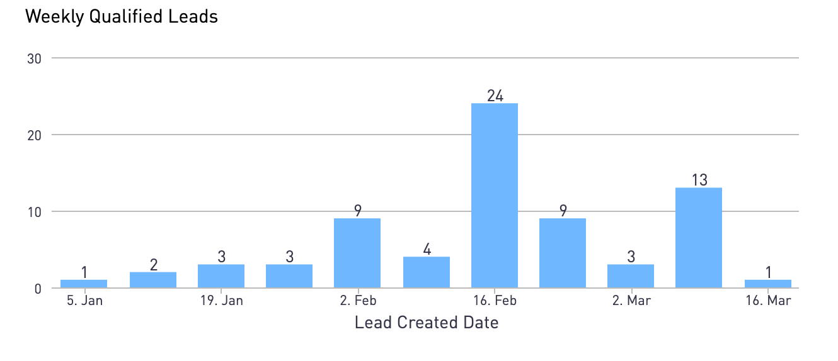
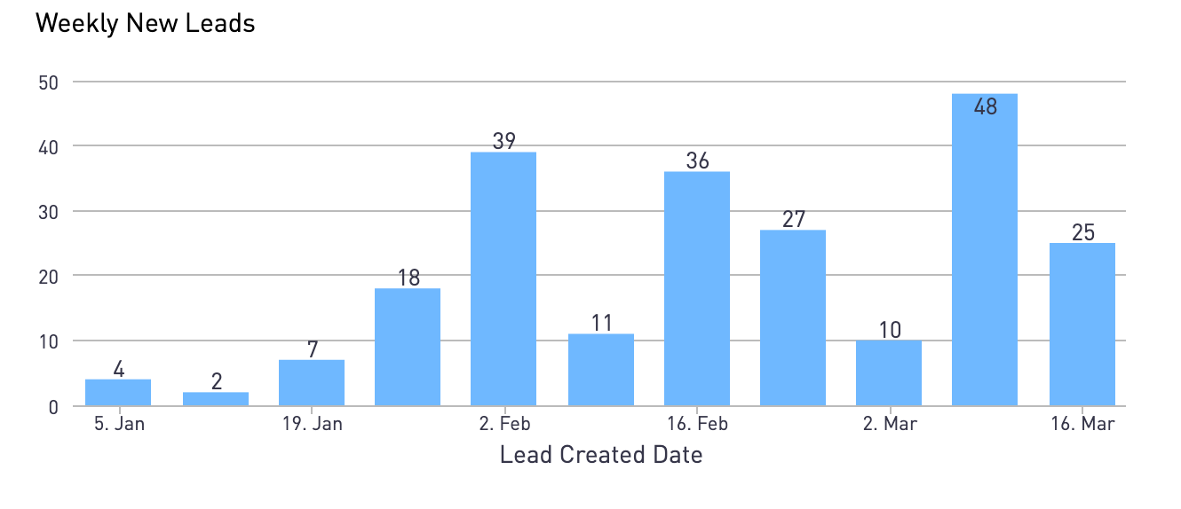
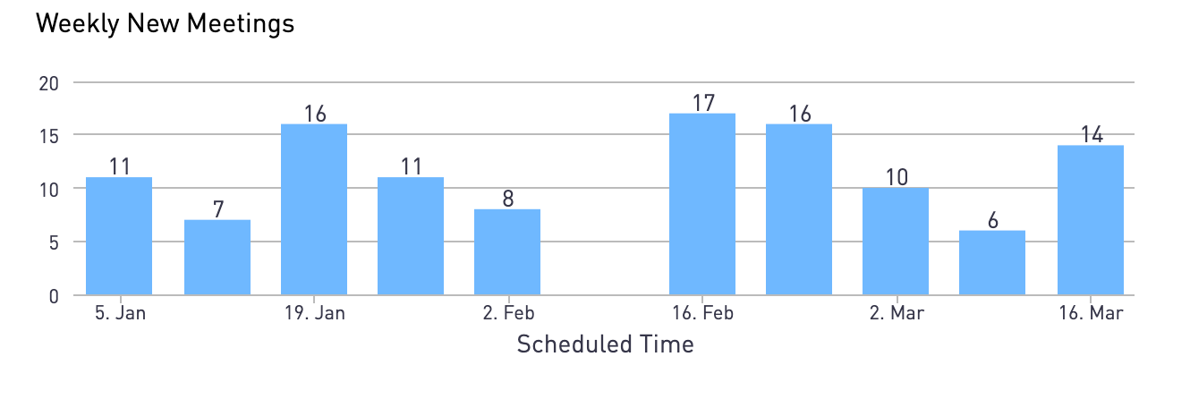
2026 Sales Pipeline & Strategy
Day 2 · 12:30 PM – End · Lief joins
New Leads Week over Week
Qualified Leads
Meetings Week over Week
Confidential · Abra Sales Offsite · March 2026
abra.com

Slide 17
2026 Sales Pipeline & Strategy
Day 2
Sales Activity | Jan | Feb | Mar
Leads | 31 | 113 | 83
# of Meetings | 45 | 51 | 26
# of Meetings | 45 | 51 | 26
# of Registrations | 10 | 4 | 9
# of KYC | 9 | 5 | 8
# of Account Created | 10 | 5 | 6
# of Account Funded | 5 | 3 | 4
Conversion Assumptions
Onboarding/Close | 50% | 75% | 44%
Meetings/Close | 11% | 6% | 15%
Average Deposit Size | $200,000 | $400,000 | $250,000
Confidential · Abra Sales Offsite · March 2026
abra.com

Slide 18
Let's Build
the Pipeline.
New York City · March 2026
Confidential · Abra Sales Offsite · March 2026
abra.com

