Slide 1

Global Impacts on Life Expectancy
By: William Yang

Slide 2
Overview
Over the years 2000 to 2015, life expectancy has positive correlations with things like vaccination rates and GDP and negative correlations with things like the prevalence of HIV/AIDS and thinness in children.
However, there are differences in correlation between life expectancy and certain factors depending on the status/wealth of a country.
This presentation closely examines the correlations between life expectancy and various factors in order to inform future decisions aimed at increasing the life expectancy in countries across the world.
A one-size-fits-all solution doesn’t work as factors may influence each other’s effects on life expectancy
Source: https://www.kaggle.com/anerisavani/life-expectancy-eda/data

Slide 3
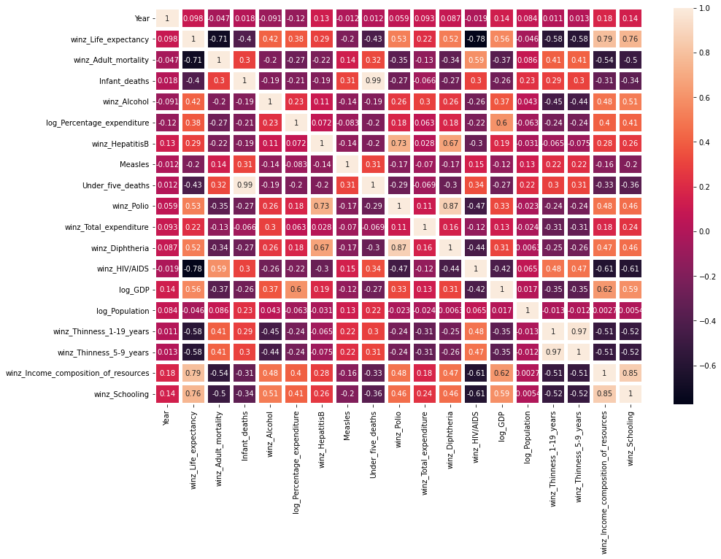
The Factors and How They Relate
Source: https://www.kaggle.com/anerisavani/life-expectancy-eda/notebook
Note: most aspects of the dataset have either been run through a log equation or winsorized to normalize the data and deal with outliers

Slide 4
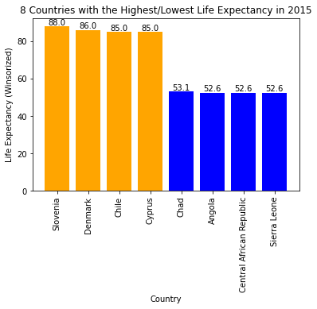
Who Fares the Best/Worst?

Slide 5

Lessons from Slovenia
Average life expectancy of 88 years
Highly developed, with a Human Development Index of 0.894¹
High vaccination rates
Health consists of 7% of government expenditure
Large number of years in schooling
1. Source: https://countryeconomy.com/hdi?year=2015

Slide 6
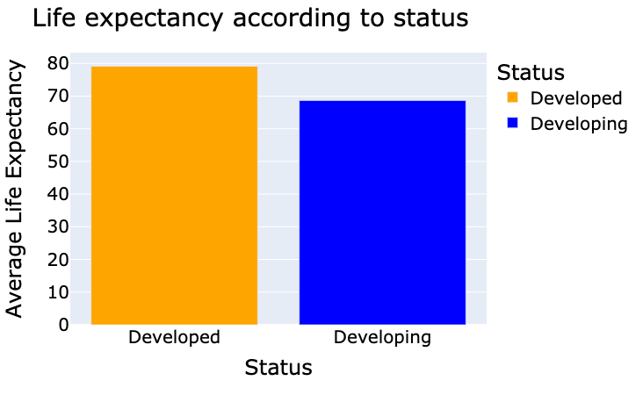
Can Slovenia be Used as a Template?
No
Factors have different effects on developing countries than they do on developed countries
Infeasible to take a unique situation for a developed country and expect it to work for developing ones
Source: https://www.kaggle.com/anerisavani/life-expectancy-eda/notebook

Slide 7
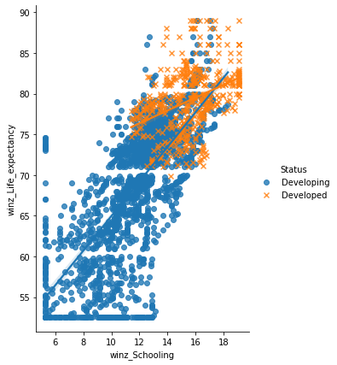
Effect of Status on the Affect of Schooling
Schooling often affects life expectancy more in a developing country than in a developed country
Also applies to factors like GDP, Diptheria, and Polio.
Source: https://www.kaggle.com/anerisavani/life-expectancy-eda/notebook

Slide 8
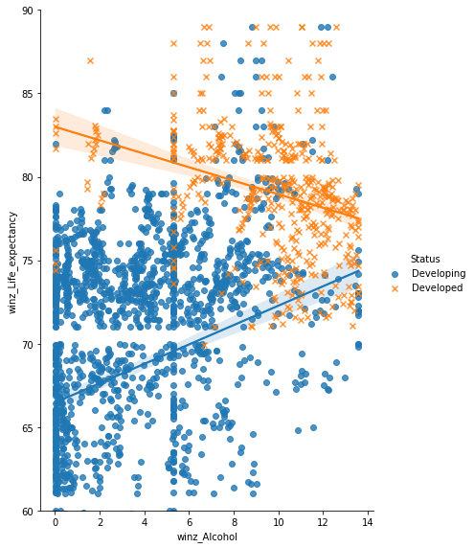
Effect of Status on the Affect of Alcohol
Developing countries have a positive correlation between life expectancy and alcohol
Developed countries have a negative correlation between life expectancy and alcohol
Source: https://www.kaggle.com/anerisavani/life-expectancy-eda/notebook

Slide 9
Aiming to Increase Life Expectancy is Complex
Not only do factors have a direct impact on life expectancy, but they also have effects on each other.
Attempting to copy the situation of a well-performing country as a one-size-fits-all solution is often impossible or will likely involve a huge amount of time, wealth, and effort.
Thoughtful and detailed analysis of the data of each unique situation is needed in order to provide solutions that will work for them.

Slide 10
Thank you
William Yang
Engineering Solutions to Real World Problems
GitHub Repository for Data: https://github.com/billbo-yang/DS503_HW3
Contact: wbyang@wpi.edu

