Slide 1

Network Forensics and Protocols
“From bits to information”

Slide 2

Outline
The Core Protocols.
ARP.
SYN.
FTP.
ICMP.
DNS.
Port Scans.
SYN Floods.
Application Layer.

Slide 3
The Core Protocols
“From bits to information”

Slide 4
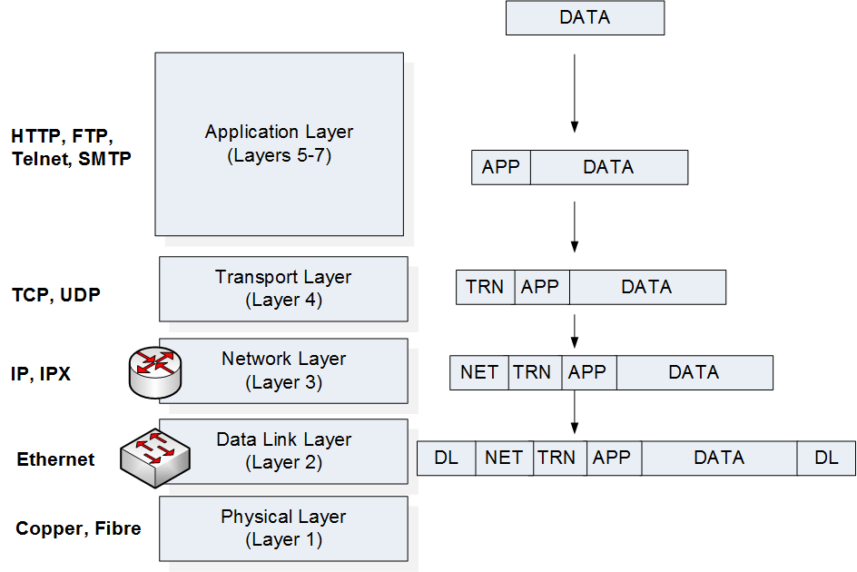
Data Encapsulation

Slide 5
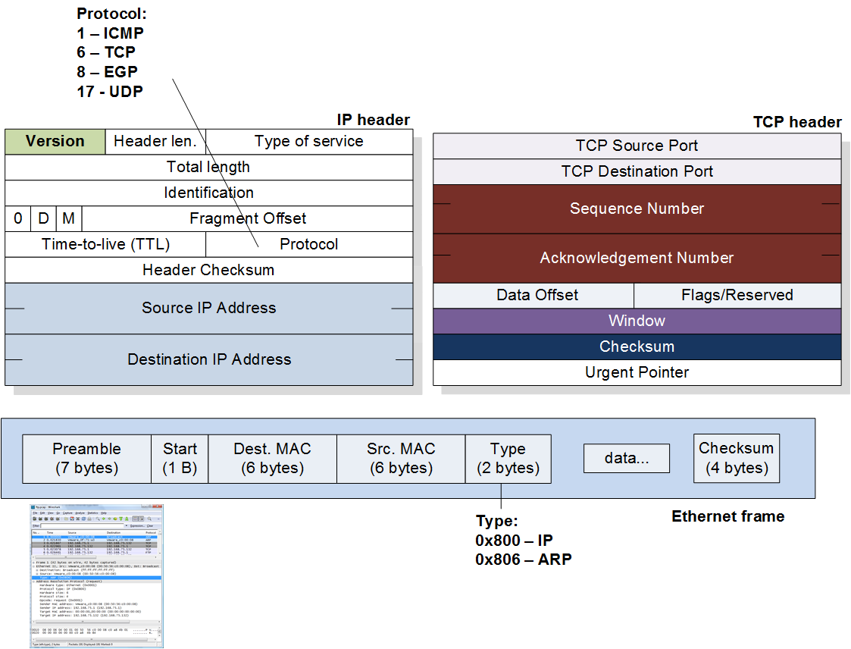
Ethernet, IP and TCP

Slide 6
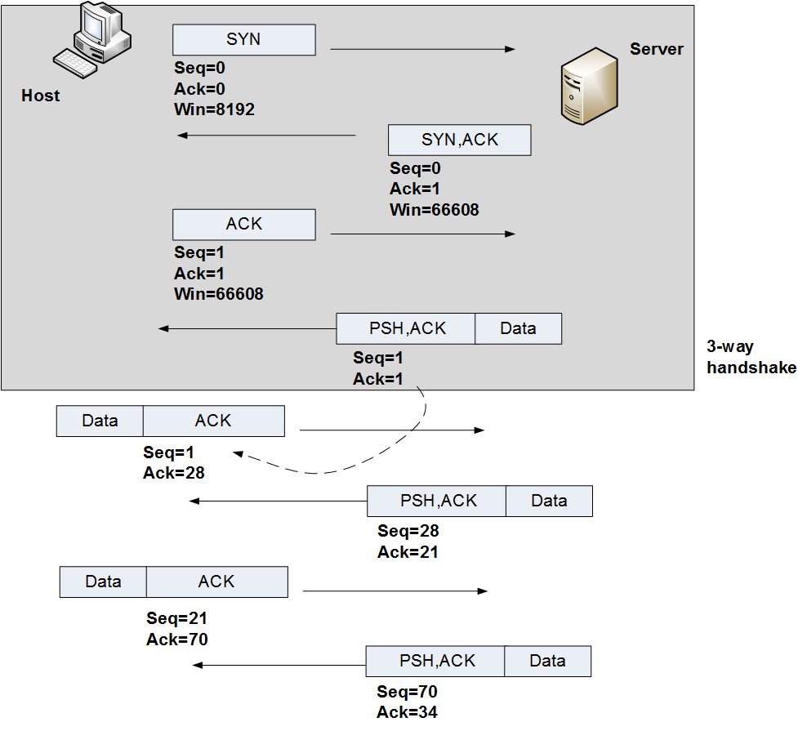
Three-way handshake

Slide 7
ARP
“From bits to information”

Slide 8
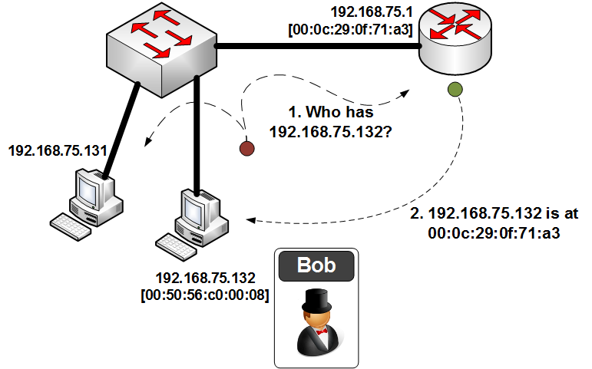
ARP

Slide 9
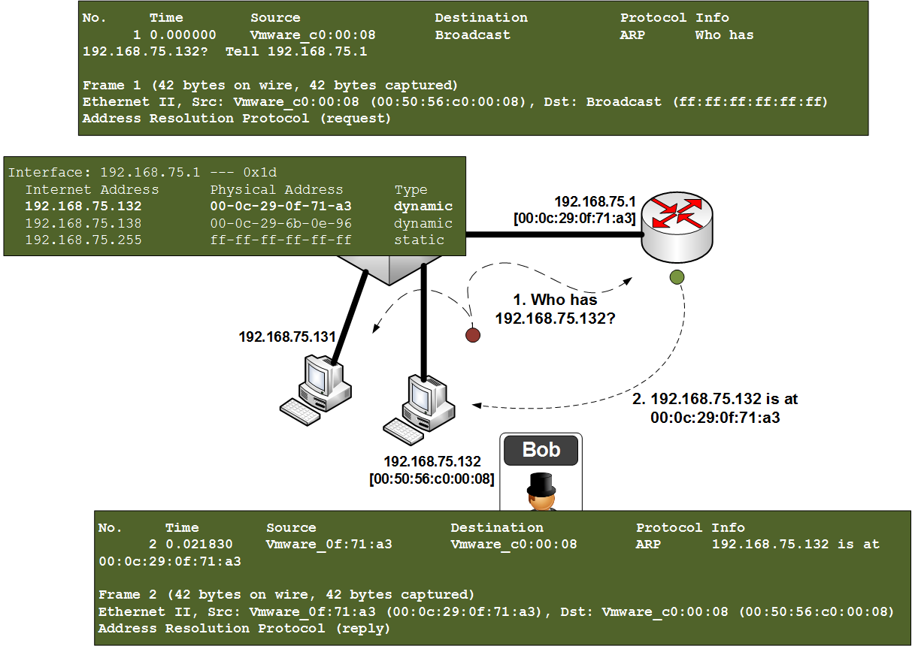
ARP
ARP

Slide 10
SYN
“From bits to information”

Slide 11
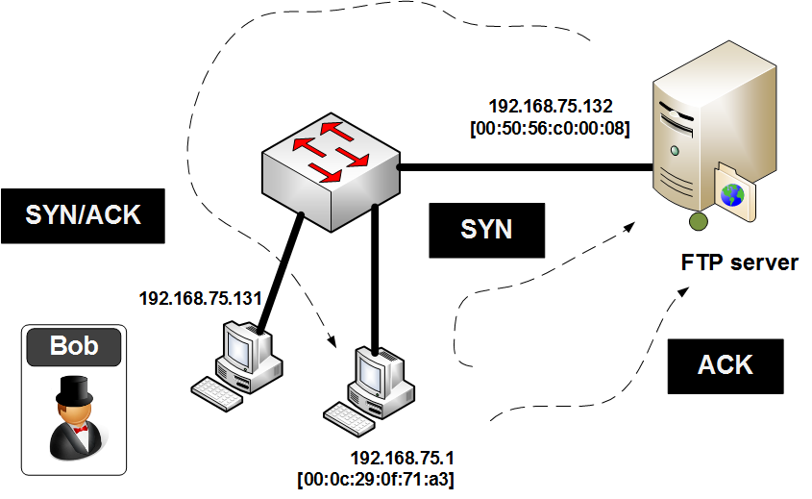
SYN
SYN

Slide 12
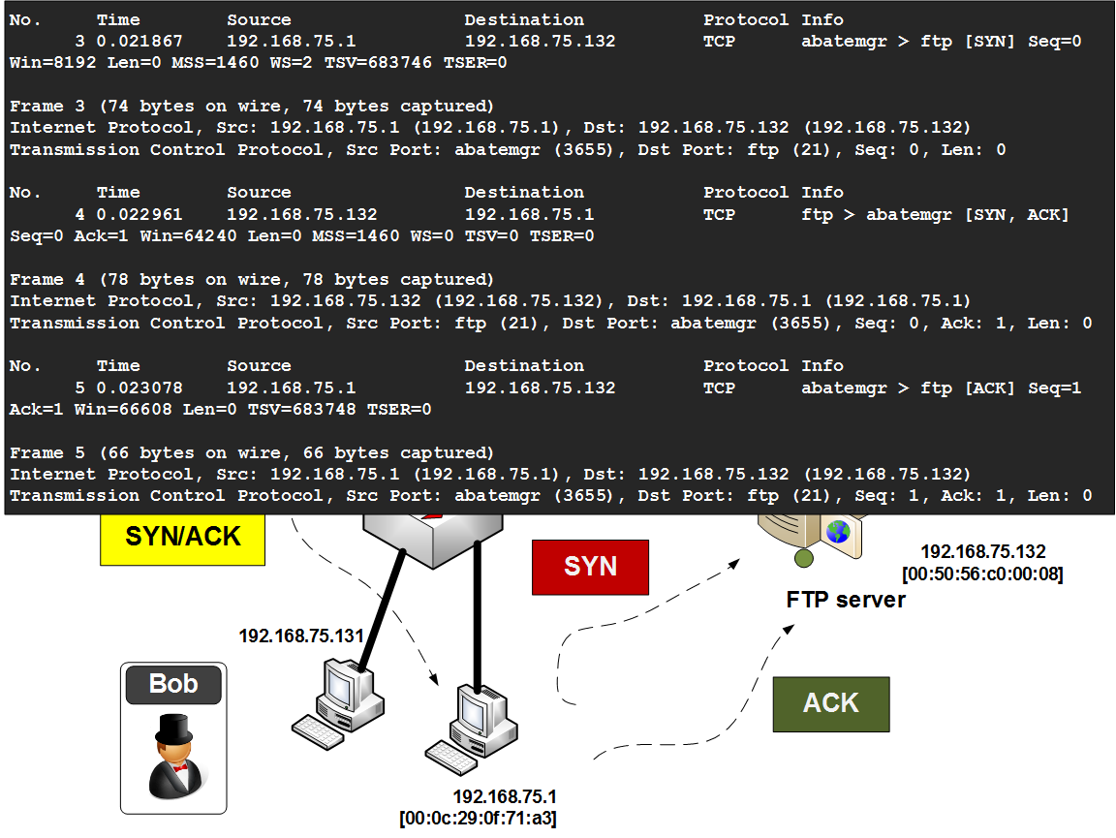
SYN

Slide 13
FTP
“From bits to information”

Slide 14
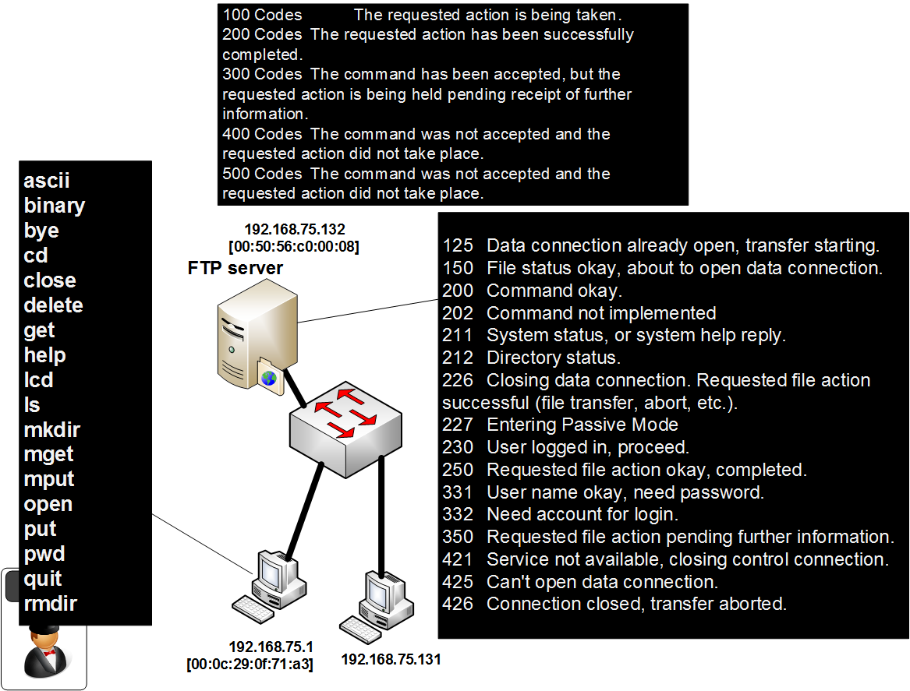
FTP
FTP

Slide 15
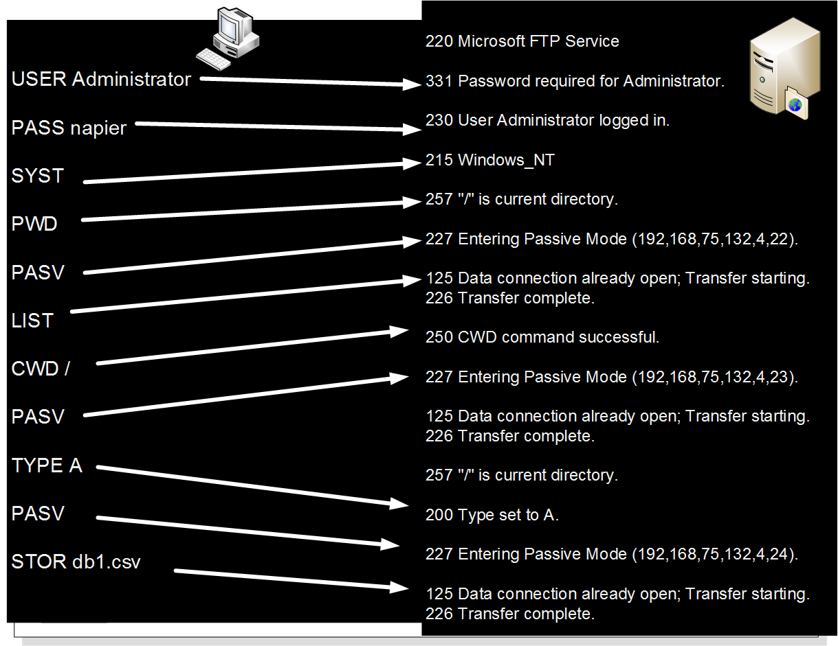
FTP

Slide 16
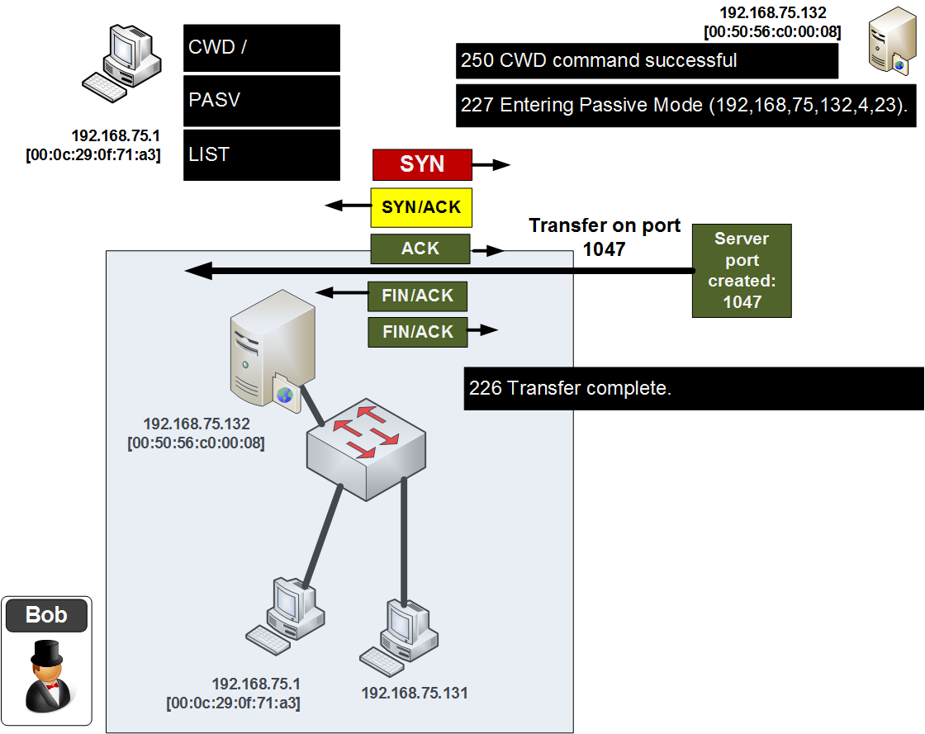
FTP

Slide 17
ICMP
“From bits to information”

Slide 18
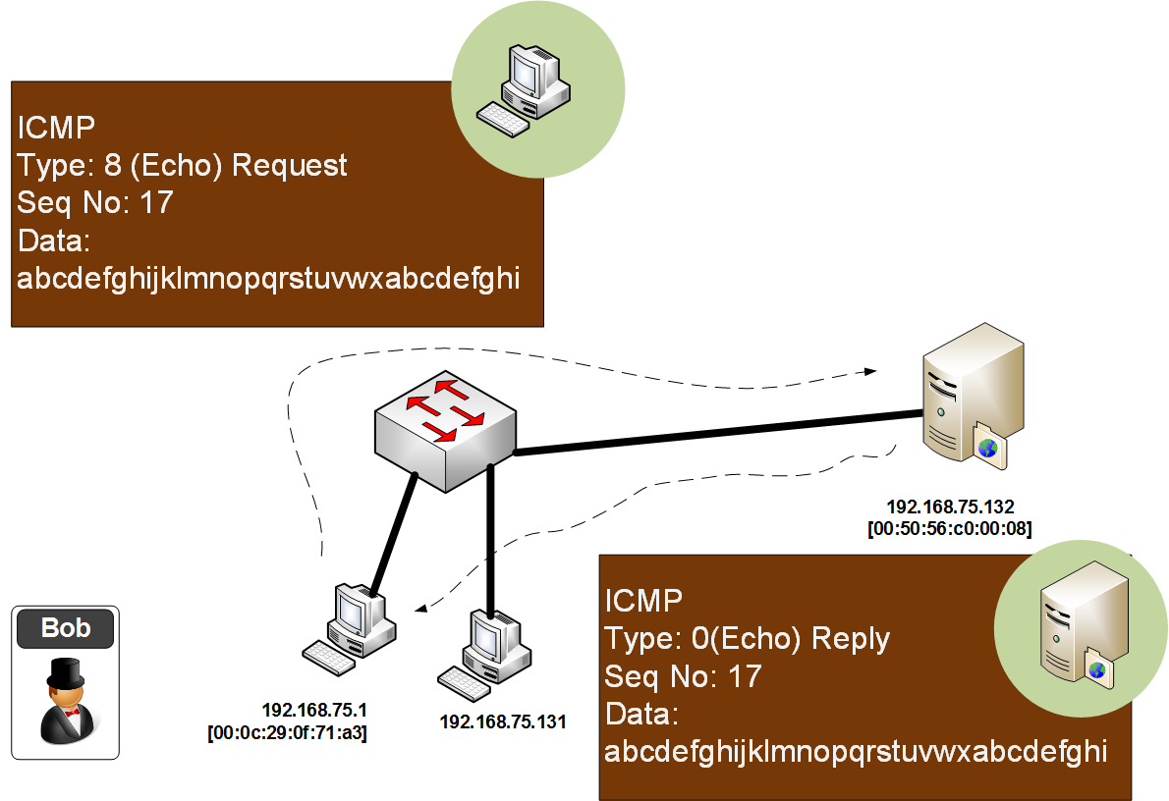
ICMP
ICMP

Slide 19
DNS
“From bits to information”

Slide 20
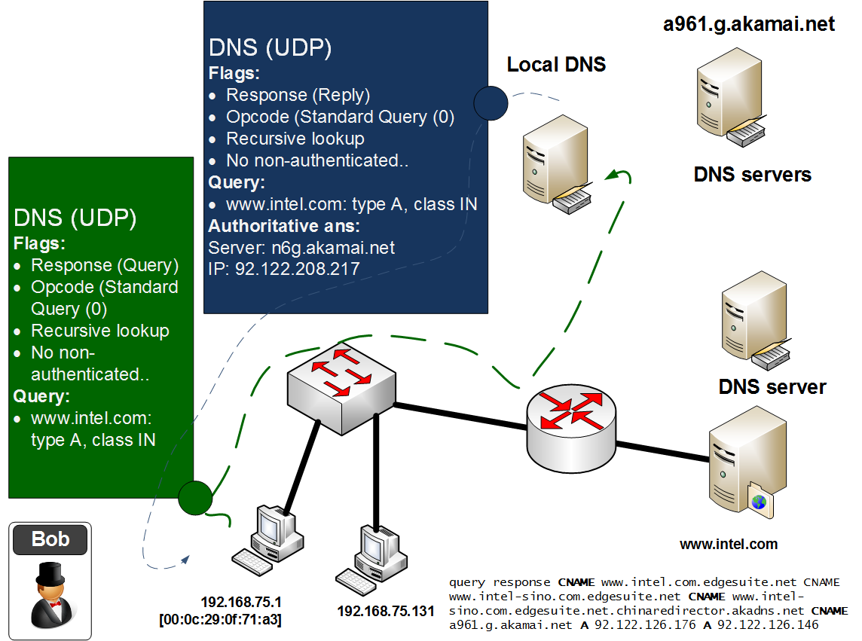
DNS
DNS

Slide 21
Port Scans
“From bits to information”

Slide 22
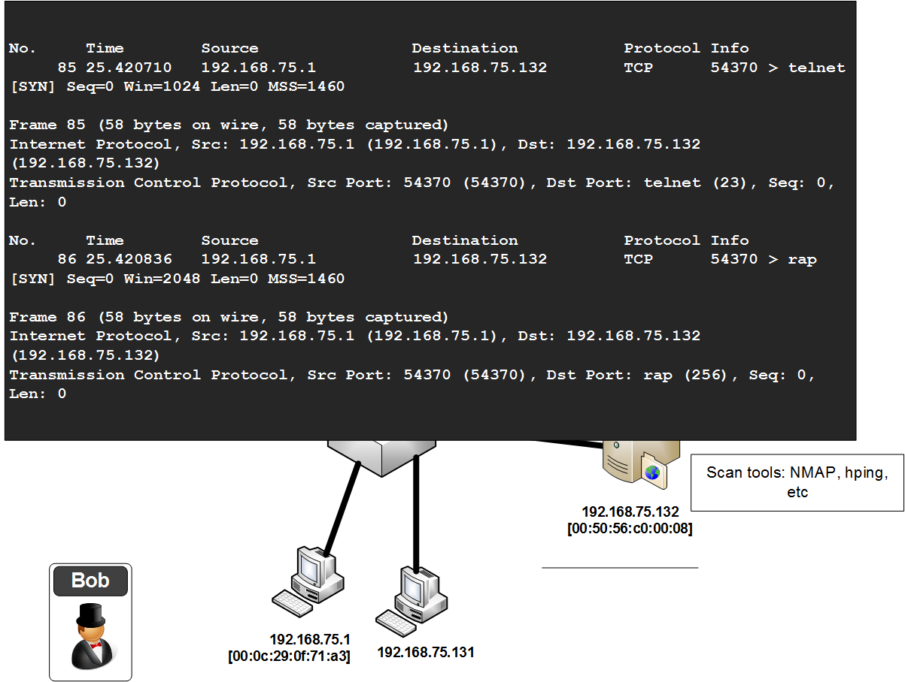
Port Scans
NMAP

Slide 23
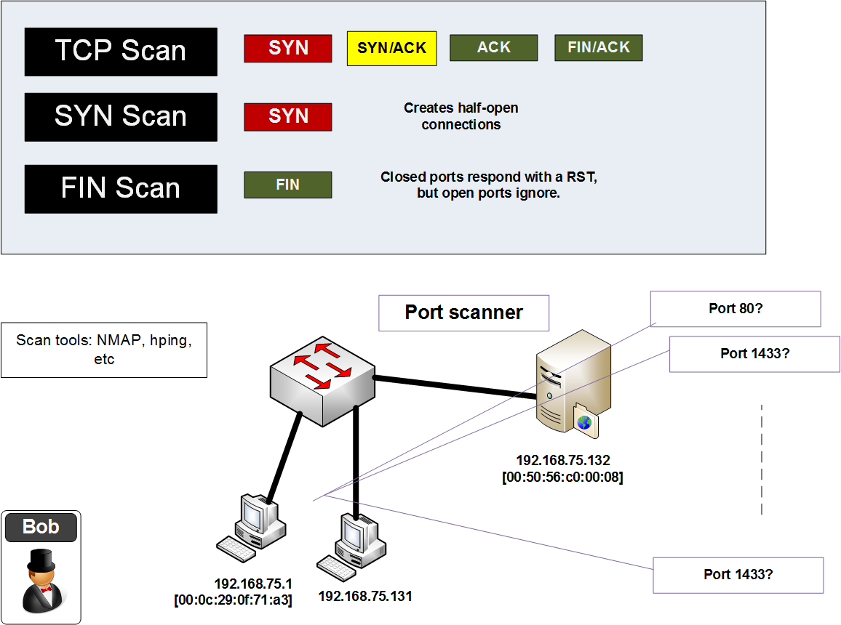
Port Scans

Slide 24
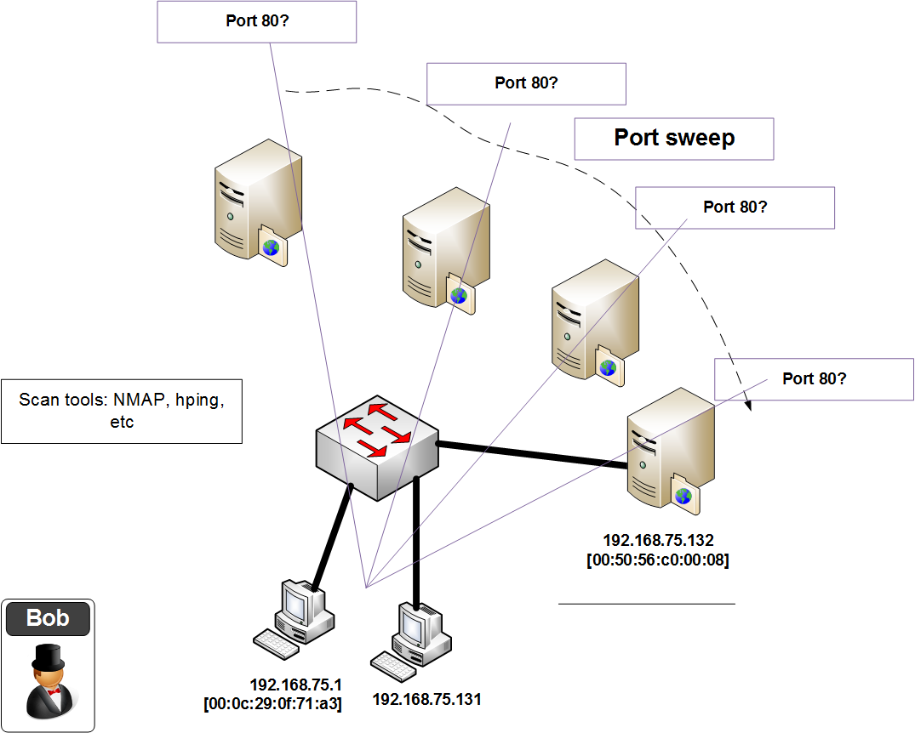
Port Scans

Slide 25
SYN Flood
“From bits to information”

Slide 26
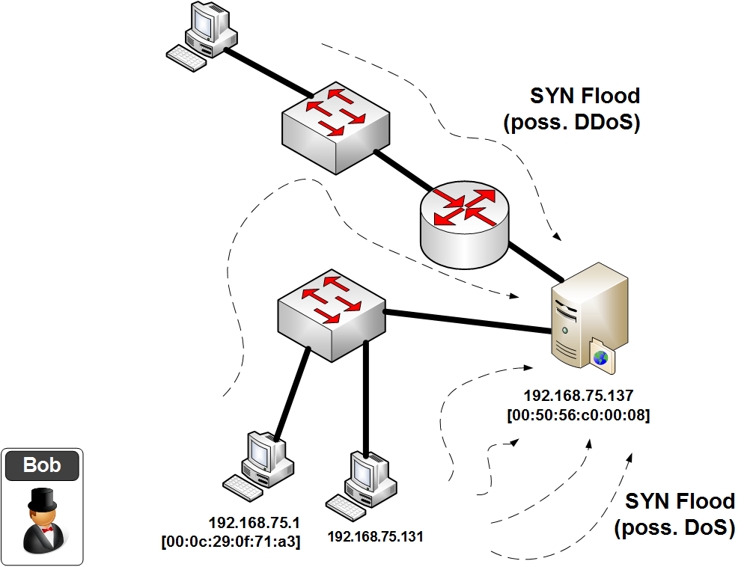
SYN Flood
SYN

Slide 27
Application Layer
“From bits to information”

Slide 28
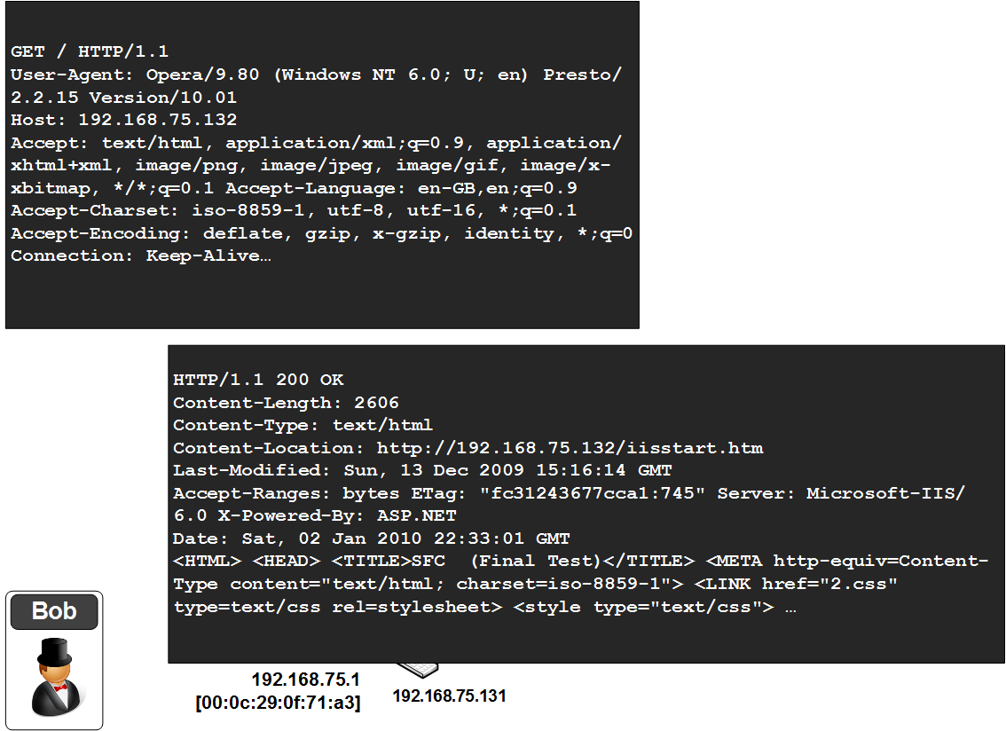
Application Layer (HTTP)
HTTP

Slide 29
Network Forensics and Protocols
“From bits to information”

