Slide 1
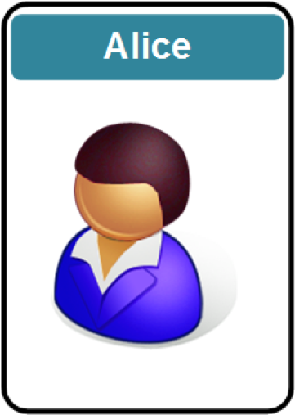
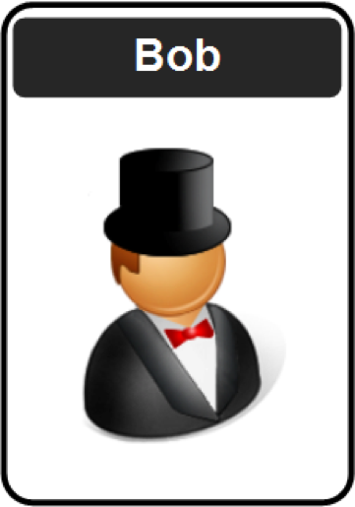
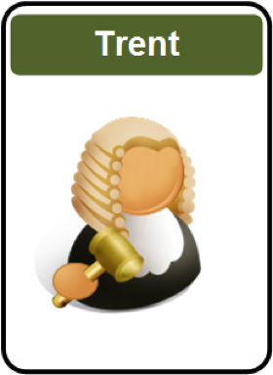
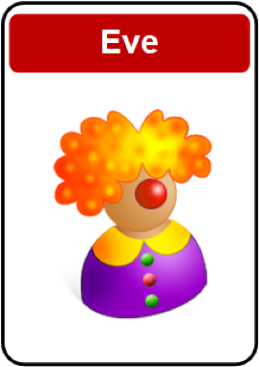
Applied Crypto: Introduction
1. Cryptography Fundamentals. 2. Symmetric Key Encryption. 3. Hashing and MAC.
4. Asymmetric (Public) Key Encryption.
5. Key Exchange.
6. Trust and Digital Certificates.
7. Tunnelling.
8. Cryptocurrencies and Blockchain.
9. Future Cryptography.
10. Host/Cloud Security. Prof Bill Buchanan OBE, FRSE https://asecuritysite.com/encryption https://github.com/billbuchanan/appliedcrypto

Slide 2

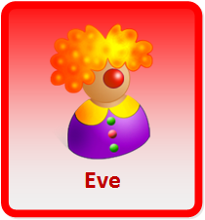
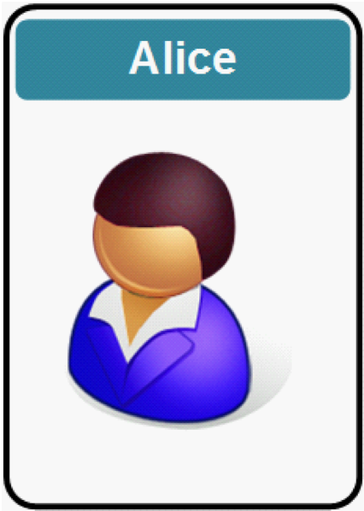
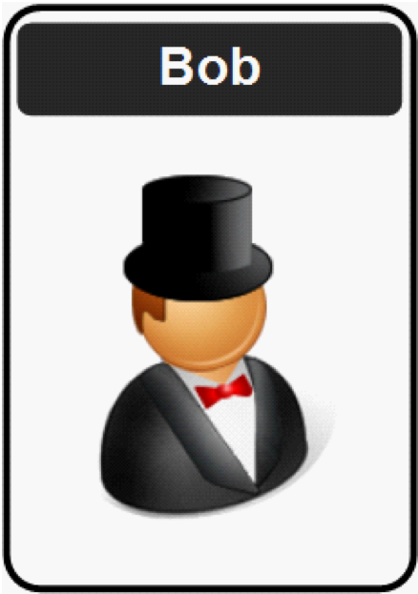
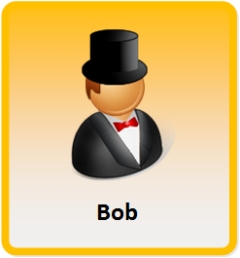
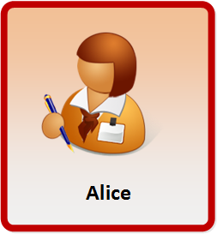
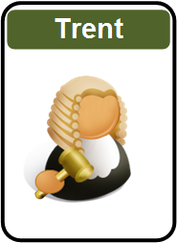

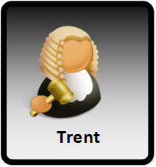
Disclaimer
Encryption works great, until it doesn't.
Encryption works great, as long as no one makes a mistake.
Encryption works great, unless something goes wrong.
Encryption works great, as long as everything works right.

Slide 3
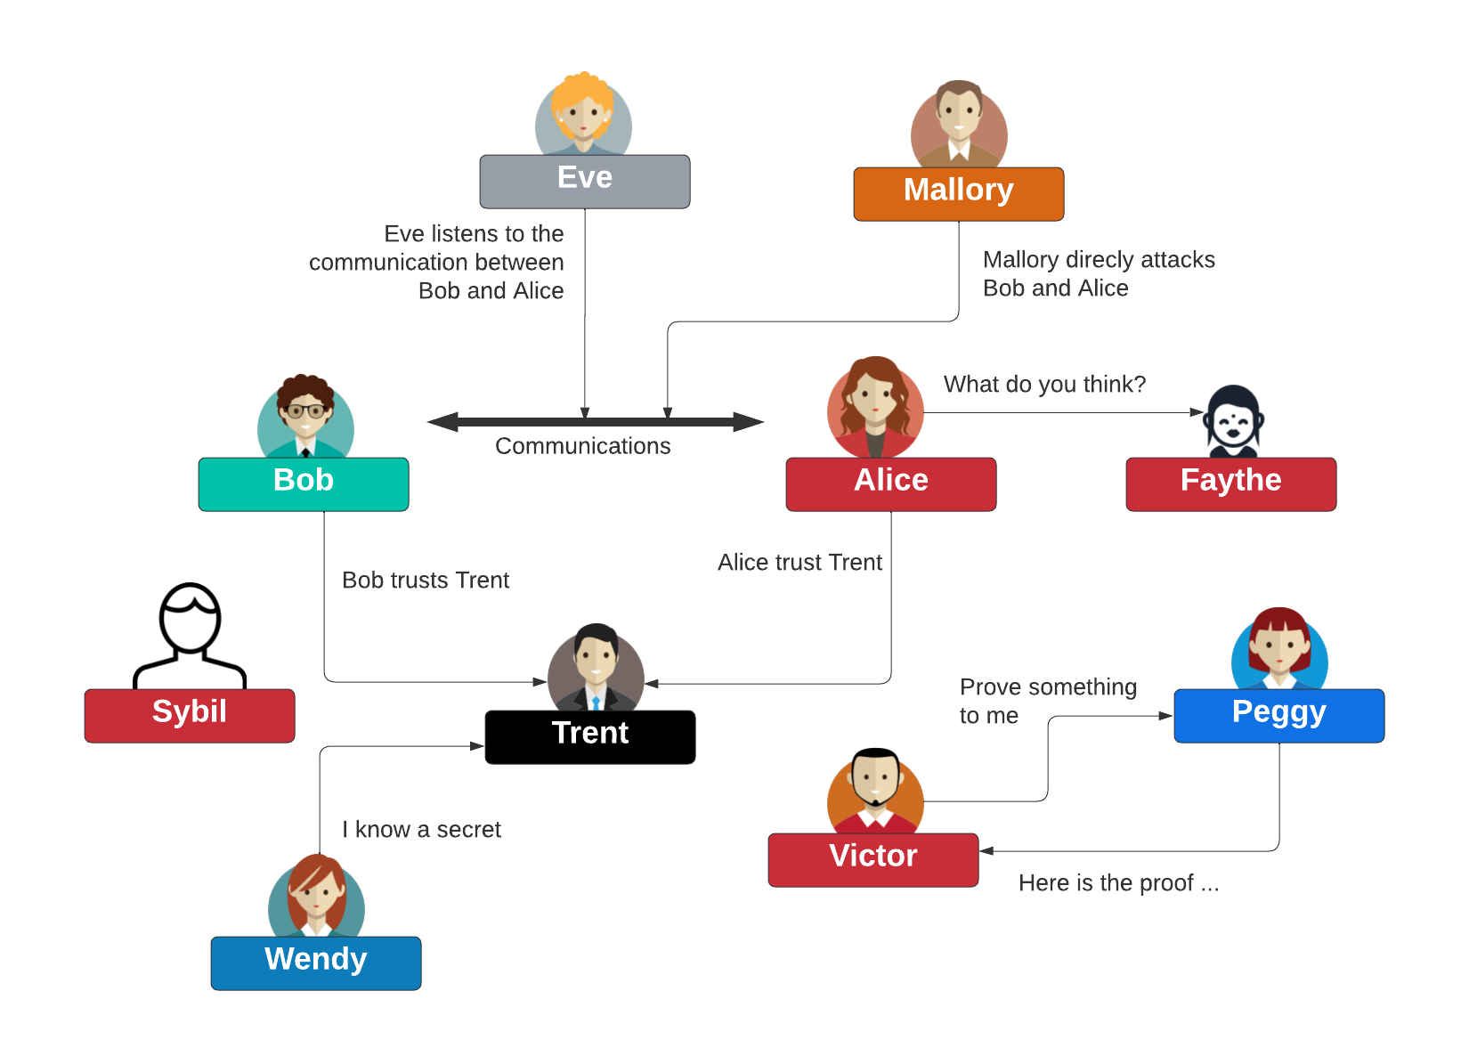
Cyber Actors

Slide 4






Module Delivery
Web site
youtube.com
Teams
Overleaf
@billatnapier
asecuritysite.com
github.com/billbuchanan/appliedcrypto

Slide 5



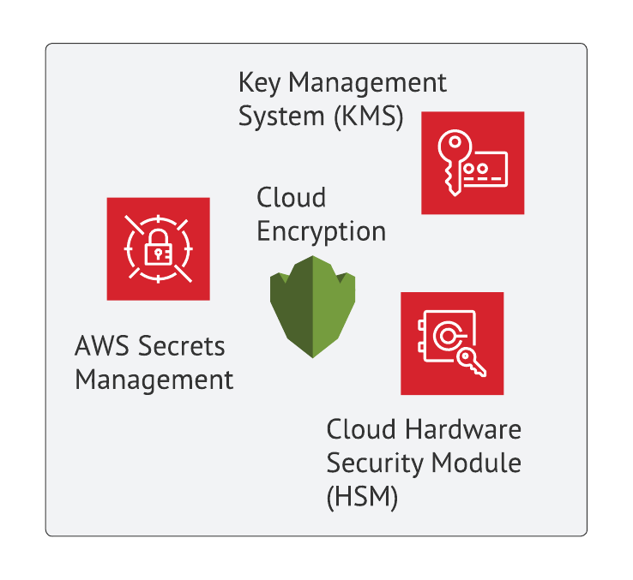


Module Delivery
Web site
youtube.com
Overleaf
Lectures/Lab Demos
Coursework submission
Labs
github.com/billbuchanan/appliedcrypto

Slide 6
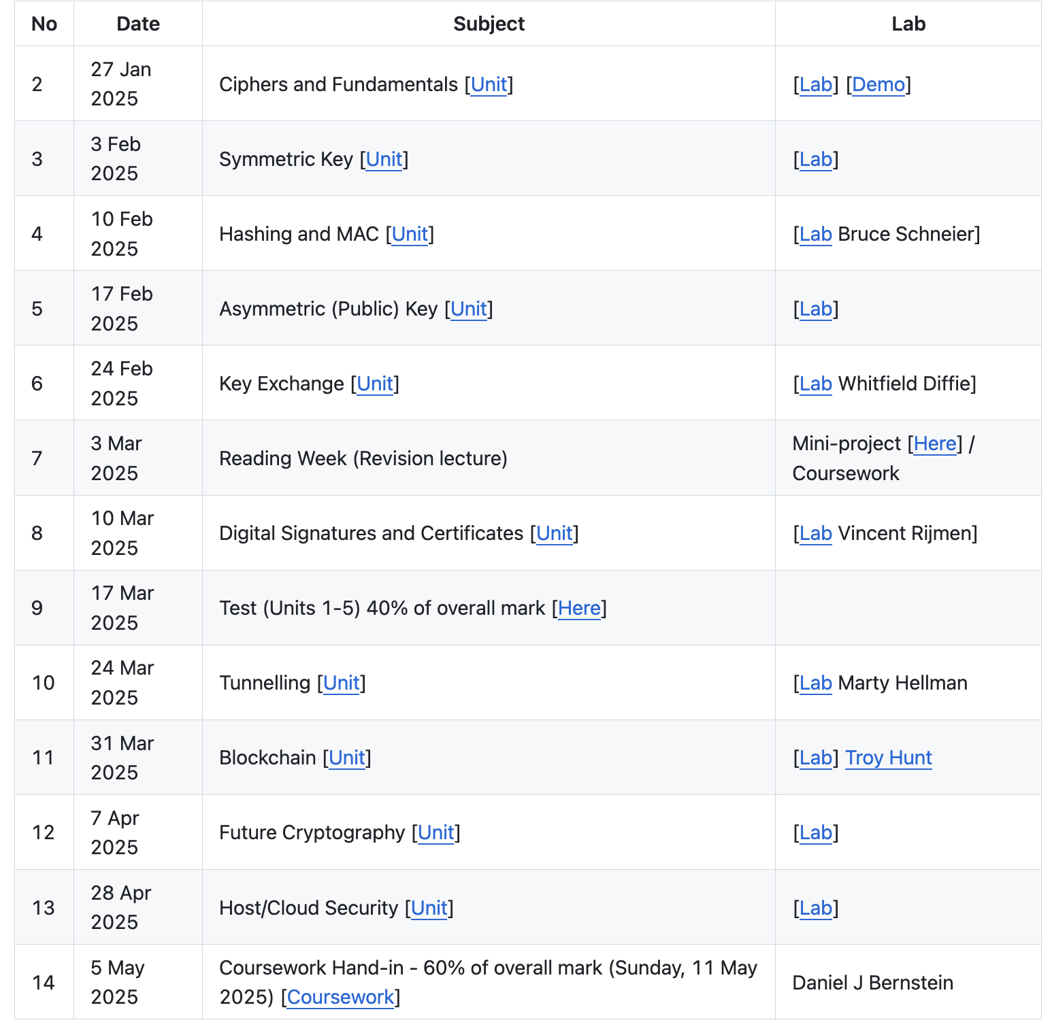
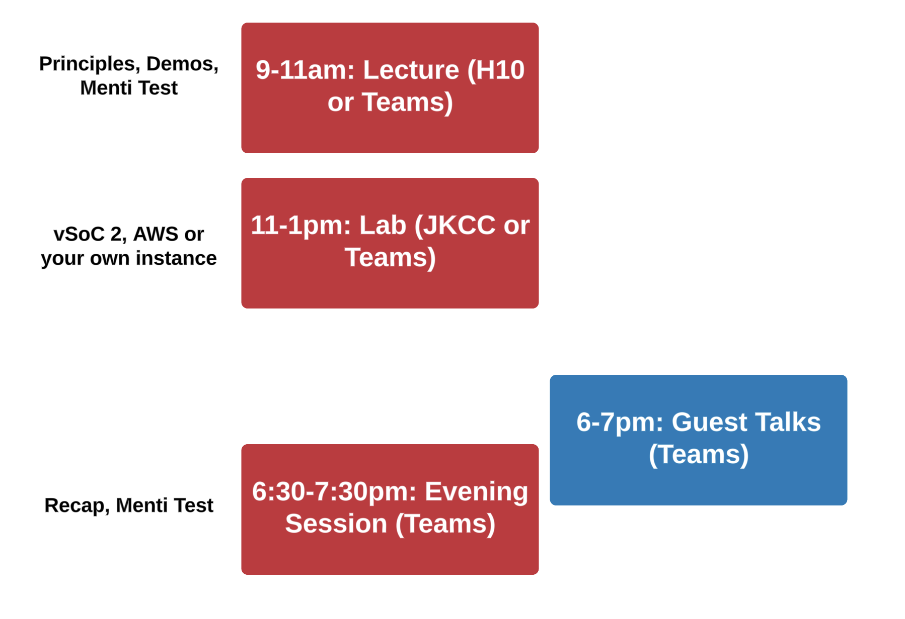
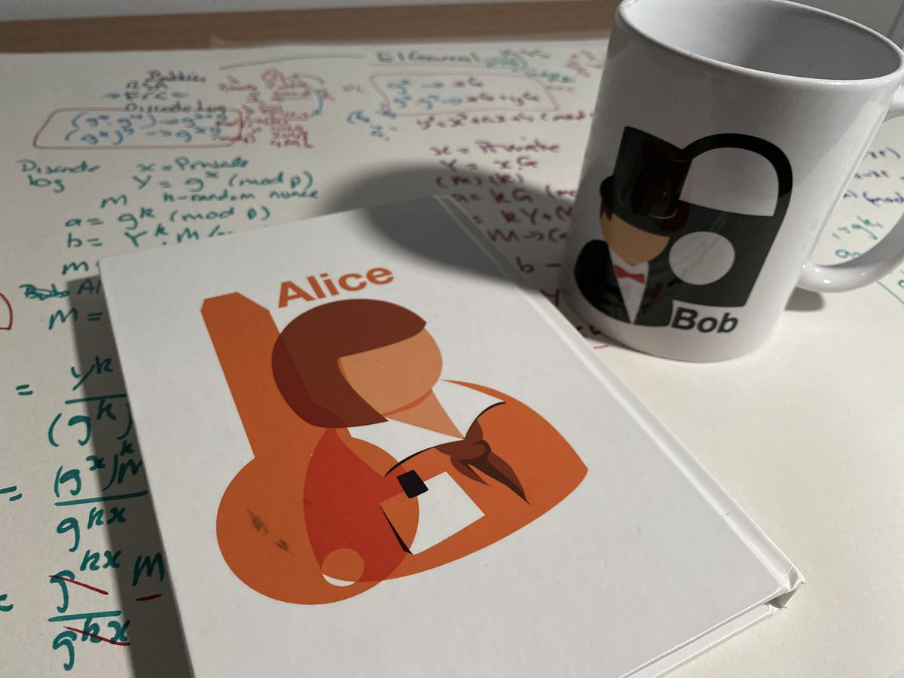
Draft Timetable
Web site

Slide 7
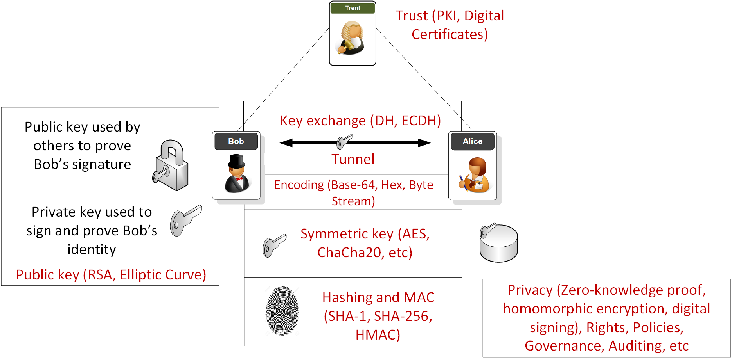
Overview

Slide 8
1. Fundamentals Traditional Ciphers. Key-based Encryption. Encoding Methods. Frequency Analysis. GCD. Random Numbers. Prime Numbers. Big Integers. Encryption Operators (MOD, XOR and Shift). Prof Bill Buchanan OBE, FRSE https://asecuritysite.com/ https://github.com/billbuchanan/appliedcrypto

Slide 9
2. Symmetric Key Basics Block or Stream? Secret Key Methods Salting AES 3DES
ChaCha20/Poly1305 Key Entropy Prof Bill Buchanan OBE https://asecuritysite.com/ https://github.com/billbuchanan/appliedcrypto

Slide 10
3. Hashing and MAC Hashing Methods. Cracking. Typical Methods: MD5, SHA-1, SHA-3, LM, Bcrypt, PBKDF2 Hashed Passwords. Timed One Time Passwords. Message Authentication Codes (MACs). Prof Bill Buchanan OBE https://asecuritysite.com/ https://github.com/billbuchanan/appliedcrypto

Slide 11
4. Asymmetric Key Principles. RSA. Elliptic Curve. Using Private Key to Authenticate. PGP: Signed Email. Prof Bill Buchanan OBE https://asecuritysite.com/ https://github.com/billbuchanan/appliedcrypto

Slide 12
5. Key Exchange Principles. Diffie-Hellman (DH). Passing the secret key with key exchange.
Elliptic Curve Diffie-Hellman (ECDH) Prof Bill Buchanan OBE https://asecuritysite.com/ https://github.com/billbuchanan/appliedcrypto

Slide 13
6. Signatures and Digital Certificates Principles.
Trust Infrastructures. PKI Infrastructure. Creating Signed Certificates.
Signatures (DSA, ECDSA, Hashed-based). Prof Bill Buchanan OBE https://asecuritysite.com/ https://github.com/billbuchanan/appliedcrypto

Slide 14
7. Tunnelling SSL/TLS.
Key generation/key exchange.
SSH.
IPSec.
Prof Bill Buchanan OBE https://asecuritysite.com/ https://github.com/billbuchanan/appliedcrypto

Slide 15
8. Blockchain & Cryptocurrencies Principles. Bitcoin. Ethereum. Smart Contracts. Prof Bill Buchanan OBE https://asecuritysite.com/ https://github.com/billbuchanan/appliedcrypto

Slide 16
9. Future Crypto Zero knowledge proof.
Homomorphic encryption.
Light-weight cryptography.
Quantum-robust cryptography. Secure Enclaves/Host Trust. Prof Bill Buchanan OBE https://asecuritysite.com/ https://github.com/billbuchanan/appliedcrypto

Slide 17
10. Host/Cloud Trust Infrastructures. Secure Enclaves. Hardware/Software Tokens. FIDO2. Biometric cryptography. Prof Bill Buchanan OBE https://asecuritysite.com/ https://github.com/billbuchanan/appliedcrypto

Slide 18
Applied Cryptography
1. Cryptography Fundamentals. 2. Symmetric Key Encryption. 3. Hashing and MAC.
4. Asymmetric (Public) Key Encryption.
5. Key Exchange.
6. Signatures and Digital Certificates.
7. Tunnelling.
8. Cryptocurrencies and Blockchain.
9. Future Cryptography. 10. Host/Cloud Security. Prof Bill Buchanan OBE https://asecuritysite.com/ https://github.com/billbuchanan/appliedcrypto

