Slide 1
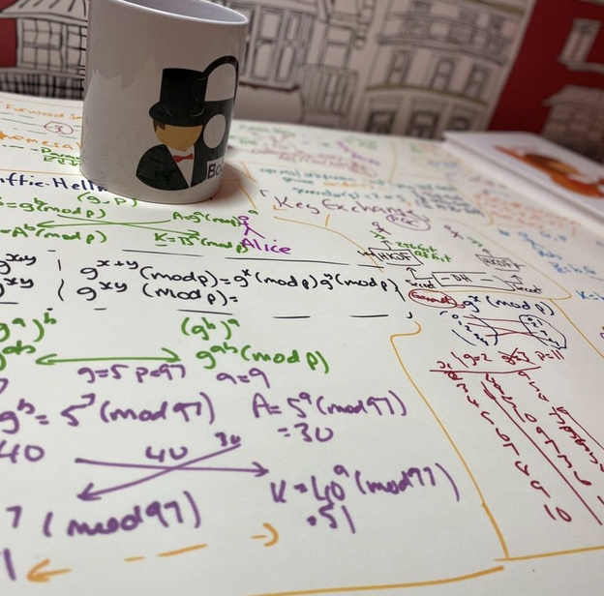
Key Exchange
Diffie-Hellman
Diffie-Hellman Weaknesses
Passing Key Using Public Key
Prof Bill Buchanan OBE http://asecuritysite.com/crypto05 http://asecuritysite.com/encryption

Slide 2
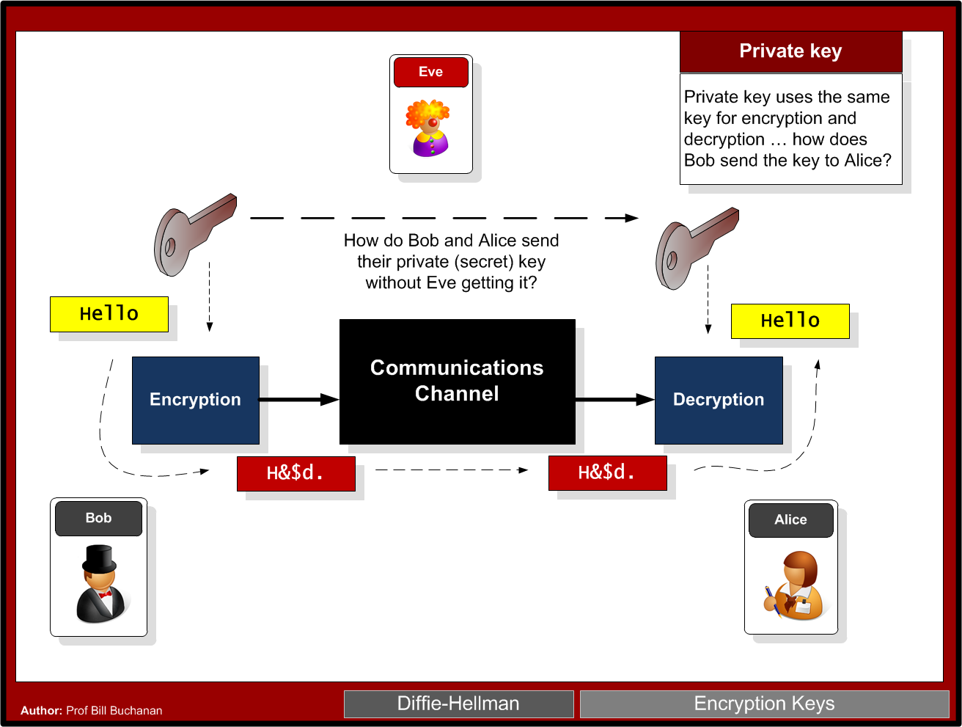

Slide 3
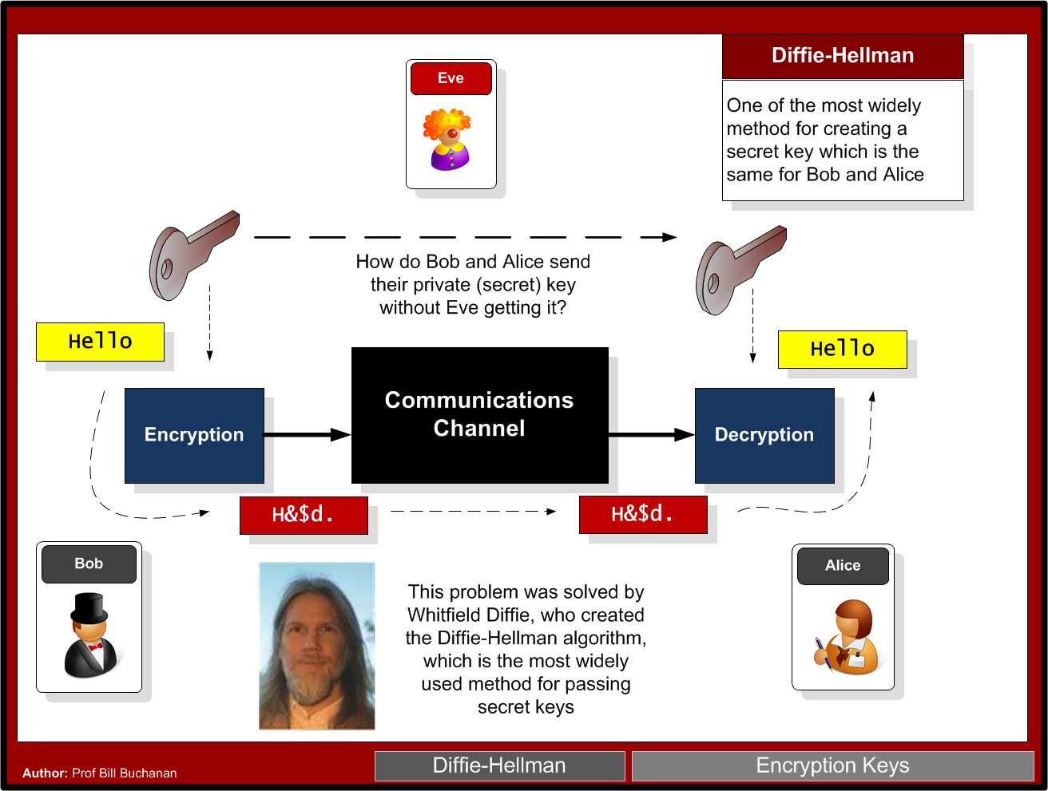

Slide 4
Key Exchange
Forward secrecy (FS), which means that a comprise of the long-term keys will not compromise any previous session keys. A leakage of the public key of the server would cause all the sessions which used this specific public key to be compromised. FS thus aims to overcome this by making sure that all the sessions keys could not be compromised, even though the long-term key was compromised.
Ephemeral. With some key exchange methods, the same key will be generated if the same parameters are used on either side. This can cause problems as an intruder could guess the key, or even where the key was static and never changed. With ephemeral methods, a different key is used for each connection, and, again, the leakage of any long-term would not cause all the associated session keys to be breached.

Slide 5
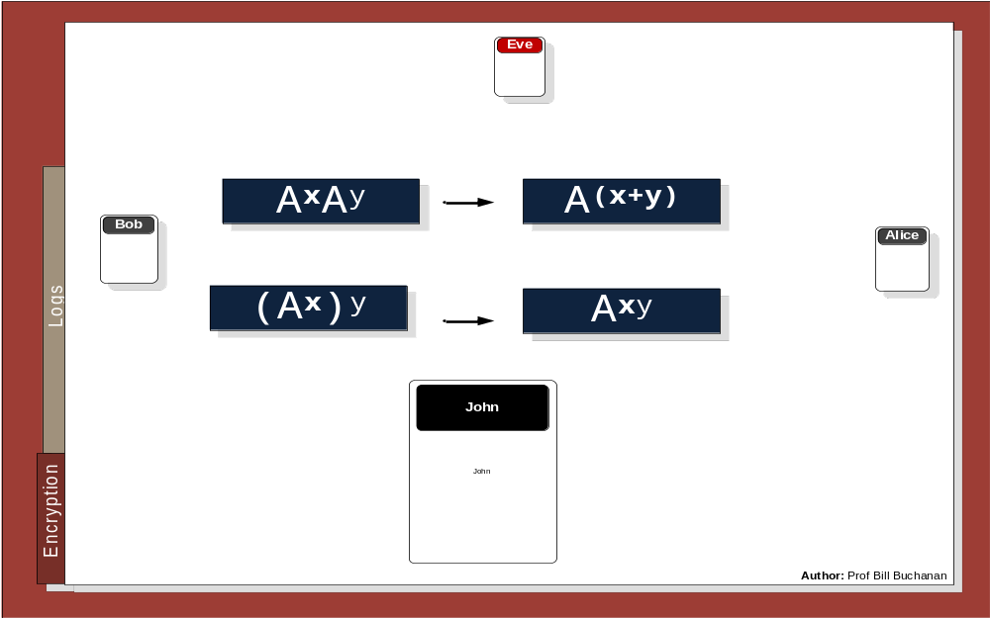


Slide 6
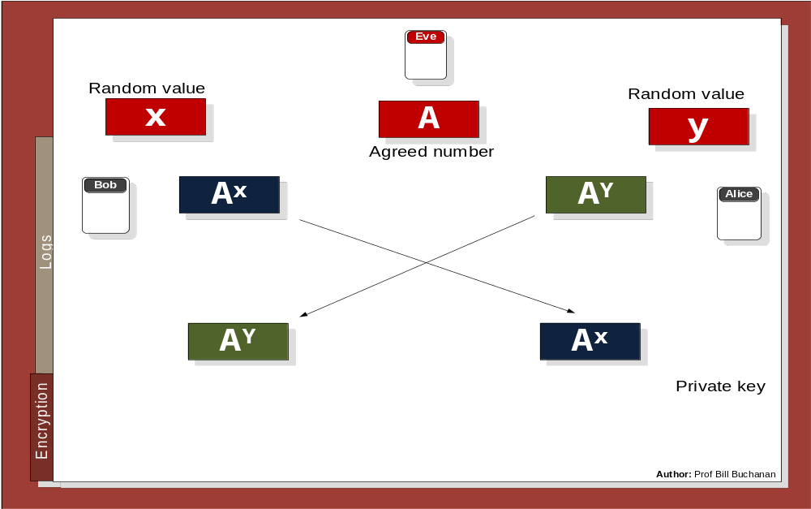

Slide 7
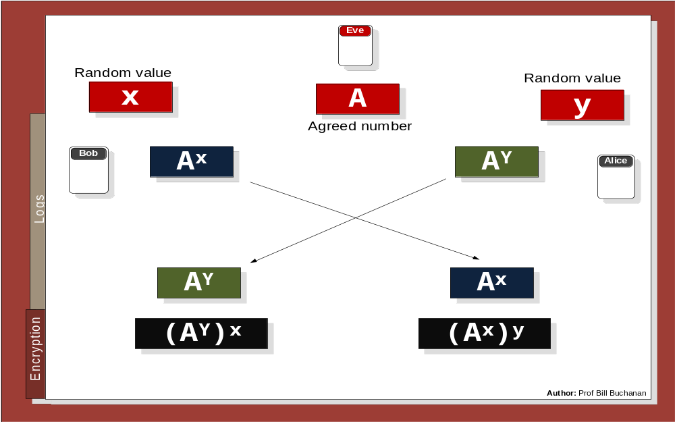

Slide 8
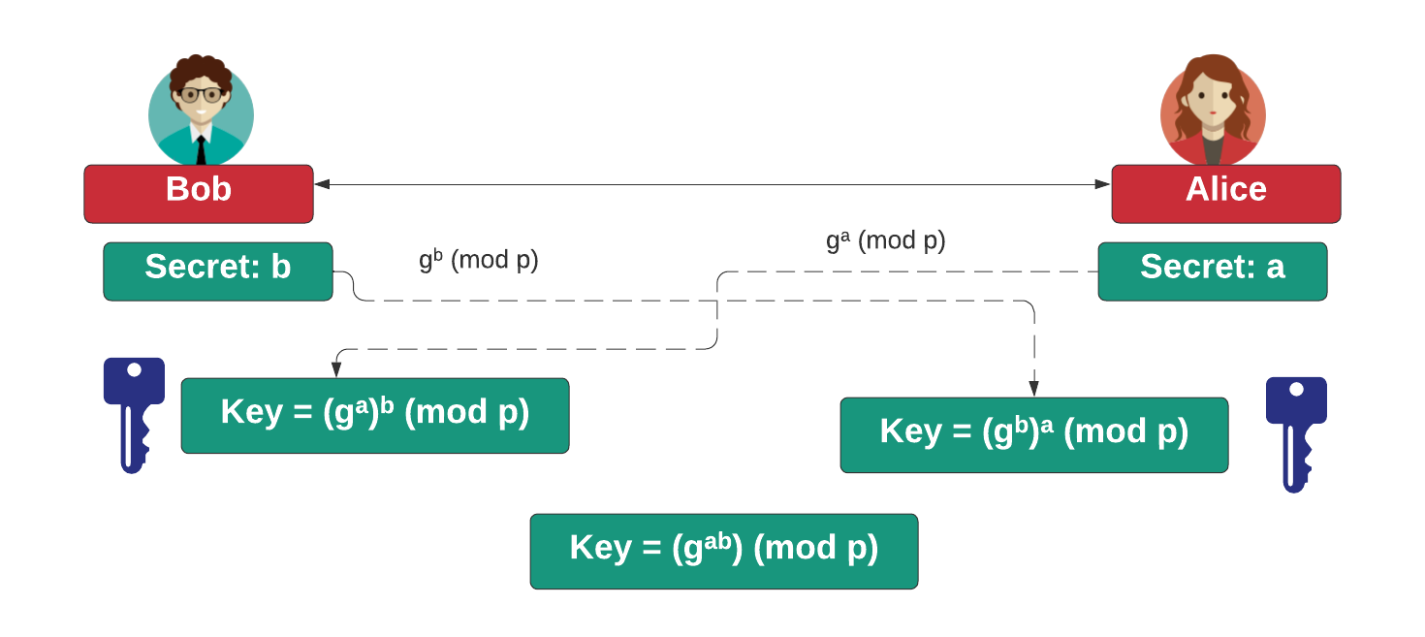

Slide 9
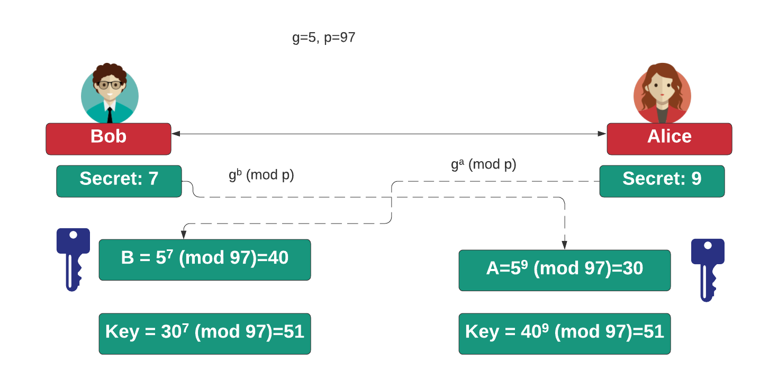

Slide 10
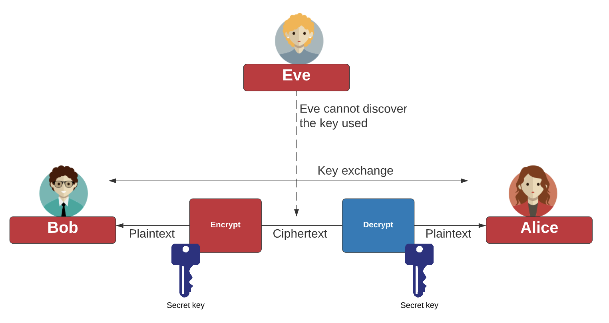

Slide 11
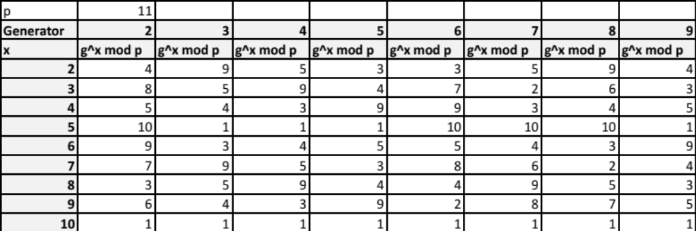
Diffie-Hellman Generator
Y = g^{x} mod p
Picking G

Slide 12
Diffie-Hellman Generation
C:\> openssl dhparam -out dhparams.pem 768 –text
C:\> type dhparams.pem
Diffie-Hellman-Parameters: (768 bit)
prime:
00:d0:37:c2:95:64:02:ea:12:2b:51:50:a2:84:6c:
71:6a:3e:2c:a9:80:e2:65:b2:a5:ee:77:26:22:31:
66:9e:fc:c8:09:94:e8:9d:f4:cd:bf:d2:37:b2:fb:
b8:38:2c:87:28:38:dc:95:24:73:06:d3:d9:1f:af:
78:01:10:6a:7e:56:4e:7b:ee:b4:8d:6b:4d:b5:9b:
93:c6:f1:74:60:01:0d:96:7e:85:ca:b8:1f:f7:bc:
43:b7:40:4d:4e:87:e3
generator: 2 (0x2)
-----BEGIN DH PARAMETERS-----
MGYCYQDQN8KVZALqEitRUKKEbHFqPiypgOJlsqXudyYiMWae/MgJlOid9M2/0jey
+7g4LIcoONyVJHMG09kfr3gBEGp+Vk577rSNa021m5PG8XRgAQ2WfoXKuB/3vEO3
QE1Oh+MCAQI=
-----END DH PARAMETERS-----
DH Group 5: 1,536 bit prime.
DH Group 2: 1,024 bit prime.
DH Group 1: 768-bit prime.

Slide 13
Key Exchange
Diffie-Hellman
Diffie-Hellman Weaknesses
Passing Key Using Public Key
Prof Bill Buchanan OBE http://asecuritysite.com/crypto05 http://asecuritysite.com/encryption

Slide 14
Diffie-Hellman Weaknesses
In 2015, a paper entitled Imperfect Forward Secrecy: How Diffie-Hellman Fails in Practice – showed that it was fairly easy to precompute on values for two popular Diffie-Hellman parameters (and which use the DHE_EXPORT cipher set).
The research team found that one was used as a default in the around 7% of the Top 1 million web sites and was hard coded into the Apache httpd service. Overall, at the time, it was found that over 3% of Web sites were still using the default.
Diffie-Hellman-Parameters: (512 bit)
prime:
00:9f:db:8b:8a:00:45:44:f0:04:5f:17:37:d0:ba:
2e:0b:27:4c:df:1a:9f:58:82:18:fb:43:53:16:a1:
6e:37:41:71:fd:19:d8:d8:f3:7c:39:bf:86:3f:d6:
0e:3e:30:06:80:a3:03:0c:6e:4c:37:57:d0:8f:70:
e6:aa:87:10:33
generator: 2 (0x2)

Slide 15
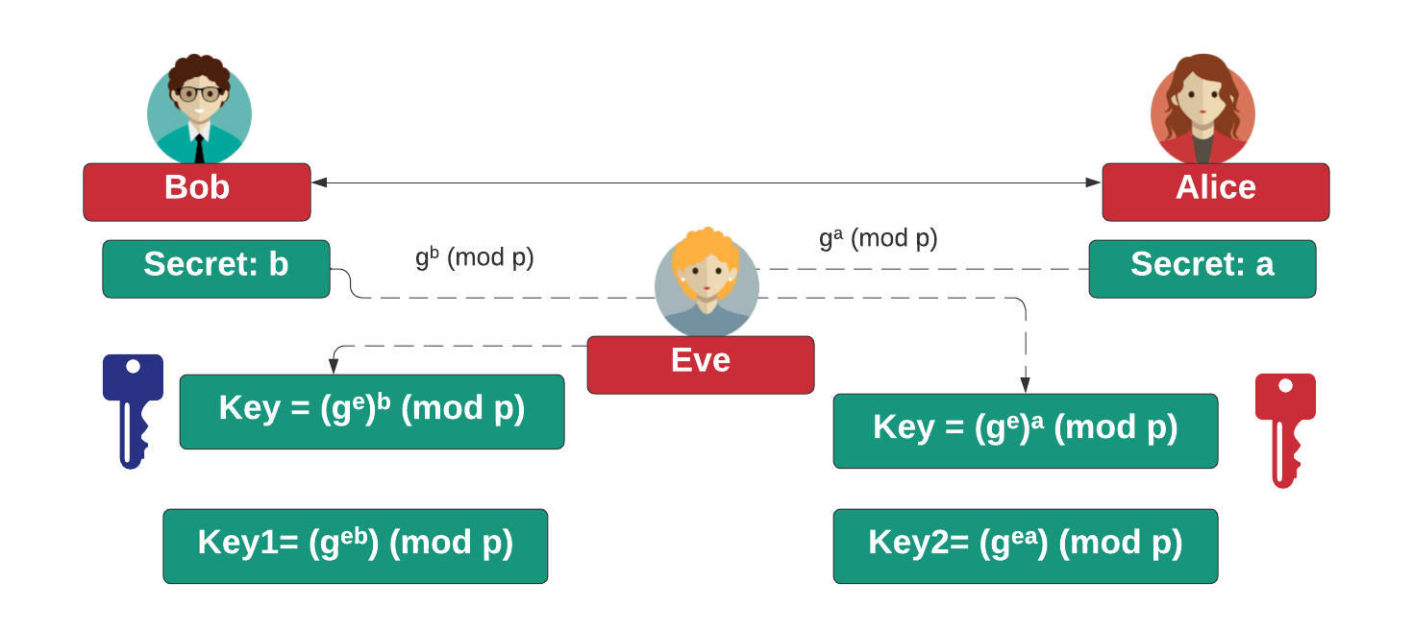
Eve-in-the-middle

Slide 16
Key Exchange
Diffie-Hellman
Diffie-Hellman Weaknesses
Passing Key Using Public Key
Prof Bill Buchanan OBE http://asecuritysite.com/crypto05 http://asecuritysite.com/encryption

Slide 17
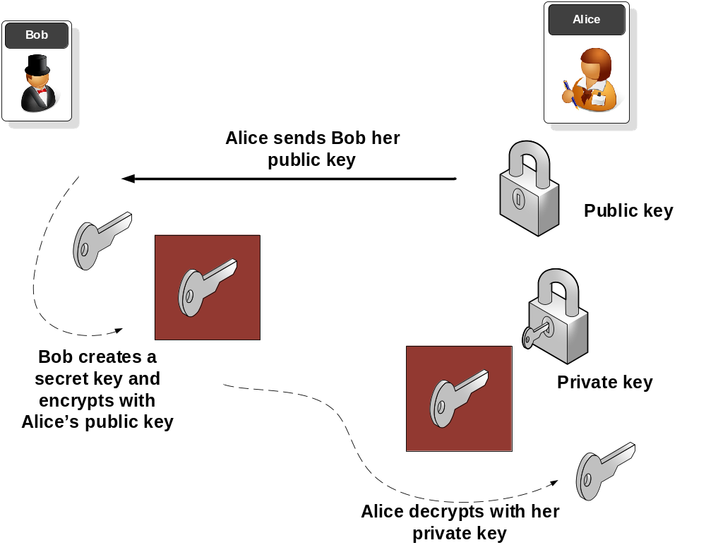
Key Exchange with Public Key

Slide 18
Key Exchange
Diffie-Hellman
Diffie-Hellman Weaknesses
Passing Key Using Public Key
Prof Bill Buchanan OBE http://asecuritysite.com/crypto05 http://asecuritysite.com/encryption

