Slide 1
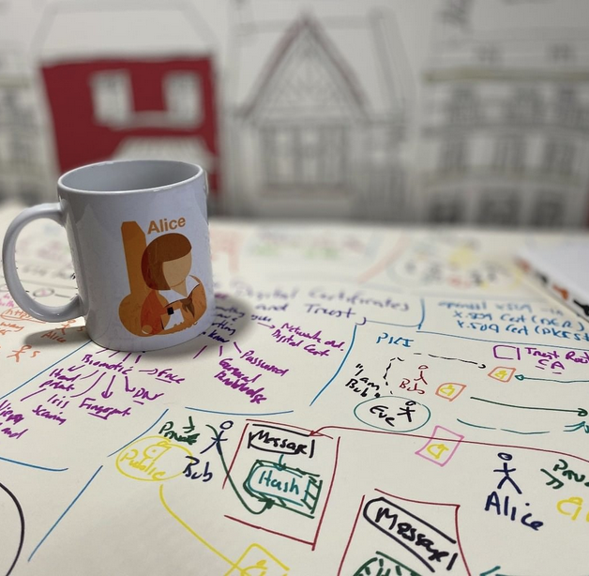
Asymmetric Key
Basics
RSA/ECC
Applications (Encryption and Signing)
Prof Bill Buchanan OBE https://asecuritysite.com/rsa https://asecuritysite.com/ecc https://asecuritysite.com/elgamal

Slide 3
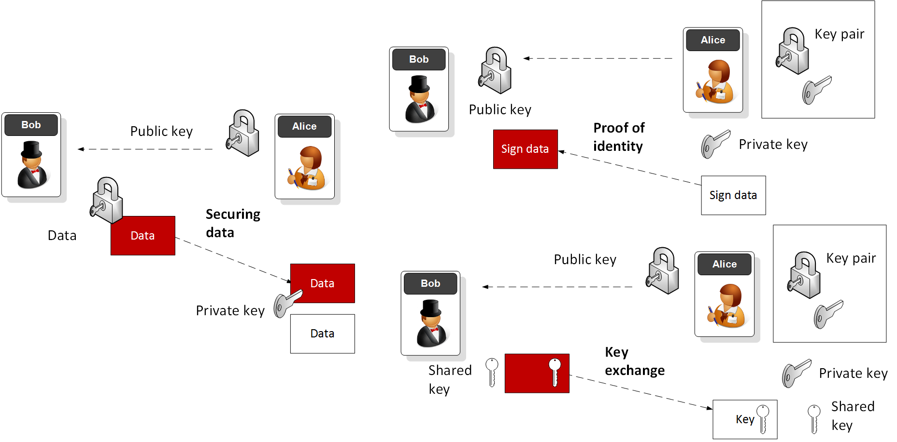
Public Key Methods

Slide 4
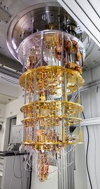
Public Key Methods
Integer Factorization. Using prime numbers. Example: RSA. Key size: 2,048 bits (modulus). Signing, Digital Certificates.
Discrete Logarithms. Y = g^{x} mod P. Example: ElGamal. Prime number size: 2,048 bits. Key handshake.
Elliptic Curve Relationships. Example: Elliptic Curve. Private key: 256 bits. Public key: 512 bits. Bitcoin, IoT, Web, etc.

Slide 5
Public Key
RSA
Prof Bill Buchanan OBE https://asecuritysite.com/rsa https://asecuritysite.com/ecc https://asecuritysite.com/elgamal

Slide 6
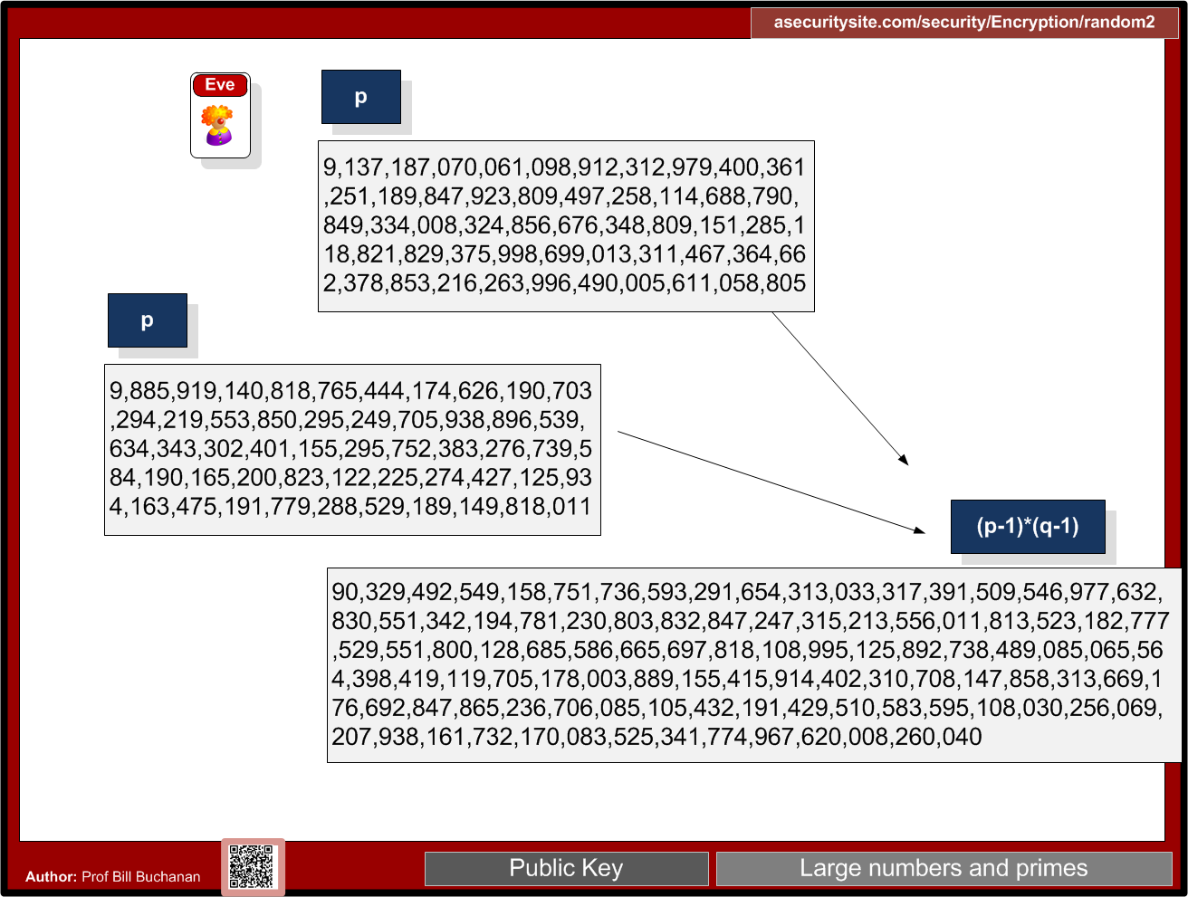

Slide 7
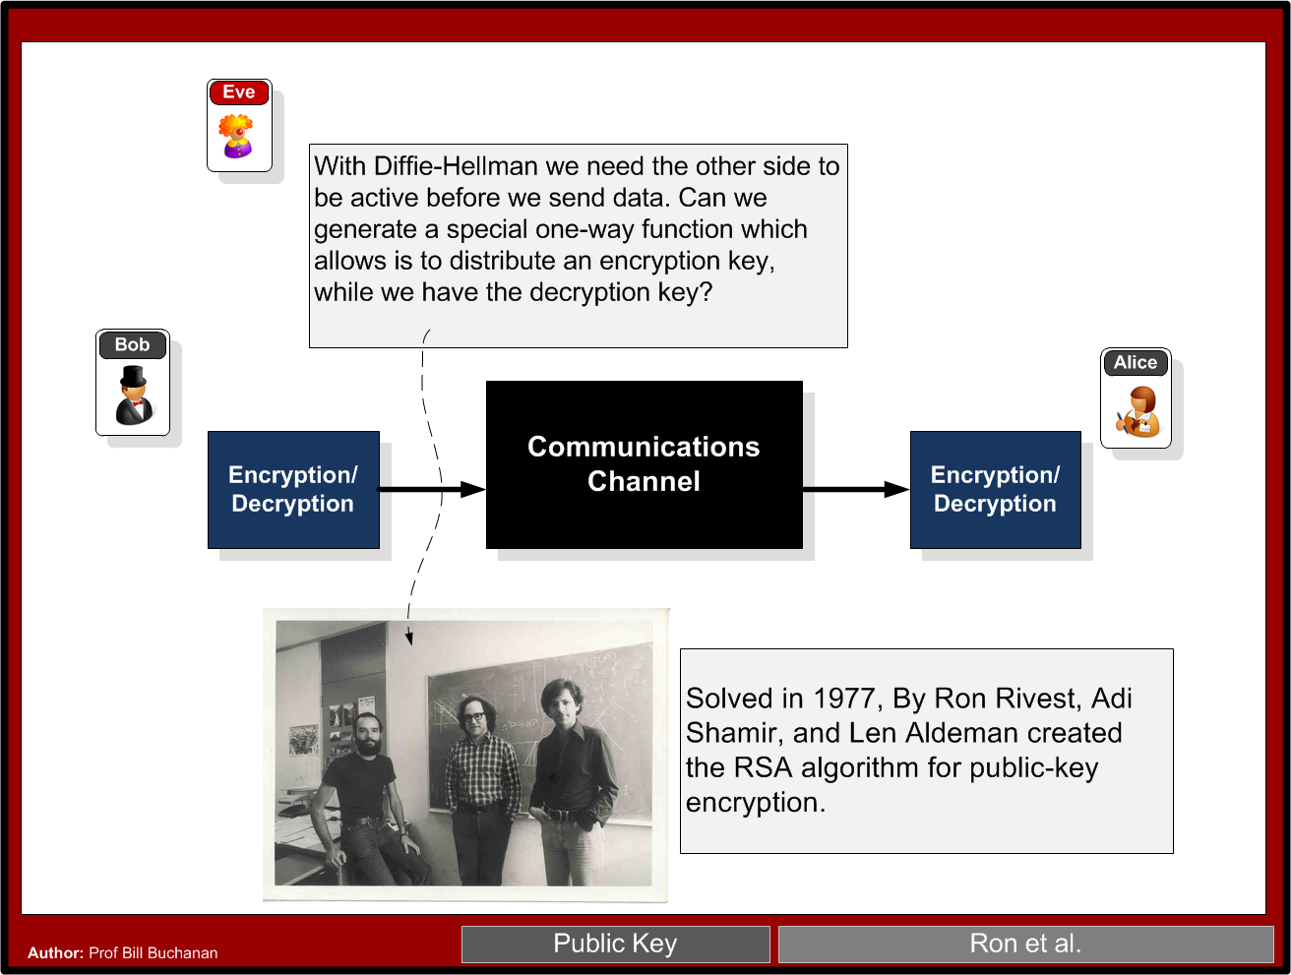

Slide 8
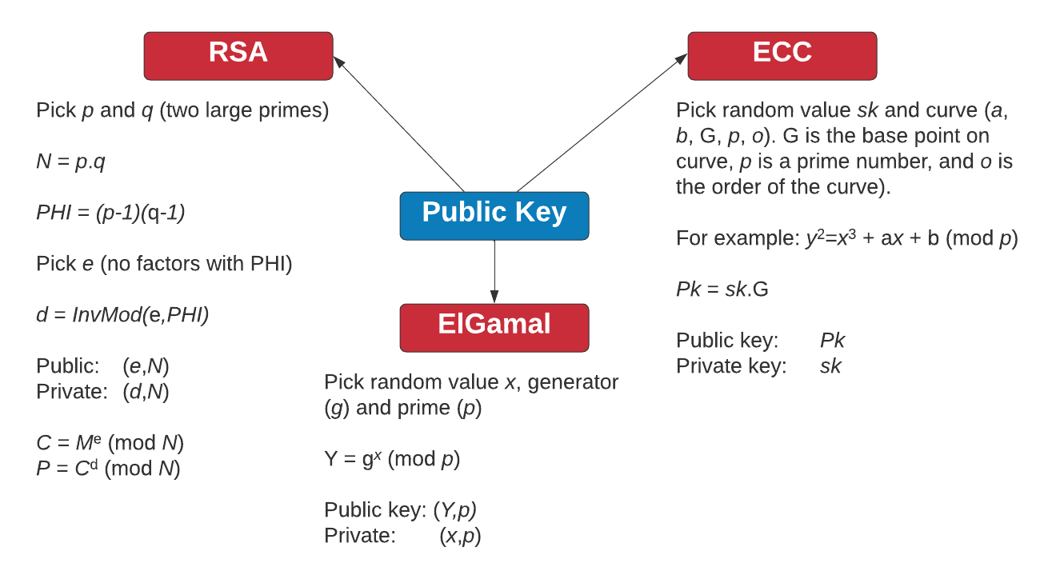
Public Key Methods

Slide 9

RSA
Two primes p, q.
Calculate N (modulus) as p x q eg 3 and 11. n=33.
Calculate PHI as (p-1)x(q-1). PHI=20
Select e for no common factor with PHI. e=3.
Encryption key [e,n] or [3,33].
(d x e) mod 20 = 1
(d x 3) mod 20 = 1
d= 7
Decryption key [d,n] or [7,33] (link)

Slide 10
RSA
Calc
Example
Encryption key [e,n] or [3,33].
Decryption key [d,n] or [7,33]
Cipher = Me mod N
eg M=5.
Cipher = 5³ mod 33 = 26
Decipher = C^{d} mod N
Decipher = (26)⁷ mod 33 = 5

Slide 11
Public Key
Basics
RSA
Applications (Encryption and Signing)
Prof Bill Buchanan OBE https://asecuritysite.com/rsa https://asecuritysite.com/ecc https://asecuritysite.com/elgamal

Slide 12
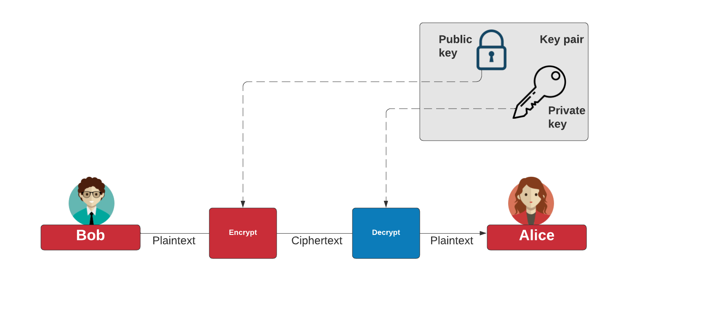
Public Key Encryption

Slide 13
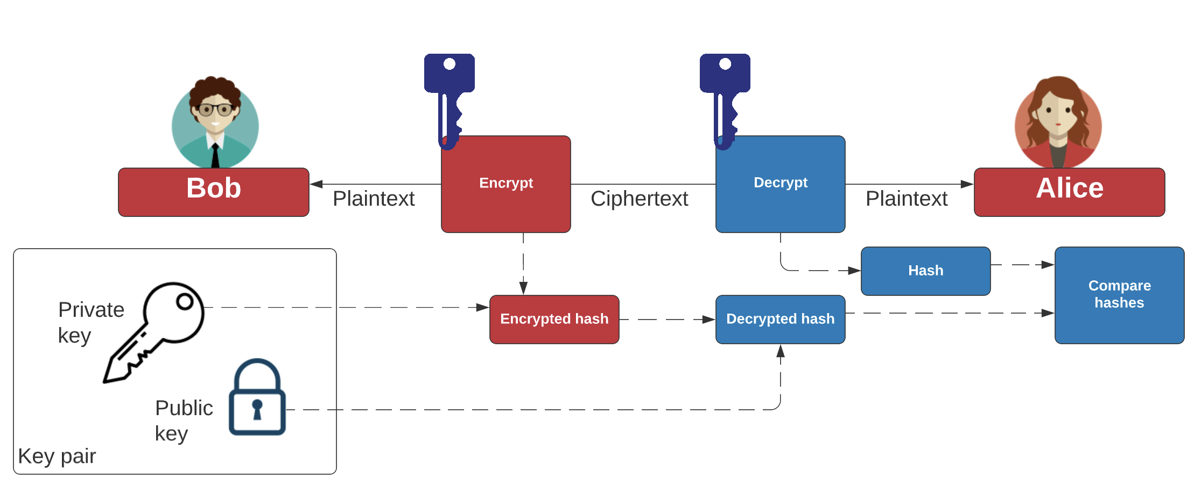
Public Key Digital Signing

Slide 14
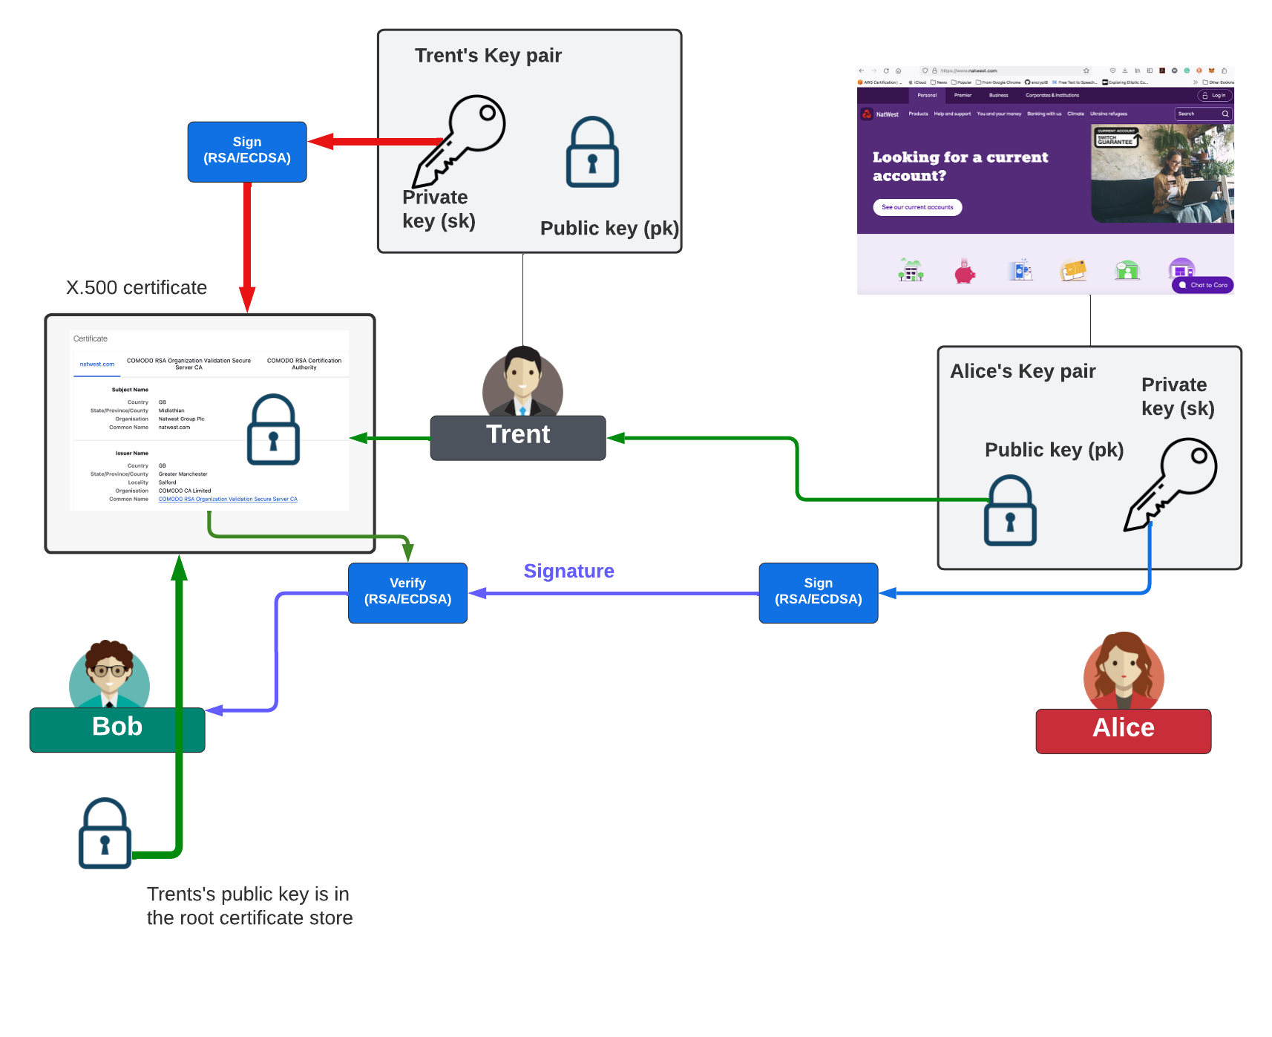
Public Key Digital Signing

Slide 15
Public Key
Basics
RSA
Applications (Encryption and Signing)
Prof Bill Buchanan OBE https://asecuritysite.com/rsa https://asecuritysite.com/ecc https://asecuritysite.com/elgamal

