Slide 1





Trust4Futures: Whitfield Diffie
Prof Bill Buchanan OBE FRSE
https://trust4futures.com

Slide 2
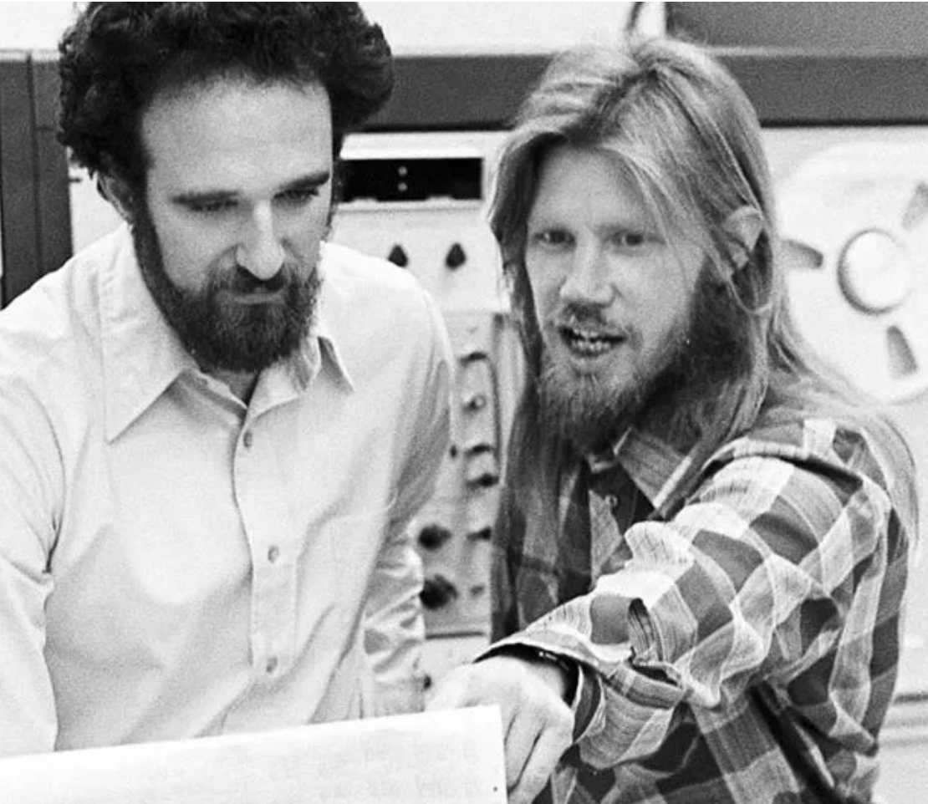
Father of Cryptography
Whitfield (Whit) was first exposed to cryptography at the age of 10 (5th Grade) when a teacher gave a talk for a day and a half.
He got serious into cryptography through the development of DES (Data Encryption Standard), and Whit thought that the standard should have more bits to make it more secure.

Slide 3
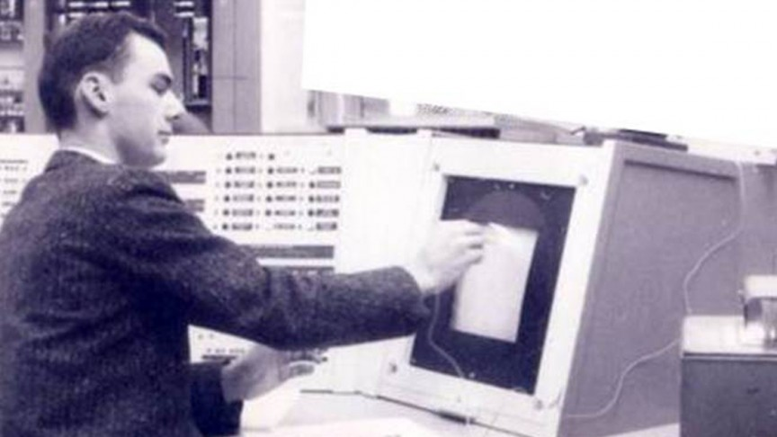
Father of Cryptography
In the early 1970s, Larry Roberts — the creator of the Internet — started and investment in the security for ARPANET. This started a major drive into finding methods that could protect the data that travelled over the public network.
Larry was a great believer in investing in academic work, and this kick started a drive toward network security — mainly focused on cryptography at the time.

Slide 4
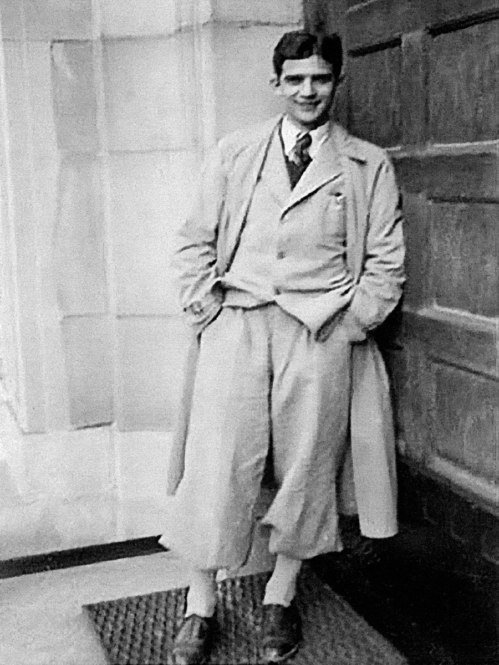
Trip to IBM
Though his interested in the DES method, Whit took a trip in 1974 to the IBM Yorktown Research Lab, and hoped to meet the creator of the DES method: Horst Feistel.
Unfortunately, Horst was not around at the time of the visit, but he was told that Marty Hellman at Stanford would be an interesting person for him to chat with.

Slide 5
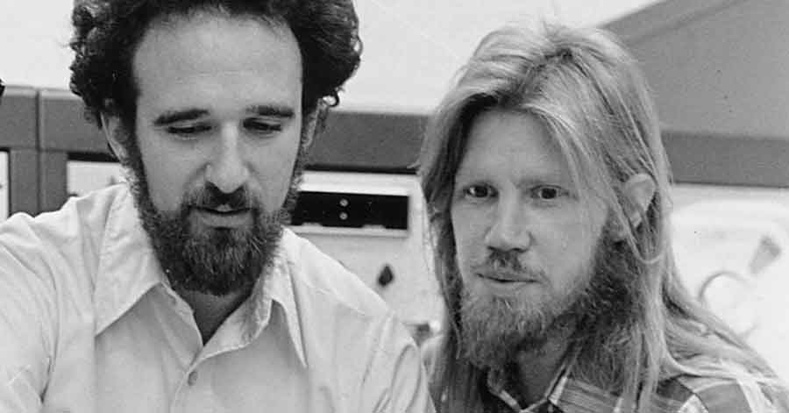
Meeting Marty
Whit then set up a short meeting Martin Hellam at Stanford (in fact, just 30 minutes) and where they discovered that they had shared interests. In fact, they got on so well that Marty invited Whit and Marty (his wife) to dinner that evening.
And, so, Whit arrived at Stanford, and started to investigate the encryption key distribution problem.
In four years, Whit and Marty discovered public key encryption.

Slide 6
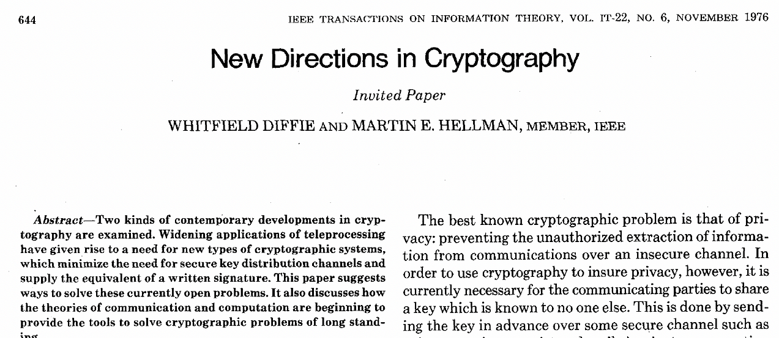
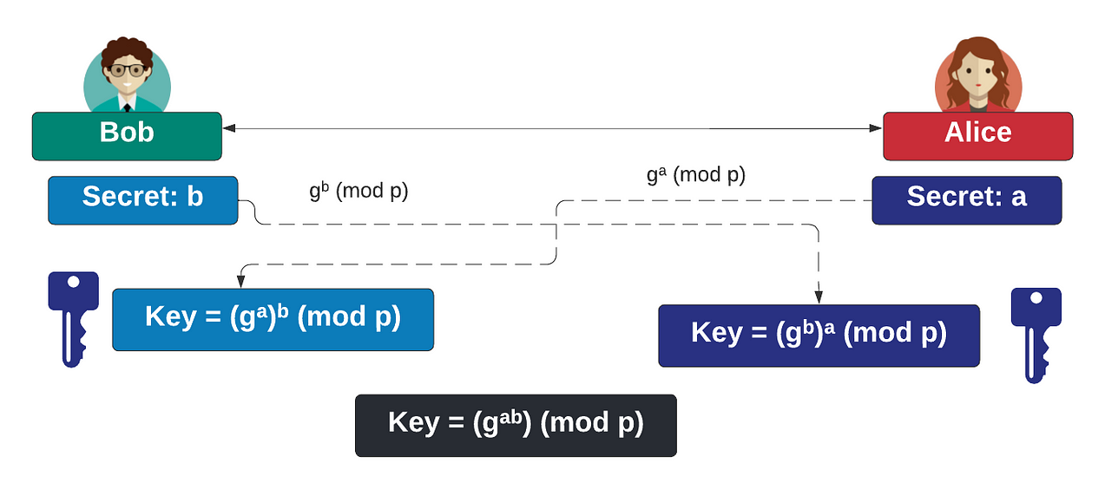
New Directions in Cryptography
Marty and Whitfield published a classic paper in 1976, on “New Directions in Cryptography”.
It outlined public key encryption and a new key exchange method.

Slide 7
One of the greats
Whitfield (Whit) Diffie is one of the greatest Computer Scientists ever.
He — along with Marty Hellman — was one of the first to propose the usage of public key encryption and co-created the Diffie-Hellman (DH) key exchange method.
Overall, the Diffie-Hellman method is still used in virtually every Web connection on the Internet and has changed from using discrete log methods to elliptic curve methods.
In 2015, Whitfield was also awarded the ACM Turing Prize — and which is the Nobel Prize equivalent in Computer Science.

