Slide 1
Object oriented Analysis &Design
面向对象分析与设计
Lecture_11 Exploration to Design
设计初探
Ch18~Ch21
主讲: 陈小红
日期: 26/11/8

Slide 2
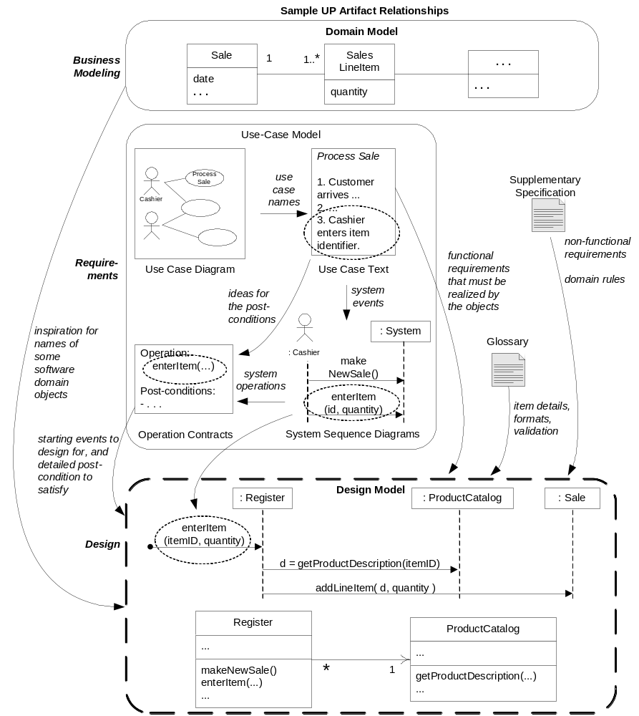
Review
启发了某些软件领域层对象的名称
用于设计的启动事件，以及需要被满足的详细后置条件

Slide 3
掌握要点
设计的切入点
POS超市收银台系统的设计
Monopoly游戏的设计

Slide 4
Chapter 18. Object Design Examples with GRASP
Objectives
  Design use case realizations.
  Apply GRASP to assign responsibilities to classes.
  Apply UML to illustrate and think through the design of objects （应用UML阐述和思考对象的设计）

Slide 5
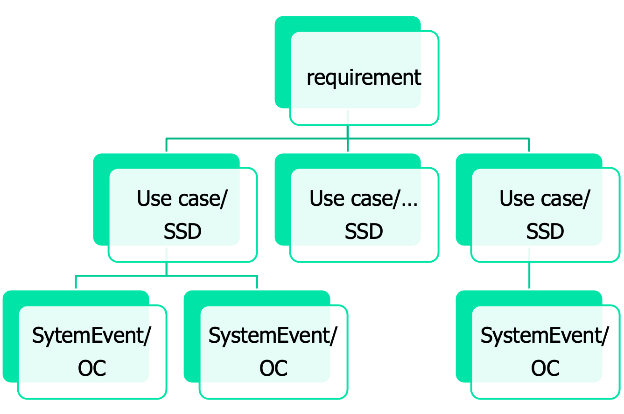
Review: OOA Requirement?

Slide 6
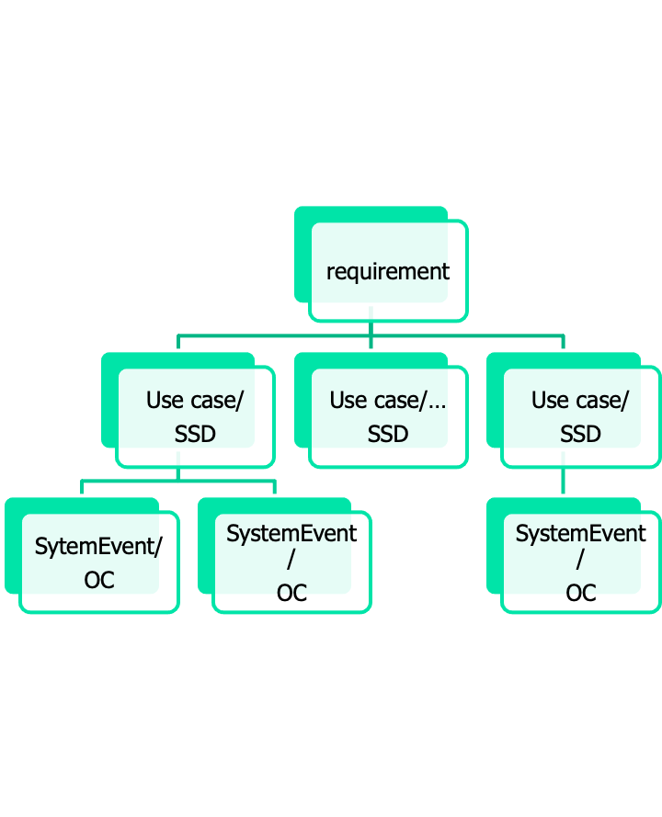

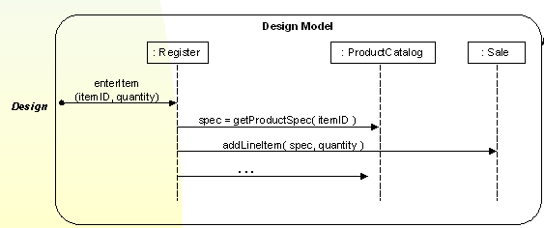
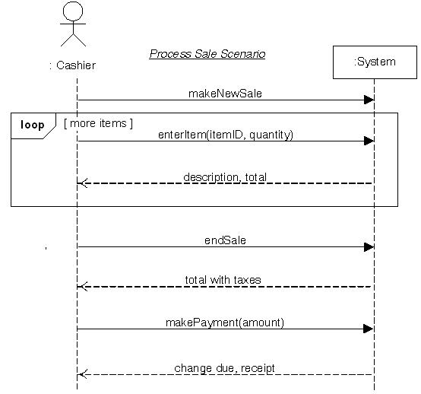
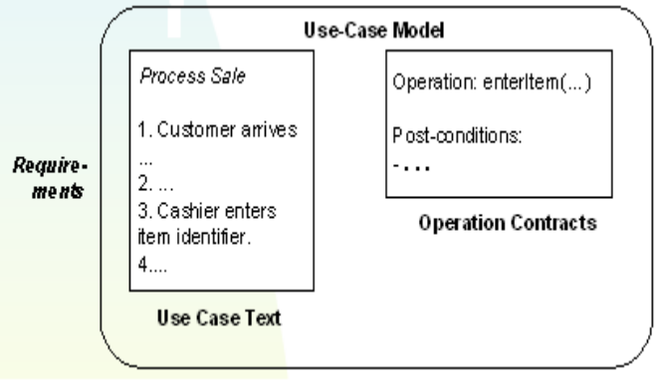
Solution: OOD？
UI
system
  'Start Up' Use Case
Use Case Realization

Slide 7
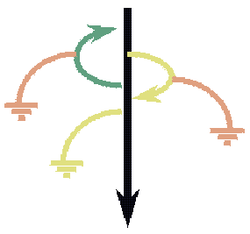
What is a Use Case Realization?
RUP define:
  A use-case realization describes how a particular use case is realized within the Design Model, in terms of collaborating objects
a designer can describe the design of one or more scenarios of a use case; each of these is called a use case realization (also called a scenario realization)
<number>/54

Slide 8
Use Case Realization
How a particular use case is realized within the Design Model in terms of collaborating objects
  Use case suggests the system operations
  System operations becoming starting messages entering the controllers for domain layer interaction diagrams
  Domain layer interaction diagrams illustrate the use case realization
  Domain model “inspires” classes but not one-to-one
  Use post-conditions from contract to design detailed message interactions
Customer needs to be involved in the process throughout
<number>/54
Notes:
这个就是整个过程,从系统操作到完成的标准

Slide 9
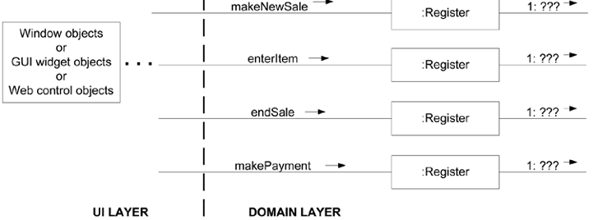
Usecase-realization Example
Process Sale use case → system operation
  makeNewSale
  enterItem
  endSale
  makePayment
How to handle system operation？
MakeNewSale is the system operation from SSD. Each main interaction diagram begins from controller objects where system operations entering domain layer. makeNewSale等是来自SSD的系统操作
每个主要交互图都从进入领域层控制器对象（如Register)的系统操作开始
<number>/54

Slide 10
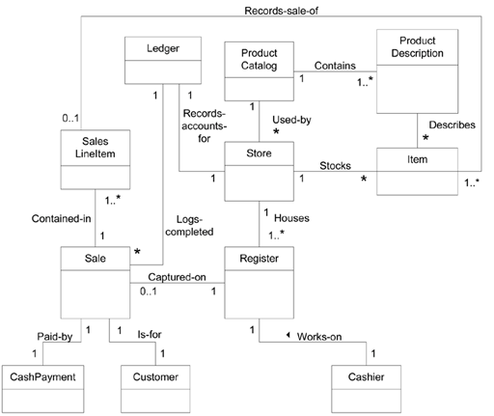
NextGen POS partial domain model
<number>/54

Slide 11
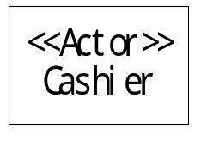
Use case realization (presented by SD )
makeNewSale
Cashier
Register
Sale
SalesLineItem
1: makeNewSale
1.1: create
1.1.1: create
By Controller Pattern
By CreatorPattern

Slide 12
启发了某些软件领域层对象的名称
用于设计的启动事件，以及需要被满足的详细后置条件
OOAD Lecture, Author: NK Jiang
<number>/54

Slide 13
Use case realization for operation contract
  Ch18.4
    Please be attentive to read and understand. 请同学们仔细地去看、体会

Slide 14
Use Case Realizations for the NextGen Iteration
1. Guideline
  Initialization and the 'Start Up' Use Case
  When coding, program at least some Start Up initialization first.
  But during OO design modeling, consider the Start Up initialization design last, after you have discovered what really needs to be created and initialized.
  Then, design the initialization to support the needs of other use case realizations

Slide 15
Use Case Realizations for the NextGen Iteration
2. How to Design makeNewSale?
2.1 Contract CO1: makeNewSale
Contract CO1: makeNewSale
Operation: | makeNewSale()
Cross References: | Use Cases: Process Sale
Preconditions: | none
Postconditions: | - A Sale instance s was created (instance creation). - s was associated with the Register (association formed). - Attributes of s were initialized.

Slide 16
Use Case Realizations for the NextGen Iteration
2.2 Choosing the Controller Class
  Candidates
    Façade controller
      Store a kind of root object because we think of most of the other domain objects as "within" the Store.
      Register a specialized device that the software runs on; also called a POSTerminal.
      POSSystem a name suggesting the overall system
    Usecase controller
      ProcessSaleHandler constructed from the pattern <use-case-name> "Handler" or "Session"
      ProcessSaleSession
  Principle
    a few system operations and if the facade controller is not taking on too many responsibilities
  Result
    Register
    Note: this Register is a software object in the Design Model. It isn't a physical register

Slide 17
Use Case Realizations for the NextGen Iteration
2.3 Creating software ‘Sale’ object
  Creator + Doamin Model + LRG
    Register
2.4 Create an empty collection to record all the future ‘SalesLineItem’ instances

Slide 18
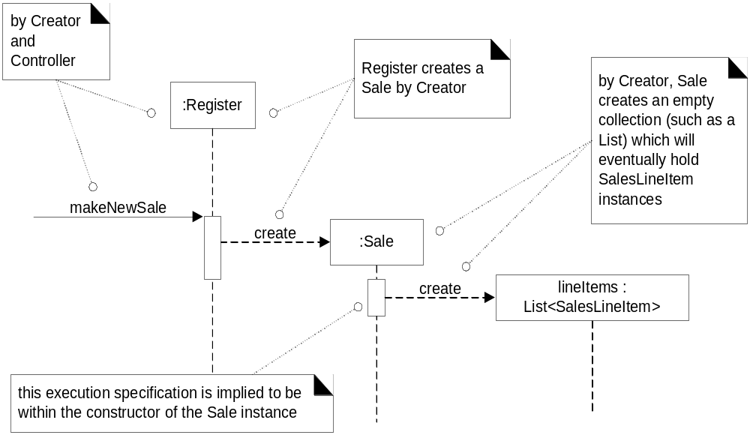
POS: makeNewSale Interactions

Slide 19
Use Case Realizations for the NextGen Iteration
3. How to Design endSale?
3.1 Contract
3.2 Choosing the Controller Class
  Register
3.3 Setting the Sale.isComplete Attribute
  Who do it?
    ‘Sale’ itself after receiving message from ‘Register’
Contract CO3: endSale
Operation: | endSale()
Cross References: | Use Cases: Process Sale
Preconditions: | There is an underway sale.
Postconditions: | Sale.isComplete became true (attribute modification).

Slide 20
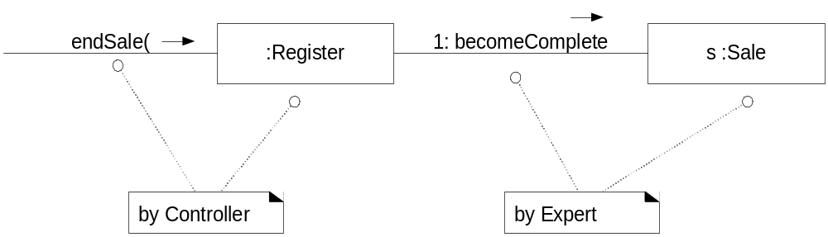
POS: endSale Interaction

Slide 21
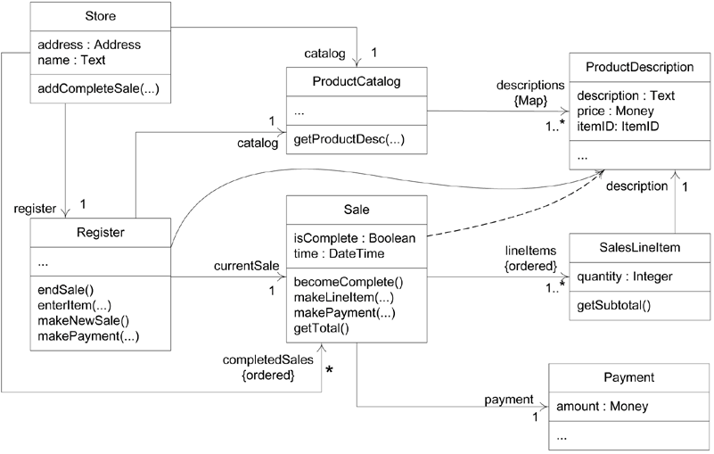
Figure 18.17. A more complete DCD reflecting most design decisions

Slide 22
Use Case Realizations for the NextGen Iteration
4. How to Connect the UI Layer to the Domain Layer?
  4.1 UI layer obtain visibility to objects in the domain layer
    1) initializer object
    E.g.
    public class Main {
    public static void main( String[] args )
    {
    // Store is the initial domain object.
    // The Store creates some other domain objects.
    Store store = new Store();
    Register register = store.getRegister();
    ProcessSaleJFrame frame = new ProcessSaleJFrame( register );
    ...
    } }
    2) from a well-known source

Slide 23
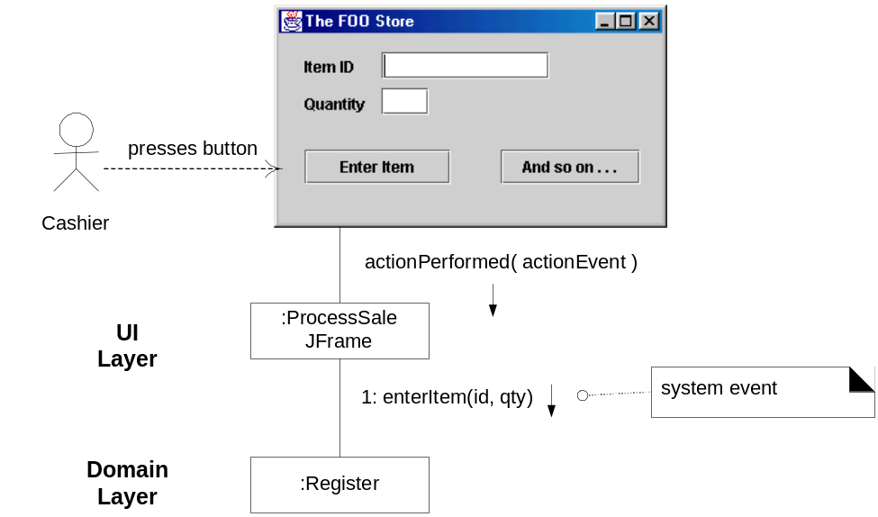
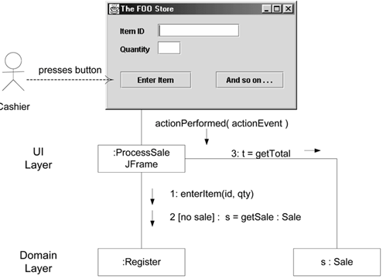
Use Case Realizations for the NextGen Iteration
4.2. we want the window to show the running total after each entry
  S1: UI -> Register -> Sale
    expand the interface of the Register object, making it less cohesive
  S2: UI -> get reference of Sale -> send msg to Sale directly
    higher coupling in and of itself is not a problem; rather, coupling to unstable things is a real problem

Slide 24
Use Case Realizations for the NextGen Iteration
5. Initialization and the 'Start Up' Use Case
  5.1 When to Create the Initialization Design?
    Guideline
      Do the initialization design last.
  5.2
    initial domain object ：Main()
    Main will create other objects
    Objects will create its sub-objects
  Guideline
    Choose as an initial domain object a class at or near the root of the containment or aggregation hierarchy of domain objects(选择位于或接近于领域对象包含或聚合层次的根类，作为初始领域对象).
    This may be a facade controller, such as Register,
    or some other object considered to contain all or most other objects, such as a Store.

Slide 25
Use Case Realizations for the NextGen Iteration
  5.3. Store.create()
  identify the following initialization work
    Create a Store, Register, ProductCatalog, and ProductDescriptions.
    Associate the ProductCatalog with ProductDescriptions.
    Associate Store with ProductCatalog.
    Associate Store with Register.
    Associate Register with ProductCatalog

Slide 26
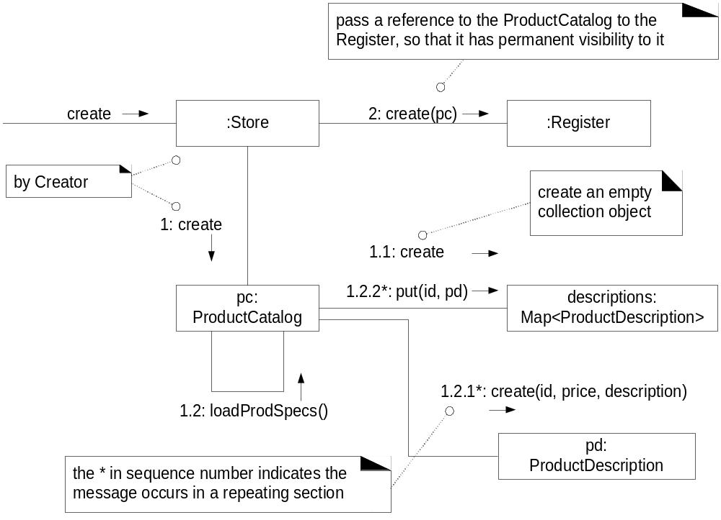
POS: StartUp

Slide 27
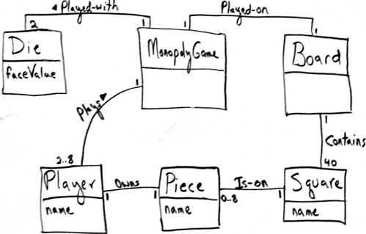
Use Case Realizations for the Monopoly Iteration
Figure 18.21. Iteration-1 Domain Model for Monopoly
System Operation
  playGame

Slide 28
Use Case Realizations for the Monopoly Iteration
6.1 Choosing the Controller Class
Represents the overall "system," "root object," a specialized device, or a major subsystem. | MonopolyGame a kind of root object: We think of most of the other domain objects as "contained within" the MonopolyGame. Abbreviated MGame in most of the UML sketches. MonopolyGameSystem a name suggesting the overall system
Represents a receiver or handler of all system events of a use case scenario. | PlayMonopolyGameHandler constructed from the pattern <use-case-name> "Handler" PlayMonopolyGameSession
We select MonopolyGame (abv. MGame)

Slide 29
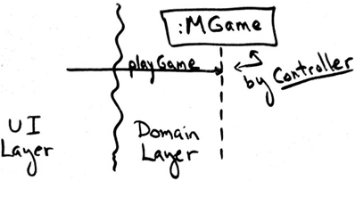
Figure 18.22. Applying Controller to the playGame system operation
6.2 Who is Responsible for Controlling the Game Loop?
  Turn: a player rolling the dice and moving the piece
  Round: all the players taking one turn
  What information is needed for the responsibility?

Slide 30
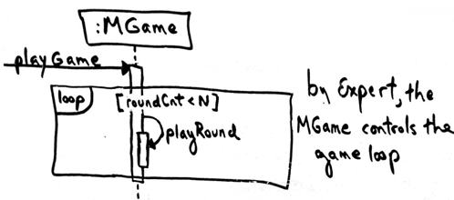
Use Case Realizations for the Monopoly Iteration
Information Needed | Who Has the Information?
the current round count(当前回合数) | No object has it yet, but by LRG, assigning this to the MonopolyGame object is justifiable.
all the players (so that each can be used in taking a turn) | Taking inspiration from the domain model, MonopolyGame is a good candidate.
MonopolyGame is a good candidate
<number>/54

Slide 31
Use Case Realizations for the Monopoly Iteration
6.3 Who Takes a Turn?
  What information is needed for the responsibility?
Information Needed | Who Has the Information?
current location of the player (to know the starting point of a move) | Taking inspiration from the domain model, a Piece knows its Square and a Player knows its Piece. Therefore, a Player software object could know its location by LRG.
the two Die objects (to roll them and calculate their total) | Taking inspiration from the domain model, MonopolyGame is a candidate since we think of the dice as being part of the game.
all the squares the square organization (to be able to move to the correct new square) | By LRG, Board is a good
three partial information experts for the "take a turn" responsibility: Player, MonopolyGame, and Board.

Slide 32
Solution
Guideline1: When there are multiple partial information experts to choose from, place the responsibility in the dominant information expert the object with the majority of the information.
  This tends to best support Low Coupling.
Guideline2: When there are alternative design choices, consider the coupling and cohesion impact of each, and choose the best.
  This can be applied.
  MonopolyGame is already doing some work, so giving it more work impacts its cohesion, especially when contrasted with a Player and Board object, which are not doing anything yet.
  But we still have a two-way tie with these objects.
Guideline3: When there is no clear winner from the alternatives other guidelines, consider probable future evolution of the software objects and the impact in terms of Information Expert, cohesion, and coupling
So , Who Takes a Turn?
  Player is most suitable

Slide 33
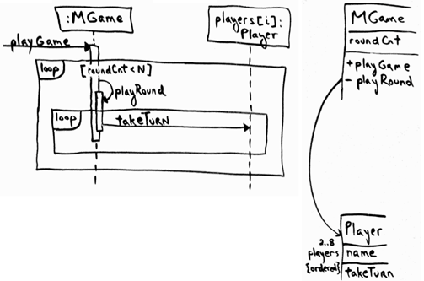
Figure 18.24. Player takes a turn by Expert

Slide 34
6.4 Taking a Turn
  calculating a random number total between 2 and 12 (the range of two dice)
  calculating the new square location
  moving the player's piece from an old location to a new square location
6.5 Who Coordinates All This?
  Player
6.6 The Problem of Visibility
  Player will need visibility to the Die, Board, and Piece objects each and every turn
6.7 The Final Design of playGame

Slide 35
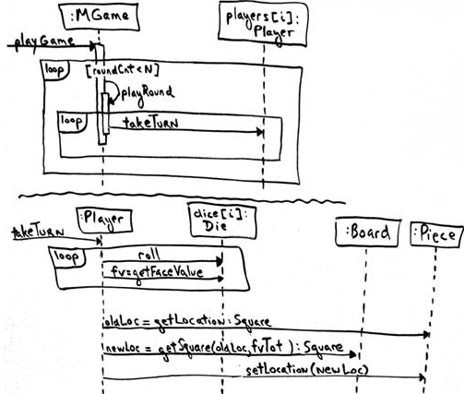
Figure 18.25. Dynamic design for playGame

Slide 36
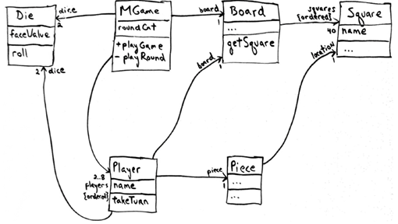
Figure 18.26. Static design for playGame

Slide 37
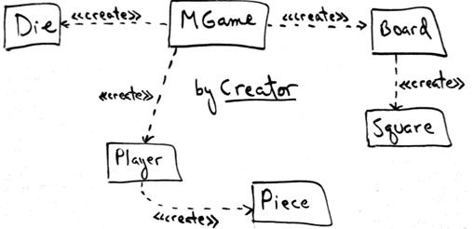
6.8 Initialization and the 'Start Up' Use Case

Slide 38
end
后续是选修内容
作业：（手写）
  整理MonopolyGame游戏，从需求到设计的全过程。
  （高级选修作业）分析设计的任务从哪里来？是否需要在需求模型中增加新的模型？需要什么样的模型，才能提供这些信息呢？
  作业提交时间： 12月1日

Slide 39


Slide 40
The Command-Query Separation Principle : CQS原则
It is important.
// style #1; used in the official solution public void roll() {
faceValue = // random num eneration
}
public int getFaceValue() {
return faceValue;
}
// style #2; why is this poor?
public int roll()
{
faceValue = // random num generation
return faceValue;
}

Slide 41
Chapter 20. Mapping Designs to Code
The creation of code in an OO language,such as Java or C#is not part of OOA/D, it's an end goal
  Creativity and Change During Implementation
Implementation in an object-oriented language requires writing source code for:
  class and interface definitions
  method definitions
Coding by artifacts of Design Model
  DCD
  SD
  Collection Classes in Code
  Exceptions and Error Handling

Slide 42
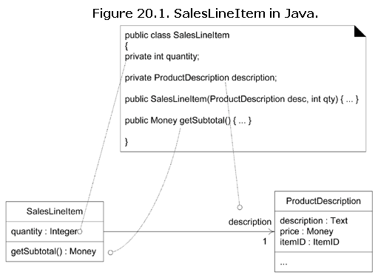
DCD to code

Slide 43
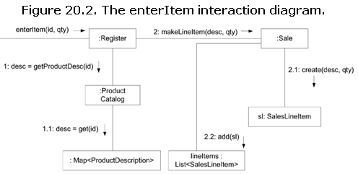
from Interaction Diagrams
The enterItem message is sent to a Register instance; therefore, the enterItem method is defined in class Register.
  public void enterItem(ItemID itemID, int qty)
Message 1: A getProductDescription message is sent to the ProductCatalog to retrieve a ProductDescription.
  ProductDescription desc = catalog.getProductDescription(itemID);
Message 2: The makeLineItem message is sent to the Sale.
  currentSale.makeLineItem(desc, qty);

Slide 44
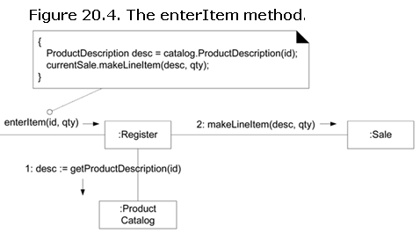
请同学们自学ch20.11, 代码，体会 面向对象的编码：
Please read ch20.11 and the code by yourself, and understand object-oriented programming.
  类之间的关系如何在代码中体现 how to reflect the association between classes in code.
  和书本前面章节的各种设计图 对照，体会设计和编码之间的联系
  Compared with the various design diagram in previous chapter, understand the connection between designing and programming.

Slide 45
Ch21 Refactoring (重构)
Refactoring
  Structured method to rewrite code maintaining external behavior while applying small internal changes (transformations)
  Continuously tested with unit tests and regression tests
Mostly for beautification

Slide 46
Conclusion
The end

