Slide 1
Object oriented Analysis &Design
面向对象分析与设计
Lecture_12 GRASP
主讲: 陈小红
日期: 26/11/8

Slide 2
掌握内容：
熟练使用5种GRASP原则
会进行设计结果的评价

Slide 3
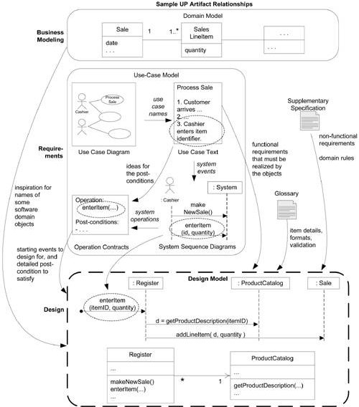
Artifact Influences

Slide 4

Design
  Supplementary Specs
  Glossary
    Data dictionary
  Use Case under development, with System Sequence Diagram (System operations) and Contracts
  Conceptual Model
Design
  Interactions, class diagram, etc
  Packages
How?

Slide 5
OOD
    After identifying your requirements and creating a domain model,
    then add methods to the appropriate classes, and define the messaging between the objects to fulfill the requirements

Slide 6
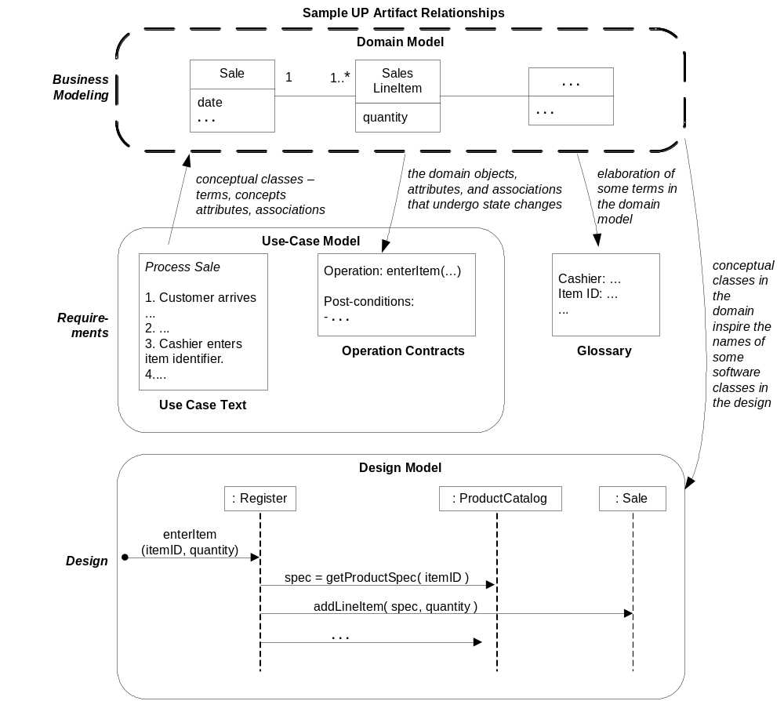

Review-where are we?

Slide 7
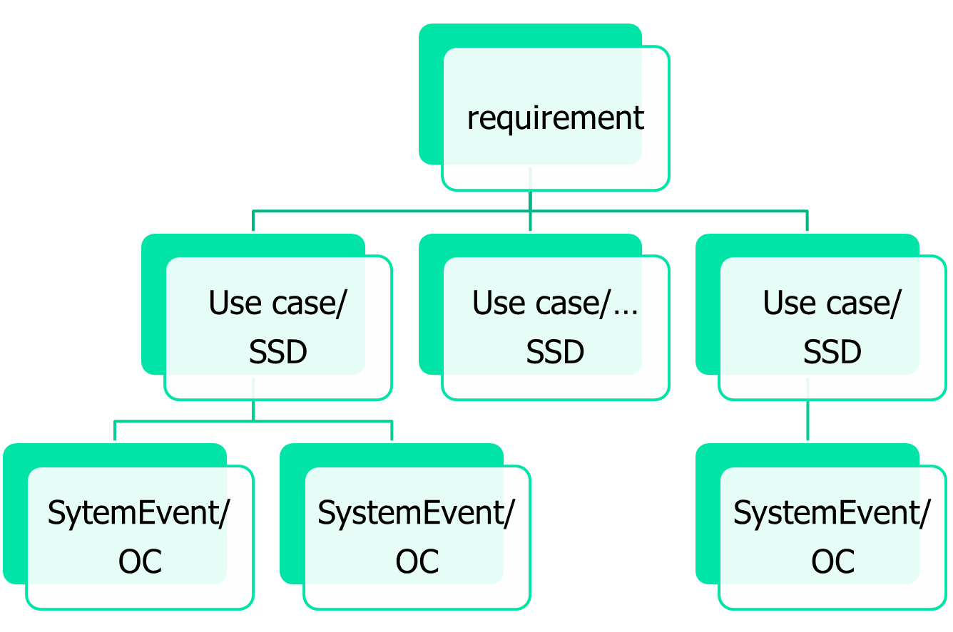
Requirement?
?

Slide 8
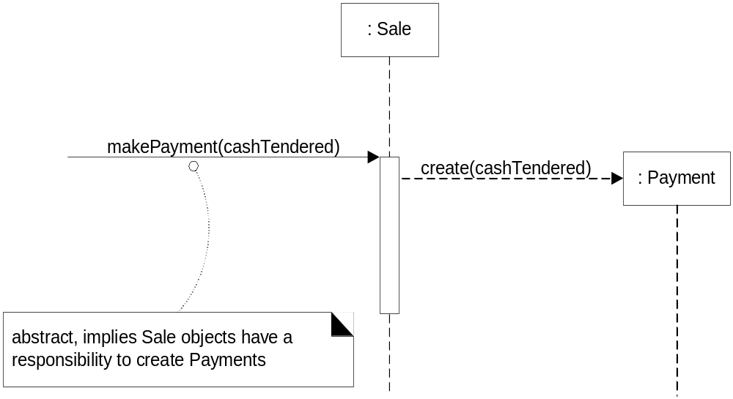
OO System
  - objects collaborating to respond to System Events
System
System Event

Slide 9
How to judge whether it is finished or not?
  Operation Contract
  Input /Output

Slide 10
How to assign?
In the process
Refer to domain model
to assign task to objects and make them collaborating with each other

Slide 11
How to evaluate whether it is a good design?
  High cohesion
  Low coupling
Cohesion，内聚：模块内的操作之间联系紧密的程度
Coupling，耦合：两个子模块之间联系的强度

Slide 12
Back to OOD
Realisation ways
The problem is
  Above advice is too general to be handled
  Deciding what methods belong to where and how objects should interact carries consequences and should be undertaken seriously
responsibility-driven design (RDD)
  thinking about how to assign responsibilities to collaborating objects

Slide 13
Ch16. Responsibilities
Responsibilities are an abstraction
Software objects do not have responsibilities, they have methods.
  The responsibility for persistence
    Large-grained responsibility
  The responsibility for tax calculation
    More fine-grained responsibility
Concretely, implemented with classes, their methods and in terms of how they collaborate with other objects.
Responsibilities are a useful metaphor

Slide 14
Responsibility-Driven Design (RDD)
In RDD when designing objects we ask questions like
  What are the responsibilities of this object?
  What does it collaborate with?

Slide 15
Basic Principles of Object Design --- GRASP Principles
What are the guiding principles to help assign responsibilities?
These principles are captured in the GRASP patterns
  General Responsibility Assignment Software Patterns
  Very basic and broad principles of object design

Slide 16
Basic Responsibilities
These responsibilities are of the following two types: doing and knowing
  Doing (行为职责）
    Do it yourself
      such as creating an object or doing a calculation
    initiating action in other objects
    controlling and coordinating activities in other objects
  Knowing（认知职责）
    knowing about private encapsulated data
    knowing about related objects
    knowing about things it can derive or calculate

Slide 17
Basic Responsibilities
Responsibilities are assigned to classes of objects during object design.
  For example, we may declare that
    "a Sale is responsible for creating SalesLineltems" (a doing), or
    “a Sale is responsible for knowing its total" (a knowing).
Relevant responsibilities related to "knowing" are often inferable from the domain model, because of the attributes and associations it illustrates.
The translation of responsibilities into classes and methods is influenced by the granularity of the responsibility.
  E.g. The responsibility
    “to provide access to relational databases"
  may involve dozens of classes and hundreds of methods, packaged in a subsystem.
  By contrast, the responsibility “to create a Sale" may involve only one or a few methods.

Slide 18
Methods Implement Responsibilities
OO System
  - objects collaborating to respond to System Events
Responsibilities are often considered during the creation of interaction diagrams.
  Next Figure indicates that Sale objects have been given a responsibility to create Payments, which is invoked with a makePayment message and handled with a corresponding makePayment method

Slide 19
Methods Implement Responsibilities
System
System Event

Slide 20

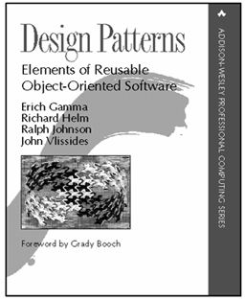

Ch17. GRASP – Designing Objects with Responsibilities
How?
  Apply Patterns and principles of responsibility assignments
    GoF (Gang of Four patterns)
      Famous 23 patterns
    GRASP (General responsibility assignment Software pattern)
      A set of (9) principles
    Others
      OCP, …
Design Patterns Explained A New Perspective on Object-Oriented Design Second Edition
By Alan Shalloway, James R. Trott
Notes:
Alexander, C., The Timeless Way of Building, New York: Oxford University Press, 1979
It is important to realize that the Gang of Four did not create the patterns described in the book. Rather, they identified patterns that already existed within the software community, patterns that reflected what had been learned about high-quality designs for specific problems

Slide 21
Patterns
Experienced object-oriented developers (and other software developers) build up a repertoire of both general principles and idiomatic solutions that guide them in the creation of software.
These principles and idioms, if codified in a structured format describing the problem and solution, and given a name, may be called patterns. For example, here is a sample pattern:
  Pattern Name: Information Expert
  Problem It Solves: What is a basic principle by which to assign responsibilities to objects? Solution: Assign a responsibility to the class that has the information needed to fulfill it.

Slide 22
Patterns
In object technology, a pattern is a named description of a problem and solution that can be applied to new contexts;
ideally, it provides advice in how to apply it in varying circumstances, and considers the forces and trade-off's. Many patterns provide guidance for how responsibilities should be assigned to objects, given a specific category of problem.
Most simply, a pattern is a named problem/solution pair that can be applied in new contexts, with advice on how to apply it in novel situations and discussion of its trade-off's.
Alexander, C., The Timeless Way of Building建筑的永恒之道 , New York: Oxford University Press, 1979
It is important to realize that the Gang of Four did not CREATE the patterns described in the book. Rather, they IDENTIFIED patterns that already existed within the software community, patterns that reflected what had been learned about high-quality designs for specific problems
Notes:
GRASP模式着重考虑设计类的原则及如何分配类的功能，而GoF模式则着重考虑设计的实现、类的交互及软件质量。可以说，GoF就是符合GRASP模式要求的面向对象设计模式。
模式不是发明与创造，而是来自我们日常设计开发中的发现与总结，是一种实践经验的积累，它带我们走向成熟。

Slide 23
GRASP Patterns
GRASP
  General Responsibility Assignment Software Patterns
  Understanding and being able to apply the ideas behind GRASP while coding or while drawing interaction and class diagrams enables developers new to object technology needs to master these basic principles as quickly as possible; they form a foundation for designing OO systems(对象技术初学者在编码或绘制交互图和类图时，应该理解并应用GRASP的基本思想，以便尽快地掌握这些基本原则，它们是设计OO系统的基础)
The GRASP patterns are a learning aid to help one understand essential object design, and apply design reasoning in a methodical, rational, explainable ways.

Slide 24

GRASP Patterns
GRASP patterns describe fundamental principles of object design and responsibility assignment. The following is a list of GRASP patterns:
  Information Expert
  Creator
  High Cohesion
  Low Coupling
  Controller
  Polymorphism
  Indirection
  Pure Fabrication
  Protected Variations

Slide 25
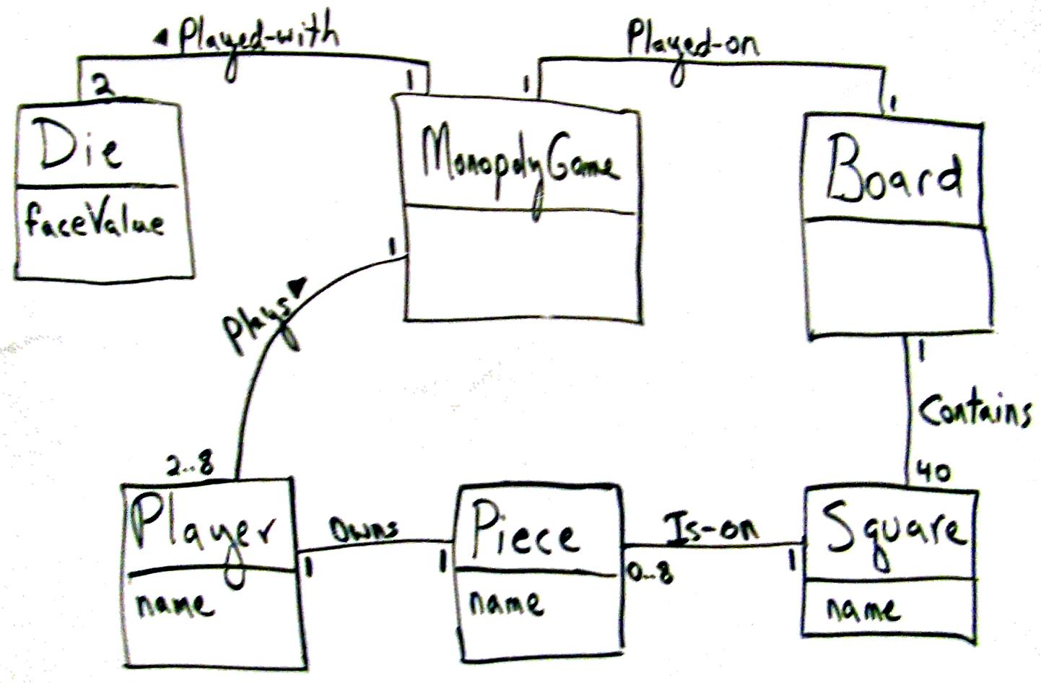
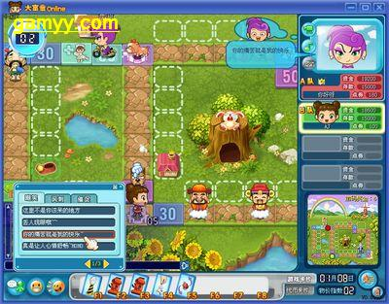
Mini Exercise 1
Figure 17.3. Monopoly iteration-1 domain model
Who will create Square object in Monopoly ? Why?
Thinking steps
  Have no design model, so start with Domain Model
  LRG: Low representational gap — build design model (dynamic and static)
Notes:
这个问题从何而来? Operation Contract ? Instance creat

Slide 26

GRASP rule1: Creator (创建者)
Name: Creator
Problem:
  Who should be responsible for creating a new instance of some class?
Solution:
  Assign class B the responsibility to create an instance of class A if one of these is true (the more the better) :
  1. B “contains” or compositely aggregates A
  2. B records A
  3. B closely uses A
  4. B has the initializing data for A that will be passed to A when it is created (B is an expert w.r.t. A)
  如果有一个以上的选项适用，通常首选 聚集 或包含A的类
Note:
  B and A refer to software objects, not domain model objects
Notes:
With respect to,意思应该译为:关于或很荣幸

Slide 27
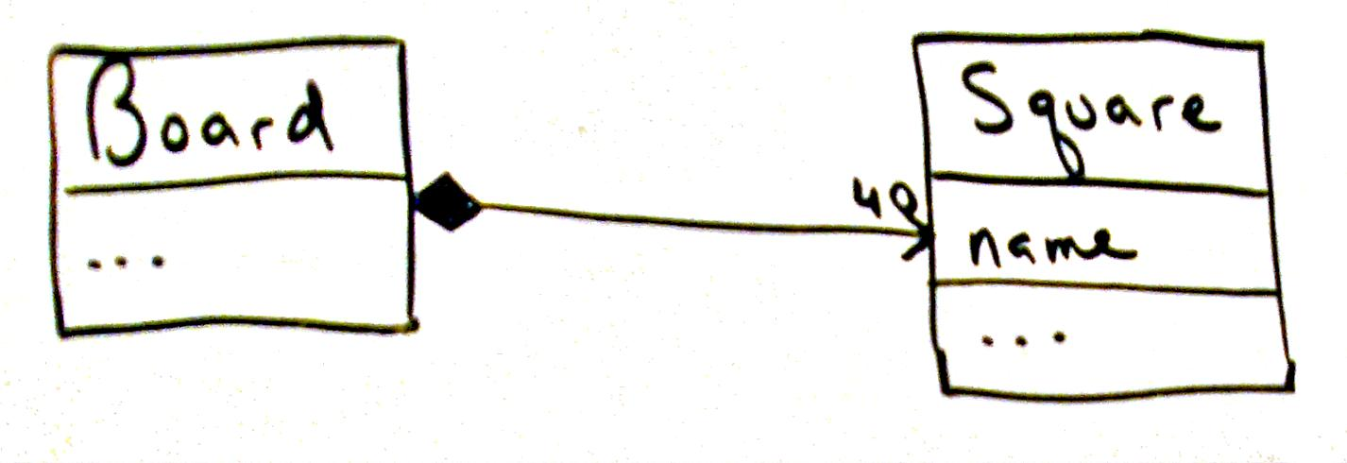
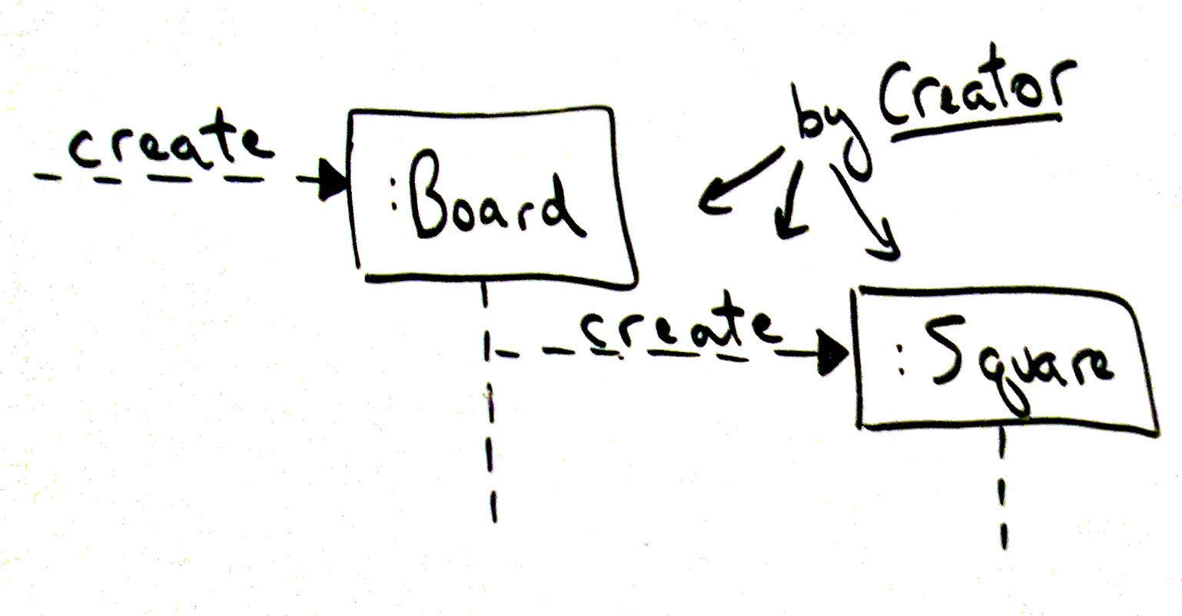
Creator : example Monopoly
Board create Square
  Because of ‘Board’ contains ‘Square’
Who create ‘Board’?

Slide 28
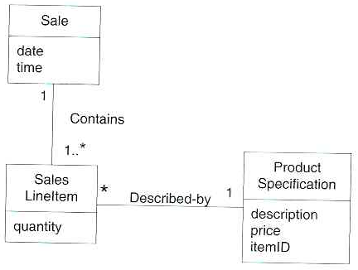
Creator : POS example
Consider the partial domain model : In the POS application, who should be responsible for creating a SalesLineltem instance?
By Creator, we should look for a class that aggregates, contains, and so on, SalesLineltem instances.

Slide 29
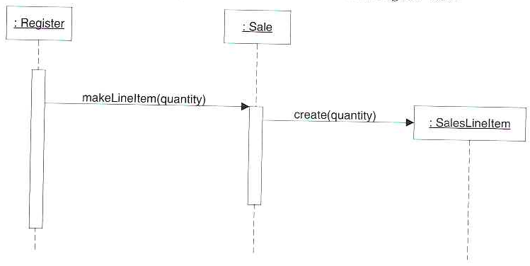
Creator : POS example
Since a Sale contains (in fact, aggregates) many SalesLineltem objects, the Creator pattern suggests that Sale is a good candidate to have the responsibility of creating SalesLineltem instances.
This leads to a design of object interactions as shown :
Figure 17-13

Slide 30
Creator — When Not to Use
When want to reuse existing instances for performance purposes (caching)
conditionally creating an instance from one of a family of similar classes based upon some external property value
  GOF pattern
Delegate responsibility further down
Other more complex situations

Slide 31
Creator — Benefits
Existing associations means created class is in any case visible to creator
High cohesion
Does not increase coupling

Slide 32

Mini Exercise 2
Given a key, which object can tell me about
  …Square in Monopoly
  …Total money of a sale in POS
Note:
  this is a knowing responsibility
Notes:
这个问题从何而来, 直接从需求来的.

Slide 33
GRASP rule2: Information Expert
Name: Information Expert(信息专家)
Problem:
  What is a general principle of assigning responsibility to objects?
Solution:
  Assign responsibility to the class that has the information necessary to fulfill responsibility

Slide 34
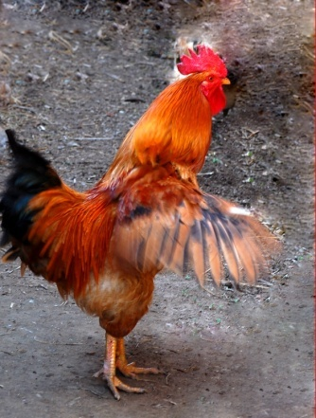

Information Expert — ”Real World” Analogy
“Do It Myself” [Coad] or “Animation” [Larman] principle
  objects are “alive” and can do things themselves
“鸡鸣狗盗”
Ultimate knowledge may require co-operation
Notes:
鸡鸣狗盗
战国时候，齐国的孟尝君喜欢招纳各种人做门客，号称宾客三千。他对宾客是来者不拒有才能的让他们各尽其能，没有才能的也提供食宿。
有一次，孟尝君率领众宾客出使秦国。秦昭王将他留下，想让他当相国。孟尝君不敢得罪秦昭王，只好留下来。不久，大臣们劝秦王说：“留下孟尝君对秦国是不利的，他出身王族，齐国有封地，有家人，怎么会真心为秦国办事呢？”秦昭王觉得有理，便改变了主意，把孟尝君和他的手下人软禁起来，只等找个借口杀掉。
泰昭王有个最受宠爱的妃子，只要妃子说一，昭王绝不说二。孟尝君派人去求她救助。妃子答应了，条件是拿齐国那一件天下无双的狐白裘（用白色狐腋的皮毛做成的皮衣）做报酬。这可叫孟尝君作难了，因为刚到秦国，他便把这件狐白裘献给了秦昭王。就在这时候，有一个门客说：“我能把狐白裘找来！”说完就走了。
原来这个门客最善于钻狗洞偷东西。他先摸清情况，知道昭王特别喜爱那件狐裘，一时舍不得穿，放在宫中的精品贮藏室里。他便借着月光，逃过巡逻人的眼睛，轻易地钻进贮藏室把狐裘偷出来。妃子见到
狐白裘高兴极了，想方设法说服秦昭王放弃了杀孟尝君的念头，并准备过两天为他饯行，送他回齐国。
孟尝君可不敢再等过两天，立即率领手下人连夜偷偷骑马向东快奔。到了函谷关（在现在河南省灵宝县，当时是秦国的东大门）正是半夜。按秦国法规，函谷关每天鸡叫才开门，半夜时候，鸡可怎么能叫呢？大家正犯愁时，只听见几声“喔，喔，喔”的雄鸡啼鸣，接着，城关外的雄鸡都打鸣了。
原来，孟尝君的另一个门客会学鸡叫，而鸡是只要听到第一声啼叫就立刻会跟着叫起来的。怎么还没睡踏实鸡就叫了呢？守关的士兵虽然觉得奇怪，但也只得起来打开关门，放他们出去。
天亮了，秦昭王得知孟尝君一行已经逃走，立刻派出人马追赶。追到函谷关，人家已经出关多时了。
孟尝君靠着鸡鸣狗盗之士逃回了齐国。

Slide 35
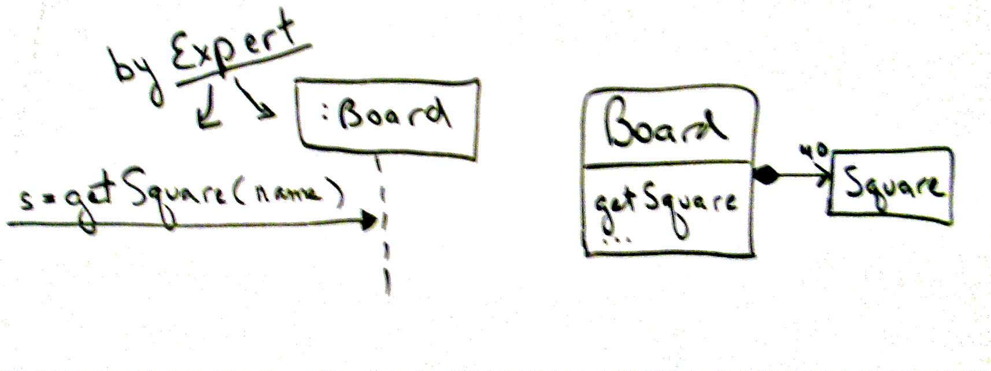
Information Expert
Information
  an object's own state,
  about other objects, the world around an object,
  information the object can derive,
  and so forth
Answer to Mini exercise 2
Figure 17.6. Applying Expert
Notes:
鸡鸣狗盗
战国时候，齐国的孟尝君喜欢招纳各种人做门客，号称宾客三千。他对宾客是来者不拒有才能的让他们各尽其能，没有才能的也提供食宿。
有一次，孟尝君率领众宾客出使秦国。秦昭王将他留下，想让他当相国。孟尝君不敢得罪秦昭王，只好留下来。不久，大臣们劝秦王说：“留下孟尝君对秦国是不利的，他出身王族，齐国有封地，有家人，怎么会真心为秦国办事呢？”秦昭王觉得有理，便改变了主意，把孟尝君和他的手下人软禁起来，只等找个借口杀掉。
泰昭王有个最受宠爱的妃子，只要妃子说一，昭王绝不说二。孟尝君派人去求她救助。妃子答应了，条件是拿齐国那一件天下无双的狐白裘（用白色狐腋的皮毛做成的皮衣）做报酬。这可叫孟尝君作难了，因为刚到秦国，他便把这件狐白裘献给了秦昭王。就在这时候，有一个门客说：“我能把狐白裘找来！”说完就走了。
原来这个门客最善于钻狗洞偷东西。他先摸清情况，知道昭王特别喜爱那件狐裘，一时舍不得穿，放在宫中的精品贮藏室里。他便借着月光，逃过巡逻人的眼睛，轻易地钻进贮藏室把狐裘偷出来。妃子见到狐白裘高兴极了，想方设法说服秦昭王放弃了杀孟尝君的念头，并准备过两天为他饯行，送他回齐国。
孟尝君可不敢再等过两天，立即率领手下人连夜偷偷骑马向东快奔。到了函谷关（在现在河南省灵宝县，当时是秦国的东大门）正是半夜。按秦国法规，函谷关每天鸡叫才开门，半夜时候，鸡可怎么能叫呢？大家正犯愁时，只听见几声“喔，喔，喔”的雄鸡啼鸣，接着，城关外的雄鸡都打鸣了。
原来，孟尝君的另一个门客会学鸡叫，而鸡是只要听到第一声啼叫就立刻会跟着叫起来的。怎么还没睡踏实鸡就叫了呢？守关的士兵虽然觉得奇怪，但也只得起来打开关门，放他们出去。
天亮了，秦昭王得知孟尝君一行已经逃走，立刻派出人马追赶。追到函谷关，人家已经出关多时了。
孟尝君靠着鸡鸣狗盗之士逃回了齐国。

Slide 36
Information Expert — How to?
1. Clearly state the responsibility
2. Look in Design Model for relevant classes
3. Else look in Domain Model and create design classes

Slide 37
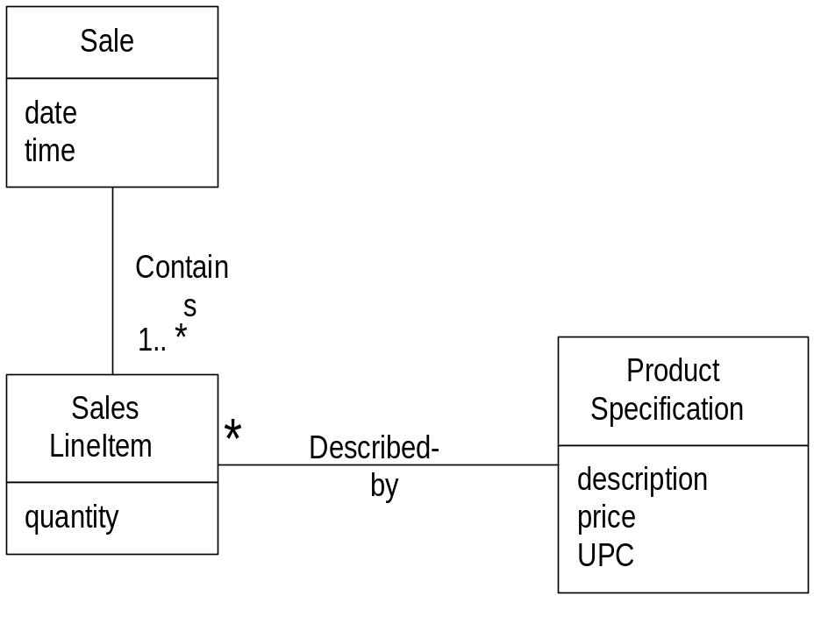
Information Expert — Sale Total Example
Who should know the grand total (总计) of a sale?
Total = ∑price_{i} *qty_{i}
Tell me the total money?
Product has information about Price so it is expert for that (getPrice method)
SalesLineItems has information about Product and Quantity so it is expert for PriceTotal (getPriceTotal method)
Sale has information SalesLineItems with associated PriceTotal so it is expert for SaleTotal (getSaleTotal method)

Slide 38
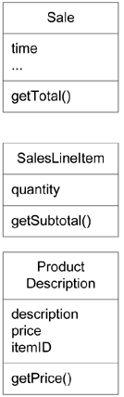
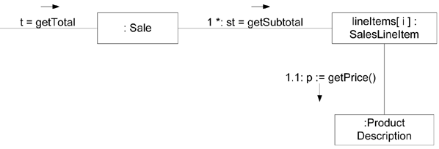

Information Expert — Sale Total
Figure 17.17. Calculating the Sale total
getSubTotal == getPriceTotal
getTotal == getSaleTotal

Slide 39
Information Expert — Sale Total
Hence responsibilities assign to the 3 classes.
Class
Responsibility
Sale
knows sale total
SalesLineItem
knows line item subtotal
ProductSpecification
knows product price

Slide 40
Partial Information Expert
Fulfilling responsibility may require information spread across different classes
  Partial information experts collaborate in task
    — getSaleTotal example
Interact through messages (methods) to share the work

Slide 41
Information Expert — Benefits
Encapsulation
  objects support their own information
  supports low coupling
Behavior is distributed across classes
  supports high cohesion
Contraindications:
Database?

Slide 42
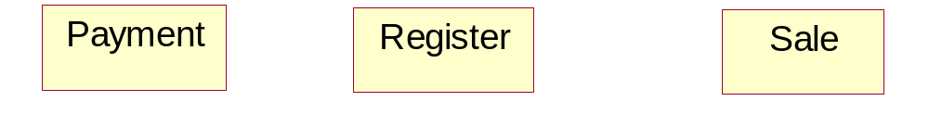
Mini-Exercise 3
Who creates the Payment?
makePayment method invoked in Register
A Payment has to be associated with the Sale
Who creates the Payment instance?
  By creator ➔ Register, Sale are candidates

Slide 43
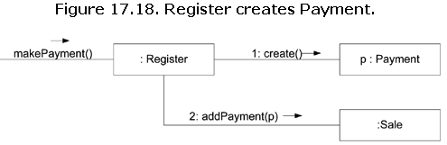
Mini-Exercise 3
Solution 1
Solution 1 — Justification
  Register records Payment
    Creator pattern
  addPayment method passes p instance of Payment as parameter
  Register coupled to Payment class
Notes:
举例: 请班长和学委共同完成某个事情. 我先给学委说,在给班长说,然后班长和学委一起做

Slide 44
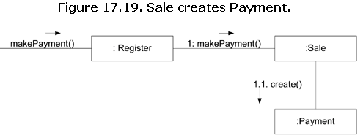
Mini-Exercise 3
Solution 2
Notes:
先找班长,让班长找学委,一起做事.

Slide 45

GRASP rule3： Low Coupling (!)
Name: Low Coupling
Problem:
  How to support low dependency, low change impact and increased reuse?
Solution:
  Assign responsibility so coupling remains low.
    Use this principle to evaluate alternatives
    All other things being equal prefer the low coupling solution
Note: Information Expert encourages Low Coupling
Why most secret service (spy) is one-way contact? 为什么特务工作都是单线联系？
Notes:
2班讲到这儿

Slide 46
Relation with the other patterns
It can't be considered in isolation from other patterns such as Expert and High Cohesion, but rather needs to be included as one of several design principles that influence a choice in assigning a responsibility.
Notes:
可以减少变化的影响,
与其它模式之间的关系?
强的

Slide 47
Coupling
Measure of how strongly one element is:
  1. connected to
  2. has knowledge of
  3. relies on
another element
(耦合：一个元素与其它元素的联接、感知以及依赖的程度的度量)

Slide 48
What is coupling?
(For Example, in Java),
common forms of coupling from X to Y include:
X has an attribute that refers to Y.
X calls on services of Y.
X has a method that references Y (parameter, local variable, or return value).
X is a direct or indirect subclass of Y.
Y is an interface, and X implements that interface.

Slide 49

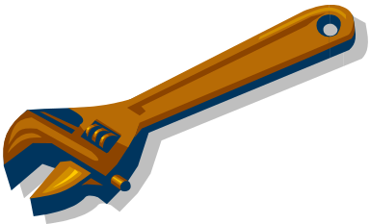
Coupling
Problems with High Coupling
  Forced local changes because of changes in related class
    If there is coupling or dependency, then when the depended-upon element changes, the dependant may be affected.
  Harder to understand in isolation
  Harder to reuse — drags in more classes

Slide 50
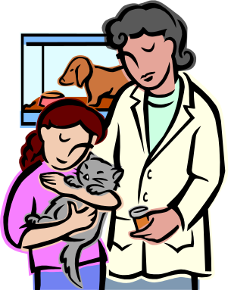

High Coupling
A subclass is strongly coupled to its superclass.
  The decision to derive from a superclass needs to be carefully considered since it is such a strong form of coupling.

Slide 51

Importance
Low Coupling is a principle to keep in mind during all design decisions; it is an underlying goal to continually consider.
It is an evaluative principle that a designer applies while evaluating all design decisions.
Notes:
基本原则之一

Slide 52

How to Evaluate Low Coupling
There is no absolute measure of when coupling is too high.
What is important is that a developer can gauge(评估) the current degree of coupling, and assess if increasing it will lead to problems.
In general, classes that are inherently very generic in nature, and with a high probability for reuse, should have especially low coupling.

Slide 53
Low Coupling-To What Degree
The extreme case of Low Coupling is when there is no coupling between classes.
  This is not desirable
    because a central metaphor of object technology is a system of connected objects that communicate via messages
    Too little coupling means we aren’t a “collaborating community of objects”
  it yields a poor design
    because it leads to a few incohesive, bloated, and complex active objects that do all the work, with many very passive zero-coupled objects that act as simple data repositories.
Some moderate degree of coupling between classes is normal and necessary
  to create an object-oriented system in which tasks are fulfilled by a collaboration between connected objects

Slide 54
Low Coupling — When Not To
High coupling to stable elements and to pervasive elements is seldom a problem.
    e.g. language libraries
    For example, a Java J2EE application can safely couple itself to the Java libraries (java.util, and so on)
    because they are stable and widespread.
Low Coupling Benefits
  Not affected by changes in other components
  Simple to understand in isolation
  Convenient to reuse

Slide 55
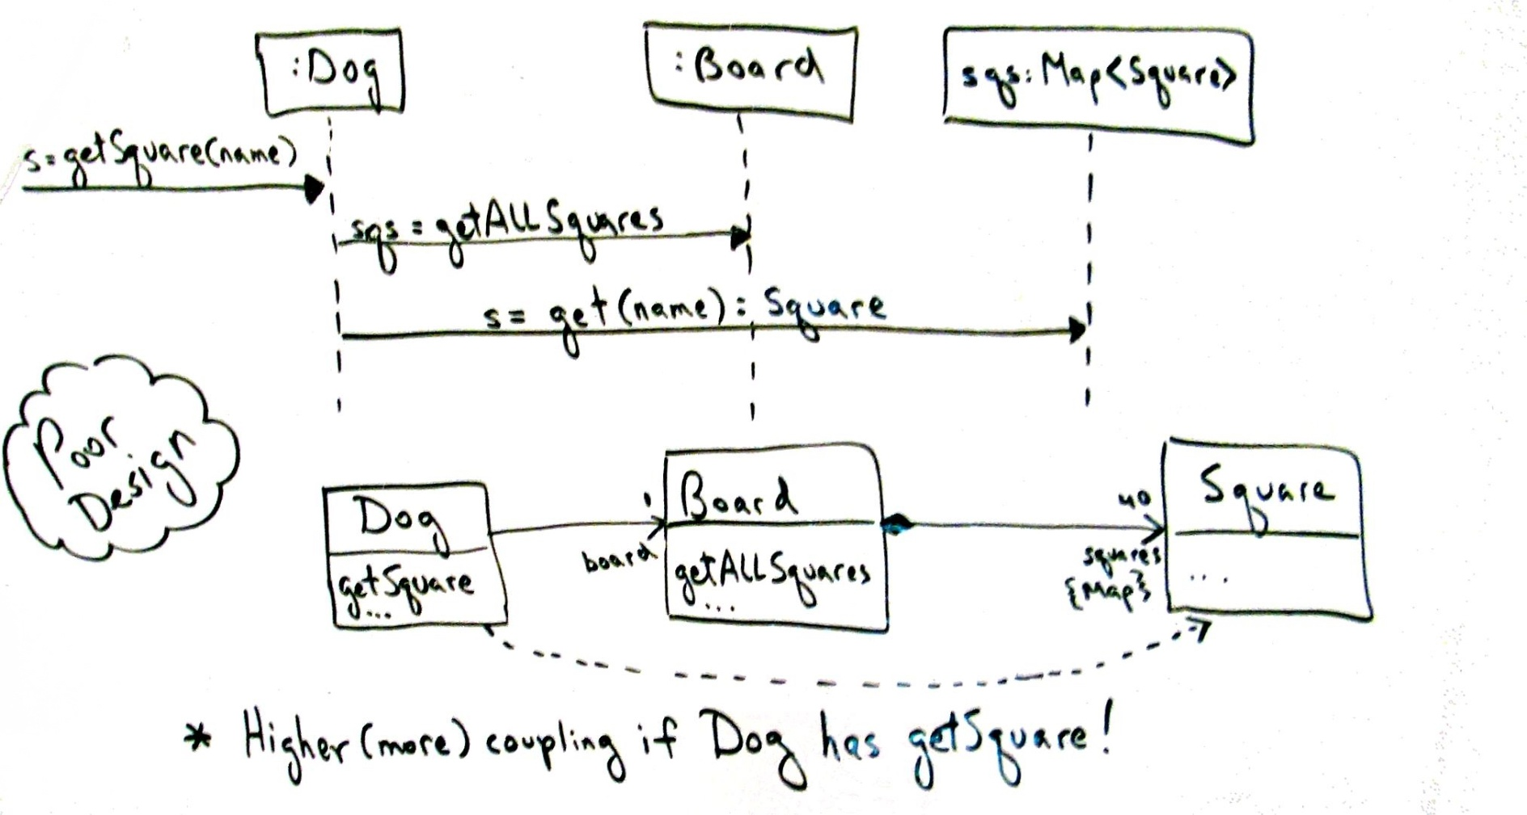
Example : Low Coupling
Why not assign getSquare to Dog (i.e., some arbitrary other class)?
Minimal coupling will reduce change (dependency)

Slide 56
Mini Exercise 4
For Monopoly game, Which object starts the game?
Understanding the Problem
  SSD — boundary between the User and SUD (system under development)
  UI layer “catches” the request
  The request is a system operation — public interface
  Model-View Separation principle says UI must not contain business logic
  Problem: to which domain layer object should the UI pass the system operation ?
Notes:
问题从何而来?

Slide 57
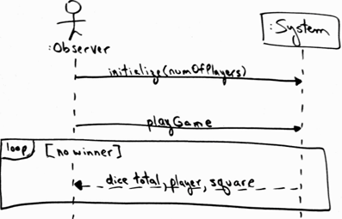
Figure 17.8. SSD for the Monopoly game.
Note the playGame operation
Play game

Slide 58
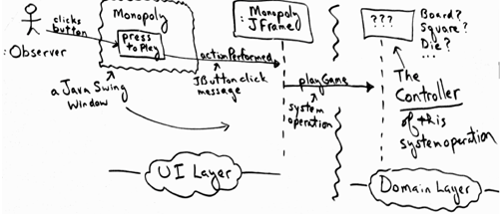
Assign responsibility to receive the system operations by an object which
  Representing System/subsystem/device or
  Handling just this use case

Slide 59
GRASP rule4: Controller
Name: Controller
Problem:
  What first object beyond the UI layer receives and co-ordinates (controls) a system operation
Solution:
  Assign the responsibility to a class representing one of the following choices:
  1. Facade(外观) Controller :
    represents the overall system, a root object, a device that the object is running within, or a major sub-system
  2. Use Case or Session Controller :
    represents a use case scenario within which the system event occurs

Slide 60
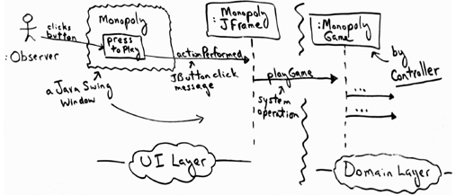
Mini Exercise 4 — Solution
The use case that the playGame system operation occurs within is called Monopoly Game.
  Thus, a software class such as PlayMonopolyGameHandler

Slide 61
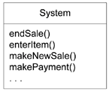
Controller — NextGen POS Example
Figure 17.20. Some system operations of the NextGen POS application
Conceptual representation — what is the class that handles these operations?

Slide 62
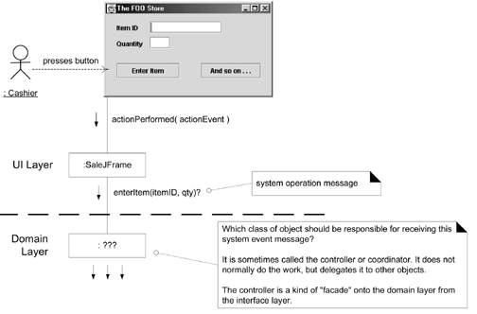

Figure 17.21. What object should be the Controller for enterItem?

Slide 63
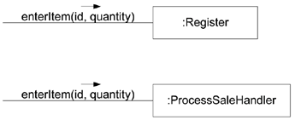
Controller Example for POS
(Solution) options
  Facade: Register, POSSystem
  Session: ProcessSaleHandler, ProcessSaleSession
Figure 17.22. Controller choices

Slide 64
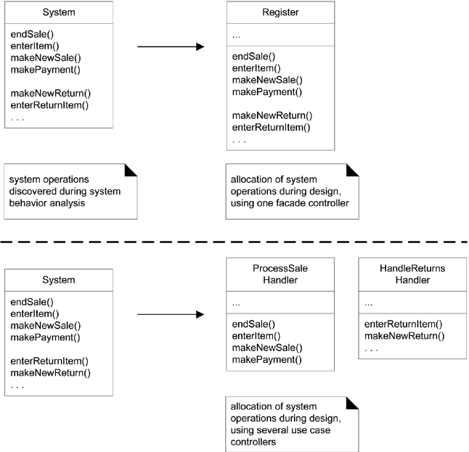
Figure 17.23. Allocation of system operations

Slide 65
Controller — Observations
Delegation pattern
External input events may come from human actors or other systems
  Facade — the “face” of the domain layer to the world
    Ex: Register
  Handler — deals with a clear cut part of the issue事物一个明确的组成部分
    Ex: ProcessSale
  Note : Session — conversation where information needs to be retained between steps

Slide 66
Controller — Facade
Facade外观模式：
  Provide a consistent interface for a set of interfaces in subsystem为子系统中的一组接口提供一个一致的界面
  “cover” over the other layers of the application
  Abstraction of an overall physical unit
    — Register, PizzaShop
  The entire software system
    — POSSystem
  Abstraction of some other overall system or sub-system concept
    — MonopolyGame
Suitable for
  relatively small systems
  and/or system with limited number of system operations
  in message handling system when can’t direct messages to alternative controllers
    — Internet application servers
Notes:
Facade外观模式：为子系统中的一组接口提供一个一致的界面

Slide 67
Session Controller — Use Case
Pure Fabrication
  — ProcessSaleHandler is not a domain concept in Domain Model
When assigning to facade may lead to high coupling or low cohesion (“Bloat”)
Many system operations across different processes
Conceptually easier to understand and build
Session Controllers Naming conventions:
    <UseCaseName> Handler or
    <UseCaseName> CoOrdinator or
    <UseCaseName>Session
  Use same controller class for all system operations in the use case scenario
  Session is a type of conversation between the actor and the SUD

Slide 68
Controller vs. UI
UI should not have responsibility for fulfilling system operations
System operations handled in domain layer
  本书把 应用逻辑层 又称为 架构的 领域层（ref ch13.6)
Controller is responsible for forwarding messages.

Slide 69
Controller — Benefits
Allows for easy change of UI and/or alternative UI
Allows for reuse of domain layer code (UI is usually application specific)
Helps ensure sequence of operation which may differ from UI input
Can reason about system state — UI does not preserve state

Slide 70
Bloated(臃肿的) Controllers — The Problem
Low cohesion — unfocused and handling too many areas of responsibility:
  When have a facade controller handling all of many system events
  When the controller performs many of the system operations instead of delegating
  When the controller has many attributes (much information) about the system
    which should be distributed to or duplicates from elsewhere

Slide 71
Bloated Controllers — The Solution
Add more controllers
  — “session controller” instead of facade
Design the controller so that it delegates operations to other objects
High Cohesion is itself a GRASP principle

Slide 72
GRASP rule 5：High Cohesion
Name：High Cohesion
Problem:
  How to keep objects focused, understandable and manageable, and as a side effect support Low Coupling?
Solution:
  Assign responsibility so cohesion remains high.
Dosage(用法):
  Used as an evaluation tool

Slide 73
Cohesion Defined
measure of how strongly related and focused the responsibilities of an object are
  Cohesion,内聚：程序中的操作之间联系紧密的程度
  Cf: Coupling，耦合：两个子模块之间联系的强度
Goal:
  highly related responsibilities
  small number of responsibilities
Judge：?
  An object with 100 methods in 2000 SLOC
        SLOC: 代码行数source lines of code
  Other object with 10 method in 200 SLOC
  Are you sure the big object can complete task without reference to outside object? (which will increase coupling)
Notes:
代码行数(source lines of code

Slide 74
Cohesion Defined-Reason
An element has high cohesion
  with highly related responsibilities,
  and which does not do a tremendous amount of work
A class with low cohesion
  does many unrelated things,
  or does too much work.
  Such classes are undesirable.
Low cohesion classes often represent
  a very large grain of abstraction,
  or have taken on responsibilities that should have been delegated to other objects.
Notes:
Here.

Slide 75
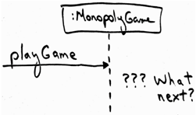
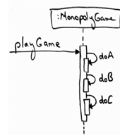
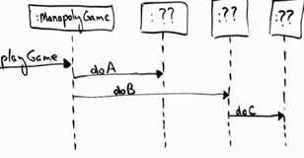

High Cohesion: Monopoly example
Based on the Controller decision, we are now at the design point
  two contrasting design approaches worth considering
Notes:
不良内聚不只是意味着对象仅依靠自己工作，它或许 需要和大量其他对象进行协作
类比：为什么要软件外包？

Slide 76

Low Cohesion — The Problem
Hard to understand
Hard to rescue
Hard to maintain
Subject to constant need to change (usually high coupling)

Slide 77
High Cohesion — NextGen POS Example
The same example problem used in the Low Coupling pattern can be analyzed for High Cohesion. Assume we have a need to create a (cash) Payment instance and associate it with the Sale.
What class should be responsible for this?
Since Register records a Payment in the real-world domain, the Creator pattern suggests Register as a candidate for creating the Payment.
The Register instance could then send an addPayment message to the Sale, passing along the new Payment as a parameter

Slide 78
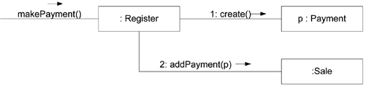
High Cohesion — NextGen POS Example
This assignment of responsibilities places the responsibility for making a payment in the Register. The Register is taking on part of the responsibility for fulfilling the makePayment system operation.
In this isolated example, this is acceptable;
but if we continue to make the Register class responsible for doing some or most of the work related to more and more system operations, it will become increasingly burdened with tasks and become incohesive.

Slide 79

High Cohesion — NextGen POS Example
Imagine that there were fifty system operations, all received by Register. If it did the work related to each, it would become a "bloated" incohesive object.
The point is not that this single Payment creation task in itself makes the Register incohesive, but as part of a larger picture of overall responsibility assignment, it may suggest a trend toward low cohesion.
And most important in terms of developing skills as an object designer, regardless of the final design choice, the valuable thing is that at least a developer knows to consider the impact on cohesion.

Slide 80
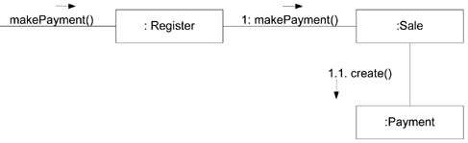
High Cohesion — NextGen POS Example
By contrast, as shown in next Figure , the second design delegates the payment creation responsibility to the Sale, which supports higher cohesion in the Register.
Since the second design supports both high cohesion and low coupling, it is desirable.
Delegating to Sale creates greater cohesion in Register

Slide 81
Things to remember about high cohesion
In practice, the level of cohesion alone can't be considered in isolation from other responsibilities and other principles such as Expert and Low Coupling.
Like Low Coupling, High Cohesion is a principle to keep in mind during all design decisions; it is an underlying goal to continually consider.
It is an evaluative principle that a designer applies while evaluating all design decisions.

Slide 82
High Cohesion — When Not to
One case is the grouping of responsibilities or code into one class or component to simplify maintenance by one person.
  For example, suppose an application contains embedded SQL statements that by other good design principles should be distributed across ten classes, such as ten "database mapper" classes.
  Now, it is common that only one or two SQL experts know how to best define and maintain this SQL. The software architect may decide to group all the SQL statements into one class, so that it is easy for the SQL expert to work on the SQL in one location.
Another case for components with lower cohesion is with distributed server objects. (Performance issues demand grouping a set of operations together)
  Because of overhead and performance implications associated with remote objects and remote communication, it is sometimes desirable to create fewer and larger, less cohesive server objects that provide an interface for many operations.
Notes:
Ch17.14

Slide 83
High Cohesion-benefits
As a rule of thumb, a class with high cohesion:
  has a relatively small number of methods, with highly related functionality,
  and does not do too much work.
  It collaborates with other objects to share the effort if the task is large.
A class with high cohesion is advantageous because it is relatively easy to maintain, understand, and reuse.
The high degree of related functionality, combined with a small number of operations, also simplifies maintenance and enhancements.

Slide 84
High Cohesion a real-world analogy
The High Cohesion pattern has a real-world analogy.
  It is a common observation that if a person takes on too many unrelated responsibilities-especially ones that should properly be delegated to others-then the person is not effective.
  This is observed in some managers who have not learned how to delegate. These people suffer from low cohesion; they are ready to become "unglued“.
Coupling and cohesion are truly fundamental principles in design, and should be appreciated and applied as such by all software developers.

Slide 85
GRASP Review / Summary

Slide 86
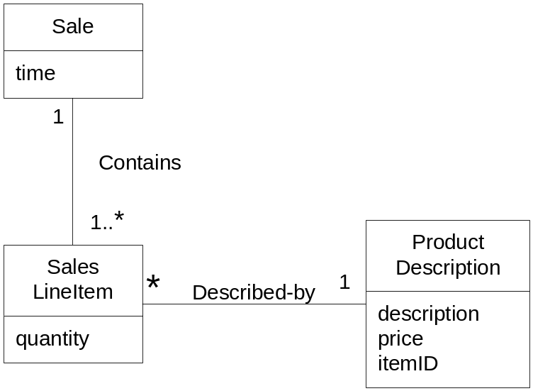
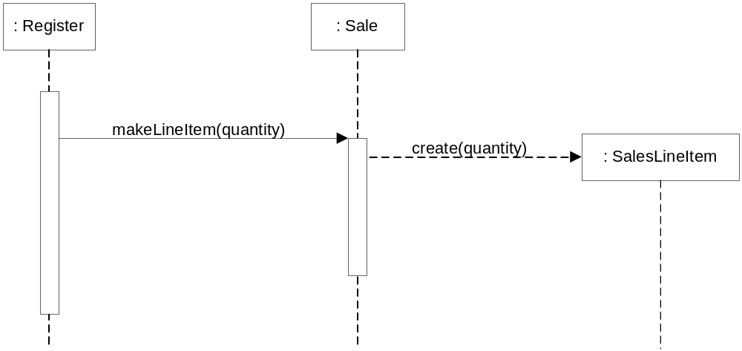
POS: Creator Example
In the NextGen POS application, who should be responsible for creating a SalesLineItem instance?
-- who aggregates, contains, and so on, SalesLineItem ?
Domain Model

Slide 87
NextGEN POS application, some class needs to know the grand total of a sale.
First Step: Start assigning responsibilities by clearly stating the responsibility
  Who should be responsible for knowing the grand total of a sale?
Second Step: Where to find the class
  Design Model first
  Domain Model Second
Sale knows
  All the SalesLineItem instances of a sale and the sum of their subtotals

Slide 88
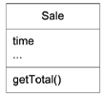


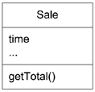

POS: Expert Example
A New method
How to determine the line item subtotal?
This notation will imply we are iterating over all elements of a collection
A New method

Slide 89
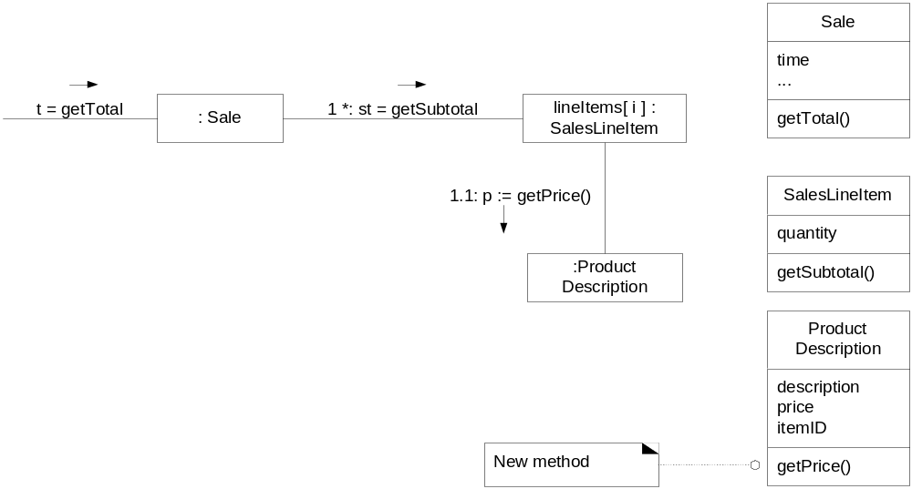
POS: Expert Example cont.
Get Price

Slide 90
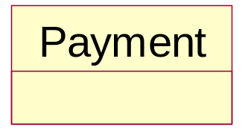
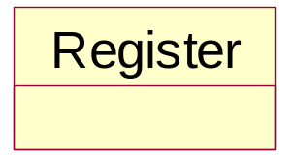
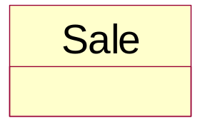
POS: Low Coupling Example bad and good
Assume we need to create a Payment instance and associate it with the Sale. What class should be responsible for this?

Slide 91
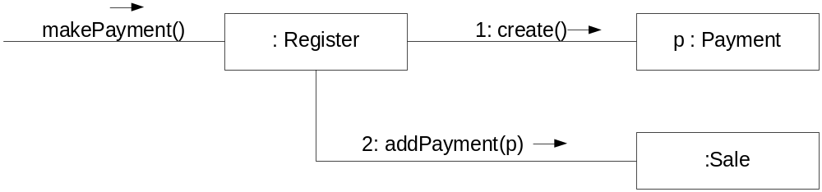
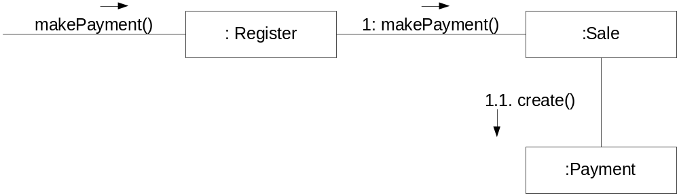
POS: Low Coupling Example bad and good
the Creator pattern suggests Register as a candidate for creating the Payment
supports Low Coupling

Slide 92
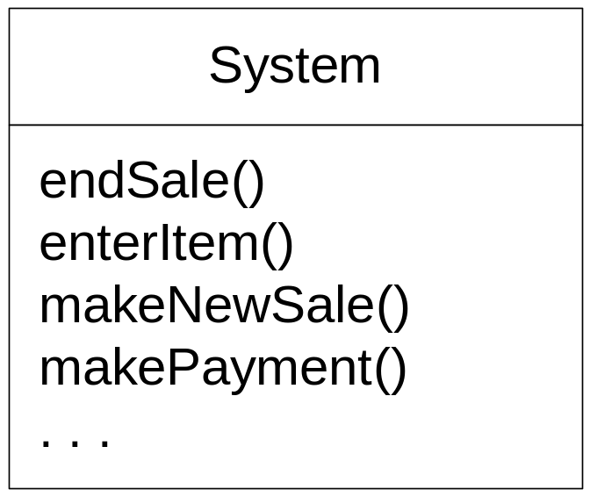
POS: Controller Example
NextGen application contains several system operations
during design, a controller class is assigned the responsibility for system operations

Slide 93
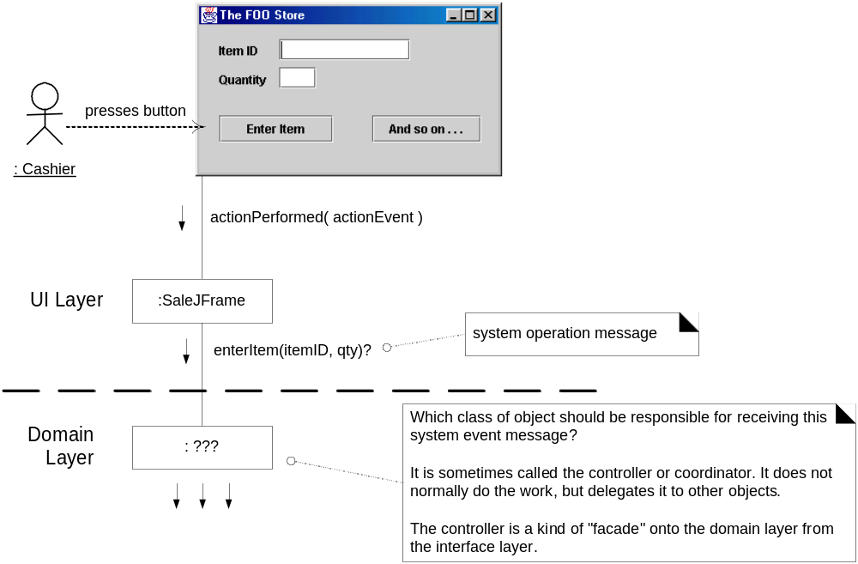
POS: Controller Example

Slide 94
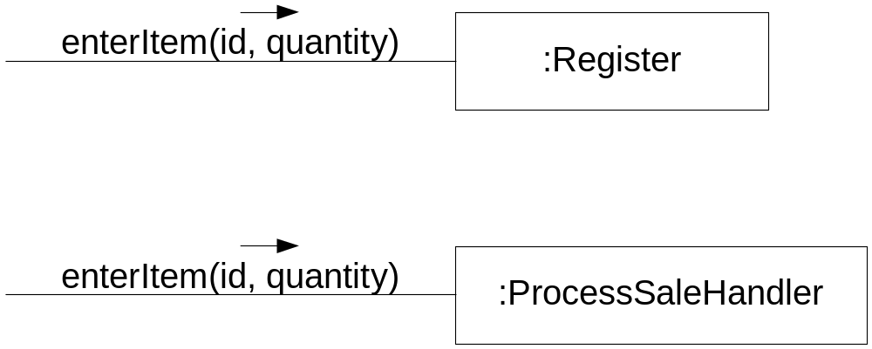
POS: Controller Example - choices
Who should be the controller for system events such as enterItem and endSale?
some choices
Represents the overall "system," "root object," device, or subsystem. | Register, POSSystem
Represents a receiver or handler of all system events of a use case scenario | ProcessSaleHandler, ProcessSaleSession

Slide 95
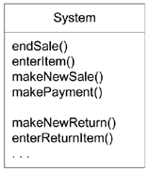
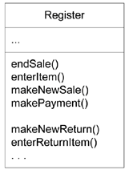
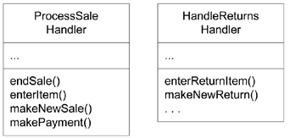
POS: Controller Example - choices
During design, the system operations are assigned to one or more controller classes, such as Register
Find system operations in analyzing system behaviors
在系统行为分析中发现系统操作
Use one Facade controller to assign system operations in design在设计过程中使用一个外观控制器分配系统操作
Use several use case controller to assign system operations in design
在设计过程中使用若干用例控制器分配系统操作

Slide 96

POS: Controller Example – final choice (conformity to physical entity)

Slide 97

POS: UI Thin Layer should not handle System Operations (bad example)

Slide 98

Exercise
Which class should be responsible for creating the Transaction class?
Select any 1 option:
  LineItem
  Customer
  Station
  Payment
  Cashier

Slide 99

Exercise
A well designed Object Oriented System is : (Single select)
A. Is loosely cohesive and loosely coupled.
B. Is tightly cohesive and loosely coupled.
C. Is tightly cohesive and tightly coupled.
D. Is loosely cohesive and tightly coupled.
Consider the following design.
How would the introduction of a subtotal() method in OrderLine improve the design?
(a) It enhances the coherence of Article.
(b) It reduces the coupling of Order.
(c) It reduces the coherence of Order.
(d) It enhances the coupling of Article.

Slide 100
Homework
  Review : Read Text book Ch17~18
  Preparation: Read Text book Ch21 “refactoring”
End

