Slide 1
Object oriented Analysis &Design
面向对象分析与设计
Lecture_14 Design Pattern Principles
主讲: 陈小红
日期: 26/11/8
Notes:
Question 1: UML 在我们的设计里面起到一个什么作用? UML as blue print (ch 22)

Slide 2
32种设计模式
Factory
Façade
Observer
Adaptor
Singleton
Command
Composite
Strategy
内容主要来自如下几本书：
《设计模式》《大话设计模式》《深入浅出设计模式》

Slide 3

Design Pattern & Design Principle
So many patterns
3 Principles
Let’s get started!
Patterns
Principles

Slide 4
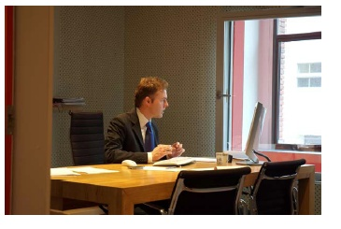
The Job
Joe works at a company that produces a simulation game called SimUDuck. He is an OO Programmer and his duty is to implement the necessary functionality for the game.
The game should have the following specifications:
  A variety of different ducks should be integrated into the game
  The ducks should swim
  The duck should quack

Slide 5
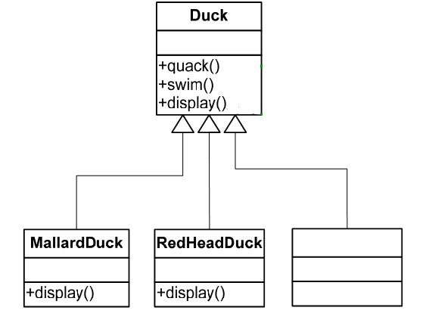
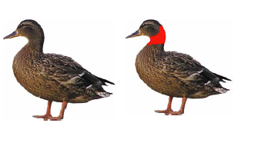
A First Design for the Duck Simulator Game
All ducks quack() and swim(). The super-class takes care of the implementation
The display() method is abstract since all the duck subtypes look different
Each duck subtype is responsible for implementing its own display() behavior for how it looks on the screen
Lots of other types of ducks inherit from the Duck type

Slide 6
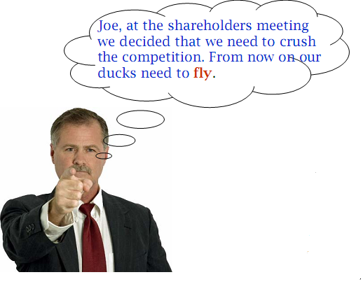
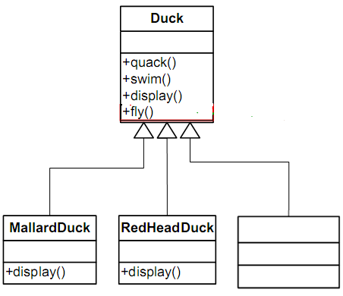
Ducks That Fly
All subclasses inherit fly()

Slide 7
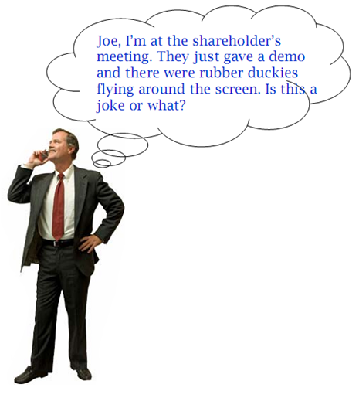
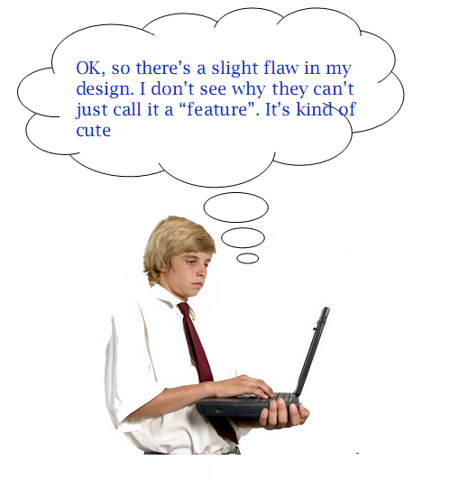
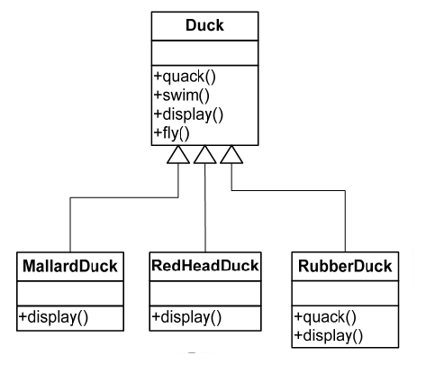

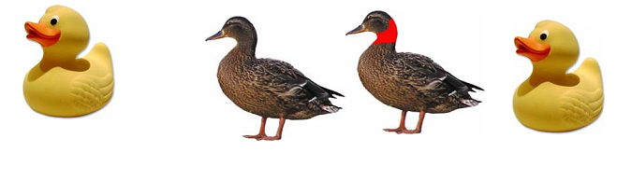
But Something Went Wrong
By putting fly() in the super-class Joe gave flying ability to all ducks

Slide 8
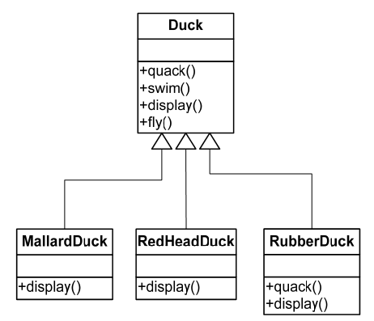
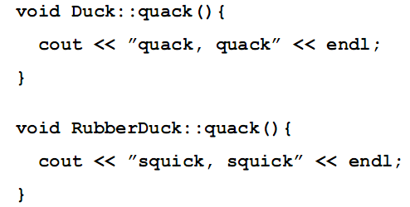
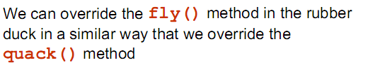
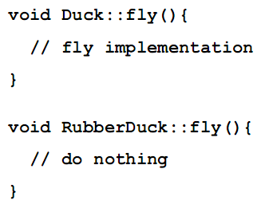
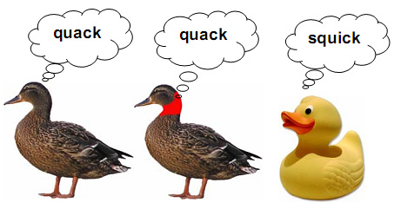
Inheritance at Work

Slide 9
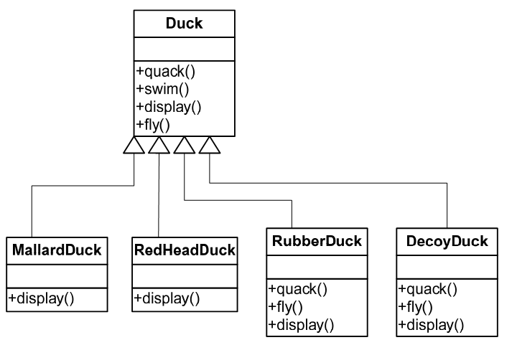
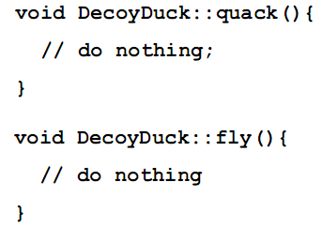
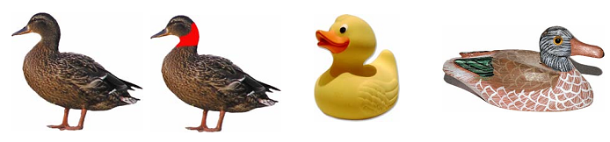
Yet Another Duck is Added to the Application
Problem?
Notes:
但这种实现在扩展时存在缺陷，比如飞翔(Fly)，野鸭可以Fly，但家鸭不会，如果在超类中实现fly()抽象函数，然后子类重写方式，必须每个子类都需要为继承的fly()函数重写代码，这样不会飞的鸭子子类们都要写一遍，势必造成重复代码浪费。此外，不会飞的实例中存在fly()函数也不雅观^_^。

Slide 10
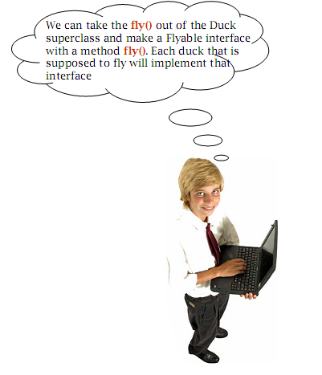

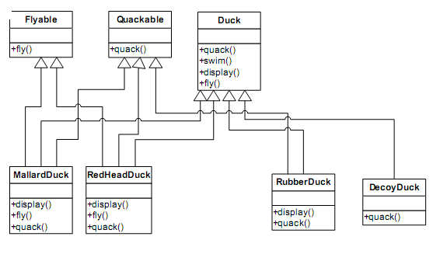

How About an Interface
Notes:
这种方式是一种笨方法，容易造成重复的代码变多，而且无法复用！！！！

Slide 11


Design Principle 1
Notes:
设计原则: 找出应用中可能需要变化之处,把它们独立出来,不要和那些不需要变化的代码混在一起. 分离意味着,代码的变化不会影响不变得成分.
间接性

Slide 12
What is changing?

Slide 13
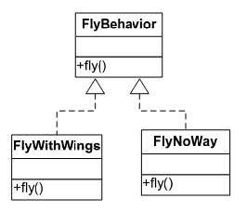
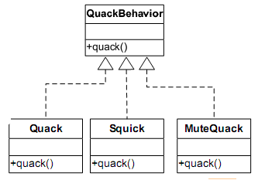





Embracing Change in Ducks
fly() and quack() are the parts that vary
We create a new set of classes to represent each behavior
Void Squick(): :quack{
cout<<“Squick”<<endl;
};
Notes:
Virtual void fly=0

Slide 14
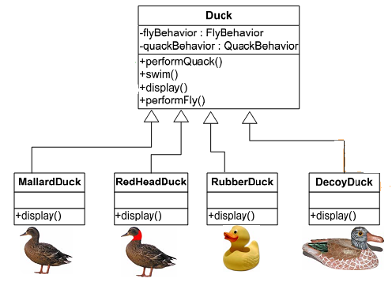
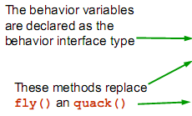
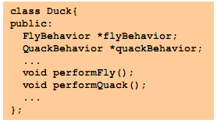
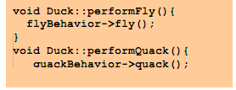


Integrating the Duck Behavior

Slide 15

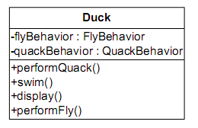

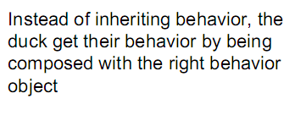
Design Principle Ahead
Notes:
这次Duck类不会实现这两种接口，而是另外定义额外的行为类专门实现这两个接口。这种与之前的行为来自超类的具体实现或是子类implements某个接口由子类自行实现不同【基于“实现”的方式，限制的很死，没办法更改行为(除非写更多代码)】。

Slide 16
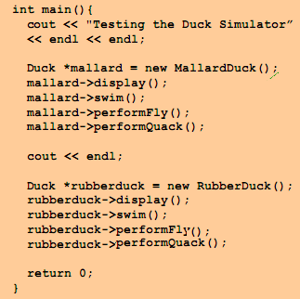
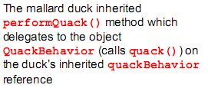
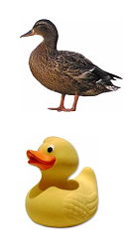
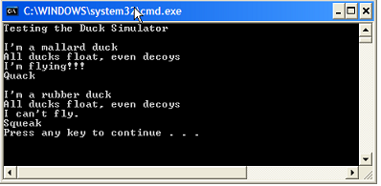
Testing the Duck Simulator

Slide 17
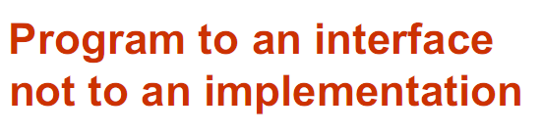
Design Principle 2
Notes:
针对"接口"编程，真正意思是"真正的行为，不会被绑死在超类性的行为上。针对超类型编程"，关键就在于多态，利用多态，程序可以针对超类型编程，执行时会根据实际情况执行

Slide 18
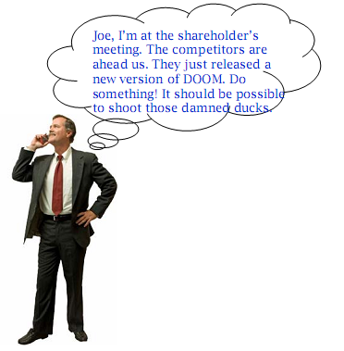
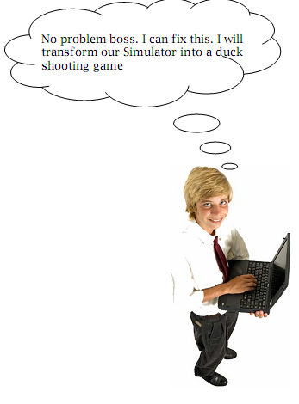
Shooting ducks dynamically

Slide 19
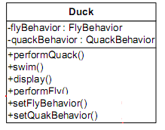
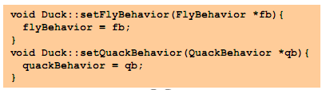
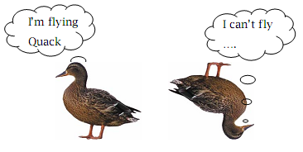
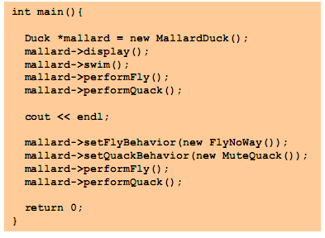
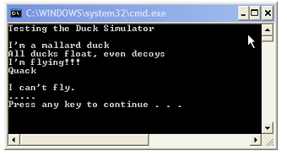
Shooting Ducks Dynamically
Notes:
来动态改变飞翔的行为

Slide 20
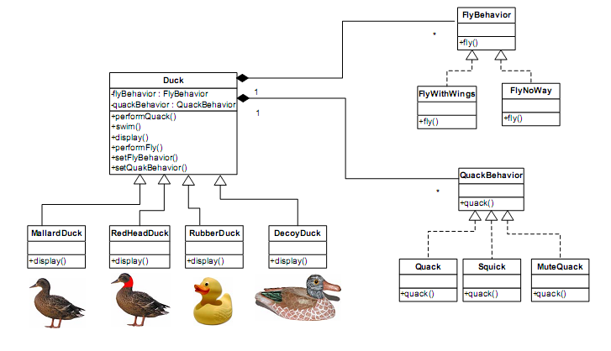
The Big Picture

Slide 21
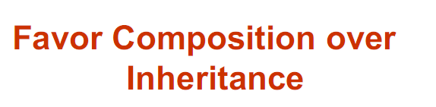
Design Principle 3
Notes:
使用组合建立系统具有很大的弹性，不仅可将算法族封装成类，更可以在"运行时动态地改变行为"，只要组合的行为对象符合正确的接口标准即可

Slide 22
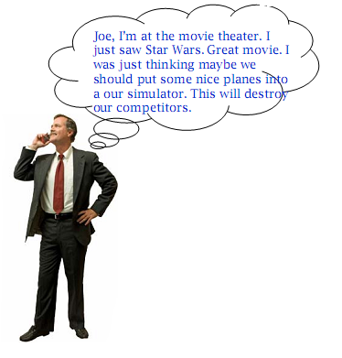
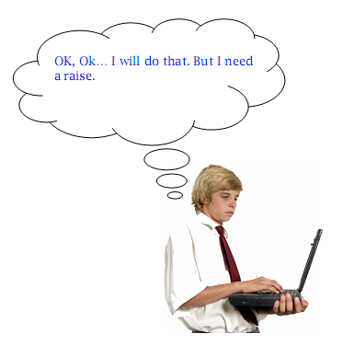
Yet another change

Slide 23
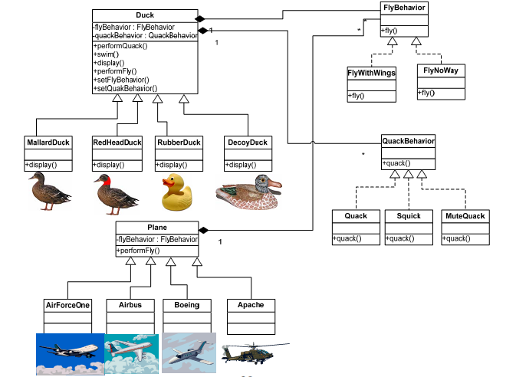
Behavior Reuse

Slide 24

Congratulations
This is a new pattern called STRATEGE!
Notes:
策略模式定义了算法族,分别封装起来,让他们之间可以相互替换,此模式让算法的变化独立于使用算法的客户.

Slide 25
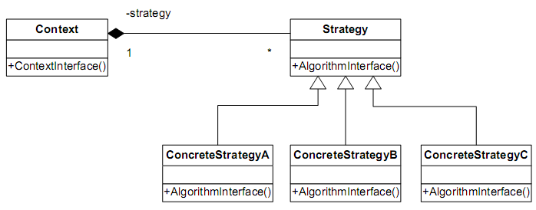
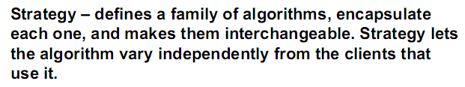
Strategy Pattern Diagram

Slide 26
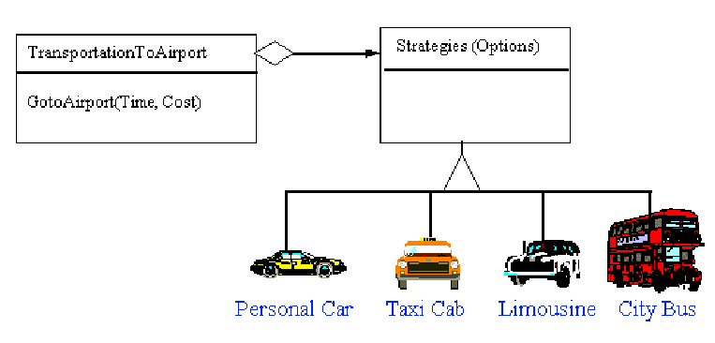
Strategy –Non Software Example

Slide 27

Conclusion
Design principles
  Encapsulate that vary.
  Program to an interface not to an implementation.
  Favor composition over inheritance.
Design pattern
  Strategy

Slide 28
Embracing Change
In SOFTWRRE projects you can count on one thing that is constant:
CHANGE
Solution
  Deal with it
    Make CHANGE part of your design

Slide 29
思考题
如何解决商家打折问题?
巴黎春天打折
  折扣方式改掉怎么办?
  多种折扣方式同时使用怎么办?
Notes:
一个新的例子: 关于比如人种的调查,中国人, 英国人的头发的种类有黑红蓝白等

Slide 30
Homework
写出商场促销的策略模式的设计方案,画出主要的类,并给出简单代码和实现结果。
11月19日提交,纸版和电子版.

