Slide 1
Object oriented Analysis &Design
面向对象分析与设计
Lecture_17 Design Pattern-Singleton
主讲: 陈小红
日期: 26/11/8
Notes:
Question 1: UML 在我们的设计里面起到一个什么作用? UML as blue print (ch 22)

Slide 2
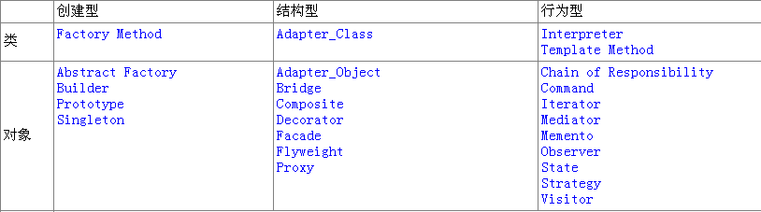
GoF设计模式的分类
（１）Creational（创建型）5个
（２）Structural（结构型）7个
（３）Behavioral（行为型）11个

Slide 3
一个类可以有多少个实例?
类的多重性

Slide 4
单例模式Singleton
有些类也需要计划生育

Slide 5
Problem
Application needs one, and only one, instance of an object.
  examples: keyboard reader, bank data collection
  we'd like to make it illegal to have more than one, just for safety's sake
Notes:
受控访问

Slide 6
Intent
Ensure a class has only one instance, and provide a global point of access to it.

Slide 7


只有一个实例的类
这个类谁来实例化?
  保证它是唯一的实例
这个类的实例可以随时访问
自己
提供访问该实例的方法
Notes:
全局变量可以保证访问实例,但是不能保证实例唯一
举例子可以是自己给别人的交互,每个人都是独一无二的

Slide 8
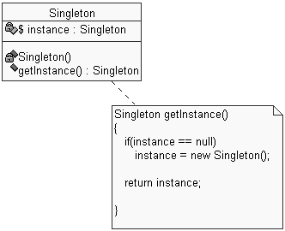
Pattern: Singleton
a class that has only one instance

Slide 9
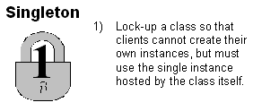
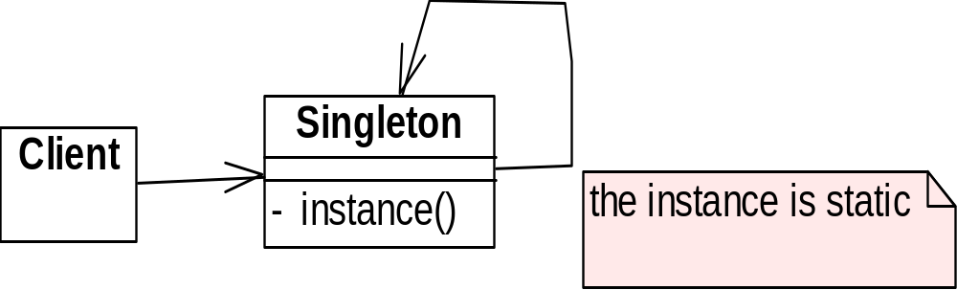
Structure Summary

Slide 10
When to do the instantiation?
Constructor: Hungry instantiation
When used: Lazy instantiation
creation on first use
Which one is better？

Slide 11
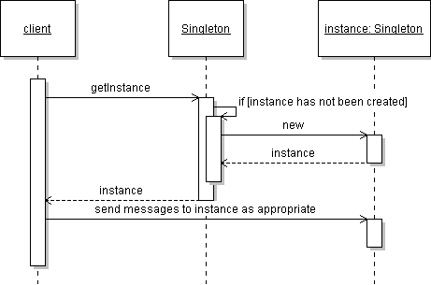
Singleton sequence diagram

Slide 12

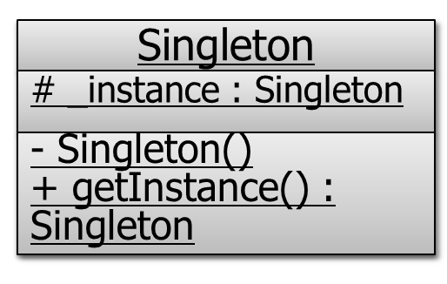
Singleton
Ensure a class has only one instance, and provide a global point of access to it.
public class Singleton {
private Singleton() {}
private static Singleton _instance = null;
public static Singleton getInstance () {
if (_instance == null) _instance = new Singleton();
return _instance;
}
...
}
Lazy instantiation
Tactic of delaying the creation of an object, the calculation of a value, or some other expensive process until the first time it is needed.
return _instance;
Notes:
make constructor(s) private so that they can not be called from outside
declare a single static private instance of the class
write a public getInstance() or similar method that allows access to the single instance

Slide 13
Singleton – implementation 2
class Singleton {
public:
static Singleton* Instance(); // gives back a real object!
static proof(void); // proof that the object was made
protected:
Singleton(); // constructor
private: static Singleton* _singleton;
};
Singleton* Singleton::_singleton = 0;
Singleton* Singleton::Instance() {
if (_singleton == 0) {
singleton = new Singleton;
} // endif
return _singleton;
} // end Instance()

Slide 14
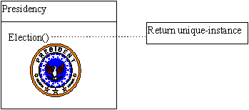
Example
国不可一日无君
一山不容二虎

Slide 15
Forces
  There are two forces that affect the Singleton:
    There must be exactly one instance of the class
    The instance must be (easily) accessible to all potential clients
Solution (Check list)
  Define a private static attribute in the "single instance" class.
  Define a public static getInstance() function in the class.
  Do "lazy initialization" (creation on first use) in the getter function.
    class itself responsible for creating, maintaining, and providing global access to its own single instance.
  Define all constructors to be protected or private.
  Clients may only use the getter function to manipulate the Singleton.

Slide 16
Java Code Fragment: Singleton Pattern
How the Singleton pattern works: A special method
class USTax {
public:
static USTAX* getInstance(); // public static getter function
private:
USTax();
static USTax* instance;
}
USTax* USTax::instance = 0;
USTax* USTax::getInstance(){
if (instance == 0) {
instance = new USTax;
}
return instance;
}
constructors to be private
private static attribute
Notes:
The Singleton pattern works by having a special method that is used to instantiate the desired object. Here is what is most interesting about this special method:
When this method is called, it checks to see whether the object has already been instantiated. If it has, the method just returns a reference to the object. If not, the method instantiates it and returns a reference to the new instance.
To ensure that this is the only way to instantiate an object of this type, I define the constructor of this class to be protected or private.

Slide 17
Singleton example
consider a singleton class RandomGenerator that generates random numbers
public class RandomGenerator {
private static RandomGenerator gen = new RandomGenerator();
public static RandomGenerator getInstance() {
return gen;
}
private RandomGenerator() {}
public double nextNumber() {
return Math.random();
}
}
possible problem: always creates the instance, even if it isn't used
Notes:
这叫饿汉实例化

Slide 18
Singleton example 2
variation: don't create the instance until needed
// Generates random numbers.
public class RandomGenerator {
private static RandomGenerator gen = null;
public static RandomGenerator getInstance() {
if (gen == null)
gen = new RandomGenerator();
return gen;
}
}
What could go wrong with this version?
Notes:
实现了懒汉实例化.但是如果有超过两个以上线程同时访问该函数,可能会生成造成多个实例

Slide 19
Singleton example 3
variation: solve concurrency issue by locking
// Generates random numbers.
public class RandomGenerator {
private static RandomGenerator gen = null;
public static synchronized
RandomGenerator getInstance() {
if (gen == null)
gen = new RandomGenerator();
return gen;
}
}
Is anything wrong with this version?
Notes:
在整个函数上加了锁,是满足的只创建一个实例的问题,但是性能不佳,我们只需要在创建实例的时候进行加锁

Slide 20
Singleton example 4
variation: solve concurrency issue without unnecessary locking
// Generates random numbers.
public class RandomGenerator {
private static RandomGenerator gen = null;
public static RandomGenerator getInstance() {
if (gen == null) {
synchronized (RandomGenerator.class) {
// must test again -- can you see why?
if (gen == null)
gen = new RandomGenerator();
}
}
return gen;
}
}
Notes:
为什么需要双重判断呢? 如果同时有两个线程等在锁外,如果里面不加判断,会出现创建多个实例

Slide 21
Conclusion
The Singleton pattern ensures that a class has only one instance and provides a global point of access to that instance.
But, The Singleton design pattern is one of the most inappropriately used patterns
  The Singleton does not do away with the global; it merely renames it
When is Singleton unnecessary?
  Short answer: most of the time.
  Long answer: when it's simpler to pass an object resource as a reference to the objects that need it, rather than letting objects access the resource globally

Slide 22
Lab related Implement (Before ):
  A global variable is default initialized when it is declared - but it is not initialized in earnest until its first use.
  This requires that the initialization code be replicated throughout the application.
class GlobalClass {
int m_value;
public:
GlobalClass( int v=0 ) { m_value = v; }
int get_value() { return m_value; }
void set_value( int v ) { m_value = v; }
};
// Default initialization
GlobalClass* global_ptr = 0;
void foo( void ) {
// Initialization on first use
if ( ! global_ptr )
global_ptr = new GlobalClass;
global_ptr->set_value( 1 );
cout << "foo: global_ptr is "
<< global_ptr->get_value() << '\n';
}
void bar( void ) {
if ( ! global_ptr )
global_ptr = new GlobalClass;
global_ptr->set_value( 2 );
cout << "bar: global_ptr is "
<< global_ptr->get_value() << '\n';
}
int main( void ) {
if ( ! global_ptr )
global_ptr = new GlobalClass;
cout << "main: global_ptr is "
<< global_ptr->get_value() << '\n';
foo();
bar();
}
// main: global_ptr is 0
// foo: global_ptr is 1
// bar: global_ptr is 2

Slide 23
Lab
// Purpose. Singleton design pattern lab.
// Problem. The application would like a single instance of globalObject to exist, and chooses to implement it as a global. Globals should always be discouraged. Additionally, any code that references the global object, has to first check if the pointer has been initialized, and initialize it if it has not.

Slide 24
// Assignment.
Replace the global variable globalObject with a private static data member.
Provide the pattern-specified accessor function.
Provide for initialization and init testing in the GlobalObject class.
All client code should now use the Singleton accessor function instead of referencing the globalObject variable.
Remove any client code dealing with globalObject initialization.
Guarantee that the GlobalObject class cannot be instantiated.

Slide 25
要求
要求：上交电子版
写出代码
写出最后运行结果
Deadline: 1月5日

