Slide 1
Object Oriented Analysis &Design
面向对象分析与设计
Lecture_02 类图
Presenter: Xiaohong Chen
陈小红
2020/9/15

Slide 2
类、关系、类图
目标：
掌握类的关系以及类图的画法

Slide 3
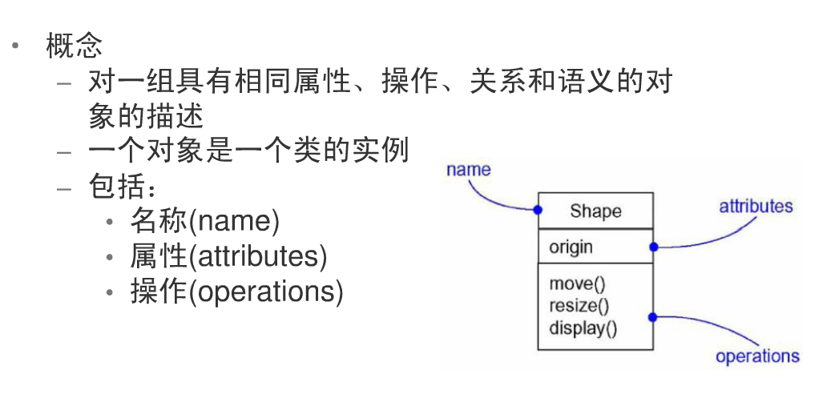
类
概念

Slide 4



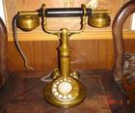

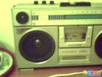
Exercise
How many classes do you find?
bald eagle
Indian elephant
rotary phone
black and white TV
tape recorder
Mako
  animal and digital devices 动物 和电子设备
  Indoor and outdoor things室内事物 和 室外事物
  moving and static things 移动事物 和 静止事物
  If only one class?如果只有一个类？
  图标（Icon)
  endangered things 濒危事物
  thing
In general, class design depends on application domain 总之，类的选择依赖于应用领域
Notes:
The purpose of this chart is to motivate the need for classes.
An obvious answer is two: animals and electronic equipment.
Many other names for these classes are possible and that’s
fine. Another possible answer is things found in the house and
things found outside the house. Or things that move and things
that don’t move. Challenge the students to find a single class that
includes all the objects. Suppose you are the maker of this chart?
How many classes do you see? The answer is one: icons.
Another student said that the chart showed “things that were becoming extinct” since it included: a bald eagle, an Indian elephant, a rotary phone, a black and white TV, a mako灰鲭鲨shark and a beta camcorder !! This is good for a laugh.
Bottom line: The classes chosen depend on the application domain.

Slide 5
类之间的关系
Dependency 依赖
Association 关联
  Aggregation 聚合
  Composition 组合
Generalization 泛化
Realization 实现

Slide 6

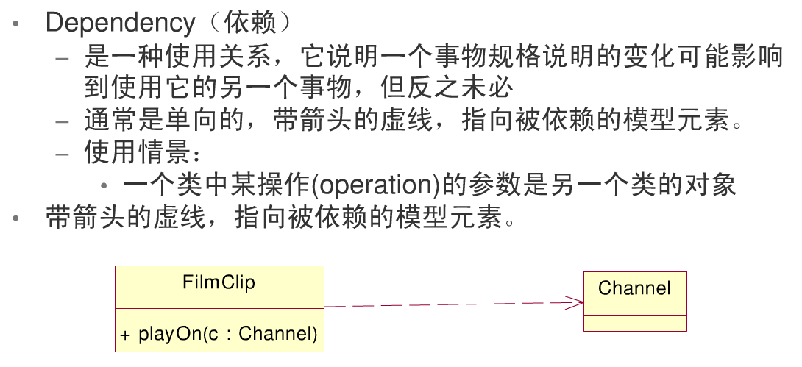
类之间的关系

Slide 7
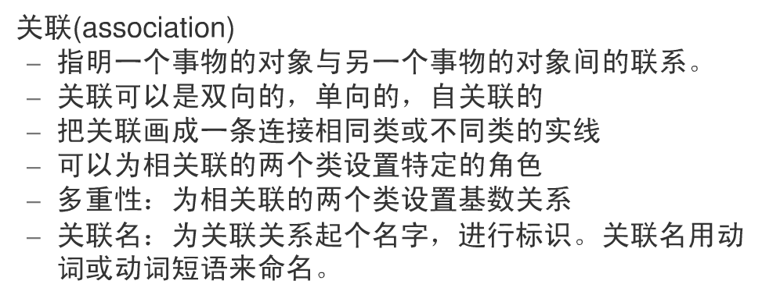

Slide 8
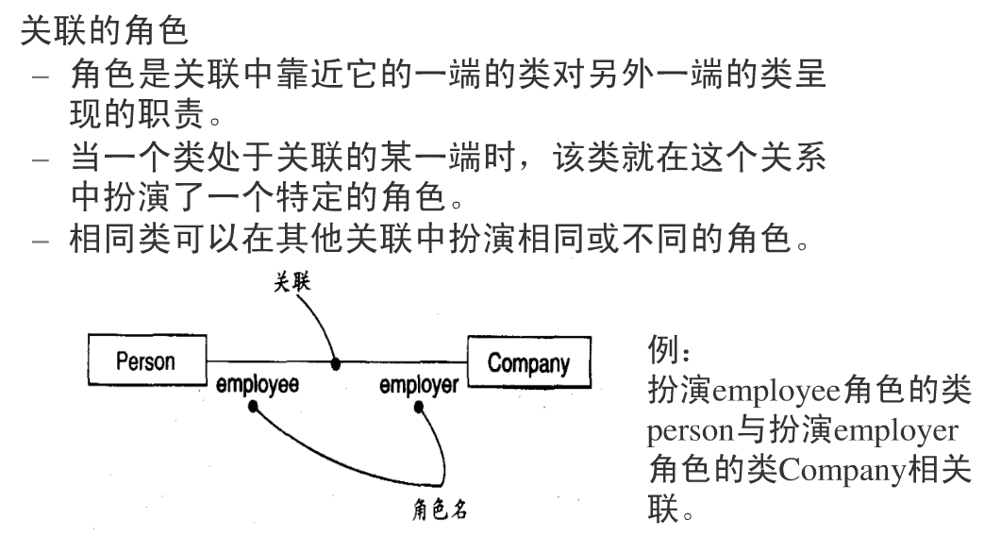

Slide 9
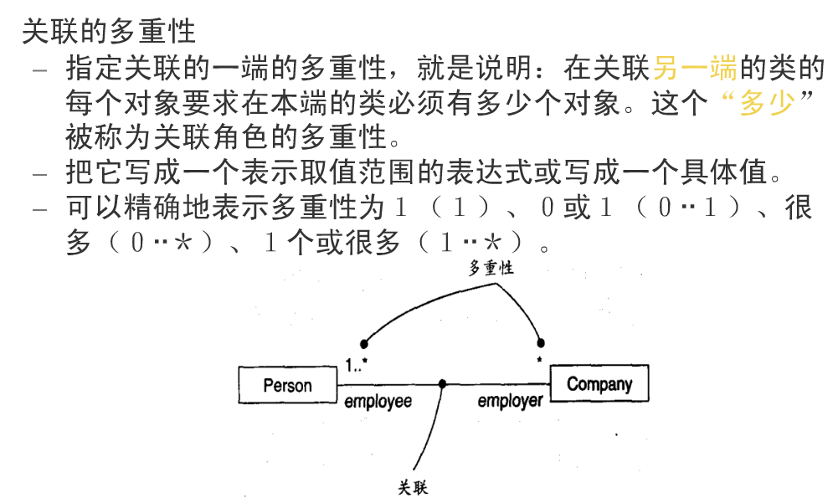

Slide 10
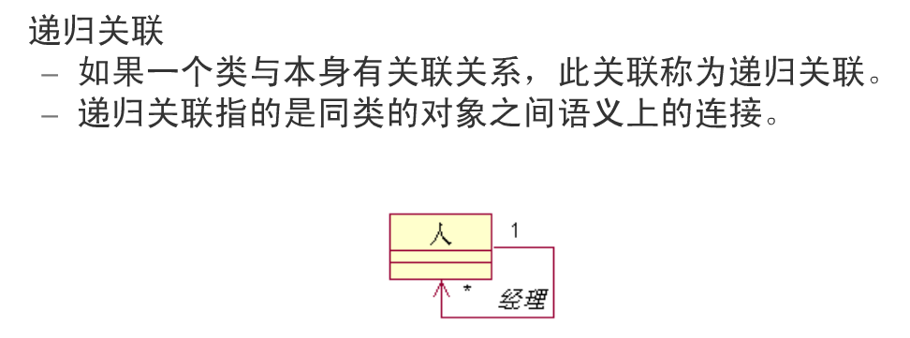

Slide 11
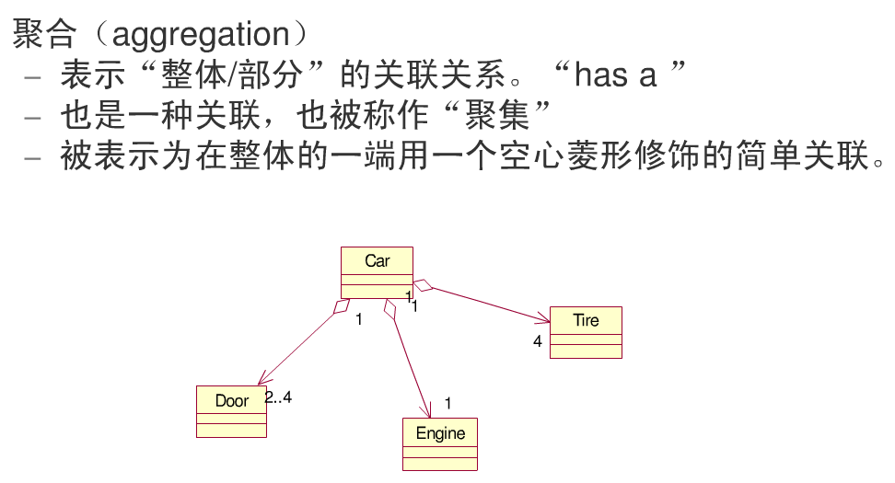

Slide 12
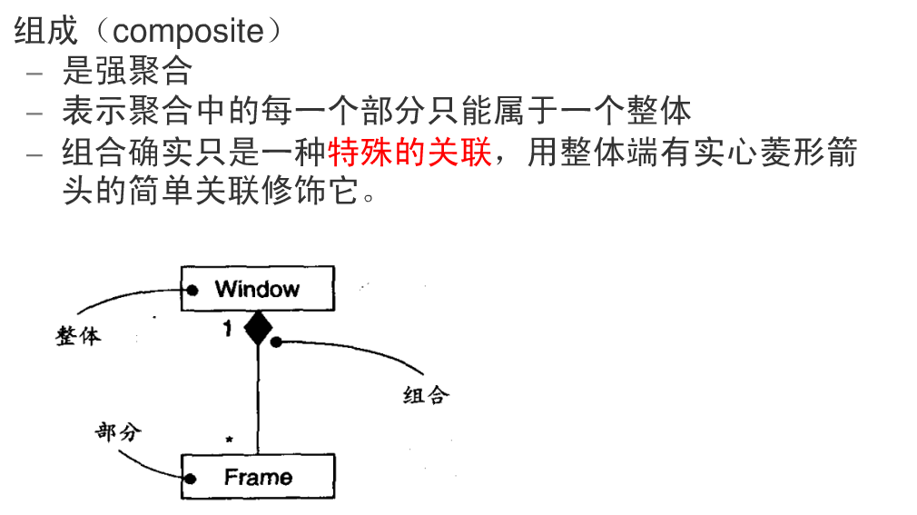
组合

Slide 13
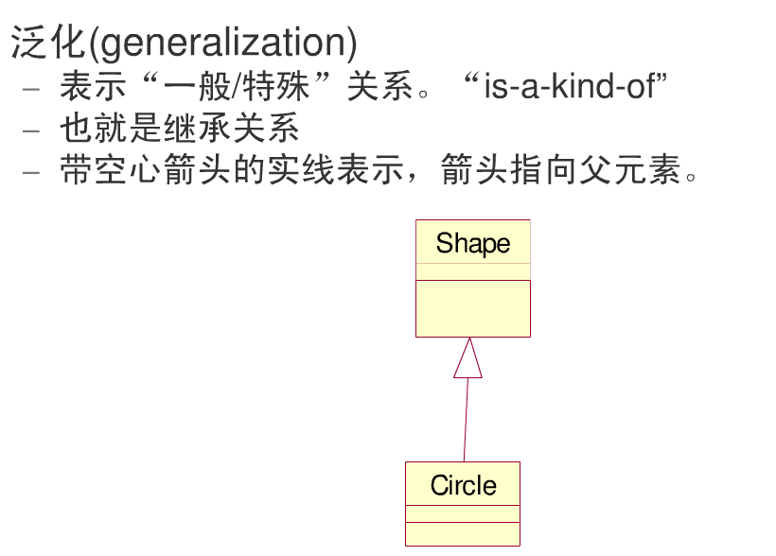

Slide 14
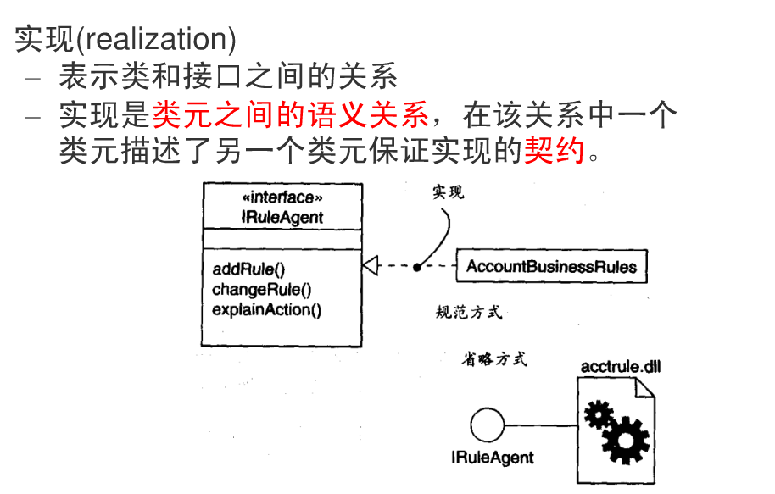

Slide 15
类图
类图
  表示一系列类、接口和它们之间的关系
  表示系统的静态视图
类图的元素
  类
  关系

Slide 16
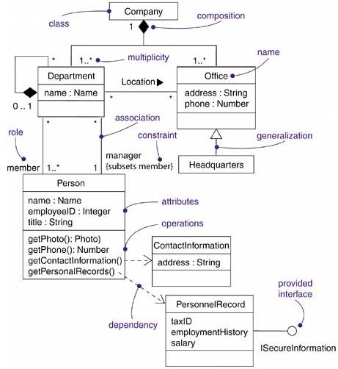
类图的例子
请同学们说出阴影部分所代表的模型元素

Slide 17
练习 1：
创建一个类图。下面给出创建类图所需的信息。
学生（student）可以是在校生（undergraduate）或者毕业生（graduate）。
在校生可以是助教（tutor）。
一名助教指导一名学生。
教师和教授属于不同级别的教员。
一名教师助理可以协助一名教师和一名教授，一名教师只能有一名教师助理，一名教授可以有5名教师助理。
教师助理是毕业生。

Slide 18
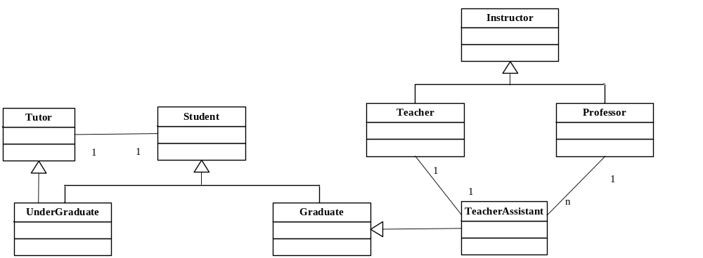

Slide 19
练习 2
Video Store
  Many customers
  Rent, return videos
  Customer number videos rented
  Video rent date / due date
Please find classes and draw Class Diagram

Slide 20
作业-手写
网上订餐系统涉及到的类图？？？
下周二交

Slide 21
End

