Slide 1
Object Oriented Analysis &Design
面向对象分析与设计
CRC card:
Identifying Classes and Objects
Chapter 14.6
Presenter: Xiaohong Chen
陈小红
2020/11/17

Slide 2
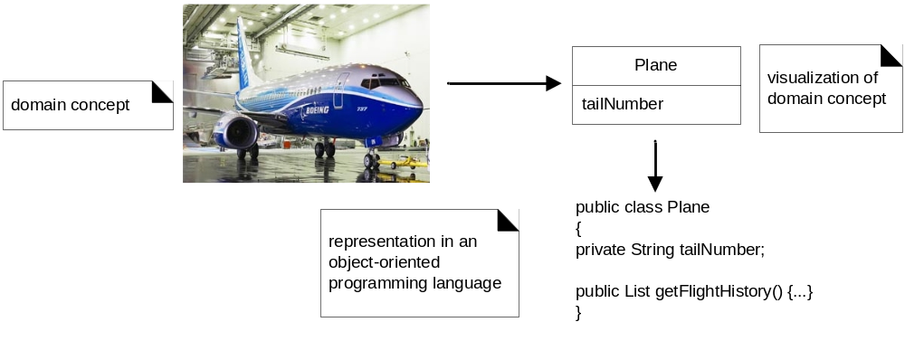
OOAD Review
What is OOA?
  finding and describing the objects or concepts in the problem domain
What is OOD?
  defining software objects and how they collaborate to fulfill the requirements.
For example, Airplane example of object and class discovery
  OOA:
    in the case of the flight information system, some of the concepts include
    Plane, Flight, and Pilot.
  OOD:
    a Plane software object may have a tailNumber attribute and a getFlightHistory method
  At last, implement…

Slide 3

Review: OOAD Simple Example
Dice game example
  software simulates a player rolling two dice. If the total is seven, they win; otherwise, they lose
Notes:
Before diving into the details of requirements analysis and OOAD, we present a birds-eye view of a few key steps and diagrams, using a simple example.

Slide 4
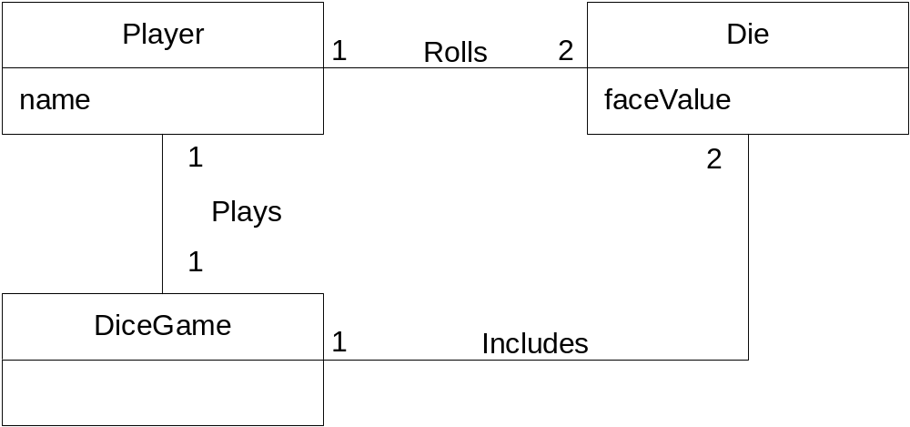
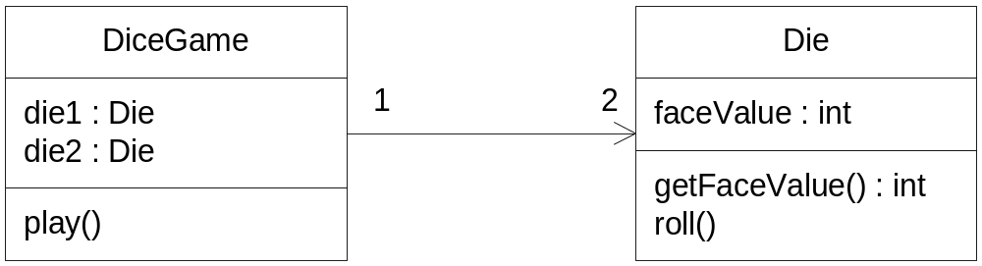
Class diagram
Roll()
<number>/77
Notes:
要求学生画出交互图

Slide 5
What’s next for design?
methods
Notes:
上面是复习, 以及总结常见的错误, class with attributs 下面如果继续设计,怎么继续?

Slide 6
How to find methods in class?
Part of identifying the classes
  is the process of assigning responsibilities to each class
  need not described in Domain Model, but in design model
Every activity that a system must accomplish must be represented by one or more methods in one or more classes
We generally use verbs for the names of methods
In early stages it is not necessary to determine every method of every class
  – begin with primary responsibilities and evolve the design

Slide 7
CRC
One way to find class and assign its responsibilities
  (“Responsibility-Driven Design”)
From Domain Classes and Use Cases to
Design Classes

Slide 8
掌握的内容：
会熟练使用CRC进行
  类的识别
  方法的识别
理解CRC在OOAD中的阶段

Slide 9
CRC
Stands for:
  Classes (of objects)
  Responsibilities (of the objects in each class)
  Collaborations (with objects in other classes)
    In UML, these will be examples of “associations”
Notes:
Remember that an application may have “singleton” classes (classes instantiated only once).

Slide 10


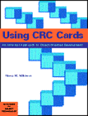
Origin of CRC
Contributors:
  Kent Beck and Ward Cunningham
    “A Laboratory for Teaching Object-Oriented Thinking”
    OOPSLA’89
    also founders of the ideas of XP and design patterns
  Rebecca Wirfs-Brock popularized with “Responsibility-Driven Design” (RDD)
  References
    Rebecca Wirfs-Brock, Brian Wilkerson, Lauren Wiener, Designing Object-Oriented Software, Prentice-Hall, 1990.
    David Bellin and Susan Simone, The CRC Card Book, Addison Wesley Longman, 1997. (google 图书)
Notes:
Kent Beck and Ward Cunningham first introduced CRC cards at OOPSLA ’89 in their paper “A Laboratory for Teaching Object-Oriented Thinking”. Originally their purpose was to teach programmers the object-oriented paradigm.
Kent Beck and Ward Cunningham together had experienced an approach to software development that made every thing seem simple and more efficient. Object-oriented programming systems, languages and applications

Slide 11
The Basic Idea
CRC cards are paper index cards on which one writes the responsibilities and collaborators of classes.
Each card represents one class.
A CRC modeling session involves
  a group sitting around a table, discussing and writing on the cards as they play "what if" scenarios with the objects, considering what they must do and what other objects they must collaborate with
A card contains:
  The name of the class.
  The responsibilities of the class.
  Collaborations: other classes with which this class inter-operates, in conjunction with the attendant responsibility.

Slide 12

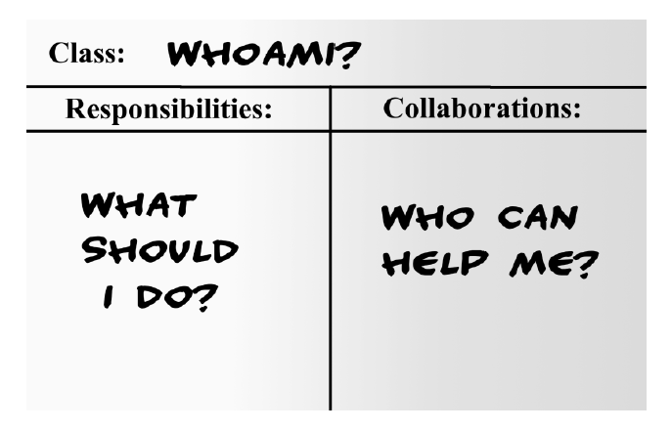
A typical CRC card

Slide 13
Image of CRC cards
Super/sub-class are optional
Class Name
super class
sub-classes
Responsibilities
___________
___________
____________
Collaborations
____________
____________
____________
Use index cards, or single PowerPoint slides.
Limiting the size of a card is an attempt at preventing
the class from becoming too complex.

Slide 14
CRC Cards Technique
CRC properties
  Informal, non-detailed
  Used for group brain-storming
  Ending result is a first cut at classes for an object-oriented model
  Not intended to provide a complete design

Slide 15
Process
Brainstorming
Identify core classes (go to analysis)
  Critical classes
  Irrelevant classes
  Undecided classes
Assign responsibilities
Assign collaborations
Notes:
Combine Synonyms

Slide 16
CRC Input : Use-Case
A good starting point for CRC analysis is a clear statement of all of the use-cases.
Use-cases drive the introduction of CRC cards.
Use-cases, or their accompanying scenarios, can be used as a kind of script for the role-playing method of checking the CRC cards.
  The role-playing could be replaced with sequence diagrams.

Slide 17
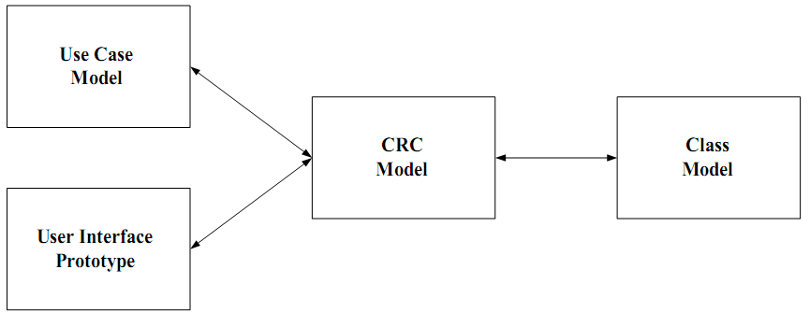
How CRC modeling fits in
Notes:
in general the definition of use cases
and prototypes generally come before a CRC model, which in turn generally comes before a class
diagram. The reason for this is simple: Use cases and user interface prototypes are less detailed than
CRC models, which in turn are less detailed than class diagrams. Yes, while you are CRC modeling you
will draw sketches, or prototypes of screens. Yes, while you are CRC modeling you will identify new use
cases and/or update existing ones. In general, however, you will find that it is better to start out “simple”
with use cases and prototypes, get a little more complicated with CRC cards, and then get even more
complicated with class diagrams.

Slide 18
Sample Application:
A graph-drawing program
Process screen image
Typical Application
Use-Cases:
  Draw shape
  Move shape
  Resize shape
  Connect shapes
  Erase shape
  Erase connector

Slide 19
Example of CRC card for a graph-drawing program (1)
Class
Shape

Slide 20
Example of CRC card for a graph-drawing program (2)
Shape
Remember size
Remember position
Remember fill color
Remember border
Remember connectors
Change size
Change position
Responsibilities

Slide 21
Example of CRC card for a graph-drawing program (3)
Shape
Remember size
Remember position
Remember fill color
Remember border
Remember connectors
Change size
Change position
Line
Collaborations
Connector

Slide 22
Example of CRC card for a graph-drawing program (4)
Shape
super class: Drawable
sub-classes: Rect, Oval, Group
Super- and
Sub-classes
Remember size
Remember position
Remember fill color
Remember border
Remember connectors
Change size
Change position
Line
Connector
Notes:
Canvas : Drawable

Slide 23
Example of CRC card for a graph-drawing program (5)
Drawable
super class:
sub-classes: Shape
Responsibilities
Draw self on canvas
Canvas
Collaborations
Note: The Drawable doesn’t necessarily need to remember a Canvas,
since the Canvas could be passed as an argument to the draw method.

Slide 24
Example of CRC card for a graph-drawing program (6)
Canvas
super class:
sub-classes:
Remember Drawables contained in self.
Responsibilities
Drawable
Collaborations

Slide 25
Summary
Guidelines:
  Who?
  How?
  Where?

Slide 26
下面的内容自学

Slide 27
CRC guide-who
Who Writes CRC Cards?
  No one individual has all needed knowledge
  Best to write CRC cards as a team, rather than individually
  Analysis team should consist of five or six experienced individuals :
    one or two user domain experts
    one or two systems analysts
    one OO software designer
    one team facilitator and leader
    The team can include clients as well as developers (even though we are partly in the design phase)
  Smaller teams lack diversity, larger teams make consensus difficult to achieve
  Facilitator should be skilled at OO and group techniques, not be a "boss" of team
  Writing of CRC cards focuses team activities

Slide 28
CRC guide-how
Brainstorming
  Groups work by
    collecting a diverse set of ideas,
    comparing the ideas, and
    synthesizing unanticipated solutions.
  A "brainstorming" session is a good way to collect the ideas quickly and creatively.
  Brainstorming principles [Bellin and Simone]:
    All ideas are potentially good ideas.
      Don‘t censure yourself or others -- all ideas are equal
    Think fast and furiously; ponder later.
      A fast-paced discussion encourages individual creativity
    Give every voice a turn.
      Include everyone in the group. Don't let the loudmouths dominate.
    A little humor can be a powerful force.
      Humor can help break down barriers, relieve tension, and build trust needed for a cohesive and effective group

Slide 29
CRC guide-where to find the candidate classes
Sources for the Candidate Classes
  Before the brainstorming session, assign each team member an investigative task [Bellin and Simone]:
  Read all requirements documents
    Examine the formal requirements document (if any)
    Don't overlook the indirect sources -- memos, meeting minutes, etc.
    Circle nouns and noun phrases -- these are potential classes
  Look carefully at reports
    Examine the reports generated in the system being replaced (manual or automated)
    Examine the profiles for the reports desired in the new system
    Again circle nouns and noun phrases -- these are potential classes
  Conduct interviews
    Talk to experienced users of the current system
    Record interview or take careful, precise notes
    Again identify nouns and noun phrases as candidate classes
  Examine documentation and files
    Review the documentation on the current system
    Try to review any unofficial or personal notes users or maintainers of the system have
    Again identify nouns and noun phrases as candidate classes
  A good analyst is a good detective!

Slide 30
Once the CRC cards are constructed …
Examine?

Slide 31
Once the CRC cards are constructed …
Team can engage in role-playing to verify that use-case scenarios make sense for chosen CRC.
Each person can role-play one or more class cards.
If something doesn’t work, change the class accordingly.
Revision of use-cases might also be indicated.
Notes:
类似小孩玩‘过家家’

Slide 32
Summary：Steps for creating Model using CRC
1) Team building
  Including client, designer, analyst, and a leader. If there are not so many people, the team can consist of only you and your client.
2) objects finding
  Find out the nouns and phrases in the requirement, and pay attention that the singular number of plural numbers (usually a set) is the correct one.
  write down the concepts you first conceive on the paper, no matter how ridiculous they are.
3) Selection
  Classify objects into three groups, the core object (the first to be realized), optional (uncertainty right now), and the unnecessary object. Your project scope should be confirmed before hand. Some objects which are not belonging to this projects can be put aside
4) Card fetching
  Fetch the CRC card, and write core class down on each card, then write optional class and excluded class down on different papers.
5) Role playing
  A team is better than a person alone to carry out the task. Everyone is in charge of several classes. For every scenario in use case.
  The leader assign a class to one person, and he will evaluate that if he can complete it independently, if not, everyone will look at their classes, and stand up if he could do it so as to continue this process.
  Anyone can sit down after fulfilling his responsibilities.
  In this process, responsibilities of class would be continuously modified and actor’s name would be written down.
Notes:
最好是一个团队执行，一个人很难做。每个人负责几个类。对每一个Use case其中的情景。导引者指定从某一个人的类开始，某一个人看一看自己能够独立完成，如果不能完成，大家看一看手中的类，谁能完成，就站起来，宣布自己能够完成，以致继续这个过程，每个人完成自己的职责就坐下。在这过程中不断修改类的责任，并写下协作者的名字。

Slide 33
总结
CRC卡方法
  类的识别
  方法的识别
思考
  CRC card 得到的类？
  是分析类还是设计类？？

Slide 34
作业：
Exercise yourself*
  Review the ATM case and CRC principle and method carefully, and understand the essence of using such method to analyze classes and responsibilities.
  Deadline:
  11.24
Notes:
此处也可以使用museum的例子

