Slide 1
UML及形式化建模
UML Unified Modeling Language
Lec 04 Usecase 案例 ref text Ch17-18
主讲: 姜宁康 博士
日期: 26/11/8

Slide 2
大夏学堂
提醒：
  参与论坛讨论，都是平时成绩的一部分。不能放弃啊！
  不要怕提出自己的想法
  不要怕提出反对意见
  不要担心其他人的反映
UML Lecture_04, Author: NK Jiang
<number>/50

Slide 3
Review Usecase
参与者/ 用例 /用例图
  如何发现参与者？
    ①谁使用系统？
    ②谁安装系统、维护系统？
    ③谁启动系统、关闭系统？
    ④谁从系统中获取信息，谁提供信息给系统？
    ⑤在系统交互中，谁扮演了什么角色？
    ⑥系统会与哪些其他系统相关联？
    ⑦系统有无定时器？
  如何发现用例？
    ①参与者希望系统提供什么功能；
    ②系统是否存储和检索信息；
    ③当系统改变状态时，是否通知参与者；
    ④是否存在影响系统的外部事件，是哪个参与者通知系统这些外部事件。
  用例图
    Actor之间的关系/用例之间的关系、用例图上的基本建模元素
<number>/50

Slide 4
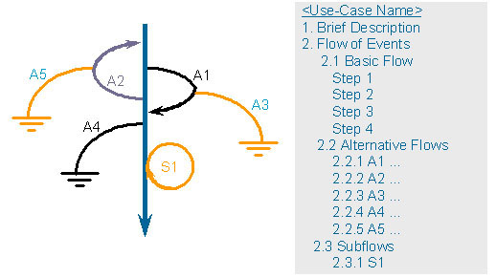
Review Usecase
用例描述（Usecase Description
是不是就这么简单呢？
  例如，“打”
    “甲和乙打起来了”
    “领导和群众打成一篇”
  意境的差异
    “两个黄鹂鸣翠柳”
    翻译成英文就成了
    “两个小鸟在唱歌 there are two birds singing”
  文化、习俗的差异
建模的主要目的是沟通！
UML Lecture_01, Author: NK Jiang
<number>/50

Slide 5
Review
(1) Whenever you can say that
“Item B is always a type of Item A,” or
“Item B is always a kind of Item A,”
that indicates that you have a generalization relationship such that Item B is the specialization and Item A is the generalization;
(2) Includes relationships are identified when one Use Case always uses another Use Case;
(3) Extend relationships are identified when one Use Case sometimes (but not always) uses another Use Case.
UML Lecture_01, Author: NK Jiang
<number>/50

Slide 6
Exercise
1/ What is TRUE about Use Cases? (Pick 3)(Multiple Choices)
  A. Use cases provide the basis of communication between sponsors and developers in planning phase
  B. Use cases description provides a good source to identify domain concepts
  C. A fully-dressed use case should include both “what’s” and “how’s” so that they are ready for “realization”
  D. A use case is an interaction between a user and a system.
2/ Which of the following is false about Use Case Analysis?
  A: An Actor must be directly associated with at least one use case in the system.
  B: A use case must be directly related to at least one actor of the system
  C: A use case can be related to actors and other use cases.
  D: Actors can be people, machines, or other systems.
UML Lecture_01, Author: NK Jiang
<number>/50
Notes:
1\C :false
2\B

Slide 7
本讲主要内容
用例描述注意事项、要点
用例建模案例
  数字相机
  银行支付系统
系统开发与UML
  过程及概念
UC Description - How to Formulate作简洁陈述
UML Lecture_01, Author: NK Jiang
<number>/50

Slide 8
Use case Description
Be written in different formats and levels
  Brief / summary
  Casual
    Informal paragraph format.
    Multiple paragraphs that cover various scenarios. The prior Handle Returns example was casual
  fully dressed
    All steps and variations are written in detail
UML Lecture_01, Author: NK Jiang
<number>/50
Notes:
Answer to exercise
1/ ABD
2/ B
3/B

Slide 9
UC Description - How to Formulate作简洁陈述
Clear and consistent writing style
  makes both reading and writing easier and more enjoyable
Use Simple Grammar:
  Subject + Verb + Object + Prepositional Phrase
  e,.g., The System deducts the amount from the account balance.
Show clearly "Who has the ball“
  A scenario(场景） is similar to a group of children (actors/system) kicking the ball (message/data passed from actor to actor).
Write from a Bird‘s Eye View（设计师所站的角度要高一点）
  Don't fall into programmer's trap to take only the system's perspective.
  E.g.,
    The Customer puts card and PIN in the ATM
    Instead of : Get ATM card and PIN.
<--- Better!
UML Lecture_01, Author: NK Jiang
<number>/50
Notes:
formulate [简明英汉词典]
[5fC:mjuleit]
vt.用公式表示, 明确地表达, 作简洁陈述
v.阐明

Slide 10
UC Description - How to Formulate
Show the process moving forward
  Find the right granularity（事件的粒度？） for events
  Ask "Why is the actor doing that?"
    Eg,. User enters name and address
    Instead of: User hits tab key
Show the actor's intent, not the movement
  Don't pollute the use case with your current idea of the user interface. E.g,
    1. User enters name and address. (better)
  Instead of
    1. System asks for name.
    2. User enters name.
    3. System prompts for address.
    4. User enters address and clicks "OK".
不要将用户界面的设计混杂到用例中：用例应该是“界面无关的”
UML Lecture_01, Author: NK Jiang
<number>/50

Slide 11
UC Description - How to Formulate
One step in reality(事实) is one step in description. E.g.,
  1. The Customer enters the order number.
  2. The System detects that it matches the winning number of the month.
  3. The System registers the Customer and order number as the month's winner, and sends an email to the SalesManager.
  4. The System congratulates the Customer and gives them instructions on how to collect the prize.
Instead of
  1. The Customer enters the order number. The System detects that it matches the winning number of the month. The System registers the Customer and order number as the month‘s winner, and sends an email to the SalesManager. The System congratulates the Customer and gives them instructions on how to collect the prize.
不要整段整段地书写！
每一步说明一件事情
UML Lecture_01, Author: NK Jiang
<number>/50
Notes:
reality英 [riˈæləti] 美 [riˈælɪti]
n.事实; 现实，现实性; 真实情况，实际情形; 实体，实在;

Slide 12
UC Description - How to Formulate
'Validate' instead of 'Check Whether'
  If the system has to verify something, 'check' is a poor word
    You always had to write later "If the check passes..." "If the check fails..."
    Better words to use: 'establish', 'validate', 'ensure', 'verify‘
  E,g
    1. The System validates that the password is correct.
    2. The System asks the Database for User's profile.
  Instead of
    1. The System checks whether the password is correct.
    2. If it is, the System asks the Database for User's profile.
语气要注意，要使用确定性语言，少用分支语言
UML Lecture_01, Author: NK Jiang
<number>/50

Slide 13
UC Description - How to Formulate
Idiom "Do Steps x - y until Condition"
  Occasionally, one step or group of steps should be repeated.
  This can be expressed in the step itself or in form of meta information.
  E.g,
  The User selects one or more products.
  The User searches through various product catalogs until he finds the one he wants to use.
(cf, better following:)
  1. The Customer supplies either account identifier or name and address.
  2. System brings up the Customer's preference information.
  3. Customer selects an item to buy, marks it for purchase.
  4. System adds the item to the Customer's "shopping cart."
  Customer repeats steps 3-4 until indicating that s/he is done.
  5. Customer purchases the items in the shopping cart.
UML Lecture_01, Author: NK Jiang
<number>/50

Slide 14
UC Description - How to Formulate
Prevent 'should'/'could' that make sentence weaker
  Keep in mind you describe the solution.
The System validates the amount entered.
Instead of:
The amount entered should be validated by the System.
Be precise
  Avoid vague terminology like 'very', 'more', 'rather', 'appropriate', 'relevant', 'sufficient'.
Write in present tense
  Avoid 'will do'/'shall do' what is often found in other requirement documents.
'if' -> only in meaning -> "if cond. then action else skip"
  Flow expresses linear sequence of actions
  Branches for conditionals are explored using extensions (Exception)
叙述要求准确
UML Lecture_01, Author: NK Jiang
<number>/50

Slide 15
Example: withdrawCash
Explain why the UC description given below has some deficiencies. Which important information are missing? How would you rephrase the text?
  WithdrawCash (basic flow)
    1) The use case starts when the Customer inserts the bank card.
    2) The system reads the card and requests the Customer to enter the Personal Identification Number(PIN).
    3) The system presents a menu of choices.
    4) The Customer indicates the wish to withdraw cash.
    5) The system requests the amount to be dispensed and the Customer shall enter the amount.
    6) The desired amount of cash is dispensed and card is ejected.
    7) The Customer will take the cash and card.
    8) The use case ends.
UML Lecture_01, Author: NK Jiang
<number>/50

Slide 16
Example withdrawCash
WithdrawCash (basic flow improved)
  1. The use case starts when the Customer inserts the bank card.
  2. The system reads the card and requests the Customer to enter the Personal Identification Number(PIN).
  3. The Customer enters the PIN.
  4. The System validates the PIN and asks BankSystem to validate the Customer’s card.
  5. The BankSystem informs System that Customer’s card is valid
  6. The system presents a menu of choices.
  7. The Customer indicates the wish to withdraw cash and enters the amount.
  8. The System asks the BankSystem to deduct entered amount of money from the Customer’s account.
  9. The BankSystem informs the System that Customer’s account is updated.
  10. The System dispenses requested amount of cash and ejects card.
  11. The Customer takes the cash and card.
  12. The use case ends.
UML Lecture_01, Author: NK Jiang
<number>/50

Slide 17
案例
数字照相机 系统建模
UML Lecture_01, Author: NK Jiang
<number>/50

Slide 18
Example: Digital Camera
Phase:
  Requirement Elicitation 需求发现、收集
Artifact:
  Use Case Model
Based on:
  Discussion with stakeholders (here: a video showing possible usages of a digital camera), own experiences in using digital camera, common sense 基于各类利益相关方的信息交流
Objectives:
  To make the expected behavior in all possible situations explicit 把各种可能的情况下，相机所具有的功能都分析清楚
利益相关方
UML Lecture_01, Author: NK Jiang
<number>/50

Slide 19
Digital Camera: Actor
Photographer
  Take the photos by using the camera
Archivist
  To archive the photos
ArchiveServer
  The place where to store and manage photos persistently
SystemTimer
  An special actor, which can generate an event to switch off the machine after a period of inactive.
UML Lecture_01, Author: NK Jiang
<number>/50

Slide 20
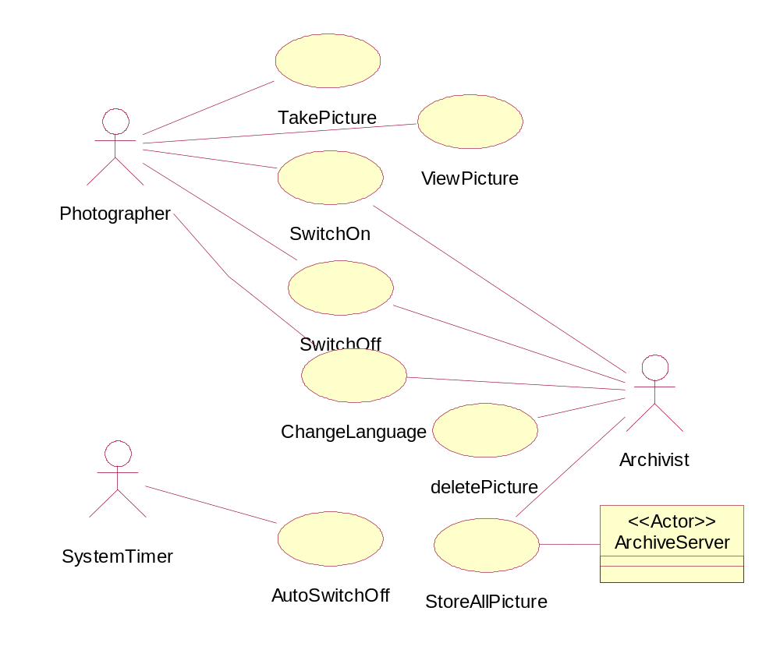
Digital Camera: Usecase Diagram
系统时钟是一个特殊的参与者
UML Lecture_01, Author: NK Jiang
<number>/50

Slide 21
Digital Camera: UC-Description
UseCase_1: TakePicture
Brief Description : The Photographer wants to take a picture. The camera offered different modes to be adjusted by the Photographer before taking a picture.
Primary Actor: Photographer
Precondition: System is switched on.
Main Success Scenario:
  1. If System is not in shot-mode the Photographer indicates the wish to go into shotmode
  2. System goes into shot-mode
  The steps 3-5 are optional and can be executed in any order
  3 Photographer (de)selects delay-mode
  4 Photographer zooms in/out
  5 Photographer changes flash mode (on, off, auto)
  6 Photographer presses the shot button
  7 System measures distance to the subject and light intensity. System adjusts lens aperture, exposure time and flash usage
  8 If System is in delay-mode, it waits a predefined amount of time
  9 System takes the picture and stores it in the memory card
  10 Use case ends
UML Lecture_01, Author: NK Jiang
<number>/50

Slide 22
Digital Camera: UC-Description
UseCase_1 : TakePicture (cont.)
  Extensions:
    1a. Photographer selects other than the shot-mode
    1a.1. Use case ends in failure
    9a. System ascertains that memory card is full
    9a.1. System informs the Photographer
    9a.2. Use case ends in failure
UML Lecture_01, Author: NK Jiang
<number>/50

Slide 23
Digital Camera: UC-Description
UseCase_2: ViewPictures
Use Case: ViewPictures
Brief Description : The Photographer wants to view some pictures. The Photographer can go forth and back in the picture list; the successor of the last picture on the memory card is the first picture on the same memory card (ie., the picture list is cyclic).
Primary Actor: Photographer
Precondition: System is switched on.
Main Success Scenario:
  1. If System is not in view-mode the Photographer indicates the wish to go into view-mode
  2. System goes into view-mode and shows the last picture
  The steps 3-4 can be repeated as long as the Photographer wishes
  3. Photographer indicates the wish to go forth (back) in the picture list.
  4. System shows next/previous picture.
  5. Use case ends.
UML Lecture_01, Author: NK Jiang
<number>/50

Slide 24
Digital Camera: UC-Description
UseCase_2: ViewPictures(Cont.)
Extensions:
  1a. Photographer selects other than the view-mode
  1a.1. Use case ends in failure
  2a. System ascertains that there are no pictures
  2a.1. System informs Photographer
  2a.2. UC ends in failure
  4a. System ascertains that it currently shows the last (first) picture on the memory card
  4a.1. System shows as the next picture the first (last) one on the memory card (ie., memory card is cyclic)
  4a.2. Use case continues at step 3
UML Lecture_01, Author: NK Jiang
<number>/50

Slide 25
Digital Camera: UC-Description
UseCase_3: SwitchOn
Brief Description :
  The User (Photographer or Archivist) wants to switch on the camera.
Primary Actor: User (Photographer or Archivist)
Precondition: System is switched off.
Main Success Scenario:
  1. User switches on the camera.
  2. System is switched on and goes into shot-mode.
  3. Use case ends.
UML Lecture_01, Author: NK Jiang
<number>/50

Slide 26
Digital Camera: UC-Description
Use Case_4: SwitchOff
Brief Description : The User (Photographer or Archivist) wants to switch off the camera. Switching off the camera is always possible and the system is switched off as soon as the current activity has been finished.
Primary Actor: User (Photographer or Archivist)
Precondition: System is switched on.
Main Success Scenario:
  1. User indicates the wish to switch off the camera.
  2. System finishes its current activity (e.g., deleting pictures), closes the cover for the lens and switches off
  3. Use case ends.
UML Lecture_01, Author: NK Jiang
<number>/50

Slide 27
Digital Camera: UC-Description
Use Case_5: ChangeLanguage
Brief Description : The User (Photographer/Archivist) wants to
change the language used by the GUI of the system.
Primary Actor: User (Photographer/Archivist)
Precondition: System is switched on.
Main Success Scenario:
1. User indicates the wish to change the language
2. System presents a list of available languages
3. User chooses the new language
4. System adapts its GUI to the chosen language
5. Use case ends
Extension:
3a. System times out when waiting on the choice of User
3a.1. Use case ends in failure
UML Lecture_01, Author: NK Jiang
<number>/50

Slide 28
Digital Camera: UC-Description
UseCase_6: AutoSwitchOff
Use Case: AutoSwitchOff
Brief Description : In order to save energy, the System switches off once the users has not interact with it for a predefined amount of time (e.g. 5 minutes).
Primary Actor: System Timer
Precondition: System is switched on.
Main Success Scenario:
1. The use case starts after none of the actors has interact with the system for a predefined amount of time.
2. System closes the cover for the lens and switches off
3. Use case ends
UML Lecture_01, Author: NK Jiang
<number>/50

Slide 29
Digital Camera: UC-Description
Use Case_7: DeletePictures
Brief Description : The Archivist wants to delete some pictures.
Primary Actor: Archivist
Precondition: System is switched on.
Main Success Scenario:
  1. If System is not in view-mode the Archivist indicates the wish to go into view-mode.
  2. System goes into view-mode and shows the last taken picture.
  Step 3-6 are can be repeated as long as the Archivist wishes.
  3. Archivist indicates the wish to go forth (back) in the picture list
  4. System show next/previous picture
  5. Archivist selects current picture
  6. System adds current picture to selected picture list
  7. Archivist indicates the wish to delete all selected pictures
  8. System asked for second confirmation to delete selected pictures
  9. Archivist confirms deletion of pictures
  10. System deletes all selected pictures and squeezes remaining pictures on the memory card
  11. Use case ends
UML Lecture_01, Author: NK Jiang
<number>/50

Slide 30
Digital Camera: UC-Description
Use Case_7: DeletePictures (Cont.)
Extensions:
  1a. Photographer selects other than the view-mode
  1a.1. Use case ends in failure
  2a. System ascertains that there are no pictures
  2a.1. System informs Archivist
  2a.2. UC ends in failure
  3a. Archivist indicates the wish to delete all pictures
  3a.1 Use case continues at step 8
  4a. System ascertains that it currently shows the last (first) picture on the memory card
  4a.1. System shows as the next picture the first (last) one on the memory card (ie., memory card is cyclic)
  4a.2. Use case continues at step 3
  6a. System ascertains that selected picture was already selected
  6a.1. Systems releases pictures from the selection list
  6a.2. Use case continues at step 3 or 7
  9a. Archivist does not confirm deletion of pictures
  9a.1. System deselects all pictures
  9a.2. Use case ends in failure
UML Lecture_01, Author: NK Jiang
<number>/50

Slide 31
Digital Camera: UC-Description
Use Case_8: StoreAllPictures
Brief Description : The Archivist wants to store all pictures on the ArchiveServer (in most cases an ordinary computer).
Primary Actor: Archivist
Precondition: System is switched on.
Main Success Scenario:
  Steps 1-2 are skipped if System is already connected to ArchiveServer
  1. Archivist connects System with ArchiveServer
  2. System establishes connection to ArchiveServer
  3. Archivist indicates the wish to store all pictures
  4. System informs ArchiveServer about the request to store pictures
  5. ArchiveServer provides structure of archive and current folder
  6. System presents location of current folder to Archivist and asks for confirmation
  7. Archivist confirms current folder
  8. System informs ArchiveServer on Archivist's selection of storage location and sends all pictures to ArchiveServer
  9. ArchiveServer stores received pictures in selected folder and sends confirmation to
  System
  10. System informs Archivist that all pictures have been successfully stored
  11. Use case ends
UML Lecture_01, Author: NK Jiang
<number>/50

Slide 32
Digital Camera: UC-Description
UseCase_8: StoreAllPictures(Cont.)
Extensions:
  2a. System cannot establish connection to ArchiveServer
  2a.1. System informs Archivist
  2a.2. Use case ends in failure
  7a. Archivist selects another folder
  7a.1. Use cases continues at step 8
  7b. Archivist creates a new folder
  7b.1. System informs ArchiveServer on Archivist's request
  7b.2. ArchiveServer creates a new folder of the indicated name and at the chosen location
  7b.3. Use case continues at step 8
  9a. ArchiveServer ascertains that there is not enough memory to store all pictures
  9a.1. ArchiveServer informs System
  9a.2. System informs Archivist
  9a.3. Use case ends in failure
UML Lecture_01, Author: NK Jiang
<number>/50

Slide 33
Re-Thinking
Questions
  Would you also represent SwitchOn/ SwitchOff /ChangeLanguage as separate use cases?
  Could you imagine to have between ViewPictures and DeletePictures the relationship <<include>>/ <<extend>>?
    If yes, how would you rephrase the textual part of DeletePictures? Which version would you prefer?
  Is there a relationship between SwitchOff and AutoSwitchOff?
UML Lecture_01, Author: NK Jiang
<number>/50

Slide 34
案例2：支付系统（1/3）
系统需求说明
Acme公司要开发一套新的薪水支付系统。
  系统需要记录员工上班时间，并能根据工时或销售总额（仅限销售人员）自动生成工资帐单。
  新系统具有Windows-Based台式机界面和Web-Based界面，可以在公司范围内任一台电脑上运行
  允许员工：输入上下班时间、输入销售订单、个性化设置（如改变自己喜欢的支付方式），生成各种报表
  为安全和审计的原因，员工只能访问和修改他们自己的时间信息和销售订单
系统保留公司所有员工的信息（目前大约有5,000雇员）。
  要求系统能根据员工指定的支付方法， 准时把正确的工资额支付给每位员工
公司原来的一个数据库（ Project Management Database ，运行在IBM主机上的DB2）中保存了原来所有的项目和费用信息。
  从成本角度考虑，公司不打算放弃它。新系统必须和它共存并一起工作。
  新系统只能访问原数据库中的数据但不能更改它的内容
公司部分员工是按时计酬的：
  他们上班打卡，系统记录时间并统计每个支付帐号每天的工时
  如果有人某天工作超过8小时，公司支付1.5倍的薪水。
  这类人员每个星期五结清工资
UML Lecture_01, Author: NK Jiang
<number>/50

Slide 35
Usecase 案例2：支付系统（2/3）
公司部分员工是固定的月薪制
  即便如此，他们也要打卡并统计工作日期和工时数，以此，公司可以统计生产效率
  这类人员在每月的最后一个工作日支付薪水
部分有底薪人员能从他们的销售业绩中提取佣金
  他们提交能反映日期和金额的购买订单
  佣金率因人而异：可以是 10%, 15%, 25%, or 35%.
新系统的一个最主要的功能是员工报告
  员工能从系统查到自己的工时数、为某一个项目工作的总工时数、今年以来已得到的薪水总和、剩余的假期等.
员工可以选择他们的支付方式.
  现金支票邮寄到他们指定的地址，或
  员工直接到财务室领取薪水支票
  转入员工指定的银行账户.
支付系统管理员维护员工信息
  增加员工、删除员工、更改员工信息，如姓名、地址、支付类别（计时、月薪、佣金）以及产生管理类的报表.
  管理员要指明本次支付的结束日期，系统从上次支付后的日期统计金额
  每个星期五或月末，管理员运行程序自动支付员工工资并生成工资单
UML Lecture_01, Author: NK Jiang
<number>/50

Slide 36
Usecase 案例2：支付系统（3/3）
其他要求
  Reliability 可靠性
    The main system must be running 98% of the time. It is imperative that the system is up and running during the times the payroll is run (every Friday and the last working day of the month).
  Performance 性能
    The system shall support up to 2000 simultaneous users against the central database at any given time, and up to 500 simultaneous users against the local servers at any one time.
  Security 安全性
    The system should prevent employees from changing any timecards other than their own. Additionally, for security reasons, only the Payroll Administrator is allowed to change any employee information with the exception of the payment delivery method.
  Design Constraints 设计约束
    The system shall integrate with an existing legacy system, the Project Management Database, which is a DB2 database running on an IBM mainframe.
UML Lecture_01, Author: NK Jiang
<number>/50

Slide 37
案例2：支付系统：需求分析
列出参与者
理出用例
画出用例图
描述每个用例
标明系统非功能性需求
UML Lecture_01, Author: NK Jiang
<number>/50

Slide 38
案例2：支付系统 Actors List and their brief description
BankSystem
  Any bank(s) to which direct deposit transactions are sent.
Commissioned Employee
  An employee that is paid by commissions only (no salary).
Employee
  A person that works for the company that owns and operates the payroll system (Acme, Inc.)
PayrollAdministrator
  The person responsible for maintaining employees and employee information in the system.
Printer
  Print
Project Management Database
  The Project Management Database is a legacy database that contains information regarding time card charge numbers and maintains hours charged against various projects.
UML Lecture_01, Author: NK Jiang
<number>/50

Slide 39
案例2：支付系统：用例
Login
  This use case describes how a user logs into the Payroll System.
Create Administrative Report
  The use case allows the Payroll Administrator to create either a "Total Hours Worked" or "Pay Year-to-Date" report.
Create Employee Report
  The use case allows the Employee to create a "Hours Worked," "Vacation/Sick Leave," or "Total Pay Year-to-Date" report.
Run Payroll
  The use case describes how the payroll is run every Friday and the last working day of the month.
Select Payment Method
  This use case describes how a user selects a payment method. The payment method indicates how the Employee will be paid. The employee may choose to either pick up his check directly, receive it in the mail, or have it deposited directly into a specified bank account.
UML Lecture_01, Author: NK Jiang
<number>/50

Slide 40
案例2：支付系统：用例
Maintain Employee Information
  This use case allows the Payroll Administrator to maintain employee information. This includes adding, changing, and deleting employee information from the system.
Maintain Purchase Order
  This use case allows an employee to record and maintain purchase orders. Commissioned employees must record each of their purchase orders in order to receive commissions.
Maintain Timecard
  This use case allows the Employee to update and submit timecard information. Hourly and salary employees must submit weekly timecards recording all hours worked that week and which projects the hours are billed to. An Employee can only make changes to the timecard for the current pay period and before the timecard has been submitted.
UML Lecture_01, Author: NK Jiang
<number>/50

Slide 41
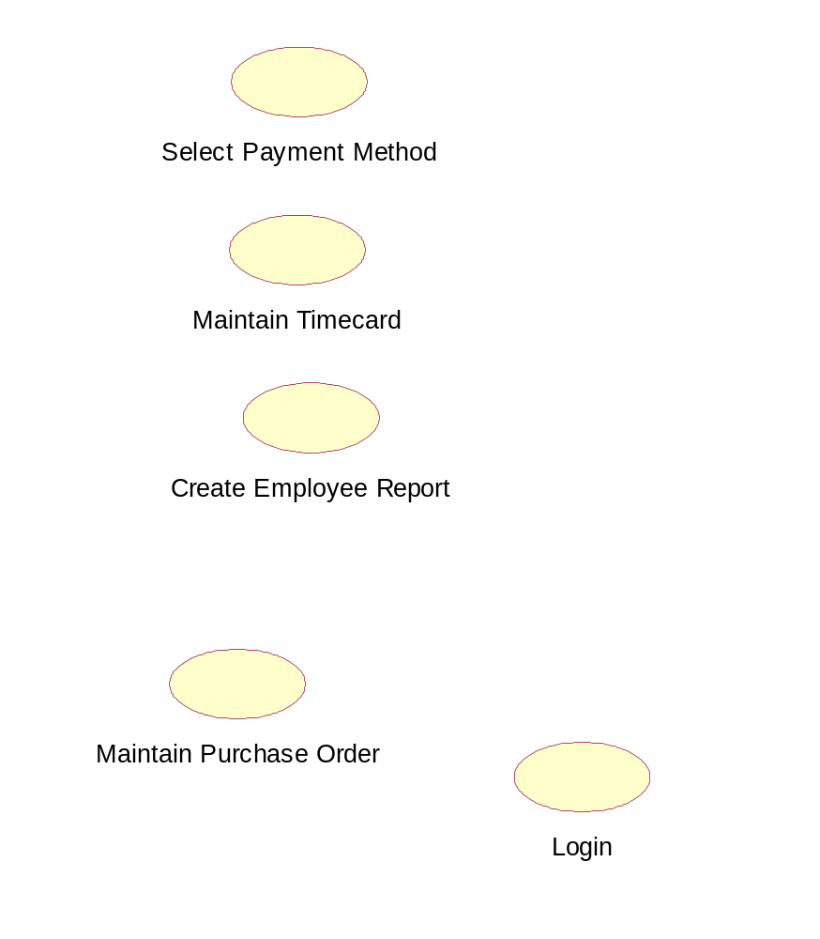
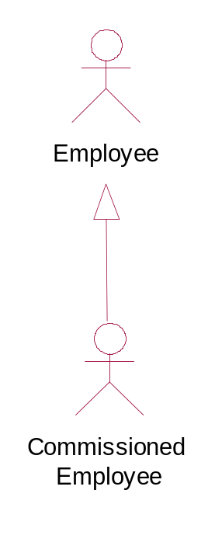
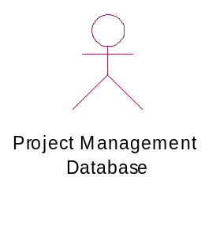
案例2：支付系统：Usecase diagram
UML Lecture_01, Author: NK Jiang
<number>/50

Slide 42
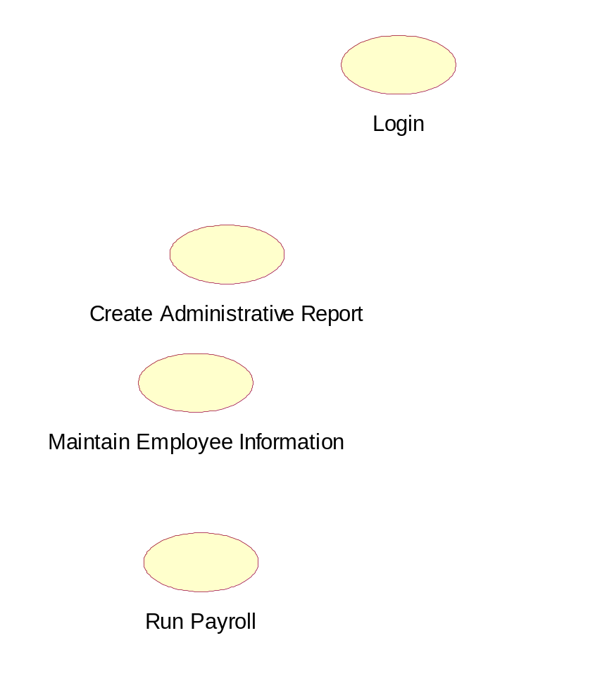
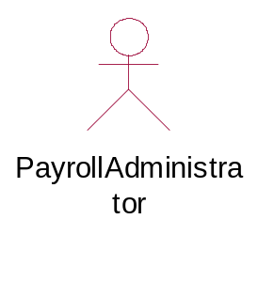
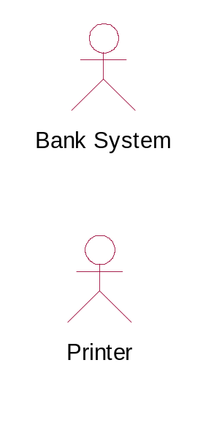
案例2：支付系统：Usecase diagram
UML Lecture_01, Author: NK Jiang
<number>/50

Slide 43
案例2：支付系统：非功能性需求
新系统具有Windows-Based台式机界面和Web-Based界面，可以在公司范围内任一台电脑上运行
Reliability
Performance
Security
Design constraints
UML Lecture_01, Author: NK Jiang
<number>/50

Slide 44
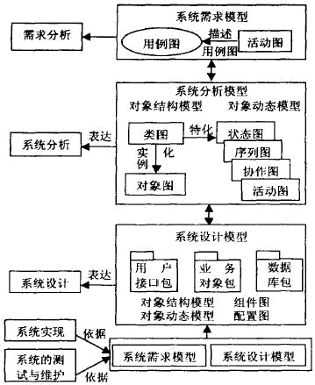
UML图与系统开发的关系及表达
对象静态关系:
类图和对象图
用例图： (U se case ) 从用户角度描述系统功能。
活动图：描述满足用例要求所要进行的活动及约束关系
对象的状态及交互关系:四图
软件体系结构和硬件体系结构及通信机制:组件图和配置图
UML Lecture_01, Author: NK Jiang
<number>/50

Slide 45
二、课程项目
自组织一个项目小组（2~3人），根据阶段任务安排，完成相应的模型分析、设计、文档化等工作（逐步安排、阶段提交）
在文档中注明小组成员姓名、学号。
项目的需求：
1）开发“高校晚自修管理系统”
2）各小组自定根据自己对晚自修管理的理解
  学生、老师、辅导员、学院领导、教务员等多个方面考虑具体的需求
文档
  提交的文件名: SRS_G组长名+学号后三位_自修管理_v0.1.doc
  文档模版：SRS_Gxx_xxxxx_v0.1.doc
第一次提交
  3月26号 （共计2周时间）
  要求：高校晚自修管理系统的详细需求分析

Slide 46
End
UML Lecture_01, Author: NK Jiang
<number>/50

