Slide 1
Object oriented Analysis &Design
面向对象分析与设计
Lecture_02 用例模型
Use Case & Requirements
Text CH6
Presenter: Xiaohong Chen
陈小红
2020/10/13
Notes:
主要是复习 use case ,进一步细化use case 的使用, 然后介绍需求的基本写法.
Ch 1.6 + ch 5 + ch 6 + ch 7

Slide 2
Use Cases
Use Case is the main input of OOAD
Target of the Lecture
  Guide to identify and write use cases.
  Evaluate use cases.
  Use the brief, casual, and fully dressed formats, in an essential style.

Slide 3
用例 Use Case
根据用户对产品的功能的期望, 提取出产品外部功能的描述。
  用例视图 （use case view) ，描述产品外部功能的视图
    从软件产品的使用者的角度，而不是开发者的角度
    讨论‘ what’ 而不是 ‘how’
    从用户角度出发，系统需要为用户提供的功能需求

Slide 4
用例模型= 用例图+用例描述

Slide 5
用例图
System Boundary
NextGen POS
communication
alternate
notation for
a computer
system actor
Process Sale
Customer
Payment
Authorization
Service
Handle Returns
《actor》
Tax Calculator
Cashier
Actor
Cash In
《actor》
Accounting System
Manager
Analyze Activity
《actor》
Sales Activity System
《actor》
HR System
Manage Security
Manage Users
Use case
...
System
Administrator

Slide 6
Use Case Elements
Actor
  Actors are usually individuals involved with the system defined according to their roles. The actor can be a human or other external system.
Use Case
  A use case describes how actors use a system to accomplish a particular goal. Use cases are typically initiated by a user to fulfill goals describing the activities and variants involved in attaining the goal.
Relationship
  The relationships between and among the actors and the use cases.
System Boundary
  The system boundary defines the system of interest in relation to the world around it.
Notes:
Use cases define interactions between external actors and the system to attain particular goals.

Slide 7

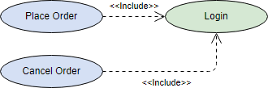
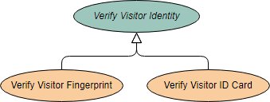
Use Case relationship
<<include>> Use Case
  The time to use the <<include>> relationship is after you have completed the first cut description of all your main Use Cases. You can now look at the Use Cases and identify common sequences of user-system interaction.
<<extend>> Use Case
Abstract and generalized Use Case
An extending use case is, effectively, an alternate course of the base use case. The <<extend>> use case accomplishes this by conceptually inserting additional action sequences into the base use-case sequence.

Slide 8
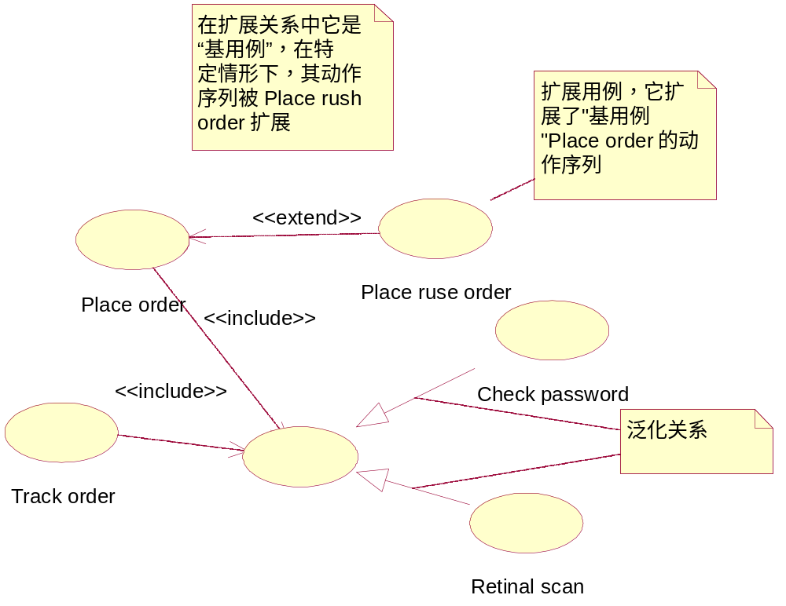
Example： 泛化、包含和扩展
Authentication

Slide 9
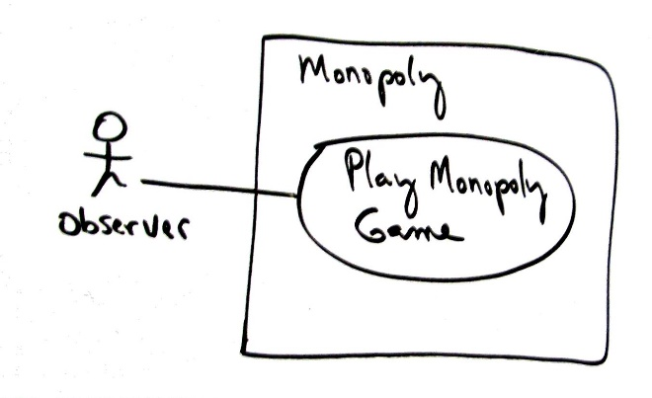
Use Case description
Scope: Monopoly application
Level: user goal
Primary Actor: Observer
Stakeholders and Interests:
  - Observer: Wants to easily observe the output of the game simulation.
Main Success Scenario:
  1.Observer requests new game initialization, enters number of players.
  2.Observer starts play.
  3.System displays game trace for next player move (see domain rules, and "game trace" in glossary for trace details).
  Repeat step 3 until a winner or Observer cancels.
Extensions:
*a. At any time, System fails:
  (To support recovery, System logs after each completed move)
  1. Observer restarts System.
  2. System detects prior failure, reconstructs state, and prompts to continue.
  3. Observer chooses to continue (from last completed player turn).
Special Requirements:
  - Provide both graphical and text trace modes.

Slide 10
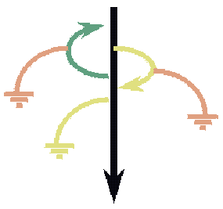
用例的描述
The two main parts of the flow of events :
The main flow of events should cover what "normally" happens when the use case is performed.
The alternative flows of events cover behavior of optional or exceptional character in relation to the normal behavior.
UseCase description
scenario

Slide 11
Exercise: use case diagram
A library information system
System contains a catalog (database) with books and journals.
Library clerks access the system
  to enter book data (populate the catalog)
  to search the catalog
  to complete a booking
  to handle returns
Library members access the system
  to search the catalog
Notes:
Take a piece of paper, and a pen and try to draw a use case diagram

Slide 12
Reference
Library information system
Enter book data
Library clerk
Search catalog
Complete booking
Library member
Handle returns

Slide 13
基本建模元素
对软件产品的需求分析首先就要定义软件系统的边界，包括两个方面的内容
  分析软件产品与外界的联系
  确定软件产品与外界的联系时，包含的动态行为及其相互关系
在UML的用例图（use case diagram）中，下列建模元素为上述两个方面的内容提供支持
  系统参与者(actor)
  用例(use case)
  依赖、泛化以及关联关系

Slide 14

课堂练习：ATM机取款系统

Slide 15
12306订票系统

Slide 16
基本内容：自学

Slide 17
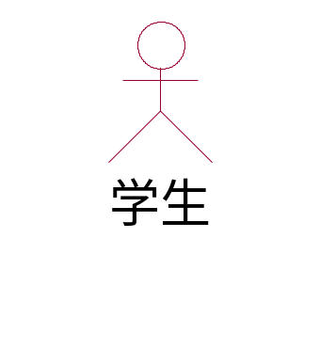
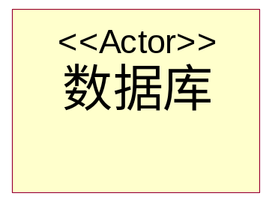
1 系统参与者
系统参与者
  代表位于系统之外并和系统进行交互的一类对象
  用它可以对软件系统与外界发生的交互进行分析和描述
系统参与者 代表的角色有：
  人
  硬件设备
  系统

Slide 18
1 系统参与者
系统参与者除了可以代表作为人的软件使用者之外，还可以代表
  直接和软件系统交互的软件系统赖以运行的软/硬件平台
  与软件系统有信息交换的计算机外部设备
  例如， 淘宝
    支付系统？

Slide 19
1 how to find actor
根据下面的一些问题来寻找系统的参与者：
  ①谁使用系统？Who or what uses the system
  ②谁安装系统、维护系统？Who installs the system? Who maintains the system
  ③谁启动系统、关闭系统？Who starts and stops the system
  ④谁从系统中获取信息，谁提供信息给系统？Who gets and provides information to the system
  ⑤在系统交互中，谁扮演了什么角色？What roles do they play in the interaction
  ⑥系统会与哪些其他系统进行交互？What other systems interact with this system
  ⑦Does anything happen at a fixed time?

Slide 20
练习：查找 Actor
手机软件系统的Actor有：
  用户
  网络
  SIM卡
学院管理系统的Actor有：
  用户/学生/教师/系统管理员
  数据库
  如果有子系统
    其它系统 可以作为一个 Actor
银行ATM机的Actor有：
  用户/管理员
  数据库

Slide 21
2 用例 （Use Case)
指定系统参与者以后
  需要详细描述系统参与者和软件系统交互的具体内容
    对交互所代表的软件系统的功能进行分类
    对这些功能，详细指定其代表的软件系统的动态行为
  在UML里，软件系统的功能和其代表的动态行为通过用例来建模的。
用例：描述了当系统参与者和软件系统进行交互时，软件系统所执行的一系列的动作序列。

Slide 22
2 用例
这些动作序列
  包含正常使用的各种动作序列
  包含对非正常使用时软件系统的动作序列的描述
一个用例代表系统参与者和系统的一次交互
  用例视图中用例的设置，就代表了软件系统的功能的划分
    仔细考虑每个用例代表的动态行为的内容，使得每个用例都能产生一个有价值的、可观察的结果。
    用例的划分应使得功能的分布较为均衡、易于理解、易于使用。

Slide 23
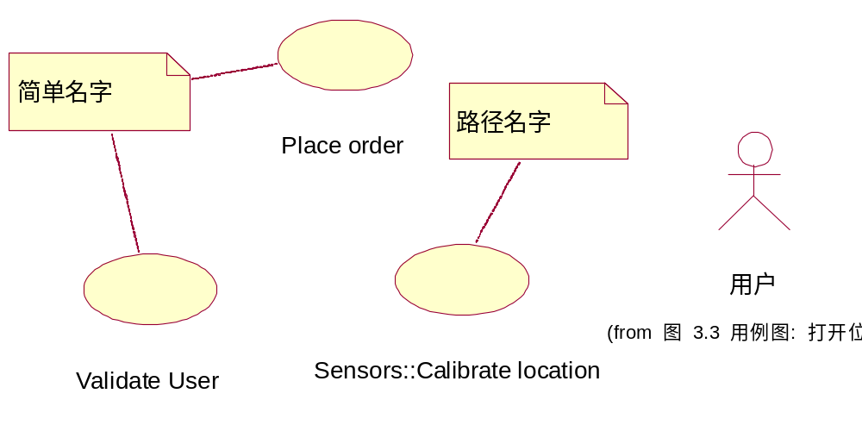
2.1 用例和系统参与者的绘制
用例的名字分为两种
    简单名字
    路径名字/全称名字(Qualified Name)
简单名字是一个不包含冒号的字串
路径名则是简单名字前面加上一个包含此用例的所在的模型包的名字,它们之间用两冒号隔开 。

Slide 24
2.2 how to find use case
根据下面的一些问题来识别用例：
  ①参与者希望系统提供什么功能；What functions will the actor want from the system?
  ②系统是否存储和检索信息；
  ③当系统改变状态时，是否通知参与者；Are any actors notified when the system changes?
  ④是否存在影响系统的外部事件，是哪个参与者通知系统这些外部事件。Are there external events that notify the system?
  ⑤Start with actors, then identify what they want to do？
  ⑥Which actors trigger activity?

Slide 25
3 参与者和用例之间的关系：关联关系
例子：假定设计开发一个名为“位图观察器(bmpviewer)”的软件产品，为用户提供图像显示和浏览的功能
  经过对用户提出的功能需求的分析和整理，得出用户期望的产品功能如下：
    打开一个bitmap文件
    可对文件进行放大显示(Zoom-in)
    可对文件进行缩小显示(Zoom-out)
    可对文件进行浏览(Pan)
    可将文件保存到磁盘
  Actor？
    用户
    位图文件
    显示窗口
  用例？
    把上列的每项功能都用一个用例表示
  把上述功能通过用例和参与者的概念表示在用例图上

Slide 26
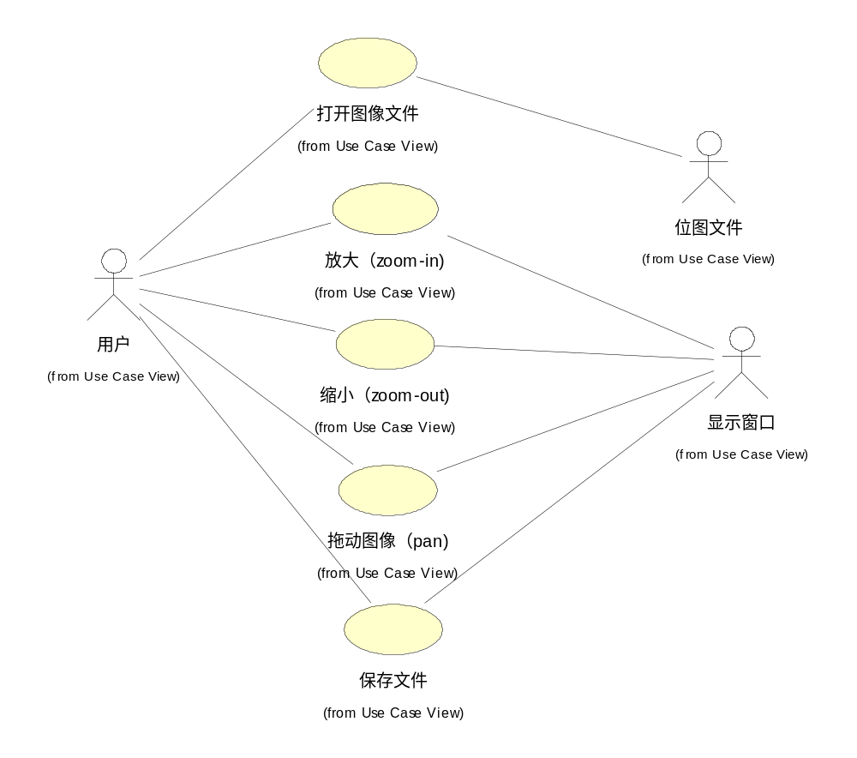
用例为软件系统的功能建模

Slide 27
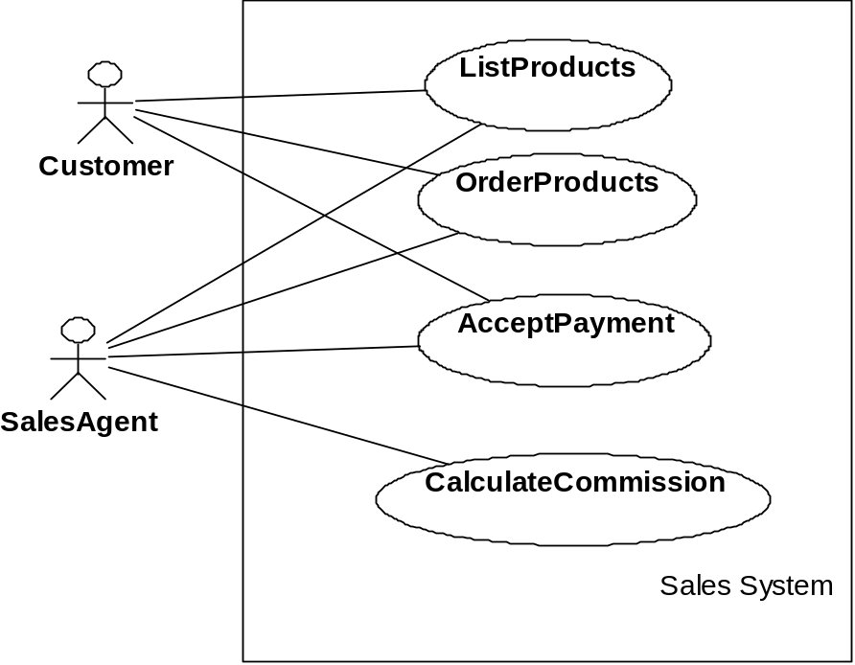
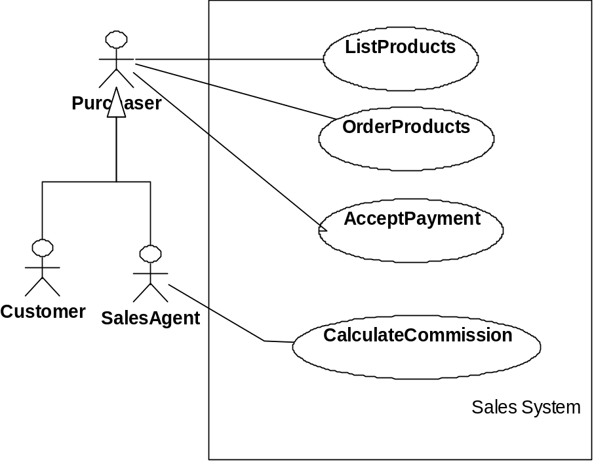
3.1 参与者/参与者之间的关系：泛化关系
We can simplify with actor generalization!
Notes:
Purchaser is an abstraction actor. Introduced simply to capture the common behavior of the two concrete actors--- that the can both act in a purchasring role.

Slide 28
3.2 用例之间的关系：泛化关系
考虑订单管理系统（Order Management System）的部分用例模型
  It is useful to separate ordinary Customer from Internet Customer, since they have slightly different properties. However, since Internet Customer does exhibit all properties of a Customer, you can say that Internet Customer is a specialization of Customer, indicated with an actor-generalization.
  The concrete use cases in this diagram are
    Phone Order (initiated by the Customer actor) and
    Internet Order (initiated by Internet Customer).
    These use cases are both variations of the more general Place Order usecase, which in this example is abstract

Slide 29
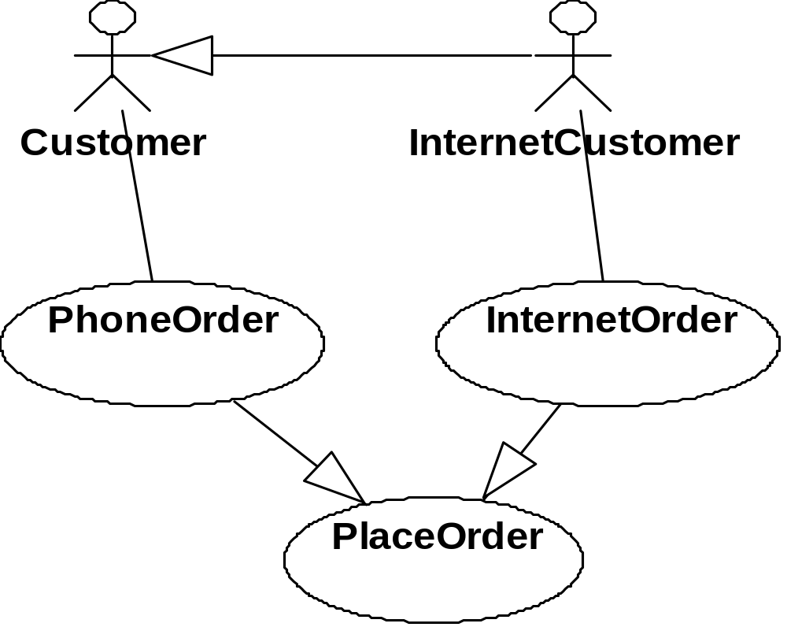
3.2 用例之间的关系：泛化关系

Slide 30
3.3 用例之间的关系：包含关系
在分析和整理系统参与者和系统用例的时候，除了使用泛化关系之外，还可能用到
  包含关系(include)
  扩展关系（extend）
包含关系：
  位于两个用例之间的包含关系意味着基用例显式地在其指定位置将另一个用例包含进来, 使其成为自己的行为的一部分。
    包含关系可用于提取公用的用例
    在具有包含关系的两个用例中
      被包含的那个用例不能单独存在，它只能以实例的形式存在于包含它的用例之中。

Slide 31
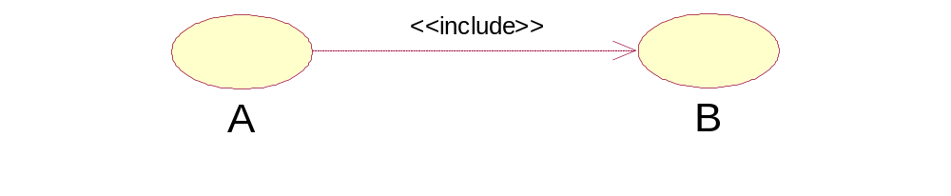
3.3 用例之间的关系：包含关系
Reading:
B is included in A
One step in A calls the use case B
  A is called including use case, B is called included use case
  in former versions of UML, you find the stereotype <<use>> instead of <<include>>
<<include>> relationship is used to sort out common behavior across multiple use cases
  an included use case B for just one including

Slide 32
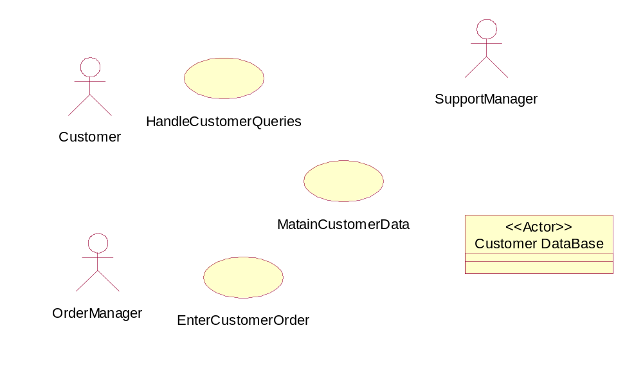
Example: <<include>>
<<include>>
<<include>>

Slide 33
Example : <<include>>
Use Case: Handle Customer Queries
Brief Description: The use case allows a Customer to submit requests.
Primary Actor: Customer
Level: User-goal
Main Success Scenario:
  1. The Customer calls the service center.
  2. The System opens a customer service request (CSR) and logs date and time.
  3. The System routes the call to the next available SupportManager and displays the CSR to them.
  4. The SupportManager enters the Customer's identification number.
  5. If no prior calls have been placed by this Customer, the SupportManager maintains customer data*.
  [The remainder of use case is omitted for brevity.]
  * -- the underlined text indicates that another use case is included (called).

Slide 34
3.4 用例之间的关系：扩展关系
扩展关系
  两个用例之间的扩展关系，代表基用例可以隐式地包含另一个用例作为其行为的一部分，包含的位置间接地由另一个用例（扩展用例）确定。基用例可以独立于扩展用例单独存在。
    当一个用例有多个子流程时，可以用扩展关系对其进行扩展，使得此基用例的不同子流程能在不同的情形下以扩展用例的形式被激活。
  UML把包含关系和扩展关系表示为依赖关系的构造
    在任何一种图形表示中，箭头所指的模型元素分别代表被包含的用例或被扩展用例(基用例), 而包含关系和扩展关系的构造标记分别是<<include>>和<<extend>>(下页图)

Slide 35

<<extend>> Relationship
Reading:
C extends D in one
of the extension points
An extension point is a labeled position in D's event flow
C is called extending use case, D is called extended use case or base use case
<<extend>> is used to add behavior to base use case
Extended use case D should be meaningful also without the extending use case C

Slide 36
Example : <<extend>>
Use Case: Maintain Customer Data
Brief Description: The Manager (determined by including use case) adds Customer information.
Level: Subfunction
Main Success Scenario:
  1. The Manager enters or changes the Customer information in any order.
  2. The Manager saves the additions or changes.
  3. System sends data to CustomerDatabase.
  4. The use case ends.
Extensions:
  2a. The Manager aborts the additions or changes.
    2a.1. Use case continues at step 1.
  3a. CustomerDatabase is out of service:
    3a.1. Use case ends in failure.

Slide 37
Extensions:
  2a. The Manager aborts the additions or changes.
    2a.1. Use case continues at step 1.
  3a. CustomerDatabase is out of service:
    3a.1. Use case ends in failure.

Slide 38
Example： 泛化、包含和扩展
Authentication

Slide 39
4 案例
考虑订单管理系统（Order Management System）的部分用例模型
  It is useful to separate ordinary Customer from Internet Customer, since they have slightly different properties. However, since Internet Customer does exhibit all properties of a Customer, you can say that Internet Customer is a specialization of Customer, indicated with an actor-generalization.
  The concrete use cases in this diagram are
    Phone Order (initiated by the Customer actor) and
    Internet Order (initiated by Internet Customer).
    These use cases are both variations of the more general Place Order usecase, which in this example is abstract.
  The Request Catalog use case represents an optional segment of behavior that is not part of the primary purpose of Place Order. It has been factored out to an abstract usecase to simplify the Place Order use case.
  The Supply Customer Data use case represents a segment of behavior that was factored out since it is a separate function of which only the result is affecting the Place Order use case.
    The Supply Customer Data use case can also be reused in other use cases.
    Both RequestCatalog and Supply Customer Data are abstract in this example.

Slide 40
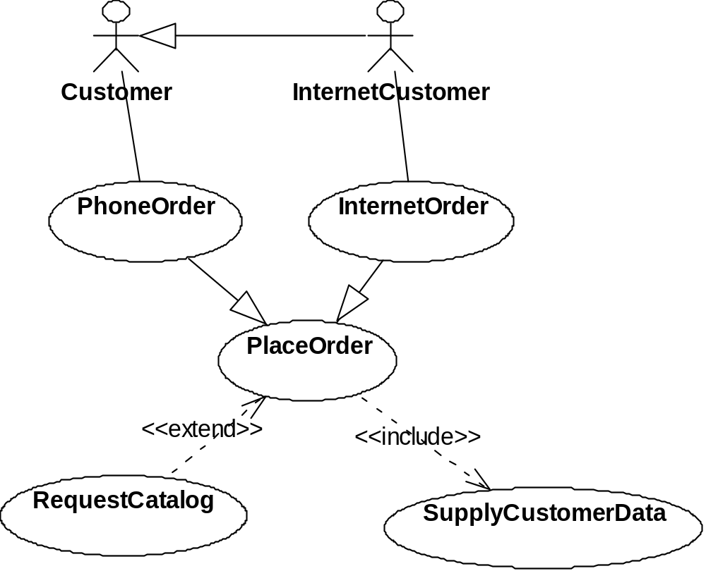

Slide 41
5 用例的描述
事件流的描述
  用例代表系统和系统参与者之间发生的一系列的事件，这些事件流构成了用户对系统功能的一次使用。
  对事件流的描述包括四种形式，即：
    形式文本
    非形式文本
    交互图
    状态图
  有相应的UML成员作为这些描述的载体
    文本和正式文本可用注标（note）表示，
    交互图和活动图本身即是一个标准的UML成员。

Slide 42
主事件流（main flow of events）和次要事件流（alternative flow of events）。
  用来区分对系统功能的合法使用和非法使用
    主事件流（main flow of events）
      合法使用，只有一个
    次要事件流（alternative flow of events）
      可包含若干个。
在描绘事件流时，必须用足够清晰的语言以使得一个普通的用户能够理解。

Slide 43
5 用例的描述
The two main parts of the flow of events :
The main flow of events should cover what "normally" happens when the use case is performed.
The alternative flows of events cover behavior of optional or exceptional character in relation to the normal behavior.
UseCase description
scenario

Slide 44
Scenario
Scenario (use-case instance)
  A sequence of actions and interactions between actors and the system in the course of particular story, transaction, or use of the system
  it is also called a use case instance

Slide 45
5 用例的描述－格式1
Section title
Section content
Summary
Give the role, purpose and the summary of the use case.
Actor List
List the actor involved in the use case.
Pre-condition
Give the conditions that must be filled to activate the use case.
Description
Detail operations performed during the use case.
Post-condition
Give the modified states of the system, modified resources, etc ... .
Exception
Give the possible errors or exceptions that must be taken into account during the use case execution.

Slide 46
5 用例的描述－格式2
Login （use case)
Brief Description
This use case describes how a user logs into the Payroll System.
Flow of Events
Basic Flow
This use case starts when the actor wishes to Login to the Payroll System.
The system requests that the actor enter his/her name and password
The actor enters his/her name and password.
The system validates the entered name and password and logs the actor into the system.
Alternative Flows
  Invalid Name/Password
If in the Basic Flow, the actor enters an invalid name and/or password, the system displays an error message. The actor can choose to either return to the beginning of the Basic Flow or cancel the login, at which point the use case ends.
Special Requirements
None.
Pre-Conditions
None.
Post-Conditions
If the use case was successful, the actor is now logged into the system. If not, the system state is unchanged.
Extension Points
None.

Slide 47
From our text book
  Basic definition
  use case/ identify?evaluation?
  guidelines

Slide 48
Conclusion
UML
Use case for requirements

Slide 49
课后作业: 订餐系统的用例模型
1.find actors
2.find use cases
3.draw use case diagram
4.specification use case by text format

Slide 50
作业要求
要求至少3个有效用例
10月20日提交，用例模型的word版
用例描述写2个，必须包含异常场景。
提交到大夏学堂。

Slide 51
Next class: ch8~10,ch15
  Key topic located in ch9: Domain Model
  Ch10,Ch15: System sequence diagram.
    You should already understand(!?)
      Really?
      Please review / preparation
End

