Slide 1
Object oriented Analysis &Design
面向对象分析与设计
需求模型
Use Case & Requirements
Text CH6
Presenter: Xiaohong Chen
陈小红
2020/10/13
Notes:
主要是复习 use case ,进一步细化use case 的使用, 然后介绍需求的基本写法.
Ch 1.6 + ch 5 + ch 6 + ch 7

Slide 2
掌握的重点-用例
什么是用例的本质？
如何评价用例？
如何写出好的用例？

Slide 3

用例的本质是什么？

Slide 4
1. Definition: (must understand)
What Scenarios, and Use Cases?
What is Actors?
What is Usecase Diagram?
What is Usecase Model?

Slide 5
Use Case Elements
Scenario (use-case instance)
  A sequence of actions and interactions between actors and the system in the course of particular story, transaction, or use of the system
  it is also called a use case instance
Use Case
  A collection of related scenarios, some successful some exceptional or failures, describing actors interacting with the system to support a specific goal

Slide 6
Use Case Elements
Actor
  Entity with behavior, usually external to our system (some are more obviously external, others not), and interact with system
  Can be people, organization, software, and machine
  There are three types:
    Primary – user has goals fulfilled through using services of the SuD (主要参与者)
      Why identify? To find user goals, which drive the use cases
      For example, the cashier in POS
    Supporting – provides supports such as external systems（协助参与者）
      Example, the automated payment authorization service.
      Often a computer system, but could be an organization or person.
      Why identify? To clarify external interfaces and protocols
    Offstage – has interest in the system’s behavior（幕后参与者）,but is not primary or supporting;
      for example, a government tax agency
      Why identify? To ensure that all necessary interests are identified and satisfied. Offstage actor interests are sometimes subtle or easy to miss unless these actors are explicitly named

Slide 7
Use Case Elements
Usecase diagram
  The relation among actors, usecases, and show the system boundary
Use case diagrams and use case relationships are secondary in use case model.
Use cases are text documents, not diagrams, and use-case modeling is primarily an act of writing text, not drawing diagrams.

Slide 8
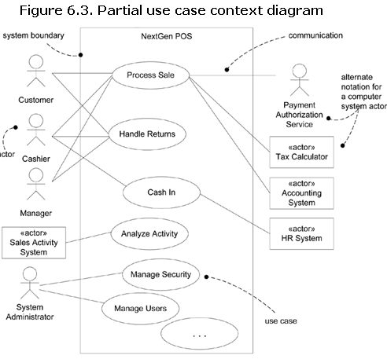
Use Case Diagrams
Notes:
Ch 6.17, a use case diagram is an excellent picture of the system context; it makes a good context diagram, that is, showing the boundary of a system, what lies outside of it, and how it gets used. It serves as a communication tool that summarizes the behavior of a system and its actors.

Slide 9
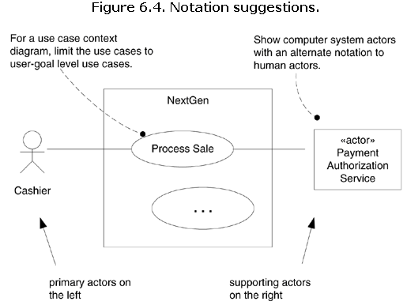
Use Case Diagrams
Notes:
Keywords and stereotypes

Slide 10
Use Case Elements
Use case Model
  The use-case model should serve as a communication medium and can serve as a contract between the customer, the users, and the system developers on the functionality of the system, which allows:
    Customers and users to validate that the system will become what they expected.
    System developers to build what is expected.
use-case modeling is primarily an act of writing text, not drawing diagrams.

Slide 11
如何去评价用例是否是好的用例？

Slide 12
2.4 How to Identify Good Use Cases
Which of these is a valid use case?
  Negotiate a Supplier Contract
  Handle Returns
  Log In
  Move Piece on Game Board
Ways：
  Boss test
    Can you excuse your time doing THIS?
  EBP test
    A task performed by one person in one place at one time, in response to a business event, which adds measurable business value and leaves the data in a consistent state
      e.g., Approve Credit or Price Order [original source lost].
  Size test
    Remember that use case(s) will be processed in your time boxes
    Seldom a single action or step
Notes:
Ch6.16什么样的测试有助于发现有用的用例?

Slide 13
Example: Applying the Tests
“Negotiate a Supplier Contract”
  Much broader and longer than an EBP. Could be modeled as a business use case, rather than a system use case.
“Handle Returns”
  OK with the boss. Seems like an EBP. Size is good.
“Log In”
  Boss not happy if this is all you do all day!
  But seems meet EBP
“Move Piece on Game Board”
  Single step fails the size test.

Slide 14
Use case description的形式

Slide 15
2. Use Case
Three Common Use Case Formats
  brief
    Terse one-paragraph summary, usually of the main success scenario.
    Useful during inception and early analysis in general to identify scope and risks
  casual
    Informal paragraph format. Multiple paragraphs that cover various scenarios.
  fully
    dressed All steps and variations are written in detail, and there are supporting sections, such as preconditions and success guarantees
    Needed in Inception for the important use cases to establish glossary, extract concepts, assess risk
    Needed in Elaboration/construction when iterating on
    10% of the critical use cases would be written this way

Slide 16
2.1 Use Case Example
Brief or Casual format
  For example, use case “Process Sale”:
    A customer arrives at a checkout with items to purchase.
    The cashier uses the POS system to record each purchased item.
    The system presents a running total and line-item details.
    The customer enters payment information, which the system validates and records.
    The system updates inventory.
    The customer receives a receipt from the system and then leaves with the items.

Slide 17
2.1 Use Case Example
Fully dressed Process Sale
  Notice the template
  shows the ability of use cases to capture complex real-world requirements, and deeply branching scenarios

Slide 18
如何写出更好的用例？?

Slide 19
3. Guideline
3.1 (ch6.11) Write use cases in an essential style; keep the user interface out and focus on actor intent.
  1/ Find “the goal of the goal “. Example, “Log on” →
    thinking of a GUI, dialog box, user ID, and password .
    But this is the mechanism, not the goal
    the system analyst arrives at a mechanism-independent goal :
      "identify myself and get authenticated “
      "prevent theft …".
  2/ essential style, example
    “Manage Users” use case
      …
      Administrator identifies self.
      System authenticates identity.
      …
    针对这种意图和职责的设计,可以非常灵活:生物信息读取、GUI 等

Slide 20
3. Guideline
3.1 (ch6.11) Write use cases in an essential style; keep the user interface out and focus on actor intent.
  3. Concrete Style
    may be avoid during early requirements Work, example,
      …
      Adminstrator enters ID and password in dialog box.
      System authenticates Administrator.
      System displays the "edit users" window.
      …
    这种方式可以用, 但尽量不要在需求分析的早期!

Slide 21
3. Guideline
3.2 (ch6.12) Write Terse(简洁的)Use Cases
  用词简洁
    “System authenticates…” ←> “The system authenticates… ”
3.3 (ch6.13) Write Black-Box Use Cases
  do not describe the internal workings of the system, its components, or design.
  Rather, the system is described as having responsibilities
  one can specify what the system must do (the behavior or functional requirements) without deciding how it will do it (the design).
  Example
Black-box style | Not
The system records the sale. | The system writes the sale to a database. …or (even worse): The system generates a SQL INSERT statement for the sale…

Slide 22
3. Guideline
3.4 (ch6.14) Take an Actor and Actor-Goal Perspective
  "an observable result of value to a particular actor” is a subtle but important concept that Jacobson considers critical, because it stresses two attitudes during requirements analysis:
    Write requirements focusing on the users or actors of a system, asking about their goals and typical situations.
    Focus on understanding what the actor considers a valuable result
Notes:
jacobson

Slide 23
3. Guideline
3.5 (ch6.15) How to Find Use Cases
  Choose the system boundary.
  Identify the primary actors
  Identify the goals for each primary actor.
  Define use cases that satisfy user goals; name them according to their goal.

Slide 24
System boundary
For POS system, in/out Sys?
  Cashier?
  payment authorization service:
    No, there is an external payment authorization service actor
  Ask About Actor Goals Rather Than Use Cases
    "What are the system tasks?“
    "Who uses the system and what are their goals?"
    "What do you do?" (roughly a task-oriented question, not good) or,
    "What are your goals whose results have measurable value?"
      Prefer the second question
  Is the Cashier or Customer the Primary Actor?

Slide 25
Three important questions
To sponsors and users
  Is this what you want (need)?
  Will you be able to tell, upon delivery, whether you got this?
To the developers:
  Can you implement this?

Slide 26
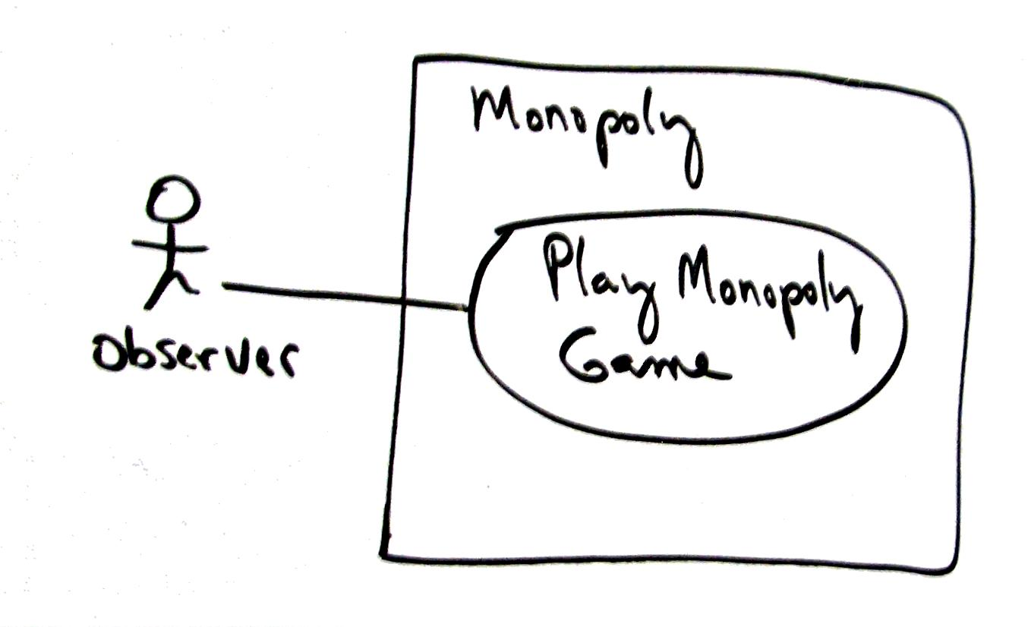
4. Example. Monopoly Game
significant use case : Play Monopoly Game

Slide 27
4. Example- Monopoly Game
Scope: Monopoly application
Level: user goal
Primary Actor: Observer
Stakeholders and Interests:
  - Observer: Wants to easily observe the output of the game simulation.
Main Success Scenario:
  1.Observer requests new game initialization, enters number of players.
  2.Observer starts play.
  3.System displays game trace for next player move (see domain rules, and "game trace" in glossary for trace details).
  Repeat step 3 until a winner or Observer cancels.
Extensions:
*a. At any time, System fails:
  (To support recovery, System logs after each completed move)
  1. Observer restarts System.
  2. System detects prior failure, reconstructs state, and prompts to continue.
  3. Observer chooses to continue (from last completed player turn).
Special Requirements:
  - Provide both graphical and text trace modes.

Slide 28
需求
Requirements Analysis
  the process of understanding what is needed or wanted, and expressing the results in writing
需求模型
  用例模型
  系统顺序图
  操作契约

Slide 29
重点掌握：
问题列表：
需求=功能？
需求=用例？
如何从用例到功能？

Slide 30
1. 需求是什么？需求的定义：
In systems engineering, a requirement can be a description of what a system must do, reffered to as a Functional Requirement
-------------Wikipedia
需求==功能?/用例？

Slide 31
Definition by IEEE Standard
A requirement is:
User view
A condition or capability needed by a user to solve a problem or achieve an objective.
A condition or capability that must be met or possessed by a system or system component to satisfy a contract, standard, specification, or other formally imposed document.
A documented representation of a condition or capability as in 1 or 2.
Developer view
Notes:
1990/ Glossary of software engineering Terminology //// user generize to stakholder

Slide 32
需求与功能
POS：买单是需求，商品扫描，收银是功能
汽车：驾驶是需求，刹车、加速是功能
打印机：打印是需求，进纸、设定、与电脑相连是功能
ATM：取款、存款、查询余额是需求，密码验证、识别卡是功能

Slide 33
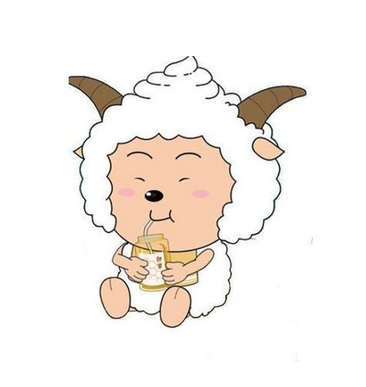
需求的重要性
  Garbage in, garbage out!
需求分析的目的
  我要一只羊
    饥肠辘辘的人说，
    慈爱的父亲说，
    农场主说，
  需求背后的问题
  挖掘客户的问题，实现客户价值！

Slide 34
需求分析的三层境界
  记录员，记录客户需求
  分析员，与客户一起分析问题，完善需求
  引导员，能够引导客户需求

Slide 35
需求分析的方法
  518(5W1H8C)(此处阅读葵花宝典63-69页)
    5W: When, Where, Who, What, Why
    1H: How
    8C(Constraints): Performance, Cost, Time, Reliability, Security, Compliance, Technology, Compatibility

Slide 36
过程
Requirement-function-write them

Slide 37
Example: The kennel or dog house
Inception: the starting idea
  the client wants a kennel
  – a dog house
We want to provide a high quality doghouse-
one that is fit for its purpose
the “purpose” may not be quite what the client or the designer thinks at first look
  depends on where the house and kennel are
  depends on owner’s use of or relationship with dog

Slide 38
Example: what requirements?
The kennel must
  keep the dog alive in freezing Canberra堪培拉winter or
  dry and cool in Brisbane布里斯班
  provide satisfactory (to owner) level of dog happiness
  anchor the dog to the home base
    to provide security and visitor announcement services
  have good enough appearance to satisfy owner’s family, and increase or maintain house property value
  be easy for the owner to keep clean, remove fleas etc.
  be “right size” for the number and size of dogs
  be maintainable: materials should need attention no more than once in 3 years in the intended location
Notes:
Canberra [简明英汉词典]
[5kAnbErE]
n.堪培拉(澳大利亚首都)
Brisbane [简明英汉词典]
[5brizbEn]
[澳大利亚东部港市](昆士兰州首府)
flea [简明英汉词典]
[fli:]
n.跳蚤, 低廉的旅馆，生蚤的动物

Slide 39
Example: Dog house requirements
These requirement statements are
  not expressed well: too broad and too vague to enable us to create a design
  not logically organised
  can be managed easily because there are very few requirements listed

Slide 40
2. Use Cases与需求分析
Capturing functional requirements using use cases

Slide 41
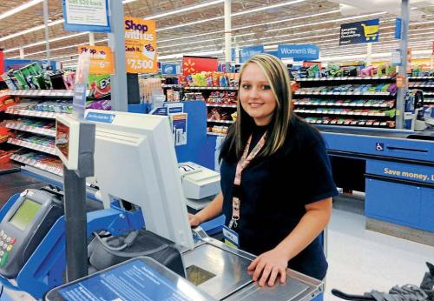
CASE STUDY 1: NextGen POS
系统包括计算机、条码扫描仪等硬件。
记录销售信息；
处理支付过程；
为不同服务的应用程序（税金、库存等）提供接口；
一定的容错性，不能瘫痪；
支持日益增多的客户终端和接口。

Slide 42
Use Case Diagrams
Notes:
Ch 6.17, a use case diagram is an excellent picture of the system context; it makes a good context diagram, that is, showing the boundary of a system, what lies outside of it, and how it gets used. It serves as a communication tool that summarizes the behavior of a system and its actors.

Slide 43
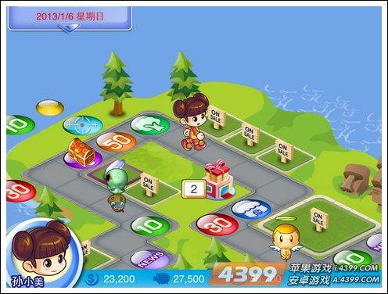
CASE STUDY 2: Monopoly game

Slide 44
Use case: play monopoly game
Scope: Monopoly application
Level: user goal
Primary Actor: Observer
Stakeholders and Interests:
  - Observer: Wants to easily observe the output of the game simulation.
Main Success Scenario:
  1.Observer requests new game initialization, enters number of players.
  2.Observer starts play.
  3.System displays game trace for next player move (see domain rules, and "game trace" in glossary for trace details).
  Repeat step 3 until a winner or Observer cancels.
Extensions:
*a. At any time, System fails:
  (To support recovery, System logs after each completed move)
  1. Observer restarts System.
  2. System detects prior failure, reconstructs state, and prompts to continue.
  3. Observer chooses to continue (from last completed player turn).
Special Requirements:
  - Provide both graphical and text trace modes.

Slide 45
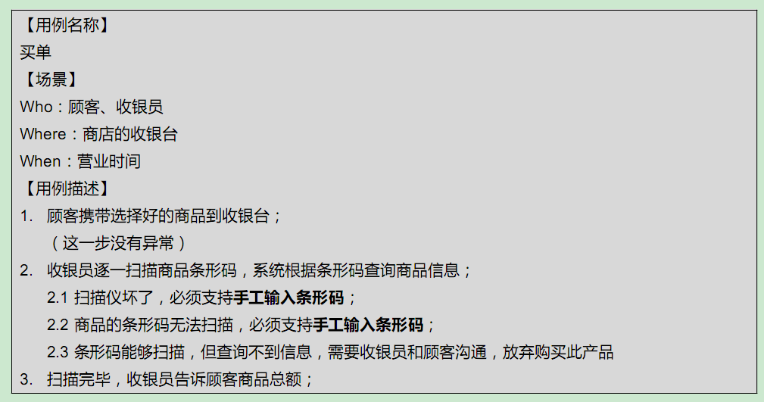
3. 从用例到功能

Slide 46
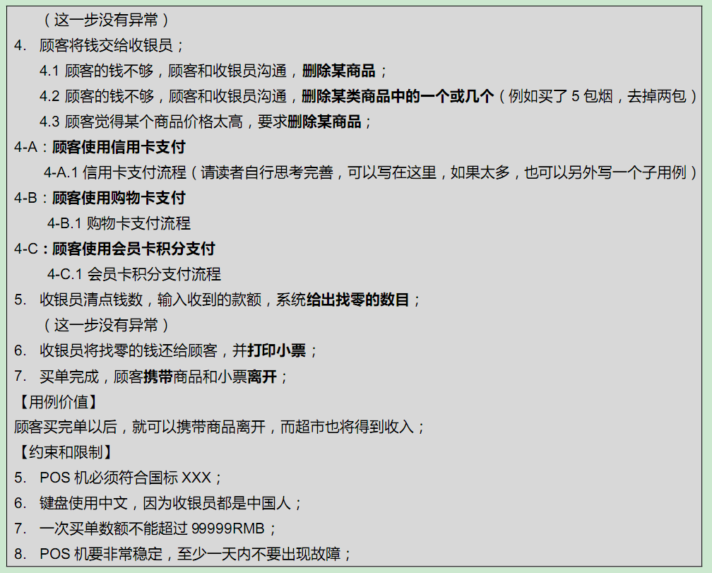

Slide 47
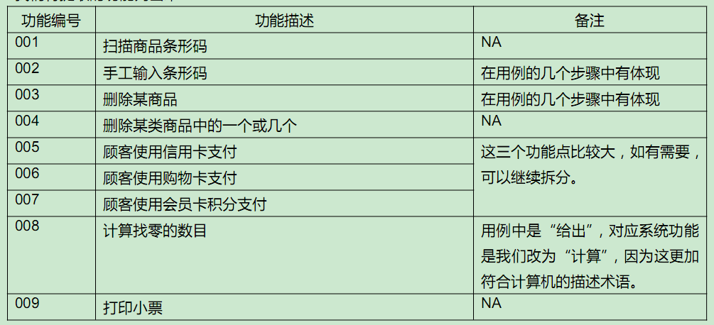

Slide 48
Exercise:
  Detail description for use case: “get money from ATM”
Next class: ch8~10,ch15
  Key topic located in ch9: Domain Model
  Ch10,Ch15: System sequence diagram.
    You should already understand(!?)
      Really?
      Please review / preparation
End

