Slide 1
Object oriented Analysis &Design
面向对象分析与设计
Ch8~10,15 System Sequence Diagram
Ch11 Operation Contract
Presented by: Xiaohong Chen
2020/10/20

Slide 2
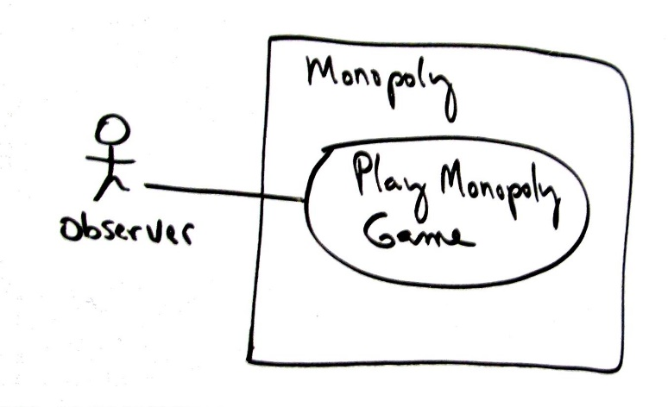
Review: Use case model
Scope: Monopoly application
Level: user goal
Primary Actor: Observer
Stakeholders and Interests:
  - Observer: Wants to easily observe the output of the game simulation.
Main Success Scenario:
  1.Observer requests new game initialization, enters number of players.
  2.Observer starts play.
  3.System displays game trace for next player move (see domain rules, and "game trace" in glossary for trace details).
  Repeat step 3 until a winner or Observer cancels.
Extensions:
*a. At any time, System fails:
  (To support recovery, System logs after each completed move)
  1. Observer restarts System.
  2. System detects prior failure, reconstructs state, and prompts to continue.
  3. Observer chooses to continue (from last completed player turn).
Special Requirements:
  - Provide both graphical and text trace modes.

Slide 3
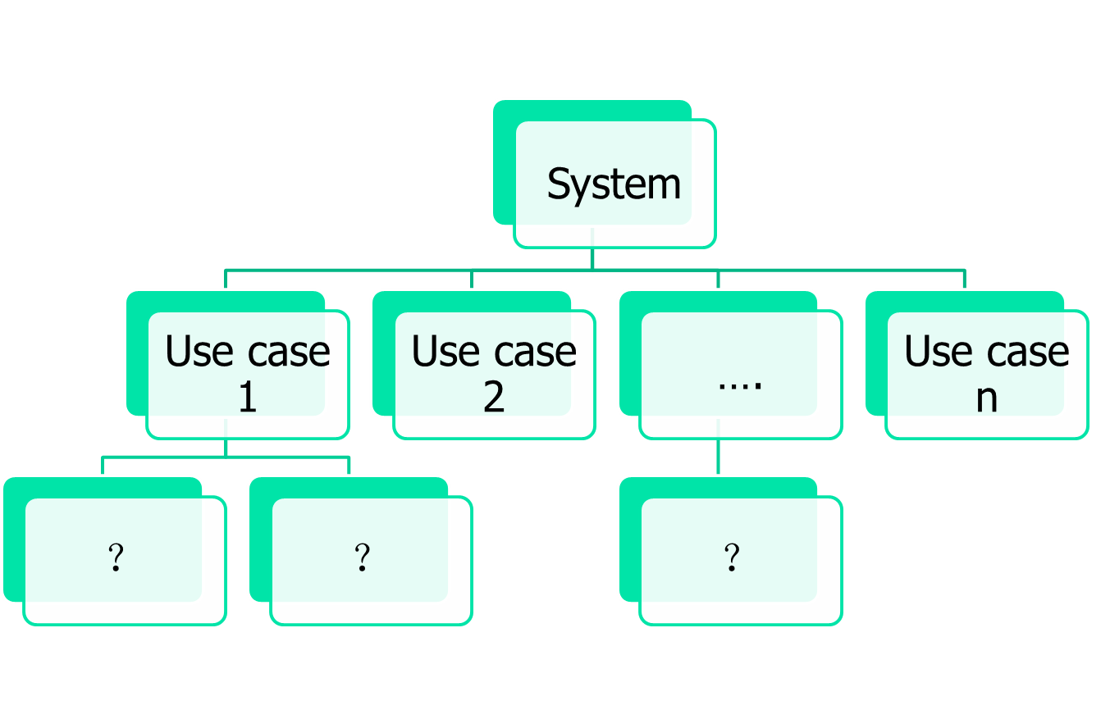
Review-use case 需求模型

Slide 4
Outline
Interaction Diagram （交互图）预备工作
System sequence diagram（系统顺序图）
  Identify system events.
  Create system sequence diagrams for use case scenarios.
Operation contract （操作契约）

Slide 5
要求掌握的内容
画好系统顺序图
  掌握黑盒子画法
写出正确的操作契约
  掌握操作契约的入口点
  掌握操作契约的格式

Slide 6
问题列表
顺序图与系统顺序图的区别？
操作契约与领域模型之间的关系？
操作契约的输入？

Slide 7
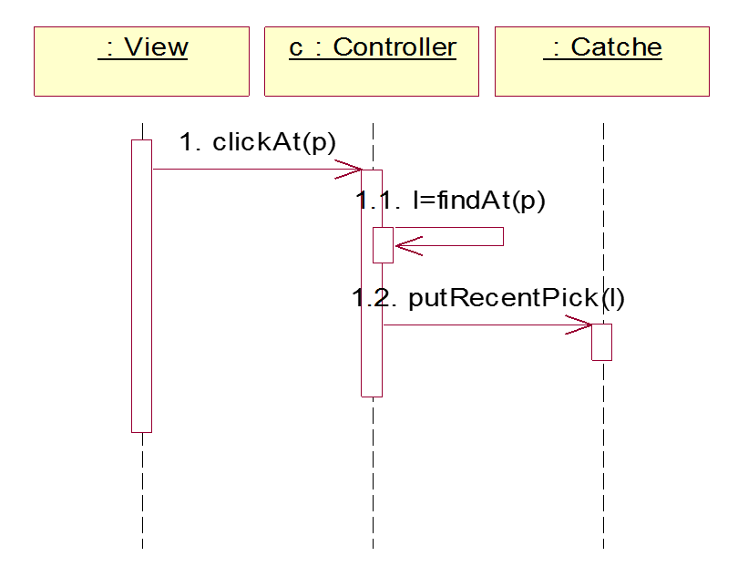
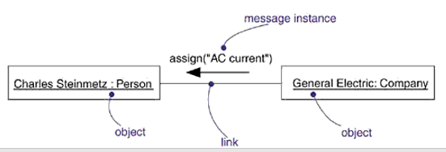
Interaction diagram 交互图
在UML中使用交互图建模系统中的交互行为：
  交互图描述了一系列的对象之间传递的消息
交互图分为两种：
  顺序图 Sequence diagram
  协作图 collaboration diagram
它们在语义上是等价的
  顺序图：强调消息的时间顺序
  协作图：强调接收和发送消息的对象的结构组织
顺序图
协作图

Slide 8
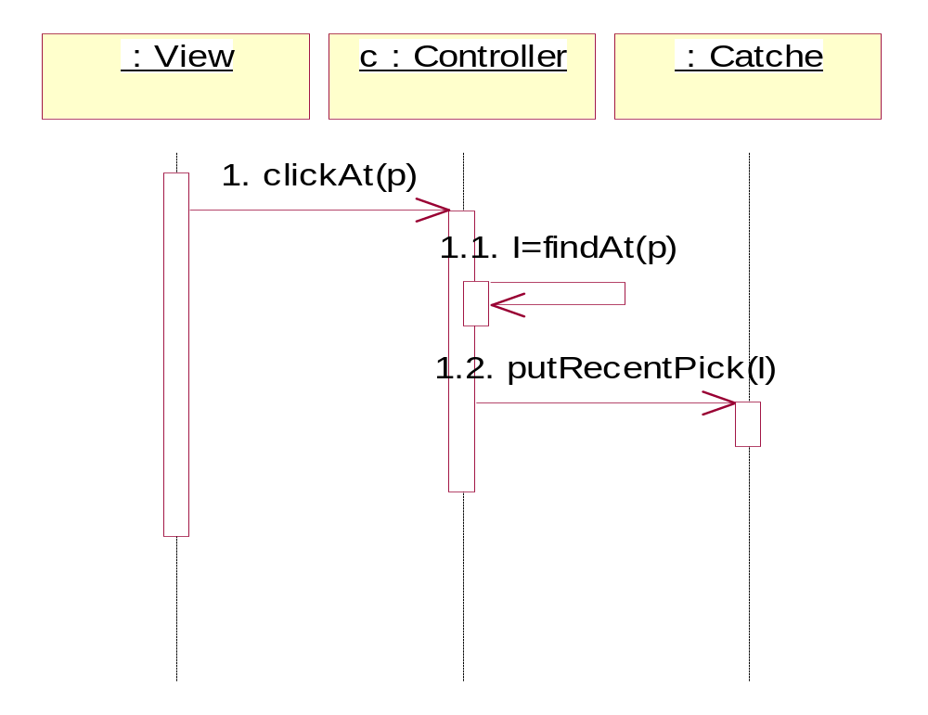
顺序图
1.3 return recent
Notes:
对象生存线，控制焦点，

Slide 9
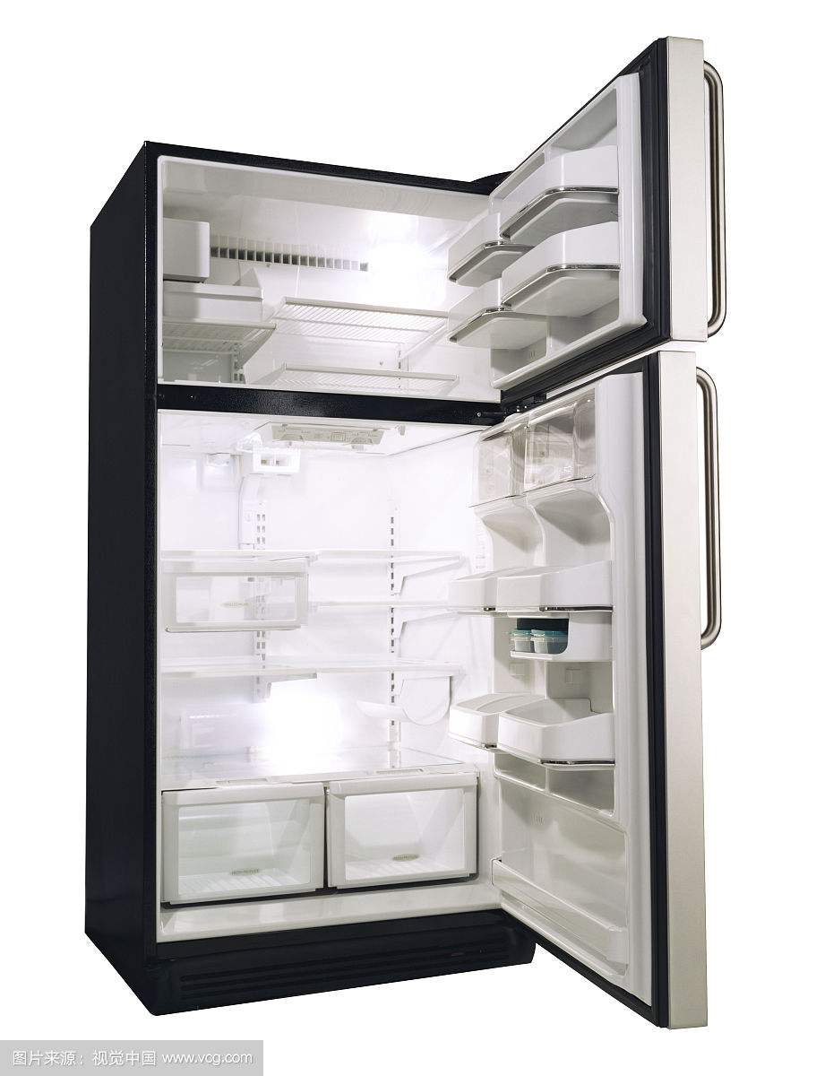

练习
把大象关进冰箱的过程
超市收银台买单付钱的过程?

Slide 10
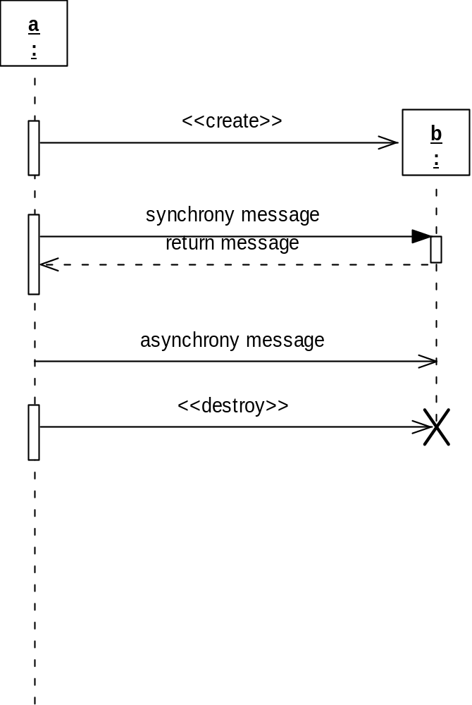
不同的消息表示
在UML里，消息用箭头表示，从发送消息的对象指向接收消息的对象
  同步消息 ：实心箭头
  异步消息 ：枝状箭头
在消息的各种形式中
  创建和销毁消息
    用消息的 构造型来表示 《create》，《destroy》
    返回消息，用带虚线的箭头表示
Notes:
要求大家能够使用UML建模元素来表示这些不同种类的消息；注意，不同的UML版本和工具在表示消息类型时有些区别；

Slide 11
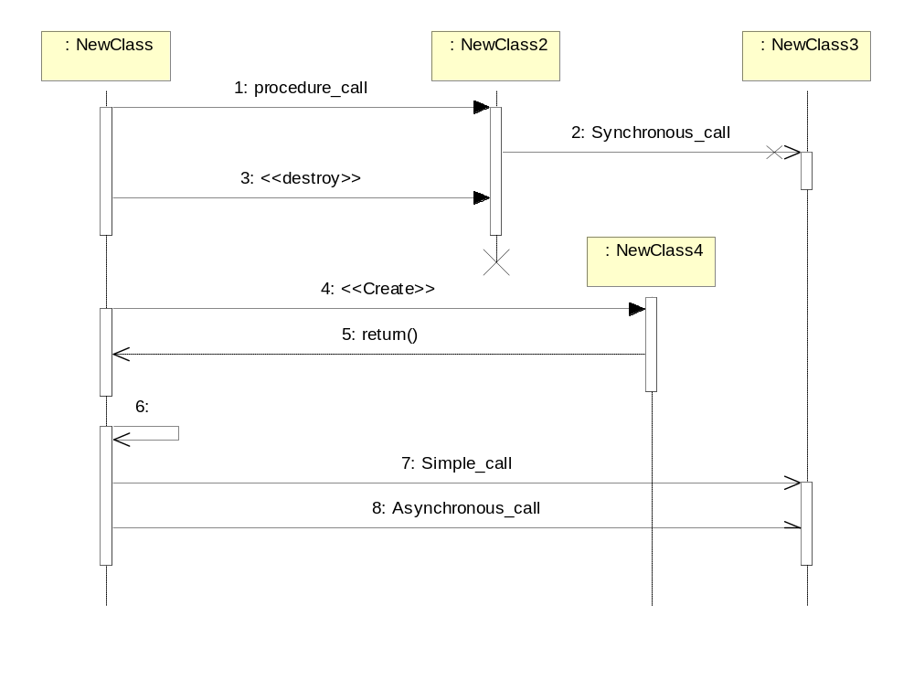
测试
撤销对象
调用自己的消息
消息的发送形式

Slide 12
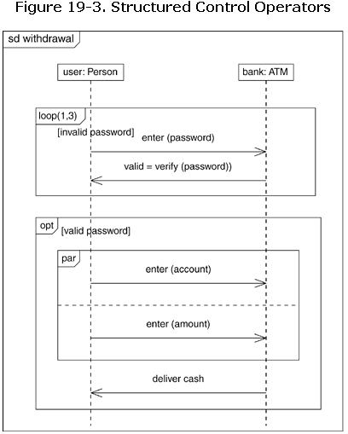
顺序图中的结构化控制
顺序图中的结构化控制
  可选执行 （标签: opt)
  条件执行 （标签:alt)
  并行执行 （标签:par)
  循环（迭代）执行 （标签:loop)
Notes:
组合片段：顺序图内不同行为的区域。顺序图常用于建模系统中对象之间的交互行为，不善于建模选择、循环等控制结构，这些控制结构最好由活动图建模

Slide 13
超市收银台买单付钱过程如何表示？

Slide 14
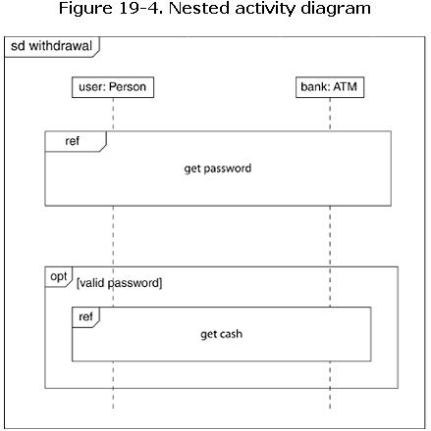
顺序图
Ref (reference):
表示引用其他交互

Slide 15
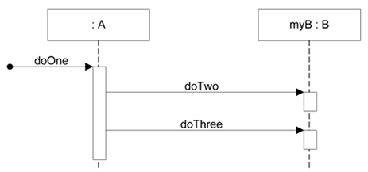
SD到类图的映射
public class A {
private B myB = new B();
public void doOne() {
myB.doTwo();
myB.doThree();
} //
…
}
A
B
B myB
doOne()
doTwo()
doThree()

Slide 16

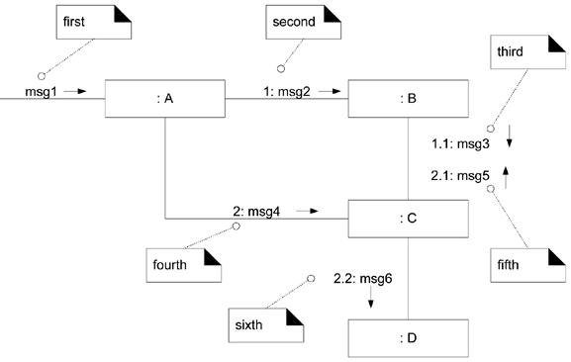
协作图

Slide 17
(Ch10,15 ) System Sequence Diagram
SSD:
  System Sequence Diagram
What is SSD?
  A SSD is a picture that shows, for one particular scenario of a use case, the events that external actors generate, inter-system events , and their order
  All systems are treated as a black box;
  the emphasis of the diagram is events that cross the system boundary from actors to systems
System Event
  external input events
    actor generates events to a system
system operation
  to handle the system event , for example
  when a cashier enters an item's ID, the cashier is requesting the POS system to record that item's sale (the enterItem event). That event initiates an operation upon the system.
  Operations that the system offers in its public interface

Slide 18
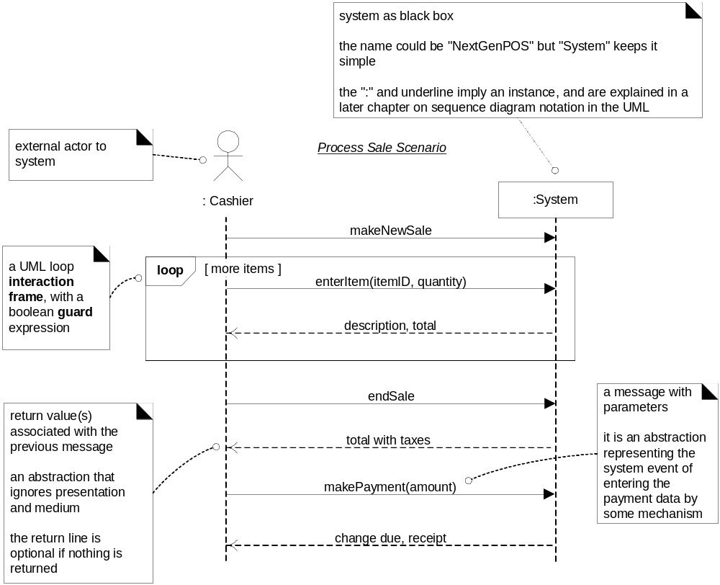
(Ch10,15 ) System Sequence Diagram

Slide 19
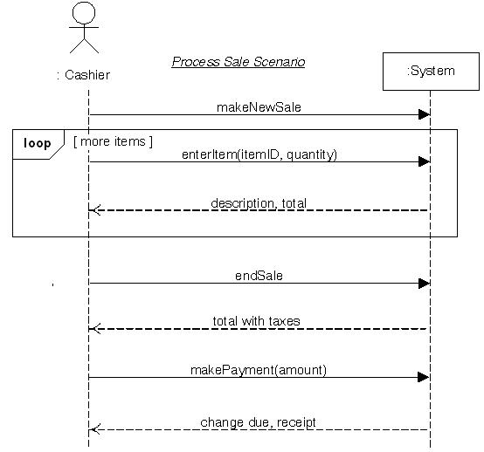
SD 案例 （POS系统）用例描述和用例图
用例：处理销售
1、顾客携带所购商品来到POS机付款处进行购买交易
2、收银员开始一次新的销售交易
3、收银员输入商品ID
4、系统逐条记录出售的商品条目，并显示该商品的描述、价格和累计额。价格通过一组价格规则来计算
5、收银员重复步骤3~4，直到结束
6、系统显示总额
7、收银员告知顾客总额并提请付款。
8、顾客支付，系统处理支付。
。。。。
（此处仅有主事件流）

Slide 20
(Ch10,15 ) System Sequence Diagram
Cf: SSD & SD
  SSD: to emphasize to treat systems as black boxes.
  SD will be used to illustrate the design of interacting software objects to fulfill work
SSD and Use case
  it is generated from inspection of a use case

Slide 21
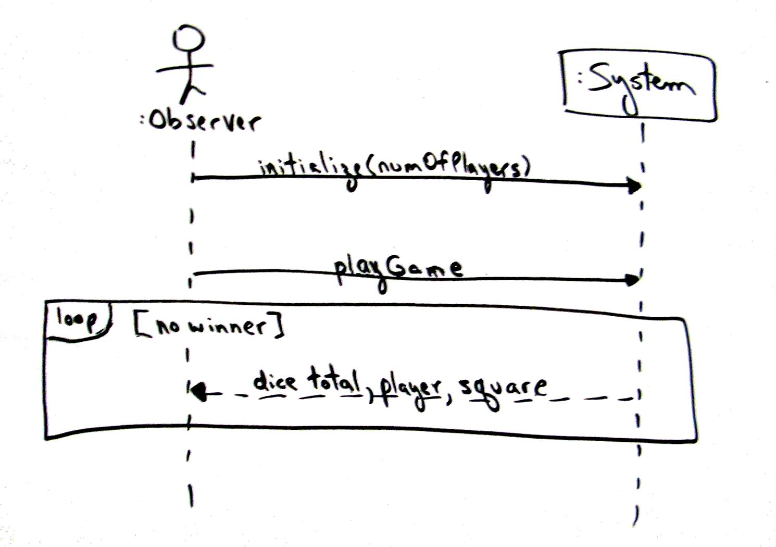
Monopoly Game-SSD
Fig 10-5

Slide 22
Next
Operation Contracts:
  More on the Use Case Model

Slide 23
Operation Contracts:
More on the Use Case Model
Use cases - the way to describe requirements
  For certain scenarios, system sequence diagrams
  What is system operation?
Use Case Model and Domain Model are developed in parallel
Operation Contracts: a way to describe use cases in more detail
  Part of the Use Case Model

Slide 24
System Operations
:Cashier
:System
makeNewSale()
enterItem(itemID,quantity)
description, total
*[more items]
  Operations that the system as a black box component offers in its public interface
System
设计类
makeNewSale()
enterItem(itemID,quantity)
函数怎么写？
Notes:
系统操作是作为黑盒构件的系统在其公共接口中提供的操作.
SSD展示了系统事件,即涉及系统的事件或I/O消息.

Slide 25
Example of a Contract for enterItem
Operation: enterItem(itemID: ItemID, quantity: Integer)
Cross References: Use Cases: ProcessSale
Preconditions: There is a sale underway
Postconditions:
A SaleLineItem instance sli was created
sli was associated with the current Sale
sli.quantity became quantity
sli was associated with a ProductDescription, based on itemID match

Slide 26
Definition: What are the Sections of a Contract? (11.2 )
A description of each section in a contract is shown in the following schema.
Operation: | Name of operation, and parameters
Cross References: | Use cases this operation can occur within
Preconditions: | important assumptions about the state of the system or objects in the Domain Model before execution of the operation. These are non-trivial assumptions the reader should be told.
Postconditions: | This is the most important section. The state of objects in the Domain Model after completion of the operation. Discussed in detail in a following section.

Slide 27
Postconditions
Definition
  The postconditions describe changes in the state of objects in the domain model.
  Domain model state changes include
    instances created / deleted,
    associations formed or broken,
    and attributes changed.
Why postcondition?
  they aren't always necessary
    If developers can comfortably understand what to do without them, then avoid writing contracts
  postconditions support fine-grained detail and precision in declaring what the outcome of the operation must be
  A contract is an excellent tool of requirements analysis or OOA
    the design can be deferred, and we can focus on the analysis of what must happen, rather than how it is to be accomplished

Slide 28
How to create and write Postcondition?
Apply the following advice to create contracts
  Identify system operations from the SSDs.
  For system operations that are complex and perhaps subtle in their results, or which are not clear in the use case, build a contract.
  To describe the postconditions, use the following categories:
    instance creation and deletion
    attribute modification
    associations formed and broken
What's the Most Common Mistake ?
  Writing Contracts
    (better) A SalesLineItem was created.
    (worse) A SalesLineItem is created ; or Create a SalesLineItem
  forgetting to include the forming of associations , ex,
    The SalesLineItem was associated with the Sale (association formed).

Slide 29
Postcondition & Domain Model
postconditions are expressed in the context of the Domain Model objects
  What instances can be created?
    those from the Domain Model;
  What associations can be formed?
    those in the Domain Model;
  and so on.
It's common during the creation of the contracts to discover the need
  to record new conceptual classes, attributes, or
  associations in the domain model

Slide 30
For example
系统事件？

Slide 31
How to define the post condition of end sale?
SalesLineItem
*
Described-by
quantity:integer
1..*
1
Product
Description
Contained-in
descr:String
price:Money
id:ItemID
1
Sale
date:Date
time:Time
isComplete:Boolean

Slide 32
Summary
System sequence diagram
Operation contract

Slide 33
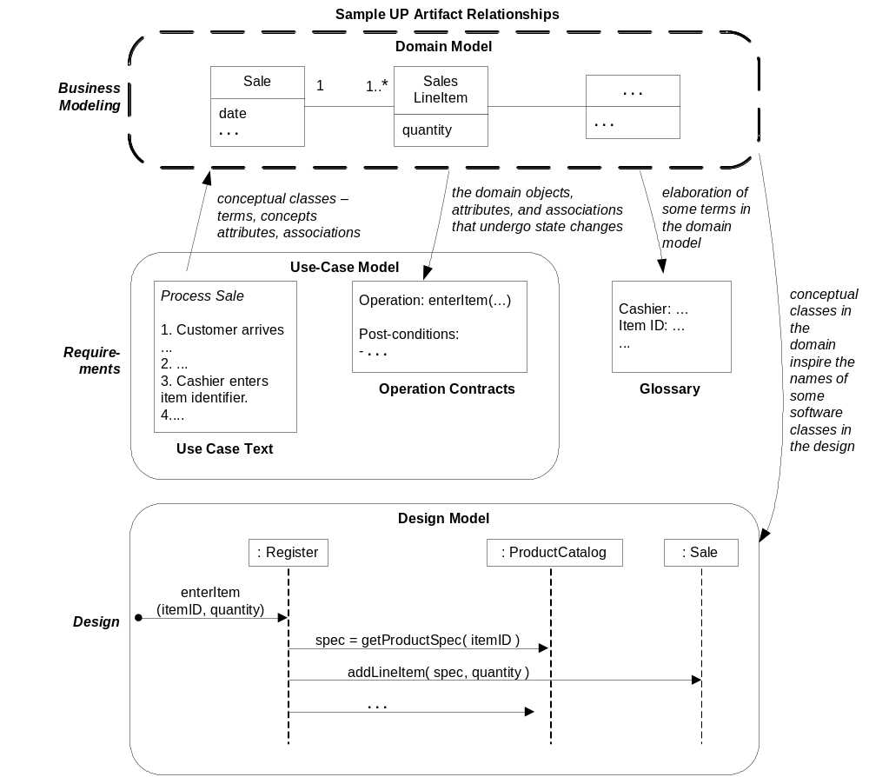
Review-where are we?

Slide 34
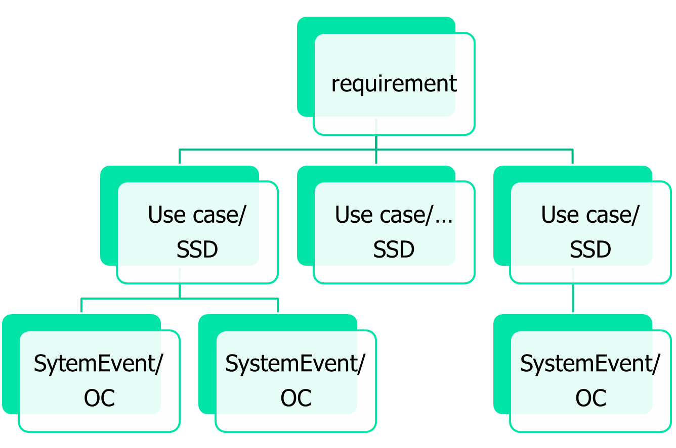
Summary: OOA Requirement?

Slide 35
HomeWork
Read / review text book Ch9 ~14
Preparation: Review of OOA
把上次的作业的两个用例描述转换为SSD，并给出两个系统事件的操作契约。
End

