Slide 1
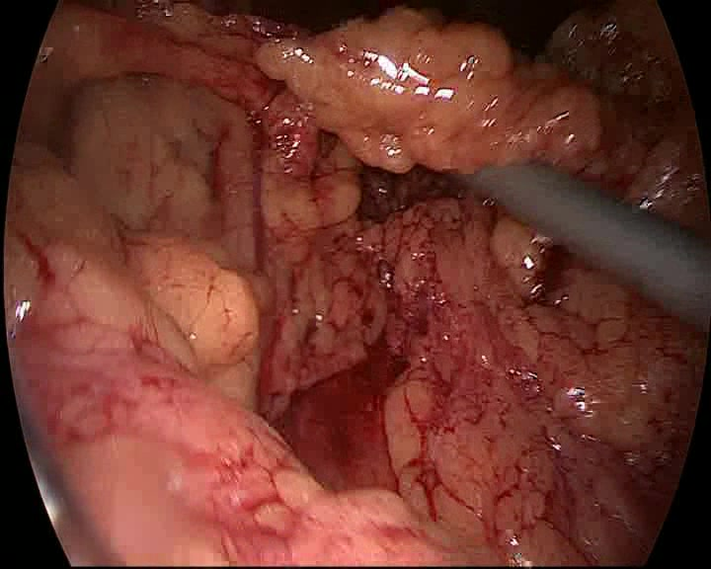
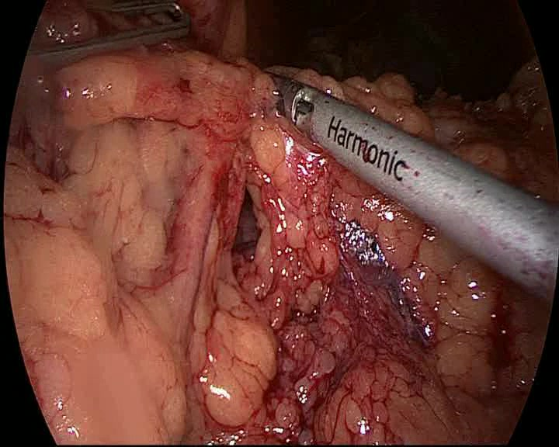
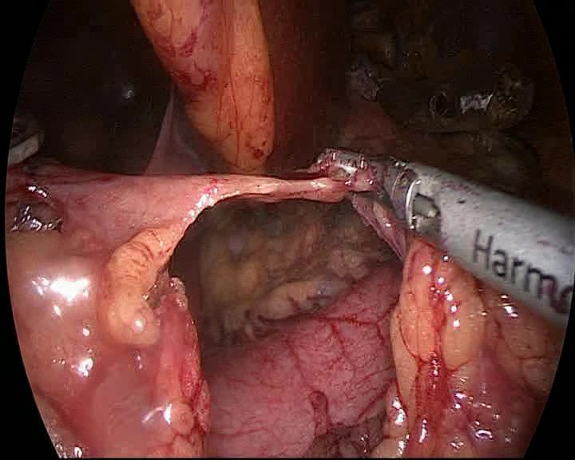
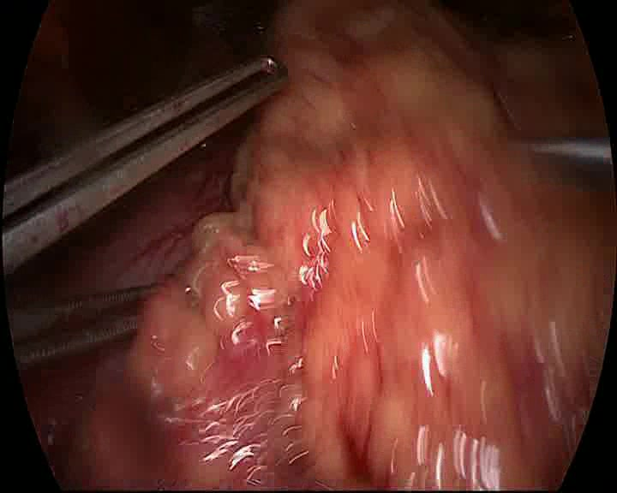
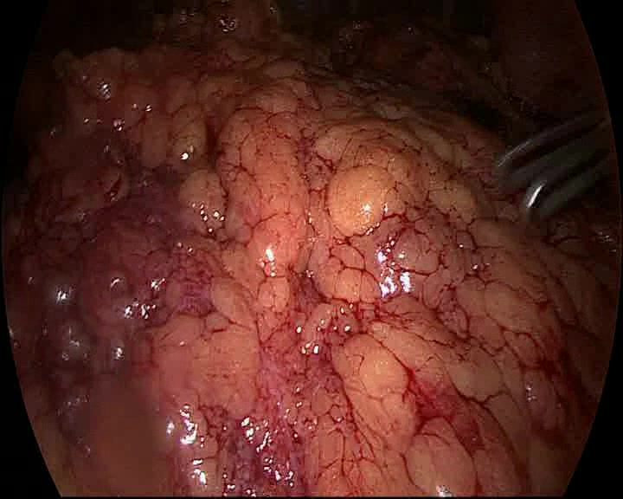
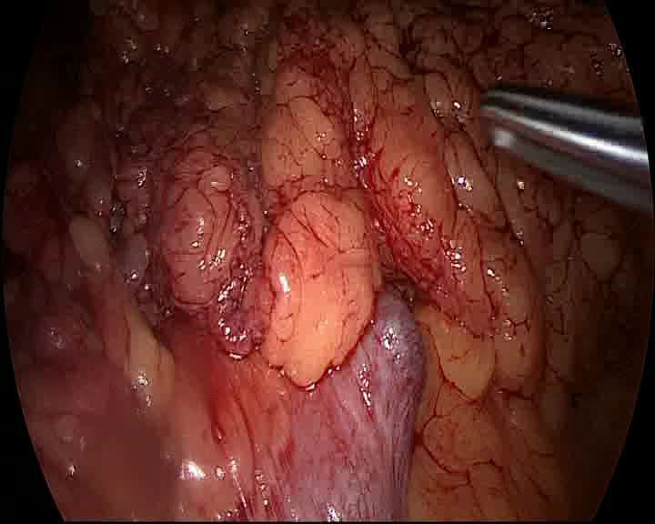
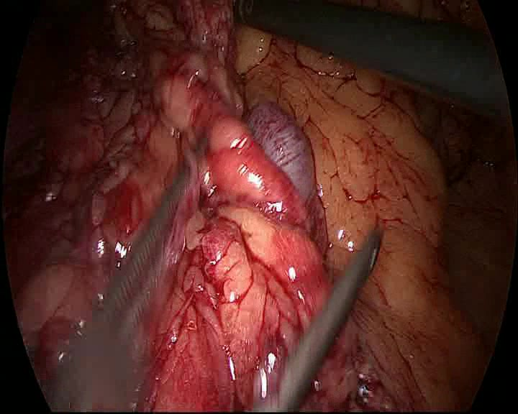
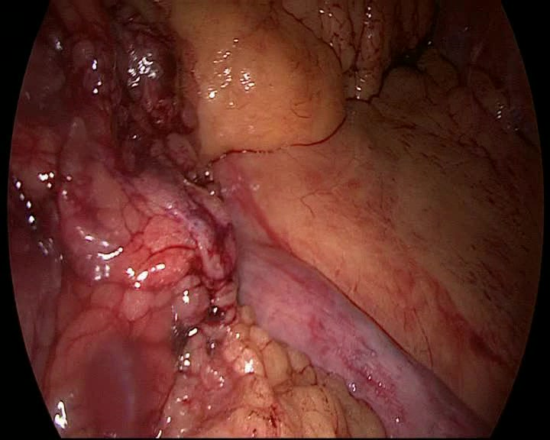
Overall pipeline: workflow-conditioned RSD prediction
The model combines visual prefix evidence with a workflow token, then tests whether that token helps across datasets and protocols.
Observed prefix clip x_1:t
8 sampled frames from a real MB140 / BBP12 case; orange marks the current timestamp.
x_t
strict prefix-only protocol
clip ends at t; no future frames
x_1
x_2
x_3
x_4
x_5
x_6
x_7
x_8
8 x 768 frame tensor
1. Visual model path
RSD
head
t_1
HTA-inspired
6-block
temporal head
remaining
surgery
duration
8-frame
clip
ViT-B/16
frame encoder
t_2
append
workflow token
9-token
sequence
t_3
t_4
phase
head
t_5
t_6
t_7
t_8
768
deviation
head
2. Workflow signal
3. Evaluation question
oracle diagnostic path
MB140
within-center
MB140
cross-center
full phase
sequence
phase
bigrams
TF-IDF
+ PCA
centroid
map
z or posterior q
workflow token
E[z] or sum q_k E[k]
P1
P2
P3
P2
P4
P5
Cholec80
contrast
shuffled-token
control
causal-at-inference path
prefix
pixels
phase-head
predictions
prefix phase
sequence
At inference: no ground-truth phase labels and no full-case workflow labels.
strict prefix-only vs centered-window
Claim: workflow conditioning helps when workflow variation exists and the token carries meaning.
Study scope: MultiBypass140 + Cholec80 | conditions: no-token, retrospective oracle, causal-at-inference | metric: validation MAE in minutes

