Slide 1
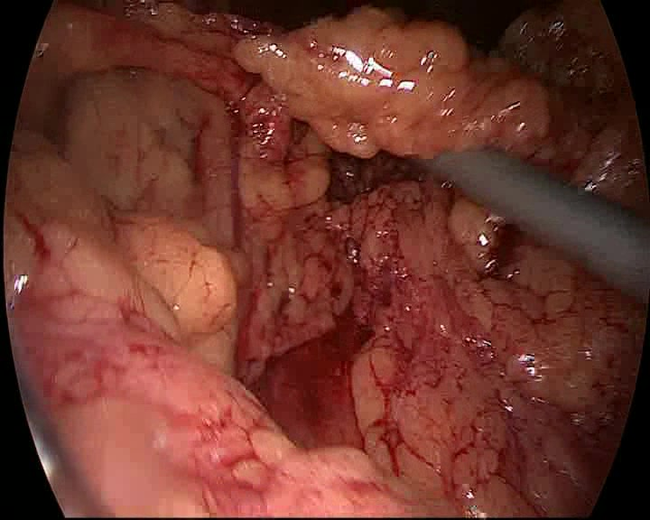
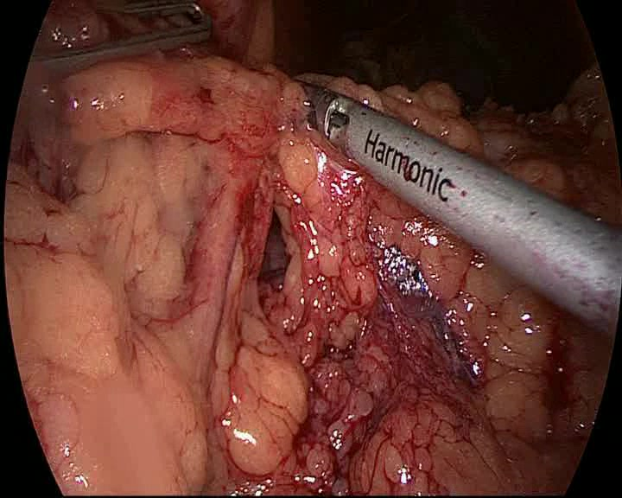
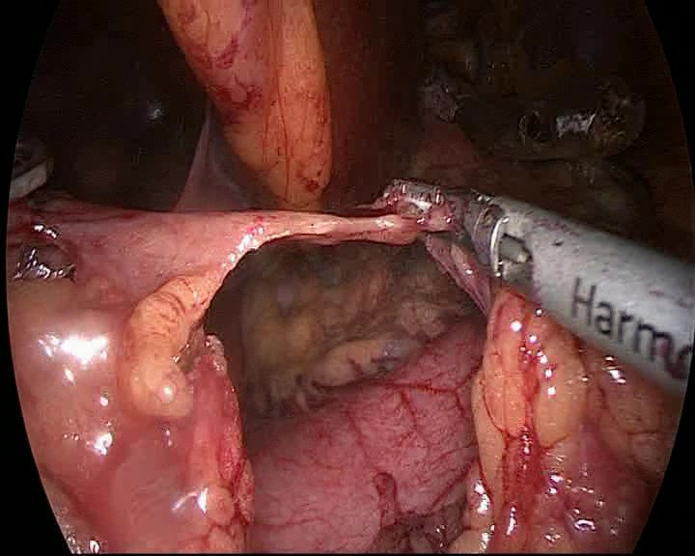
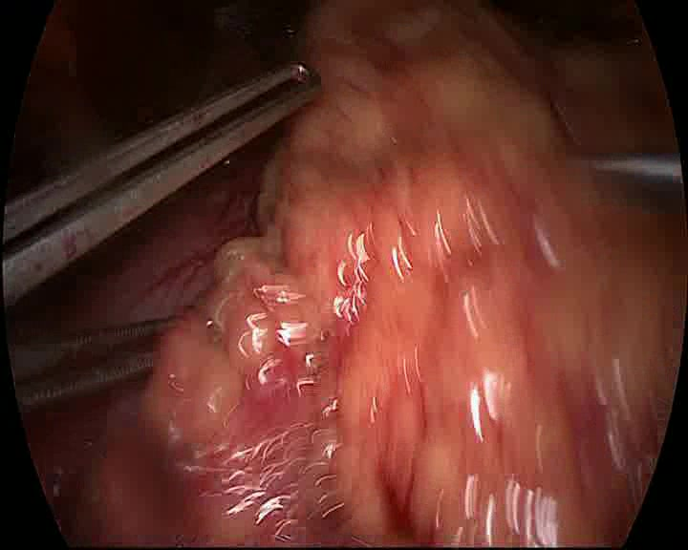
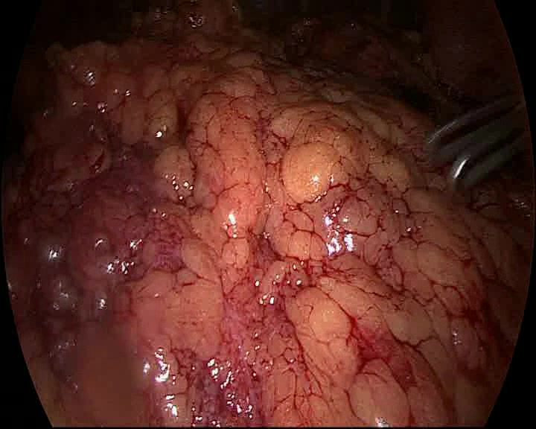
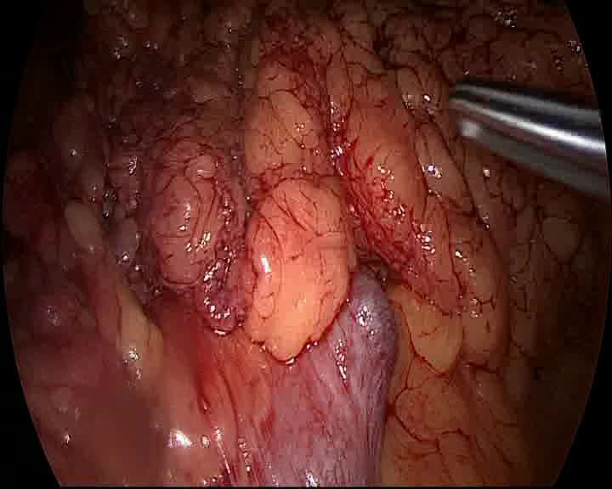
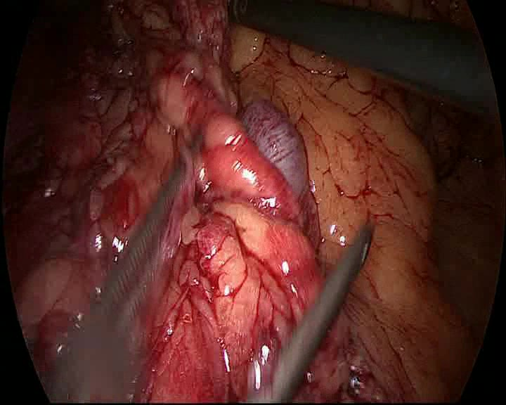
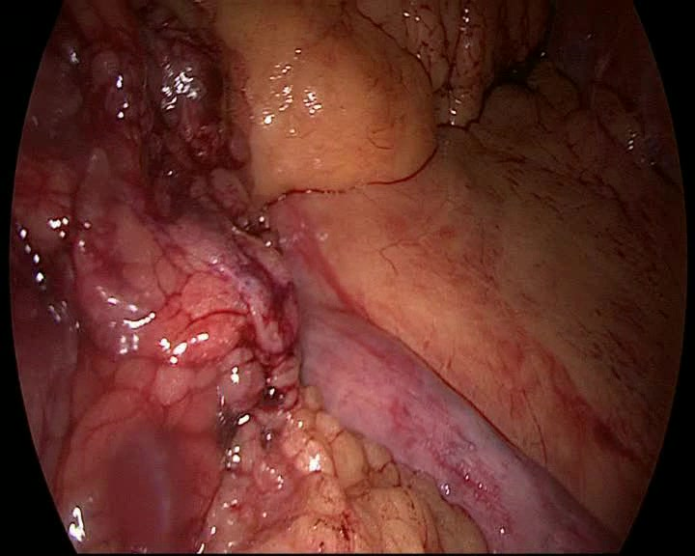
Detailed pipeline: workflow-conditioned RSD prediction
Every node shows the object being passed forward: frames, features, phase patterns, workflow token, temporal model, and evaluation.
Observed prefix clip
x_t
8 sampled BBP12 frames; the last frame is the current timestamp.
A. Visual prediction path
frames x features
learned 768-d vector
RSD
RSD minutes
phase
6 frozen + 6 trainable blocks
deviation
8-frame clip
ViT-B/16 encoder
8 x 768 tensor
workflow token
local + global attention
HTA temporal head
task heads
B. Workflow-token construction
oracle path
P1->P2
learned 768-d vector
no GT phases or full-case labels
P1
P2
P3
P2
P4
P5
P2->P3
pixels
phase
q
P3->P2
q in Delta^(K-1)
full phase sequence
phase bigrams
TF-IDF + PCA
workflow centroids
soft posterior q
soft token
causal-at-inference path
C. Evaluation and controls
MB140
cross-center
MB140
cross
Chole
shuffle
Cholec80
shuffle
workflow conditioning helps when workflow variation exists and the token is meaningful
strict vs centered
evaluation
protocols
result pattern
All non-image elements are editable PowerPoint shapes; real surgical frames remain embedded image thumbnails.

