Slide 1
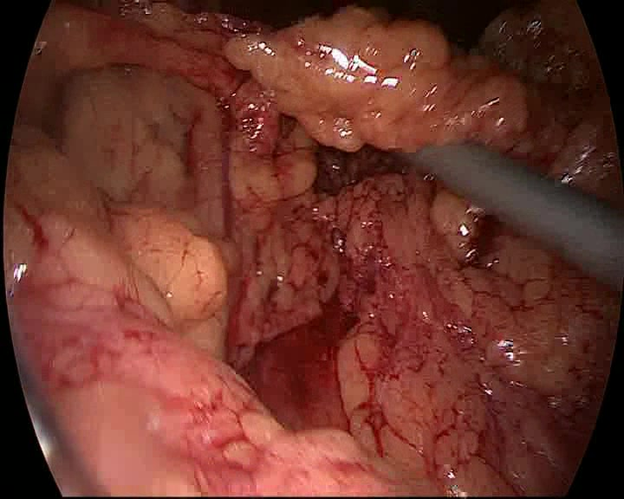
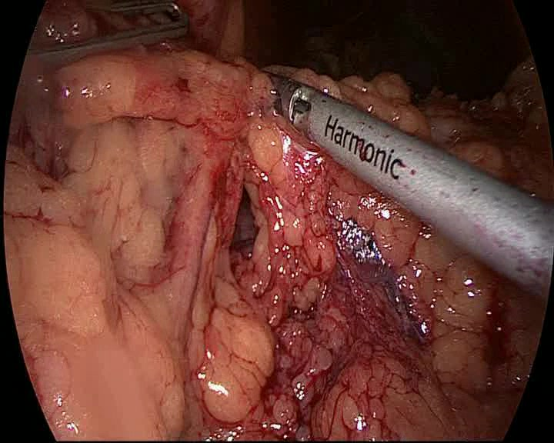
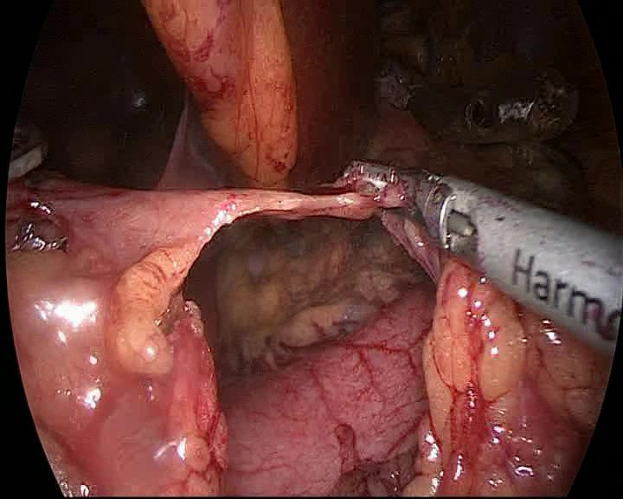
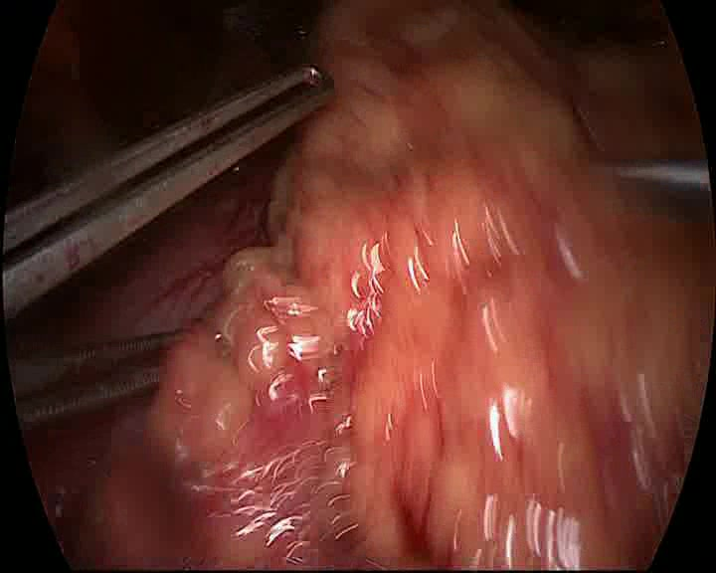
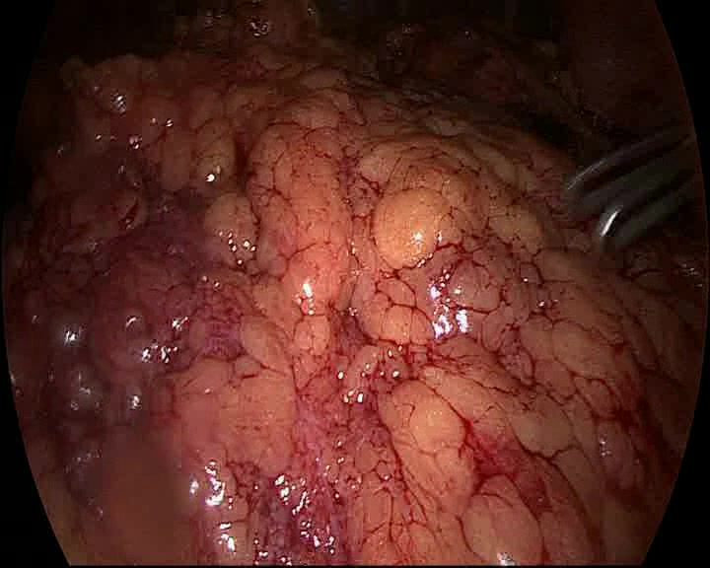
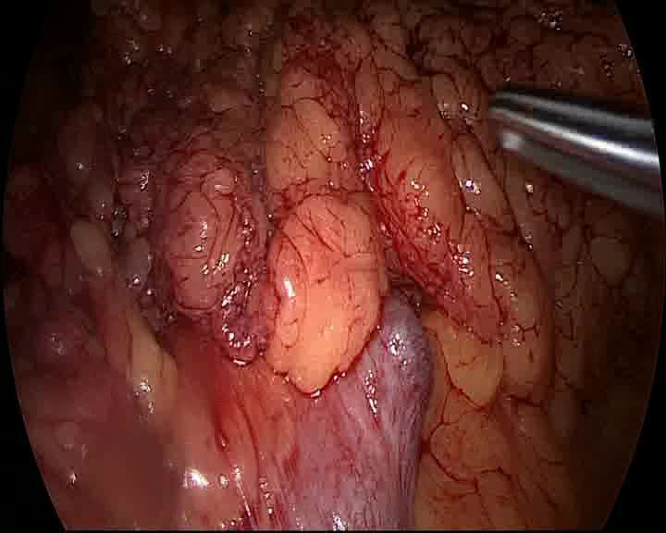
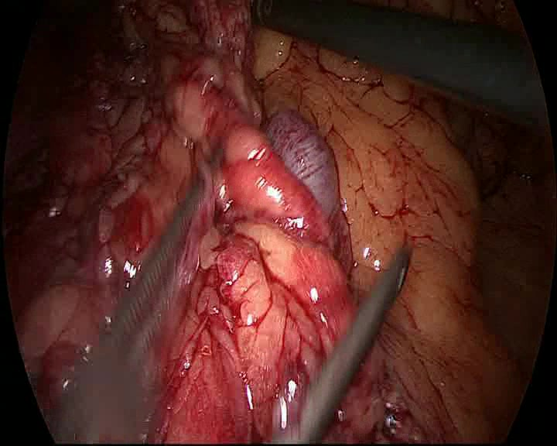
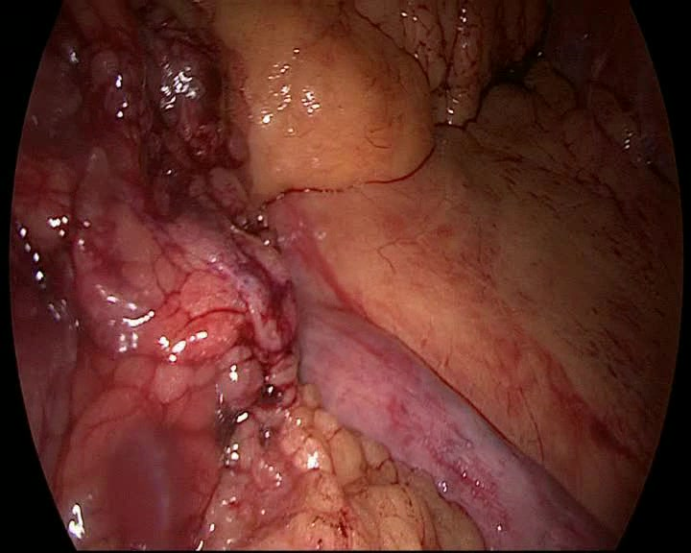
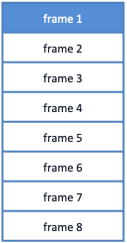



RSD
head
HTA-inspired
6-block
temporal head
remaining
surgery duration
$$⋯$$
surgical video
$$⋯$$
phase
head
0
t
T
deviation
head
8-frame clip at time t
16 x 16 px patches (196 + 1)
ViT transformer
blocks
768-d
frame feature
224 x 244 x 3 frame
Block 12
$$′$$
Block 11
Block 10
Block 9
frame tensor (8 x 768)
Block 8
Block 7
frame 1
frame 2
frame 3
frame 4
frame 5
frame 6
frame 7
frame 8
Block 6
16 x 16 x (768,)
16 x 16 x (768,)
Block 5
CLS’
CLS
Block 4
(768,)
(768,)
Block 3
(768,)
Block 2
197 x (768,)
Block 1
loop 1..12
(8, 768)

Slide 2
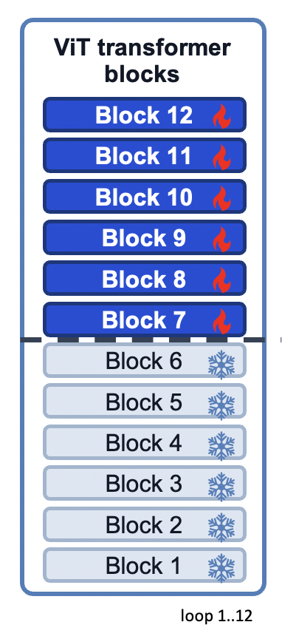
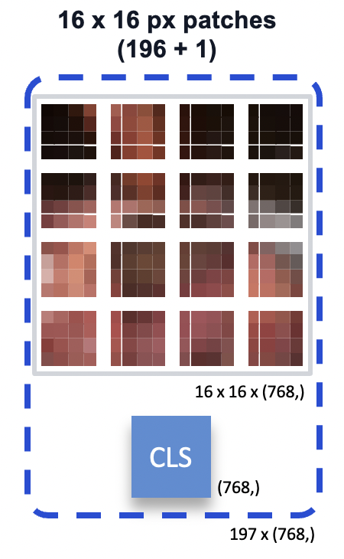
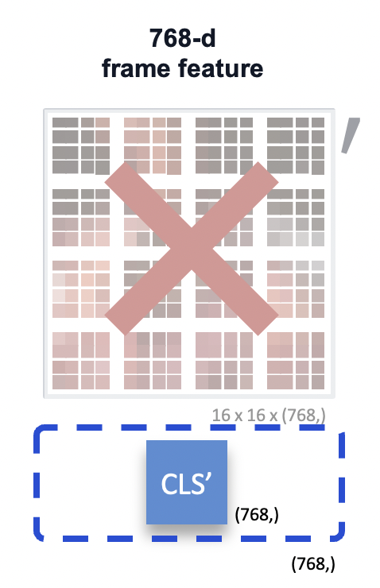
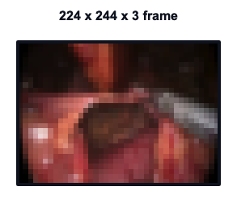



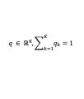
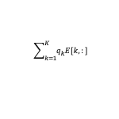




Phase
head
Deviation
head
$$⋯$$
surgical video
$$⋯$$
RSD
head
0
t
T
frame tensor (8 x 768)
frame 1
frame 2
frame 3
frame 4
frame 5
frame 6
frame 7
frame 8
8-frame clip at time t
Oracle setting
(uses full surgery information)
A
Access
D
Reconstruction
Bigram corpus
TF-IDF
PCA
K workflow clusters
Workflow Embedding
HTA-inspired
6-block
temporal head
B
Dissection
E
Closure
b₁
b₂
b₃
...
b₆₃
(8, 768)
C
Skeletonization
F
Other
$$A→B, B→B, B→C, C→D, D→E, E→F$$
S₁
PC 2
PC 1
1
...
surgery 1
A
B
B
C
D
E
F
S₂
2
...
Workflow token
$$A→B, B→C, C→C, C→D,D→E, E→F$$
surgery 2
A
B
C
C
D
E
F
⋮
⋮
...
$$wₜ ∈ ℝ⁷⁶⁸$$
⋮
★
★
★
★
✚
✚
★
★
✚
✚
✚
...
⋮
Sₙ
✚
K
...
$$A→B, B→B, B→C, C→E,E→D, D→F$$
Rows: surgeries
Columns: all bigrams in the corpus
MultiBypass140: 16 PCs
Cholec80: 10 PCs
K=6 (MultiBypass140),
K=4 (Cholec80)
Each row $E[k, 768]$is a learnable
embedding for cluster k.
surgery n
A
B
B
C
D
E
F
Used as the workflow
input to the model
Causal-at-inference setting
(uses observed prefix only)
Observed surgical prefix
(up to t)
Phase prediction on prefix
Cluster probabilities
Weighted average of embeddings
A
B
B
C
...
1
$$q_{1}$$
$$\sum_{k=1}^{K}{q_{k}E[k,:]}$$
2
$$q_{2}$$
t
...
⋮
⋮
...
K
$$q_{K}$$
i.e., soft mixture of
cluster embeddings
$$q ∈ ℝᴷ, \sum_{k=1}^{K}{q_{k}}=1$$

