Slide 1
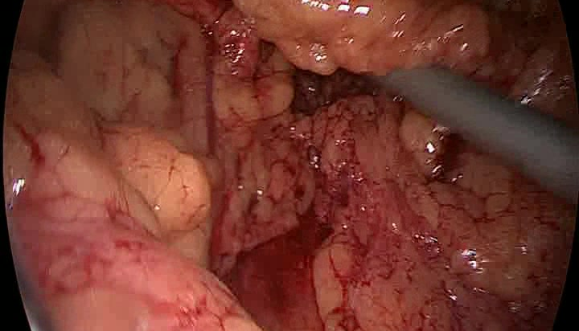
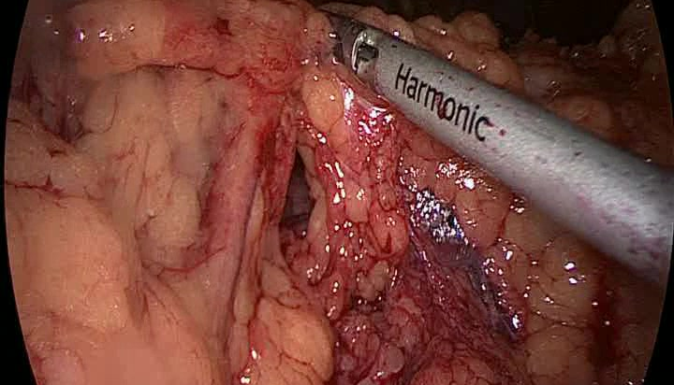
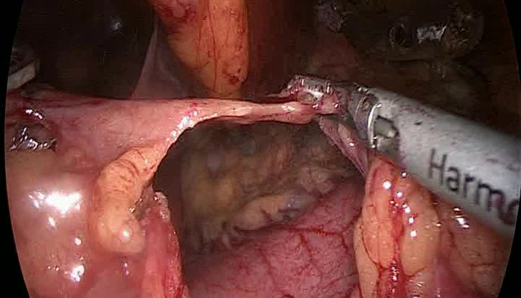
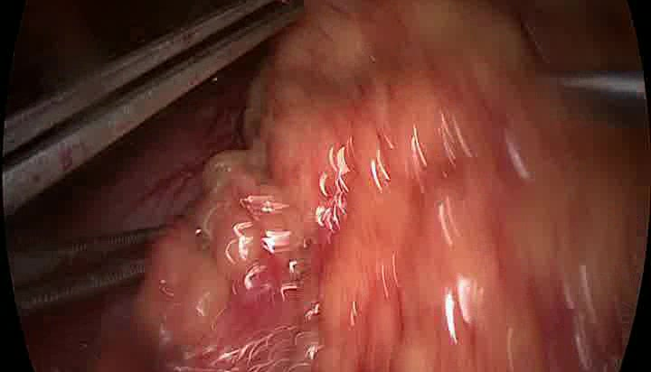
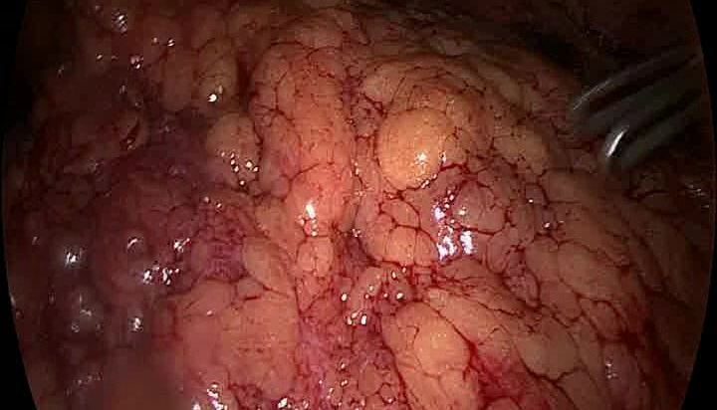
Causal inference step 1: get phase predictions without using workflow identity
First pass uses a dummy workflow slot. The phase head reads visual-prefix features before workflow-token mixing.
Observed prefix frames
x_t
Concrete MB140 / BBP12 prefix ending at the current timestamp.
A. Phase branch: visual features only
prefix
frames
visual encoder
ViT-B/16
frame
features
phase
head
phase
probabilities
argmax gives phase label
same frame features
B. Temporal branch: dummy workflow token fills the slot for this first pass
placeholder cluster id
z_dummy, e.g. 0
workflow token
E[z_dummy]
HTA blocks
[E[z_dummy], f_1:t]
temporal
features
placeholder token
does not affect phase
used later after soft-token re-run
Result of step 1: keep the phase probabilities from branch A; use them next to build the prefix phase sequence and infer the soft workflow token.

