Slide 1
TORONTO FOURCAST
Two home-price
questions
Toronto home-price prediction challenge
OFF-MARKET
LIST-AWARE
Estimate before listing
No asking price available
Estimate after listing
Asking price is an input
Separate tracks keep the information boundary clear.
Notes:
A home estimate can answer two different questions. Before the owner lists, there is no asking price to guide the estimate. After listing, the model can also use the asking price. We kept those tasks separate because an estimate that sees list price cannot answer the off-market question.
Source: Official handout and rubric: https://github.com/erwinzhang7/SSU-Data-Dash/blob/main/handout.md and https://github.com/erwinzhang7/SSU-Data-Dash/blob/main/rubric.md

Slide 2
The test moves forward in time
Train on earlier sales. Predict the next month.
TRAINING HISTORY
SIX WALK-FORWARD MONTHS
HIDDEN TEST
Earlier sales only
within each fold
Dec 2025 - May 2026
10,069 homes per track
Later hidden sales
Sale prices unavailable
Each fold uses only sales available before that month.
Synthetic transaction records. Community labels and coordinates do not map to real Toronto addresses.
TORONTO FOURCAST
2 / 6
Notes:
The challenge provides synthetic Toronto-style transaction data. We tested the model with six walk-forward monthly windows, for 10,069 homes per track overall. In each window, we trained on sales before the month and predicted sales in that month. We did not use hidden sale prices or outside records.
Source: Official starter README and handout: https://github.com/erwinzhang7/SSU-Data-Dash and https://github.com/erwinzhang7/SSU-Data-Dash/blob/main/handout.md

Slide 3
The two models keep inputs separate
BOTH TRACKS
OFF-MARKET
Home area, rooms, parking
Property type, house style
Municipality, community
Coordinates and listing month
No list-price input
LIST-AWARE
Adds the asking price
Histogram gradient boosting
trained on log sale price
FROZEN RELEASE
Published structured model
Remarks kept in experiment archive
TORONTO FOURCAST
3 / 6
Notes:
Both models use home size, rooms, parking, location coordinates, property type, house style, municipality, community, and listing time. The list-aware model also receives list price; the off-market model never sees it. Both models predict log sale price with histogram gradient boosting. The frozen release is the previously published structured-feature version. Remarks predictions remain in a separate experiment archive.
Source: Frozen feature and model definitions: https://github.com/billchenziang33/toronto-home-price-prediction-2026/blob/7cffe186bd9f0a2e8fc22f3897d52b3dbaaa8df8/features.py and https://github.com/billchenziang33/toronto-home-price-prediction-2026/blob/7cffe186bd9f0a2e8fc22f3897d52b3dbaaa8df8/models.py

Slide 4
The frozen model beats both starters
MdAPE is the competition score; MAPE is the tie-breaker.
Track | Starter MdAPE | Frozen MdAPE | Frozen MAPE
Off-market | 20.8% | 10.60% (10.38–10.85) | 13.40% (13.17–13.65)
List-aware | 7.3% | 4.36% (4.26–4.46) | 5.57% (5.47–5.66)
Parentheses show 95% home-bootstrap intervals. 10,069 validation homes per track.
Validation results only. Hidden-test performance is not yet known.
TORONTO FOURCAST
4 / 6
Notes:
On the same walk-forward validation, off-market MdAPE fell from the starter's 20.8 percent to 10.60 percent. List-aware MdAPE fell from 7.3 percent to 4.36 percent. The table reports the published structured model and its reproduced starter comparison. These are validation results, not a claim about the hidden test.
Source: Official starter baselines and rubric: https://github.com/erwinzhang7/SSU-Data-Dash/blob/main/handout.md and https://github.com/erwinzhang7/SSU-Data-Dash/blob/main/rubric.md

Slide 5
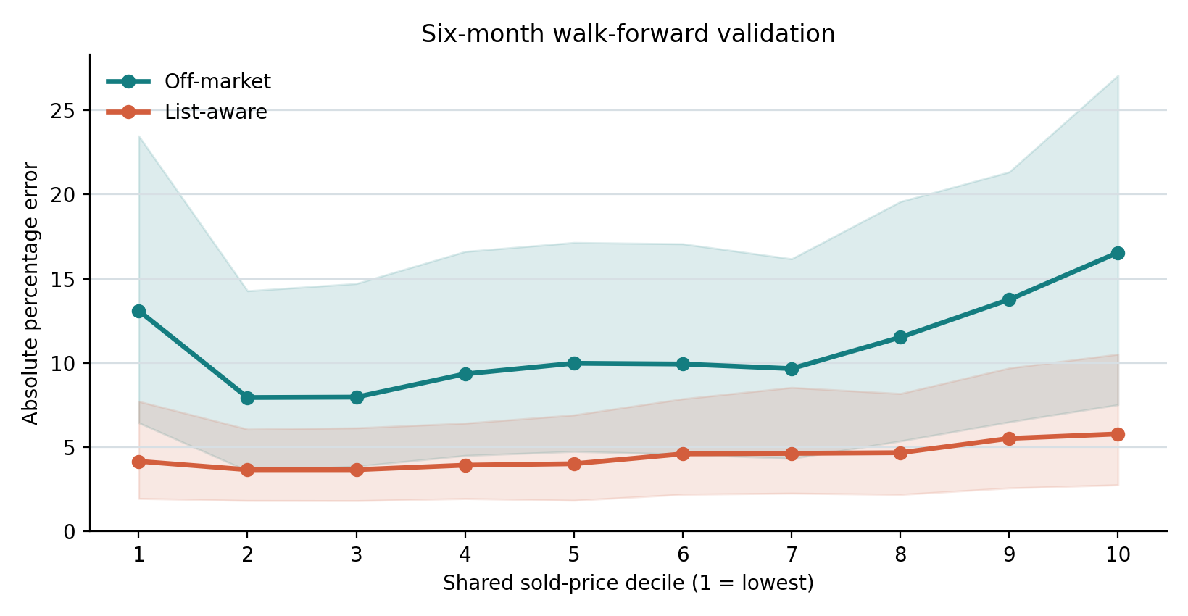
Error rises at the price extremes
Median absolute percentage error by shared sold-price decile
OFF-MARKET
13.10% lowest decile
16.55% highest decile
LIST-AWARE
5.79% highest decile
Price segments use the same frozen walk-forward predictions as the headline scores.
TORONTO FOURCAST
5 / 6
Notes:
The error chart shows a remaining weakness. Off-market MdAPE is 13.10 percent in the cheapest price decile and 16.55 percent in the most expensive, compared with roughly 8 to 12 percent through the middle. List-aware MdAPE rises to 5.79 percent in the top decile. These slices come from the same frozen validation predictions as the headline scores.
Source: Computed from the frozen six-month predictions archived at evidence/validation_predictions_frozen.csv.

Slide 6
Use the result within its limits
A stronger first estimate
for this synthetic benchmark
LIMITS
Synthetic communities and coordinates do not map to Toronto.
Six validation months may differ from the hidden period.
Home-bootstrap intervals do not capture shared monthly shocks.
Corrected remarks intervals include zero on both tracks.
Next test: price-tail calibration using forward-only predictions.
TORONTO FOURCAST
6 / 6
Notes:
Our results are useful within this synthetic benchmark, but the community names and coordinates do not map to real Toronto. The hidden period may behave differently from the six validation months, and home-level bootstrap intervals do not capture shared month shocks. The organizer says remarks reflect market dynamics, so we tested them separately. After correcting the paired MdAPE calculation, both confirmation-period intervals include zero. We therefore kept the published structured model frozen and retained the remarks predictions as an experiment. A next step is to test price-tail calibration with the same forward-only validation. Thank you.
Source: Official handout: https://github.com/erwinzhang7/SSU-Data-Dash/blob/main/handout.md. Organizer reply on remarks: https://discord.com/channels/1536459393493762058/1558195702700441700/1558522942113980459. Corrected analysis: experiments/remarks_experiment_audit.json.

