Slide 1
Git GITHUB GITPAGES

Slide 2
WHAT IS GIT
Git is a free and open source distributed version control system designed to handle everything from small to very large projects with speed and efficiency.
It allows to track changes in an application, in a folder, in a single file over time. Across different users and different computers

Slide 3
Git is easy to learn and fast. With Git, nearly all operations are performed locally, giving it a huge speed advantage on centralized systems that constantly have to communicate with a server somewhere. Git was built to work on the Linux kernel, meaning that it has had to effectively handle large repositories from day one.

Slide 4
GIT FEATURES
The Git feature that really makes it stand apart from nearly every other SCM (Source Code Management) out there is its branching model.
Git allows and encourages you to have multiple local branches that can be entirely independent of each other. The creation, merging, and deletion of those lines of development takes seconds.
This means that you can do things like:

Slide 5
Frictionless Context Switching. Create a branch to try out an idea, commit a few times, switch back to where you branched from, apply a patch, switch back to where you are experimenting, and merge it in.
Role-Based Codelines. Have a branch that always contains only what goes to production, another that you merge work into for testing, and several smaller ones for day to day work.

Slide 6
Feature Based Workflow. Create new branches for each new feature you're working on so you can seamlessly switch back and forth between them, then delete each branch when that feature gets merged into your main line.
Disposable Experimentation. Create a branch to experiment in, realize it's not going to work, and just delete it - abandoning the work—with nobody else ever seeing it (even if you've pushed other branches in the meantime).

Slide 7
Distributed
One of the nicest features of any Distributed SCM, Git included, is that it's distributed. This means that instead of doing a "checkout"(downloading a single file) of the current tip of the source code, you do a "clone" of the entire repository.
Multiple Backups
This means that even if you're using a centralized workflow, every user essentially has a full backup of the main server. Each of these copies could be pushed up to replace the main server in the event of a crash or corruption. In effect, there is no single point of failure with Git unless there is only a single copy of the repository.
Data Assurance
The data model that Git uses ensures the cryptographic integrity of every bit of your project. Every file and commit is checksummed(cryptographic hash function on a piece of data) and retrieved by its checksum when checked back out. It's impossible to get anything out of Git other than the exact bits you put in.

Slide 8
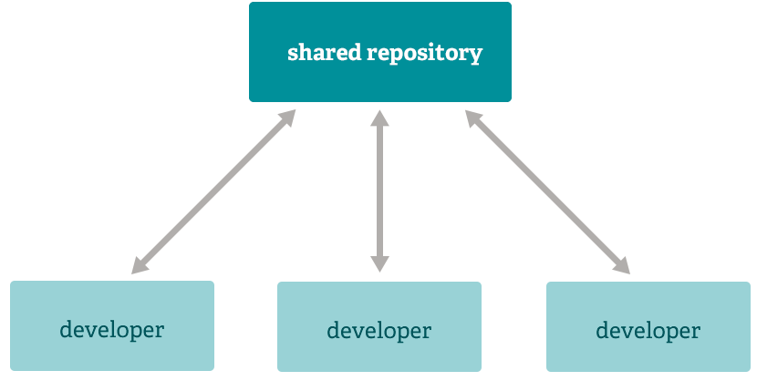
Any Workflow
Because of Git's distributed nature and superb branching system, an almost endless number of workflows can be implemented with relative ease.
1) SUBVERSION-STYLE WORKFLOW

Slide 9
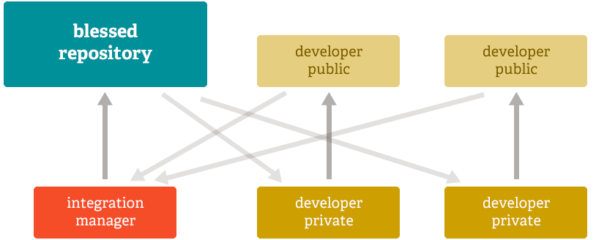
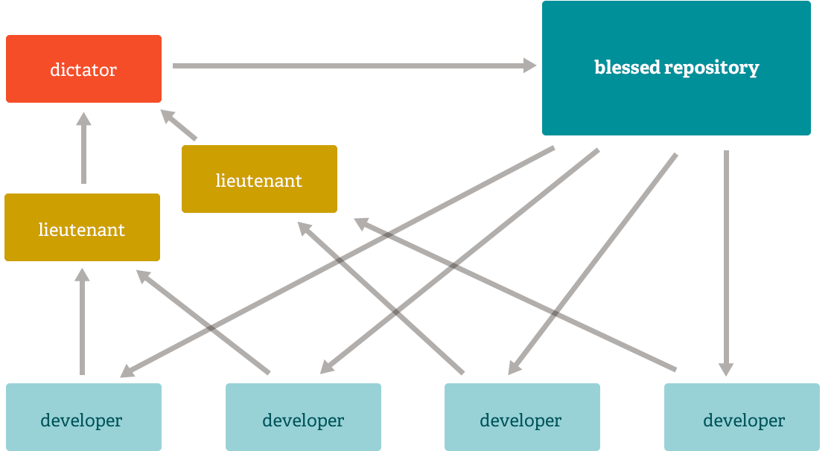
2) INTERGRATION MANAGER WORKFLOW
3)DICTATOR AND LIEUTENANTS WORKFLOW

Slide 10
WHAT IS GITHUB
GitHub is a code hosting platform for collaboration and version control.
GitHub lets you (and others) work together on projects.
GitHub essentials are:
Repositories
Branches
Commits
Pull Requests
Git (the version control software GitHub is built on)

Slide 11
Repository
A GitHub repository can be used to store a development project.
It can contain folders and any type of files (HTML, CSS, JavaScript, Documents, Data, Images).
A GitHub repository should also include a licence file and a README file about the project.
A GitHub repository can also be used to store ideas, or any resources that you want to share.

Slide 12
Branch
A GitHub branch is used to work with different versions of a repository at the same time.
By default a repository has a master branch (a production branch).
Any other branch is a copy of the master branch (as it was at a point in time).
New Branches are for bug fixes and feature work separate from the master branch. When changes are ready, they can be merged into the master branch. If you make changes to the master branch while working on a new branch, these updates can be pulled in.

Slide 13
Commits:
At GitHub, changes are called commits.
Each commit (change) has a description explaining why a change was made.
Pull Requests:
Pull Requests are the heart of GitHub collaboration.
With a pull request you are proposing that your changes should be merged (pulled in) with the master.
Pull requests show content differences, changes, additions, and subtractions in colors (green and red).
As soon as you have a commit, you can open a pull request and start a discussion, even before the code is finished.
A a great way to learn GitHub, before working on larger projects, is to open pull requests in your own repository and merge them yourself.
You merge any changes into the master by clicking a "Merge pull request" button.

Slide 14
WHAT IS GIT PAGES
THIS IS A FREE HOSTING SERVICE FOR STATIC WEBSITES OFFERED BY GITHUB, WHERE EACH REPOSITORY ON OUR ACCOUNT CAN HAVE IT’S OWN HOSTED WEBSITE.
GIT PAGES IS DEPENDENT ON GIT AND GITHUB

