Slide 1
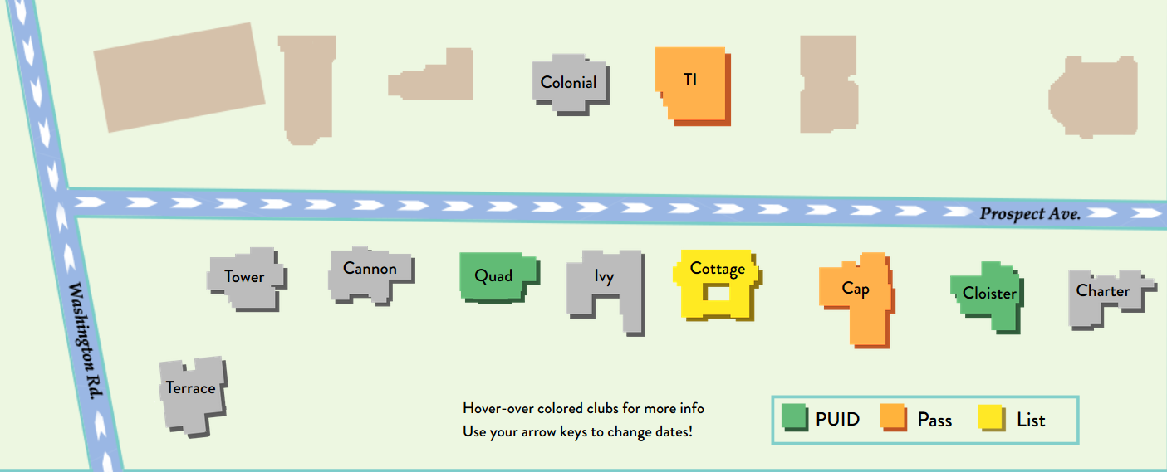
ProspectAve
Your New Guide to the Street
Bill Dong, Ben Liang, Michael Man, June Ho Park, Yang Tu
Notes:
YANG

Slide 2
The Problem
Which clubs are open? Themes?
What do you need to get in?
Current solutions:
Facebook, flyers, word of mouth
Slow and inefficient
Often wrong
Notes:
MICHAEL
Eating clubs are a huge part of life at Princeton (lawnparties)
No way of knowing which clubs are open on a given night, or whether they have special events going on
Not knowing what’s needed to get in--if I don’t have passes, are any clubs PUID?
Eating clubs try to get around this by making Facebook events, posting flyers, etc
It’s a pain for officers to invite hundreds of people to Facebook events every time your club has an event
Also annoying to go around campus posting dozens of flyers; wastes time and paper
Info spreads by word of mouth, but can often be wrong b/c of lack of single source that has reliable info

Slide 3
Our Solution
Centralized platform
User-friendly
Attractive UI
Mobile Support
Notes:
JUNE
4 key ideas to try to fix this: centralized platform, user-friendly, attractive UI, mobile support
Wanted to create one page where it’s possible for any student to view all eating club events on any date (not just today)
Goal was to make our site as user-friendly as possible for students and officers; officers can add an entire semester’s worth of events with a few clicks
Simple but attractive UI
Realized many students would want to check events on the go, so designed completely different layout for mobile

Slide 4

DEMO
Notes:
YANG + BILL
DEMO PLAN:
Index.html:
Show them main page
Hover over events
Change date (on map and using calendar)
Calendar filters
officer.html
Add event
Edit event
Index.html
Show event was added
Mobile.html
Date swipe
Select events
Mobile demo:
What if you don’t have your laptop or if you’re already at the street and want to see if any clubs are PUID?
We designed our mobile page with those issues in mind
We replaced the map you saw on the webapp with these panels, one for each club, so you can still see what’s going on at all the clubs on the street at once
Just as easy to use as the webapp--swipe to change date, panel changes color when there’s an event
If I wanted to learn more about an event, I can tap on it to pull up more information, and swipe left to make it go away
In case you want to see future dates or PUID events, still have calendar

Slide 5
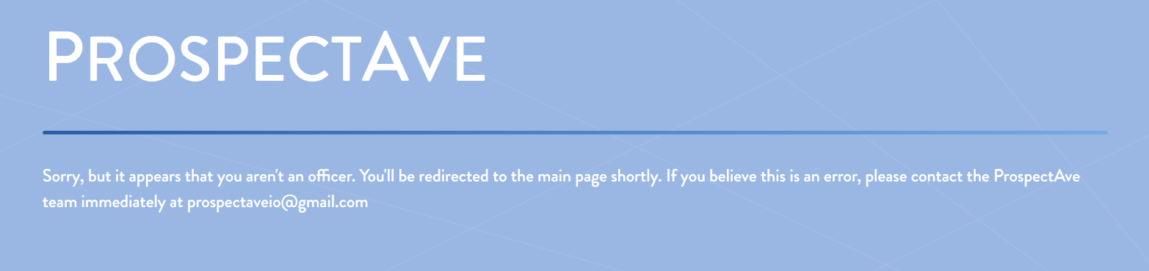
Additional Features
Responsive Design
Failed Login Redirection
Feedback
Notes:
BENJAMIN
Bulk upload feature: if a club has multiple events that are similar (no themes) there’s a form where officers can select multiple dates
Can upload entire semester’s events in seconds
Responsive UI: 3 different possible layouts depending on screen size/mobile, everything automatically changes size when you adjust screen width
Since only eating club officers can log in, we redirect non-officers to the main page when they try to log in
Feedback

Slide 6
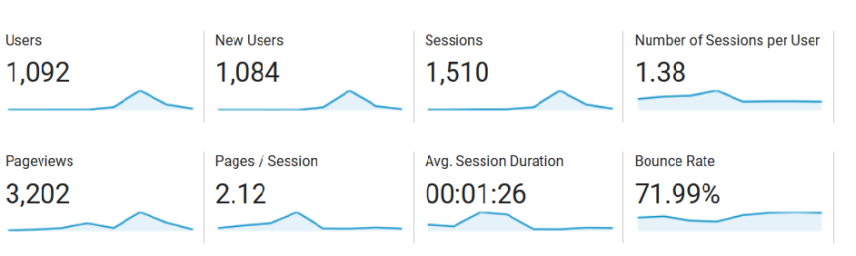
Analytics
Our numbers just 3 days after release
Notes:
Ben
We started advertising before lawnparties and we had all lawnparties acts in our system which def attracted some users
Our goal was to make a simple and quick way for students to check which events are open, which we accomplished (1:26 average session duration)

Slide 7



Architecture
Frontend
HTML, CSS, JS
Backend
Node.js
SQLite
Notes:
MICHAEL
Frontend is HTML, CSS and JS
CSS for theme and responsive styling (3 different layouts)
JS libraries: Calendar, Google Analytics for pageviews
jQuery as well
Node and SQLite backend
Node for CAS authentication, mapping officers to their correct club, and sending data to the clients as JSON
SQLite b/c we needed a small, compact database

Slide 8
Node.js Server
ran with pm2
Scripts to analyze logs
SQLite3
CAS
Request --> netID
Event data
Event data
Login
View, Add, Edit, Delete
Desktop Client
Mobile Client
Officer Client
Notes:
MICHAEL
Frontend is HTML, CSS and JS
CSS for theme and responsive styling (3 different layouts)
JS libraries: Calendar, Google Analytics for pageviews
jQuery as well
Node and SQLite backend
Node for CAS authentication, mapping officers to their correct club, and sending data to the clients as JSON
SQLite b/c we needed a small, compact database

Slide 9
Challenges
Mobile UI
Advertising
Meeting with officers
Notes:
BILL
When we were first talking about ideas for Prospectave, the map was a big one--however, we quickly realized that we wouldn’t be able to port that to mobile
So we spent a lot of time designing a completely different UI for mobile, one that is still visually appealing while also allowing the user to easily see what’s going on at all 11 clubs at once just by glancing at the screen
Spent a lot of time advertising and figuring out the best ways to advertise
Talked to friends, posted in Facebook groups, emailed listservs, printed and posted flyers all over campus
Launched before Lawnparties, since we thought it would be nice to have a place to see all the Lawnparties acts; as Ben said, it worked out
Our project can’t function without actual data from the eating clubs, so setting up meetings was v important
Reaching out to all 11 clubs, making sure everyone was on board with Prospectave, having the meetings, getting actual eating club events on our app was a challenge but also essential to our project

Slide 10
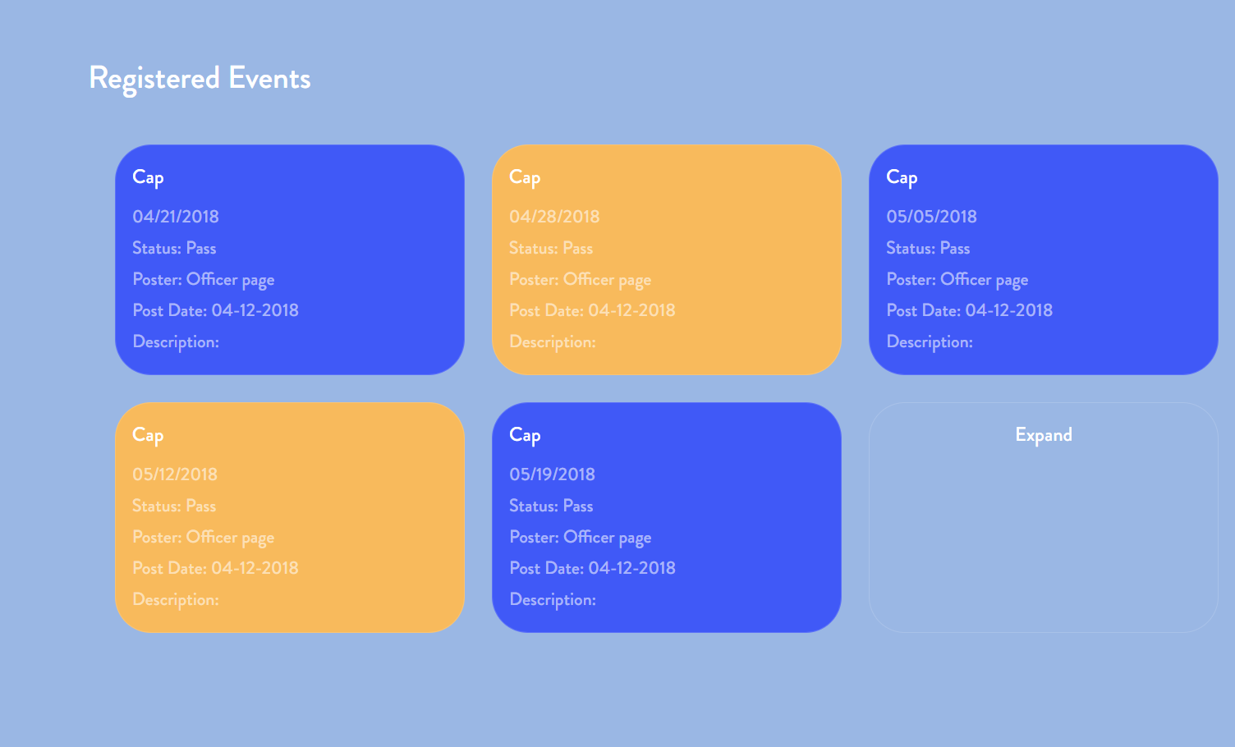
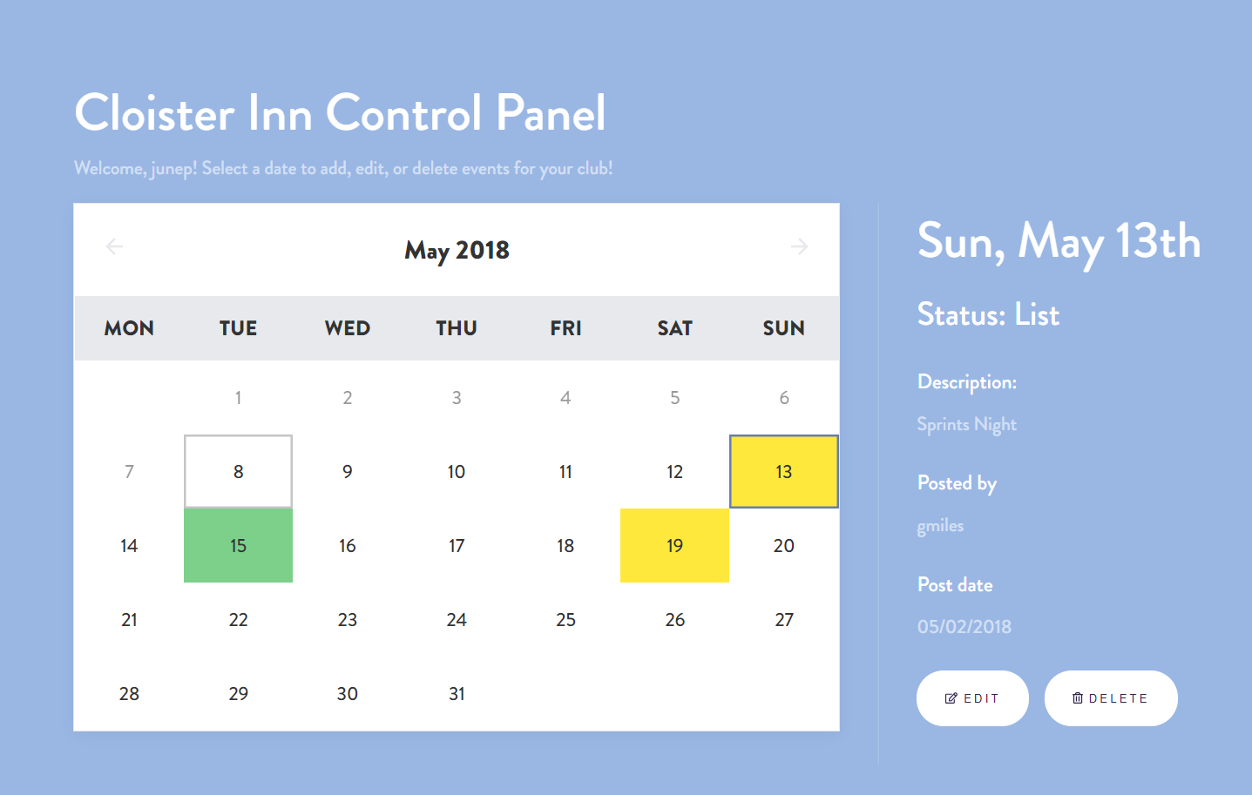
Design Challenge
Notes:
JUNE
Really focused on making officer UI as easy as possible, so we had trouble deciding on an implementation--went through several different iterations before we came up with the current layout (table, block)
First started with a table - too bland
Moved onto block design, but we realized that it was too much information all at once, and checking dates was unintuitive
We also used t have the event form below the main control panel
Our final solution was to have this calendar
Officers can see in an instant which days their club was open for
We also moveed the event form into the calendar so that it was more compact, and officers didn’t have to scroll down

Slide 11
Trade-Offs
Information vs Cleanliness
Students vs. Eating Clubs
Compatibility vs Specificity
Notes:
BEN
Our main goal was to keep the interface clean, but we also wanted to provide as much info as possible--needed to decide on a balance
For example, no support for attachments (flyers) yet to keep interface clean
Issues with some past projects like this were that it was too complicated for officers to use and they lost interest
We made it as easy to use as possible, but could come at the cost of loss of control for officers
Portable and modular code

Slide 12
Maintaining
Continue working with officers
Frosh Week
Updating NetIDs
Notes:
JUNE
We really want to maintain this app for as long as possible, and not just end as a 333 project
We want students in the future to be able to use our app
Will reach out to officers again over the summer about next year
Frosh don’t really know what’s happening over frosh week--info usually just spreads by word of mouth
We’re planning on getting all events on Prospectave for frosh week

Slide 13
Future Updates
Image uploading
Theme nights
Support for bicker events
Notes:
BILL
We have lots of ideas for future updates, also got feedback from officers
One feature we want to implement in the future is image uploading--similar to the flyers eating clubs post
Better support for theme nights by letting clubs add titles for their nights
Prebicker events--clubs have trouble advertising these sometimes Prospectave could help
Students also have trouble keeping track of which bicker events are at which times
If we added better support we could help with those issues

Slide 14
Acknowledgements
Prof. Kernighan
Jérémie Lumbroso
Ashley Kling (TA)
Eating club officers
Notes:
YANG
jeremie

Slide 15
Questions?

