Slide 1
SSH and Friends
Remotely going where everyone has gone before
Bill Farrow
Embedded Linux Software Engineer
Beyond Electronics Corp
Triangle Linux Users Group (TriLUG)
bill-self@arrowsreach.com
Notes:
My name is Bill Farrow
I do Embedded Linux professionally
I have been using Linux since the early 1990's
Oh, and I am on the TriLUG steering committee

Slide 2
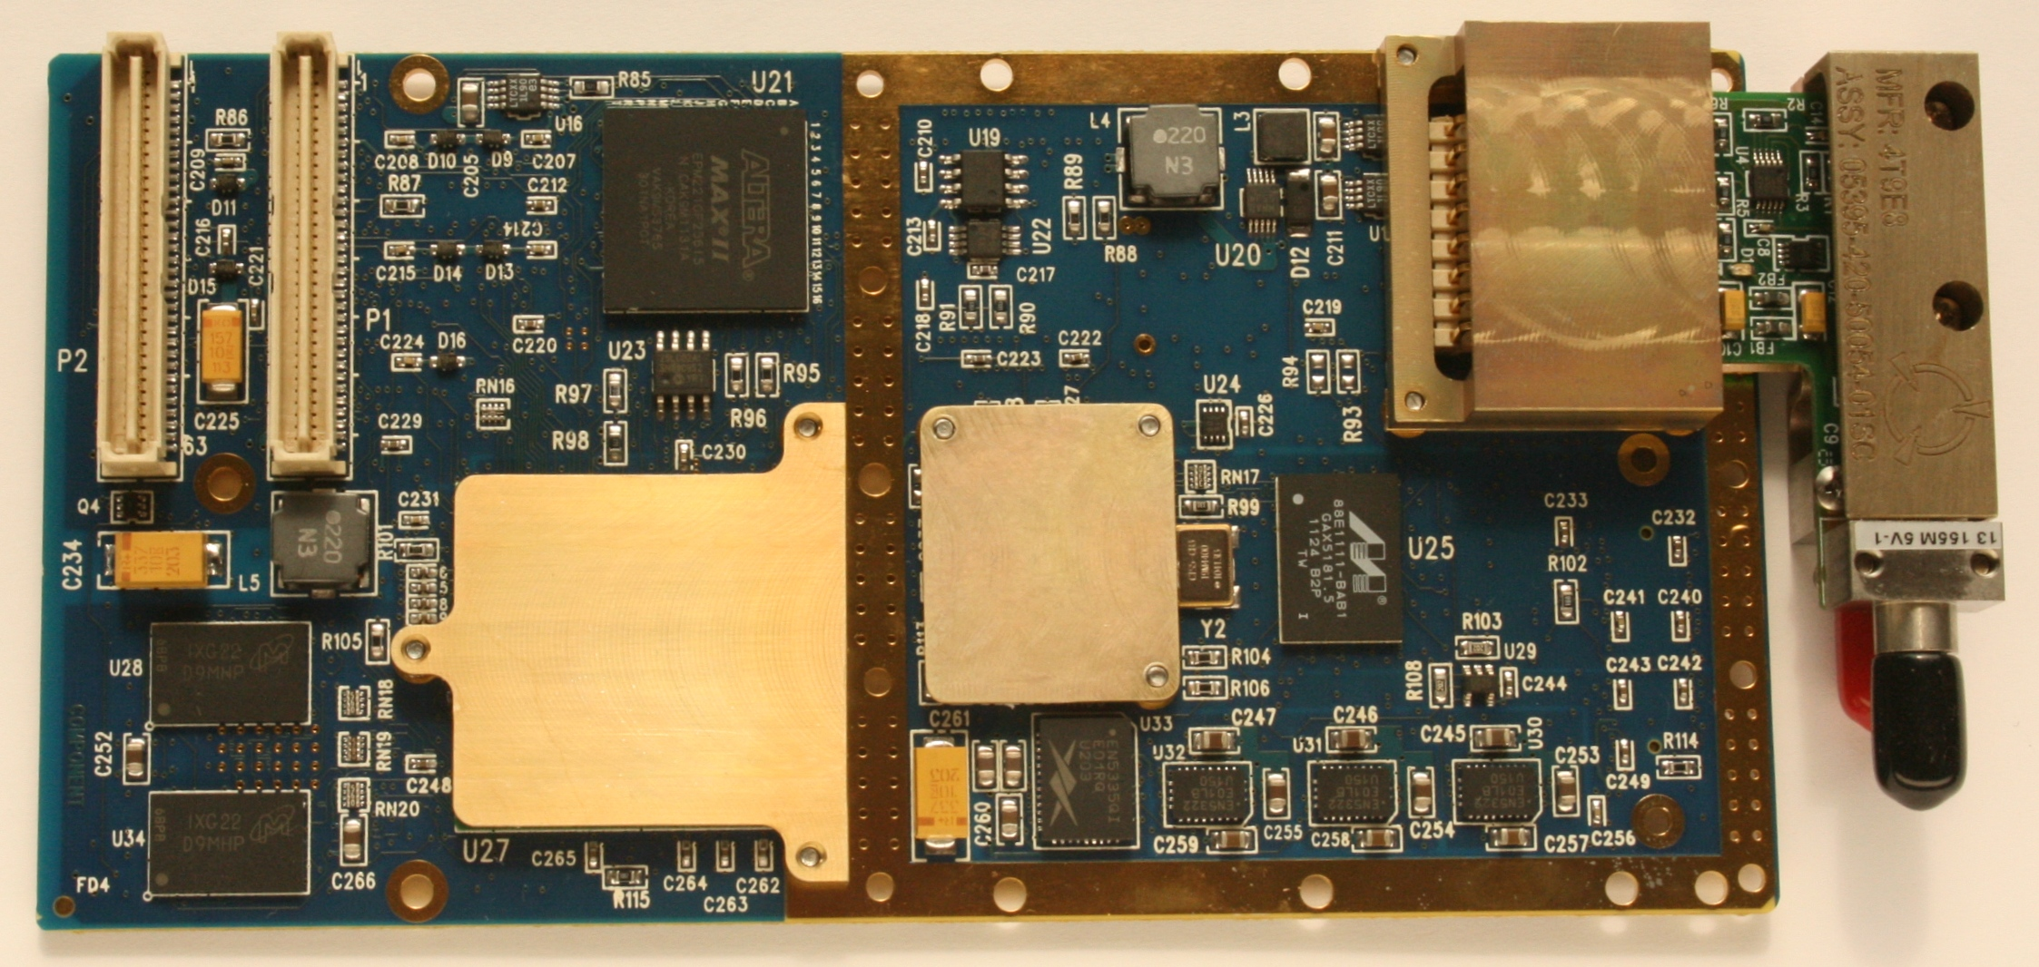
My work
Shock & Vibration
PCI Bus
Fiber Optics
High/Low Temperature
PowerPC
Conduction Cooled
Notes:
Embedded engineering
Lab full of embedded boards
Remote power switches
Work from home – bad weather, sick children
Music
PowerPC processor
Conduction cooled board – no moving parts
Shock, vibration, extended temperature testing

Slide 3
Where is SSH used
Home networks
Work networks
Cloud Servers
  Linode, Amazon, Eucalyptus, etc
Embedded devices
  Linux Internet of Things
  Smart Grid
  Appliances - TV's ... Clock Radios

Slide 4
Overview
Why ? Telnet, rlogin
Basic Usage
Secure Copy (scp)
SSH Filesystem (sshfs)
Keys
Config File
X Windows
Tunneling
Authentication Forwarding
Notes:
“The Secure Shell (SSH) is a protocol for secure remote login and other secure network services over an insecure network.” - RFC4253
strong encryption, server authentication, integrity protection, compression.
Public Private key system, symmetric encryption, message authentication.

Slide 5
History
1995 – Tatu Ylönen (Finland) opensource → proprietary
1998 – OpenSSH fork - OpenBSD developers
2006 SSH-2 – better security and more features
2003 Dropbear SSH
  Busybox
Notes:
2006 - RFC 4253 published
2006 - Internet Engineering Task Force (IETF) – standardized version 2.x

Slide 6
Telnet
1969 – RFC15
TCP/IP client / server
No encryption - clear text
Authentication provided by external applications
RSH – remote shell
Notes:
Very old !!
Still in use today ? WTF
Q: Anyone using telnet ? Why ?
rsh, rlogin – run commands remotely, nice for scripts

Slide 7
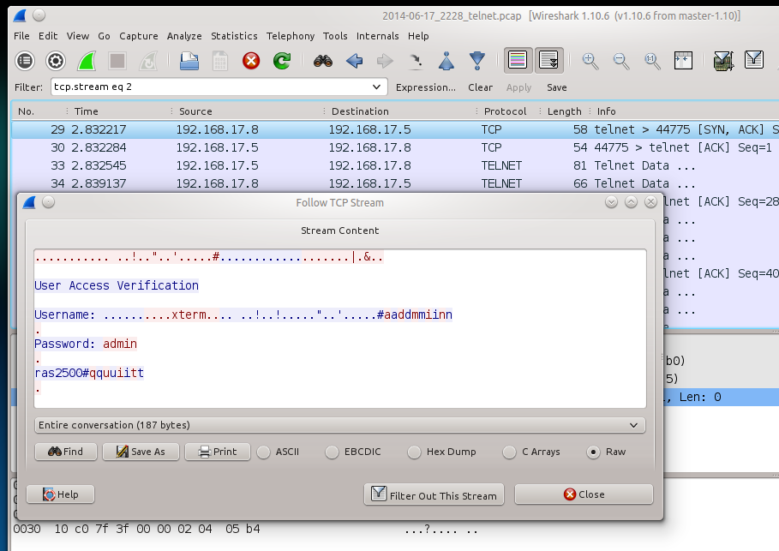
Telnet Demo

Slide 8
Basic Usage
ssh example.com
bill@example:~$
ssh fred@example.com
fred@example:~$
ssh example.com uptime
23:04:55 up 12 days, 1:55, 4 users, load average: 0.10, 0.04, 0.05
Notes:
1. Remote shell
2. Remote shell with different username
3. Run a command on a remote system

Slide 9
Secure Copy
Copy from remote computer
Copy to remote computer
scp example.com:myfile.txt .
scp myfile.txt fred@example.com:.

Slide 10
Secure Copy
Copy folders recursively
Don't hog your bandwidth
scp -r example.com:myfile.txt .
scp -l 10 fred@example.com:myLargeFile.img .
MyLargeFile.img 2% 128KB 68.0KB/s - stalled -

Slide 11
SSH Filesystem
Mount a remote folder
Un-mount
mkdir rDocuments
sshfs example.com:Documents rDocuments
ls rDocuments
fususermount -u rDocuments

Slide 12
Host Keys
Unknown host !!
Host key fingerprint
ssh example.com
The authenticity of host 'example.com (10.1.1.10)' can't be established.
RSA key fingerprint is f3:be:9b:63:52:78:82:59:78:de:7e:12:b9:e8:c3:a8.
Are you sure you want to continue connecting (yes/no)? no
Host key verification failed.
ssh-keygen -l -f /etc/ssh/ssh_host_rsa_key
2048 f3:be:9b:63:52:78:82:59:78:de:7e:12:b9:e8:c3:a8 example.com (RSA)

Slide 13
Public Key Authentication
Passwords ? Who needs them
Create a public/private key pair
ssh-keygen
Generating public/private rsa key pair.
Enter file in which to save the key (/home/fred/.ssh/id_rsa):
Enter passphrase (empty for no passphrase):
Enter same passphrase again:
The key fingerprint is:
4d:b2:08:ed:69:23:9f:59:d4:2f:cb:37:ea:ff:86:27

Slide 14
Deploy Public Key
Send your public key file to remote host
Better yet - send a specific key only
ssh-copy-id example.com
ssh-keygen -f .ssh/example_rsa
Ssh-copy-id -i .ssh/example_rsa example.com

Slide 15
Public Key Authentication
Use your key
Use the Key Agent
ssh -i .ssh/example_rsa example.com
ssh-add .ssh/example_rsa
This is getting complicated ...

Slide 16
Config File
Less typing … more work
cat .ssh/config
Host example.com
User fred
IdentityFile ~/.ssh/example_rsa
ssh -i .ssh/example_rsa fred@example.com
ssh example.com

Slide 17
Tab Completion
Type even less
ssh ex [TAB]
ssh example.com

Slide 18
X Windows
Tunnel X11 traffic through ssh
ssh -X example.com
xeyes

Slide 19
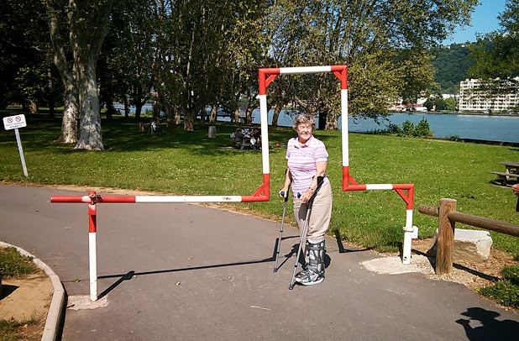
Port Tunneling
Firewalls and NAT

Slide 20
Port Tunneling
Port Forwading
  Access services from remote system
Reverse Port Forwading
ssh -L 8080:localhost:80 example.com
ssh -R 2022:localhost:22 example.com

Slide 21
Remote Browsing
Browse the web from home
SOCKS Proxy
  Dynamic Port Forwarding
Configure your web browser proxy settings
  Proxy: localhost
  Port: 8080
ssh -D 8080 -C -N example.com

Slide 22
Control Master
Multiplex your SSH sessions ?
Faster slave connections
Closing the Master will close the slaves
cat .ssh/config
ControlMaster auto
ControlPath ~/.ssh/master-%r@%h:%p

Slide 23
Scripting
Passphraseless Keys == Security Nightmare ?
Limit access of particular keys
cat .ssh/authorized_keys
# Zoneminder SMTP mail tunnel
command="nc localhost 25",no-X11-forwarding,no-agent-forwarding,no-port-forwarding ssh-rsa AAAAB3NzaC1y....XXX bill@atom

Slide 24
Control Master
Multiplex your SSH sessions ?
Faster slave connections
Closing the Master will close the slaves
cat .ssh/config
ControlMaster auto
ControlPath ~/.ssh/master-%r@%h:%p

Slide 25
Keyboard Tricks
Quick logout
Forcibly close your SSH session
SSH Stuck ?
CRTL-D
~.
CTRL-S ---> CRTL-Q

Slide 26
Getting Tricky
Clone your remote hard drive (securely)
VNC via SSH
ssh -X bill@example.com "SUDO_ASKPASS=/usr/lib/ssh/x11-ssh-askpass sudo dd if=/dev/vda1 bs=1M" | pv > /tmp/backup.img
export VNC_VIA_CMD='/usr/bin/ssh -l fred -f -L "$L":"$H":"$R" "$G" sleep 20'
xvncviewer -via example.com localhost:0

Slide 27
Go Home
So much more....
sshlf - Dual use port https 443
ssh-askpass - Pretty GUI for unlocking keys
KDE fish:/ - any file path or url can use ssh
virt-manager - remote access to KVM guests
Bill Farrow
bill-self@arrowsreach.com
IRC: freenode.net #trilug

