Slide 1
Philosoraptor
Team
Skyhook
Philosohook
PHAT-TACO Experiment
Pressure Humidity And Temperature
Tests And Camera Observations
Hannah Gardiner, Bill Freeman, Randy Dupuis, Corey Myers, Andrea Spring

Slide 2
Preliminary Design Review (PDR)
Organization and Responsibilities
Goals and objectives
Science background
Technical background
Payload Design
Development plan

Slide 3
Organization and Responsibilities
Member | Primary Responsibility | Secondary Responsibility
Hannah Gardiner | Project Management and editing | Testing and implementation
Bill Freeman | Software Design | Electrical Design and editing
Randy Dupuis | Electrical Design | Software Design
Andrea Spring | Mechanical Design | Project Management
Corey Myers | Testing and Implementation | Mechanical Design

Slide 4
Mission Goal
To measure atmospheric conditions in order to study the layers of the atmosphere from liftoff to landing and study the surrounding environment of the payload in order to validate atmospheric conditions measured

Slide 5
Objectives
The overall objective is to accurately measure and record internal and external temperature and humidity and external pressure on a balloon flight in order to study the atmosphere and take video of the flight.

Slide 6
Science Objectives
Determine atmospheric layers flown through during flight
Characterize atmospheric conditions in layers
Determine effects of passing through clouds on temperature, pressure, and humidity
Identify the altitude range of cloud layers in order to estimate peaks in atmospheric turbulence and humidity
Determine balloon expansion as a function of altitude to approximate relative pressure

Slide 7
Technical Objectives
Build a working payload that can withstand conditions of a balloon flight
Record temperature, pressure, and relative humidity up to 100,000 feet
Determine at what time and altitude the payload enters and exits clouds
Determine the radius of the balloon at several times, altitudes, and temperatures during flight
Achieve Pre-PDR, CDR, FRR, and final payload on time as specified by LaACES management

Slide 8
Science background

Slide 9
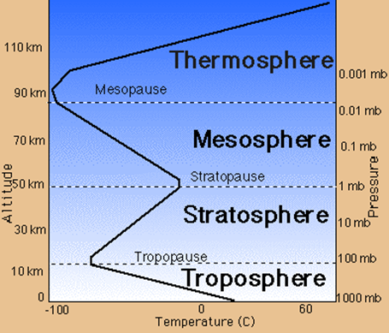
Science Background: Earth’s Atmosphere
Troposphere
Clouds
Stratosphere
Less humidity & lower pressure than the Troposphere
http://www.wyckoffschools.org/eisenhower/teachers/chen/atmosphere/earthatmosphere.htm

Slide 10
US Model Atmosphere¹ 1976
“A hypothetical vertical distribution of atmospheric temperature, pressure, and density”
Can calculate properties of the atmosphere
Pressure
Temperature
Density
¹U.S. Standard Atmosphere, 1976, U.S. Government Printing Office, Washington, D.C., 1976.

Slide 11
Temperature
Identify layers of atmosphere using temperature lapse rate
Troposphere Tropopause Stratosphere
Theory
Oolman, Larry. "Atmospheric Soundings." Wyoming Weather Web. Web. 28 Nov. 2010. <http://weather.uwyo.edu/upperair/sounding.html>.

Slide 12
Pressure
We shall compare measured pressure with expected pressure of the US Standard Atmosphere
Troposphere Tropopause Stratosphere
Oolman, Larry. "Atmospheric Soundings." Wyoming Weather Web. Web. 28 Nov. 2010. <http://weather.uwyo.edu/upperair/sounding.html>.

Slide 13
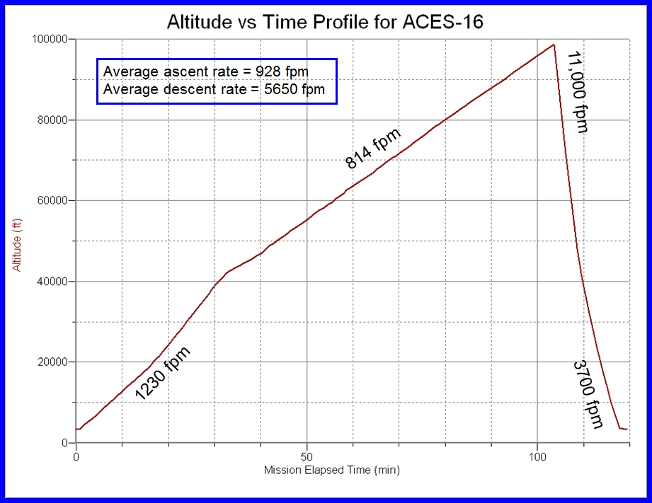
Balloon Radius
Kaymont 2000 gm sounding balloon
Ascent rate should be constant during flight
Has not been in previous flights

Slide 14
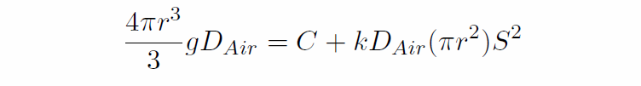
Balloon Radius
Summation of all forces on an object with constant velocity is zero:
R is the radius of the balloon in m
D_{air} is the density of air in kg/m³
g is gravitational acceleration in m/s²
C is the weight in newtons
k is a geometrical and substance factor in drag that is d’less
S is the vertical speed of the balloon in m/s

Slide 15
Balloon Radius vs. Altitude

Slide 16
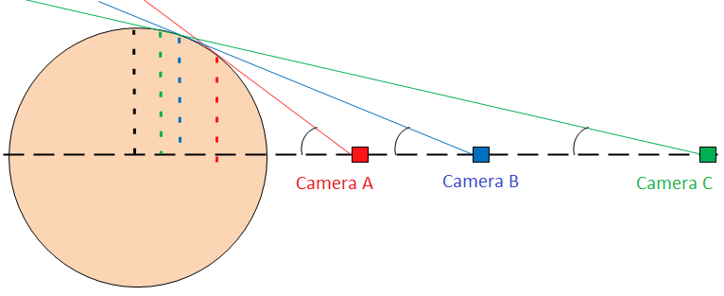
Placement of Camera
Placement of the camera is important
Too close and the apparent radius is not close to the actual radius (Camera A)
Too far and the radius is not easy to measure (Camera C)

Slide 17
Technical background

Slide 18
Temperature Sensors
Required range: 30 to -70 ± 0.6 °C
Resistive Temperature Detector
Thermocouple
Operation: 0 to 1000°C
Cost: $75
Operation: -60 to 150°C
Cost: $1700
Thermistor
Diode
Operation: -80 to 150°C
Cost: $8.00
Operation: -65 to 200°C
Cost: $0.02

Slide 19
Pressure Sensors
Required range: 1 to 0.008 ± 0.004 atm
Piezoelectric
Piezoresistive
Low cost, Small in Size, and High Repeatability
Produces Linear Output
Require a circuit with higher impedance to measure the voltage stored in the sensor
Voltage across the sensor can be lost before a measurement is taken
Low cost, Small in Size, and High Repeatability
Produces Linear Output
Better low frequency response than piezoelectric sensors

Slide 20
Humidity Sensors
Required range: 0 to 100 ± 0.5 % relative humidity
Capacitive
Resistive
Have protective coating to protect the circuitry
Capacitance changes linearly with relative humidity
Have built in circuitry to transform the output to a voltage
Operation:-40 to 85°C
Output is related to relative humidity in an inverse exponential relationship
Operation: -40 to 100°C

Slide 21
Camera
CCD
CMOS
Not as susceptible to noise
Can consume about 100x as much power as a CMOS
Higher quality, resolution, and sensitvity
More susceptible to noise than CCD’s
Low power
Lower sensitivity due to light hitting transistors instead of photodiodes
Easier to mass produce and cost less

Slide 22
Electronics design

Slide 23
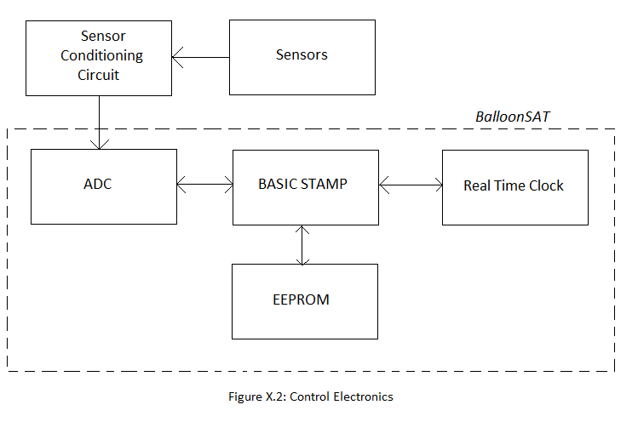
Control Electronics

Slide 24
Possible Power Sources
Photovoltaic Panel
Each cell produces about 0.5V
Current depends on surface area and illumination
Back up batteries required for cloud coverage
Thermoelectric Generator
Require an active heat source
More suited for deep space missions
Battery
Light-weight, and inexpensive
Variety of Voltages and Capacities available

Slide 25
Power Budget
Component | Current (mA) | Voltage (V) | Power (mW) | Capacity (mA-hours)
Temperature Sensor | 1 | 12 | 12 | 4
Pressure Sensor | 2 | 12 | 24 | 8
Internal Humidity Sensor | 0.5 | 5 | 2.5 | 2
External Humidity Sensor | 0.5 | 5 | 2.5 | 2
Camera | 250 | 4.5 | 1125 | 1000
BalloonSat | 52 | 12 | 624 | 208
Total | 306 | 12 | 1790 | 1224

Slide 26
Power Supplies
Supply | Current (mA) | Voltage (V) | Power (mW) | Capacity (mA-hours)
Power Supply 1 | 56 | 12 | 665 | 224
Power Supply 2 | 250 | 4.5 | 1125 | 1000
Total | 306 | 12 | 1790 | 1224
Power supply Requirements
Supply | Current (mA) | Voltage (V) | Power (mW) | Capacity (mW-hours)
Power Supply1 | 56 | 1.5 | ~80 | 320
Power Supply 2 | 250 | 1.5 | ~375 | 1500
Requirements for Each Battery in the Power Supply

Slide 27
Software design

Slide 28
Data Storage
Data Type | Minimum | Maximum | Precision | # steps | # bytes | Total Bytes
Pressure | 0.008 | 1 | 0.004 | 248 | 1 | 1
Temperature x2 | -70 | 30 | 0.5 | 240 | 1 | 2
Humidity x2 | 0 | 100 | 0.5 | 200 | 1 | 2
Timestamp (H,M,S) | 0 | 60 | 1 | 60 | 3 | 3
1 Data point every 6 seconds (10/min)
100 minutes ascent – 1000 data points
Storage needed – 8000 bytes
EEPROM storage – 8191 bytes
Total time to take data – 102 minutes
Total time to take data – 408 minutes
Secure Digital: 2$/GB
Flash memory: 2.5$/GB

Slide 29
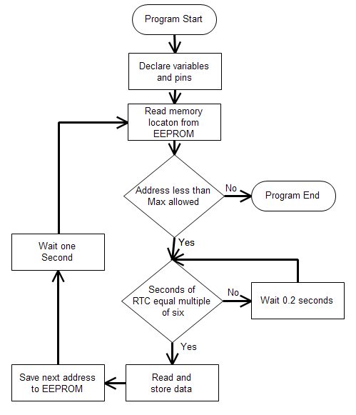
During Flight Flowchart
Must take data every six seconds
Stores data in raw ADC counts
Can’t run out of memory before ascent is over
Can’t overwrite data if the power restarts

Slide 30
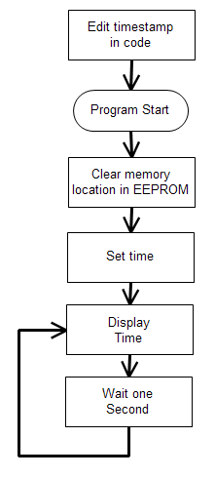
Pre Flight Flowchart
Must be able to calibrate Real Time Clock (RTC)
LaACES Management will provide a flight profile of altitude vs time
This program sets the time and allows for the During Flight program to start at the correct location

Slide 31
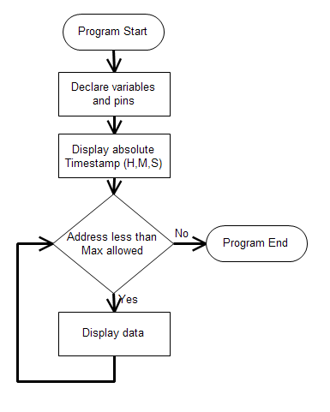
Post Flight Flowchart
Must be able to read out all data to debug screen
Excel data sheet will contain conversions from ADC counts to atmospheres, kelvin, and % humidity
Excel sheet will also convert timestamps into altitude

Slide 32
Post Flight Data Processing
EEPROM readout data
Timestamp -> altitude
ADC counts -> pressure, temperature, humidity
Video data
Video timestamp -> altitude
Video -> size of balloon (pixels -> cm)
Video -> cloud types
Video -> payload passing through cloud

Slide 33
Mechanical design

Slide 34
Thermal Design
Temperature Range: -70ºC to 25ºC
Construction Material: Insulating foam with a very low thermal conductivity
Heat produced by electronics
Component | Lowest Temp. (ºC) | Highest Temp. (ºC)
Electronics | -40 | 85
Pressure Sensor | -20 | 85
Humidity Sensor | -40 | 85
Temp Sensor | -65 | 200
Camera | -20 | 100
Batteries | -40 | 60

Slide 35
Payload Design
External
Internal
Hexagonal
9.5 cm sides
21 cm high; 23 cm including the bottom
2 holes in the lid
Temperature and Humidity Sensors
Camera
Balsa wood 7.5 cm wide and 21 cm
Hold components
Increase stability
Camera against opposite wall

Slide 36
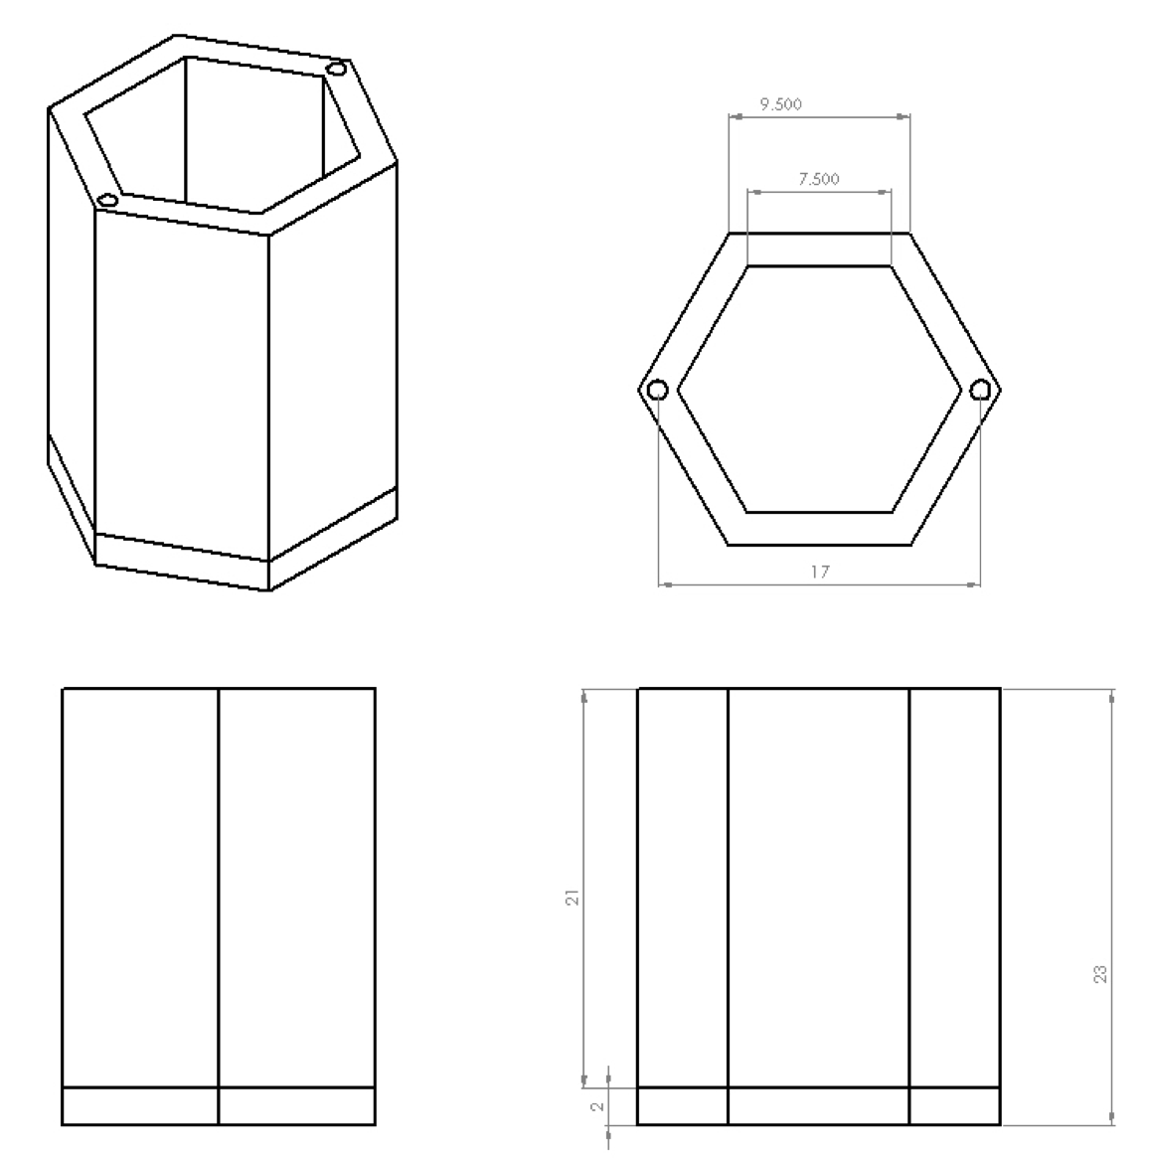
External Design - Drawings
Top
Side
Front

Slide 37
Development

Slide 38
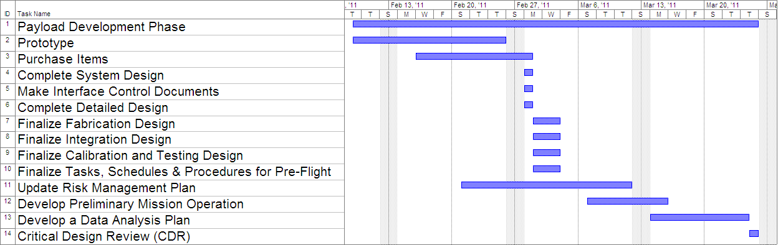
Timeline and Milestones

Slide 39
Payload Development Plan
The next step in our project
We must know the specifications for our project in order to move on to the CDR stage
Sensors and the camera type will be finalized for prototyping
Circuitry will be prototyped on a solderless breadboard
The payload box will also be prototyped

Slide 40
What is next
FRR
Final payload box is made
Electrical components put together
Software is finalized
Launch trip
FRR Defense
Balloon Flight and data acquisition
Science presentation

Slide 41
Questions?

