Slide 1
Team
Philosohook
PHAT-TACO Experiment
Pressure Humidity And Temperature
Tests And Camera Observations
Hannah Gardiner, Bill Freeman, Randy Dupuis, Corey Myers, Andrea Spring

Slide 2
Critical Design Review
Goals and objectives
Science background
Payload Design
Mechanical Design
Electronics Design
Software Design
Flight Operations
Budgeting and Development

Slide 3
Mission Goal
To study the layers of the atmosphere using an instrumented sounding balloon flown in East Texas during May and to analyze the balloon and the environment surrounding the payload in order to study the relationship between the temperature and humidity profiles acquired during flight.

Slide 4
Objective
The overall objective is to measure and record humidity, pressure, and internal and external temperature on a sounding balloon flight while taking video of the flight.

Slide 5
Science background

Slide 6
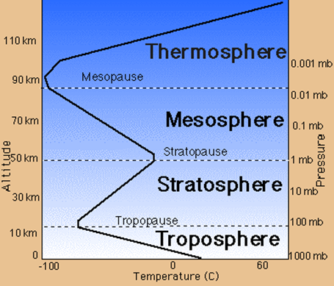
Science Background: Earth’s Atmosphere
Troposphere
Clouds
Stratosphere
Less humidity & lower pressure than the Troposphere
http://www.wyckoffschools.org/eisenhower/teachers/chen/atmosphere/earthatmosphere.htm

Slide 7
US Model Atmosphere¹ 1976
“A hypothetical vertical distribution of atmospheric temperature, pressure, and density”
Can calculate properties of the atmosphere
Pressure
Temperature
Density
¹U.S. Standard Atmosphere, 1976, U.S. Government Printing Office, Washington, D.C., 1976.

Slide 8
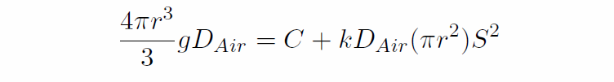
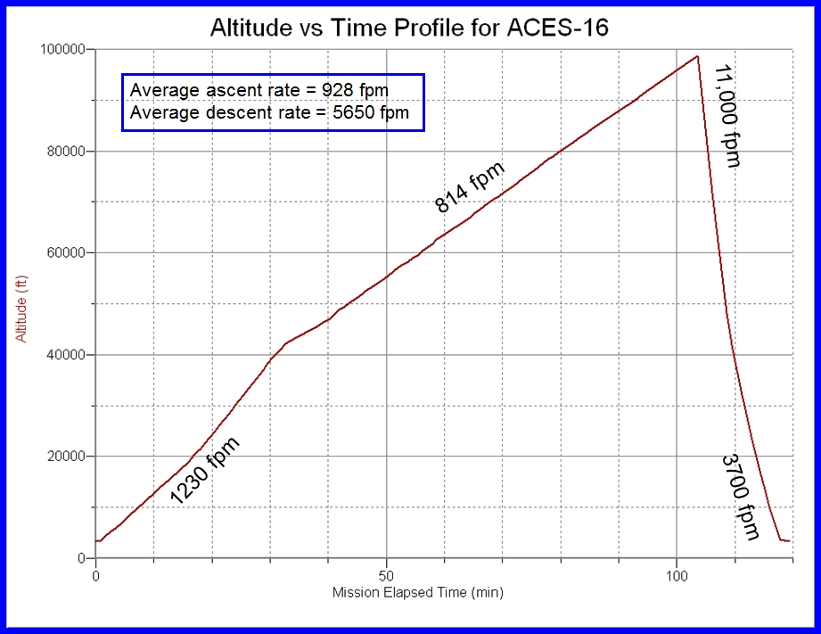
Balloon Radius
Kaymont 3000 gm sounding balloon
Ascent rate should be constant during flight
Has not been in previous flights

Slide 9
System design

Slide 10
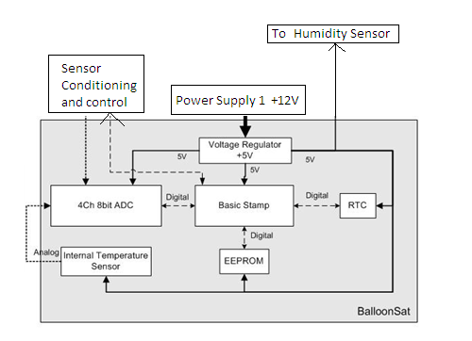

Slide 11
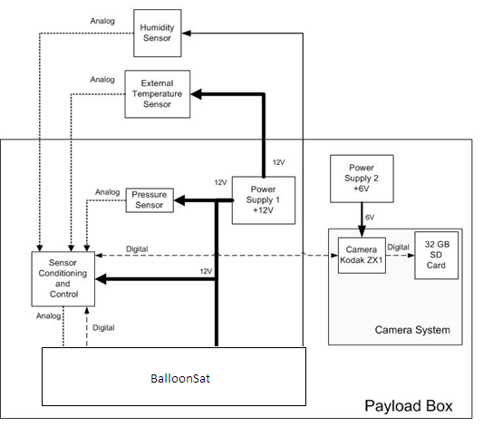

Slide 12
Mechanical design

Slide 13
Thermal Design
Temperature Range: -80ºC to 30ºC
Construction Material: Insulating foam with a low thermal conductivity
Heat produced by electronics
-3.9ºC
Component | Lowest Temp. (ºC) | Highest Temp. (ºC)
Electronics | -40 | 85
Pressure Sensor | -20 | 85
Humidity Sensor | -40 | 85
Temp Sensor | -65 | 200
Camera | -40 | 100
Batteries | -40 | 60

Slide 14
Payload Design
External
Internal
Hexagonal
9.5 cm sides
10 cm high; 14 cm including the bottom
2 holes in the lid
Temperature and Humidity Sensors
Camera
BalloonSat, sensors and conditioning will be on the bottom
Camera will be in a cut out in the top
Camera will be secured by duct tape and an optional basswood shelf

Slide 15
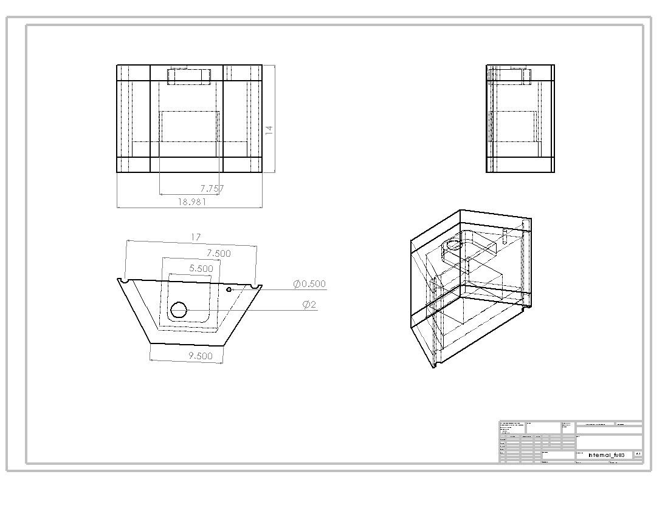
Mechanical Drawings
Front
Side
Axonometric
Top

Slide 16
Weight Budget
Component | Weight (g) | Uncertainty (+/-g) | Measured or estimated
BalloonSat | 65 | 2 | Measured
Power Supply 1 | 65 | 2 | Measured
Power Supply 2 | 80 | 2 | Measured
Signal Conditioning Board and sensors | 65 | 5 | Estimated*
Foam Structure | 50 | 15 | Measured
Camera | 95 | 5 | Measured
Total | 420 | 28

Slide 17
Electronics design

Slide 18
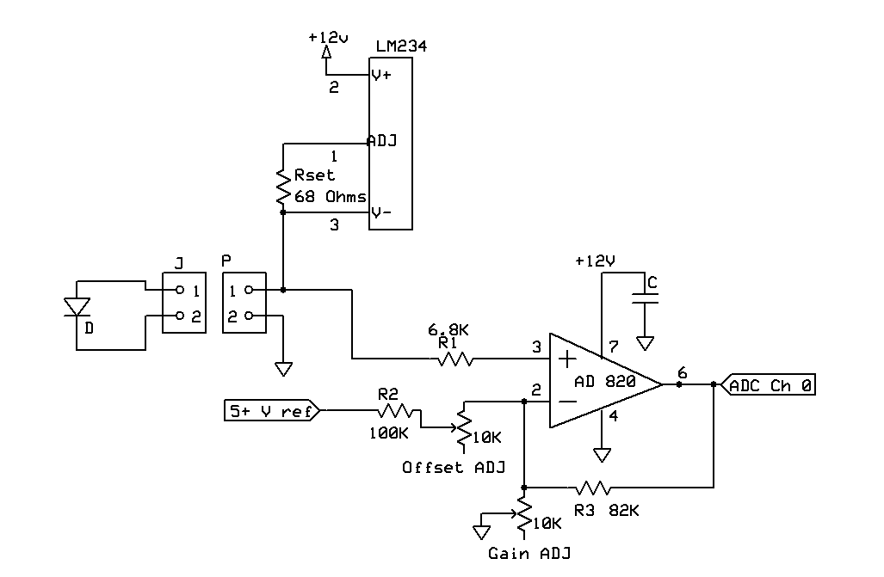
Temperature Sensor Interface

Slide 19
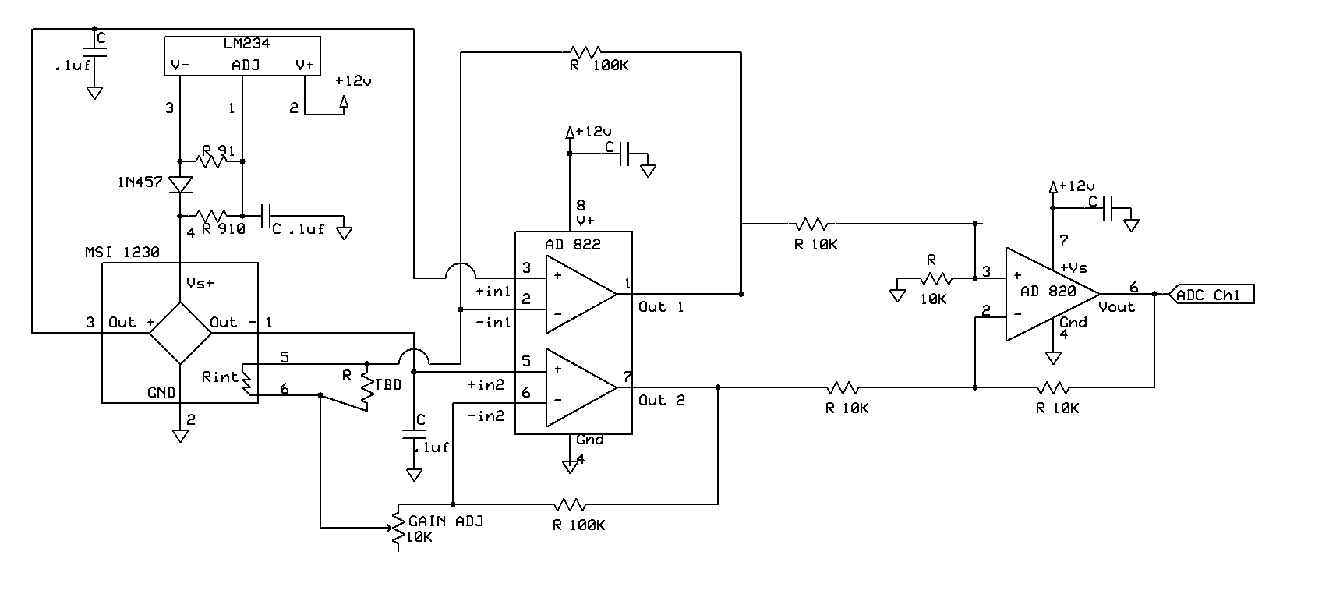
Pressure Sensor Interface

Slide 20
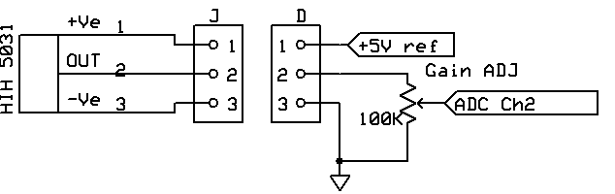
Humidity Sensor Interface

Slide 21
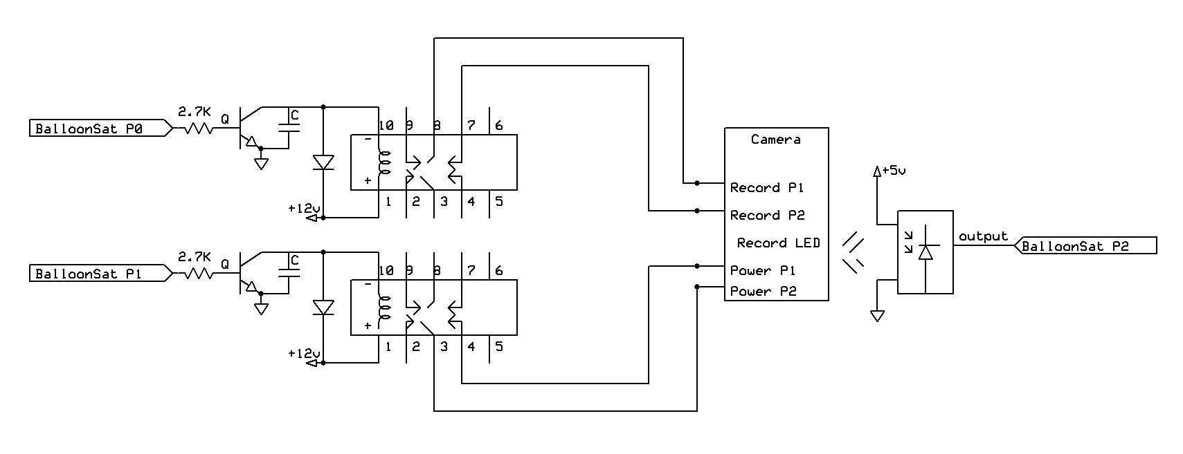
Camera Interface

Slide 22
Power

Slide 23
Power Budget
Component | Current (mA) | Voltage (V) | Power (mW) | Capacity (mA-hours)
Temperature Sensor | 1.2 | 12 | 14.4 | 4.8
Pressure Sensor | 2.1 | 12 | 25.2 | 8.4
Humidity | .5 | 12 | 6 | 2
Balloon Sat | 52 | 12 | 624 | 208
Camera | 220 | 7 | 1540 | 880
Power Supply 1 | 55.8 | 12 | 669.6 | 223.2
Power Supply 2 | 220 | 7 | 1540 | 880

Slide 24
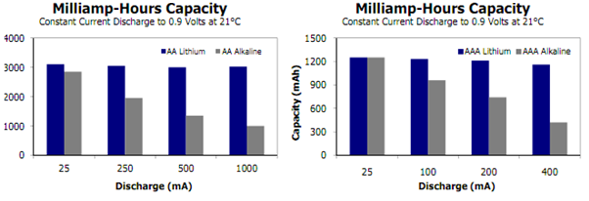
Battery Selection
Component | Current (mA) | Voltage (V) | Power (mW) | Capacity (mA-hours)
Power Supply 1 | 58 | 12 | 680.6 | 232
Power Supply 2 | 220 | 7 | 1540 | 880

Slide 25
Software design

Slide 26
Software Background
Basic stamp controls everything
Measure and record temperature, pressure, and humidity every six seconds
Check to see if the camera is recording
Stop, then restart the video every 10 minutes
Save “camera status byte” to EEPROM

Slide 27
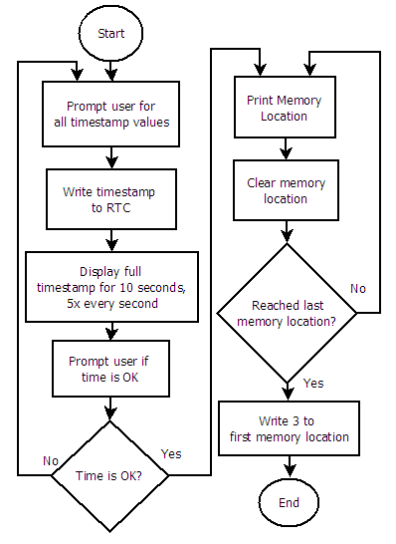
Pre Flight Flowchart
Must be able to calibrate Real Time Clock (RTC)
LaACES Management will provide a flight profile of altitude vs time
This program sets the time and allows for the During Flight program to start at the correct location
First two bytes on the EEPROM store the location of the last saved data point

Slide 28
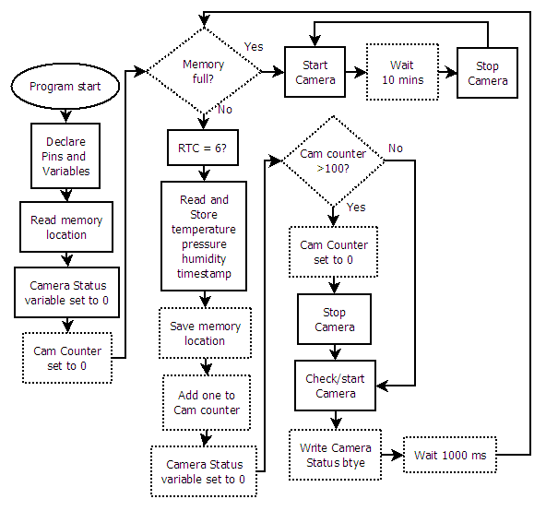
During Flight
Controls all aspects of the payload
Takes T,P,H data every 6 sec
Also checks if the camera is still recording

Slide 29
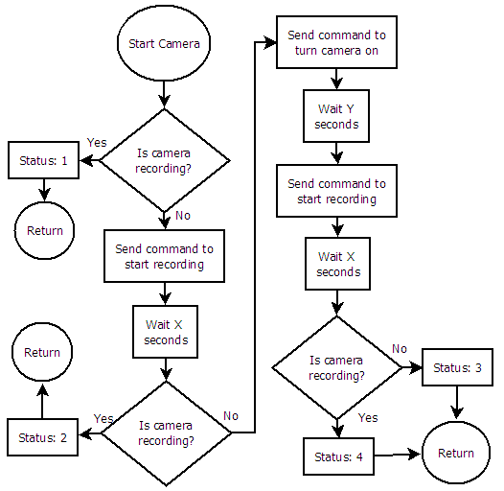
During Flight Subroutines
Makes sure the camera is recording
If camera is not recording, this subroutine tries to start recording again
Status nibble set so we know what is happening to the camera

Slide 30
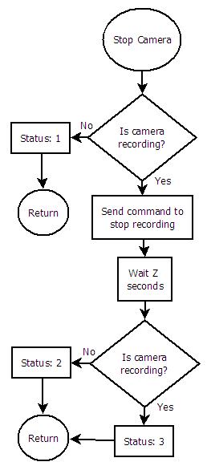
During Flight Subroutines
If the camera is recording, stop recording
Set status nibble according to how the subroutine ends

Slide 31
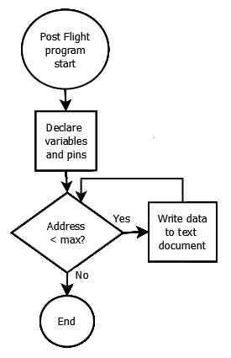
Post Flight Flowchart
Must be able to read out all data to debug screen
Excel data sheet will contain conversions from ADC counts to atmospheres, kelvin, and % humidity
Excel sheet will also convert timestamps into altitude

Slide 32
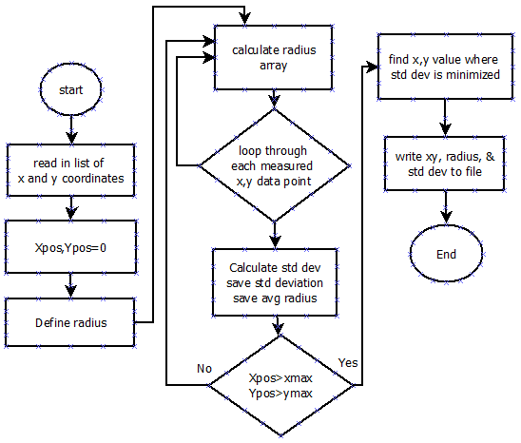
Post flight Balloon Radius Calculator
Doesn’t need entire balloon to calculate radius
Works similar to most “fitting” programs
Better than only using two points

Slide 33
Post Flight Data Processing
EEPROM readout data
Timestamp -> altitude
ADC counts -> pressure, temperature, humidity
Video data
Video time + EEPROM information -> altitude
Video -> size of balloon (pixels -> cm)
Video -> payload passing through cloud

Slide 34
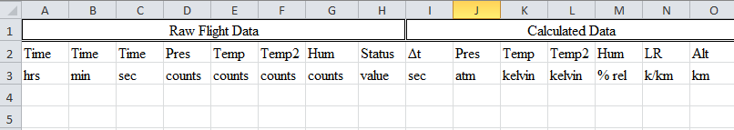
Magical Post-Flight Excel Sheet
Data will be in comma delimited text file after downloading with Term232
Equations will already be programmed into sheet
Also calculates uncertianties
Will convert EEPROM timestamp into guzik-friendly format

Slide 35
Flight Operations: Testing

Slide 36
Shock Test
With the system powered up and the lid taped down, the payload will be dropped from a height of 5 ft.
After the drop, the lid will be removed and all components checked and any shifting noted.
Data must verify that the force involved in the test did not disrupt the data collection process.

Slide 37
Vacuum Test
The powered up payload will be placed in the vacuum chamber.
The vacuum will be turned on to decrease the pressure for one hour.
Data must be verified that it was recorded accurately throughout the length of the test.

Slide 38
Thermal Test
The powered up payload will be placed first at room temperature for 15 minutes.
Refrigerator for 45 minutes.
A dry ice cooled environment, approximately -78°C, for an hour.
Refrigerator for 45 minutes.
Room temperature for 15 minutes.
Data must be verified that it was recorded accurately throughout the length of the test.

Slide 39
Flight Operations: Calibrations

Slide 40
Temperature Calibration
Use HOBO to measure temperatures at various locations alongside the sensor.
The sensor and Hobo will measure
Room temperature.
Refrigerator.
Icebox filled with dry ice.
Outside the physics building.
Each temperature placement will be carried out for 10-15 minutes.
The voltage output data from our sensor will be compared to the data from the HOBO

Slide 41
Humidity Calibration
The HOBO sensor will be used to accurately measure the humidity in various conditions
Both placed in sealable container inside saturated environment at 0˚C
Seal container
Transport container to varying temperatures
The voltage output data from our sensor will be compared to the data from the HOBO

Slide 42
Humidity Calibration
http://www.engineeringtoolbox.com/humidity-ratio-air-d_686.html

Slide 43
Pressure Calibration
We will adjust the variable resistor on the payload to set ground-level pressure
The payload will be placed in the vacuum chamber
We will stop the vacuum chamber and allow the pressure sensor to take several measurements at that pressure and record the pressure indicated by the vacuum chamber pressure gauge.
A line of best fit will be created for the pressure sensor’s output voltage versus absolute pressure.

Slide 44
Camera Calibration
First we will start the camera to make sure it is operating properly.
A fellow teammate holding a ruler will stand at a prescribed distance away from the camera.
Video will be taken for about 1-2 minutes in order to collect data.
After data collection is complete, the pixels of the camera images will be used to determine the angular resolution of the pixels.

Slide 45
Pre-Launch Checklist
Event | Time needed
Verify that all components are ready for flight and operational. | 10 minutes
Load the correct pre-flight software and during flight software. | 5 minutes
Put in the appropriate fresh batteries for each of the power sources and make sure each power source is connected to its appropriate components. | 2 minutes
Place components in payload and tape the lid shut and check to make sure camera is facing up and through the hole in the lid. | 1 minute
Attach the payload to the launch vehicle and check to make sure it is secure. | 10 minutes
Measure distance from Balloon to payload. | 2 minutes
Total Time | 30 minutes

Slide 46
Payload Recovery
Telemetry will be tracked by GPS satellite signals via additional payloads on balloon vehicle
Sounding beacon
Colorful parachute

Slide 47
Budgeting and Development

Slide 48
Budget
Component | Price
Temperature Sensor | $0.02
Pressure Sensor | $40
Humidity Sensor | $14.11
Camera | $40
32 GigaByte SD Card | $64
Expanded EEPROM | $1.50
Batteries | $12
Single OpAmp Integrated Circuit | $2.25
BalloonSat | --
Miscellaneous parts and contingency | $170
Total Expected Expenditure: | $343.88

Slide 49
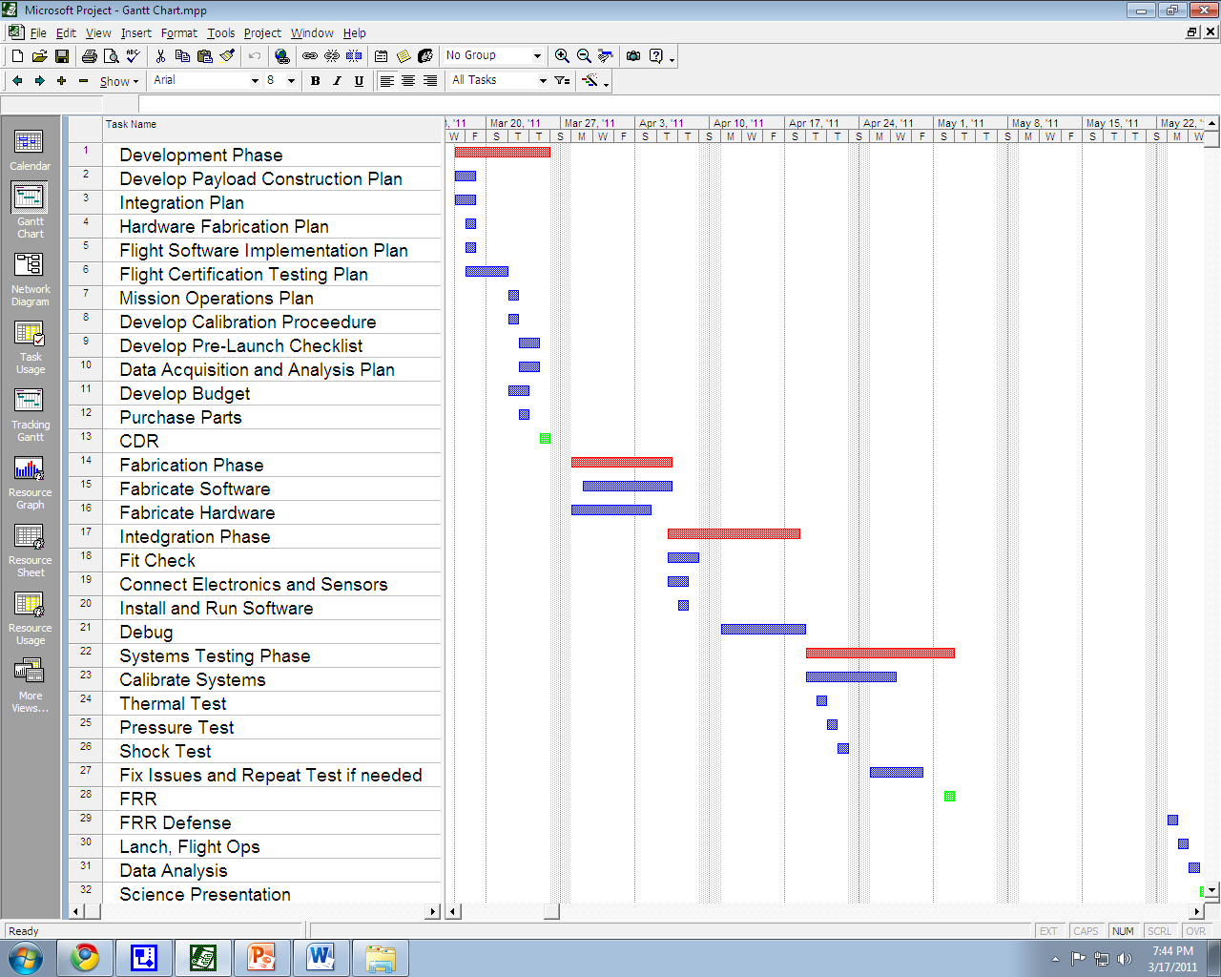
Timeline

Slide 50
What is next
Integration phase
Components are created
Connect together
Test
Debug
Systems testing phase
Calibrate systems
Thermal, shock, and vacuum tests
FRR Defense
Flight
Analysis and Science Presentation

Slide 51
Questions
?

