Slide 1
Team
Philosohook
PHAT-TACO Experiment
Pressure Humidity And Temperature
Tests And Camera Observations
Hannah Gardiner, Bill Freeman, Randy Dupuis, Corey Myers, Andrea Spring

Slide 2
Flight Readiness Review
Goals and objectives
Science background
Payload Design
Mechanical Design
Electronics Design
Software Design
Flight Operations

Slide 3
Mission Goal
To study the layers of the atmosphere using an instrumented sounding balloon flown in East Texas during May and to analyze the balloon and the environment surrounding the payload in order to study the relationship between the temperature and humidity profiles acquired during flight.

Slide 4
Objective
The overall objective is to measure and record humidity, pressure, and internal and external temperature on a sounding balloon flight while taking video of the flight.

Slide 5
Science background

Slide 6
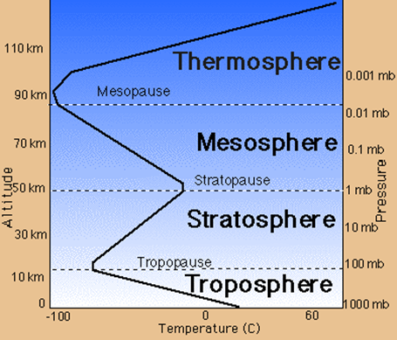
Science Background: Earth’s Atmosphere
Troposphere
Clouds
Stratosphere
Less humidity & lower pressure than the Troposphere
http://www.wyckoffschools.org/eisenhower/teachers/chen/atmosphere/earthatmosphere.htm

Slide 7
US Model Atmosphere¹ 1976
“A hypothetical vertical distribution of atmospheric temperature, pressure, and density”
Can calculate properties of the atmosphere
Pressure
Temperature
Density
¹U.S. Standard Atmosphere, 1976, U.S. Government Printing Office, Washington, D.C., 1976.
Notes:
Possible deletion

Slide 8
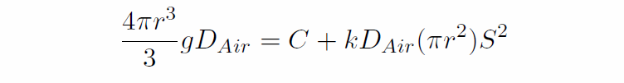
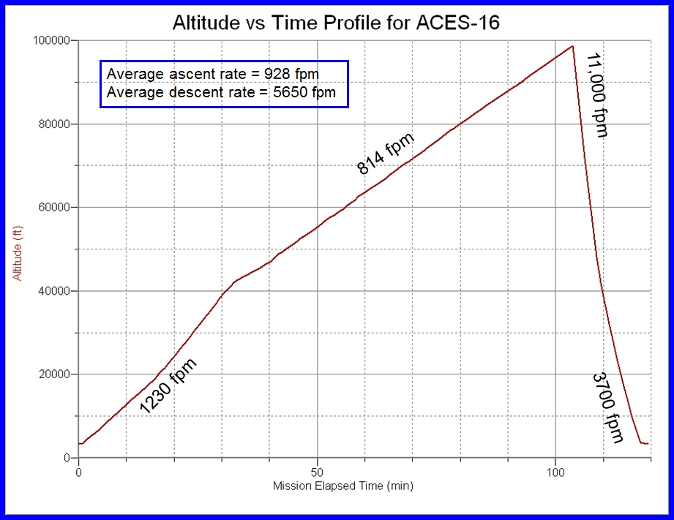
Balloon Radius
Kaymont 3000 gm sounding balloon
Ascent rate should be constant during flight
Has not been in previous flights

Slide 9
System design

Slide 10
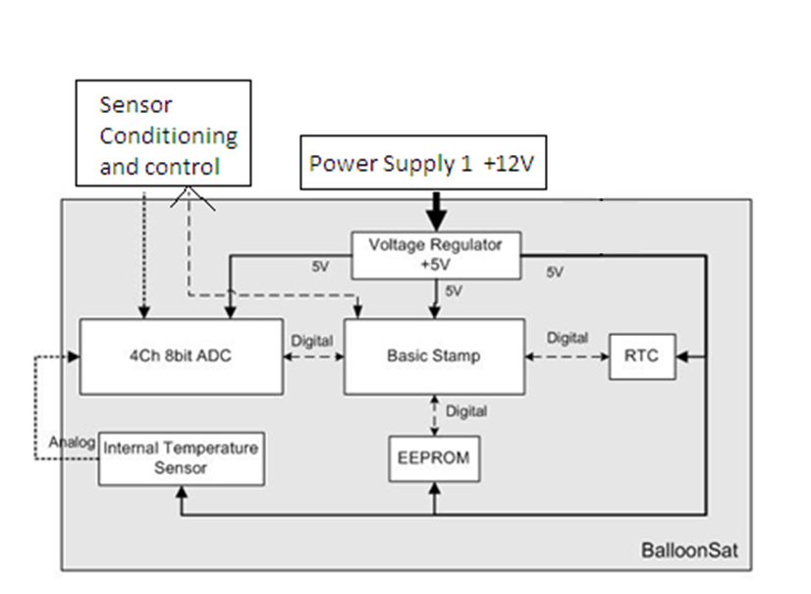

Slide 11
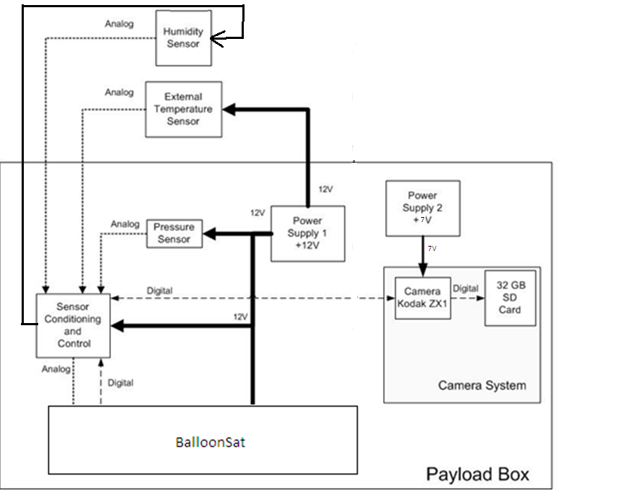

Slide 12
Mechanical design

Slide 13
Thermal Design
Temperature Range: -80ºC to 30ºC
Construction Material: Insulating foam with a low thermal conductivity
Heat produced by electronics
15.8ºC
Component | Lowest Temp. (ºC) | Highest Temp. (ºC)
Electronics | -40 | 85
Pressure Sensor | -20 | 85
Humidity Sensor | -40 | 85
Temp Sensor | -65 | 200
Camera | -40 | 100
Batteries | -40 | 60

Slide 14
Payload Design
External
Internal
Hexagonal
10 cm sides
14 cm high; 17.5 cm including the bottom
1 hole in the lid for the camera
A 14 cm x 15.5 cm insert will hold all components
Batteries and camera on one side
BalloonSat and Conditioning on the other
Secured by Velcro

Slide 15
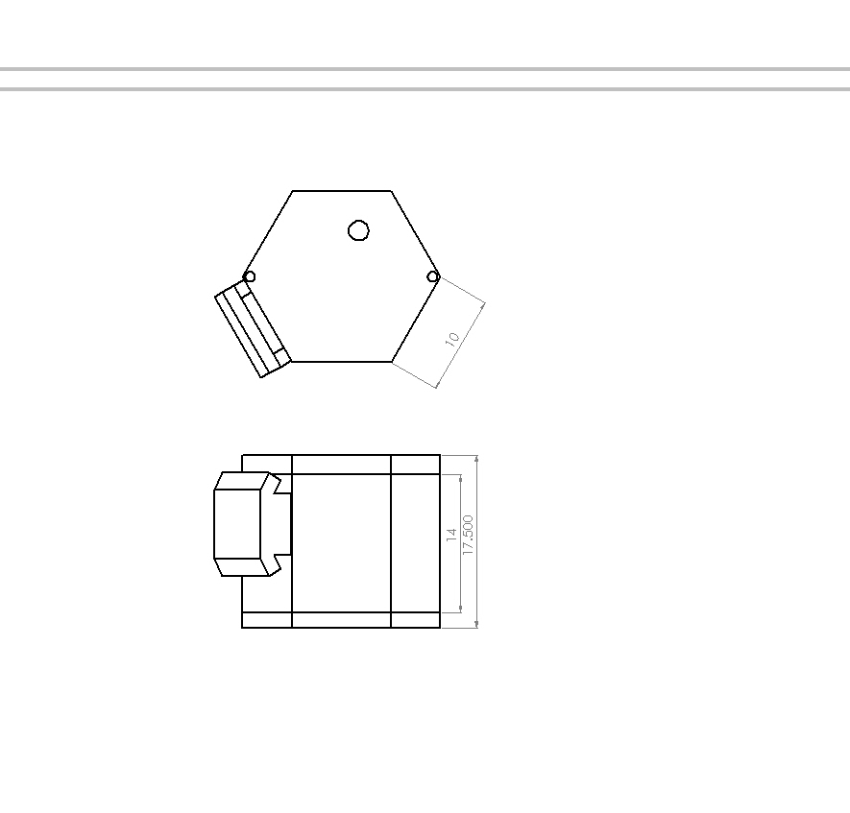
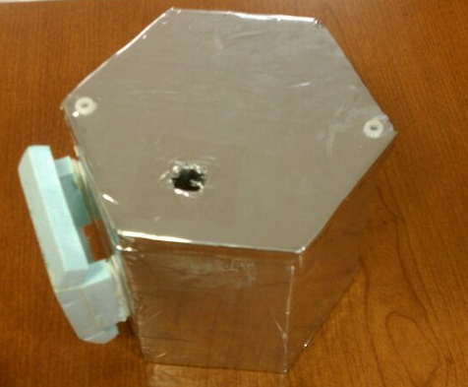
Mechanical Drawings - External
Top
Front

Slide 16
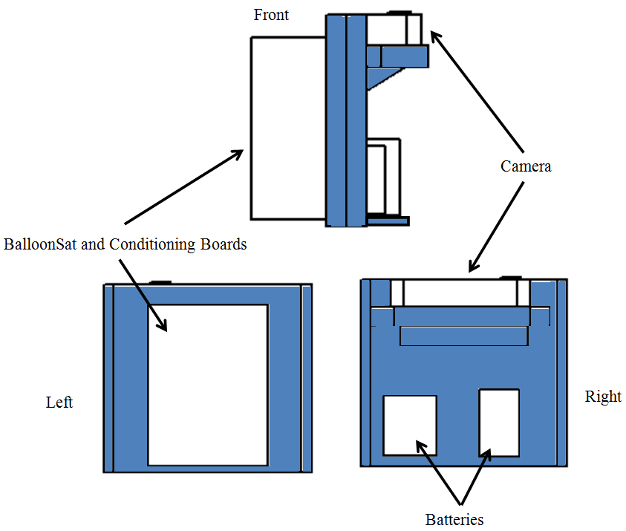
Mechanical Design - Internal

Slide 17
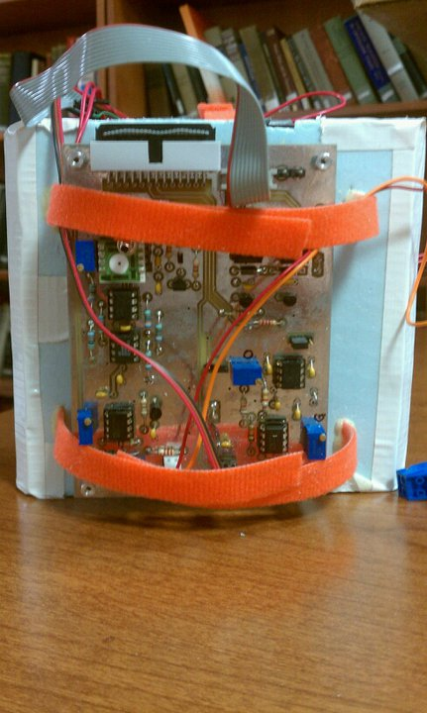
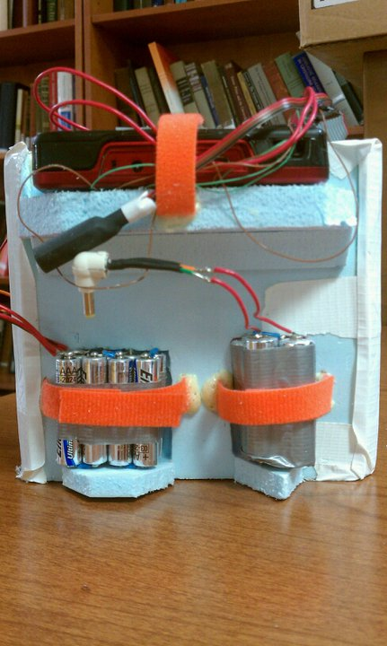
Mechanical Design - Internal

Slide 18
Mass Budget
Component | Mass (g) | Uncertainty (+/-g)
BalloonSat | 66.3 | .05
Power Supply 1 | 71.8 | .05
Power Supply 2 | 63.7 | .05
Signal Conditioning Board and sensors | 101.5 | .05
Foam Structure | 99.6 | .05
Camera | 97.8 | .05
Total | 500.7 | .12

Slide 19
Electronics design

Slide 20
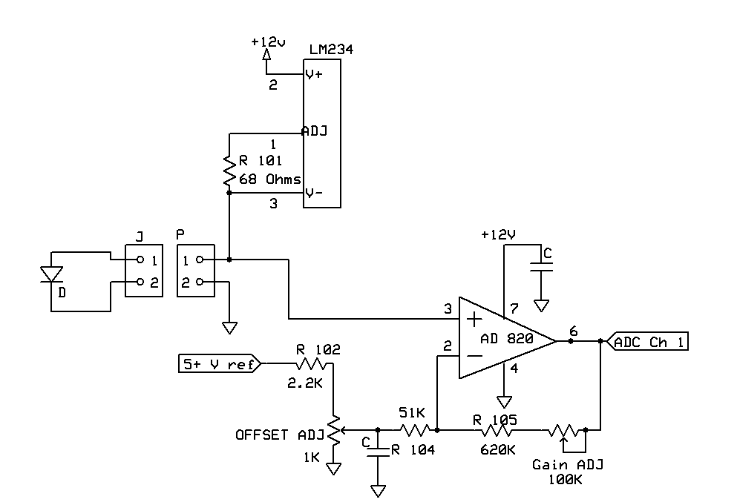
Temperature Sensor Interface

Slide 21
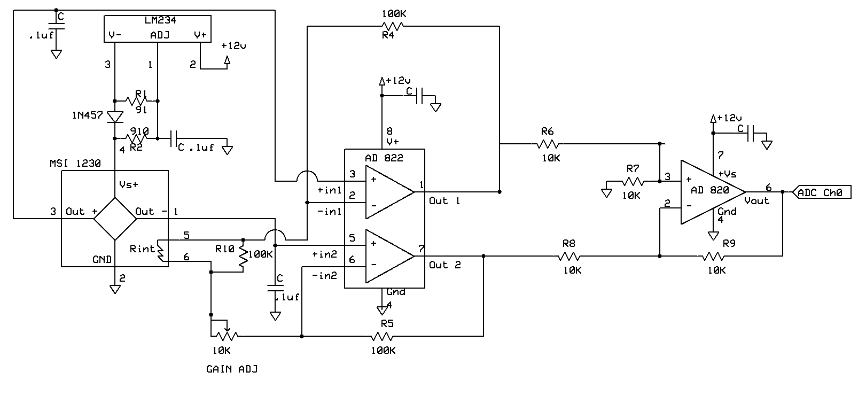
Pressure Sensor Interface

Slide 22
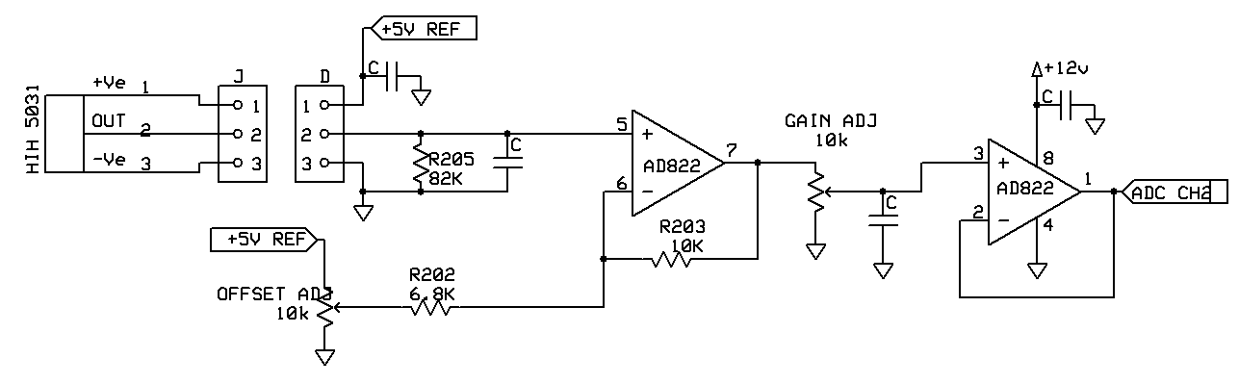
Humidity Sensor Interface

Slide 23
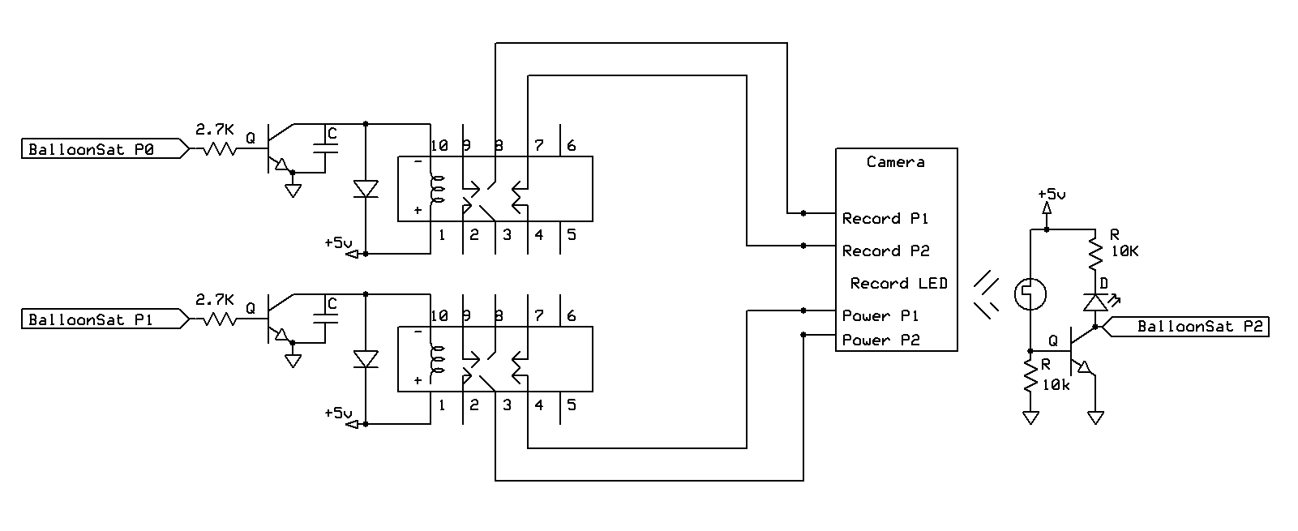
Camera Interface

Slide 24
Power

Slide 25
Power Budget
Component | Current (mA) | Voltage (V) | Power (mW) | Capacity (mA-hours)
Temperature Sensor | 1.2 | 12 | 14.4 | 4.8
Pressure Sensor | 2.1 | 12 | 25.2 | 8.4
Humidity | .5 | 12 | 6 | 2
Balloon Sat | 52 | 12 | 624 | 208
Camera | 220 | 6 | 1320 | 880
Power Supply 1 | 55.8 | 12 | 669.6 | 223.2
Power Supply 2 | 220 | 6 | 1540 | 880

Slide 26
Software design

Slide 27
Software Background
Basic stamp controls everything
Measure and record temperature, pressure, and humidity every six seconds
Check to see if the camera is recording
Stop, then restart the video every 10 minutes
Save “camera status byte” to EEPROM

Slide 28
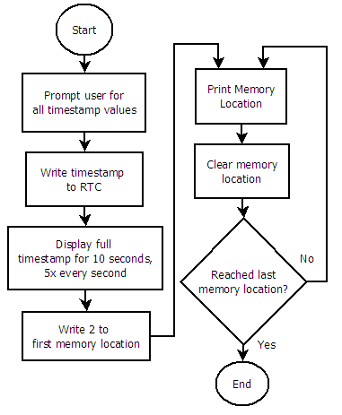
Pre Flight Flowchart
Must be able to calibrate Real Time Clock (RTC)
LaACES Management will provide a flight profile of altitude vs time
First two bytes on the EEPROM store the location of the last saved data point

Slide 29
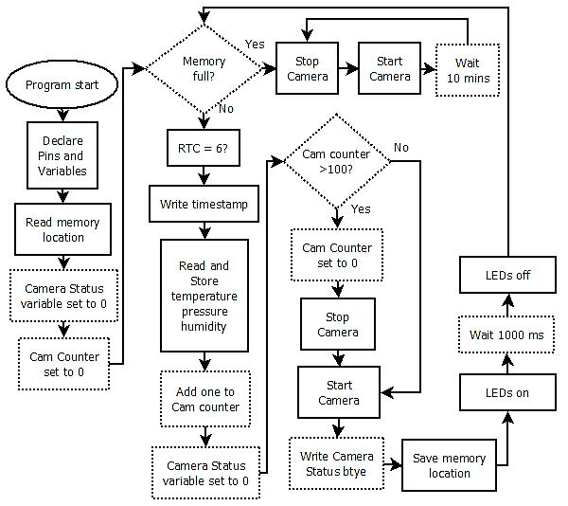
During Flight
Controls all aspects of the payload
Takes T,P,H data every 6 sec
Also checks if the camera is still recording

Slide 30
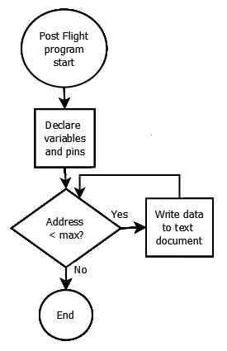
Post Flight Flowchart
Must be able to read out all data to debug screen
Excel data sheet will contain conversions from ADC counts to atmospheres, kelvin, and % humidity
Excel sheet will also convert timestamps into altitude

Slide 31
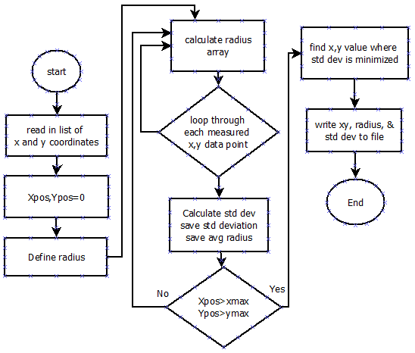
Post flight Balloon Radius Calculator
Doesn’t need entire balloon to calculate radius
Works similar to most “fitting” programs
Better than only using two points

Slide 32
Flight Operations: Testing

Slide 33
Thermal Test

Slide 34
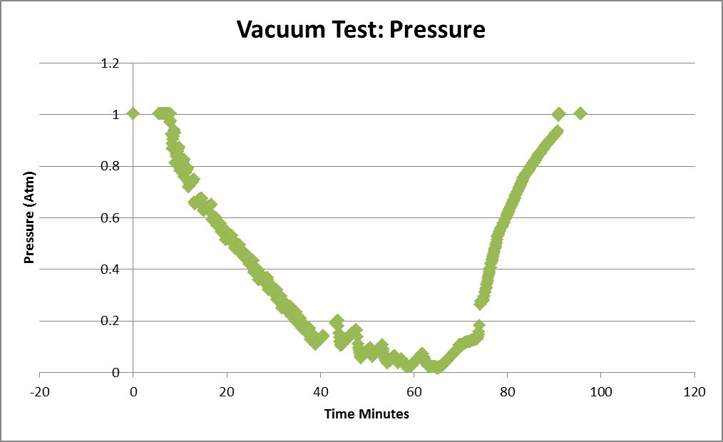
Vacuum Test

Slide 35
Shock Test

Slide 36
Flight Operations: Calibrations

Slide 37
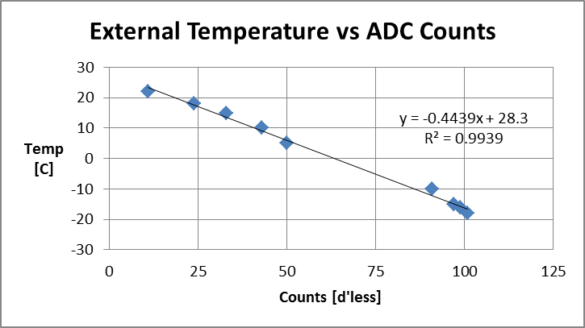
Temperature Calibration
External temperature sensor:
Temperature(C°) = -.4439(ADC Count) + 28.3
Error: ((.013151*ADC Count)^2+(.917709)^2)^.5 C°

Slide 38
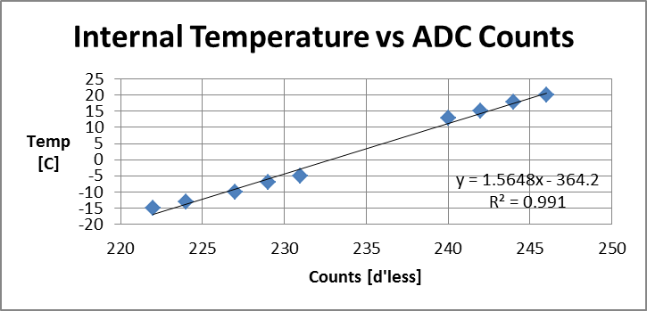
Temperature Calibration
Internal temperature sensor:
Temperature(C°) = 1.5648(ADC Count) - 364.2
Error: 2.07 C° (error variation because of ADC Counts is very small)

Slide 39
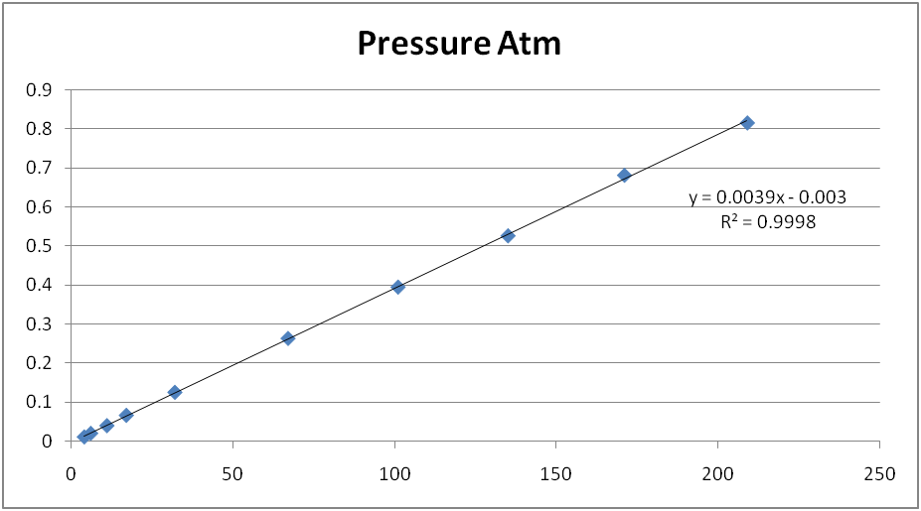
Pressure Calibration
Pressure
Counts
Pressure Sensor:
Pressure(Atm)=.0039464(ADC counts)-.002953703
Error=((1.98378e-5*ADC counts)^2+(.002055339)^2)^.5 Atm

Slide 40
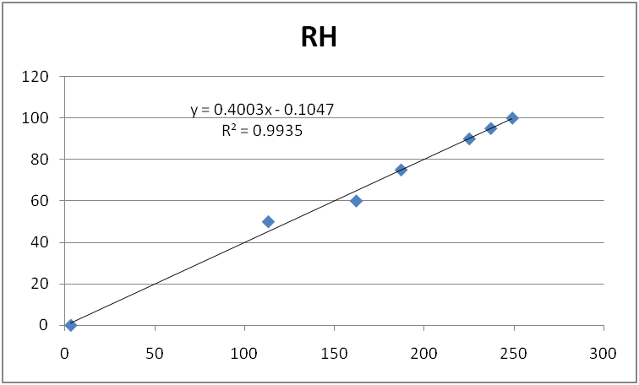
Humidity Calibration
Humidity
Counts
Humidity Sensor:
RH(%)= 0.4003(ADC count) – .1047
Error: ((0.01453*ADC count)^2+(2.706038)^2)^.5%

Slide 41
Pre-Launch Checklist
Event | Time needed | T- minus to launch
Verify that all components are ready for flight and operational. | 10 minutes | 2 days
Run pre-flight software | 25 minutes | 12 hours
Load during flight software | 1 minute | 11.5 hours
Put in the appropriate fresh batteries for each of the power sources and make sure each power source is connected to its appropriate components. | 2 minutes | 1 hour
Place components in payload and tape the lid shut and check to make sure camera is facing up and through the hole in the lid. | 1 minute | 1 hour
Attach the payload to the launch vehicle and check to make sure it is secure. | 10 minutes | 45 minutes
Take picture from a distance in order to calculate distance from payload to balloon. | 2 minute | 5 minutes
Total Time | 51 minutes

Slide 42
What is next
Flight
Analysis of data
Science Presentation

Slide 43
Questions
?

