Slide 1
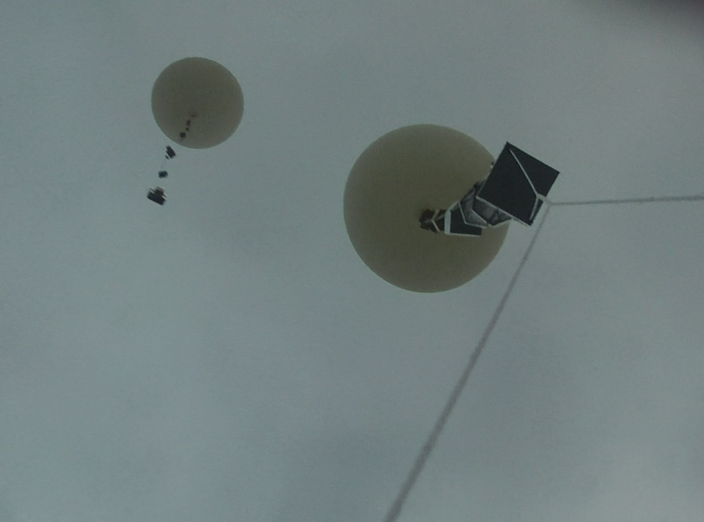
Science Presentation
Team Philosohook
PHAT-TACO Experiment
On board ACES-23
Hannah Gardiner, Bill Freeman, Randy Dupuis, Corey Myers, Andrea Spring

Slide 2
Science Presentation
Goals and objectives
Science background
Mechanical Design
Electrical Design
Testing
Calibrations
Results

Slide 3
Mission Goal
To study the layers of the atmosphere using an instrumented sounding balloon flown in East Texas during May and to analyze the balloon and the environment surrounding the payload in order to study the relationship between the temperature and humidity profiles acquired during flight.

Slide 4
Objective
The overall objective is to measure and record humidity, pressure, and internal and external temperature on a sounding balloon flight while taking video of the flight.

Slide 5
Science background

Slide 6
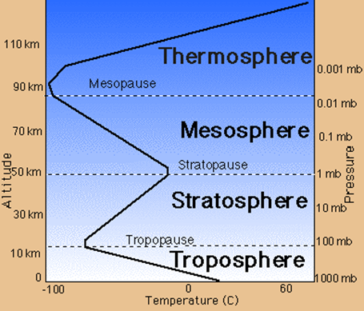
Science Background: Earth’s Atmosphere
Troposphere
Clouds
Stratosphere
Less humidity & lower pressure than the Troposphere
http://www.wyckoffschools.org/eisenhower/teachers/chen/atmosphere/earthatmosphere.htm

Slide 7
US Model Atmosphere¹ 1976
“A hypothetical vertical distribution of atmospheric temperature, pressure, and density”
Can calculate properties of the atmosphere
Pressure
Temperature
Density
¹U.S. Standard Atmosphere, 1976, U.S. Government Printing Office, Washington, D.C., 1976.
Notes:
Possible deletion

Slide 8
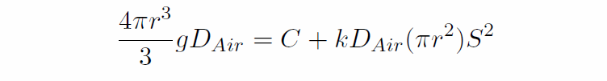
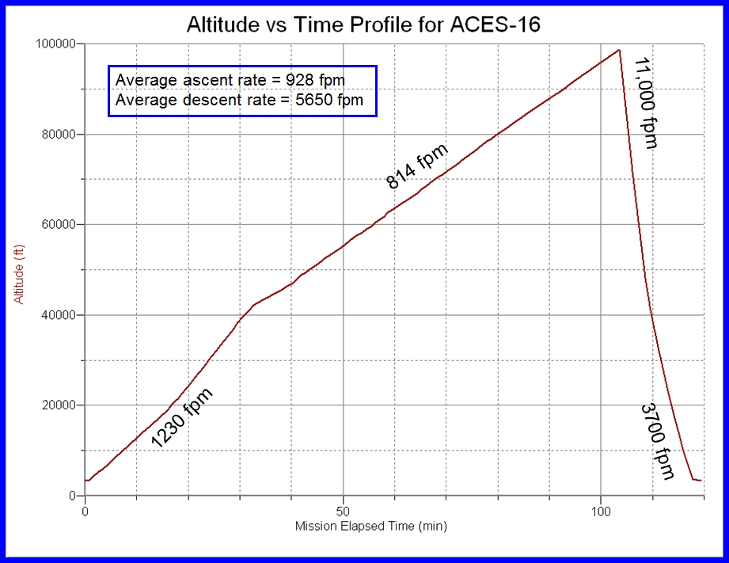
Balloon Radius
Kaymont 3000 gm sounding balloon
Ascent rate should be constant during flight
Has not been in previous flights

Slide 9
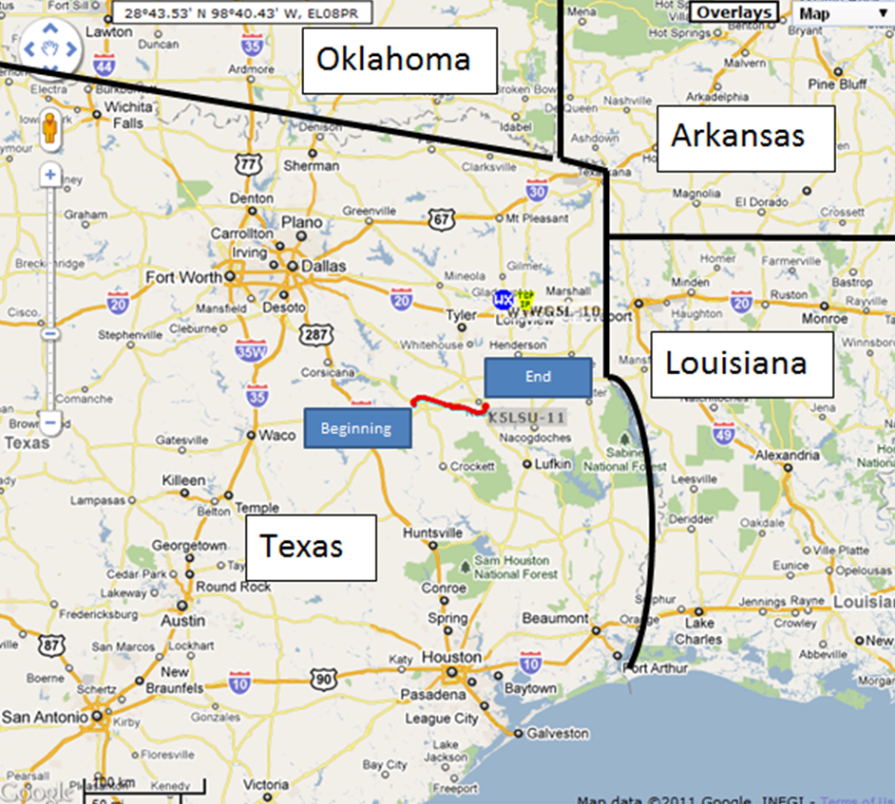
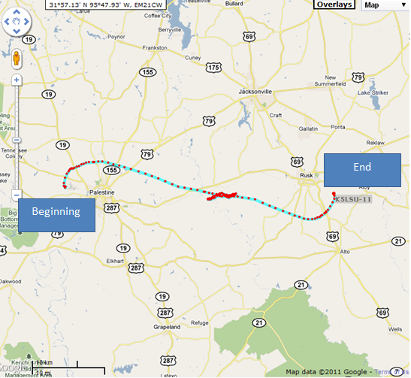
Our Flight Path
Local Area
Regional Area
Palestine to Rusk

Slide 10
Mechanical design

Slide 11
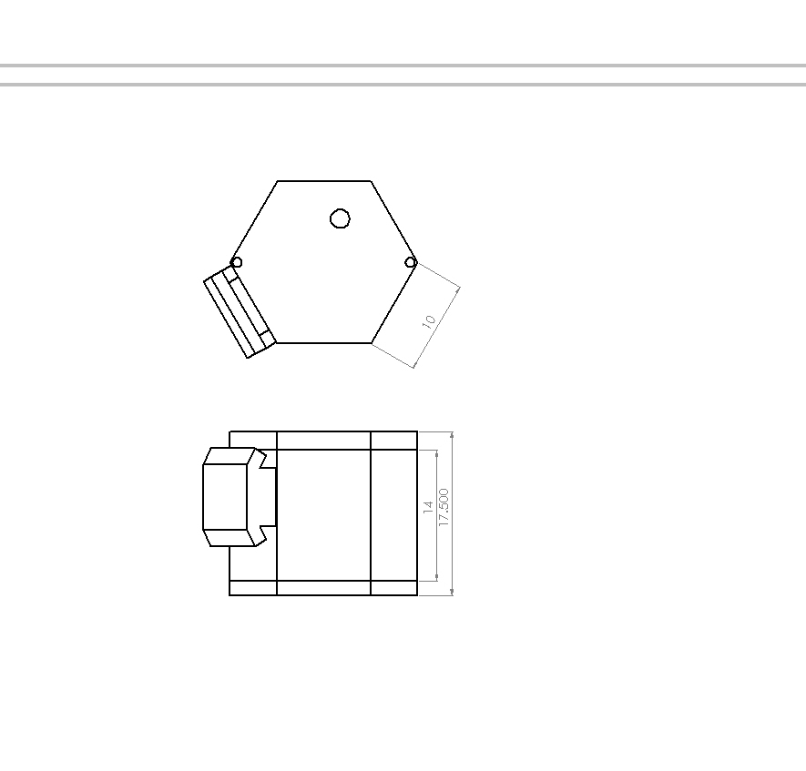
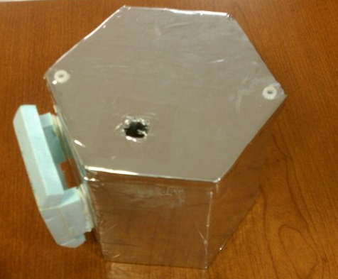
Mechanical Drawings - External
Top
Front

Slide 12
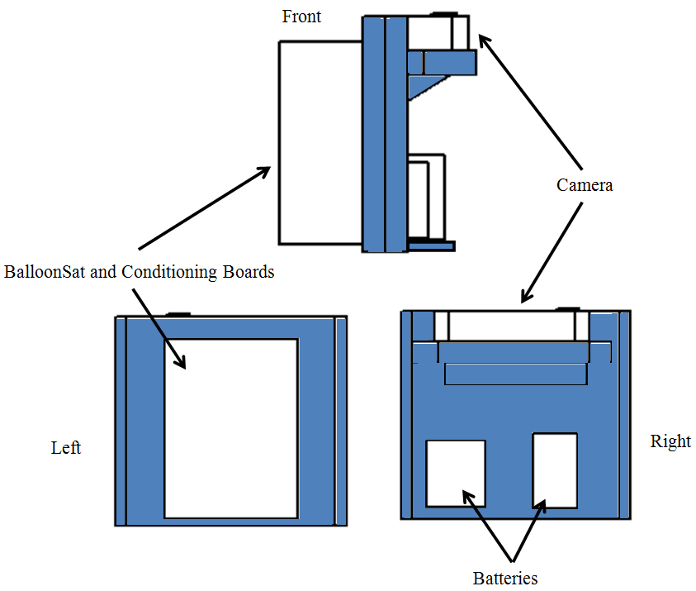
Mechanical Design - Internal

Slide 13
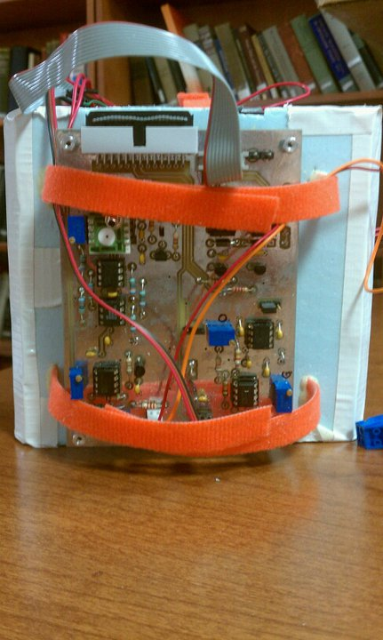
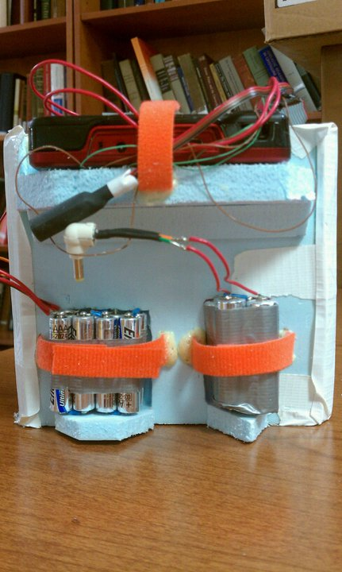
Mechanical Design - Internal

Slide 14
Electronics design

Slide 15
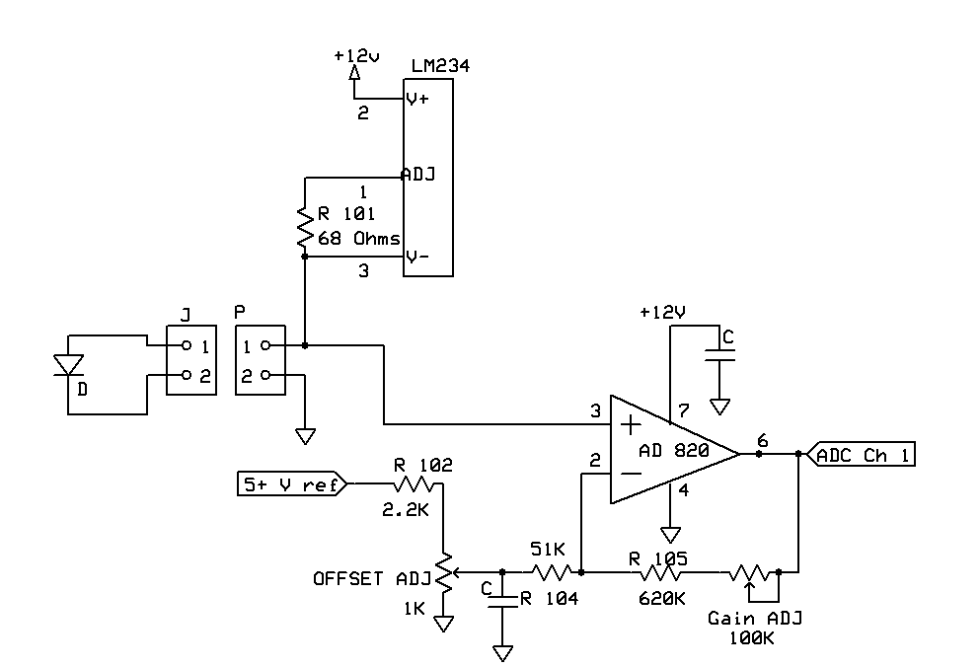
Temperature Sensor Interface

Slide 16
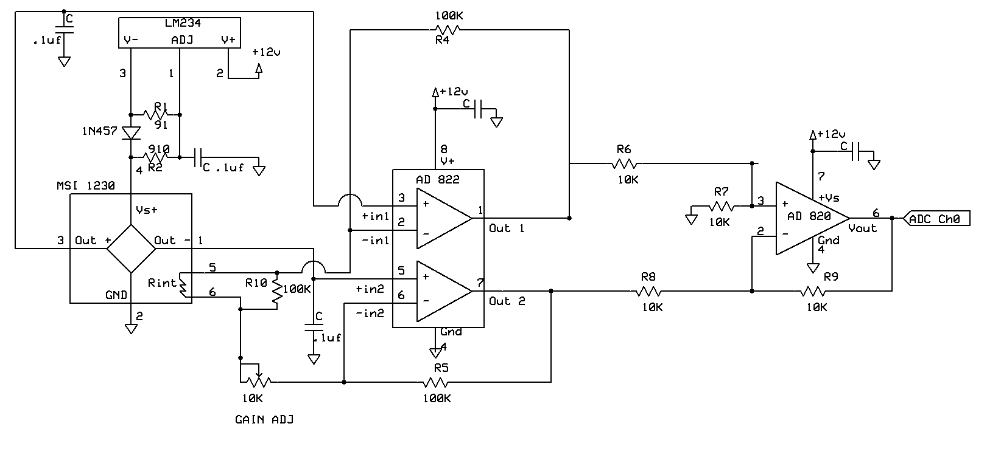
Pressure Sensor Interface

Slide 17
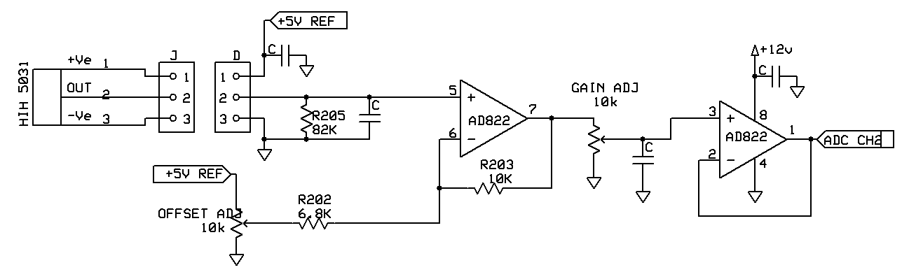
Humidity Sensor Interface

Slide 18
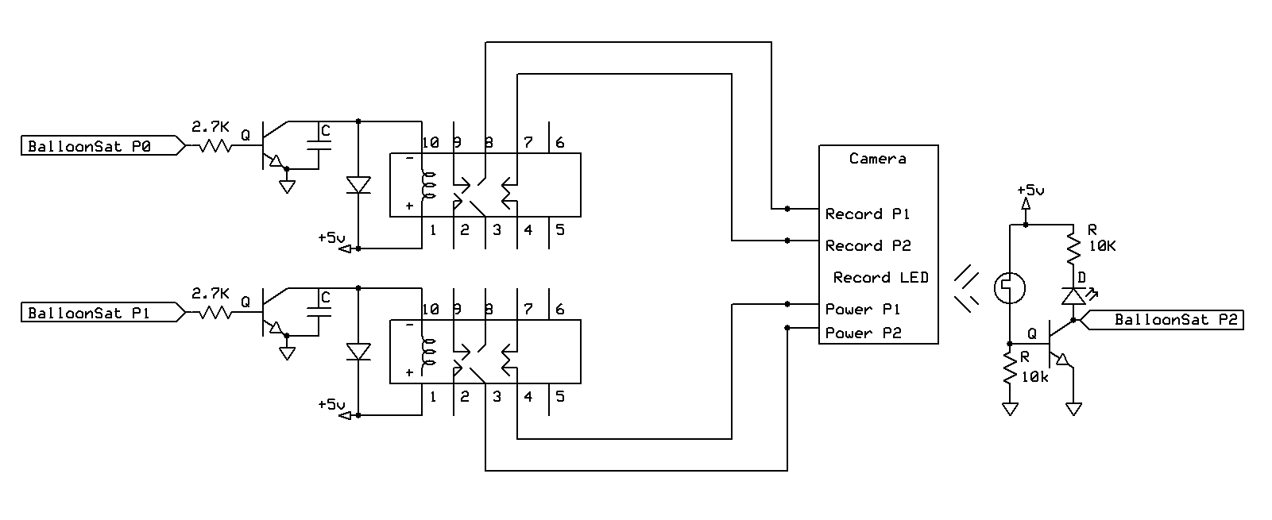
Camera Interface

Slide 19
Flight Operations: Testing

Slide 20
Thermal Test

Slide 21
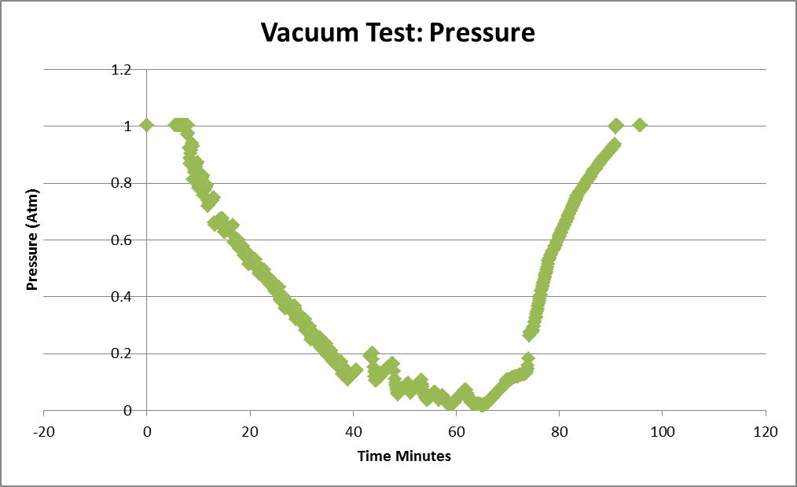
Vacuum Test

Slide 22
Shock Test

Slide 23
Flight Operations: Calibrations

Slide 24
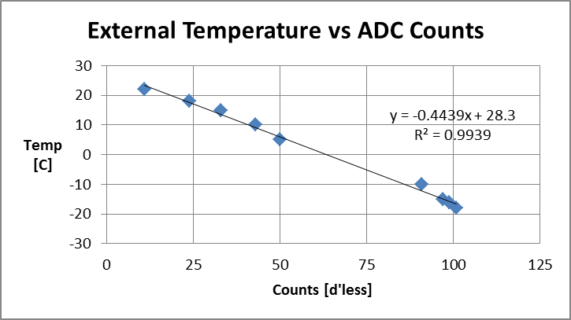
Temperature Calibration
External temperature sensor:
Temperature(C°) = -.4439(ADC Count) + 28.3
Error: ((.013151*ADC Count)^2+(.917709)^2)^.5 C°

Slide 25
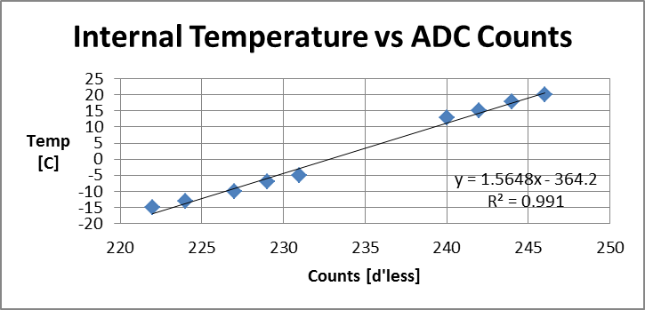
Temperature Calibration
Internal temperature sensor:
Temperature(C°) = 1.5648(ADC Count) - 364.2
Error: 2.07 C° (error variation because of ADC Counts is very small)

Slide 26
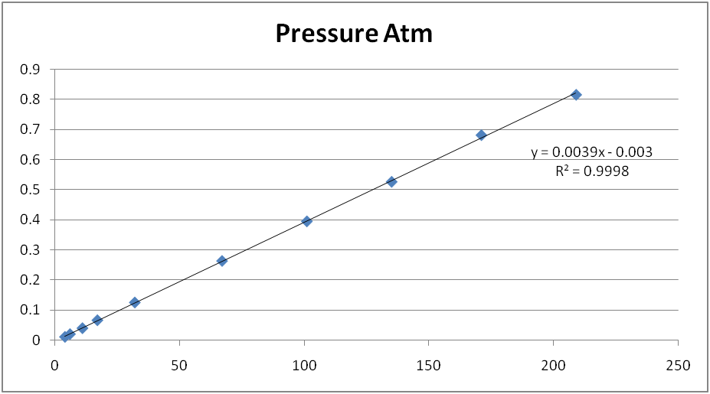
Pressure Calibration
Pressure
Counts
Pressure Sensor:
Pressure(Atm)=.0039464(ADC counts)-.002953703
Error=((1.98378e-5*ADC counts)^2+(.002055339)^2)^.5 Atm

Slide 27
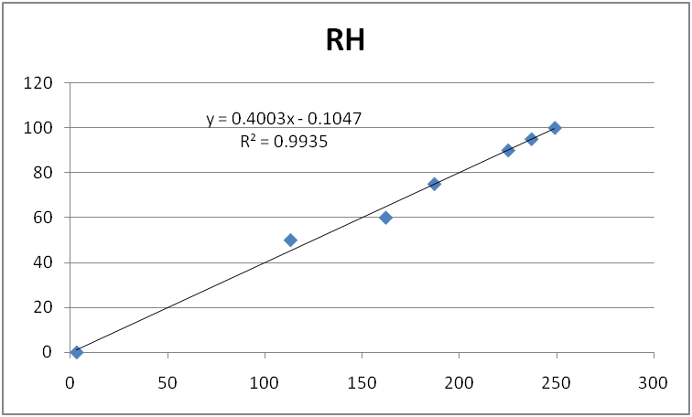
Humidity Calibration
Humidity
Counts
Humidity Sensor:
RH(%)= 0.4003(ADC count) – .1047
Error: ((0.01453*ADC count)^2+(2.706038)^2)^.5%

Slide 28
Results

Slide 29
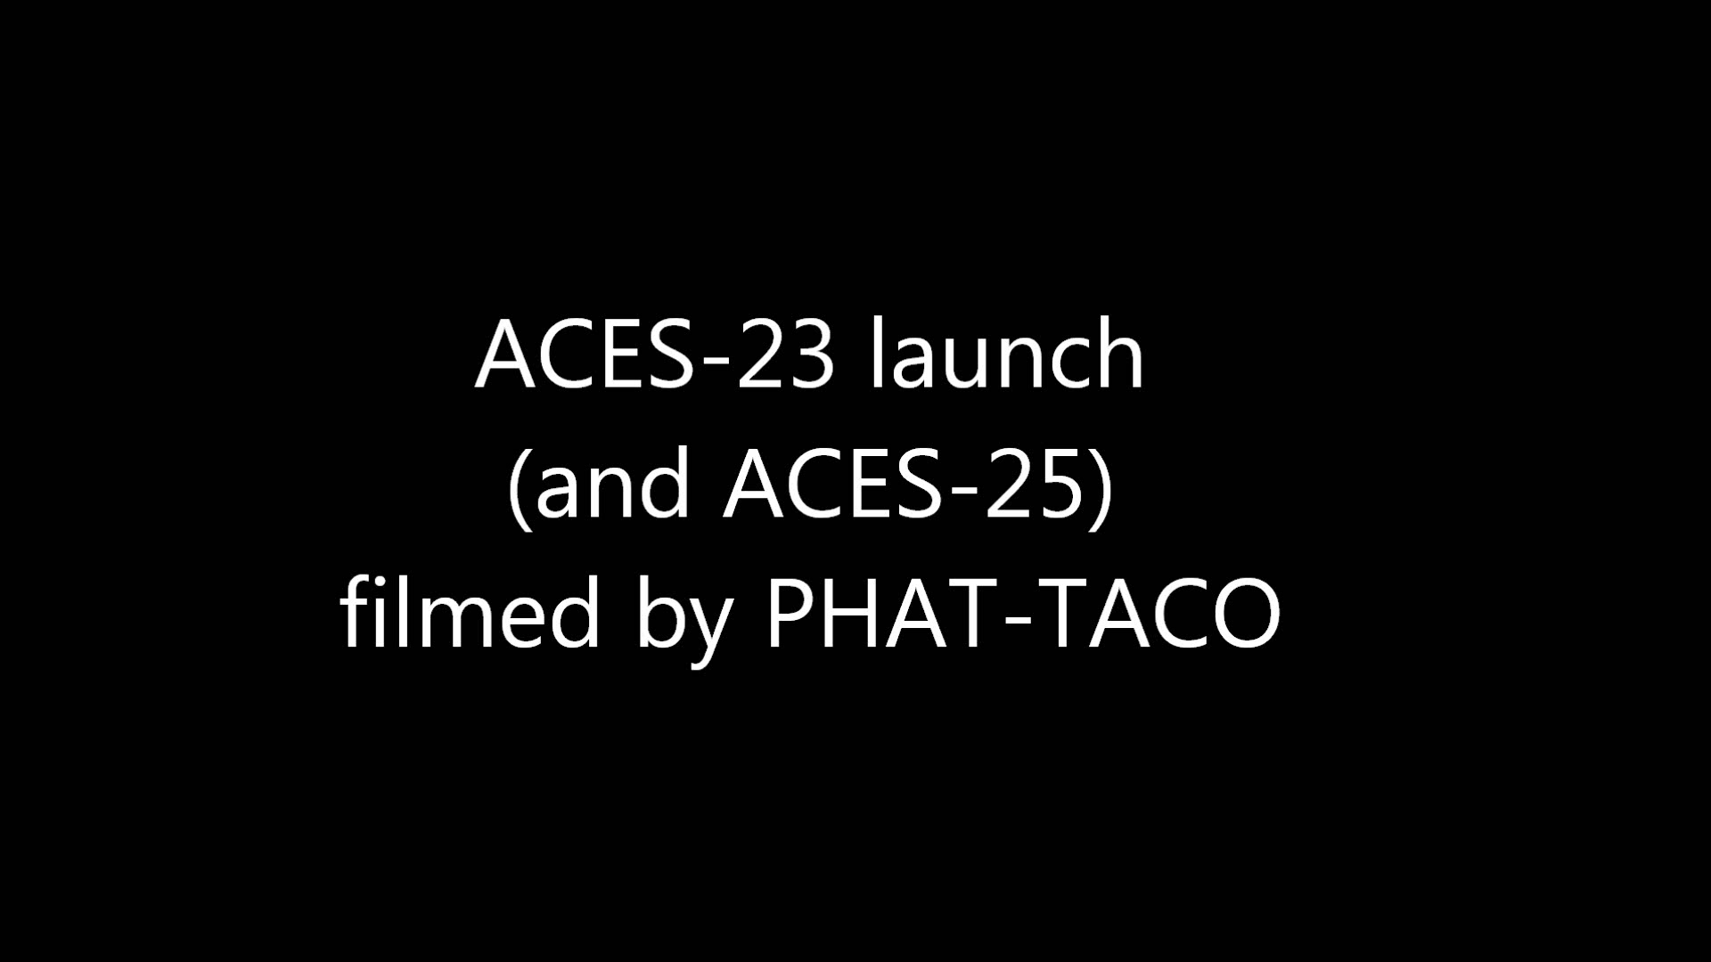

Slide 30


Slide 31
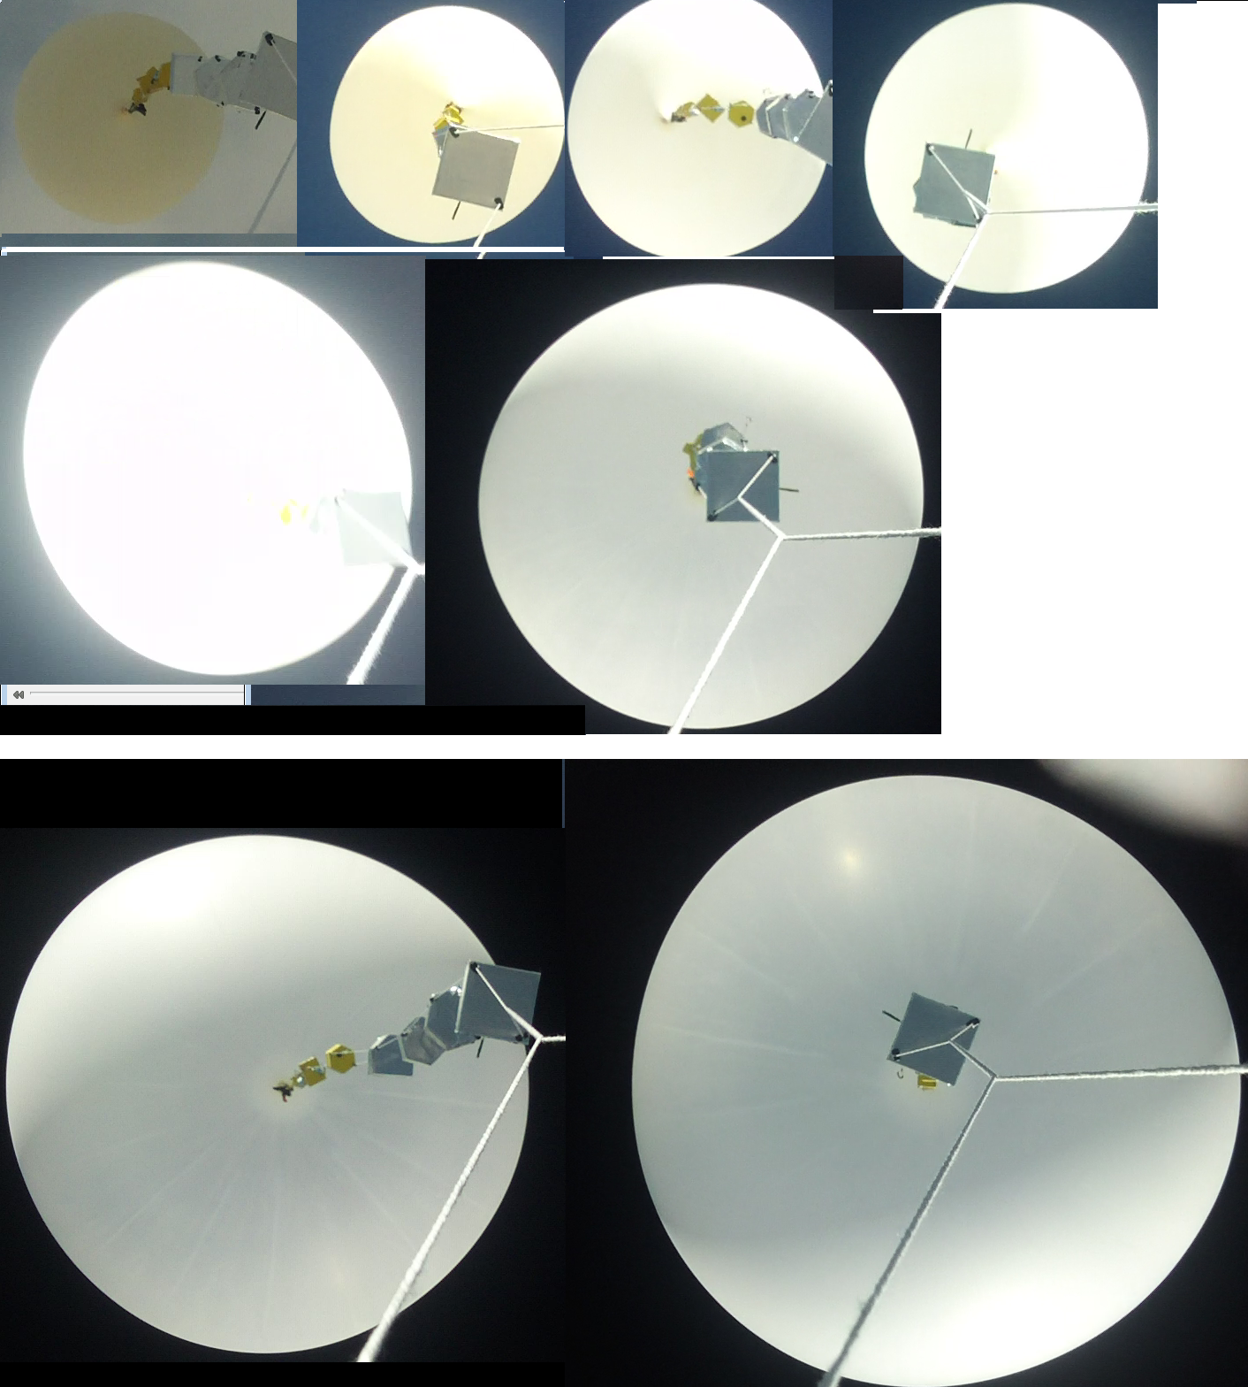

Slide 34
Lapse rate averaged over one kilometer
RED line is the expected value from US standard atmosphere
Tropopause begin
13.6 km (44600 ft.)
Tropopause end
18 km (59000 ft)

Slide 39
Clouds
Passed through 3 clouds
Ascent
1.02 to 1.14 km (3363 to 3763 feet)
1.18 to 1.23 km (3863 to 4043 feet)
Descent
0.86 to 0.66 km (2837 to 2150 feet)

Slide 41
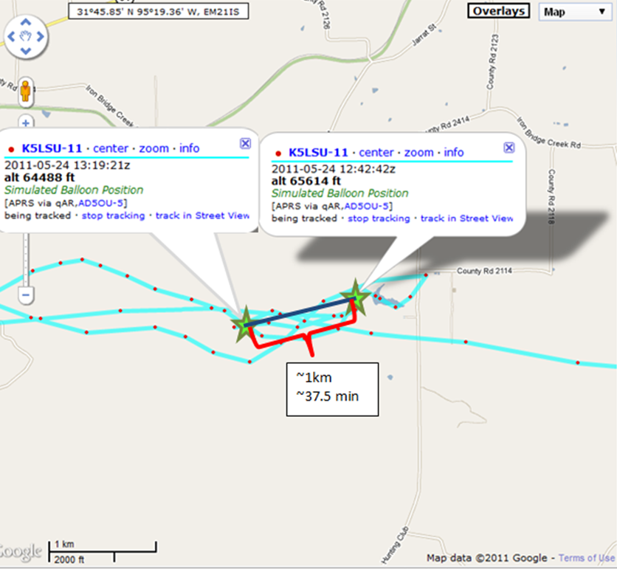
Humidity Difference?
10% difference in humidity between ascent and descent
20 km mark on ascent and descent
1 km difference
37.5 minute difference

