Slide 1
Analysis of a Binary Star Occulted by Saturn’s rings
Bill Freeman
Louisiana State University
Cornell Astronomy REU program 2009
Advisors: Philip Nicholson and Matt Hedman

Slide 2
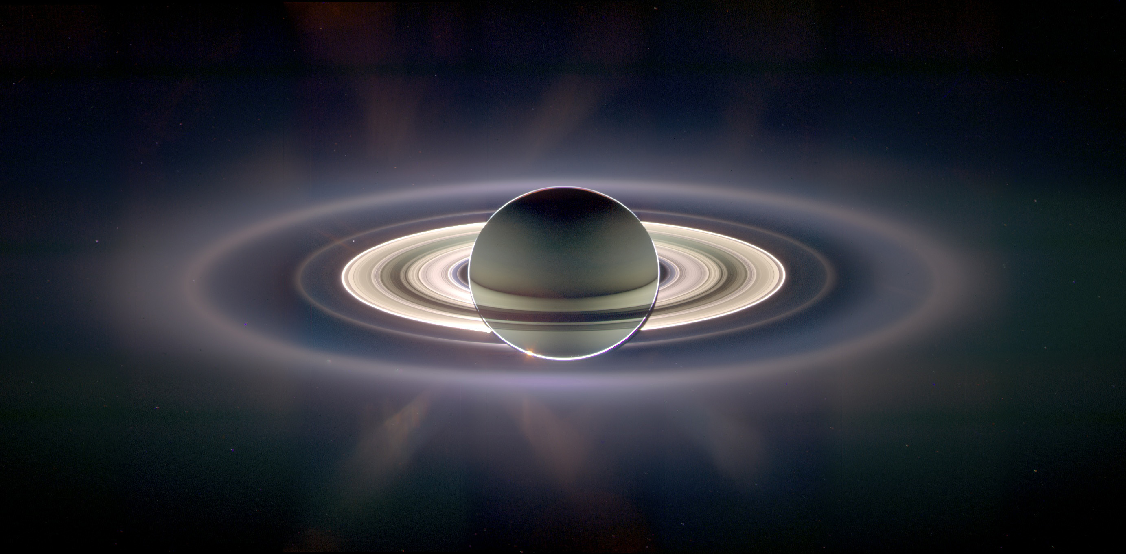

Cassini's Visual and Infrared Mapping Spectrometer (VIMS)!

Slide 3
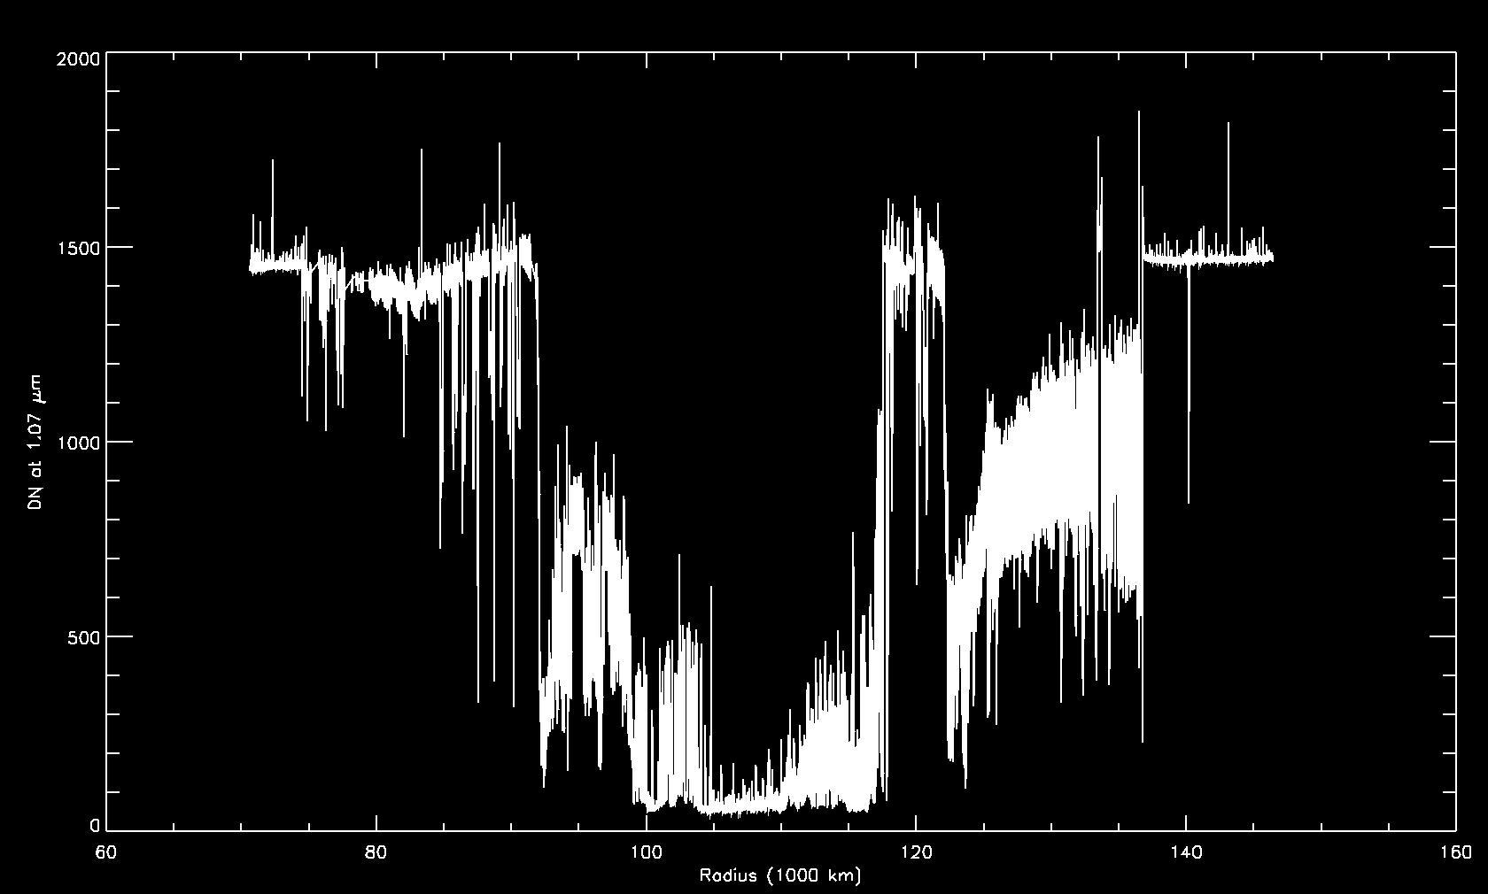
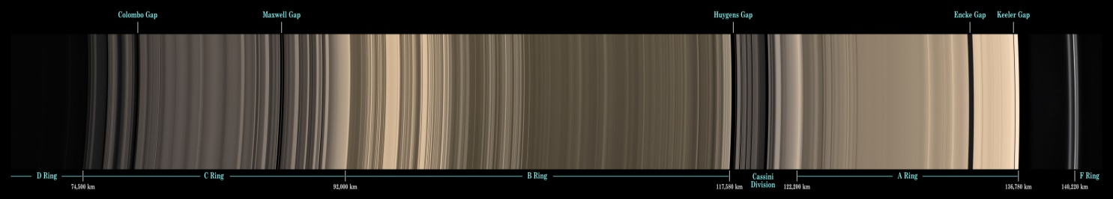
Occultation Data
Cassini Division
F ring
C ring
B ring
A ring

Slide 4
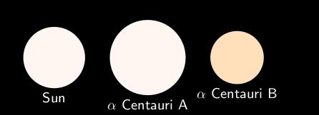
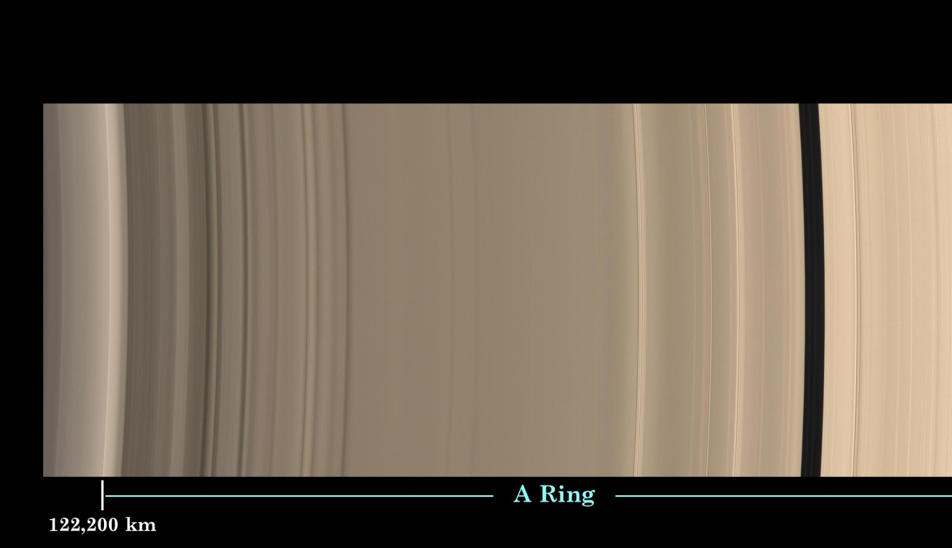

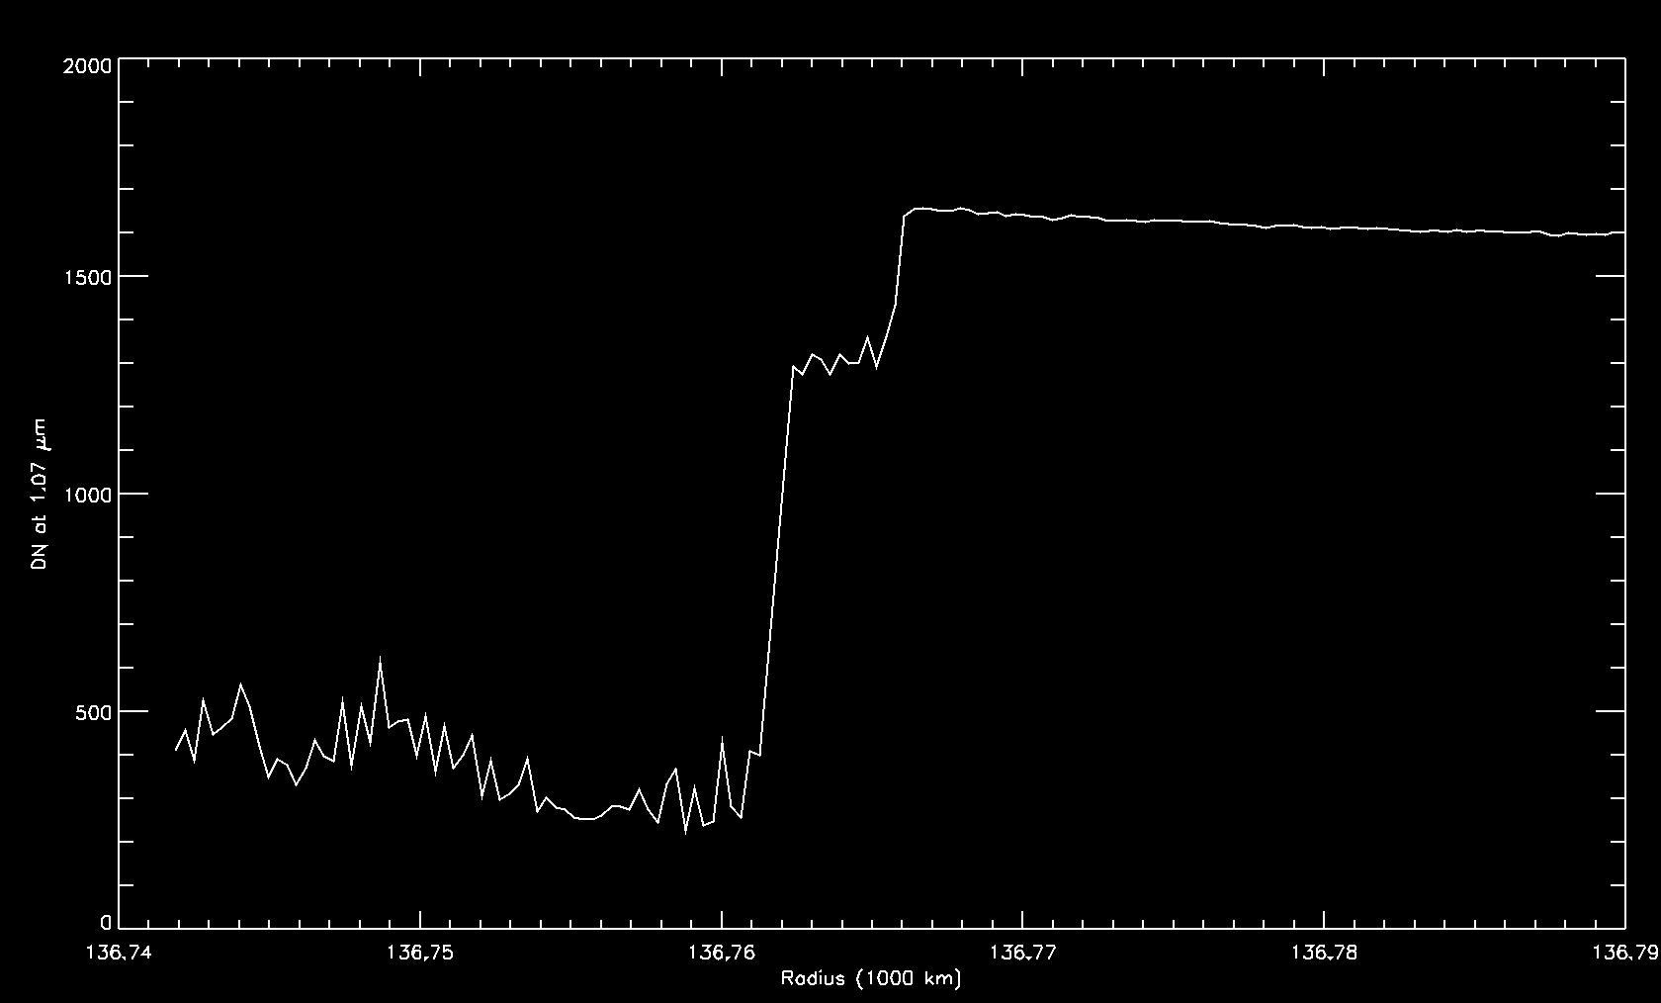
View of the VIMS pixel used to take the occultation
Flux recorded by the VIMS pixel used to take the occultation
Second drop in signal as second star passes behind the rings.
Constant signal outside of rings!
Slight drop in signal as one star is hidden by the rings.

Slide 5
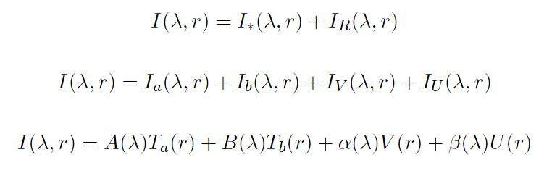
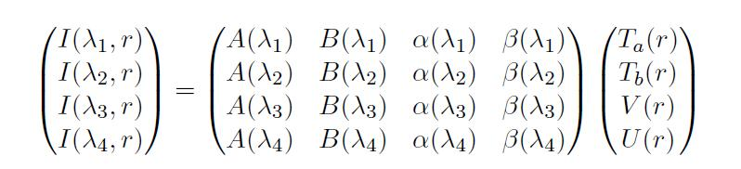

Math behind the occultation
Transmission varies from 0 to 1 where 1 indicates we can see all of the star signal while 0 indicates the star is completely blocked!
V and U have no upper limit, but they vary smoothly because of the large pixel size (200x400km).
Choosing 4 wavelengths… Once we know A, B, Alpha, and Beta, we can solve for Ta, Tb, V, and U!

Slide 6
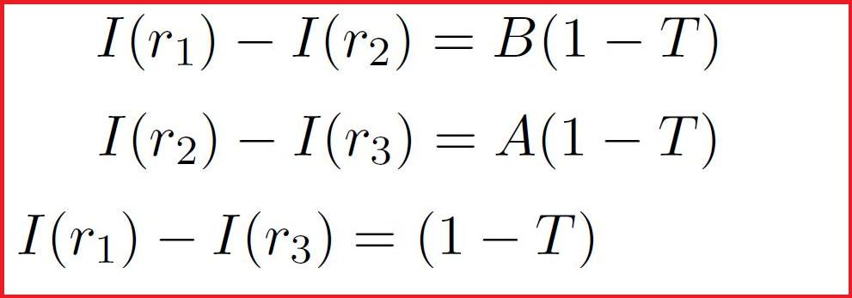
Determining A and B
A Ring Edge
Level 1
Level 2
Level 3

Slide 7
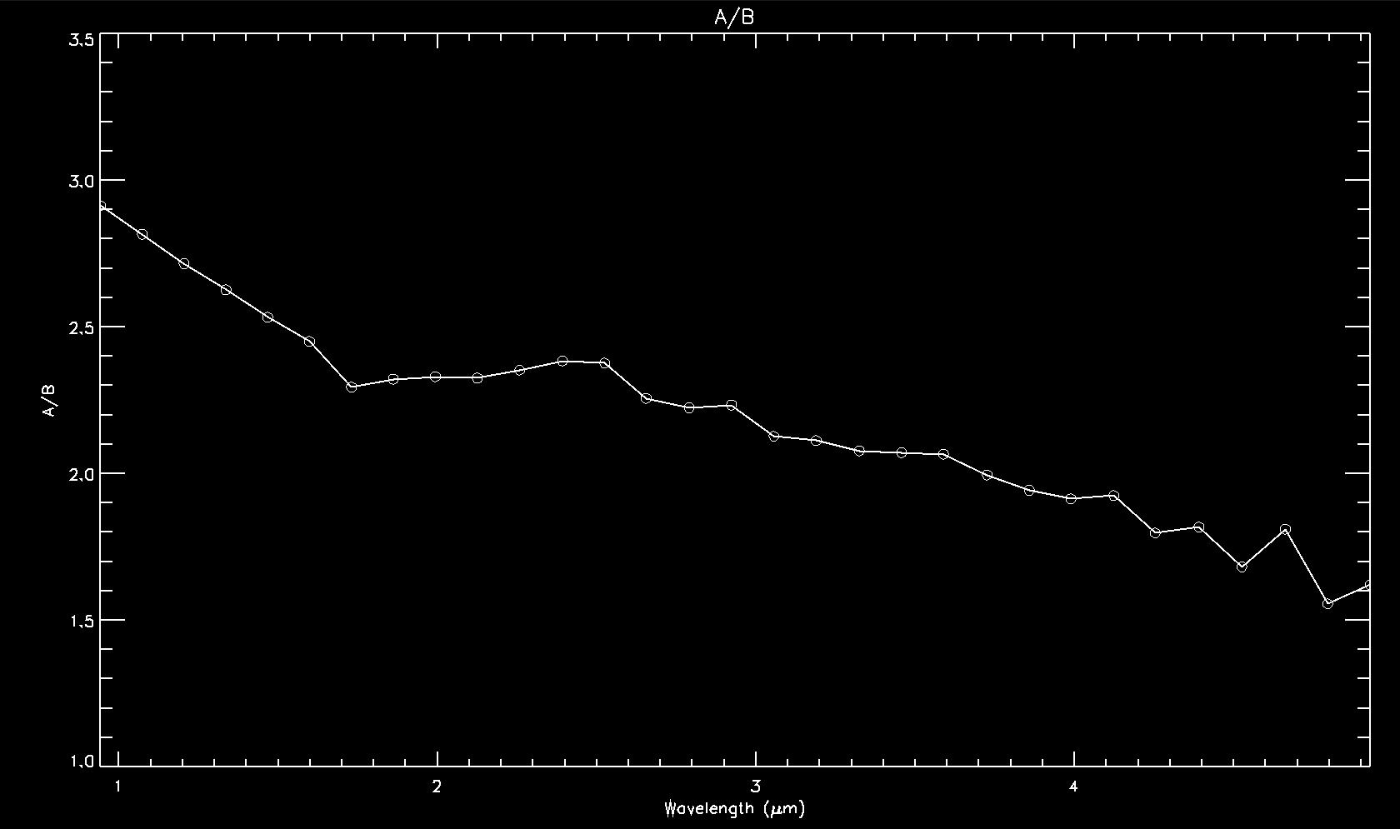
A/B vs wavelength

Slide 8
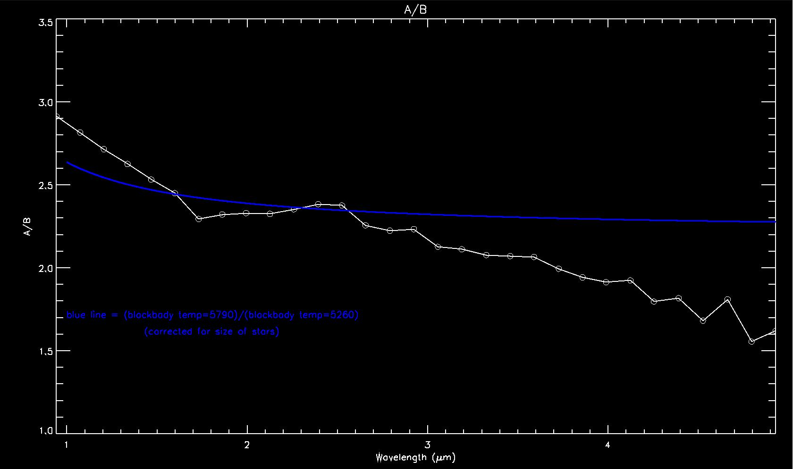
A/B vs wavelength
The blue line is what we expect A/B to be if the stars were perfect black bodies (based on temperature and radii).

Slide 9

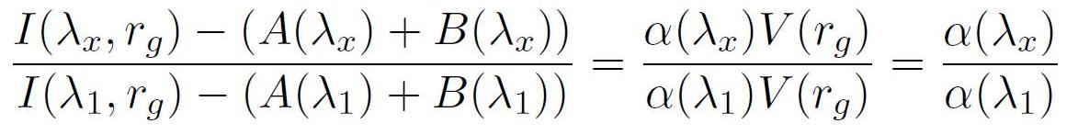
Now that we have A and B, time to find Alpha
To get Alpha, we look in the gaps (radius r_{g}) where the total signal from Alpha Centauri is 1 and U is 0. (T_{a}=T_{b}=1, U=0)

Slide 10
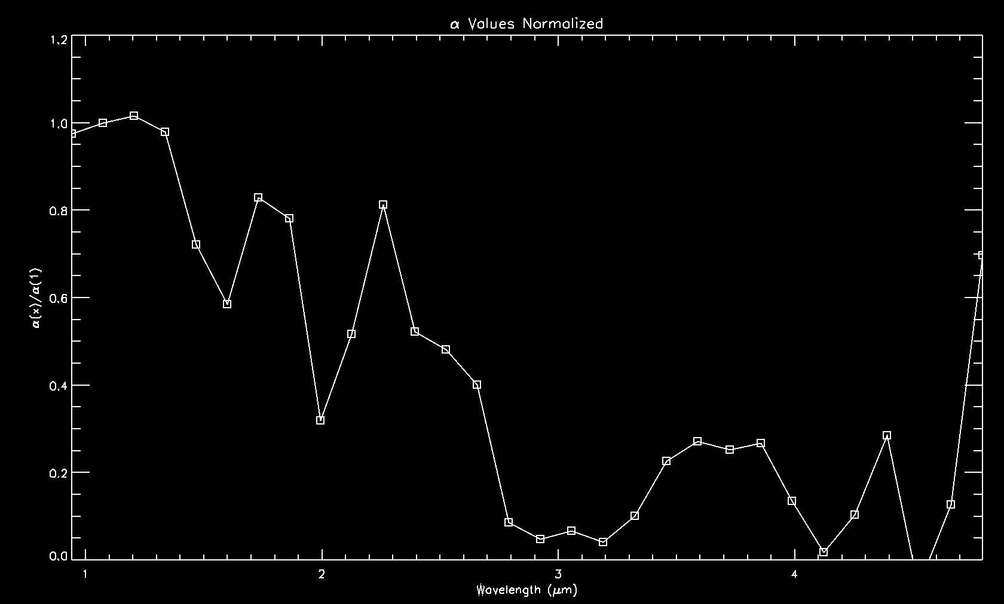
Based on previous observations, we expected ice absorption bands at 1.55, 2.0, and 3.0 microns.

Slide 11
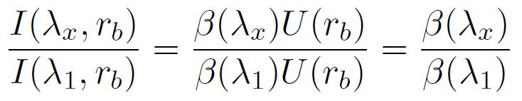
Now that we have A, B, and Alpha, time to find Beta...
To get Beta, we look in the very opaque B ring. Here, the ring is so opaque it blocks all light from both the sun, and Alpha Centauri. (T_{a}=T_{b}=V=0)

Slide 12
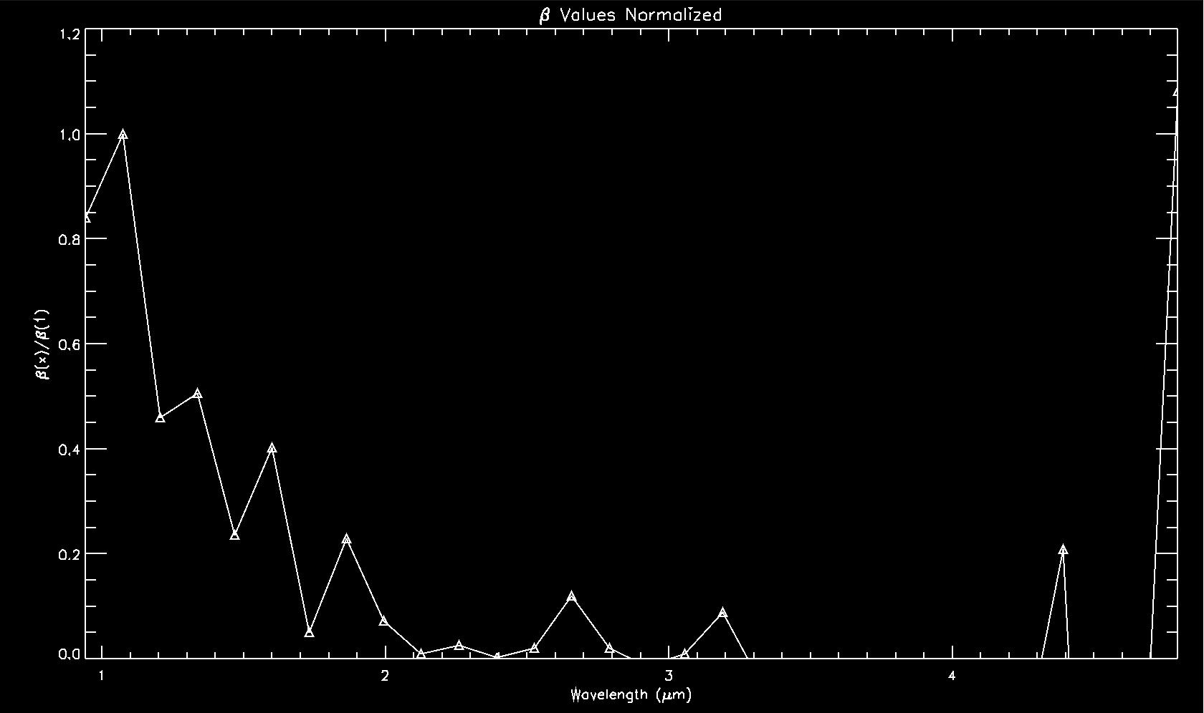
Methane absorption bands at 1.4, 1.7, and 2.3, combined with the ring absorption bands at 1.55, 2.0, and 3.0 microns.

Slide 13
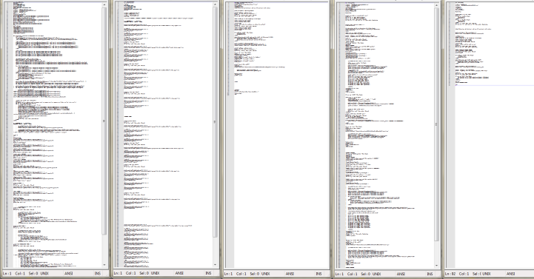
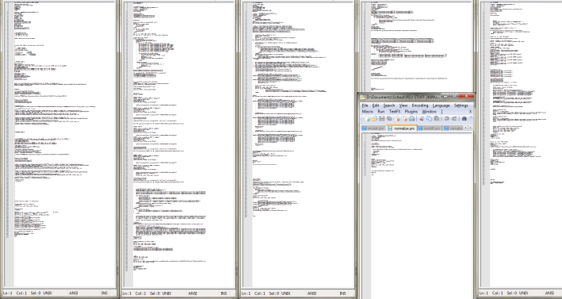
Finally! We have A, B, Alpha, and Beta for all wavelengths. After some math/linear algebra we solve for Ta, Tb, V, and U. (Using lots of code)

Slide 14
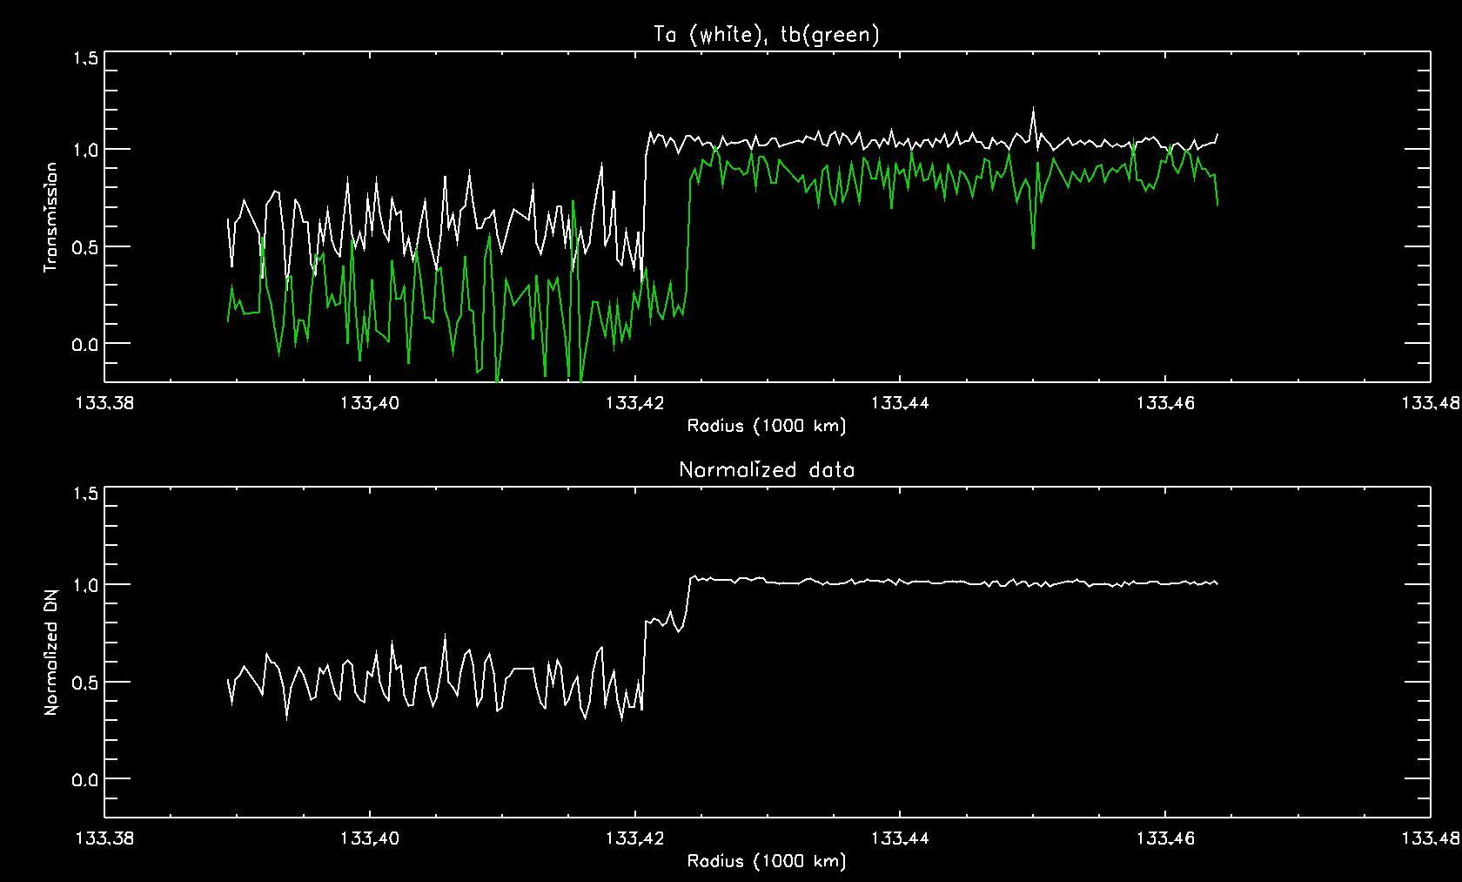
Encke gap edge

Slide 15
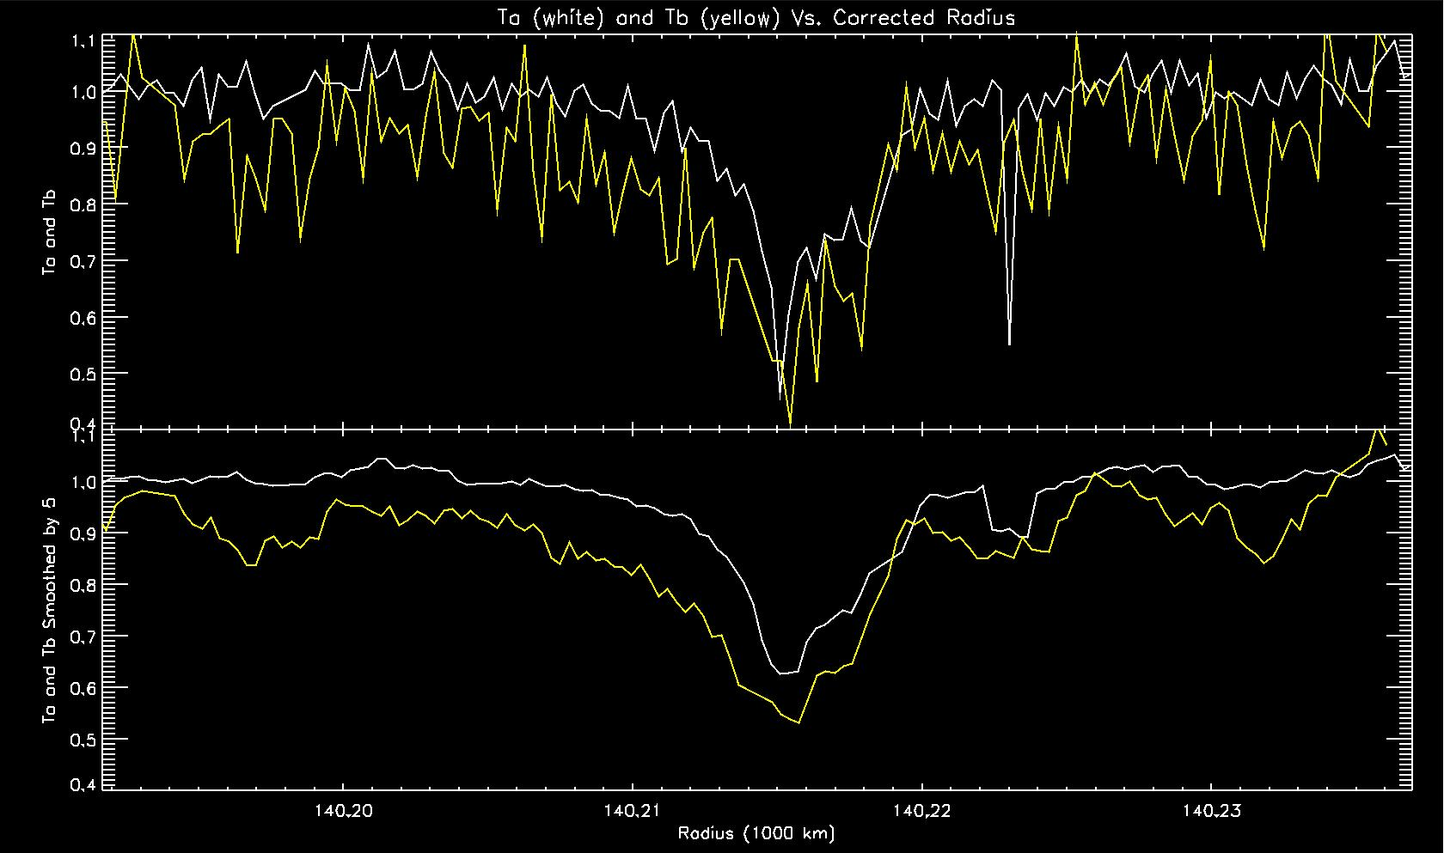
F ring

Slide 16
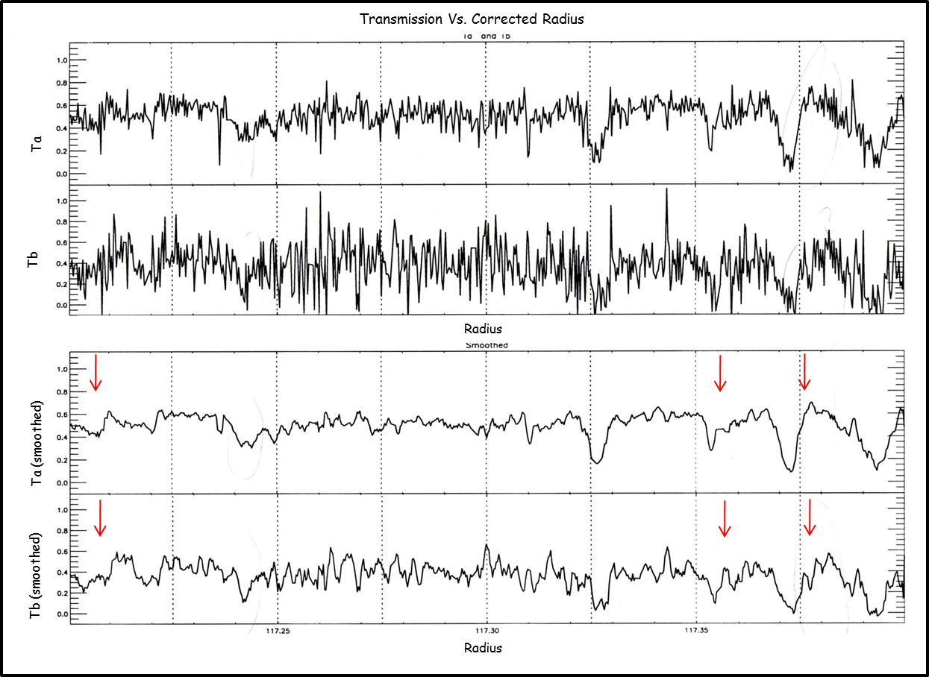
Outer Edge of the B ring
*Dashed vertical lines spaced 25 km apart

Slide 17
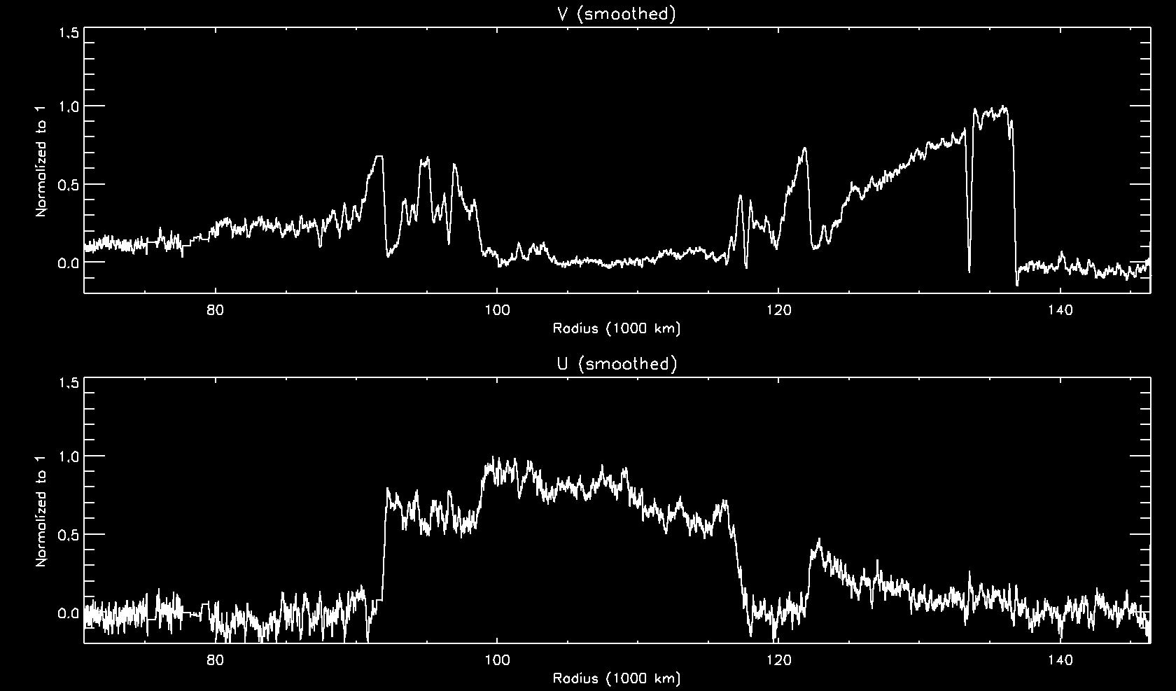
Reflected sunshine (top) and reflected Saturnshine (bottom)
Encke Gap
B ring
Cassini Division
C ring
A ring

Slide 18
Conclusions (Part 1)
First time an algorithm has been used to separate elements of a binary star occultation using VIMS data.
Since the separation of Ta and Tb was successful, we can continue to search for longitudinal variations.
Random noise for Ta and Tb is doubled and tripled, respectively, from the original data.

Slide 19
Conclusions (Part 2)
First time that both the reflected sunlight and Saturnshine have both been obtained from an occultation
Alpha parameter is not perfectly constant with radius, but the analysis could be refined to correct this.
As initially suspected, Saturnshine plays a significant role in the Bring, but not anywhere else in the ring system.

Slide 20
Future Work?
Look for variations in the ring with longitude
Work on reducing noise in Ta and Tb
Apply same method to other binary star occ

