Slide 1



Investigation of the Origin of 2008TC3 Through Spectral Analysis of F-type Asteroids and Lab Spectra of Almahata Sitta and Mineral Mixtures
By Bill Freeman
SETI Institute and Louisiana State University
Mentors: Janice Bishop, Franck Marchis, and Josh Emery
*Feel free to ask clarifying questions during the talk

Slide 2
Outline
Intro
Different asteroid types and classification
Almahatta Sitta and 2008 TC3 spectral features
Lab Mixtures
Create ureilite analog in lab
Olivine / Pyroxene / Carbon
Reducing asteroid spectra
Data reduction program based off previous work
PCA and classification and spectral features

Slide 3
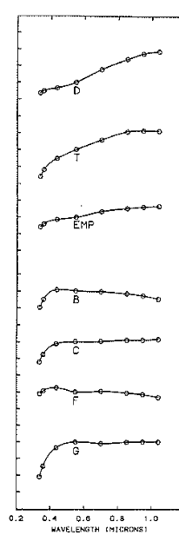
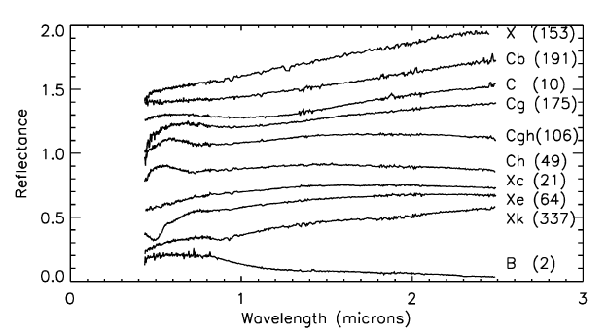
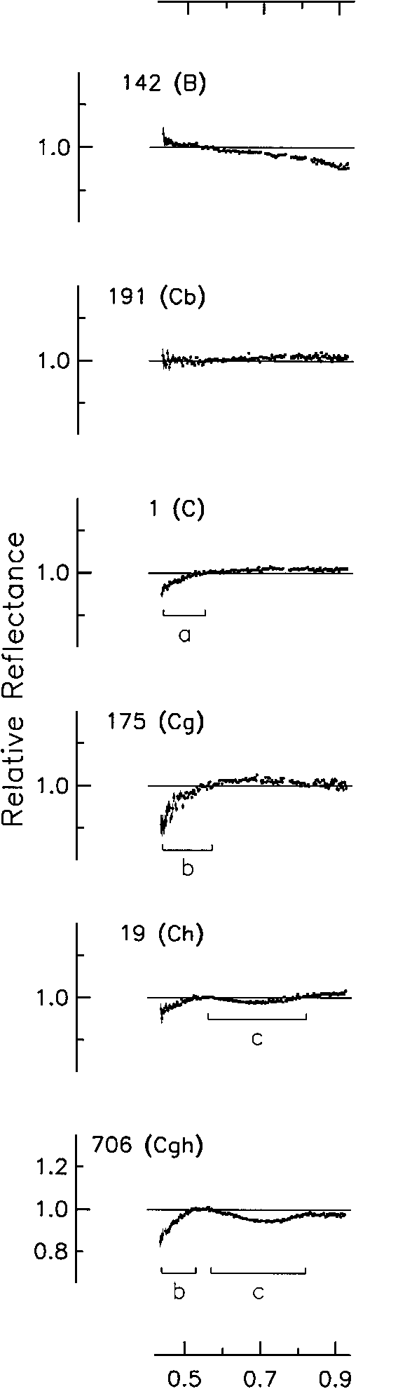
Taxonomic Classifications
B type
F type
☹
DeMeo et al. (2009)
Deleted F-Type in BB2002 classification because of range of wavelength does not extend to 0.35 µm
B type
F type
Bus & Binzel (2002)
Tholen (1984)

Slide 4
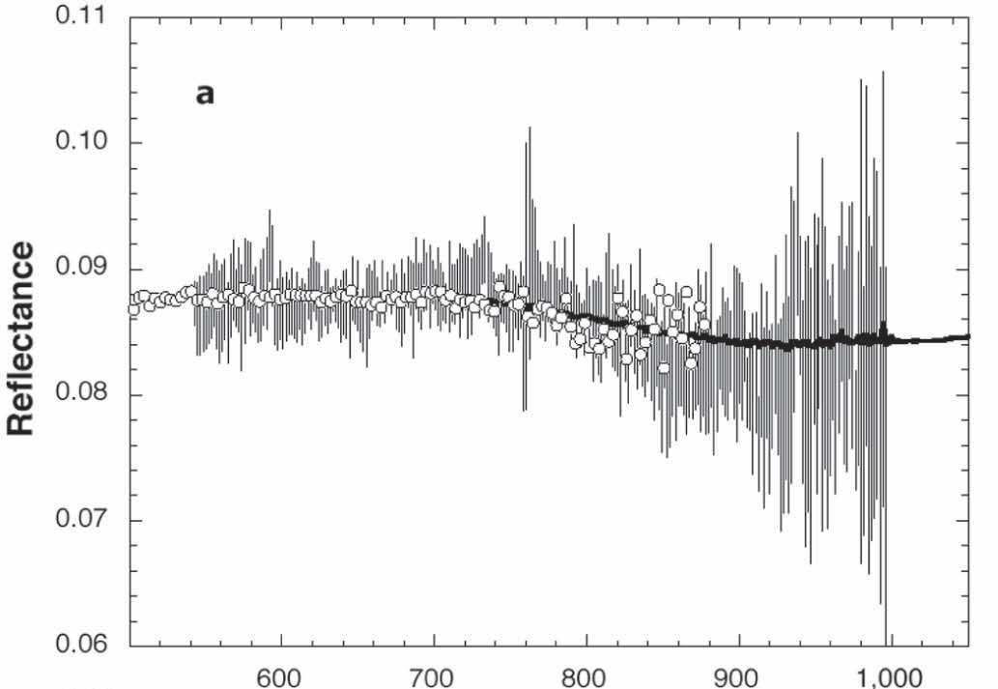
2008 TC3 spectra
4.2m William Herschel Telescope
ISIS spectrograph
meteorite - circles / black line
asteroid - vertical lines
Jenniskins et al 2009
Wavelength (nm)

Slide 5
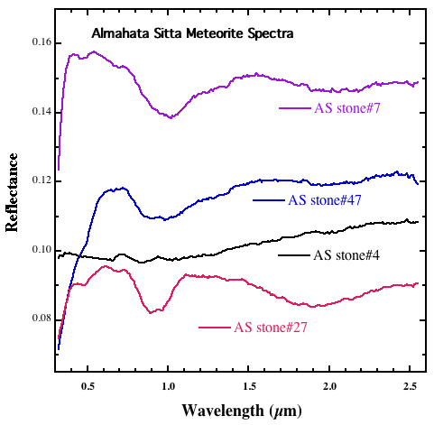
Almahatta Sitta Spectra
1 and 2 µm bands are indicative of Olivine and Pyroxene
Location and shape show composition
Absolute reflectance and depth mean different amounts of Carbon
Hiroi et al 2010

Slide 6
Lab Mixtures
Create ureilite analogs in the lab
Make Olivine / Pyroxene mixtures
Test characteristics of three types of carbons by mixing them with clays
Mix ideal carbon with the Olivine / Pyroxene mixtures

Slide 7
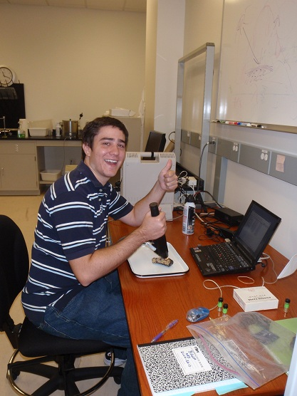
Lab mixtures
Reflectance spectra of simulated ureilites
Mixtures of olivine, pyroxene with a grain size <124 µm
Spectra from 0.35-2.5 µm
ASD Reflectance spectrometer
2 nm spectral sampling

Slide 8
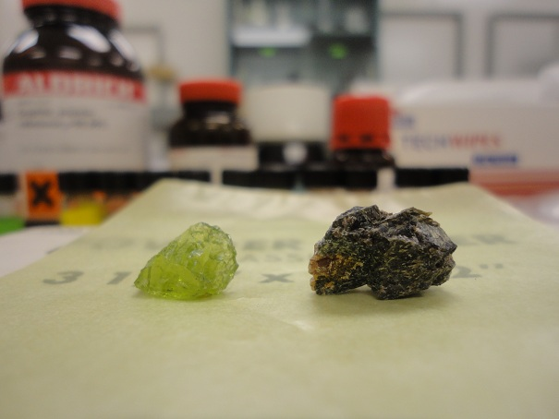
Pyroxene / Olivine
Olivine
Pyroxene

Slide 9
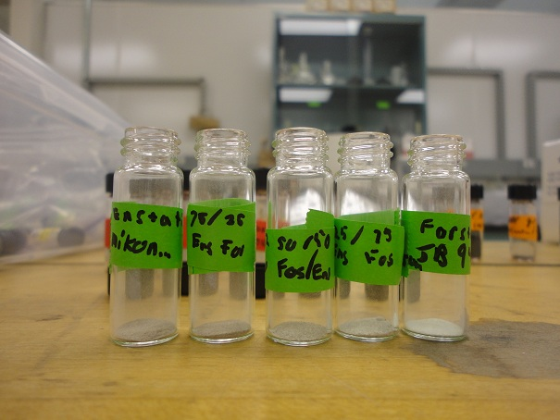
Pyroxene / Olivine
Pyroxene
75/25
50/50
25/75
Olivine

Slide 10
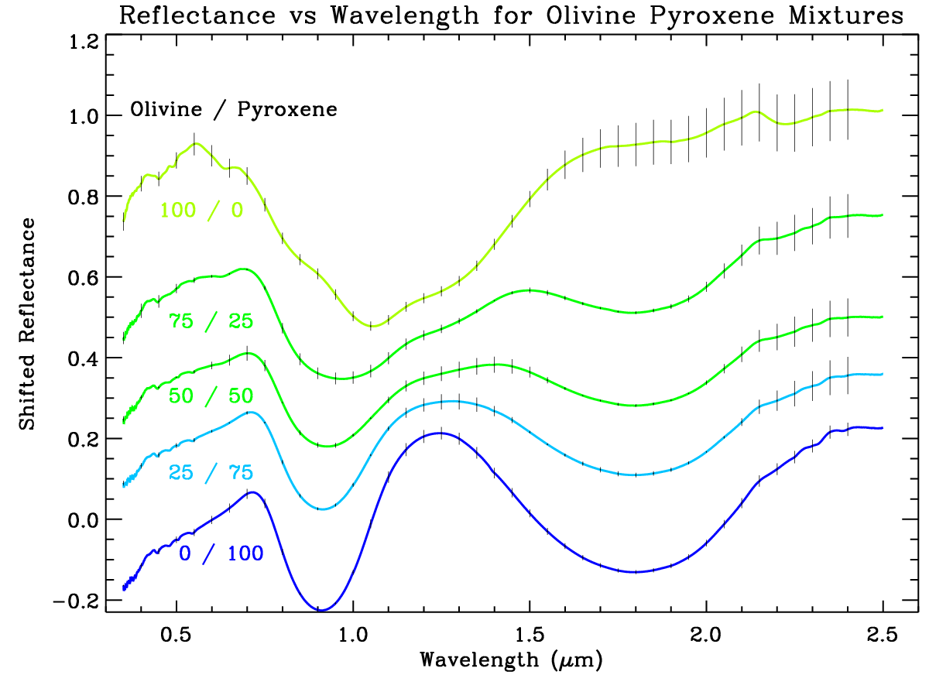
Pyroxene / Olivine

Slide 11
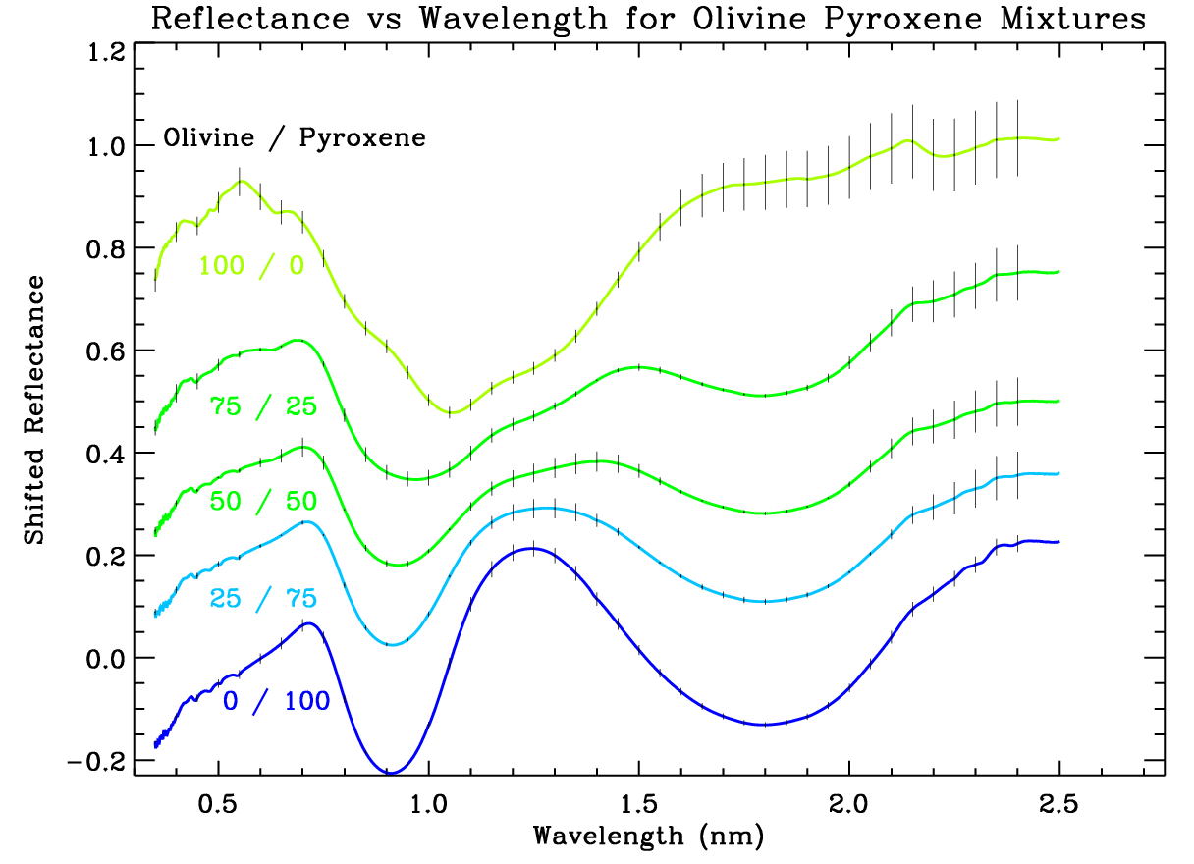
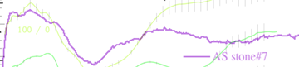
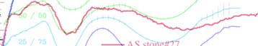
Almahatta Sitta
The reflectance scales are not comparable. We need to add Carbon!

Slide 12
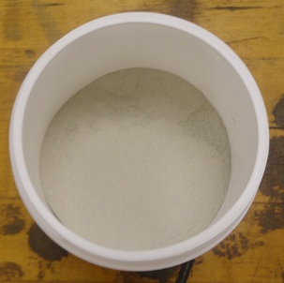
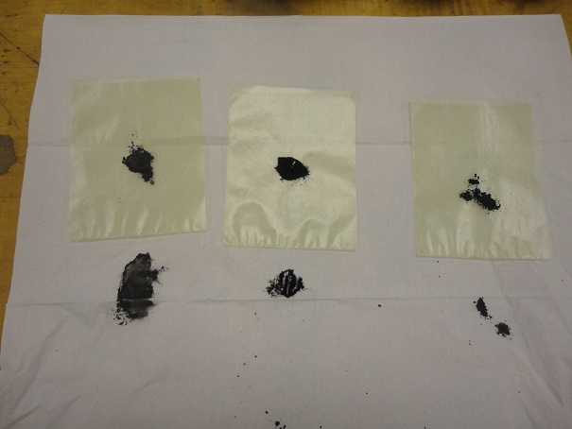
Montmorillonite / Carbon
Montmorillonite clay
Graphite
45 µm
Nanopowder
50 nm (.05 µm)
Glassy
2-12 µm

Slide 13
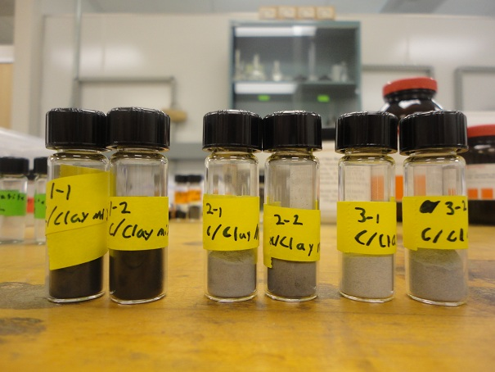
Montmorillonite / Carbon
Nanopowder
50 nm (.05 µm)
Glassy
2-12 µm
Graphite
45 µm
2% 5%
2% 5%
2% 5%

Slide 14
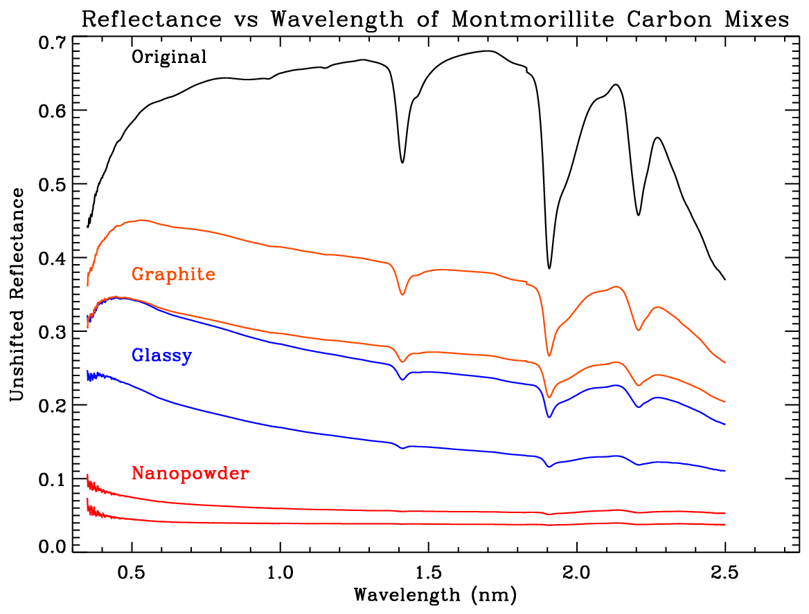
Montmorillonite / Carbon

Slide 15
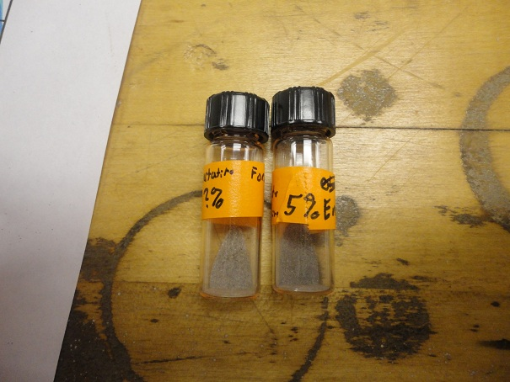
(1:1 Olivine / Pyroxene) + C
FAIL

Slide 16
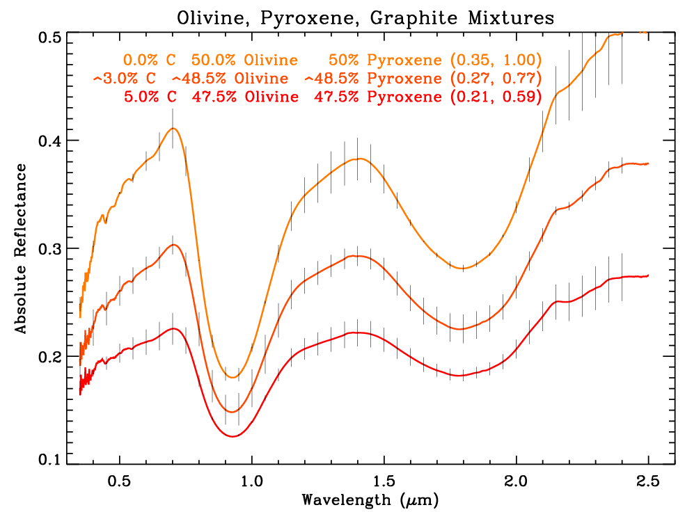
(1:1 Olivine / Pyroxene) + C
0.382
0% - 100%
3% - 77%
5% - 58%
0.293
0.223

Slide 17
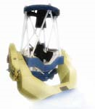
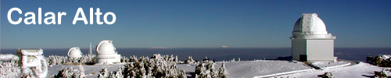
Data taken this summer
CAFOS
Observed seven main-belt, F-type, low albedo asteroids that are in potential families of 2008TC3
2.2m telescope at Calar Alto (Spain)
CAFOS low resolution spectrograph
B-100 (0.32-0.58 µm)
R-400 (0.47-1.1 µm)
2.2m telescope on Calar Alto
http://www.caha.es/telescopes-overview-and-instruments-manuals.html
http://www.caha.es/calar-alto-observatory.html

Slide 18
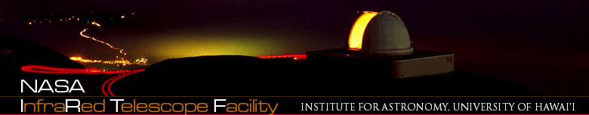
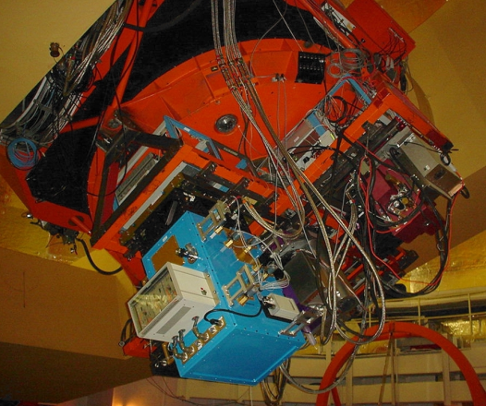
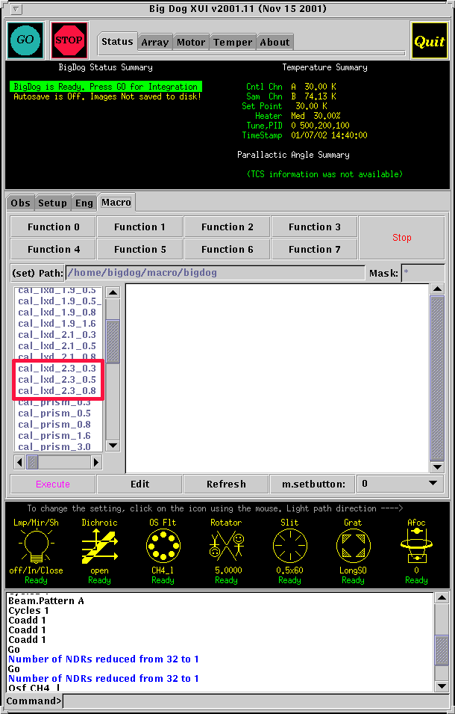
Data taken this summer
IRTF (Infrared Telescope Facility)
IRTF and SpeX low-resolution spectrograph
near-infrared (0.7-2.5 µm) spectra
Observed remotely with Josh Emery
Image of IRTF
Image of SpeX
Screenshot of telescope interface
http://irtfweb.ifa.hawaii.edu/~spex/
http://irtfweb.ifa.hawaii.edu/
http://irtfweb.ifa.hawaii.edu/~spex/work/spectra/taking_spectra.html

Slide 19
Asteroid Reflectance Spectroscopy
Subtract Bias/dark
Divide Flat Field
Correct for slanted image
Extract data (3D -> 2D)
Correlation between pixels and wavelength
Divide by nearby solar analog

Slide 20
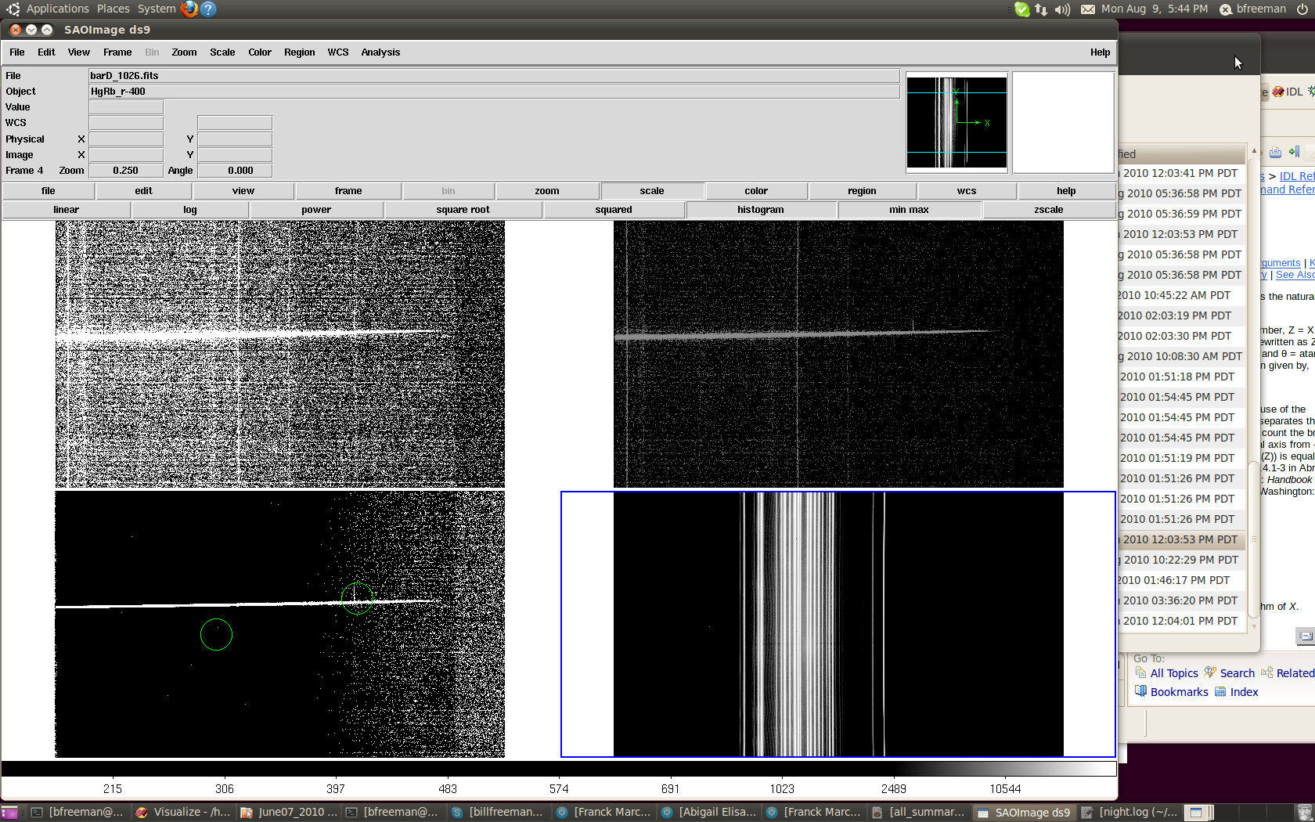
Asteroid Reflectance Spectroscopy
Subtract Bias/dark
Divide Flat Field
Correct for slanted image
Extract data (3D -> 2D)
Correlation between pixels and wavelength
Divide by nearby solar analog
Position
Wavelength

Slide 21
Asteroid Reflectance Spectroscopy
Subtract Bias/dark
Divide Flat Field
Correct for slanted image
Extract data (3D -> 2D)
Correlation between pixels and wavelength
Divide by nearby solar analog

Slide 22
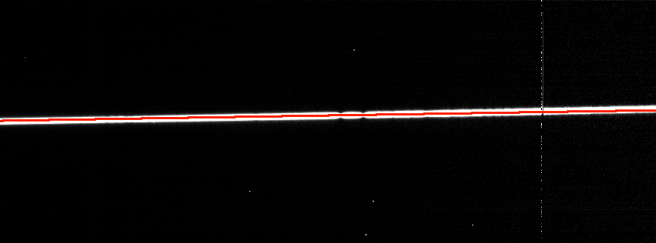
Asteroid Reflectance Spectroscopy
Subtract Bias/dark
Divide Flat Field
Correct for slanted image
Extract data (3D -> 2D)
Correlation between pixels and wavelength
Divide by nearby solar analog

Slide 23
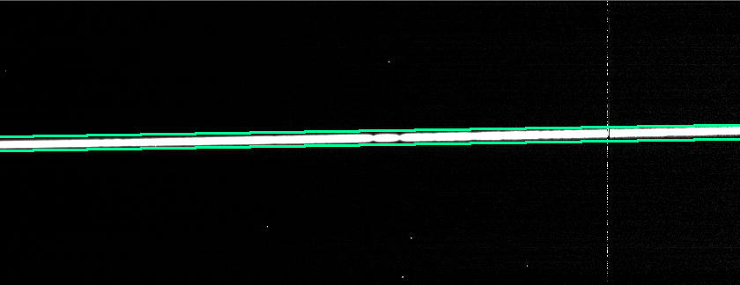
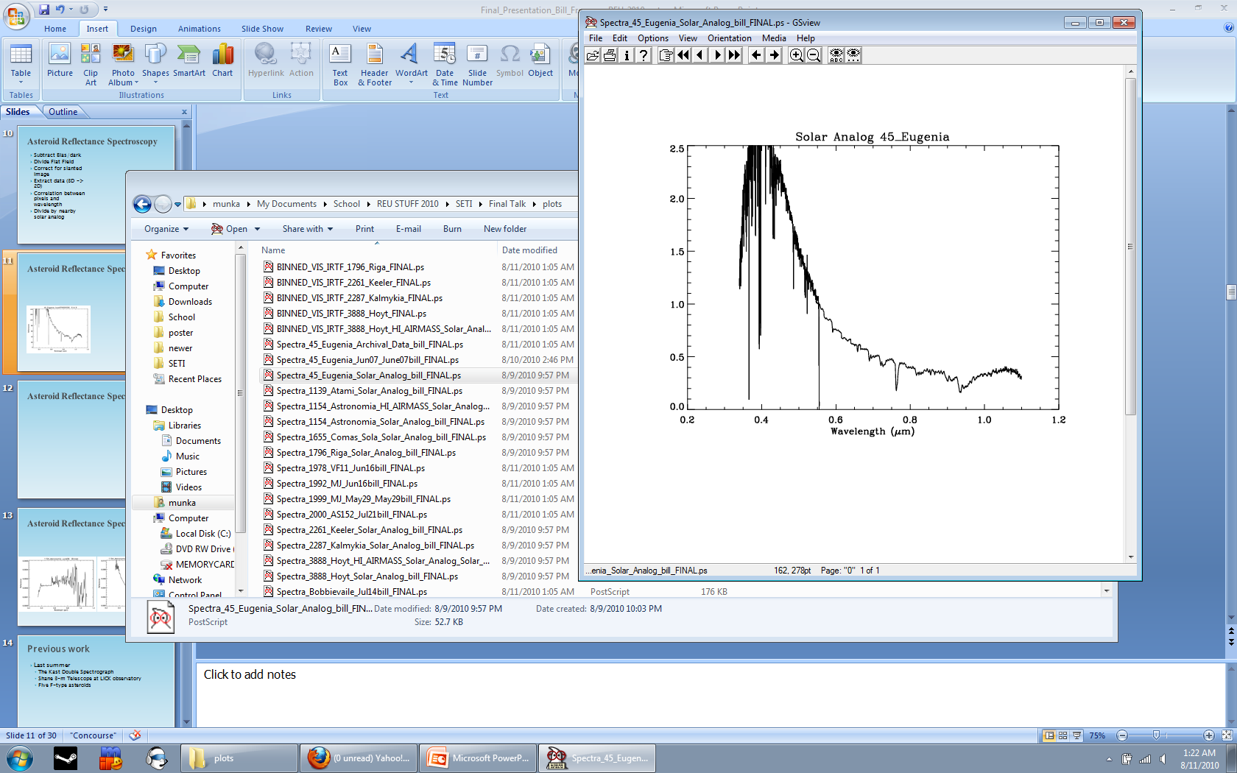
Asteroid Reflectance Spectroscopy
Position, wavelength, and flux
Subtract Bias/dark
Divide Flat Field
Correct for slanted image
Extract data (3D -> 2D)
Correlation between pixels and wavelength
Divide by nearby solar analog
Wavelength and flux

Slide 24
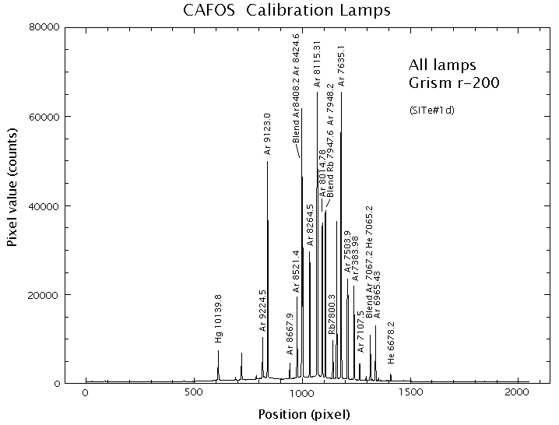
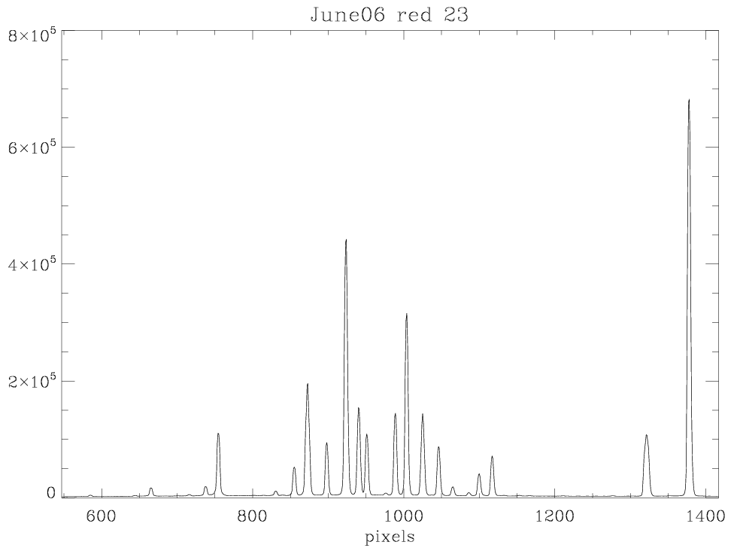
Asteroid Reflectance Spectroscopy
Subtract Bias/dark
Divide Flat Field
Correct for slanted image
Extract data (3D -> 2D)
Correlation between pixels and wavelength
Divide by nearby solar analog

Slide 25
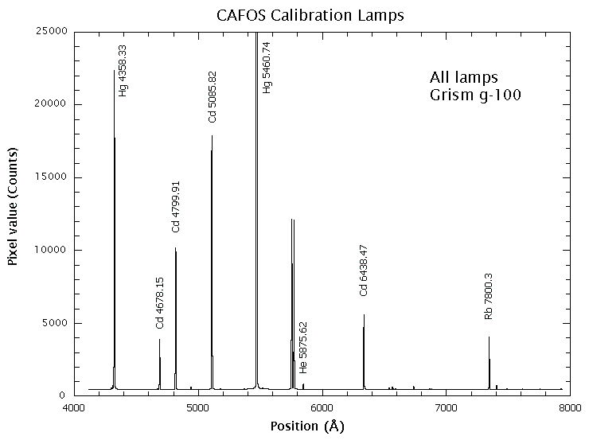
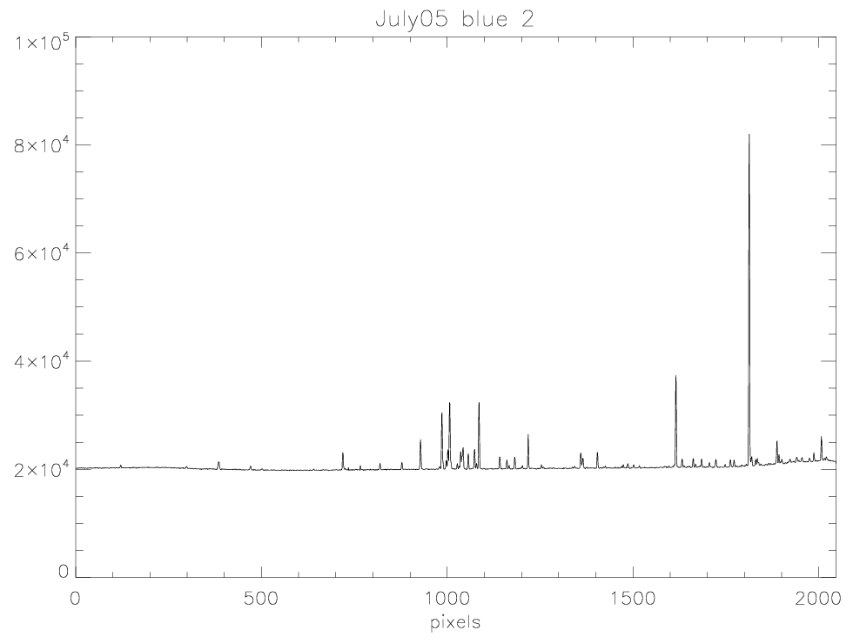
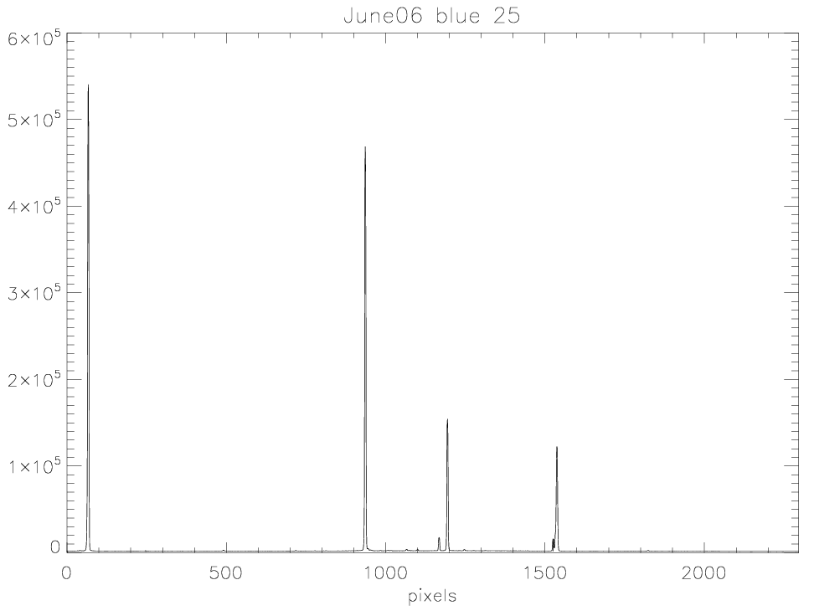
Asteroid Reflectance Spectroscopy
Subtract Bias/dark
Divide Flat Field
Correct for slanted image
Extract data (3D -> 2D)
Correlation between pixels and wavelength
Divide by nearby solar analog

Slide 26
Asteroid Reflectance Spectroscopy
Subtract Bias/dark
Divide Flat Field
Correct for slanted image
Extract data (3D -> 2D)
Correlation between pixels and wavelength
Divide by nearby solar analog

Slide 27
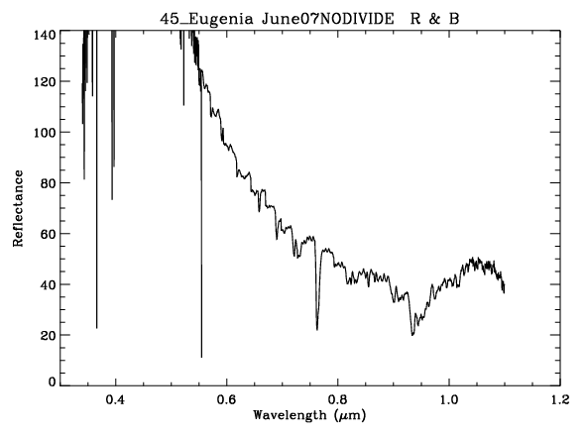
Asteroid Reflectance Spectroscopy
Original Asteroid Spectrum
Nearby solar analog
O2
O2

Slide 28
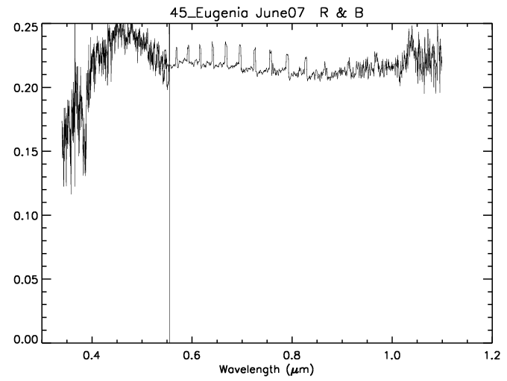
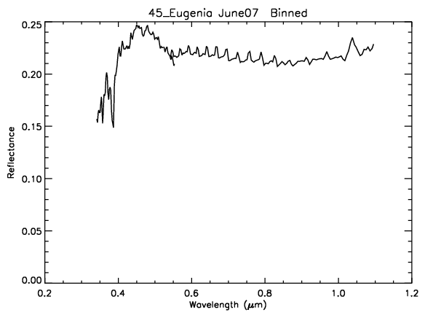
Asteroid Reflectance Spectroscopy
Binned to a Resolution of 100 = λ/Δλ
Unbinned
Binned

Slide 29
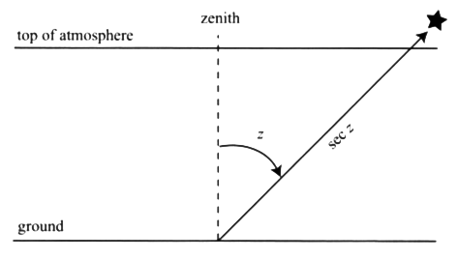
Asteroid Reflectance Spectroscopy
But why can’t you use a spectra of the actual sun?
Airmass: Due to the strong dependency of atmospheric diffraction on wavelength, the shape of the spectra will change
Image credit: Birney et al (2006)

Slide 30
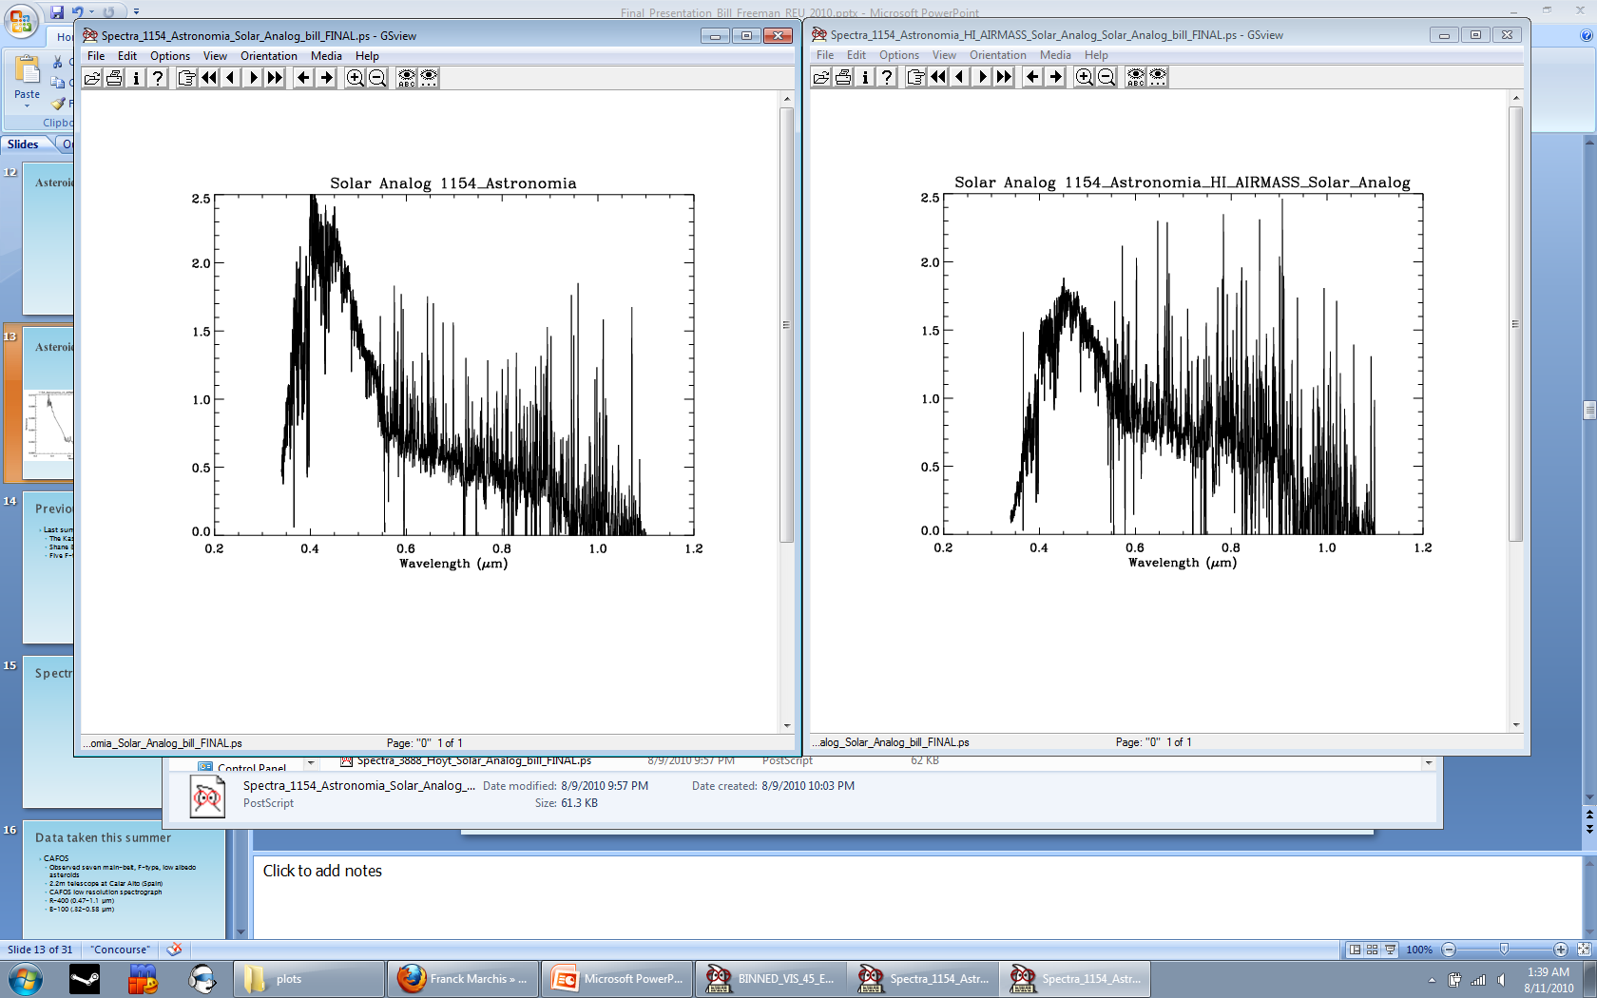
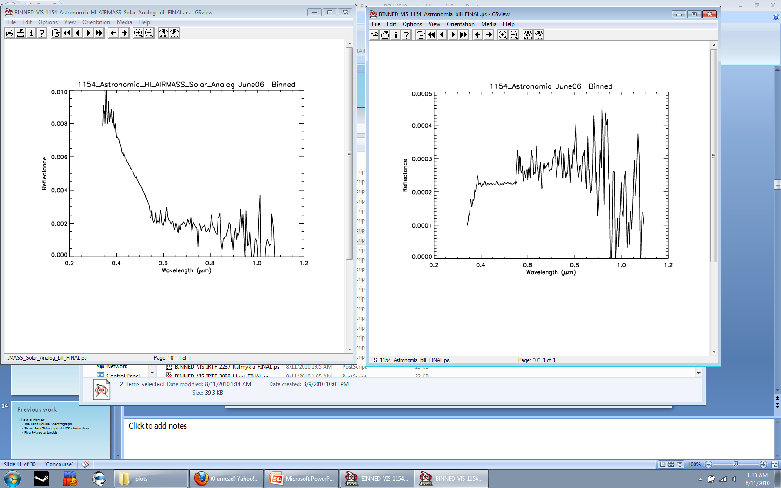
Asteroid Reflectance Spectroscopy
2.37
High
Airmass
1.66
Lower
Airmass
1.83
Δ-0.59
1.83
Δ0.16
Seeing
Humidity
Temp
Clouds…

Slide 31
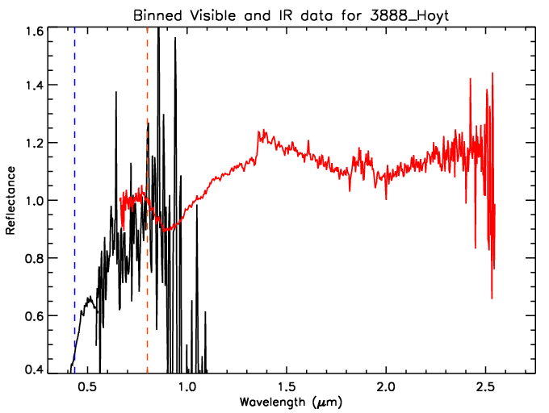
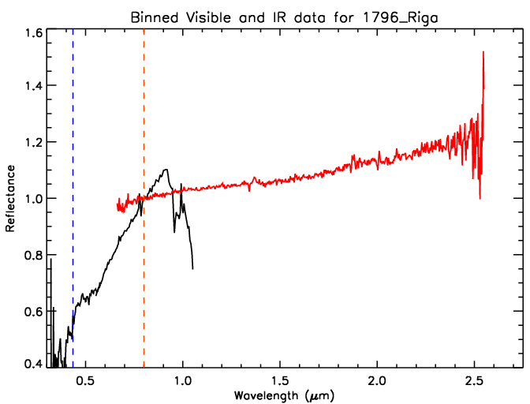
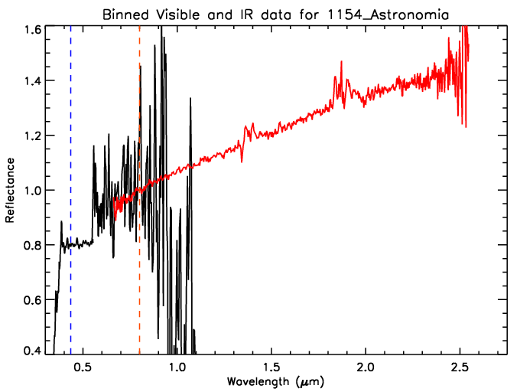
Reduced data from CALA and IRTF
Orange line – Data normalized to 1 (0.8 µm)
Blue line – Cut off of BB classification (0.435 µm)
Airmass too low?

Slide 32
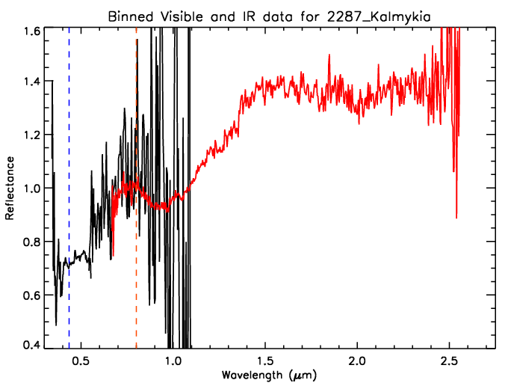
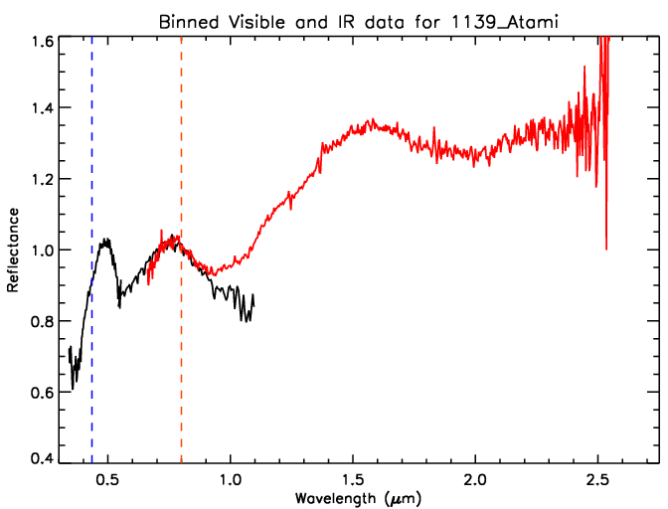
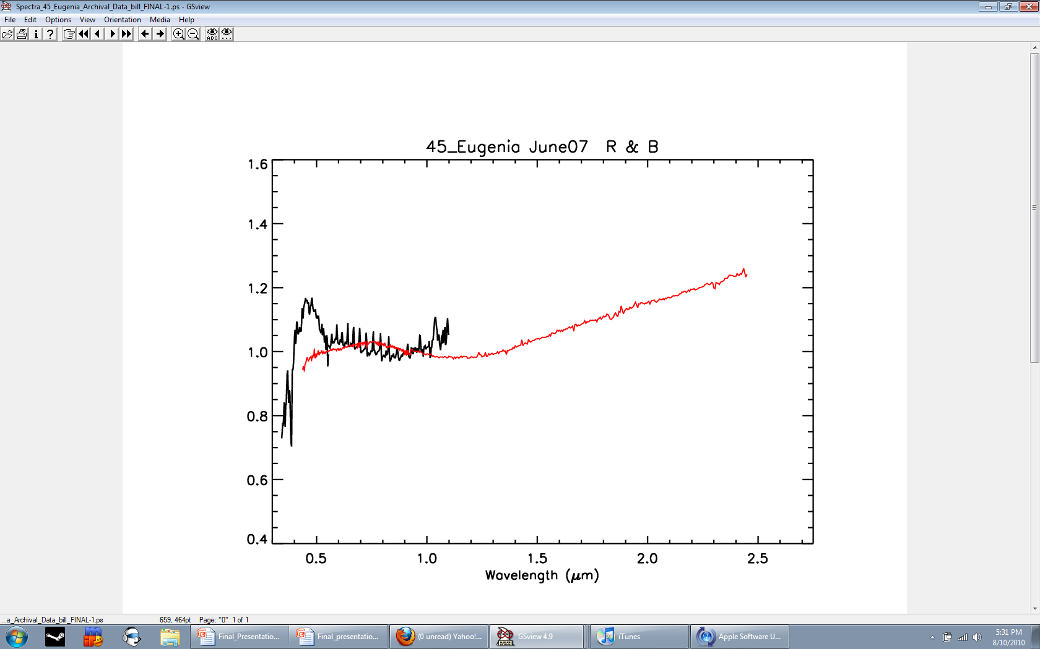
Reduced data from CALA and IRTF
Archival

Slide 33
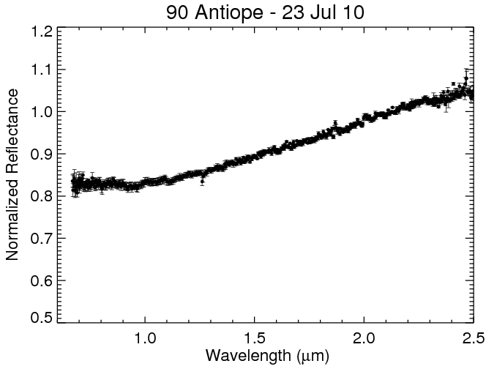
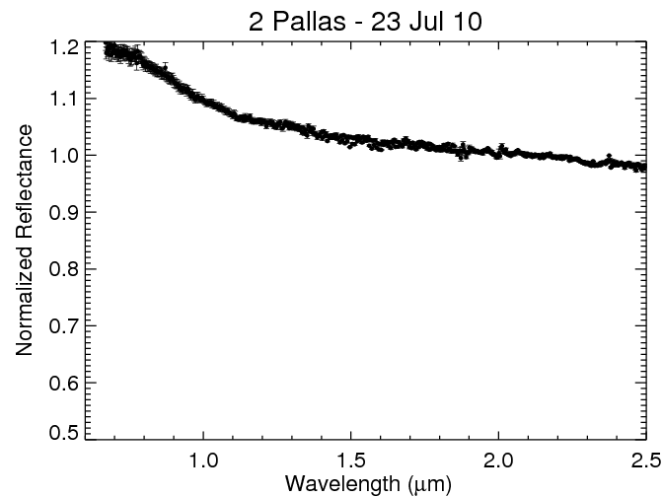
IRTF only observations

Slide 34
PCA and UV absorption
Formula from Hiroi et al. 1996 studying C, G, B, and F type asteroids and carbonaceous chondrites
0.35 feature = ln(0.35-0.37) - ln(0.54-0.56)
*A negative value indicates absorption*
Object | slope | PC2’ | PC3’ | 0.35 µm feature | 0.35 µm feature | Type | Type
name | Arbitrary Units | 1µm feature | Higher Order | (Hiroi et al 1996) | Y/N | Tholen or BB 2002 | This work
1154 Astronomia | -13.98 | -0.99999 | -0.00217 | -0.363 | Y | ? | F
2287 Kalmykia | -1.40 | -0.00233 | 0.00420 | -0.029 | ? | ? | S
1655 Comas Sola | -16.76 | -0.00216 | 0.99999 | 1.873 | N? | B | ?
3888 Hoyt | -0.32 | -0.00077 | 0.00092 | -1.150 | Y | ? | S/F??
1796 Riga | 3.45 | -0.00047 | 0.00107 | -0.437 | Y | Cb | C/Cb
45 Eugenia | -0.04 | -0.00012 | 0.00015 | -0.237 | Y | C | C
1139 Atami | 0.15 | -0.00007 | -0.00004 | -0.237 | Y | S | S
2261 Keeler | 71.27 | 0.00029 | 0.00037 | -0.043 | N? | ? | S

Slide 35
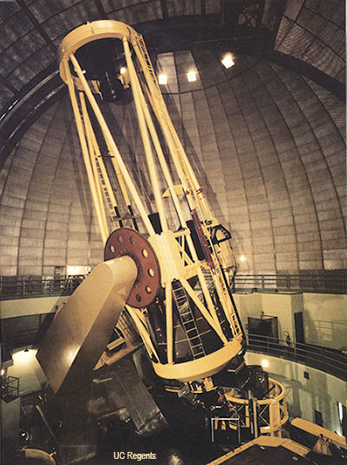
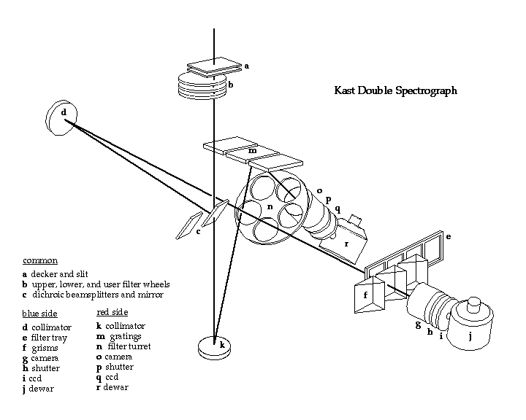
Previous work
Last summer
The Kast Double Spectrograph
Shane 3-m Telescope at LICK observatory
Five F-type asteroids
Original version of the reduction software
Left: Shane 3-m Telescope
Right: Kast double spectrograph
http://mthamilton.ucolick.org/techdocs/instruments/kast/hw_overview.html
http://www.ucolick.org/public/telescopes/shane.html

Slide 36
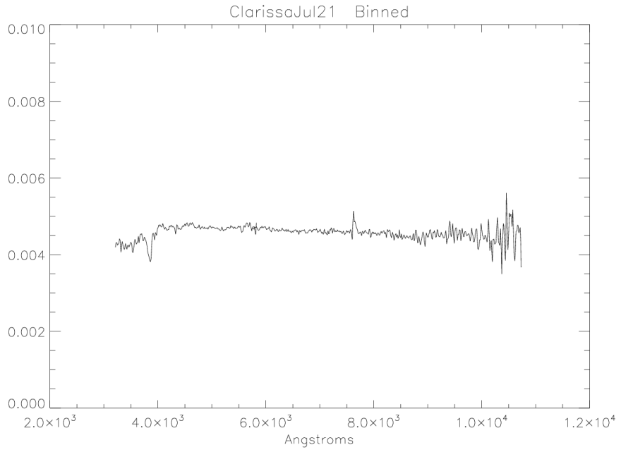
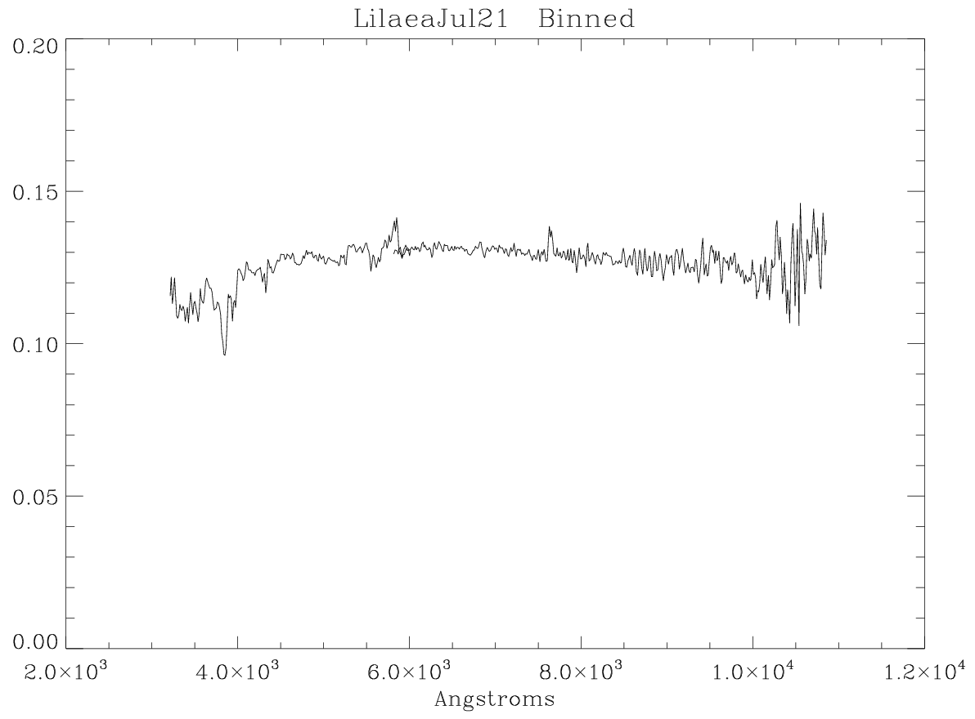



Spectra from Kast
Examples of B or F type
asteroids observed last summer
Much less noise than the CAFOS data

Slide 37
Conclusions
Lab mixtures create a good match to the Almahatta Sitta meteorite data
Carbon is needed to match the reflectivity
Telescopic data shows 0.35 µm absorption that differentiates F and B types
Classified using PCA: 2-F, 1-B, 2-C, and 3-S
Noisy data is making classifying and analyzing difficult

Slide 38
Future work
Apply Modified Gaussian Modeling
Send lab samples to get reflectance spectra at more wavelengths
Get enough olivine/pyroxene mixtures to do several mixtures with varying amounts of all three
Other telescopes / more data / reobserve
Binning pixels to reduce noise (BB2002)
Other methods of reducing noise
Apply UV absorption analysis to Kast data

Slide 39
Works Cited
Schelte J. Bus and Richard P. Binzel. Phase II of the Small Main-Belt Asteroid Spectroscopic Survey: The Observations. 2002
Schelte J. Bus and Richard P. Binzel. Phase II of the Small Main-Belt Asteroid Spectroscopic Survey: A Feature-Based Taxonomy. 2002
D.J. Tholen and M. A. Barucci. Asteroid Taxonomy. 1989
Hiroi et al. Reflectance Spectroscopy of Almahata Sitta Meteorite Samples from Asteroid 2008 TC3. LPI.41.1148H. 2010
Hiroi et al. 1996 Thermal metamorphism of the C, G, B, and F asteroids seen from the 0.7 um, 3um, and UV absorption strengths in comparison with carbonaceous chondrites. M&PS.31.321H. 1996
Jenniskens P et al. The Impact and recovery of asteroid 2008 TC3. Nature, 458, 485-488. 2009.

Slide 40
Acknowledgments
Janice Bishop, Franck Marchis, and Josh Emery – awesomest mentors ever
Abigail E. Reiss – Previous REU work
Mario Parente – Gaussian modeling help
Peter Jenniskens – AS recovery / related asteroids
Muawia Shaddad – Almahatta Sitta recovery
David Barrado – CAFOS observations
David Byn – CAFOS calibration help
Takahiro Hiroi – meteorite reflectance spectra
Nancy McKeown – ENVI help
Heather Makarewicz – Gaussian modeling help
Emilio Enriquez – Conference call setup
Lauren Hunkins – Gaussian modeling GUI
Kaysea Perry – Let me into the lab
Ali Bramson – SETI Gurls
Keaton Burns – Bothered me while I was working
Lee Saper – Taught us all the WAH game
All the other REU students – For making the summer awesome
Cynthia Phillips – making the REU experience awesome!!

Slide 41


The end!
Questions??!?

