Slide 1

Book Sales Analysis
EDA of two bookstores’ sales in Europe

Slide 2
SCOPE
The purpose of this data analysis project is to analyze the book sales data from two book stores operating in Europe.
The analysis will focus on exploring various aspects of the sales data, including the most popular products, performance of individual stores, popularity of products by country, and correlations between sales and economic indicators.
The project will utilize historical sales data from two bookstores in various European countries for the years 2017 to 2020.
Data Source: Kaggle

Slide 3
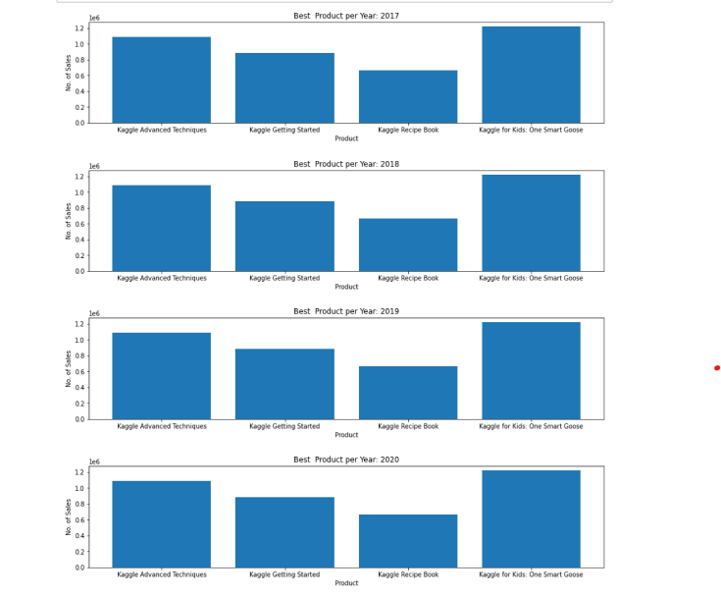
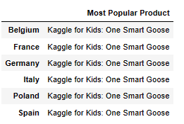
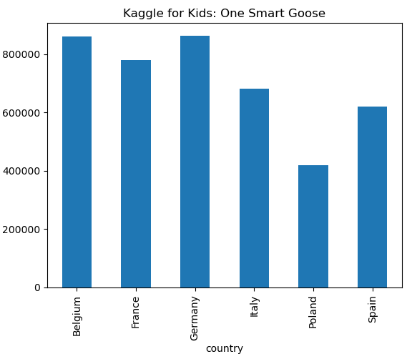
Most popular Product :
Kaggle for Kids: One Smart Goose

Slide 4
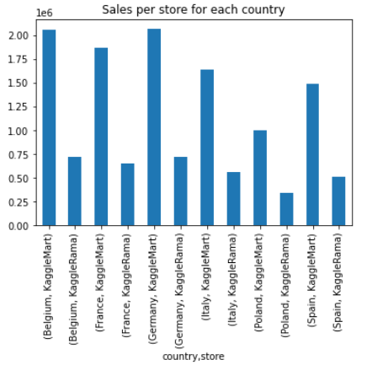
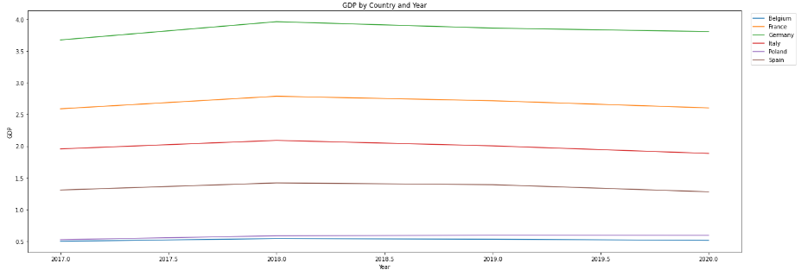
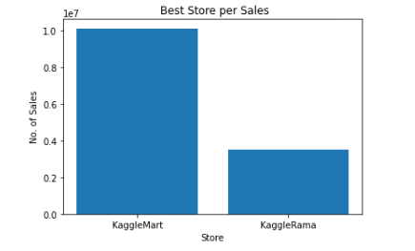
Kaggle Mart dominates as it outperformed KaggleRama in each country.
Greater GDP does not necessarily translate into increased sales. e.g Belgium.

Slide 5
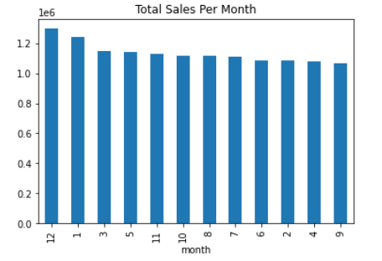
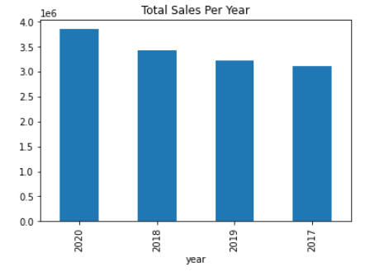
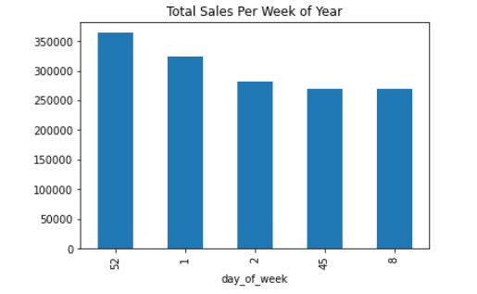
The highest number of sales typically occurs during December and January, primarily due to holiday vacations.
The year 2020 had the highest sales performance.

Slide 6
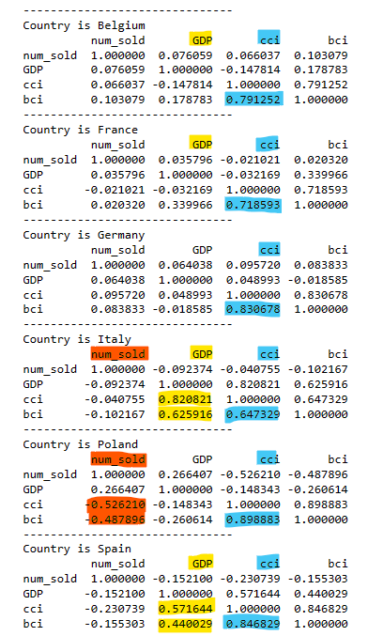
Trying to find dependencies between sales and macro metrics (GDP, BCI, CCI).
Not the obvious results meaning that the higher the macro the higher the sales.
Strong correlation between CCI and BCI for all countries.
Poland has stronger correlation between sales and macro metrics.

Slide 7
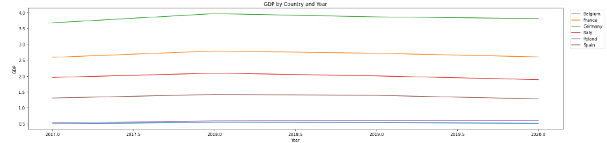
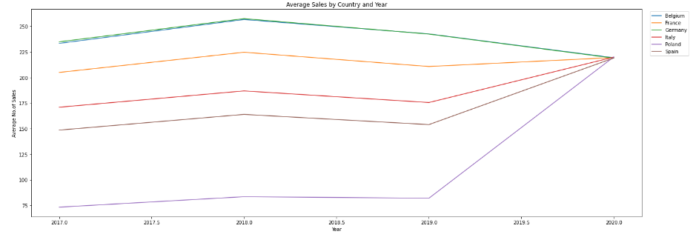

Slide 8
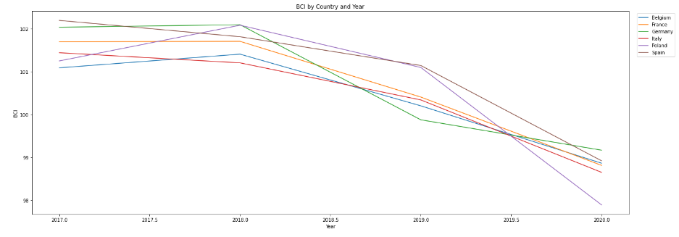
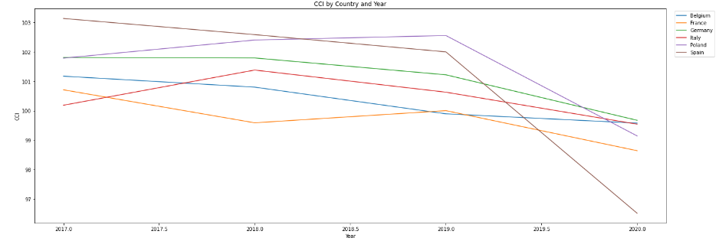

Slide 9
Summary / Food for thoughts
During a period of a sudden drop of most significant macroeconomic metrics (BCI,CCI), sales in both stores recorded the highest sales.
Perhaps people realizing that the economic environment around them is getting worse are turning their consumer behavior towards things of timeless value such as books.
Goal
Smaller markets like Spain or Poland offer a promising environment for investing in a bookstore due to its favorable sales potential.

