Slide 1

Data Science 2023
Vasileios Gianoulas
&
Nasos Karathanasopoulos
&
Dimitris Tomaras
on
Heart Disease Prediction

Slide 2

Contents
Who we are
The Problem
The Data
Our Solution
Our Model Performance
Future & Next Steps

Slide 3

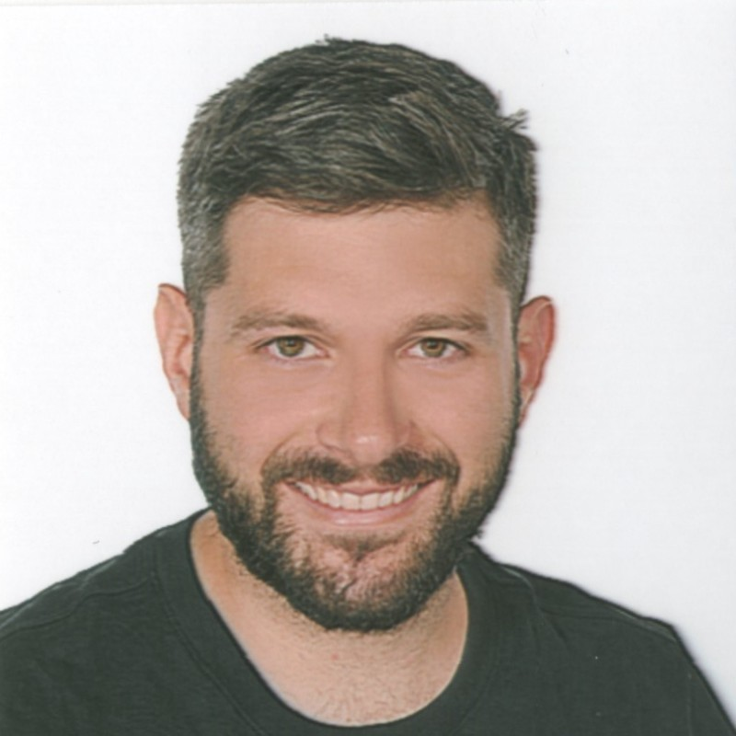

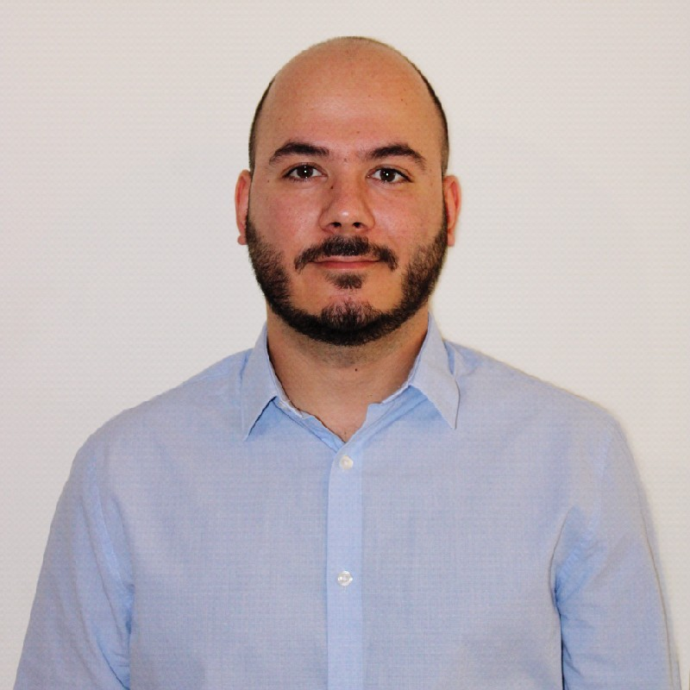
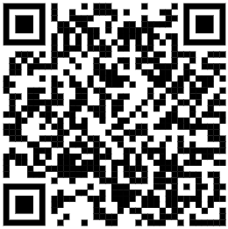
Who we are
Dimitris Tomaras
Nasos Karathanosopoulos
Vasileios Giannoulas

Slide 4

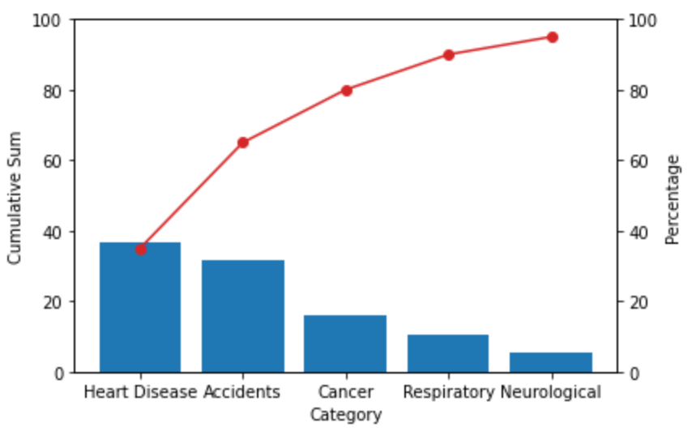
The Problem
Insurance Company
Pareto Analysis indicated that 39% of all expenses are due to hospitalizations related to heart diseases
In an effort to reduce the insurance premioums, «Safe» company would like to predict which customers are more like to have HD
A global contest was called with real anonymized data from US hospitals

Slide 5
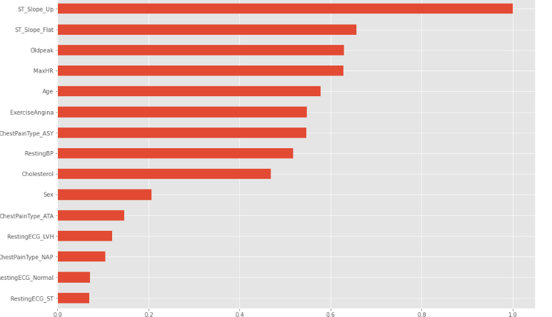
Features
The Data
Age
Sex
Chest PainType: Typical Angina, Atypical Angina, Non-Anginal Pain, Asymptomatic
Resting blood pressure
Cholesterol
Fasting blood sugar
Resting electrocardiogram results Normal Having ST-T wave abnormality Showing probable or definite left ventricular hypertrophy
Maximum heart rate achieved
Exercise Angina
Oldpeak (Numeric value measured in depression]
ST_Slope: the slope of the peak exercise Up: upsloping, Flat: flat, Down: downsloping

Slide 6
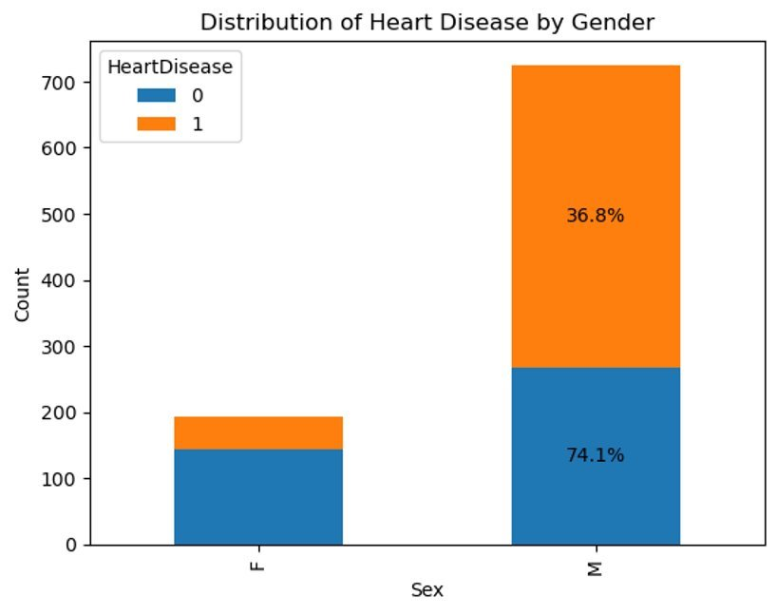
Distribution Of Genders
The Data
It is evident that men are more
likely to have heart disease.

Slide 7
Our Solution
Classification Problem
K-NN
SVM
Naïve Bayes
Random Forest
Decision Tree
Bagging Classifier
GradientBoostingClassifier
AdaBoostClassifier
XGBClassifier
LGBMClassifier
Select the best model of each Category
Optimization of each model via Grid Search
Select the model with best performance on Train and Test set (K-NN model)

Slide 8
Our Model Performance
Performance of Best Model (K-NN Classifier)
Best Score (f1_macro) in Training Set: 0.86
Percentage of False Negatives: 9.86%
Test Score (f1_macro): 0.93
Classification Report
precision recall f1-score support
0 0.91 0.96 0.93 71
1 0.96 0.91 0.94 79
accuracy 0.93 150
macro avg 0.93 0.93 0.93 150
weighted avg 0.93 0.93 0.93 150

Slide 9
Future & Next Steps
Ideas in order to improve our Model
Acquisition of more data to train
Running more advanced models (NN)

Slide 10
Thank you! – We are here to answer your Questions!

