Slide 1
Sequential analysis: balancing the tradeoff between detection accuracy and detection delay
XuanLong Nguyen
xuanlong@eecs.berkeley.edu
Radlab, 11/06/06

Slide 2
Outline
Motivation in detection problems
  need to minimize detection delay time
Brief intro to sequential analysis
  sequential hypothesis testing
  sequential change-point detection
Applications
  Detection of anomalies in network traffic (network attacks), faulty software, etc

Slide 3
Three quantities of interest in detection problems
Detection accuracy
  False alarm rate
  Misdetection rate
Detection delay time

Slide 4
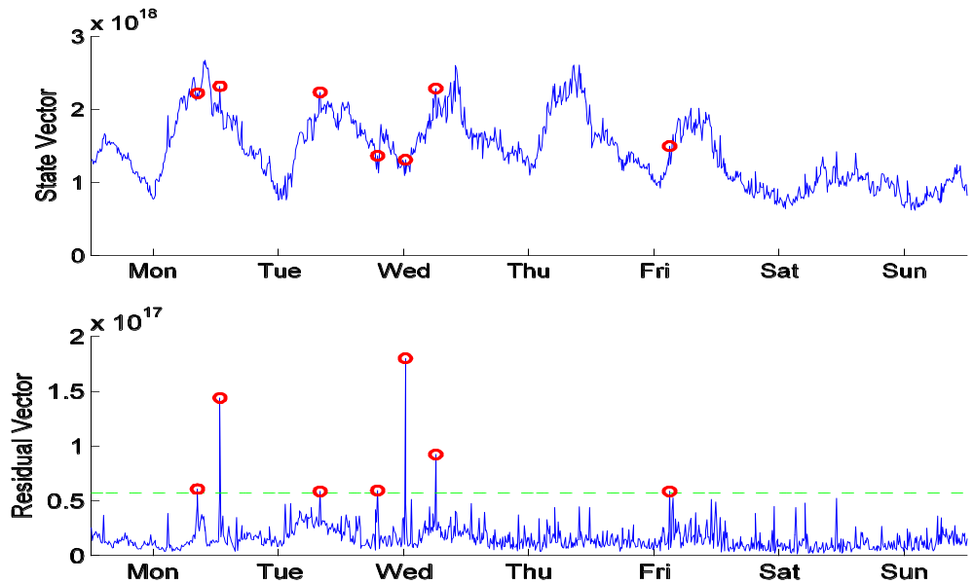
Network volume anomaly detection
[Huang et al, 06]

Slide 5
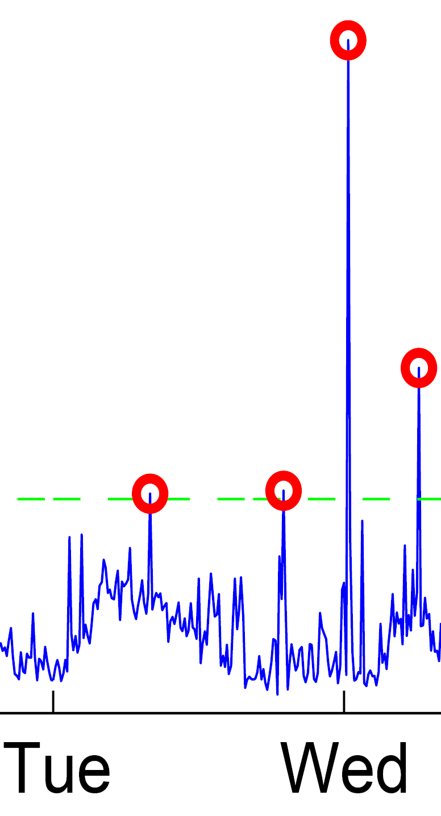
So far, anomalies treated as isolated events
Spikes seem to appear out of nowhere
Hard to predict early short burst
  unless we reduce the time granularity of collected data
To achieve early detection
  have to look at medium to long-term trend
  know when to stop deliberating

Slide 6
Early detection of anomalous trends
We want to
  distinguish “bad” process from good process/ multiple processes
  detect a point where a “good” process turns bad
Applicable when evidence accumulates over time (no matter how fast or slow)
  e.g., because a router or a server fails
  worm propagates its effect
Sequential analysis is well-suited
  minimize the detection time given fixed false alarm and misdetection rates
  balance the tradeoff between these three quantities (false alarm, misdetection rate, detection time) effectively

Slide 7
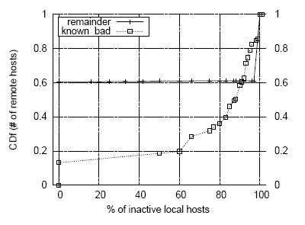
Example: Port scan detection
(Jung et al, 2004)
Detect whether a remote host is a port scanner or a benign host
Ground truth: based on percentage of local hosts which a remote host has a failed connection
We set:
  for a scanner, the probability of hitting inactive local host is 0.8
  for a benign host, that probability is 0.1
Figure:
  X: percentage of inactive local hosts for a remote host
  Y: cumulative distribution function for X
80% bad hosts

Slide 8
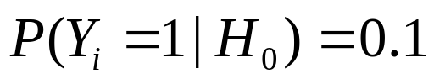
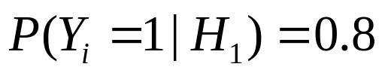
Hypothesis testing formulation
A remote host R attempts to connect a local host at time i
  let Yi = 0 if the connection attempt is a success,
  1 if failed connection
As outcomes Y1, Y2,… are observed we wish to determine whether R is a scanner or not
Two competing hypotheses:
  H0: R is benign
  H1: R is a scanner

Slide 9
An off-line approach
Collect sequence of data Y for one day
(wait for a day)
2. Compute the likelihood ratio accumulated over a day
  This is related to the proportion of inactive local hosts that R tries to connect (resulting in failed connections)
3. Raise a flag if this statistic exceeds some threshold

Slide 10
A sequential (on-line) solution
Update accumulative likelihood ratio statistic in an online fashion
2. Raise a flag if this exceeds some threshold
Acc. Likelihood ratio
Threshold a
Stopping time
Threshold b
0
24
hour

Slide 11
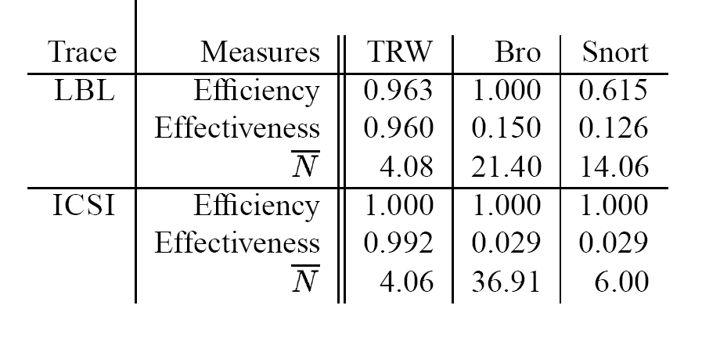
Comparison with other existing intrusion detection systems (Bro & Snort)
0.963
0.040
4.08
1.000
0.008
4.06
Efficiency: 1 - #false positives / #true positives
Effectiveness: #false negatives/ #all samples
N: # of samples used (i.e., detection delay time)

Slide 12
Two sequential decision problems
Sequential hypothesis testing
  differentiating “bad” process from “good process”
  E.g., our previous portscan example
Sequential change-point detection
  detecting a point(s) where a “good” process starts to turn bad

Slide 13
Sequential hypothesis testing
H = 0 (Null hypothesis):
normal situation
H = 1 (Alternative hypothesis): abnormal situation
Sequence of observed data
  X1, X2, X3, …
Decision consists of
  stopping time N (when to stop taking samples?)
  make a hypothesis
  H = 0 or H = 1 ?

Slide 14
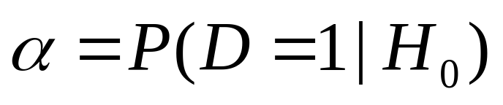
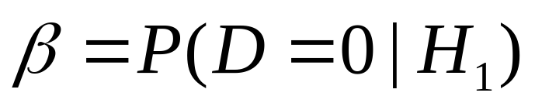
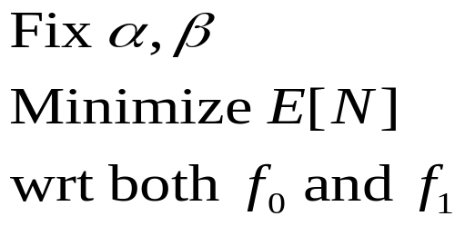
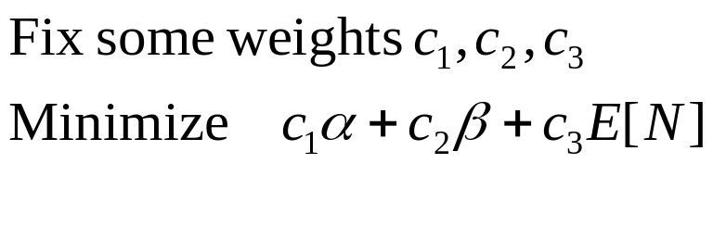
Quantities of interest
False alarm rate
Misdetection rate
Expected stopping time (aka number of samples, or decision delay time) E N
Frequentist formulation:
Bayesian formulation:

Slide 15



Key statistic: Posterior probability
As more data are observed, the posterior is edging closer to either 0 or 1
Optimal cost-to-go function is a function of
G(p) can be computed by Bellman’s update
  G(p) = min { cost if stop now,
  or cost of taking one more sample}
  G(p) is concave
Stop: when pn hits thresholds
  a or b
N(m0,v0)
N(m1,v1)
:= optimal G
G(p)
p1, p2,..,pn
0
a
b
1 p

Slide 16

Multiple hypothesis test
H=1
Suppose we have m hypotheses
H = 1,2,…,m
The relevant statistic is posterior probability vector in (m-1) simplex
Stop when pn reaches on of the corners (passing through red boundary)
H=2
H=3

Slide 17

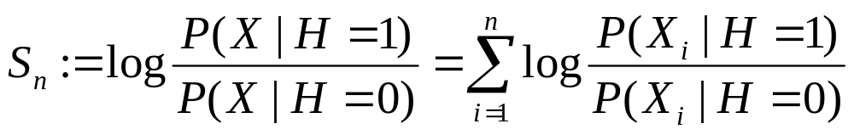
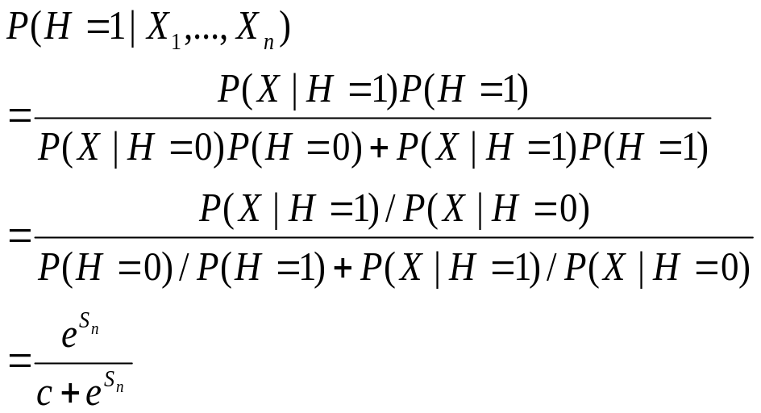
Thresholding posterior probability = thresholding sequential log likelihood ratio
Log likelihood ratio:
Applying Bayes’ rule:

Slide 18
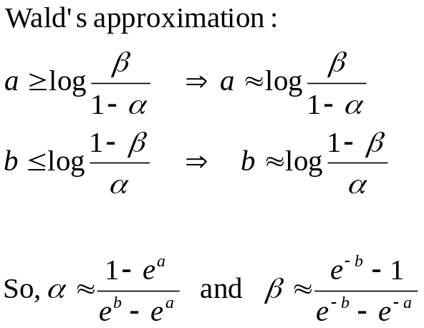
Thresholds vs. errors
Sn
Acc. Likelihood ratio
Threshold b
0
Stopping time (N)
Threshold a
Exact if there’s no overshoot
at hitting time!

Slide 19

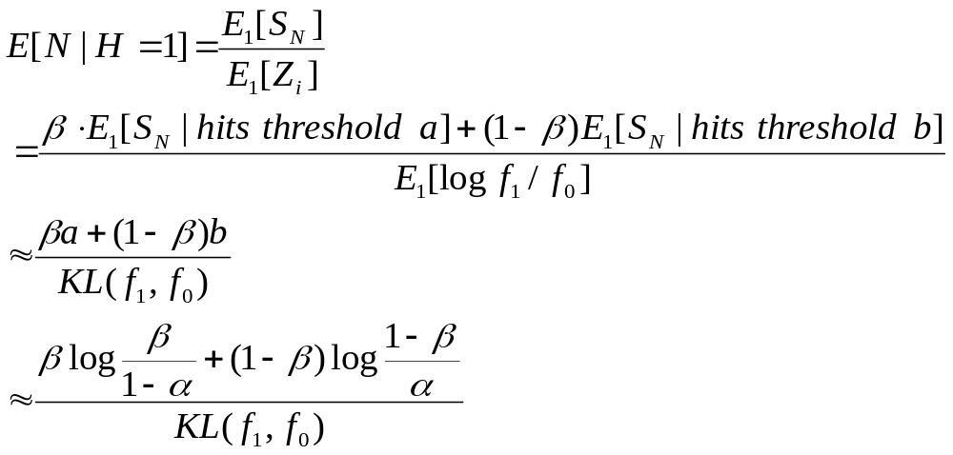
Expected stopping times vs errors
The stopping time of hitting time N of a random walk
What is E[N]?
Wald’s equation

Slide 20
Outline
Sequential hypothesis testing
Change-point detection
  Off-line formulation
    methods based on clustering /maximum likelihood
  On-line (sequential) formulation
    Minimax method
    Bayesian method
  Application in detecting network traffic anomalies

Slide 21
Change-point detection problem
Xt
t1
t2
Identify where there is a change in the data sequence
  change in mean, dispersion, correlation function, spectral density, etc…
  generally change in distribution

Slide 22
Off-line change-point detection
Viewed as a clustering problem across time axis
  Change points being the boundary of clusters
Partition time series data that respects
  Homogeneity within a partition
  Heterogeneity between partitions

Slide 23
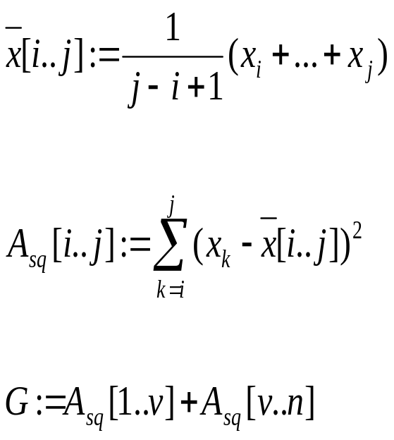
A heuristic: clustering by minimizing intra-partition variance
Suppose that we look at a mean changing process
Suppose also that there is only one change point
Define running mean x[i..j]
Define variation within a partition Asq[i..j]
Seek a time point v that minimizes the sum of variations G
(Fisher, 1958)

Slide 24
Statistical inference of change point
A change point is considered as a latent variable
Statistical inference of change point location via
  frequentist method, e.g., maximum likelihood estimation
  Bayesian method by inferring posterior probability

Slide 25
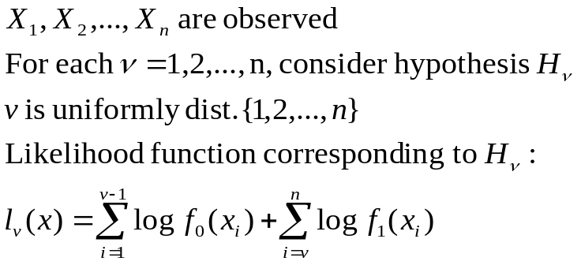

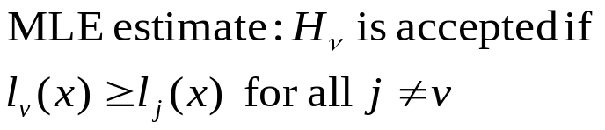
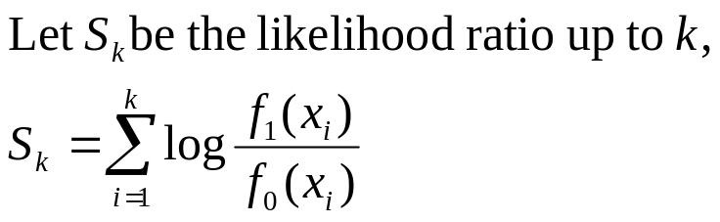
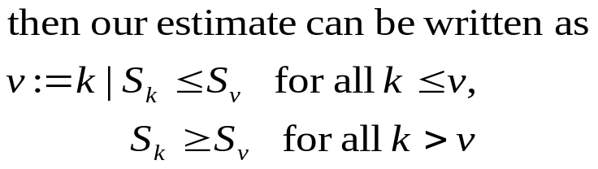
Maximum-likelihood method
[Page, 1965]
Hypothesis Hv: sequence has
density f0 before v, and f1 after
Hypothesis H0: sequence is
stochastically homogeneous
This is the precursor for various
sequential procedures (to come!)
f1
Sk
f0
1
v
n
k

Slide 26
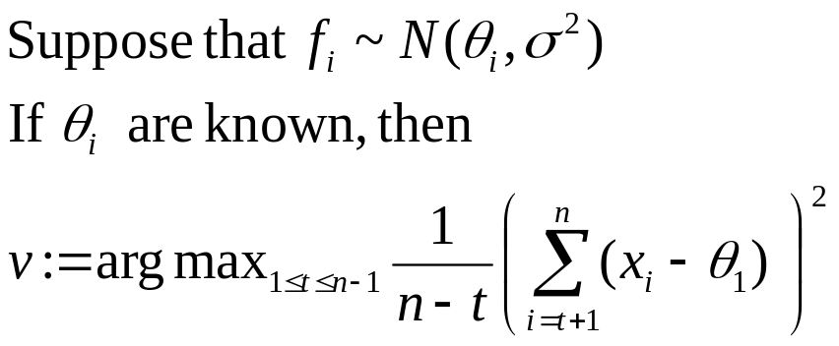
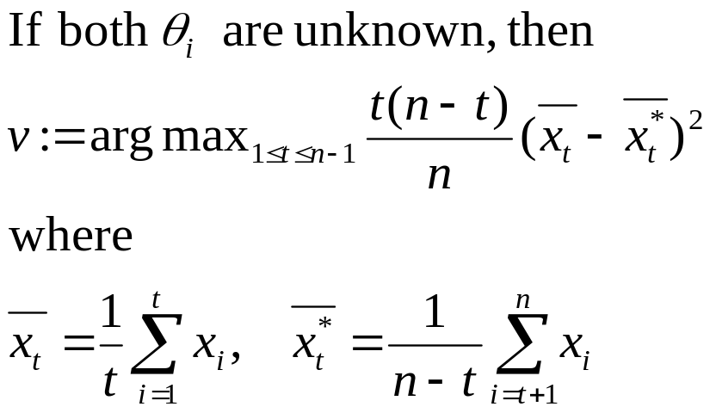
Maximum-likelihood method
[Hinkley, 1970,1971]

Slide 27
Sequential change-point detection
f0
f1
Data are observed serially
There is a change from distribution f0 to f1 in at time point v
Raise an alarm if change is detected at N
Delayed alarm
False alarm
time
N
Change point v
Need to
(a) Minimize the false alarm rate
(b) Minimize the average delay to detection

Slide 28
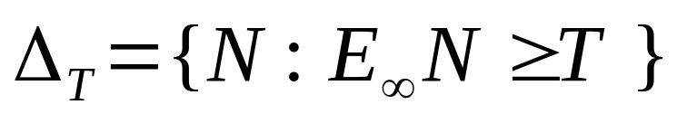
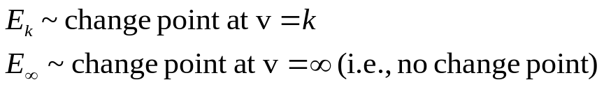

Minimax formulation
Among all procedures such that the time to false alarm is
bounded from below by a constant T, find a procedure that
minimizes the average delay to detection
Class of procedures with false alarm condition
Cusum,
SRP tests
Average delay to detection
Cusum test
average-worst delay
worst-worst delay

Slide 29

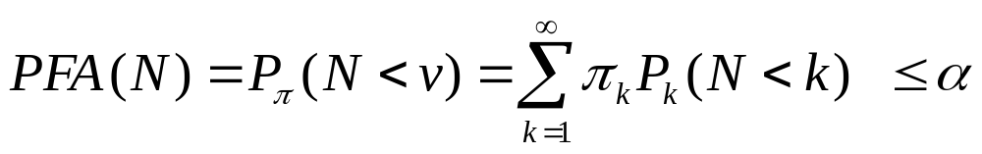

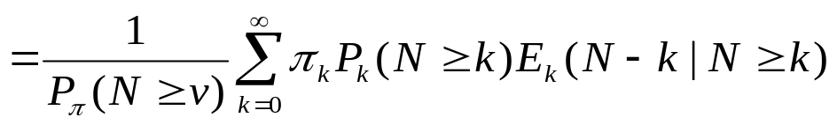
Bayesian formulation
Assume a prior distribution of the change point
Among all procedures such that the false alarm probability is
less than \alpha, find a procedure that minimizes the average
delay to detection
False alarm condition
Average delay to detecion
Shiryaev’s test

Slide 30
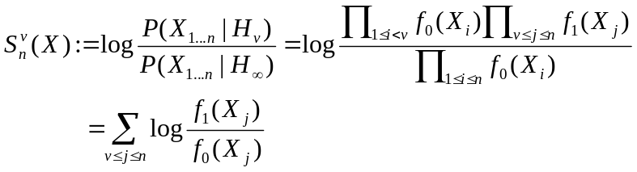


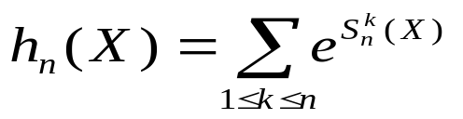
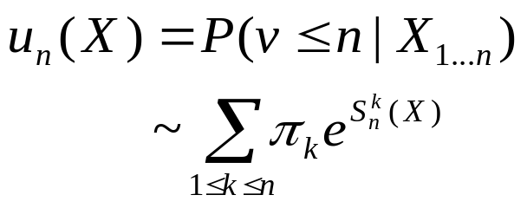
All procedures involve running likelihood ratios
Likelihood ratio for v = k vs. v = infinity
Hypothesis Hv: sequence has
density f0 before v, and f1 after
Hypothesis : no change point
All procedures involve online thresholding:
Stop whenever the statistic exceeds a threshold b
Cusum test :
Shiryaev-Roberts-Polak’s:
Shiryaev’s Bayesian test:

Slide 31
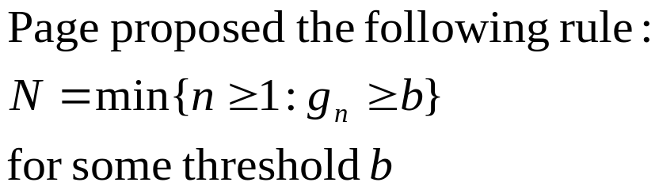
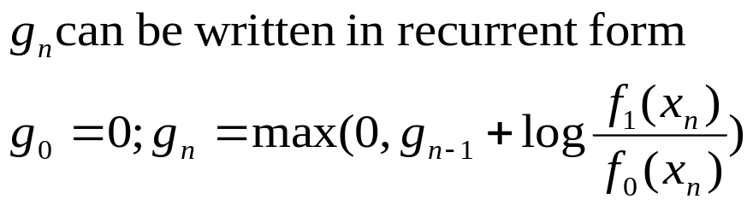

Cusum test (Page, 1966)
gn
b
Stopping time N
This test minimizes the worst-average detection delay (in an asymptotic sense):

Slide 32


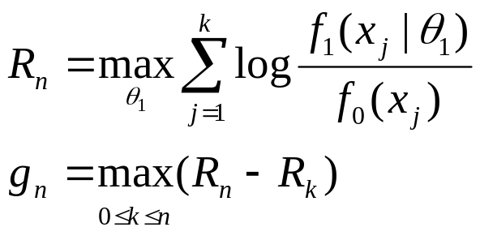
Generalized likelihood ratio
Unfortunately, we don’t know f0 and f1
Assume that they follow the form
f0 is estimated from “normal” training data
f1 is estimated on the flight (on test data)
Sequential generalized likelihood ratio statistic (same as CUSUM):
Our testing rule: Stop and declare the change point
at the first n such that
gn exceeds a threshold b

Slide 33
Change point detection in network traffic
[Hajji, 2005]
N(m0,v0)
N(m1,v1)
N(m,v)
Data features:
number of good packets received that were directed to the
broadcast address
number of Ethernet packets with an unknown protocol type
number of good address resolution protocol (ARP) packets
on the segment
number of incoming TCP connection requests (TCP packets
with SYN flag set)
Changed behavior
Each feature is modeled as a mixture of 3-4 gaussians
to adjust to the daily traffic patterns (night hours vs day times,
weekday vs. weekends,…)

Slide 34
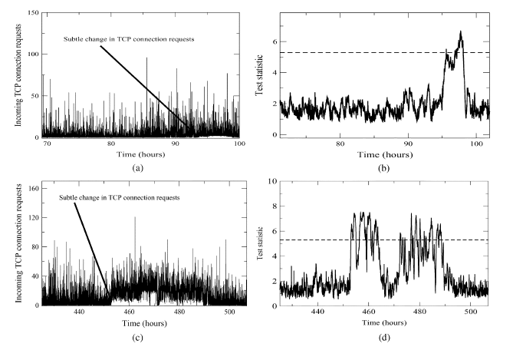
Subtle change in traffic
(aggregated statistic vs individual variables)
Caused by web robots

Slide 35
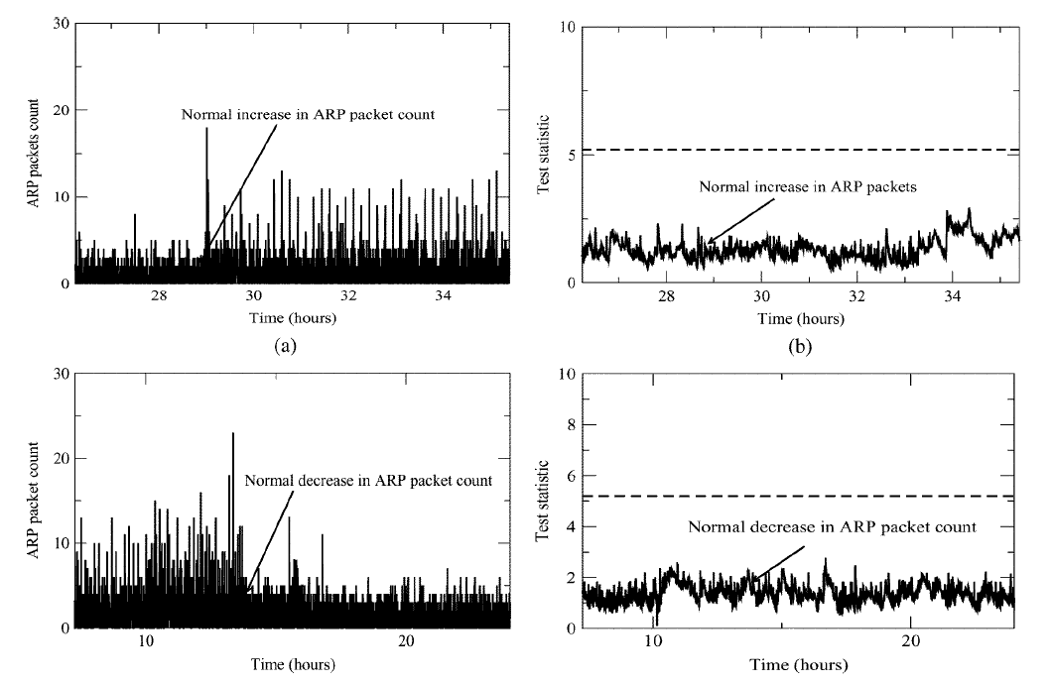
Adaptability to normal daily and weekely fluctuations
weekend
PM time

Slide 36
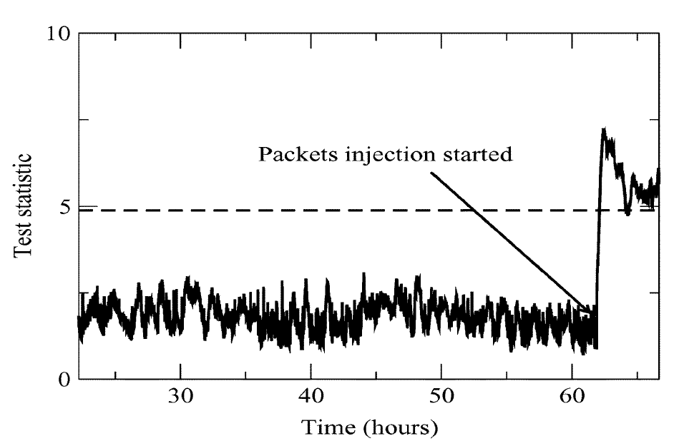
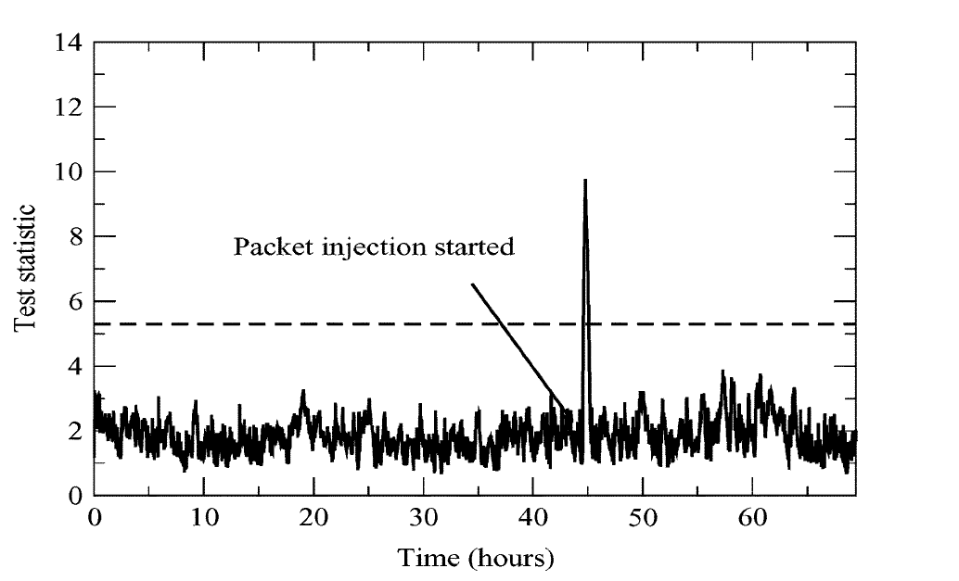
Anomalies detected
Broadcast storms, DoS attacks
injected 2 broadcast/sec
16mins delay
Sustained rate of TCP connection requests
injecting 10 packets/sec
17mins delay

Slide 37
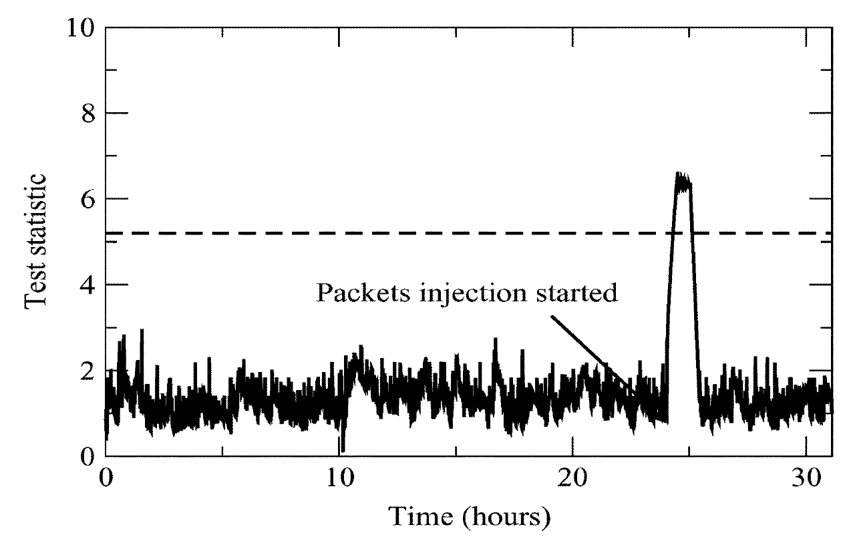
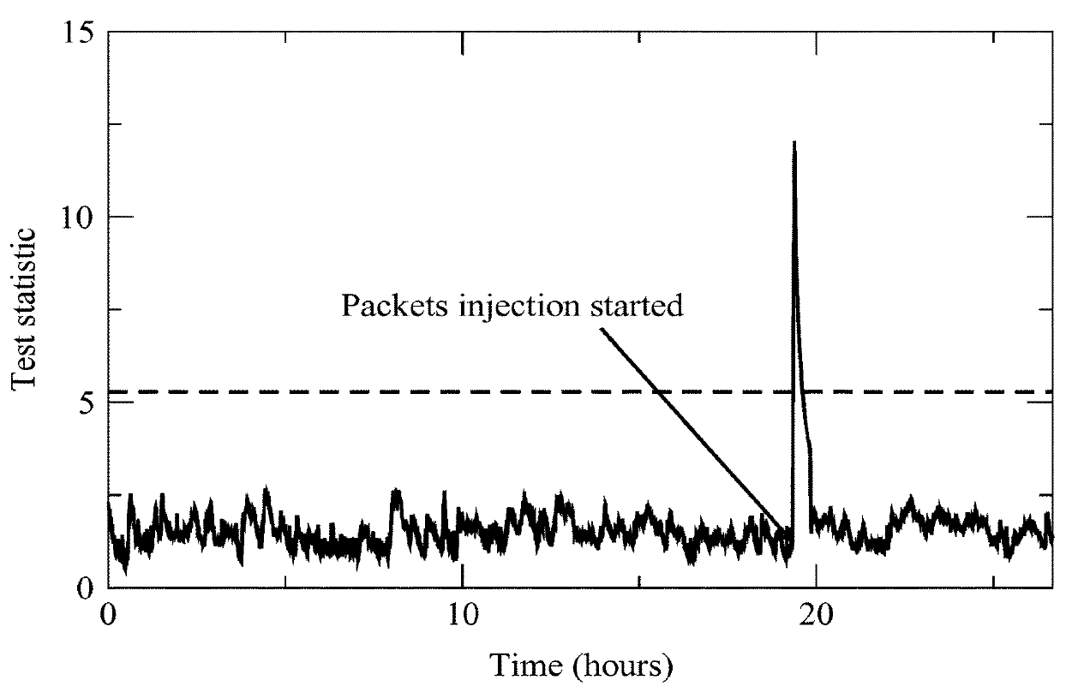
Anomalies detected
ARP cache poisoning attacks
16mins delay
TCP SYN DoS attack, excessive
traffic load
50 seconds delay

Slide 38
Summary
Sequential hypothesis test
  distinguish “good” process from “bad”
Sequential change-point detection
  detecting where a process changes its behavior
Framework for optimal reduction of detection delay
Sequential tests are very easy to apply
  even though the analysis might look difficult

Slide 39
References
Wald, A. Sequential analysis, John Wiley and Sons, Inc, 1947.
Arrow, K., Blackwell, D., Girshik, Ann. Math. Stat., 1949.
Shiryaev, R. Optimal stopping rules, Springer-Verlag, 1978.
Siegmund, D. Sequential analysis, Springer-Verlag, 1985.
Brodsky, B. E. and Darkhovsky B.S. Nonparametric methods in change-point problems. Kluwer Academic Pub, 1993.
Baum, C. W. & Veeravalli, V.V. A Sequential Procedure for Multihypothesis Testing. IEEE Trans on Info Thy, 40(6)1994-2007, 1994.
Lai, T.L., Sequential analysis: Some classical problems and new challenges (with discussion), Statistica Sinica, 11:303—408, 2001.
Mei, Y. Asymptotically optimal methods for sequential change-point detection, Caltech PhD thesis, 2003.
Hajji, H. Statistical analysis of network traffic for adaptive faults detection, IEEE Trans Neural Networks, 2005.
Tartakovsky, A & Veeravalli, V.V. General asymptotic Bayesian theory of quickest change detection. Theory of Probability and Its Applications, 2005
Nguyen, X., Wainwright, M. & Jordan, M.I. On optimal quantization rules in sequential decision problems. Proc. ISIT, Seattle, 2006.

